Slide 1
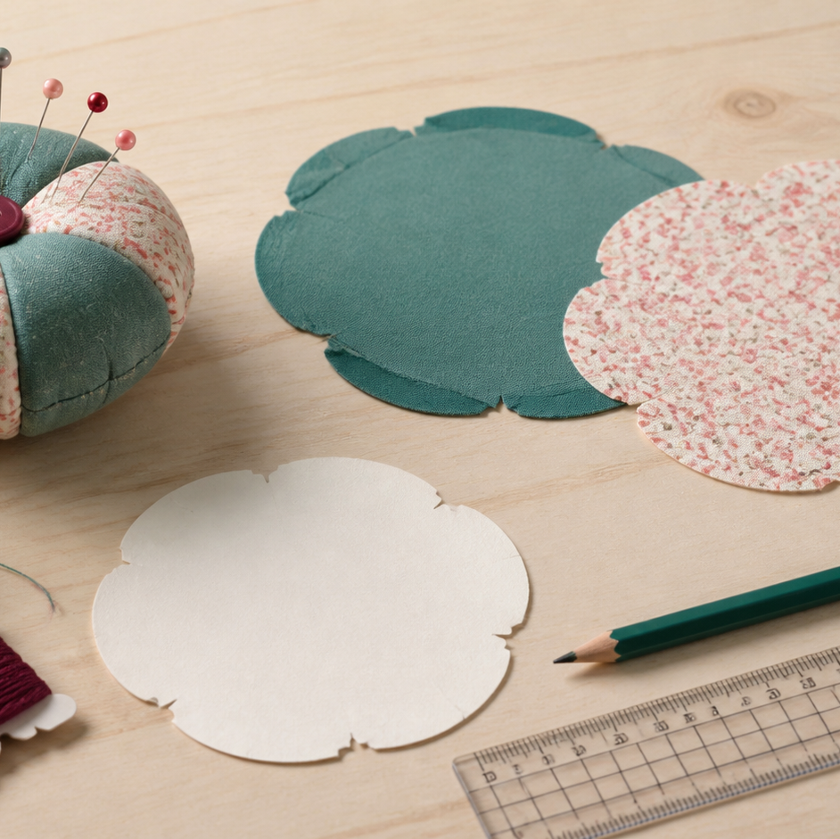
MODULE 03 · WEEK 4
Pincushion Project
Plan, make and evaluate a pincushion against clear success criteria.
Teacher-led classroom presentation
Notes:
Talking points
- Introduce Pincushion Project as a connected set of three ideas, not three isolated worksheets.
- Read the outcome aloud and link it to the current project stage.
- Keep local machine, pattern, safety and assessment details within the current teacher demonstration and authorised class documents.
Prompt: Which word in the outcome tells us what evidence we need to produce?
Likely misconception: Finishing a slide deck is the evidence; the evidence is the student's explanation and project decision.
Transition: Preview the three ideas and activate prior knowledge.
[Sources]
- Course sequence: WWHS Year 8 Accessories and Shorts Textiles Technology Program 2024, as bounded by source map v1.0.
- Curriculum: NESA Textiles Technology 7–10 Syllabus (2025), https://curriculum.nsw.edu.au/learning-areas/tas/textiles-technology-7-10-2025/overview/course
- Visual: Stage 08 approved module asset module-03-pincushion-project.png; provenance retained in the visual production manifest.

Slide 2
Three ideas, one connected decision
Listen for the relationship between the ideas. Each one changes what you notice, choose or explain.
1
2
3
Brief and success criteria
Plan, materials and technique sample
Make, evaluate and improve
RETRIEVAL WARM-UP
Which idea feels most familiar—and what evidence supports what you think you know?
MODULE 03 · YEAR 8 TEXTILES TECHNOLOGY
02
Notes:
Talking points
- Name all three substantive sections using the exact module language.
- Ask students to predict where the ideas connect to current project work.
- Accept a tentative response, but ask what evidence supports it.
Prompt: Which idea is most likely to change a practical or design decision today?
Likely misconception: The sequence means students can forget idea one after moving to idea two; the ideas need to remain connected.
Transition: Begin with Brief and success criteria.
[Sources]
- Named section sequence: frozen Stage 01 course inventory and Year 8 Textiles theory package v1.0.
- Curriculum context: NESA Textiles Technology 7–10 Syllabus (2025), https://curriculum.nsw.edu.au/learning-areas/tas/textiles-technology-7-10-2025/overview/course

Slide 3
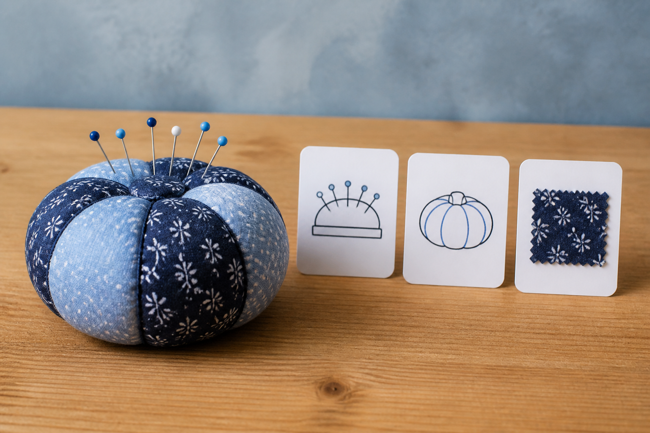
3.1 · UNPACK THE DESIGN BRIEF
Brief and success criteria
THE KEY IDEA
A brief identifies the product, user, purpose and confirmed constraints. Missing specifications become questions, not assumptions. Criteria should be important, specific and connected to observable evidence. Plan evidence before making so useful progress can be captured.
USE THIS IDEA
Annotate the current pincushion brief using three colours: confirmed product and user facts, constraints, and questions needing confirmation. Draft three checkable criteria and name one piece of evidence that could test each criterion.
Look closely: find visible evidence for this claim — A brief identifies the product, user, purpose and confirmed constraints.
MODULE 03 · YEAR 8 TEXTILES TECHNOLOGY
03
Notes:
Talking points
- Teach students to interpret the authorised pincushion project as a design problem and create measurable practice criteria without inventing specifications.
- Emphasise: A brief identifies the product, user, purpose and confirmed constraints.
- Connect the image to the decision: Show an annotated brief moving into separate facts, constraints, questions, criteria and evidence plans.
Prompt: Justify three criteria by linking each one to a confirmed need in the brief and a suitable method of gathering evidence.
Likely misconception: A brief tells the designer exactly what the product should look like. Correction: A brief frames the problem and limits; designers still develop and justify possible responses.
Transition: Carry this decision into Plan, materials and technique sample.
[Sources]
- Content: Year 8 Textiles theory package v1.0; source domains pincushion project identity; design brief; criteria and evidence planning.
- Curriculum: NESA Textiles Technology 7–10 Syllabus (2025), https://curriculum.nsw.edu.au/learning-areas/tas/textiles-technology-7-10-2025/overview/course
- Outcomes context: https://curriculum.nsw.edu.au/learning-areas/tas/textiles-technology-7-10-2025/outcomes
- Visual: Stage 08 approved teaching asset m03-s01-pincushion-criteria.png; provenance retained in the visual production manifest.

Slide 4
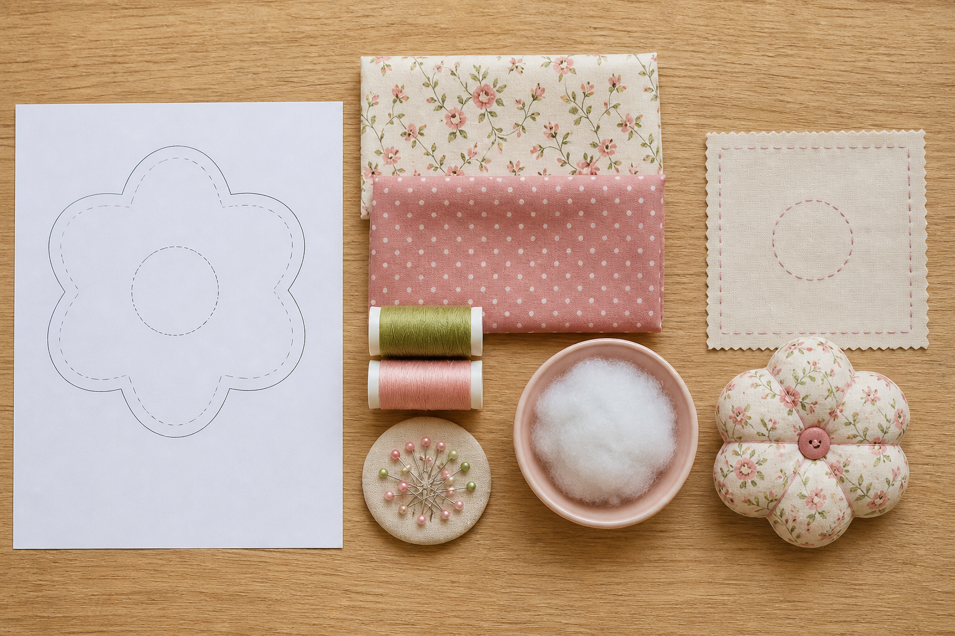
3.2 · MATCH MATERIALS TO CONFIRMED NEEDS
Plan, materials and technique sample
THE KEY IDEA
Material choices should connect properties and evidence to confirmed product needs. Plans show logical order, dependencies, resources and checkpoints. A technique sample should answer one clear design or production question. An unsuccessful sample is useful when it leads to a justified next step.
USE THIS IDEA
Create a short pincushion production plan with dependencies and approval checkpoints. Complete one teacher-authorised sample that answers a named material or technique question, then attach a brief evidence-based decision to the sample.
Look closely: find visible evidence for this claim — Material choices should connect properties and evidence to confirmed product needs.
MODULE 03 · YEAR 8 TEXTILES TECHNOLOGY
04
Notes:
Talking points
- Develop source-safe planning, material justification and sampling for the pincushion project before final construction.
- Emphasise: Material choices should connect properties and evidence to confirmed product needs.
- Connect the image to the decision: Show a planning pathway linking material choice, dependencies, checkpoints, one-variable sampling and a recorded decision.
Prompt: Explain how the selected material and one technique sample respond to confirmed criteria, including what evidence supports the next-step decision.
Likely misconception: A production plan is just a numbered list copied from instructions. Correction: A useful plan also shows resources, dependencies, checks, evidence and places where approval or adjustment may be needed.
Transition: Carry this decision into Make, evaluate and improve.
[Sources]
- Content: Year 8 Textiles theory package v1.0; source domains pincushion planning; material selection; design experimentation.
- Curriculum: NESA Textiles Technology 7–10 Syllabus (2025), https://curriculum.nsw.edu.au/learning-areas/tas/textiles-technology-7-10-2025/overview/course
- Outcomes context: https://curriculum.nsw.edu.au/learning-areas/tas/textiles-technology-7-10-2025/outcomes
- Visual: Stage 08 approved teaching asset m03-s02-pincushion-plan.png; provenance retained in the visual production manifest.

Slide 5
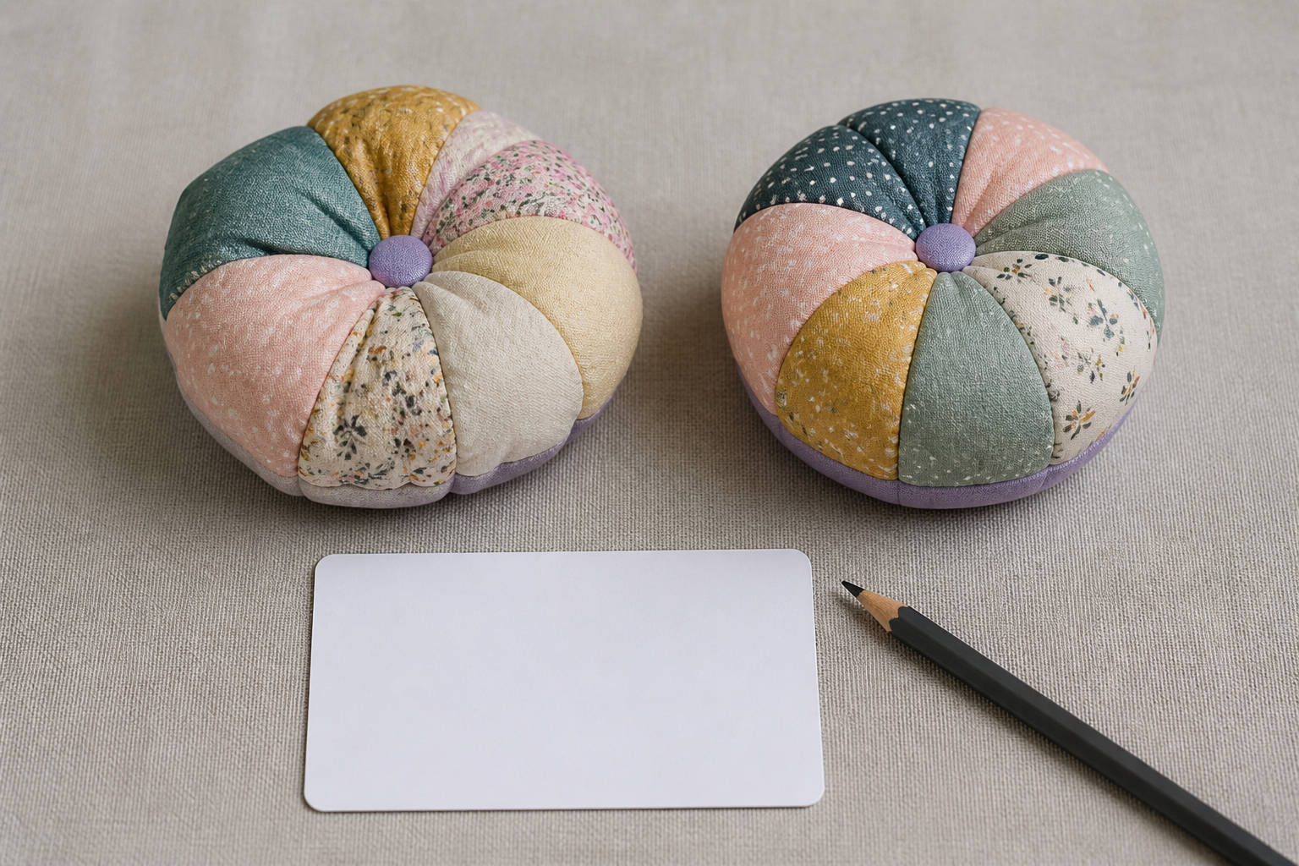
3.3 · CHECK QUALITY WHILE CHANGE IS POSSIBLE
Make, evaluate and improve
THE KEY IDEA
Quality control happens at planned stages while useful change may still be possible. Evaluation compares relevant evidence with criteria and reaches a supported judgement. Trade-offs can explain why one decision helps one criterion but limits another. A useful improvement names the stage, action and expected effect.
USE THIS IDEA
At two teacher-approved stages, photograph or record one relevant quality feature and compare it with your plan. In the final evaluation, use that progress evidence plus a finished-product observation to judge one criterion and justify one specific improvement.
Look closely: find visible evidence for this claim — Quality control happens at planned stages while useful change may still be possible.
MODULE 03 · YEAR 8 TEXTILES TECHNOLOGY
05
Notes:
Talking points
- Teach students to monitor a small project against criteria, use evidence to evaluate the result and identify a realistic improvement.
- Emphasise: Quality control happens at planned stages while useful change may still be possible.
- Connect the image to the decision: Show a project timeline with progress checkpoints, evidence capture, authorised adjustment and criterion-based final evaluation.
Prompt: Evaluate one pincushion criterion using progress and final evidence, explain any trade-off and justify one realistic improvement.
Likely misconception: Evaluation begins after the product is finished. Correction: Ongoing evaluation begins during planning and continues through checkpoints, production and final review.
Transition: Pause for retrieval before students construct evidence.
[Sources]
- Content: Year 8 Textiles theory package v1.0; source domains pincushion project; ongoing evaluation; quality and improvement.
- Curriculum: NESA Textiles Technology 7–10 Syllabus (2025), https://curriculum.nsw.edu.au/learning-areas/tas/textiles-technology-7-10-2025/overview/course
- Outcomes context: https://curriculum.nsw.edu.au/learning-areas/tas/textiles-technology-7-10-2025/outcomes
- Visual: Stage 08 approved teaching asset m03-s03-pincushion-evaluate.png; provenance retained in the visual production manifest.

Slide 6
Stop. Think. Explain.
Correct or improve each claim, then support your answer with evidence from the module.
1
Correct or improve: “A brief tells the designer exactly what the product should look like.”
2
Correct or improve: “A production plan is just a numbered list copied from instructions.”
3
Correct or improve: “Evaluation begins after the product is finished.”
4
Connect two ideas: how could one change a decision made with the other?
MODULE 03 · YEAR 8 TEXTILES TECHNOLOGY
06
Notes:
Talking points
- Give silent thinking time before taking answers.
- Require students to correct the claim, not only label it true or false.
- Ask a follow-up: What evidence from slides 3–5 supports that correction?
Prompt: Which correction becomes stronger when you use an example from your own project?
Likely misconception: Retrieval is guessing; retrieval should reconstruct the idea and its evidence.
Transition: Use the corrected ideas to build one longer piece of evidence.
[Sources]
- Retrieval claims: misconceptions and corrections in the Year 8 Textiles theory package v1.0.
- Curriculum context: NESA Textiles Technology 7–10 Syllabus (2025), https://curriculum.nsw.edu.au/learning-areas/tas/textiles-technology-7-10-2025/overview/course

Slide 7
Read → Select → Explain → Check
Evaluate one pincushion criterion using progress and final evidence, explain any trade-off and justify one realistic improvement.
1
2
3
4
READ
SELECT
EXPLAIN
CHECK
→
→
→
Underline the task word and the exact context.
Choose theory and project evidence that answers it.
Connect the evidence to a reason, effect or judgement.
Compare the response with the two success criteria.
SENTENCE SUPPORT
One decision I would make is ___ because evidence from ___ shows ___. I would check it by ___.
MODULE 03 · YEAR 8 TEXTILES TECHNOLOGY
07
Notes:
Talking points
- Model the four moves with one brief example, then remove the example from view.
- The selected evidence must answer the exact context, not merely repeat a definition.
- Use the sentence support as a starting structure; students may improve it in their own words.
Prompt: Which evidence is most relevant, and which tempting detail should be left out?
Likely misconception: A longer response is automatically stronger; relevance and explanation matter more than length.
Transition: Students now save the response in the matching module learning package.
[Sources]
- Guided response: evidence prompt for m03-s03 in the Year 8 Textiles theory package v1.0.
- Curriculum context: NESA Textiles Technology 7–10 Syllabus (2025), https://curriculum.nsw.edu.au/learning-areas/tas/textiles-technology-7-10-2025/outcomes

Slide 8
Before you leave…
1.
One idea I can now explain is…
SAVE
YOUR
WORK
2.
One practical or design decision this changes is…
3.
One question or check I still need is…
EVIDENCE DESTINATION
Complete the three learning packages and save your response on this module page.
Next: Sewing Bag Project
MODULE 03 · YEAR 8 TEXTILES TECHNOLOGY
08
Notes:
Talking points
- Use the three-part exit ticket as a quick verbal or written check.
- Direct students to the module page so the evidence is saved in the correct learning package.
- Preview the connection to Sewing Bag Project.
Prompt: Which answer would you be willing to improve after receiving feedback?
Likely misconception: Saving work means it is finished; saved evidence can still be reviewed and improved.
Transition: Continue to Sewing Bag Project when the class sequence is ready.
[Sources]
- Evidence destination: frozen family learning-package contract and local autosave workflow.
- Module sequence: WWHS Year 8 Accessories and Shorts Textiles Technology Program 2024, as bounded by source map v1.0.
- Curriculum context: NESA Textiles Technology 7–10 Syllabus (2025), https://curriculum.nsw.edu.au/learning-areas/tas/textiles-technology-7-10-2025/overview/course

