Slide 1
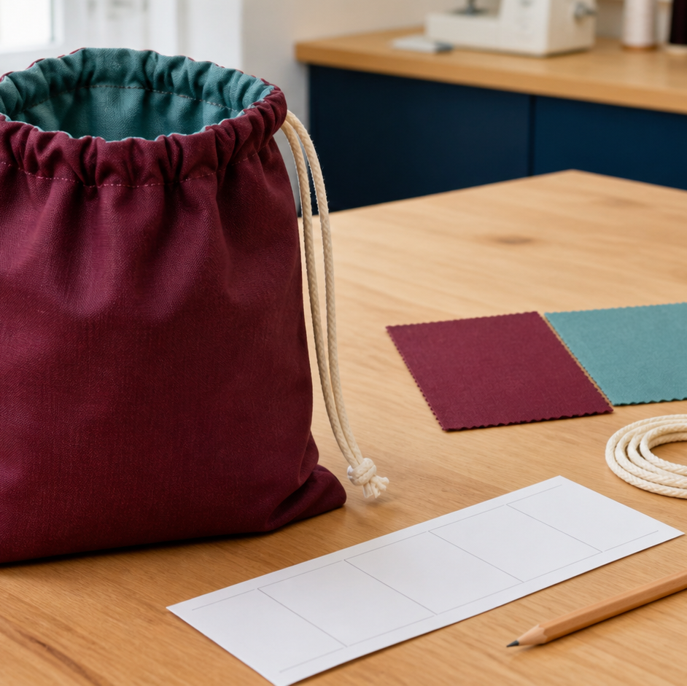
MODULE 04 · WEEKS 5–6
Sewing Bag Project
Design, construct and evaluate a sewing bag for a real user's needs.
Teacher-led classroom presentation
Notes:
Talking points
- Introduce Sewing Bag Project as a connected set of three ideas, not three isolated worksheets.
- Read the outcome aloud and link it to the current project stage.
- Keep local machine, pattern, safety and assessment details within the current teacher demonstration and authorised class documents.
Prompt: Which word in the outcome tells us what evidence we need to produce?
Likely misconception: Finishing a slide deck is the evidence; the evidence is the student's explanation and project decision.
Transition: Preview the three ideas and activate prior knowledge.
[Sources]
- Course sequence: WWHS Year 8 Accessories and Shorts Textiles Technology Program 2024, as bounded by source map v1.0.
- Curriculum: NESA Textiles Technology 7–10 Syllabus (2025), https://curriculum.nsw.edu.au/learning-areas/tas/textiles-technology-7-10-2025/overview/course
- Visual: Stage 08 approved module asset module-04-sewing-bag-project.png; provenance retained in the visual production manifest.

Slide 2
Three ideas, one connected decision
Listen for the relationship between the ideas. Each one changes what you notice, choose or explain.
1
2
3
Function and user needs
Construction sequence and decoration
Quality, evaluation and communication
RETRIEVAL WARM-UP
Which idea feels most familiar—and what evidence supports what you think you know?
MODULE 04 · YEAR 8 TEXTILES TECHNOLOGY
02
Notes:
Talking points
- Name all three substantive sections using the exact module language.
- Ask students to predict where the ideas connect to current project work.
- Accept a tentative response, but ask what evidence supports it.
Prompt: Which idea is most likely to change a practical or design decision today?
Likely misconception: The sequence means students can forget idea one after moving to idea two; the ideas need to remain connected.
Transition: Begin with Function and user needs.
[Sources]
- Named section sequence: frozen Stage 01 course inventory and Year 8 Textiles theory package v1.0.
- Curriculum context: NESA Textiles Technology 7–10 Syllabus (2025), https://curriculum.nsw.edu.au/learning-areas/tas/textiles-technology-7-10-2025/overview/course

Slide 3
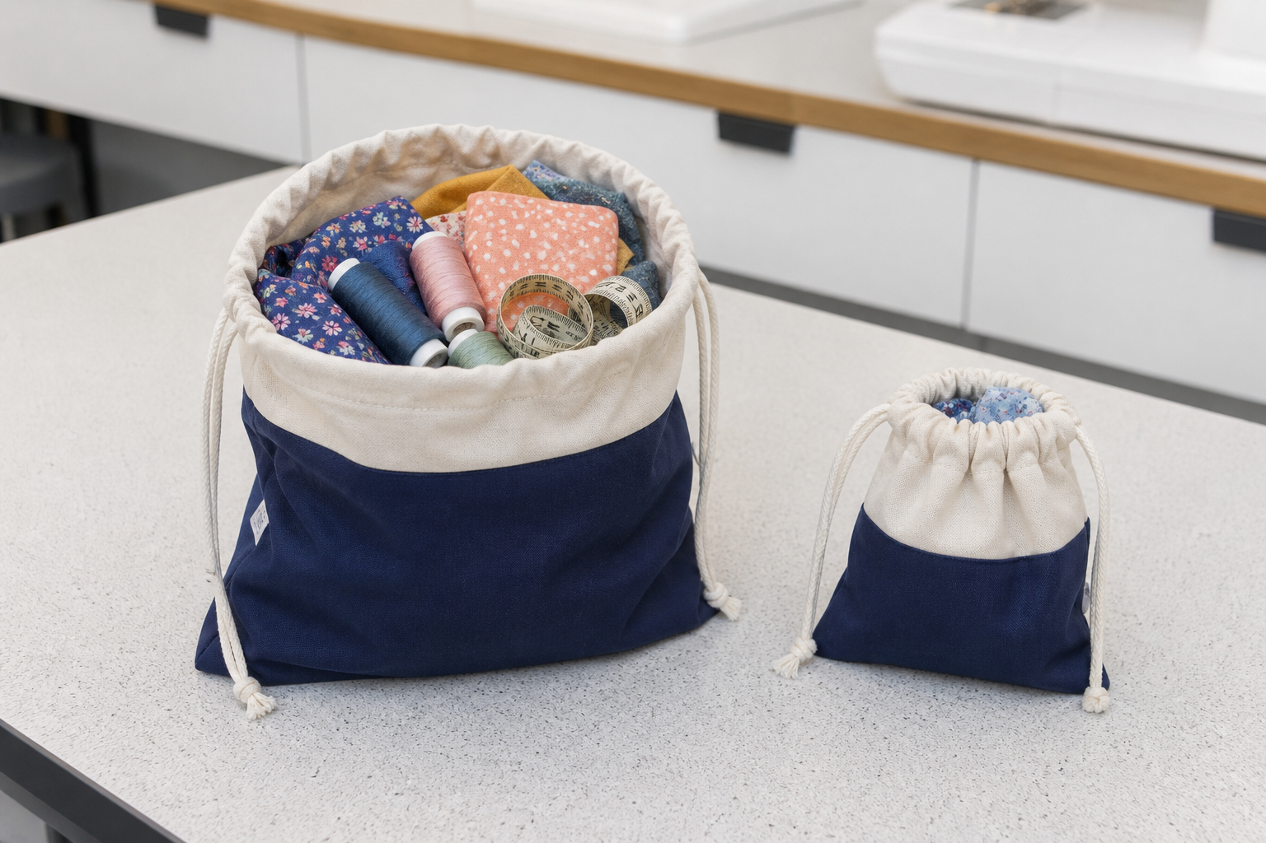
4.1 · BREAK FUNCTION INTO OBSERVABLE JOBS
Function and user needs
THE KEY IDEA
Function can be broken into observable jobs such as containment, access, carrying and storage where the brief confirms them. User needs should come from authorised evidence rather than designer assumptions. Criteria need a clear connection to the brief and a realistic way to gather evidence. Design trade-offs occur when a choice helps one need but affects another.
USE THIS IDEA
Create a user–purpose–function map for the current sewing-bag brief. Use confirmed information to write three different criteria, name the evidence for each and identify one possible trade-off that needs to be explored during idea development.
Look closely: find visible evidence for this claim — Function can be broken into observable jobs such as containment, access, carrying and storage where the brief confirms them.
MODULE 04 · YEAR 8 TEXTILES TECHNOLOGY
03
Notes:
Talking points
- Frame the sewing-bag project around user evidence, practical function and criteria that can guide design decisions.
- Emphasise: Function can be broken into observable jobs such as containment, access, carrying and storage where the brief confirms them.
- Connect the image to the decision: Show a realistic sewing-bag use scenario with a user–purpose–function–evidence chain and one visible trade-off.
Prompt: Use authorised user evidence to justify three sewing-bag criteria and explain one likely trade-off between function, appearance, resources or time.
Likely misconception: The user will probably want the same features I want. Correction: Design decisions should be based on evidence about the intended user and context, not assumed similarity.
Transition: Carry this decision into Construction sequence and decoration.
[Sources]
- Content: Year 8 Textiles theory package v1.0; source domains sewing-bag project identity; user-centred design; criteria and trade-offs.
- Curriculum: NESA Textiles Technology 7–10 Syllabus (2025), https://curriculum.nsw.edu.au/learning-areas/tas/textiles-technology-7-10-2025/overview/course
- Outcomes context: https://curriculum.nsw.edu.au/learning-areas/tas/textiles-technology-7-10-2025/outcomes
- Visual: Stage 08 approved teaching asset m04-s01-bag-user-needs.png; provenance retained in the visual production manifest.

Slide 4
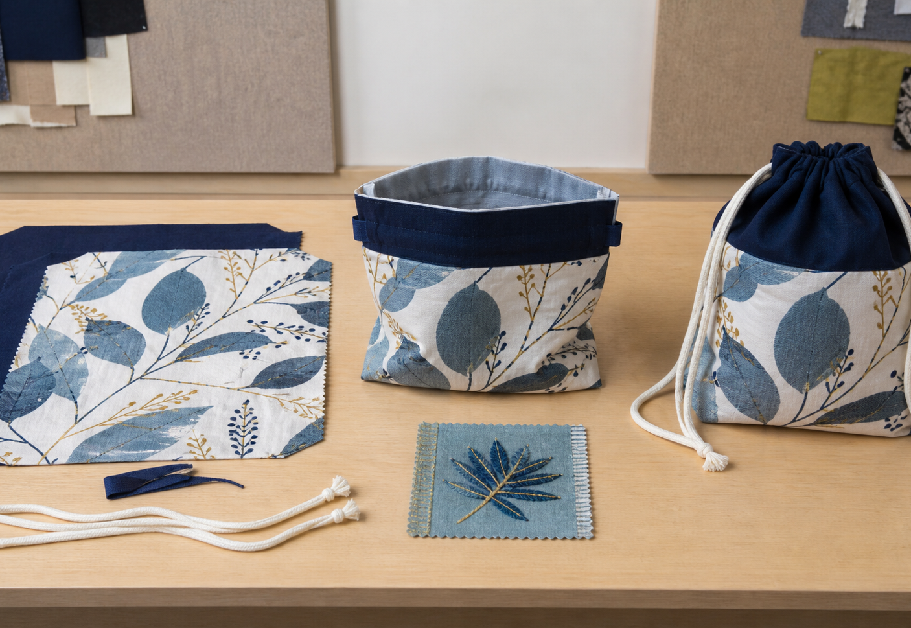
4.2 · MAP THE PRODUCT FROM PARTS TO WHOLE
Construction sequence and decoration
THE KEY IDEA
Construction planning begins with confirmed parts and how they become a whole product. Decoration should support the design concept or user and be tested on suitable material. Dependencies determine which tasks must happen before others. Checkpoints belong before important stages become hidden or difficult to correct.
USE THIS IDEA
Turn the teacher-issued sewing-bag instructions into a visual sequence. Add arrows for dependencies, mark the point where an approved decoration can be completed, and write the evidence to inspect at two checkpoints.
Look closely: find visible evidence for this claim — Construction planning begins with confirmed parts and how they become a whole product.
MODULE 04 · YEAR 8 TEXTILES TECHNOLOGY
04
Notes:
Talking points
- Develop dependency-aware construction planning and purposeful decoration decisions for the sewing-bag project.
- Emphasise: Construction planning begins with confirmed parts and how they become a whole product.
- Connect the image to the decision: Show an exploded bag view beside a dependency-aware sequence with decoration and checkpoint positions.
Prompt: Justify the position of one decorative stage and two checkpoints by explaining access, dependencies and the evidence each check protects.
Likely misconception: Instructions can be followed one line at a time without reading ahead. Correction: Reading the whole sequence reveals dependencies, preparation needs and checkpoints before work begins.
Transition: Carry this decision into Quality, evaluation and communication.
[Sources]
- Content: Year 8 Textiles theory package v1.0; source domains sewing-bag planning; construction sequencing; textile decoration.
- Curriculum: NESA Textiles Technology 7–10 Syllabus (2025), https://curriculum.nsw.edu.au/learning-areas/tas/textiles-technology-7-10-2025/overview/course
- Outcomes context: https://curriculum.nsw.edu.au/learning-areas/tas/textiles-technology-7-10-2025/outcomes
- Visual: Stage 08 approved teaching asset m04-s02-bag-sequence.png; provenance retained in the visual production manifest.

Slide 5
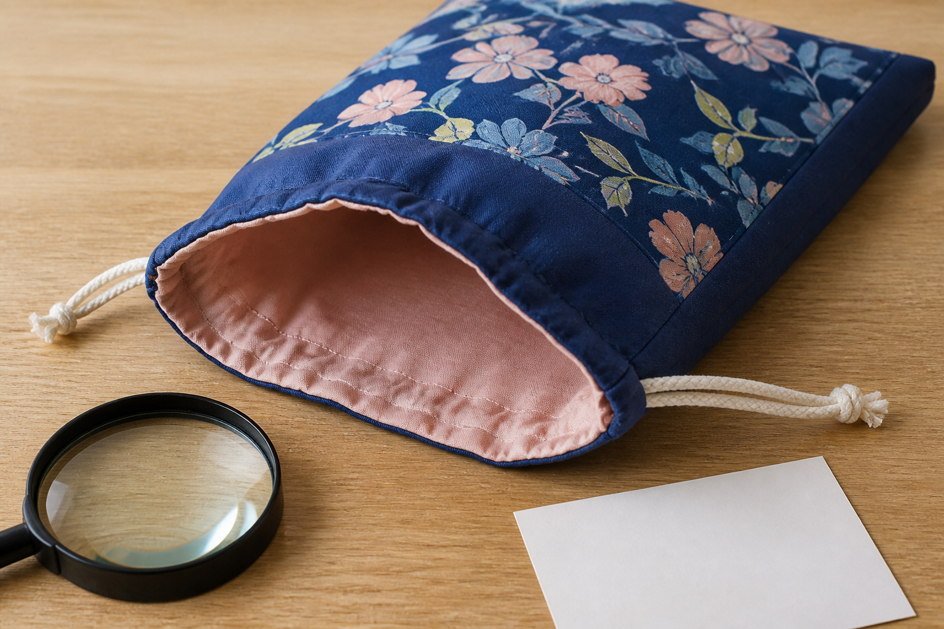
4.3 · INSPECT RELEVANT QUALITY FEATURES
Quality, evaluation and communication
THE KEY IDEA
Quality is judged against the intended purpose, user and relevant project criteria. Different viewpoints and function tests reveal different evidence. An evaluation links criterion, observation, reasoning and judgement. Clear, privacy-safe communication explains what each selected image or sample proves.
USE THIS IDEA
Select two criteria from the current bag brief. Gather a different form of evidence for each, write the criterion–observation–reasoning–judgement chain and add a captioned image or sample that makes the evidence understandable.
Look closely: find visible evidence for this claim — Quality is judged against the intended purpose, user and relevant project criteria.
MODULE 04 · YEAR 8 TEXTILES TECHNOLOGY
05
Notes:
Talking points
- Build a repeatable process for inspecting the sewing bag, evaluating it against criteria and communicating decisions with useful evidence.
- Emphasise: Quality is judged against the intended purpose, user and relevant project criteria.
- Connect the image to the decision: Show external, internal, detail and in-use evidence views linked to different sewing-bag criteria.
Prompt: Evaluate two sewing-bag criteria with different evidence types, explaining any limitation or trade-off and one justified improvement.
Likely misconception: Quality means the product has no visible mistakes. Correction: Quality is judged in relation to purpose, criteria, performance and the level of control expected for the taught techniques.
Transition: Pause for retrieval before students construct evidence.
[Sources]
- Content: Year 8 Textiles theory package v1.0; source domains sewing-bag project; quality evaluation; design communication.
- Curriculum: NESA Textiles Technology 7–10 Syllabus (2025), https://curriculum.nsw.edu.au/learning-areas/tas/textiles-technology-7-10-2025/overview/course
- Outcomes context: https://curriculum.nsw.edu.au/learning-areas/tas/textiles-technology-7-10-2025/outcomes
- Visual: Stage 08 approved teaching asset m04-s03-bag-quality.png; provenance retained in the visual production manifest.

Slide 6
Stop. Think. Explain.
Correct or improve each claim, then support your answer with evidence from the module.
1
Correct or improve: “The user will probably want the same features I want.”
2
Correct or improve: “Instructions can be followed one line at a time without reading ahead.”
3
Correct or improve: “Quality means the product has no visible mistakes.”
4
Connect two ideas: how could one change a decision made with the other?
MODULE 04 · YEAR 8 TEXTILES TECHNOLOGY
06
Notes:
Talking points
- Give silent thinking time before taking answers.
- Require students to correct the claim, not only label it true or false.
- Ask a follow-up: What evidence from slides 3–5 supports that correction?
Prompt: Which correction becomes stronger when you use an example from your own project?
Likely misconception: Retrieval is guessing; retrieval should reconstruct the idea and its evidence.
Transition: Use the corrected ideas to build one longer piece of evidence.
[Sources]
- Retrieval claims: misconceptions and corrections in the Year 8 Textiles theory package v1.0.
- Curriculum context: NESA Textiles Technology 7–10 Syllabus (2025), https://curriculum.nsw.edu.au/learning-areas/tas/textiles-technology-7-10-2025/overview/course

Slide 7
Read → Select → Explain → Check
Evaluate two sewing-bag criteria with different evidence types, explaining any limitation or trade-off and one justified improvement.
1
2
3
4
READ
SELECT
EXPLAIN
CHECK
→
→
→
Underline the task word and the exact context.
Choose theory and project evidence that answers it.
Connect the evidence to a reason, effect or judgement.
Compare the response with the two success criteria.
SENTENCE SUPPORT
One decision I would make is ___ because evidence from ___ shows ___. I would check it by ___.
MODULE 04 · YEAR 8 TEXTILES TECHNOLOGY
07
Notes:
Talking points
- Model the four moves with one brief example, then remove the example from view.
- The selected evidence must answer the exact context, not merely repeat a definition.
- Use the sentence support as a starting structure; students may improve it in their own words.
Prompt: Which evidence is most relevant, and which tempting detail should be left out?
Likely misconception: A longer response is automatically stronger; relevance and explanation matter more than length.
Transition: Students now save the response in the matching module learning package.
[Sources]
- Guided response: evidence prompt for m04-s03 in the Year 8 Textiles theory package v1.0.
- Curriculum context: NESA Textiles Technology 7–10 Syllabus (2025), https://curriculum.nsw.edu.au/learning-areas/tas/textiles-technology-7-10-2025/outcomes

Slide 8
Before you leave…
1.
One idea I can now explain is…
SAVE
YOUR
WORK
2.
One practical or design decision this changes is…
3.
One question or check I still need is…
EVIDENCE DESTINATION
Complete the three learning packages and save your response on this module page.
Next: Design Inspiration
MODULE 04 · YEAR 8 TEXTILES TECHNOLOGY
08
Notes:
Talking points
- Use the three-part exit ticket as a quick verbal or written check.
- Direct students to the module page so the evidence is saved in the correct learning package.
- Preview the connection to Design Inspiration.
Prompt: Which answer would you be willing to improve after receiving feedback?
Likely misconception: Saving work means it is finished; saved evidence can still be reviewed and improved.
Transition: Continue to Design Inspiration when the class sequence is ready.
[Sources]
- Evidence destination: frozen family learning-package contract and local autosave workflow.
- Module sequence: WWHS Year 8 Accessories and Shorts Textiles Technology Program 2024, as bounded by source map v1.0.
- Curriculum context: NESA Textiles Technology 7–10 Syllabus (2025), https://curriculum.nsw.edu.au/learning-areas/tas/textiles-technology-7-10-2025/overview/course

