Slide 1
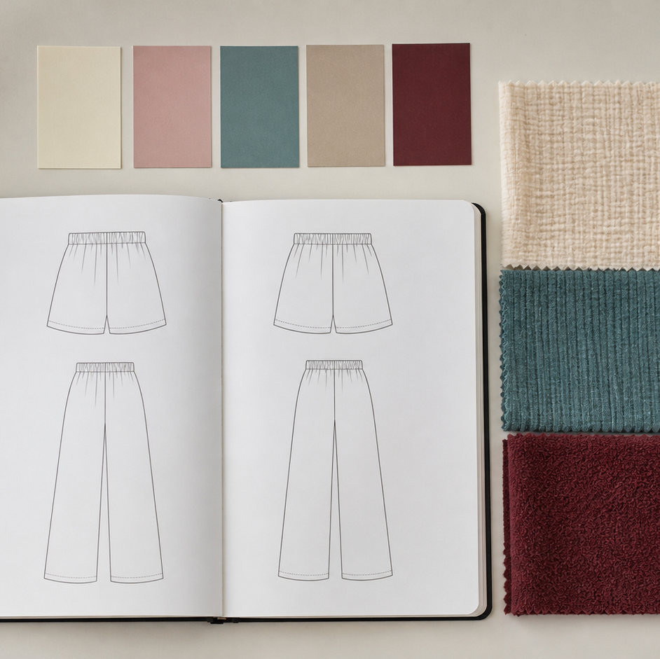
MODULE 05 · WEEK 7
Design Inspiration
Use a brief, mood board and ethical sources to develop a clear design direction.
Teacher-led classroom presentation
Notes:
Talking points
- Introduce Design Inspiration as a connected set of three ideas, not three isolated worksheets.
- Read the outcome aloud and link it to the current project stage.
- Keep local machine, pattern, safety and assessment details within the current teacher demonstration and authorised class documents.
Prompt: Which word in the outcome tells us what evidence we need to produce?
Likely misconception: Finishing a slide deck is the evidence; the evidence is the student's explanation and project decision.
Transition: Preview the three ideas and activate prior knowledge.
[Sources]
- Course sequence: WWHS Year 8 Accessories and Shorts Textiles Technology Program 2024, as bounded by source map v1.0.
- Curriculum: NESA Textiles Technology 7–10 Syllabus (2025), https://curriculum.nsw.edu.au/learning-areas/tas/textiles-technology-7-10-2025/overview/course
- Visual: Stage 08 approved module asset module-05-design-inspiration.png; provenance retained in the visual production manifest.

Slide 2
Three ideas, one connected decision
Listen for the relationship between the ideas. Each one changes what you notice, choose or explain.
1
2
3
Design brief and user
Mood boards, colour and texture
Ethical digital inspiration
RETRIEVAL WARM-UP
Which idea feels most familiar—and what evidence supports what you think you know?
MODULE 05 · YEAR 8 TEXTILES TECHNOLOGY
02
Notes:
Talking points
- Name all three substantive sections using the exact module language.
- Ask students to predict where the ideas connect to current project work.
- Accept a tentative response, but ask what evidence supports it.
Prompt: Which idea is most likely to change a practical or design decision today?
Likely misconception: The sequence means students can forget idea one after moving to idea two; the ideas need to remain connected.
Transition: Begin with Design brief and user.
[Sources]
- Named section sequence: frozen Stage 01 course inventory and Year 8 Textiles theory package v1.0.
- Curriculum context: NESA Textiles Technology 7–10 Syllabus (2025), https://curriculum.nsw.edu.au/learning-areas/tas/textiles-technology-7-10-2025/overview/course

Slide 3
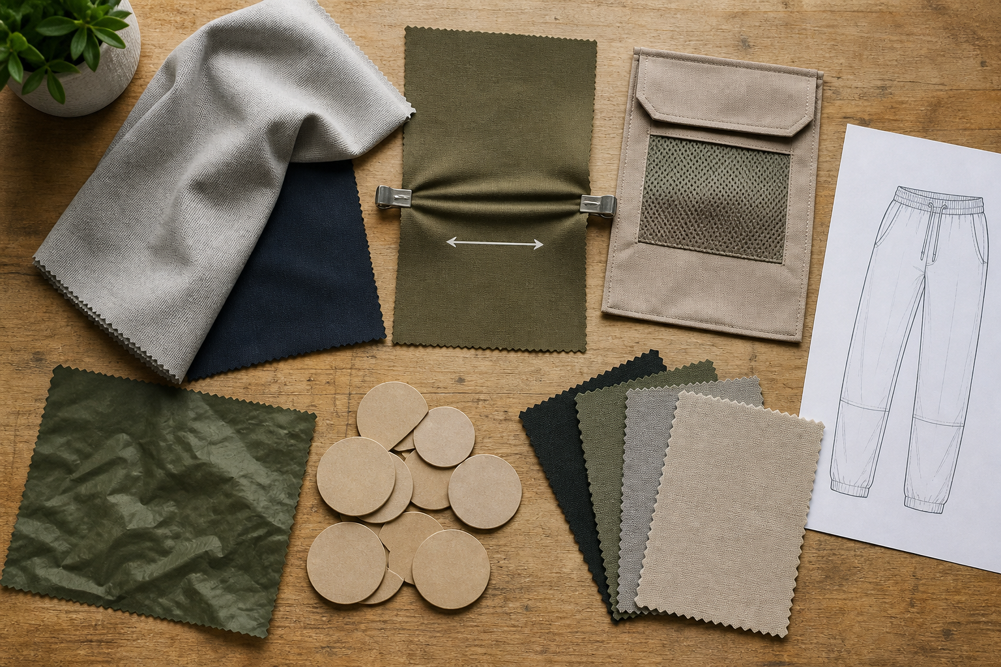
5.1 · FIND THE DECISION-MAKING INFORMATION
Design brief and user
THE KEY IDEA
A design brief provides the problem, purpose, user, context and confirmed limits. User questions should collect only information that can influence a design decision. Preferences, needs and target-market patterns are related but not identical. Confirmed constraints guide creativity; rumours and assumptions remain questions.
USE THIS IDEA
Create a brief audit with four headings: confirmed facts, user evidence, constraints and questions. Rewrite the challenge as one open design question, then state which two decisions the current user evidence can genuinely influence.
Look closely: find visible evidence for this claim — A design brief provides the problem, purpose, user, context and confirmed limits.
MODULE 05 · YEAR 8 TEXTILES TECHNOLOGY
03
Notes:
Talking points
- Develop disciplined interpretation of a design brief and ethical, efficient gathering of user information before idea generation.
- Emphasise: A design brief provides the problem, purpose, user, context and confirmed limits.
- Connect the image to the decision: Show a design brief being separated into facts, user evidence, constraints, questions and an open design direction.
Prompt: Explain how two pieces of user evidence and two confirmed constraints shape a design direction without locking in unsupported features.
Likely misconception: Designing for myself means user research is unnecessary. Correction: You still need to identify the real context, test assumptions and explain evidence for your choices.
Transition: Carry this decision into Mood boards, colour and texture.
[Sources]
- Content: Year 8 Textiles theory package v1.0; source domains design inspiration sequence; folio design evidence; user-centred design.
- Curriculum: NESA Textiles Technology 7–10 Syllabus (2025), https://curriculum.nsw.edu.au/learning-areas/tas/textiles-technology-7-10-2025/overview/course
- Outcomes context: https://curriculum.nsw.edu.au/learning-areas/tas/textiles-technology-7-10-2025/outcomes
- Visual: Stage 08 approved teaching asset m05-s01-design-brief.png; provenance retained in the visual production manifest.

Slide 4
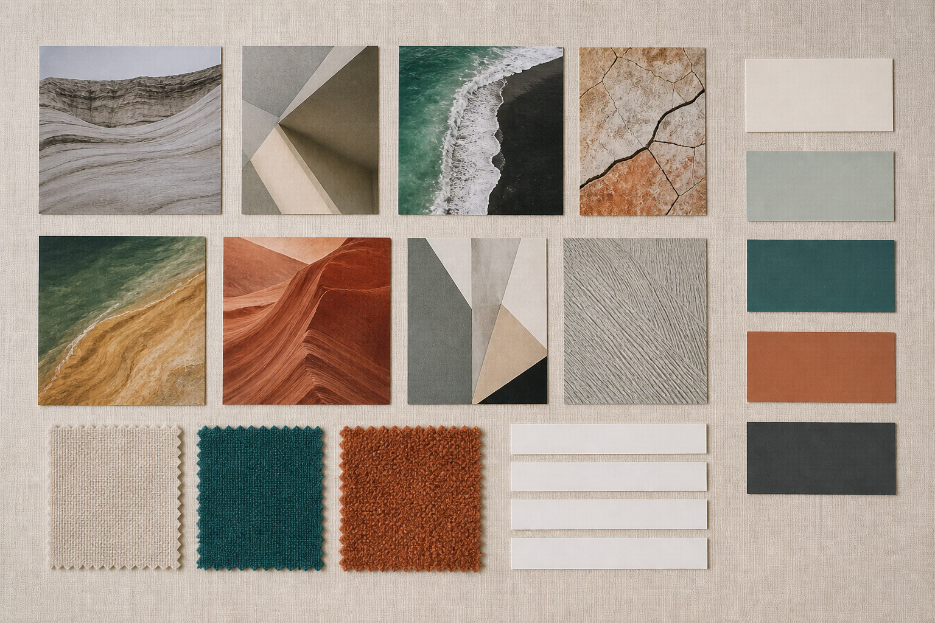
5.2 · BUILD A BOARD AROUND ONE DIRECTION
Mood boards, colour and texture
THE KEY IDEA
A mood board communicates a focused design direction rather than a collection of finished products to copy. The class guide uses six to ten images, four to six colours, three textile samples and four to six keywords. Colour roles and texture evidence help turn inspiration into design decisions. Curation removes weak items and makes relationships, evidence and unanswered questions visible.
USE THIS IDEA
Create or refine your Canva mood board using the authorised quantities. Add source records outside the visual composition, then write two sentences explaining how the palette and textile samples respond to the user and brief.
Look closely: find visible evidence for this claim — A mood board communicates a focused design direction rather than a collection of finished products to copy.
MODULE 05 · YEAR 8 TEXTILES TECHNOLOGY
04
Notes:
Talking points
- Teach students to curate a coherent mood board and use colour and texture as evidence-based design tools.
- Emphasise: A mood board communicates a focused design direction rather than a collection of finished products to copy.
- Connect the image to the decision: Show an authentic mood-board refinement from cluttered collection to a coherent image, palette, textile-sample and keyword composition.
Prompt: Justify the selected images, palette, textile samples and keywords by explaining how they support the user, purpose and two later design decisions.
Likely misconception: A mood board should contain as many images as possible. Correction: The class guidance sets a purposeful range, and each item should contribute to one clear direction.
Transition: Carry this decision into Ethical digital inspiration.
[Sources]
- Content: Year 8 Textiles theory package v1.0; source domains mood-board quantities; folio inspiration evidence; colour and texture in design.
- Curriculum: NESA Textiles Technology 7–10 Syllabus (2025), https://curriculum.nsw.edu.au/learning-areas/tas/textiles-technology-7-10-2025/overview/course
- Outcomes context: https://curriculum.nsw.edu.au/learning-areas/tas/textiles-technology-7-10-2025/outcomes
- Visual: Stage 08 approved teaching asset m05-s02-moodboard.png; provenance retained in the visual production manifest.

Slide 5
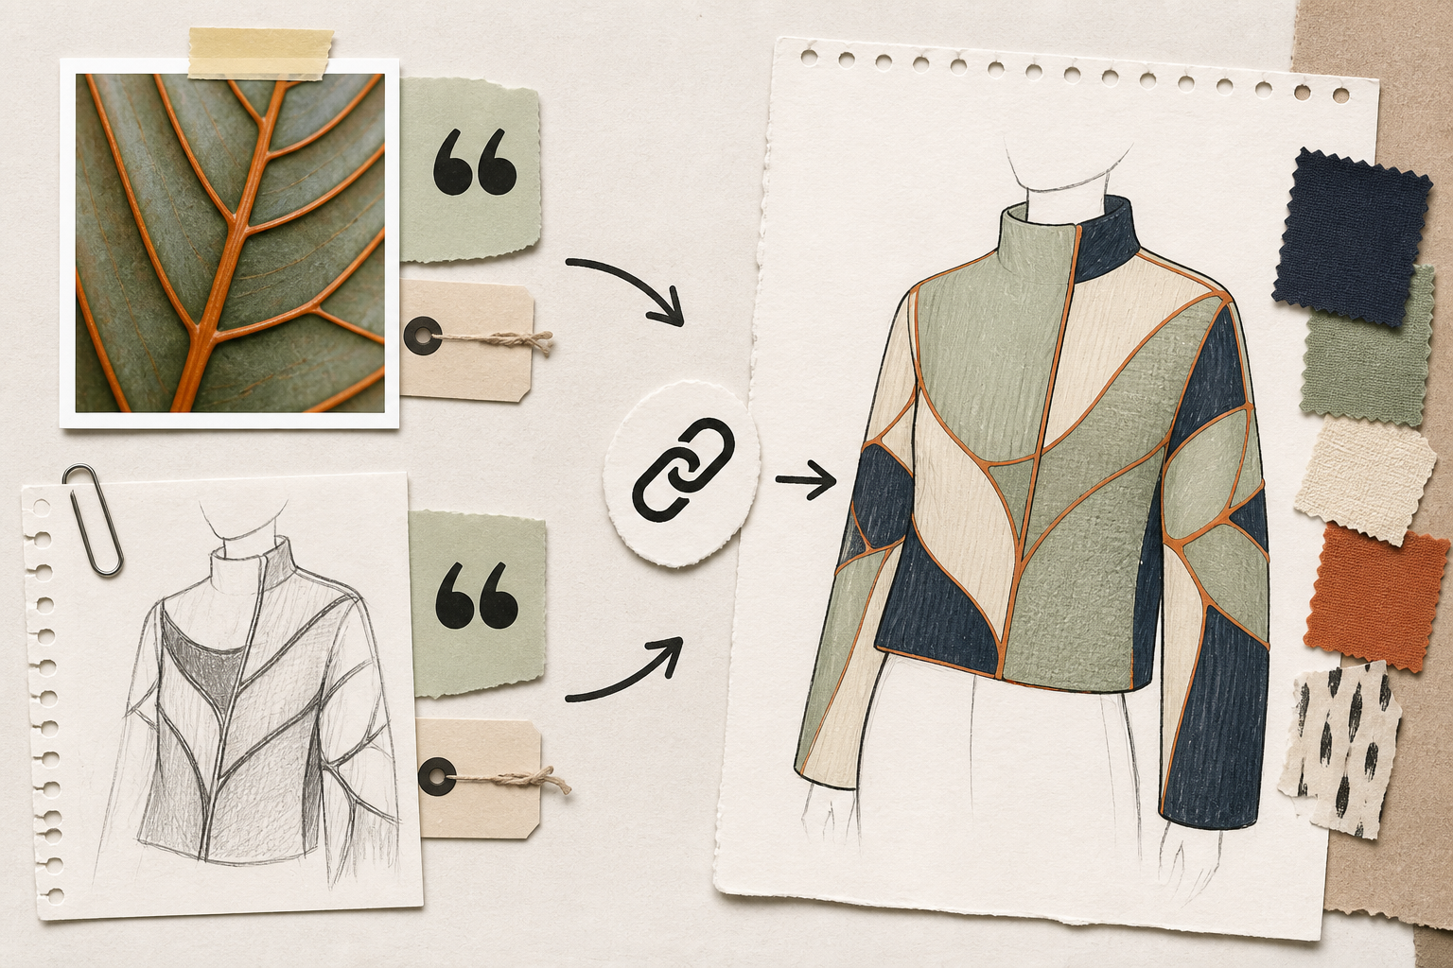
5.3 · RECORD AND CHECK THE SOURCE
Ethical digital inspiration
THE KEY IDEA
A searchable or downloadable image is not automatically licensed for reuse. Source records support acknowledgement, fact checking and later rights decisions. ICIP requires respect for the relevant peoples, knowledge, protocols and permissions. Original design development transforms an underlying quality through the brief, user evidence and experimentation.
USE THIS IDEA
Audit three items in your inspiration collection. For each, record the source, reuse status and underlying design quality. Replace any unclear public-use image in the final folio export, then develop one quality through three original thumbnails.
Look closely: find visible evidence for this claim — A searchable or downloadable image is not automatically licensed for reuse.
MODULE 05 · YEAR 8 TEXTILES TECHNOLOGY
05
Notes:
Talking points
- Teach students to research, record and transform inspiration while respecting copyright, privacy and Indigenous Cultural and Intellectual Property.
- Emphasise: A searchable or downloadable image is not automatically licensed for reuse.
- Connect the image to the decision: Show a source-to-analysis-to-thumbnails-to-sample development trail, with separate rights and cultural-protocol decision points.
Prompt: Explain how one recorded source influenced an original design direction, what rights or protocol checks were required and how the idea was transformed.
Likely misconception: Giving credit means I can use any image publicly. Correction: Acknowledgement is important, but it does not replace the licence, permission or cultural protocol required for reuse.
Transition: Pause for retrieval before students construct evidence.
[Sources]
- Content: Year 8 Textiles theory package v1.0; source domains digital design practice; source ethics; ICIP and cultural protocols.
- Curriculum: NESA Textiles Technology 7–10 Syllabus (2025), https://curriculum.nsw.edu.au/learning-areas/tas/textiles-technology-7-10-2025/overview/course
- Outcomes context: https://curriculum.nsw.edu.au/learning-areas/tas/textiles-technology-7-10-2025/outcomes
- Visual: Stage 08 approved teaching asset m05-s03-ethical-inspiration.png; provenance retained in the visual production manifest.

Slide 6
Stop. Think. Explain.
Correct or improve each claim, then support your answer with evidence from the module.
1
Correct or improve: “Designing for myself means user research is unnecessary.”
2
Correct or improve: “A mood board should contain as many images as possible.”
3
Correct or improve: “Giving credit means I can use any image publicly.”
4
Connect two ideas: how could one change a decision made with the other?
MODULE 05 · YEAR 8 TEXTILES TECHNOLOGY
06
Notes:
Talking points
- Give silent thinking time before taking answers.
- Require students to correct the claim, not only label it true or false.
- Ask a follow-up: What evidence from slides 3–5 supports that correction?
Prompt: Which correction becomes stronger when you use an example from your own project?
Likely misconception: Retrieval is guessing; retrieval should reconstruct the idea and its evidence.
Transition: Use the corrected ideas to build one longer piece of evidence.
[Sources]
- Retrieval claims: misconceptions and corrections in the Year 8 Textiles theory package v1.0.
- Curriculum context: NESA Textiles Technology 7–10 Syllabus (2025), https://curriculum.nsw.edu.au/learning-areas/tas/textiles-technology-7-10-2025/overview/course

Slide 7
Read → Select → Explain → Check
Explain how one recorded source influenced an original design direction, what rights or protocol checks were required and how the idea was transformed.
1
2
3
4
READ
SELECT
EXPLAIN
CHECK
→
→
→
Underline the task word and the exact context.
Choose theory and project evidence that answers it.
Connect the evidence to a reason, effect or judgement.
Compare the response with the two success criteria.
SENTENCE SUPPORT
One decision I would make is ___ because evidence from ___ shows ___. I would check it by ___.
MODULE 05 · YEAR 8 TEXTILES TECHNOLOGY
07
Notes:
Talking points
- Model the four moves with one brief example, then remove the example from view.
- The selected evidence must answer the exact context, not merely repeat a definition.
- Use the sentence support as a starting structure; students may improve it in their own words.
Prompt: Which evidence is most relevant, and which tempting detail should be left out?
Likely misconception: A longer response is automatically stronger; relevance and explanation matter more than length.
Transition: Students now save the response in the matching module learning package.
[Sources]
- Guided response: evidence prompt for m05-s03 in the Year 8 Textiles theory package v1.0.
- Curriculum context: NESA Textiles Technology 7–10 Syllabus (2025), https://curriculum.nsw.edu.au/learning-areas/tas/textiles-technology-7-10-2025/outcomes

Slide 8
Before you leave…
1.
One idea I can now explain is…
SAVE
YOUR
WORK
2.
One practical or design decision this changes is…
3.
One question or check I still need is…
EVIDENCE DESTINATION
Complete the three learning packages and save your response on this module page.
Next: Fibres, Yarns and Fabrics
MODULE 05 · YEAR 8 TEXTILES TECHNOLOGY
08
Notes:
Talking points
- Use the three-part exit ticket as a quick verbal or written check.
- Direct students to the module page so the evidence is saved in the correct learning package.
- Preview the connection to Fibres, Yarns and Fabrics.
Prompt: Which answer would you be willing to improve after receiving feedback?
Likely misconception: Saving work means it is finished; saved evidence can still be reviewed and improved.
Transition: Continue to Fibres, Yarns and Fabrics when the class sequence is ready.
[Sources]
- Evidence destination: frozen family learning-package contract and local autosave workflow.
- Module sequence: WWHS Year 8 Accessories and Shorts Textiles Technology Program 2024, as bounded by source map v1.0.
- Curriculum context: NESA Textiles Technology 7–10 Syllabus (2025), https://curriculum.nsw.edu.au/learning-areas/tas/textiles-technology-7-10-2025/overview/course

