Slide 1
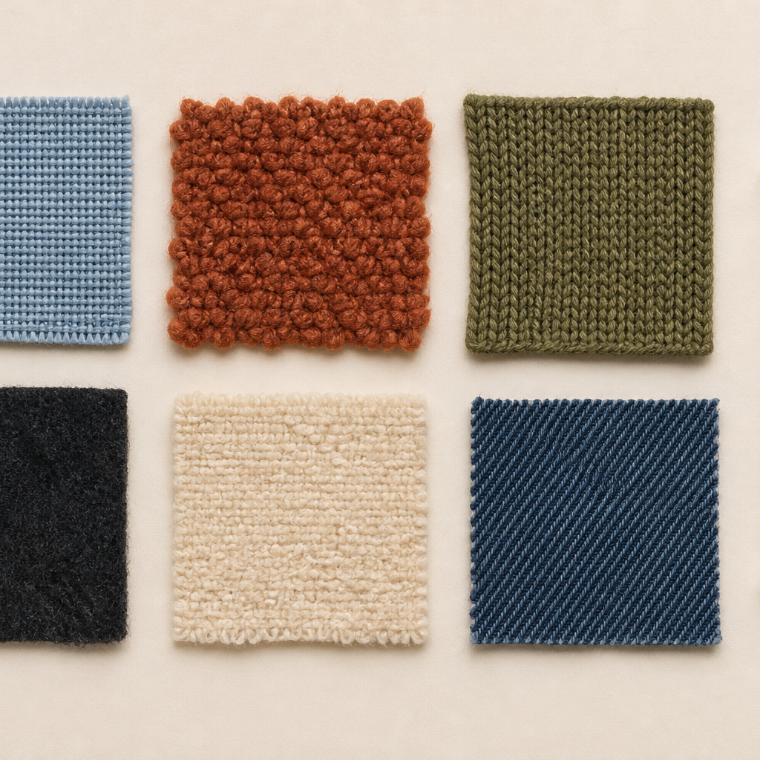
MODULE 06 · WEEK 8
Fibres, Yarns and Fabrics
Connect fibres, yarns and fabric structures to properties, testing and end use.
Teacher-led classroom presentation
Notes:
Talking points
- Introduce Fibres, Yarns and Fabrics as a connected set of three ideas, not three isolated worksheets.
- Read the outcome aloud and link it to the current project stage.
- Keep local machine, pattern, safety and assessment details within the current teacher demonstration and authorised class documents.
Prompt: Which word in the outcome tells us what evidence we need to produce?
Likely misconception: Finishing a slide deck is the evidence; the evidence is the student's explanation and project decision.
Transition: Preview the three ideas and activate prior knowledge.
[Sources]
- Course sequence: WWHS Year 8 Accessories and Shorts Textiles Technology Program 2024, as bounded by source map v1.0.
- Curriculum: NESA Textiles Technology 7–10 Syllabus (2025), https://curriculum.nsw.edu.au/learning-areas/tas/textiles-technology-7-10-2025/overview/course
- Visual: Stage 08 approved module asset module-06-fibres-yarns-fabrics.png; provenance retained in the visual production manifest.

Slide 2
Three ideas, one connected decision
Listen for the relationship between the ideas. Each one changes what you notice, choose or explain.
1
2
3
Fibre origins
Yarn and fabric structures
Properties, testing and end use
RETRIEVAL WARM-UP
Which idea feels most familiar—and what evidence supports what you think you know?
MODULE 06 · YEAR 8 TEXTILES TECHNOLOGY
02
Notes:
Talking points
- Name all three substantive sections using the exact module language.
- Ask students to predict where the ideas connect to current project work.
- Accept a tentative response, but ask what evidence supports it.
Prompt: Which idea is most likely to change a practical or design decision today?
Likely misconception: The sequence means students can forget idea one after moving to idea two; the ideas need to remain connected.
Transition: Begin with Fibre origins.
[Sources]
- Named section sequence: frozen Stage 01 course inventory and Year 8 Textiles theory package v1.0.
- Curriculum context: NESA Textiles Technology 7–10 Syllabus (2025), https://curriculum.nsw.edu.au/learning-areas/tas/textiles-technology-7-10-2025/overview/course

Slide 3
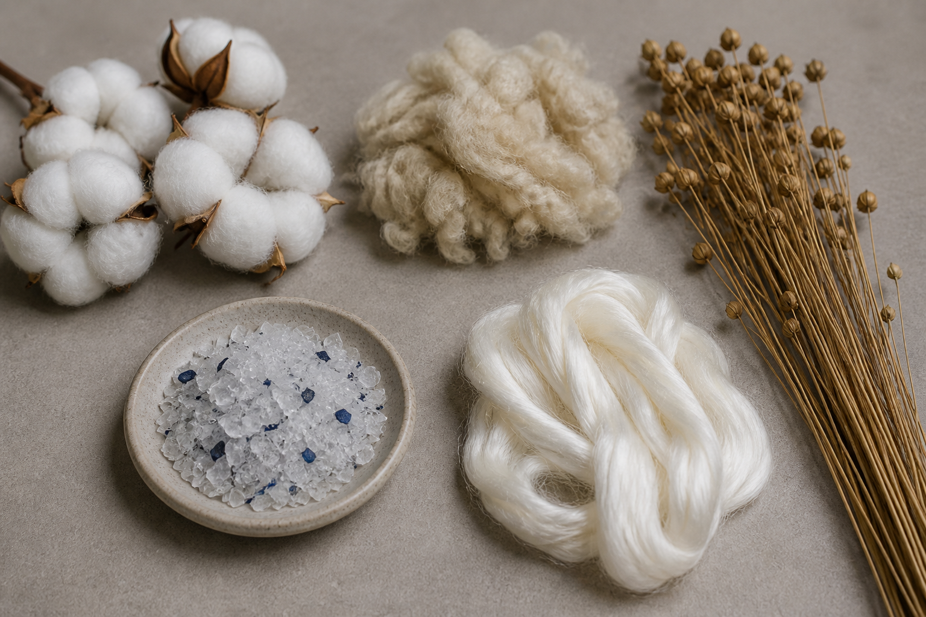
6.1 · UNDERSTAND THE FIBRE LEVEL
Fibre origins
THE KEY IDEA
Fibres are fine material units that contribute to yarns and textile structures. Natural fibres include plant and animal sources; manufactured fibres involve industrial production and may use different raw materials. Fibre origin influences possibilities but does not determine complete fabric performance. Environmental comparisons need evidence across relevant life-cycle stages and should avoid universal slogans.
USE THIS IDEA
Use teacher-supplied labels or material records to classify several fibres by origin. For one product, write two questions about production, performance, care or end of life that the fibre name alone cannot answer.
Look closely: find visible evidence for this claim — Fibres are fine material units that contribute to yarns and textile structures.
MODULE 06 · YEAR 8 TEXTILES TECHNOLOGY
03
Notes:
Talking points
- Build an accurate fibre-level vocabulary and connect origins with responsible, evidence-based material questions.
- Emphasise: Fibres are fine material units that contribute to yarns and textile structures.
- Connect the image to the decision: Show authentic fibre-to-yarn starting points for plant, animal, regenerated-cellulose and synthetic examples without implying one universal impact ranking.
Prompt: Compare two fibre origins for one intended textile use, identifying what the fibre information supports and what must be tested or researched further.
Likely misconception: Natural fibres are always sustainable. Correction: Environmental outcomes also depend on production, processing, transport, durability, care, reuse and end of life.
Transition: Carry this decision into Yarn and fabric structures.
[Sources]
- Content: Year 8 Textiles theory package v1.0; source domains fibre terminology; material origins and end use; Australian and global textile systems.
- Curriculum: NESA Textiles Technology 7–10 Syllabus (2025), https://curriculum.nsw.edu.au/learning-areas/tas/textiles-technology-7-10-2025/overview/course
- Outcomes context: https://curriculum.nsw.edu.au/learning-areas/tas/textiles-technology-7-10-2025/outcomes
- Visual: Stage 08 approved teaching asset m06-s01-fibre-origins.png; provenance retained in the visual production manifest.

Slide 4
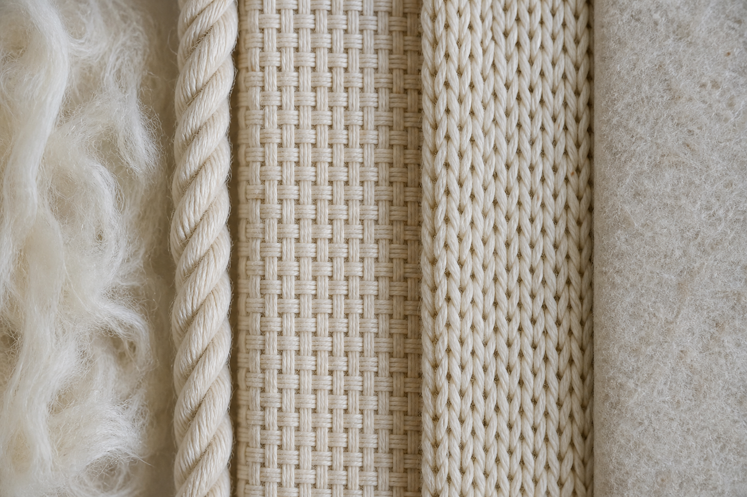
6.2 · SEE HOW A YARN IS ORGANISED
Yarn and fabric structures
THE KEY IDEA
Yarn structure depends on how fibres or filaments are organised, twisted and combined. Woven fabrics interlace yarn systems, knitted fabrics connect loops and nonwovens bond or entangle fibres. Structure can influence stretch, recovery, drape, stability, surface and edge behaviour. Claims should describe the actual sample and test rather than every fabric in a category.
USE THIS IDEA
Observe three teacher-labelled fabric samples using sight, touch and magnification. Sketch the visible structure, identify the evidence for woven, knitted or nonwoven classification, and record one performance question for a fair test.
Look closely: find visible evidence for this claim — Yarn structure depends on how fibres or filaments are organised, twisted and combined.
MODULE 06 · YEAR 8 TEXTILES TECHNOLOGY
04
Notes:
Talking points
- Explain how fibres become yarns and how woven, knitted and nonwoven structures influence observable fabric behaviour.
- Emphasise: Yarn structure depends on how fibres or filaments are organised, twisted and combined.
- Connect the image to the decision: Use macro photographs and clear enlarged structure views of woven interlacing, knitted loops and a nonwoven fibre network.
Prompt: Compare two labelled fabrics by fibre, yarn or fabric structure and use observations to explain one performance difference without overgeneralising.
Likely misconception: All fabrics made from the same fibre behave the same way. Correction: Yarn, fabric structure, finish and construction can produce different behaviour from the same fibre content.
Transition: Carry this decision into Properties, testing and end use.
[Sources]
- Content: Year 8 Textiles theory package v1.0; source domains fibre-yarn-fabric relationship; woven knitted and nonwoven structures; material performance.
- Curriculum: NESA Textiles Technology 7–10 Syllabus (2025), https://curriculum.nsw.edu.au/learning-areas/tas/textiles-technology-7-10-2025/overview/course
- Outcomes context: https://curriculum.nsw.edu.au/learning-areas/tas/textiles-technology-7-10-2025/outcomes
- Visual: Stage 08 approved teaching asset m06-s02-yarn-fabric-structures.png; provenance retained in the visual production manifest.

Slide 5
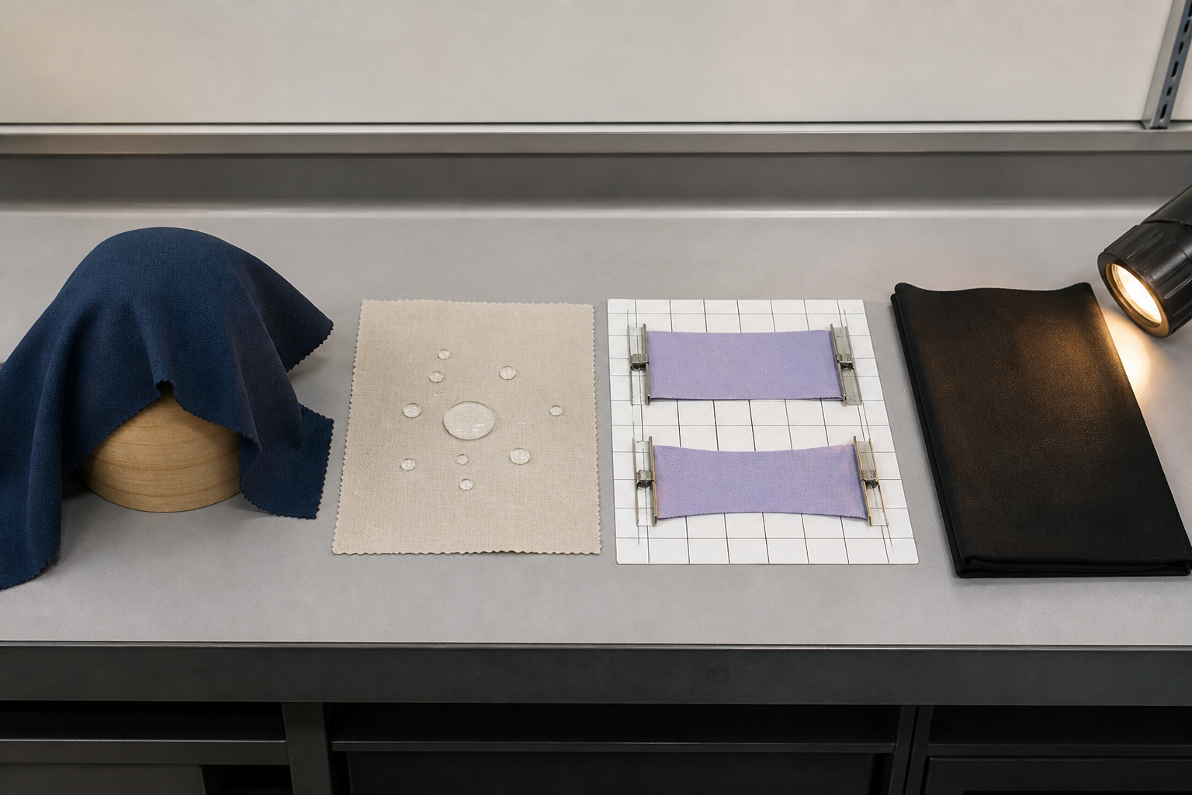
6.3 · SELECT PROPERTIES THAT MATTER
Properties, testing and end use
THE KEY IDEA
Relevant properties are selected by starting with the product’s end-use needs. A fair comparison controls important conditions and changes one main factor. Results need an evidence record and an explanation of what they mean. Material suitability is conditional and may involve competing criteria and limitations.
USE THIS IDEA
Choose one confirmed product need and one relevant property. Write a fair-test question, identify what will change and stay constant, follow the teacher-approved method, and conclude what the evidence does and does not show about suitability.
Look closely: find visible evidence for this claim — Relevant properties are selected by starting with the product’s end-use needs.
MODULE 06 · YEAR 8 TEXTILES TECHNOLOGY
05
Notes:
Talking points
- Teach students to design fair material tests and use evidence to justify fabric suitability for a particular textile end use.
- Emphasise: Relevant properties are selected by starting with the product’s end-use needs.
- Connect the image to the decision: Show a photo-rich material-testing sequence with labelled samples, controlled conditions, observations and an end-use decision.
Prompt: Design and interpret one fair material test, explaining how its evidence supports or limits a choice for a confirmed end use.
Likely misconception: The strongest fabric is the best choice for every product. Correction: Strength matters only in relation to other end-use needs, construction limits, comfort, appearance, care and resources.
Transition: Pause for retrieval before students construct evidence.
[Sources]
- Content: Year 8 Textiles theory package v1.0; source domains textile properties; materials testing; end-use selection.
- Curriculum: NESA Textiles Technology 7–10 Syllabus (2025), https://curriculum.nsw.edu.au/learning-areas/tas/textiles-technology-7-10-2025/overview/course
- Outcomes context: https://curriculum.nsw.edu.au/learning-areas/tas/textiles-technology-7-10-2025/outcomes
- Visual: Stage 08 approved teaching asset m06-s03-properties-testing.png; provenance retained in the visual production manifest.

Slide 6
Stop. Think. Explain.
Correct or improve each claim, then support your answer with evidence from the module.
1
Correct or improve: “Natural fibres are always sustainable.”
2
Correct or improve: “All fabrics made from the same fibre behave the same way.”
3
Correct or improve: “The strongest fabric is the best choice for every product.”
4
Connect two ideas: how could one change a decision made with the other?
MODULE 06 · YEAR 8 TEXTILES TECHNOLOGY
06
Notes:
Talking points
- Give silent thinking time before taking answers.
- Require students to correct the claim, not only label it true or false.
- Ask a follow-up: What evidence from slides 3–5 supports that correction?
Prompt: Which correction becomes stronger when you use an example from your own project?
Likely misconception: Retrieval is guessing; retrieval should reconstruct the idea and its evidence.
Transition: Use the corrected ideas to build one longer piece of evidence.
[Sources]
- Retrieval claims: misconceptions and corrections in the Year 8 Textiles theory package v1.0.
- Curriculum context: NESA Textiles Technology 7–10 Syllabus (2025), https://curriculum.nsw.edu.au/learning-areas/tas/textiles-technology-7-10-2025/overview/course

Slide 7
Read → Select → Explain → Check
Design and interpret one fair material test, explaining how its evidence supports or limits a choice for a confirmed end use.
1
2
3
4
READ
SELECT
EXPLAIN
CHECK
→
→
→
Underline the task word and the exact context.
Choose theory and project evidence that answers it.
Connect the evidence to a reason, effect or judgement.
Compare the response with the two success criteria.
SENTENCE SUPPORT
One decision I would make is ___ because evidence from ___ shows ___. I would check it by ___.
MODULE 06 · YEAR 8 TEXTILES TECHNOLOGY
07
Notes:
Talking points
- Model the four moves with one brief example, then remove the example from view.
- The selected evidence must answer the exact context, not merely repeat a definition.
- Use the sentence support as a starting structure; students may improve it in their own words.
Prompt: Which evidence is most relevant, and which tempting detail should be left out?
Likely misconception: A longer response is automatically stronger; relevance and explanation matter more than length.
Transition: Students now save the response in the matching module learning package.
[Sources]
- Guided response: evidence prompt for m06-s03 in the Year 8 Textiles theory package v1.0.
- Curriculum context: NESA Textiles Technology 7–10 Syllabus (2025), https://curriculum.nsw.edu.au/learning-areas/tas/textiles-technology-7-10-2025/outcomes

Slide 8
Before you leave…
1.
One idea I can now explain is…
SAVE
YOUR
WORK
2.
One practical or design decision this changes is…
3.
One question or check I still need is…
EVIDENCE DESTINATION
Complete the three learning packages and save your response on this module page.
Next: Commercial Patterns
MODULE 06 · YEAR 8 TEXTILES TECHNOLOGY
08
Notes:
Talking points
- Use the three-part exit ticket as a quick verbal or written check.
- Direct students to the module page so the evidence is saved in the correct learning package.
- Preview the connection to Commercial Patterns.
Prompt: Which answer would you be willing to improve after receiving feedback?
Likely misconception: Saving work means it is finished; saved evidence can still be reviewed and improved.
Transition: Continue to Commercial Patterns when the class sequence is ready.
[Sources]
- Evidence destination: frozen family learning-package contract and local autosave workflow.
- Module sequence: WWHS Year 8 Accessories and Shorts Textiles Technology Program 2024, as bounded by source map v1.0.
- Curriculum context: NESA Textiles Technology 7–10 Syllabus (2025), https://curriculum.nsw.edu.au/learning-areas/tas/textiles-technology-7-10-2025/overview/course

