Slide 1
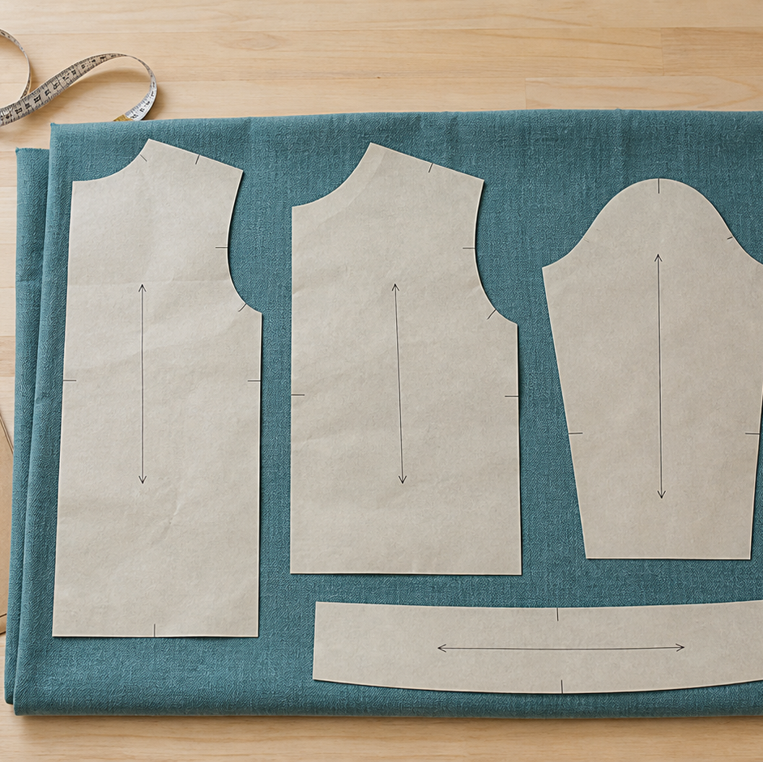
MODULE 07 · WEEKS 9–10
Commercial Patterns
Read a commercial pattern and use measurements, markings and layout information to plan resources.
Teacher-led classroom presentation
Notes:
Talking points
- Introduce Commercial Patterns as a connected set of three ideas, not three isolated worksheets.
- Read the outcome aloud and link it to the current project stage.
- Keep local machine, pattern, safety and assessment details within the current teacher demonstration and authorised class documents.
Prompt: Which word in the outcome tells us what evidence we need to produce?
Likely misconception: Finishing a slide deck is the evidence; the evidence is the student's explanation and project decision.
Transition: Preview the three ideas and activate prior knowledge.
[Sources]
- Course sequence: WWHS Year 8 Accessories and Shorts Textiles Technology Program 2024, as bounded by source map v1.0.
- Curriculum: NESA Textiles Technology 7–10 Syllabus (2025), https://curriculum.nsw.edu.au/learning-areas/tas/textiles-technology-7-10-2025/overview/course
- Visual: Stage 08 approved module asset module-07-commercial-patterns.png; provenance retained in the visual production manifest.

Slide 2
Three ideas, one connected decision
Listen for the relationship between the ideas. Each one changes what you notice, choose or explain.
1
2
3
Envelope, measurements and size choice
Pieces, markings and grainline
Layout, quantity, cost and alterations
RETRIEVAL WARM-UP
Which idea feels most familiar—and what evidence supports what you think you know?
MODULE 07 · YEAR 8 TEXTILES TECHNOLOGY
02
Notes:
Talking points
- Name all three substantive sections using the exact module language.
- Ask students to predict where the ideas connect to current project work.
- Accept a tentative response, but ask what evidence supports it.
Prompt: Which idea is most likely to change a practical or design decision today?
Likely misconception: The sequence means students can forget idea one after moving to idea two; the ideas need to remain connected.
Transition: Begin with Envelope, measurements and size choice.
[Sources]
- Named section sequence: frozen Stage 01 course inventory and Year 8 Textiles theory package v1.0.
- Curriculum context: NESA Textiles Technology 7–10 Syllabus (2025), https://curriculum.nsw.edu.au/learning-areas/tas/textiles-technology-7-10-2025/overview/course

Slide 3
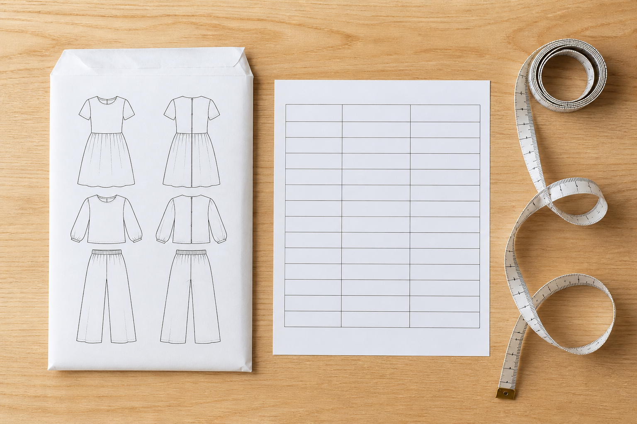
7.1 · USE THE ENVELOPE AS AN INFORMATION MAP
Envelope, measurements and size choice
THE KEY IDEA
A pattern envelope communicates design views, sizes, material guidance, components and quantities. Line drawings and view labels help match a design with its pieces and instructions. Pattern size is based on relevant measurements and the current pattern chart, not ready-to-wear size. Cross-size decisions and alterations require the pattern guidance and teacher approval.
USE THIS IDEA
Annotate the current pattern envelope to locate view information, suggested fabrics, components, quantities and the size chart. Use the approved measurement process and record the evidence for the teacher-confirmed starting size privately.
Look closely: find visible evidence for this claim — A pattern envelope communicates design views, sizes, material guidance, components and quantities.
MODULE 07 · YEAR 8 TEXTILES TECHNOLOGY
03
Notes:
Talking points
- Develop pattern-envelope literacy and an evidence-based approach to taking measurements and selecting a size from the current pattern information.
- Emphasise: A pattern envelope communicates design views, sizes, material guidance, components and quantities.
- Connect the image to the decision: Show an original generic pattern-envelope map with information zones and a separate private-measurement decision pathway.
Prompt: Justify a fictional starting-size decision using chart evidence and explain which uncertainty would require pattern-specific teacher direction.
Likely misconception: My usual shop clothing size tells me which pattern size to cut. Correction: Use the body measurements and size chart supplied with the current pattern because sizing systems differ.
Transition: Carry this decision into Pieces, markings and grainline.
[Sources]
- Content: Year 8 Textiles theory package v1.0; source domains commercial pattern envelope; body measurement; size selection.
- Curriculum: NESA Textiles Technology 7–10 Syllabus (2025), https://curriculum.nsw.edu.au/learning-areas/tas/textiles-technology-7-10-2025/overview/course
- Outcomes context: https://curriculum.nsw.edu.au/learning-areas/tas/textiles-technology-7-10-2025/outcomes
- Visual: Stage 08 approved teaching asset m07-s01-envelope-size.png; provenance retained in the visual production manifest.

Slide 4
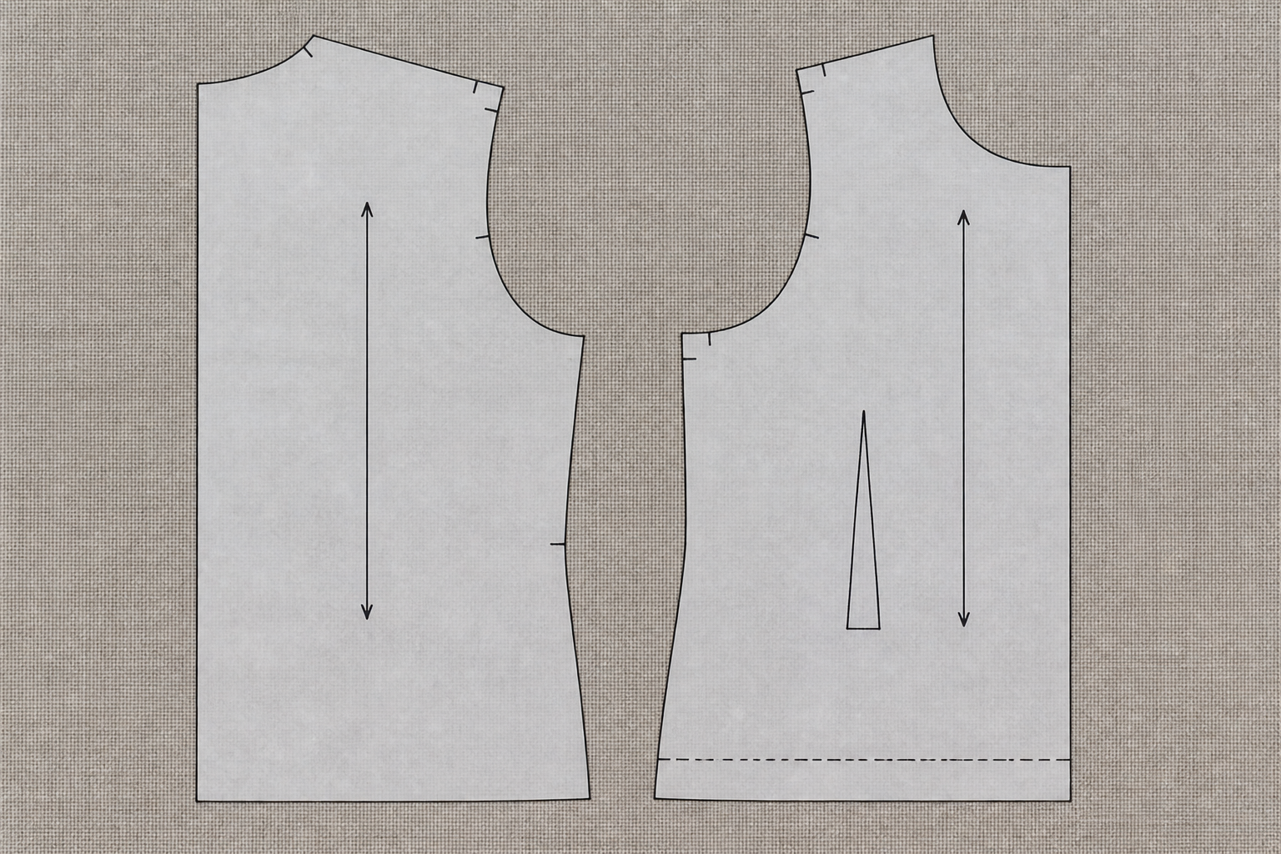
7.2 · READ THE IDENTITY OF EACH PIECE
Pieces, markings and grainline
THE KEY IDEA
Pattern-piece labels identify the part, view, quantity and other instructions. Markings communicate matching, placement, fold and construction information. The current pattern legend controls the meaning of its symbols. Grainline and fold information guide orientation and can affect how the finished product hangs and performs.
USE THIS IDEA
Choose one teacher-issued pattern piece and create an information key. Explain the purpose of each visible label or symbol using the current pattern legend, then identify which information must be checked before layout and which must be transferred for later construction.
Look closely: find visible evidence for this claim — Pattern-piece labels identify the part, view, quantity and other instructions.
MODULE 07 · YEAR 8 TEXTILES TECHNOLOGY
04
Notes:
Talking points
- Teach students to interpret pattern pieces and common markings as a precise communication system while deferring exact use to the current pattern.
- Emphasise: Pattern-piece labels identify the part, view, quantity and other instructions.
- Connect the image to the decision: Use an original generic pattern piece with clear callouts for identity, view, quantity, notches, grainline, fold and transfer information.
Prompt: Explain how piece identity, markings and grainline each protect a different part of the making process.
Likely misconception: If two pieces have a similar outline, either one can be used. Correction: Piece identity, view, size, quantity and markings determine whether a piece belongs to the selected design.
Transition: Carry this decision into Layout, quantity, cost and alterations.
[Sources]
- Content: Year 8 Textiles theory package v1.0; source domains pattern piece literacy; pattern symbols; grainline and layout preparation.
- Curriculum: NESA Textiles Technology 7–10 Syllabus (2025), https://curriculum.nsw.edu.au/learning-areas/tas/textiles-technology-7-10-2025/overview/course
- Outcomes context: https://curriculum.nsw.edu.au/learning-areas/tas/textiles-technology-7-10-2025/outcomes
- Visual: Stage 08 approved teaching asset m07-s02-markings-grainline.png; provenance retained in the visual production manifest.

Slide 5
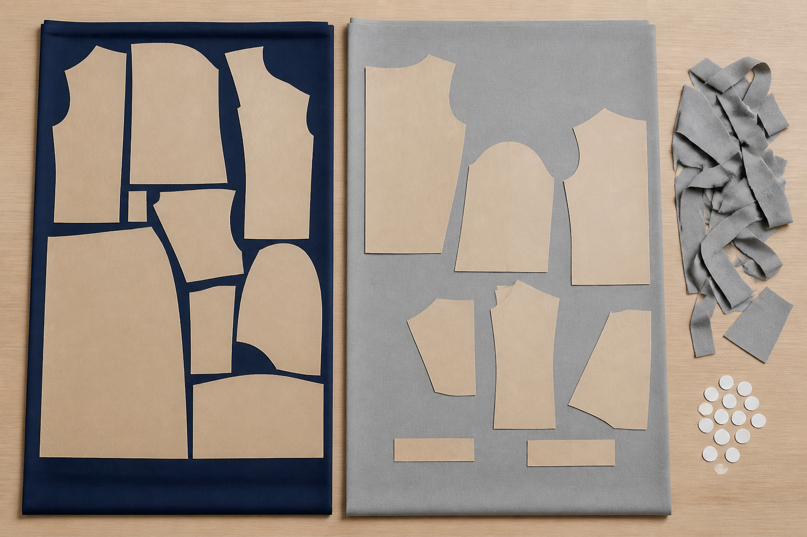
7.3 · APPLY LAYOUT CONSTRAINTS BEFORE EFFICIENCY
Layout, quantity, cost and alterations
THE KEY IDEA
A layout must first satisfy view, piece, grain, fold and material-direction requirements. Efficiency reduces unnecessary use only within those constraints. Quantity and cost calculations need the matching width, size, view, units and current price. Alterations can affect fit, matching, sequence, layout and quantity, so they require authorised guidance.
USE THIS IDEA
Using a teacher-approved mini-layout or paper simulation, identify all constraints, compare two compliant arrangements and calculate a fictional cost from supplied quantity and price. Mark any change that would count as an alteration requiring approval.
Look closely: find visible evidence for this claim — A layout must first satisfy view, piece, grain, fold and material-direction requirements.
MODULE 07 · YEAR 8 TEXTILES TECHNOLOGY
05
Notes:
Talking points
- Develop careful layout and resource reasoning that connects pattern rules, fabric characteristics, quantity, cost and authorised alterations.
- Emphasise: A layout must first satisfy view, piece, grain, fold and material-direction requirements.
- Connect the image to the decision: Show two realistic mini-layouts: one compact but invalid and one compliant, with grain, direction, fold and cost evidence visible.
Prompt: Justify a compliant layout and cost estimate, then explain how one proposed alteration could affect another pattern or resource decision.
Likely misconception: The layout with the least empty space is always the most sustainable. Correction: A valid layout must preserve pattern and material requirements; an incorrect piece may waste the entire project.
Transition: Pause for retrieval before students construct evidence.
[Sources]
- Content: Year 8 Textiles theory package v1.0; source domains pattern layout; resource quantity and cost; pattern alterations.
- Curriculum: NESA Textiles Technology 7–10 Syllabus (2025), https://curriculum.nsw.edu.au/learning-areas/tas/textiles-technology-7-10-2025/overview/course
- Outcomes context: https://curriculum.nsw.edu.au/learning-areas/tas/textiles-technology-7-10-2025/outcomes
- Visual: Stage 08 approved teaching asset m07-s03-layout-resources.png; provenance retained in the visual production manifest.

Slide 6
Stop. Think. Explain.
Correct or improve each claim, then support your answer with evidence from the module.
1
Correct or improve: “My usual shop clothing size tells me which pattern size to cut.”
2
Correct or improve: “If two pieces have a similar outline, either one can be used.”
3
Correct or improve: “The layout with the least empty space is always the most sustainable.”
4
Connect two ideas: how could one change a decision made with the other?
MODULE 07 · YEAR 8 TEXTILES TECHNOLOGY
06
Notes:
Talking points
- Give silent thinking time before taking answers.
- Require students to correct the claim, not only label it true or false.
- Ask a follow-up: What evidence from slides 3–5 supports that correction?
Prompt: Which correction becomes stronger when you use an example from your own project?
Likely misconception: Retrieval is guessing; retrieval should reconstruct the idea and its evidence.
Transition: Use the corrected ideas to build one longer piece of evidence.
[Sources]
- Retrieval claims: misconceptions and corrections in the Year 8 Textiles theory package v1.0.
- Curriculum context: NESA Textiles Technology 7–10 Syllabus (2025), https://curriculum.nsw.edu.au/learning-areas/tas/textiles-technology-7-10-2025/overview/course

Slide 7
Read → Select → Explain → Check
Justify a compliant layout and cost estimate, then explain how one proposed alteration could affect another pattern or resource decision.
1
2
3
4
READ
SELECT
EXPLAIN
CHECK
→
→
→
Underline the task word and the exact context.
Choose theory and project evidence that answers it.
Connect the evidence to a reason, effect or judgement.
Compare the response with the two success criteria.
SENTENCE SUPPORT
One decision I would make is ___ because evidence from ___ shows ___. I would check it by ___.
MODULE 07 · YEAR 8 TEXTILES TECHNOLOGY
07
Notes:
Talking points
- Model the four moves with one brief example, then remove the example from view.
- The selected evidence must answer the exact context, not merely repeat a definition.
- Use the sentence support as a starting structure; students may improve it in their own words.
Prompt: Which evidence is most relevant, and which tempting detail should be left out?
Likely misconception: A longer response is automatically stronger; relevance and explanation matter more than length.
Transition: Students now save the response in the matching module learning package.
[Sources]
- Guided response: evidence prompt for m07-s03 in the Year 8 Textiles theory package v1.0.
- Curriculum context: NESA Textiles Technology 7–10 Syllabus (2025), https://curriculum.nsw.edu.au/learning-areas/tas/textiles-technology-7-10-2025/outcomes

Slide 8
Before you leave…
1.
One idea I can now explain is…
SAVE
YOUR
WORK
2.
One practical or design decision this changes is…
3.
One question or check I still need is…
EVIDENCE DESTINATION
Complete the three learning packages and save your response on this module page.
Next: Apparel Design Plan
MODULE 07 · YEAR 8 TEXTILES TECHNOLOGY
08
Notes:
Talking points
- Use the three-part exit ticket as a quick verbal or written check.
- Direct students to the module page so the evidence is saved in the correct learning package.
- Preview the connection to Apparel Design Plan.
Prompt: Which answer would you be willing to improve after receiving feedback?
Likely misconception: Saving work means it is finished; saved evidence can still be reviewed and improved.
Transition: Continue to Apparel Design Plan when the class sequence is ready.
[Sources]
- Evidence destination: frozen family learning-package contract and local autosave workflow.
- Module sequence: WWHS Year 8 Accessories and Shorts Textiles Technology Program 2024, as bounded by source map v1.0.
- Curriculum context: NESA Textiles Technology 7–10 Syllabus (2025), https://curriculum.nsw.edu.au/learning-areas/tas/textiles-technology-7-10-2025/overview/course

