Slide 1
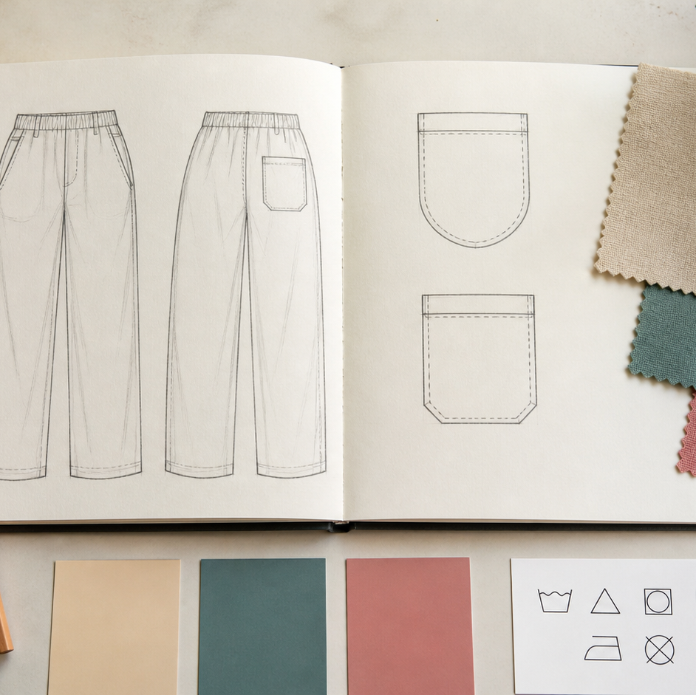
MODULE 08 · WEEKS 7–10
Apparel Design Plan
Develop apparel that balances user needs, aesthetics, function, materials and sustainability.
Teacher-led classroom presentation
Notes:
Talking points
- Introduce Apparel Design Plan as a connected set of three ideas, not three isolated worksheets.
- Read the outcome aloud and link it to the current project stage.
- Keep local machine, pattern, safety and assessment details within the current teacher demonstration and authorised class documents.
Prompt: Which word in the outcome tells us what evidence we need to produce?
Likely misconception: Finishing a slide deck is the evidence; the evidence is the student's explanation and project decision.
Transition: Preview the three ideas and activate prior knowledge.
[Sources]
- Course sequence: WWHS Year 8 Accessories and Shorts Textiles Technology Program 2024, as bounded by source map v1.0.
- Curriculum: NESA Textiles Technology 7–10 Syllabus (2025), https://curriculum.nsw.edu.au/learning-areas/tas/textiles-technology-7-10-2025/overview/course
- Visual: Stage 08 approved module asset module-08-apparel-design-plan.png; provenance retained in the visual production manifest.

Slide 2
Three ideas, one connected decision
Listen for the relationship between the ideas. Each one changes what you notice, choose or explain.
1
2
3
Target market and the apparel brief
Aesthetic and functional features
Final design, material, sustainability and sequence
RETRIEVAL WARM-UP
Which idea feels most familiar—and what evidence supports what you think you know?
MODULE 08 · YEAR 8 TEXTILES TECHNOLOGY
02
Notes:
Talking points
- Name all three substantive sections using the exact module language.
- Ask students to predict where the ideas connect to current project work.
- Accept a tentative response, but ask what evidence supports it.
Prompt: Which idea is most likely to change a practical or design decision today?
Likely misconception: The sequence means students can forget idea one after moving to idea two; the ideas need to remain connected.
Transition: Begin with Target market and the apparel brief.
[Sources]
- Named section sequence: frozen Stage 01 course inventory and Year 8 Textiles theory package v1.0.
- Curriculum context: NESA Textiles Technology 7–10 Syllabus (2025), https://curriculum.nsw.edu.au/learning-areas/tas/textiles-technology-7-10-2025/overview/course

Slide 3
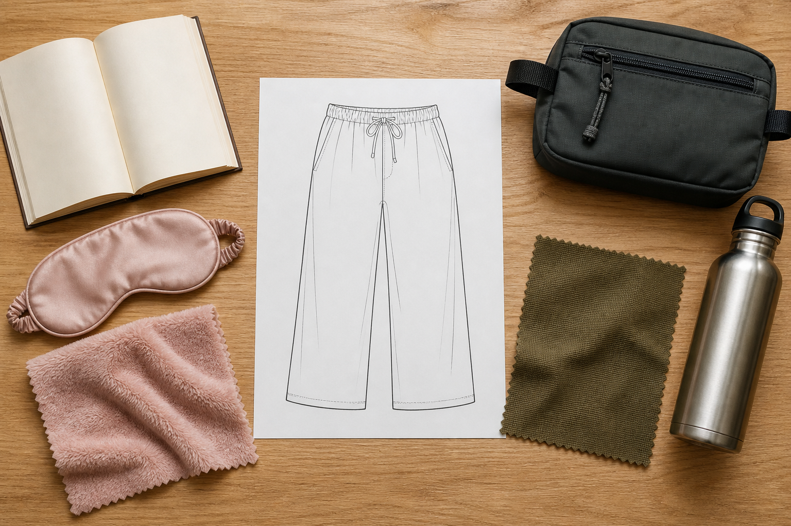
8.1 · DESCRIBE A TARGET MARKET WITH USEFUL EVIDENCE
Target market and the apparel brief
THE KEY IDEA
A target market groups relevant user and context evidence but does not define every individual. The apparel brief separates required specifications from optional design choices. Several design responses can fit the same confirmed brief. Apparel criteria need respectful, privacy-safe methods for gathering fit, movement and user evidence.
USE THIS IDEA
Audit the current apparel brief. Write a precise, non-stereotyped target-market statement, identify three confirmed constraints and draft four criteria with suitable evidence methods, including one for movement or use and one for responsible material decisions.
Look closely: find visible evidence for this claim — A target market groups relevant user and context evidence but does not define every individual.
MODULE 08 · YEAR 8 TEXTILES TECHNOLOGY
03
Notes:
Talking points
- Connect target-market evidence and the authorised shorts/pants brief to design criteria without stereotyping users or inventing specifications.
- Emphasise: A target market groups relevant user and context evidence but does not define every individual.
- Connect the image to the decision: Show an apparel design brief connecting evidence-based target-market factors to confirmed constraints, variable design choices and criteria.
Prompt: Justify an apparel design direction using target-market evidence, confirmed constraints and four criteria while explaining the limits of the evidence.
Likely misconception: People in one age group want the same colours and styles. Correction: Target markets can show patterns, but individual evidence and variation still matter.
Transition: Carry this decision into Aesthetic and functional features.
[Sources]
- Content: Year 8 Textiles theory package v1.0; source domains shorts or pants project; target markets; apparel brief and criteria.
- Curriculum: NESA Textiles Technology 7–10 Syllabus (2025), https://curriculum.nsw.edu.au/learning-areas/tas/textiles-technology-7-10-2025/overview/course
- Outcomes context: https://curriculum.nsw.edu.au/learning-areas/tas/textiles-technology-7-10-2025/outcomes
- Visual: Stage 08 approved teaching asset m08-s01-target-market.png; provenance retained in the visual production manifest.

Slide 4
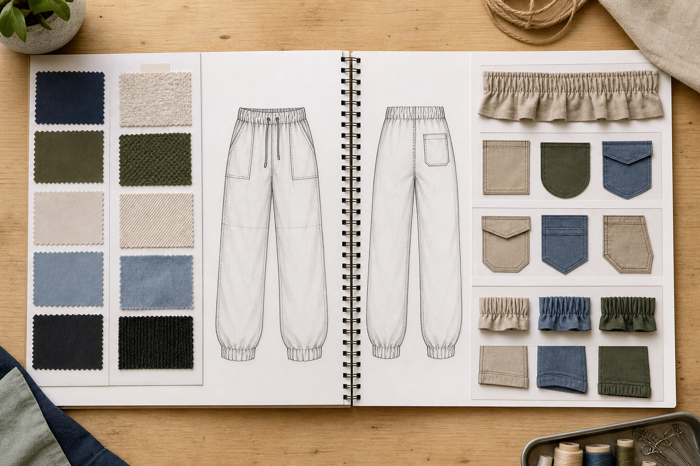
8.2 · USE ELEMENTS AND PRINCIPLES TO EXPLAIN APPEARANCE
Aesthetic and functional features
THE KEY IDEA
Aesthetic features use visual elements and principles to create an intended effect. Functional features respond to user actions and product needs. One feature can influence appearance, performance, material behaviour and construction. Designers balance priorities and explain trade-offs rather than adding every possible feature.
USE THIS IDEA
Annotate the front and back of one apparel idea. Explain two aesthetic relationships and two functional effects, then add one feasibility note showing how the current pattern, material or authorised technique affects a feature.
Look closely: find visible evidence for this claim — Aesthetic features use visual elements and principles to create an intended effect.
MODULE 08 · YEAR 8 TEXTILES TECHNOLOGY
04
Notes:
Talking points
- Teach students to analyse and balance aesthetic and functional apparel features using evidence from the brief, user and pattern.
- Emphasise: Aesthetic features use visual elements and principles to create an intended effect.
- Connect the image to the decision: Show front-and-back apparel drawings with concise callouts connecting visual elements and principles to user-focused functions.
Prompt: Explain how two aesthetic and two functional features work together in an apparel idea, including one trade-off or feasibility limit.
Likely misconception: Aesthetic means decorative and functional means plain. Correction: A feature can contribute to both appearance and performance, and functional design can be visually expressive.
Transition: Carry this decision into Final design, material, sustainability and sequence.
[Sources]
- Content: Year 8 Textiles theory package v1.0; source domains front and back design evidence; elements and principles; functional apparel features.
- Curriculum: NESA Textiles Technology 7–10 Syllabus (2025), https://curriculum.nsw.edu.au/learning-areas/tas/textiles-technology-7-10-2025/overview/course
- Outcomes context: https://curriculum.nsw.edu.au/learning-areas/tas/textiles-technology-7-10-2025/outcomes
- Visual: Stage 08 approved teaching asset m08-s02-aesthetic-functional.png; provenance retained in the visual production manifest.

Slide 5
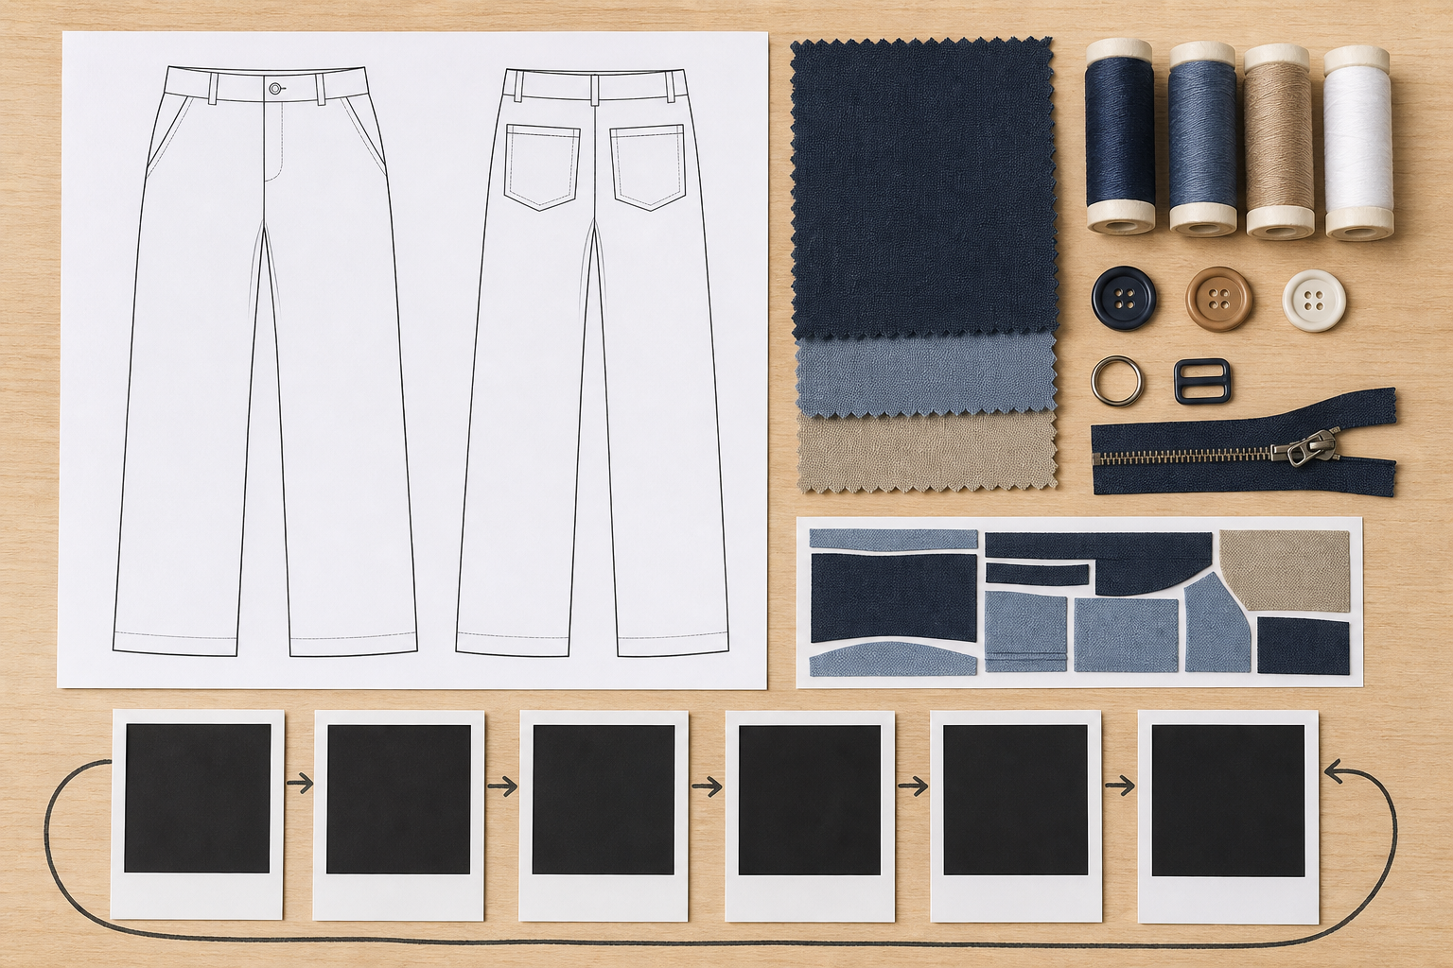
8.3 · SELECT BY COMPARING EVIDENCE
Final design, material, sustainability and sequence
THE KEY IDEA
Final selection compares developed ideas with confirmed criteria, constraints and evidence. Front and back drawings should communicate the same authorised design decision. Material justification links end-use needs with supplied information, observations and testing. Responsible planning addresses relevant sourcing, use, waste, durability, care and end-of-life trade-offs.
USE THIS IDEA
Compare at least two developed apparel ideas against confirmed criteria. Present the selected front and back design, justify the authorised material with test evidence, note one sustainability trade-off and build a high-level sequence with dependencies and checkpoints.
Look closely: find visible evidence for this claim — Final selection compares developed ideas with confirmed criteria, constraints and evidence.
MODULE 08 · YEAR 8 TEXTILES TECHNOLOGY
05
Notes:
Talking points
- Bring the design investigation into one justified final proposal that integrates evidence, material choice, resource responsibility and a feasible production sequence.
- Emphasise: Final selection compares developed ideas with confirmed criteria, constraints and evidence.
- Connect the image to the decision: Show a coherent final-design spread linking front/back views, evidence-based criteria comparison, material sample, trade-off and high-level sequence.
Prompt: Justify the final apparel proposal by linking user evidence, criteria, authorised pattern, material tests, one sustainability decision and the production sequence.
Likely misconception: The idea with the highest matrix score must be selected. Correction: A matrix supports thinking, but evidence quality, major constraints and trade-offs still require judgement.
Transition: Pause for retrieval before students construct evidence.
[Sources]
- Content: Year 8 Textiles theory package v1.0; source domains final design and folio; material selection; sustainable design and production planning.
- Curriculum: NESA Textiles Technology 7–10 Syllabus (2025), https://curriculum.nsw.edu.au/learning-areas/tas/textiles-technology-7-10-2025/overview/course
- Outcomes context: https://curriculum.nsw.edu.au/learning-areas/tas/textiles-technology-7-10-2025/outcomes
- Visual: Stage 08 approved teaching asset m08-s03-final-plan.png; provenance retained in the visual production manifest.

Slide 6
Stop. Think. Explain.
Correct or improve each claim, then support your answer with evidence from the module.
1
Correct or improve: “People in one age group want the same colours and styles.”
2
Correct or improve: “Aesthetic means decorative and functional means plain.”
3
Correct or improve: “The idea with the highest matrix score must be selected.”
4
Connect two ideas: how could one change a decision made with the other?
MODULE 08 · YEAR 8 TEXTILES TECHNOLOGY
06
Notes:
Talking points
- Give silent thinking time before taking answers.
- Require students to correct the claim, not only label it true or false.
- Ask a follow-up: What evidence from slides 3–5 supports that correction?
Prompt: Which correction becomes stronger when you use an example from your own project?
Likely misconception: Retrieval is guessing; retrieval should reconstruct the idea and its evidence.
Transition: Use the corrected ideas to build one longer piece of evidence.
[Sources]
- Retrieval claims: misconceptions and corrections in the Year 8 Textiles theory package v1.0.
- Curriculum context: NESA Textiles Technology 7–10 Syllabus (2025), https://curriculum.nsw.edu.au/learning-areas/tas/textiles-technology-7-10-2025/overview/course

Slide 7
Read → Select → Explain → Check
Justify the final apparel proposal by linking user evidence, criteria, authorised pattern, material tests, one sustainability decision and the production sequence.
1
2
3
4
READ
SELECT
EXPLAIN
CHECK
→
→
→
Underline the task word and the exact context.
Choose theory and project evidence that answers it.
Connect the evidence to a reason, effect or judgement.
Compare the response with the two success criteria.
SENTENCE SUPPORT
One decision I would make is ___ because evidence from ___ shows ___. I would check it by ___.
MODULE 08 · YEAR 8 TEXTILES TECHNOLOGY
07
Notes:
Talking points
- Model the four moves with one brief example, then remove the example from view.
- The selected evidence must answer the exact context, not merely repeat a definition.
- Use the sentence support as a starting structure; students may improve it in their own words.
Prompt: Which evidence is most relevant, and which tempting detail should be left out?
Likely misconception: A longer response is automatically stronger; relevance and explanation matter more than length.
Transition: Students now save the response in the matching module learning package.
[Sources]
- Guided response: evidence prompt for m08-s03 in the Year 8 Textiles theory package v1.0.
- Curriculum context: NESA Textiles Technology 7–10 Syllabus (2025), https://curriculum.nsw.edu.au/learning-areas/tas/textiles-technology-7-10-2025/outcomes

Slide 8
Before you leave…
1.
One idea I can now explain is…
SAVE
YOUR
WORK
2.
One practical or design decision this changes is…
3.
One question or check I still need is…
EVIDENCE DESTINATION
Complete the three learning packages and save your response on this module page.
Next: Produce the Bottoms
MODULE 08 · YEAR 8 TEXTILES TECHNOLOGY
08
Notes:
Talking points
- Use the three-part exit ticket as a quick verbal or written check.
- Direct students to the module page so the evidence is saved in the correct learning package.
- Preview the connection to Produce the Bottoms.
Prompt: Which answer would you be willing to improve after receiving feedback?
Likely misconception: Saving work means it is finished; saved evidence can still be reviewed and improved.
Transition: Continue to Produce the Bottoms when the class sequence is ready.
[Sources]
- Evidence destination: frozen family learning-package contract and local autosave workflow.
- Module sequence: WWHS Year 8 Accessories and Shorts Textiles Technology Program 2024, as bounded by source map v1.0.
- Curriculum context: NESA Textiles Technology 7–10 Syllabus (2025), https://curriculum.nsw.edu.au/learning-areas/tas/textiles-technology-7-10-2025/overview/course

