Slide 1
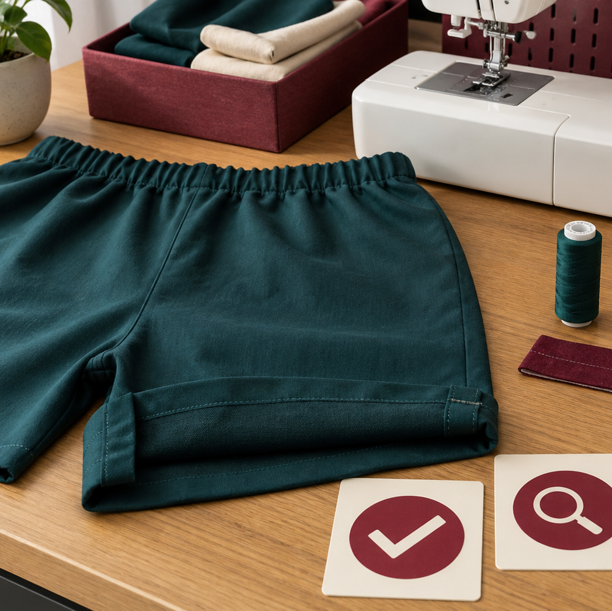
MODULE 09 · WEEKS 11–20
Produce the Bottoms
Prepare, construct and review bottoms safely under current teacher direction.
Teacher-led classroom presentation
Notes:
Talking points
- Introduce Produce the Bottoms as a connected set of three ideas, not three isolated worksheets.
- Read the outcome aloud and link it to the current project stage.
- Keep local machine, pattern, safety and assessment details within the current teacher demonstration and authorised class documents.
Prompt: Which word in the outcome tells us what evidence we need to produce?
Likely misconception: Finishing a slide deck is the evidence; the evidence is the student's explanation and project decision.
Transition: Preview the three ideas and activate prior knowledge.
[Sources]
- Course sequence: WWHS Year 8 Accessories and Shorts Textiles Technology Program 2024, as bounded by source map v1.0.
- Curriculum: NESA Textiles Technology 7–10 Syllabus (2025), https://curriculum.nsw.edu.au/learning-areas/tas/textiles-technology-7-10-2025/overview/course
- Visual: Stage 08 approved module asset module-09-produce-bottoms.png; provenance retained in the visual production manifest.

Slide 2
Three ideas, one connected decision
Listen for the relationship between the ideas. Each one changes what you notice, choose or explain.
1
2
3
Prepare and cut under teacher direction
Construct under teacher demonstration
Quality control and progress evidence
RETRIEVAL WARM-UP
Which idea feels most familiar—and what evidence supports what you think you know?
MODULE 09 · YEAR 8 TEXTILES TECHNOLOGY
02
Notes:
Talking points
- Name all three substantive sections using the exact module language.
- Ask students to predict where the ideas connect to current project work.
- Accept a tentative response, but ask what evidence supports it.
Prompt: Which idea is most likely to change a practical or design decision today?
Likely misconception: The sequence means students can forget idea one after moving to idea two; the ideas need to remain connected.
Transition: Begin with Prepare and cut under teacher direction.
[Sources]
- Named section sequence: frozen Stage 01 course inventory and Year 8 Textiles theory package v1.0.
- Curriculum context: NESA Textiles Technology 7–10 Syllabus (2025), https://curriculum.nsw.edu.au/learning-areas/tas/textiles-technology-7-10-2025/overview/course

Slide 3
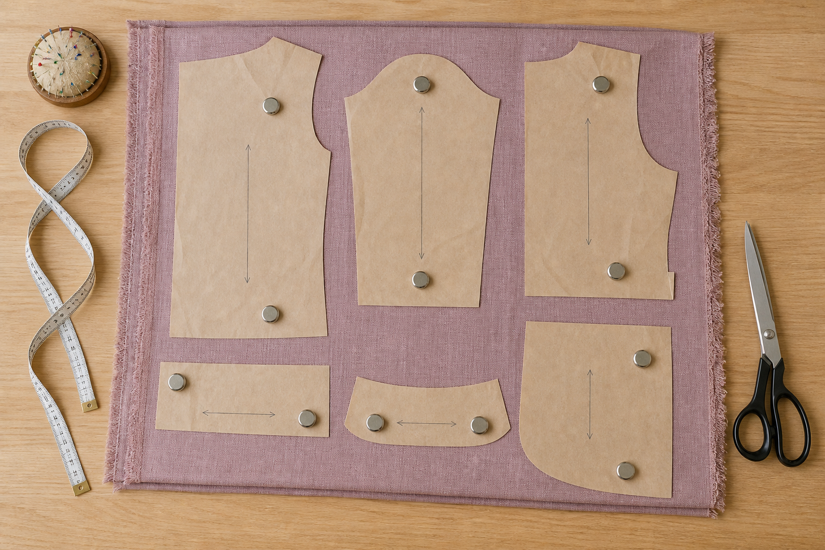
9.1 · BRING ALL DECISIONS INTO ONE PREPARED STATE
Prepare and cut under teacher direction
THE KEY IDEA
Pre-cut preparation aligns the final design, current pattern, size, alterations, material and layout. The full layout must be checked because individual pieces affect one another. Exact preparation, marking and cutting methods come from the current instructions and demonstration. Evidence should prove the decision without exposing names, measurements or unsafe staged actions.
USE THIS IDEA
Before the authorised cutting session, create a pre-cut verification record tied to the current pattern. Include the complete piece list, selected view and size, approved alterations, layout constraints, teacher checkpoint and one privacy-safe evidence image.
Look closely: find visible evidence for this claim — Pre-cut preparation aligns the final design, current pattern, size, alterations, material and layout.
MODULE 09 · YEAR 8 TEXTILES TECHNOLOGY
03
Notes:
Talking points
- Teach a disciplined pre-cut verification process that protects fit, pattern accuracy, material and privacy without publishing construction instructions.
- Emphasise: Pre-cut preparation aligns the final design, current pattern, size, alterations, material and layout.
- Connect the image to the decision: Show a full pre-cut verification scene with pattern-list, layout and privacy-safe evidence callouts, avoiding a procedural cutting depiction.
Prompt: Justify whether a proposed layout is ready for teacher approval by applying the complete pre-cut verification categories.
Likely misconception: If every piece is on the fabric, the layout is ready to cut. Correction: Piece identity, view, size, quantity, grain, fold, direction, alterations and whole-layout relationships must also be checked.
Transition: Carry this decision into Construct under teacher demonstration.
[Sources]
- Content: Year 8 Textiles theory package v1.0; source domains apparel production sequence; pattern layout verification; safe and responsible cutting preparation.
- Curriculum: NESA Textiles Technology 7–10 Syllabus (2025), https://curriculum.nsw.edu.au/learning-areas/tas/textiles-technology-7-10-2025/overview/course
- Outcomes context: https://curriculum.nsw.edu.au/learning-areas/tas/textiles-technology-7-10-2025/outcomes
- Visual: Stage 08 approved teaching asset m09-s01-prepare-cut.png; provenance retained in the visual production manifest.

Slide 4
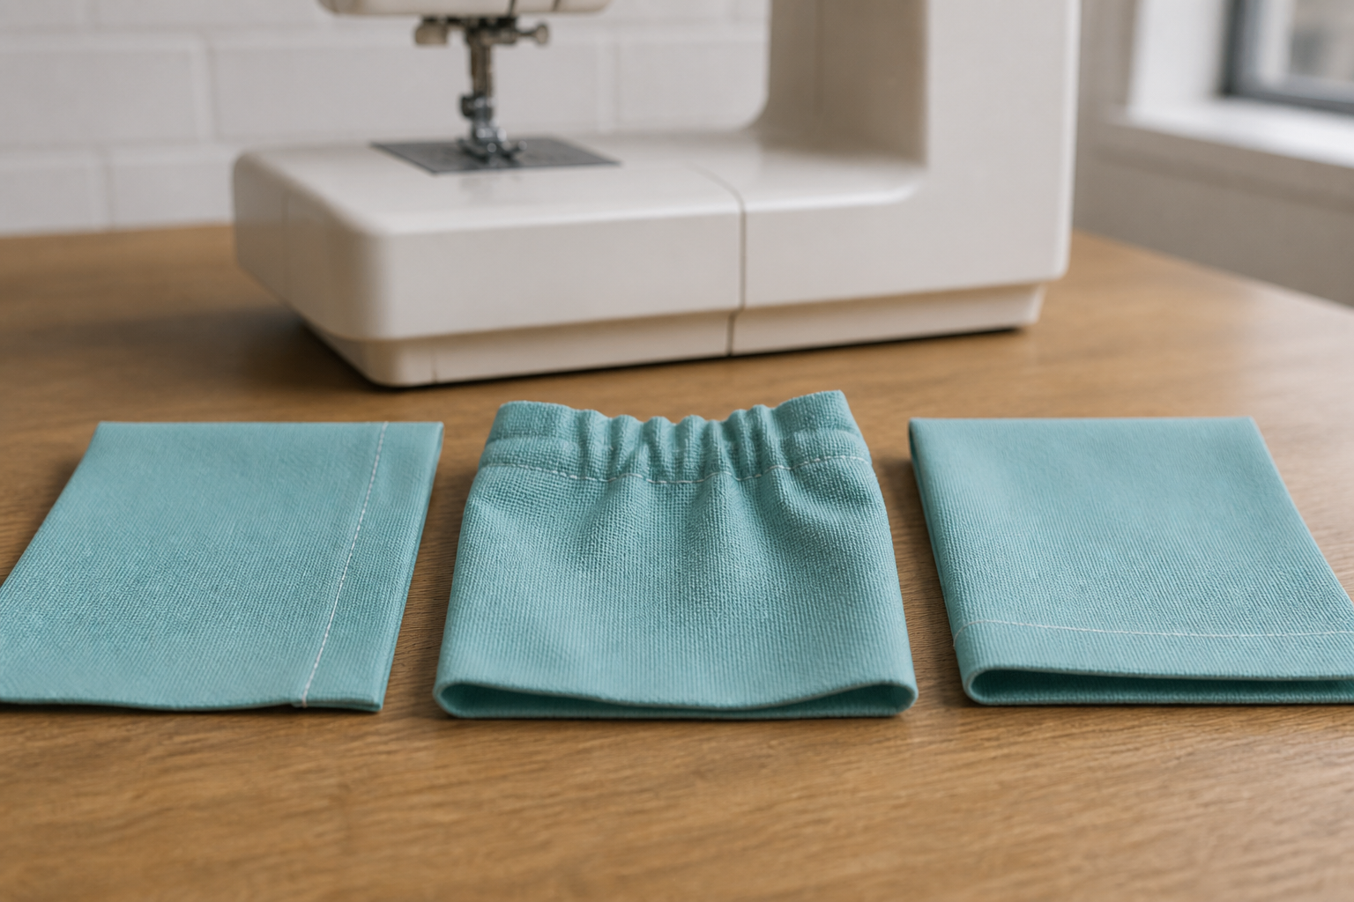
9.2 · UNDERSTAND THE ROLE OF EACH STAGE
Construct under teacher demonstration
THE KEY IDEA
Construction stages change separate pieces into the intended apparel form. Exact seams, casing, hems, allowances, settings and order come from the current pattern and teacher demonstration. Active observers identify purpose, starting condition, authorised actions, quality cues and stop points. Dependencies and hand-off records prevent students from guessing or skipping into an undemonstrated stage.
USE THIS IDEA
For one teacher-demonstrated construction stage, complete a purpose–starting condition–authorised tools–quality cues–stop points record. Add the dependency that must be checked before the next stage can begin.
Look closely: find visible evidence for this claim — Construction stages change separate pieces into the intended apparel form.
MODULE 09 · YEAR 8 TEXTILES TECHNOLOGY
04
Notes:
Talking points
- Help students understand construction stages, dependencies and demonstration literacy while keeping all practical machine and garment procedures teacher-controlled.
- Emphasise: Construction stages change separate pieces into the intended apparel form.
- Connect the image to the decision: Show a high-level parts-to-garment construction pathway with dependencies and teacher-demonstration checkpoints, not detailed operational steps.
Prompt: Explain the purpose, starting condition, quality cues and dependency for one authorised construction stage without turning the explanation into an unsupported procedure.
Likely misconception: Once I understand a general construction term, I know the steps for this garment. Correction: The current pattern and demonstration control the exact method, order, allowance, setting and checkpoints.
Transition: Carry this decision into Quality control and progress evidence.
[Sources]
- Content: Year 8 Textiles theory package v1.0; source domains apparel construction; pattern instruction literacy; teacher-demonstrated safe practice.
- Curriculum: NESA Textiles Technology 7–10 Syllabus (2025), https://curriculum.nsw.edu.au/learning-areas/tas/textiles-technology-7-10-2025/overview/course
- Outcomes context: https://curriculum.nsw.edu.au/learning-areas/tas/textiles-technology-7-10-2025/outcomes
- Visual: Stage 08 approved teaching asset m09-s02-seams-casing-hems.png; provenance retained in the visual production manifest.

Slide 5
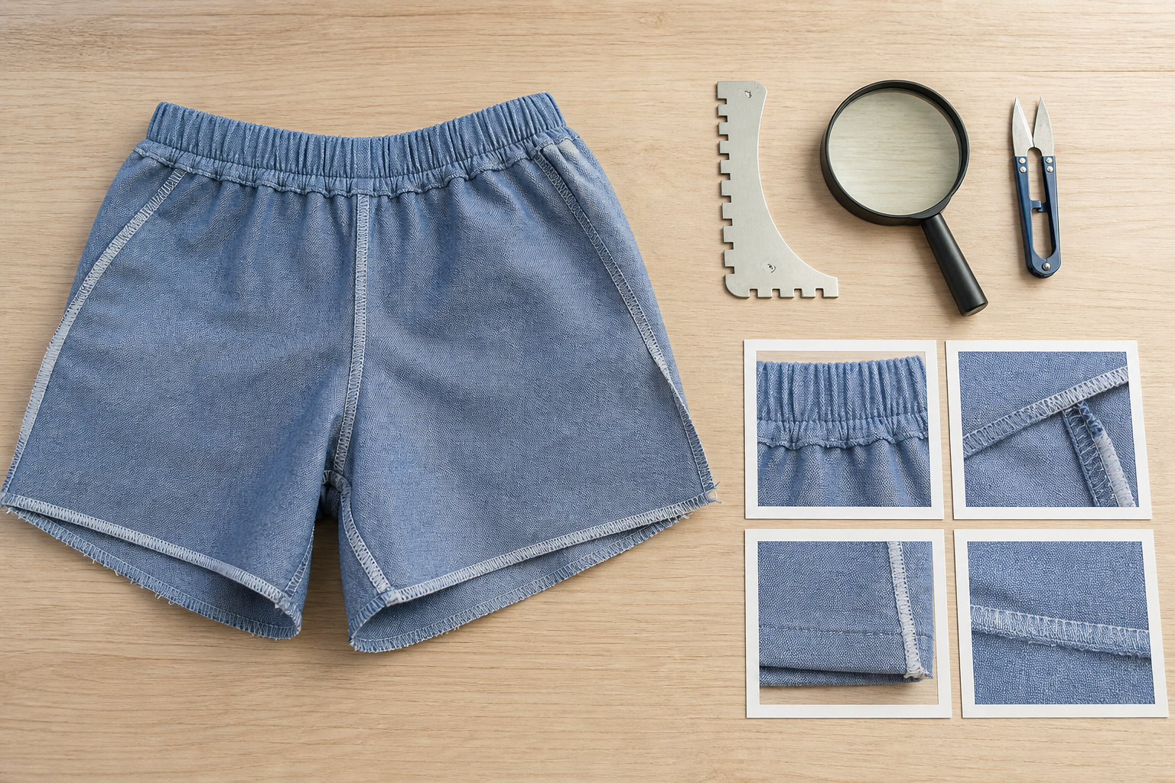
9.3 · USE CHECKPOINTS FOR HIGH-VALUE DECISIONS
Quality control and progress evidence
THE KEY IDEA
High-value checkpoints occur before important features become hidden or hard to correct. Quality control can confirm readiness, identify a difference or trigger support. Progress evidence needs a clear purpose, stage and explanation. Authorised adjustments have a recorded reason, action and result; unapproved alterations remain outside the boundary.
USE THIS IDEA
Choose three high-value checkpoints from the teacher-approved production sequence. For each, state what you will inspect, what evidence will be captured, which decision can follow and which privacy or safety condition must be protected.
Look closely: find visible evidence for this claim — High-value checkpoints occur before important features become hidden or hard to correct.
MODULE 09 · YEAR 8 TEXTILES TECHNOLOGY
05
Notes:
Talking points
- Teach students to use planned checks and privacy-safe progress evidence to maintain quality and explain production decisions.
- Emphasise: High-value checkpoints occur before important features become hidden or hard to correct.
- Connect the image to the decision: Show a privacy-safe before–checkpoint–authorised adjustment–after evidence sequence on a generic textile detail.
Prompt: Construct a traceable account of one checkpoint using the intended condition, observation, authorised response and resulting evidence.
Likely misconception: More progress photographs always mean stronger evidence. Correction: A smaller set of purposeful, annotated records is stronger than many repeated images with no explanation.
Transition: Pause for retrieval before students construct evidence.
[Sources]
- Content: Year 8 Textiles theory package v1.0; source domains apparel production; quality control; folio progress evidence.
- Curriculum: NESA Textiles Technology 7–10 Syllabus (2025), https://curriculum.nsw.edu.au/learning-areas/tas/textiles-technology-7-10-2025/overview/course
- Outcomes context: https://curriculum.nsw.edu.au/learning-areas/tas/textiles-technology-7-10-2025/outcomes
- Visual: Stage 08 approved teaching asset m09-s03-quality-progress.png; provenance retained in the visual production manifest.

Slide 6
Stop. Think. Explain.
Correct or improve each claim, then support your answer with evidence from the module.
1
Correct or improve: “If every piece is on the fabric, the layout is ready to cut.”
2
Correct or improve: “Once I understand a general construction term, I know the steps for this garment.”
3
Correct or improve: “More progress photographs always mean stronger evidence.”
4
Connect two ideas: how could one change a decision made with the other?
MODULE 09 · YEAR 8 TEXTILES TECHNOLOGY
06
Notes:
Talking points
- Give silent thinking time before taking answers.
- Require students to correct the claim, not only label it true or false.
- Ask a follow-up: What evidence from slides 3–5 supports that correction?
Prompt: Which correction becomes stronger when you use an example from your own project?
Likely misconception: Retrieval is guessing; retrieval should reconstruct the idea and its evidence.
Transition: Use the corrected ideas to build one longer piece of evidence.
[Sources]
- Retrieval claims: misconceptions and corrections in the Year 8 Textiles theory package v1.0.
- Curriculum context: NESA Textiles Technology 7–10 Syllabus (2025), https://curriculum.nsw.edu.au/learning-areas/tas/textiles-technology-7-10-2025/overview/course

Slide 7
Read → Select → Explain → Check
Construct a traceable account of one checkpoint using the intended condition, observation, authorised response and resulting evidence.
1
2
3
4
READ
SELECT
EXPLAIN
CHECK
→
→
→
Underline the task word and the exact context.
Choose theory and project evidence that answers it.
Connect the evidence to a reason, effect or judgement.
Compare the response with the two success criteria.
SENTENCE SUPPORT
One decision I would make is ___ because evidence from ___ shows ___. I would check it by ___.
MODULE 09 · YEAR 8 TEXTILES TECHNOLOGY
07
Notes:
Talking points
- Model the four moves with one brief example, then remove the example from view.
- The selected evidence must answer the exact context, not merely repeat a definition.
- Use the sentence support as a starting structure; students may improve it in their own words.
Prompt: Which evidence is most relevant, and which tempting detail should be left out?
Likely misconception: A longer response is automatically stronger; relevance and explanation matter more than length.
Transition: Students now save the response in the matching module learning package.
[Sources]
- Guided response: evidence prompt for m09-s03 in the Year 8 Textiles theory package v1.0.
- Curriculum context: NESA Textiles Technology 7–10 Syllabus (2025), https://curriculum.nsw.edu.au/learning-areas/tas/textiles-technology-7-10-2025/outcomes

Slide 8
Before you leave…
1.
One idea I can now explain is…
SAVE
YOUR
WORK
2.
One practical or design decision this changes is…
3.
One question or check I still need is…
EVIDENCE DESTINATION
Complete the three learning packages and save your response on this module page.
Next: Evaluate and Communicate
MODULE 09 · YEAR 8 TEXTILES TECHNOLOGY
08
Notes:
Talking points
- Use the three-part exit ticket as a quick verbal or written check.
- Direct students to the module page so the evidence is saved in the correct learning package.
- Preview the connection to Evaluate and Communicate.
Prompt: Which answer would you be willing to improve after receiving feedback?
Likely misconception: Saving work means it is finished; saved evidence can still be reviewed and improved.
Transition: Continue to Evaluate and Communicate when the class sequence is ready.
[Sources]
- Evidence destination: frozen family learning-package contract and local autosave workflow.
- Module sequence: WWHS Year 8 Accessories and Shorts Textiles Technology Program 2024, as bounded by source map v1.0.
- Curriculum context: NESA Textiles Technology 7–10 Syllabus (2025), https://curriculum.nsw.edu.au/learning-areas/tas/textiles-technology-7-10-2025/overview/course

