Slide 1

MODULE 10 · COURSE CONSOLIDATION
Evaluate and Communicate
Evaluate a textile product, communicate verified care information and complete a reflective folio.
Teacher-led classroom presentation
Notes:
Talking points
- Introduce Evaluate and Communicate as a connected set of three ideas, not three isolated worksheets.
- Read the outcome aloud and link it to the current project stage.
- Keep local machine, pattern, safety and assessment details within the current teacher demonstration and authorised class documents.
Prompt: Which word in the outcome tells us what evidence we need to produce?
Likely misconception: Finishing a slide deck is the evidence; the evidence is the student's explanation and project decision.
Transition: Preview the three ideas and activate prior knowledge.
[Sources]
- Course sequence: WWHS Year 8 Accessories and Shorts Textiles Technology Program 2024, as bounded by source map v1.0.
- Curriculum: NESA Textiles Technology 7–10 Syllabus (2025), https://curriculum.nsw.edu.au/learning-areas/tas/textiles-technology-7-10-2025/overview/course
- Visual: Stage 08 approved module asset module-10-evaluate-communicate.png; provenance retained in the visual production manifest.

Slide 2
Three ideas, one connected decision
Listen for the relationship between the ideas. Each one changes what you notice, choose or explain.
1
2
3
Test against criteria
Care label and swing tag
Reflection, folio and collaborative showcase
RETRIEVAL WARM-UP
Which idea feels most familiar—and what evidence supports what you think you know?
MODULE 10 · YEAR 8 TEXTILES TECHNOLOGY
02
Notes:
Talking points
- Name all three substantive sections using the exact module language.
- Ask students to predict where the ideas connect to current project work.
- Accept a tentative response, but ask what evidence supports it.
Prompt: Which idea is most likely to change a practical or design decision today?
Likely misconception: The sequence means students can forget idea one after moving to idea two; the ideas need to remain connected.
Transition: Begin with Test against criteria.
[Sources]
- Named section sequence: frozen Stage 01 course inventory and Year 8 Textiles theory package v1.0.
- Curriculum context: NESA Textiles Technology 7–10 Syllabus (2025), https://curriculum.nsw.edu.au/learning-areas/tas/textiles-technology-7-10-2025/overview/course

Slide 3
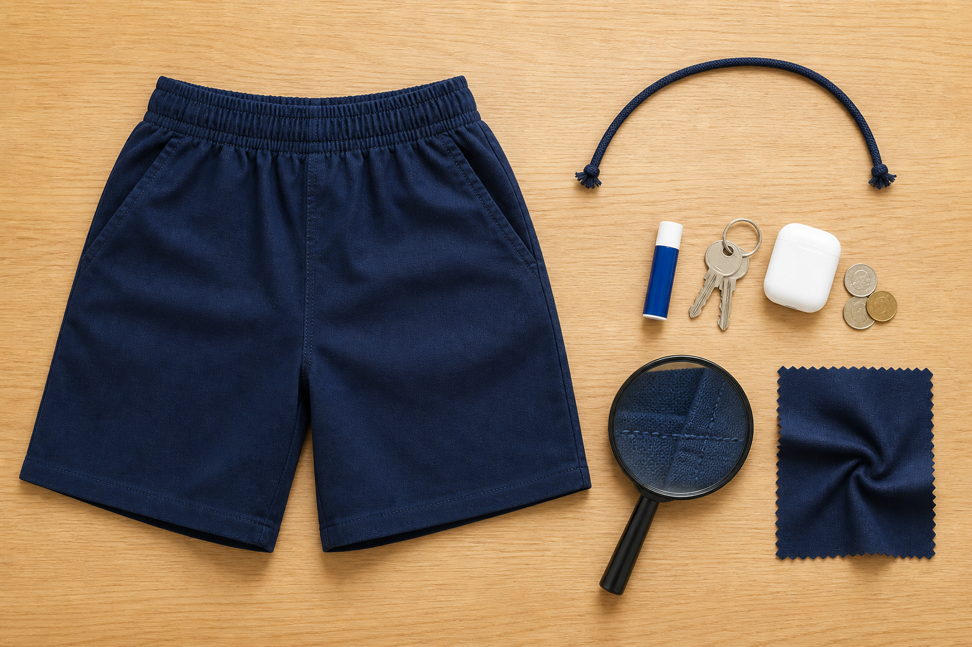
10.1 · MATCH THE EVIDENCE TO THE CRITERION
Test against criteria
THE KEY IDEA
Evaluation starts with the criterion and selects evidence that can genuinely test it. Different evidence types reveal different aspects and have limits. A reasoned judgement states the degree of success and explains why. Trade-offs and evidence limitations make an evaluation more accurate, not less successful.
USE THIS IDEA
Evaluate three confirmed apparel criteria using at least two evidence types. For each, state the degree of success and the evidence limit. Finish by explaining one trade-off without inventing a technical cause.
Look closely: find visible evidence for this claim — Evaluation starts with the criterion and selects evidence that can genuinely test it.
MODULE 10 · YEAR 8 TEXTILES TECHNOLOGY
03
Notes:
Talking points
- Teach students to match evidence to apparel criteria, make qualified judgements and explain trade-offs.
- Emphasise: Evaluation starts with the criterion and selects evidence that can genuinely test it.
- Connect the image to the decision: Show several criteria branching to appropriate evidence types, qualified judgements, trade-offs and evidence limits.
Prompt: Evaluate three criteria using appropriate evidence, stating the degree of success, one trade-off and one evidence limitation.
Likely misconception: A successful project should receive a positive judgement for every criterion. Correction: An honest evaluation may find different degrees of success and should explain them using evidence.
Transition: Carry this decision into Care label and swing tag.
[Sources]
- Content: Year 8 Textiles theory package v1.0; source domains apparel evaluation; criteria and evidence; trade-offs and improvement.
- Curriculum: NESA Textiles Technology 7–10 Syllabus (2025), https://curriculum.nsw.edu.au/learning-areas/tas/textiles-technology-7-10-2025/overview/course
- Outcomes context: https://curriculum.nsw.edu.au/learning-areas/tas/textiles-technology-7-10-2025/outcomes
- Visual: Stage 08 approved teaching asset m10-s01-test-criteria.png; provenance retained in the visual production manifest.

Slide 4

10.2 · BASE CARE INFORMATION ON EVIDENCE
Care label and swing tag
THE KEY IDEA
Care information depends on verified material, component, construction and finish evidence. Care symbols and fibre statements must come from an approved current source. A swing tag communicates product identity and selected evidence-based benefits to an audience. Clear hierarchy, accurate claims, accessibility and privacy support trustworthy communication.
USE THIS IDEA
Draft a care-label information plan and swing-tag layout for the finished product. Highlight every fibre, care, origin or sustainability claim, attach its source, and move any unverified detail to a confirmation list.
Look closely: find visible evidence for this claim — Care information depends on verified material, component, construction and finish evidence.
MODULE 10 · YEAR 8 TEXTILES TECHNOLOGY
04
Notes:
Talking points
- Develop audience-aware product communication through evidence-based care information and a purposeful swing tag, without inventing fibre or legal claims.
- Emphasise: Care information depends on verified material, component, construction and finish evidence.
- Connect the image to the decision: Show a realistic care-label and swing-tag communication system with source checks, hierarchy and unsupported-claim warnings.
Prompt: Justify the information and hierarchy in a care label and swing tag, linking every technical or environmental claim to a verified source.
Likely misconception: Care symbols are simple pictures, so their meanings can be guessed. Correction: They form a standardised system and should be checked against the approved current reference.
Transition: Carry this decision into Reflection, folio and collaborative showcase.
[Sources]
- Content: Year 8 Textiles theory package v1.0; source domains folio care-label and swing-tag evidence; product communication; ethical sustainability claims.
- Curriculum: NESA Textiles Technology 7–10 Syllabus (2025), https://curriculum.nsw.edu.au/learning-areas/tas/textiles-technology-7-10-2025/overview/course
- Outcomes context: https://curriculum.nsw.edu.au/learning-areas/tas/textiles-technology-7-10-2025/outcomes
- Visual: Stage 08 approved teaching asset m10-s02-label-tag.png; provenance retained in the visual production manifest.

Slide 5

10.3 · REFLECT FROM EVIDENCE TO NEXT ACTION
Reflection, folio and collaborative showcase
THE KEY IDEA
Reflection links a significant result with evidence, meaning, judgement and a specific next action. A traceable folio shows how sources and evidence shaped decisions across the whole process. Curation selects the strongest evidence and removes repetition and private information. A collaborative showcase needs agreed roles, consent, accurate credit and separation from official assessment records.
USE THIS IDEA
Audit your folio for traceability from brief to reflection. Select one evidence chain for a showcase, remove private or controlled material, write an accessible caption and complete an agreed group role while recording one useful piece of feedback.
Look closely: find visible evidence for this claim — Reflection links a significant result with evidence, meaning, judgement and a specific next action.
MODULE 10 · YEAR 8 TEXTILES TECHNOLOGY
05
Notes:
Talking points
- Teach students to curate a traceable folio, reflect on learning with evidence and contribute responsibly to a collaborative textile showcase.
- Emphasise: Reflection links a significant result with evidence, meaning, judgement and a specific next action.
- Connect the image to the decision: Show a calm folio evidence trail and collaborative showcase workflow with clear privacy, consent, credit and source checkpoints.
Prompt: Present one traceable learning story from source or brief through design, production evidence, evaluation and improvement, then explain your contribution to a respectful collaborative showcase.
Likely misconception: A folio is strongest when it includes every photo and worksheet. Correction: A strong folio selects and explains the evidence that best reveals decisions, learning and improvement.
Transition: Pause for retrieval before students construct evidence.
[Sources]
- Content: Year 8 Textiles theory package v1.0; source domains folio evidence; reflection and communication; collaborative textile project work.
- Curriculum: NESA Textiles Technology 7–10 Syllabus (2025), https://curriculum.nsw.edu.au/learning-areas/tas/textiles-technology-7-10-2025/overview/course
- Outcomes context: https://curriculum.nsw.edu.au/learning-areas/tas/textiles-technology-7-10-2025/outcomes
- Visual: Stage 08 approved teaching asset m10-s03-reflect-showcase.png; provenance retained in the visual production manifest.

Slide 6
Stop. Think. Explain.
Correct or improve each claim, then support your answer with evidence from the module.
1
Correct or improve: “A successful project should receive a positive judgement for every criterion.”
2
Correct or improve: “Care symbols are simple pictures, so their meanings can be guessed.”
3
Correct or improve: “A folio is strongest when it includes every photo and worksheet.”
4
Connect two ideas: how could one change a decision made with the other?
MODULE 10 · YEAR 8 TEXTILES TECHNOLOGY
06
Notes:
Talking points
- Give silent thinking time before taking answers.
- Require students to correct the claim, not only label it true or false.
- Ask a follow-up: What evidence from slides 3–5 supports that correction?
Prompt: Which correction becomes stronger when you use an example from your own project?
Likely misconception: Retrieval is guessing; retrieval should reconstruct the idea and its evidence.
Transition: Use the corrected ideas to build one longer piece of evidence.
[Sources]
- Retrieval claims: misconceptions and corrections in the Year 8 Textiles theory package v1.0.
- Curriculum context: NESA Textiles Technology 7–10 Syllabus (2025), https://curriculum.nsw.edu.au/learning-areas/tas/textiles-technology-7-10-2025/overview/course

Slide 7
Read → Select → Explain → Check
Present one traceable learning story from source or brief through design, production evidence, evaluation and improvement, then explain your contribution to a respectful collaborative showcase.
1
2
3
4
READ
SELECT
EXPLAIN
CHECK
→
→
→
Underline the task word and the exact context.
Choose theory and project evidence that answers it.
Connect the evidence to a reason, effect or judgement.
Compare the response with the two success criteria.
SENTENCE SUPPORT
One decision I would make is ___ because evidence from ___ shows ___. I would check it by ___.
MODULE 10 · YEAR 8 TEXTILES TECHNOLOGY
07
Notes:
Talking points
- Model the four moves with one brief example, then remove the example from view.
- The selected evidence must answer the exact context, not merely repeat a definition.
- Use the sentence support as a starting structure; students may improve it in their own words.
Prompt: Which evidence is most relevant, and which tempting detail should be left out?
Likely misconception: A longer response is automatically stronger; relevance and explanation matter more than length.
Transition: Students now save the response in the matching module learning package.
[Sources]
- Guided response: evidence prompt for m10-s03 in the Year 8 Textiles theory package v1.0.
- Curriculum context: NESA Textiles Technology 7–10 Syllabus (2025), https://curriculum.nsw.edu.au/learning-areas/tas/textiles-technology-7-10-2025/outcomes

Slide 8
Before you leave…
1.
One idea I can now explain is…
SAVE
YOUR
WORK
2.
One practical or design decision this changes is…
3.
One question or check I still need is…
EVIDENCE DESTINATION
Complete the three learning packages and save your response on this module page.
Next: complete your folio and collaborative showcase
MODULE 10 · YEAR 8 TEXTILES TECHNOLOGY
08
Notes:
Talking points
- Use the three-part exit ticket as a quick verbal or written check.
- Direct students to the module page so the evidence is saved in the correct learning package.
- Close by connecting the completed work to the folio and collaborative showcase.
Prompt: Which answer would you be willing to improve after receiving feedback?
Likely misconception: Saving work means it is finished; saved evidence can still be reviewed and improved.
Transition: Move into folio completion and the approved collaborative activity.
[Sources]
- Evidence destination: frozen family learning-package contract and local autosave workflow.
- Module sequence: WWHS Year 8 Accessories and Shorts Textiles Technology Program 2024, as bounded by source map v1.0.
- Curriculum context: NESA Textiles Technology 7–10 Syllabus (2025), https://curriculum.nsw.edu.au/learning-areas/tas/textiles-technology-7-10-2025/overview/course

