Slide 1
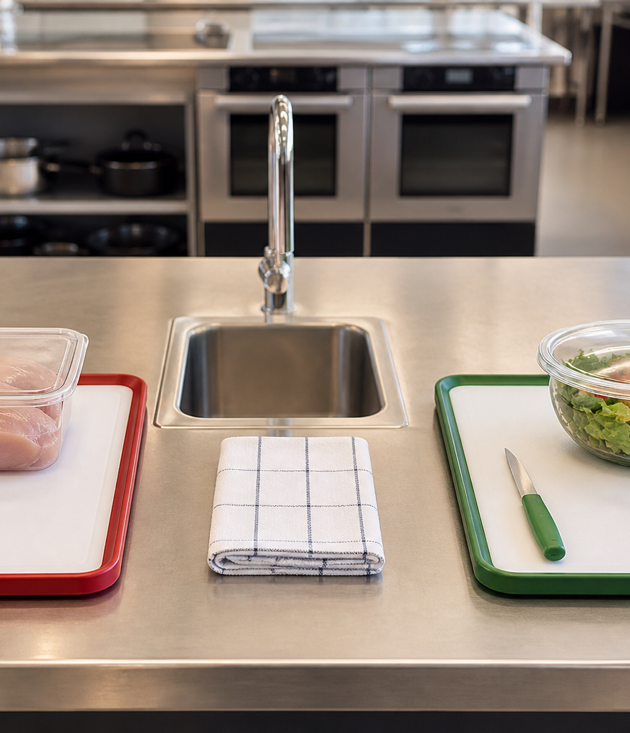
YEAR 9 FOOD IN AUSTRALIA
MODULE 01
Safety first
Safe food work begins with a specific decision: notice the hazard, trace the risk and choose a control before acting.
Generated learning visual — not documentary evidence.
Editable classroom presentation • Local review copy
Notes:
Open with the module question: how does safety first change a food decision or explanation?
State the outcome in plain language: Safe food work begins with a specific decision: notice the hazard, trace the risk and choose a control before acting.
Ask students what the visual helps them notice, then make clear that it is a generated learning visual, not documentary evidence or practical permission.
Transition: the next slide shows the three connected ideas students will use to reach the outcome.
[Sources]
- Teacher-supplied Food in Australia unit program and Classroom/Drive masters; private identifiers retained only in source-map v1.1.
- NESA Food Technology Years 7–10 Syllabus (2019), the controlling 2026 syllabus basis recorded in source-map v1.1.
- NSW Food Authority food-safety education material recorded in source-map v1.1; local procedures remain teacher-controlled.
- Course visual: assets/photos/m01-s02-safe-separation.png; Course-original generated PNG; no source image, private classroom material or student data; project-local educational use pending release authority.
[/Sources]

Slide 2
SAFETY FIRST · LEARNING PATHWAY
Three ideas build one explanation
Retrieval warm-up: What do you already know—and what needs checking?
1
2
3
From hazard to control
Hygiene breaks the contamination chain
Ready before you begin
Name hazard, harm, risk and control
Trace how contamination can travel
Check readiness before starting
Connect all three: Safe food work begins with a specific decision: notice the hazard, trace the risk and choose a control before acting.
YEAR 9 FOOD IN AUSTRALIA • MODULE 01
02
Notes:
Use the timeline as a learning sequence, not an agenda. Briefly name each idea and show how the third depends on the first two.
Retrieval prompt: ask students to define or exemplify one term from From hazard to control, then name one uncertainty to check.
Listen for unsupported certainty. Model language such as ‘the source supports…’, ‘in this context…’ and ‘Teacher to confirm…’ where relevant.
Transition: begin with From hazard to control; students will use it as the first part of the final explanation.
[Sources]
- Teacher-supplied Food in Australia unit program and Classroom/Drive masters; private identifiers retained only in source-map v1.1.
- NESA Food Technology Years 7–10 Syllabus (2019), the controlling 2026 syllabus basis recorded in source-map v1.1.
- NSW Food Authority food-safety education material recorded in source-map v1.1; local procedures remain teacher-controlled.
- Course theory section m01-s01: From hazard to control.
- Course theory section m01-s02: Hygiene breaks the contamination chain.
- Course theory section m01-s03: Ready before you begin.
[/Sources]

Slide 3
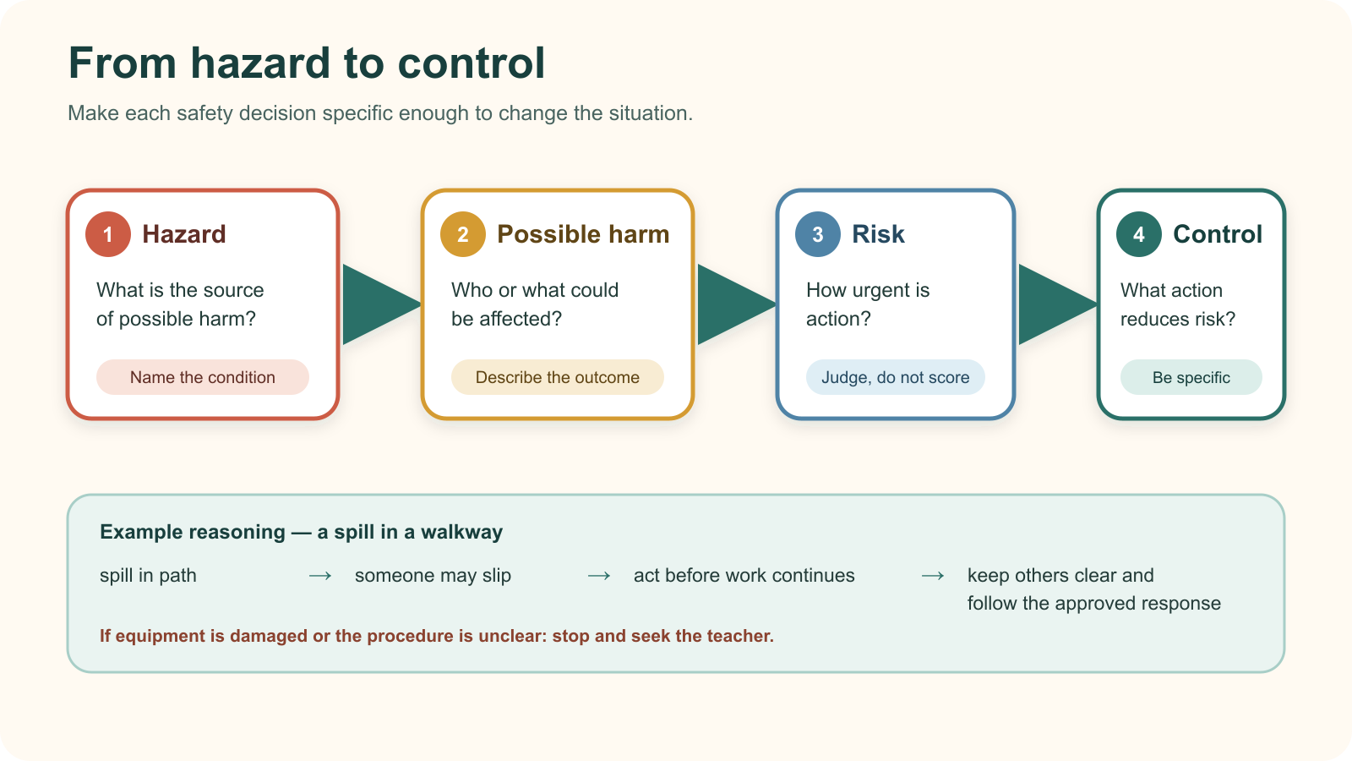
IDEA 1 · M01-S01
From hazard to control
A hazard is a source of possible harm. Risk combines likelihood and consequence. A useful control targets the specific hazard; when equipment or the method is unclear, stop and seek teacher direction rather than improvising.
Notice: At which step does a vague statement such as ‘be careful’ fail, and what specific action would improve it?
A safety response becomes useful when it names the hazard, possible harm, urgency and a specific control.
YEAR 9 FOOD IN AUSTRALIA • MODULE 01
03
Notes:
Explain: A hazard is a source of possible harm. Risk combines likelihood and consequence. A useful control targets the specific hazard; when equipment or the method is unclear, stop and seek teacher direction rather than improvising.
Ask students to respond to the on-slide notice prompt before volunteering an answer.
Misconception to correct: ‘Hazard’, ‘risk’ and ‘control’ mean the same thing.
Transition: connect this idea to safety first, then move to "the second idea".
[Sources]
- Teacher-supplied Food in Australia unit program and Classroom/Drive masters; private identifiers retained only in source-map v1.1.
- NESA Food Technology Years 7–10 Syllabus (2019), the controlling 2026 syllabus basis recorded in source-map v1.1.
- NSW Food Authority food-safety education material recorded in source-map v1.1; local procedures remain teacher-controlled.
- Course theory section m01-s01: From hazard to control.
- Course visual: assets/diagrams/m01-s01-hazard-control-pathway.svg; Course-original SVG; no third-party artwork or plan redrawn; project-local educational use pending release authority.
[/Sources]

Slide 4
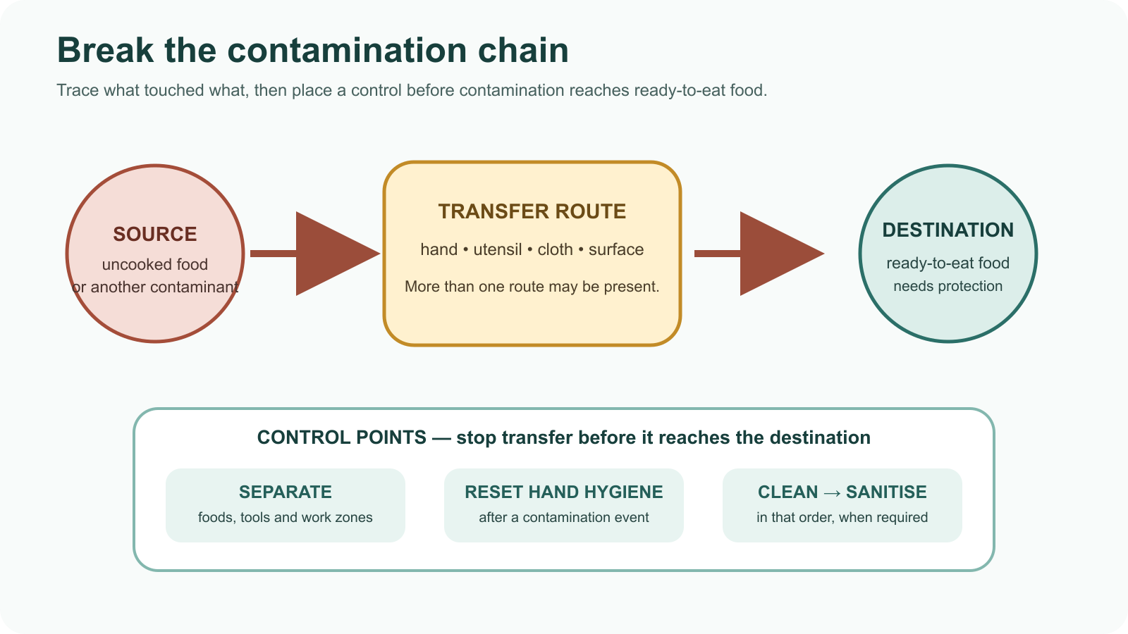
IDEA 2 · M01-S02
Hygiene breaks the contamination chain
Contamination moves through a chain: source → hand, surface or utensil → food. Hygiene controls work by breaking a transfer route. Appearance alone cannot prove that a utensil or food is safe.
Notice: Which control acts on the source, which acts on a transfer route, and why can more than one control be useful?
Trace the chain, then interrupt transfer before it reaches ready-to-eat food.
YEAR 9 FOOD IN AUSTRALIA • MODULE 01
04
Notes:
Explain: Contamination moves through a chain: source → hand, surface or utensil → food. Hygiene controls work by breaking a transfer route. Appearance alone cannot prove that a utensil or food is safe.
Ask students to respond to the on-slide notice prompt before volunteering an answer.
Misconception to correct: A clean-looking surface proves there is no contamination risk.
Transition: connect this idea to safety first, then move to "the final idea".
[Sources]
- Teacher-supplied Food in Australia unit program and Classroom/Drive masters; private identifiers retained only in source-map v1.1.
- NESA Food Technology Years 7–10 Syllabus (2019), the controlling 2026 syllabus basis recorded in source-map v1.1.
- NSW Food Authority food-safety education material recorded in source-map v1.1; local procedures remain teacher-controlled.
- Course theory section m01-s02: Hygiene breaks the contamination chain.
- Course visual: assets/diagrams/m01-s02-contamination-chain-controls.svg; Course-original SVG; no third-party artwork; project-local educational use pending release authority.
[/Sources]

Slide 5

IDEA 3 · M01-S03
Ready before you begin
Read the authorised method, check yourself and the workspace, ask about uncertainty, then set up. A checklist supports memory; it never replaces teacher direction or permission.
Notice: Which clues show that the method, workspace, equipment and personal preparation have been considered? What still requires teacher direction?
An illustrative readiness station: check the method, yourself, the workspace and visible equipment condition before work begins.
YEAR 9 FOOD IN AUSTRALIA • MODULE 01
05
Notes:
Explain: Read the authorised method, check yourself and the workspace, ask about uncertainty, then set up. A checklist supports memory; it never replaces teacher direction or permission.
Ask students to respond to the on-slide notice prompt before volunteering an answer.
Misconception to correct: A checklist gives practical permission or replaces teacher direction.
Transition: students now rehearse all three ideas through the module activity and retrieval checks.
[Sources]
- Teacher-supplied Food in Australia unit program and Classroom/Drive masters; private identifiers retained only in source-map v1.1.
- NESA Food Technology Years 7–10 Syllabus (2019), the controlling 2026 syllabus basis recorded in source-map v1.1.
- NSW Food Authority food-safety education material recorded in source-map v1.1; local procedures remain teacher-controlled.
- Course theory section m01-s03: Ready before you begin.
- Course visual: assets/photos/m01-s03-practical-readiness.png; Course-original generated PNG; no source image, private classroom material or student data; project-local educational use pending release authority.
[/Sources]

Slide 6
SAFETY FIRST · REHEARSAL
Stop. Think. Explain.
Answer silently first. Then justify one response with a partner.
1
A frayed electrical lead is noticed before a food practical. Which statement correctly separates the hazard, risk and control?
APPLIED LEARNING ACTIVITY
Food-room decision lab
2
A hand touches a phone, then a clean utensil, then ready-to-eat food. What is the strongest analysis?
Practise distinguishing hazards, possible harm and controls, then decide whether a situation is ready, needs teacher help or requires a stop.
3
A method is clear, but a piece of equipment appears damaged. What should happen next?
Try: Classify the parts of the risk pathway.
Rehearsal first. Save evidence only when the teacher directs.
YEAR 9 FOOD IN AUSTRALIA • MODULE 01
06
Notes:
Run the activity as rehearsal: Classify each statement by the job it performs, then choose the safest response to the new scenario.
Give quiet thinking time before discussion. Ask students to explain why an alternative is weaker, not merely name the correct choice.
Check 1: The frayed lead is the hazard; the chance and seriousness of harm form the risk; stopping and telling the teacher is an immediate control.
Check 2: Trace the possible transfer through each contact and interrupt it using the teacher-approved hygiene process before food handling continues.
Check 3: Stop and ask the teacher before using, testing or moving ahead with that equipment.
Misconception to correct: a correct choice without reasoning is enough evidence. Ask for the link between the claim and the source or scenario.
Transition: move from short retrieval to one constructed evidence response.
[Sources]
- Teacher-supplied Food in Australia unit program and Classroom/Drive masters; private identifiers retained only in source-map v1.1.
- NESA Food Technology Years 7–10 Syllabus (2019), the controlling 2026 syllabus basis recorded in source-map v1.1.
- NSW Food Authority food-safety education material recorded in source-map v1.1; local procedures remain teacher-controlled.
- Course activity activity-m01: Food-room decision lab.
- Course formative check check-m01-s01 for m01-s01.
- Course formative check check-m01-s02 for m01-s02.
- Course formative check check-m01-s03 for m01-s03.
[/Sources]

Slide 7
SAFETY FIRST · GUIDED RESPONSE
Build evidence someone else can follow
THE QUESTION
Explain how one readiness decision before a practical could protect more than one person, food item, piece of equipment or part of the wider food-room system.
1 READ
2 SELECT
3 EXPLAIN
4 CHECK
Underline the exact decision or explanation the prompt requires.
Choose evidence that uses a specific readiness clue.
The readiness clue is …
Shows connected consequences; does not invent permission or local procedure.
Save in My Folio only when your teacher asks. Saving is not submission.
YEAR 9 FOOD IN AUSTRALIA • MODULE 01
07
Notes:
Read the prompt aloud once, then ask students to restate its decision or explanation in their own words.
Model the sequence: Read → Select → Explain → Check. Use the starter "The readiness clue is …" only if students need it.
Look for: uses a specific readiness clue; shows connected consequences; does not invent permission or local procedure.
Misconception to correct: saving locally means the work has been submitted or formally assessed. It has not.
Transition: close with a three-part exit ticket and the teacher-controlled next step.
[Sources]
- Teacher-supplied Food in Australia unit program and Classroom/Drive masters; private identifiers retained only in source-map v1.1.
- NESA Food Technology Years 7–10 Syllabus (2019), the controlling 2026 syllabus basis recorded in source-map v1.1.
- NSW Food Authority food-safety education material recorded in source-map v1.1; local procedures remain teacher-controlled.
- Course evidence record for m01-s03: Readiness protects a system.
- Course folio contract: device-local saving is not submission.
[/Sources]

Slide 8
MODULE 01 · EXIT EVIDENCE
TEACHER TO CONFIRM
Leave with evidence, not a guess.
Local food-room procedures, equipment access and practical directions.
1. One idea I can explain is from hazard to control because …
2. One connection across the three ideas is …
3. One question or check I still need is …
NEXT STEP
Use the module page to refine one response, then follow your teacher’s directions.
Evidence destination: My Folio when directed. Exporting or saving is not submission.
Notes:
Give students one minute to write all three exit lines. Ask for a specific connection, not a generic summary.
Listen for the module takeaway: Safe food work begins with a specific decision: notice the hazard, trace the risk and choose a control before acting.
State the sign-off exactly as shown: Teacher to confirm local food-room procedures, equipment access and practical directions.
Do not announce a practical, due date, weighting, grade or submission route unless it is in the current teacher-issued instruction.
Close by directing students to the Module 01 page or My Folio only as the teacher decides.
[Sources]
- Teacher-supplied Food in Australia unit program and Classroom/Drive masters; private identifiers retained only in source-map v1.1.
- NESA Food Technology Years 7–10 Syllabus (2019), the controlling 2026 syllabus basis recorded in source-map v1.1.
- NSW Food Authority food-safety education material recorded in source-map v1.1; local procedures remain teacher-controlled.
- Current Year 9 Assessment Booklet 2026: course-level task boundaries only; this deck does not invent unit task details.
- Course source-map v1.1 and assessment-orientation boundary.
[/Sources]

