Slide 1
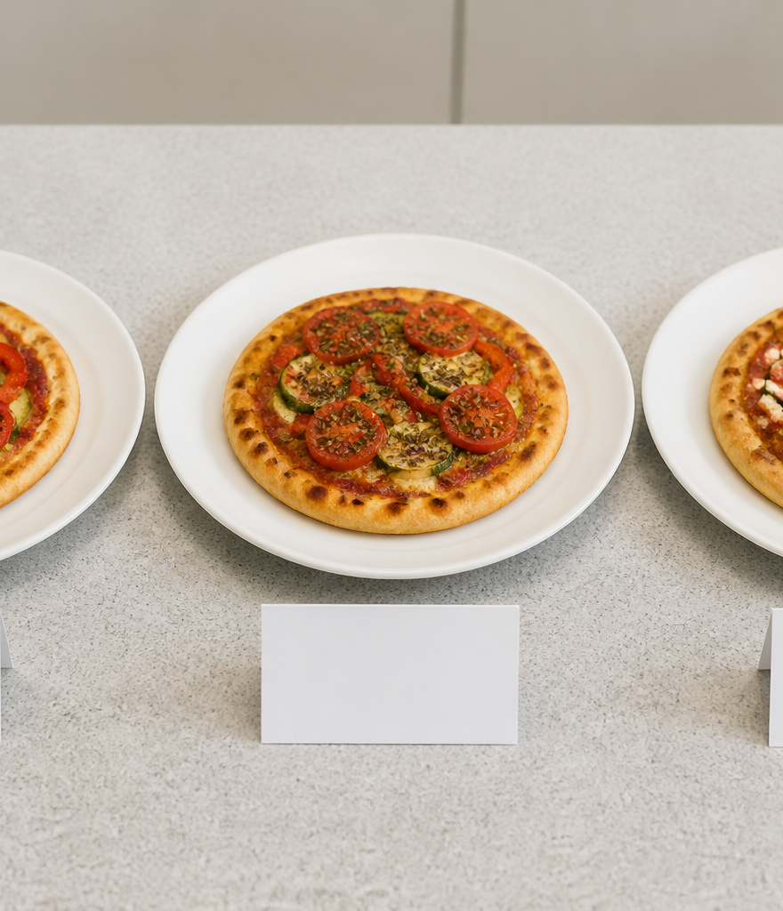
YEAR 9 FOOD IN AUSTRALIA
MODULE 02
Native foods and nutrition
Respectful food study connects Country, source authority, fair evidence and purposeful design.
Generated learning visual — not documentary evidence.
Editable classroom presentation • Local review copy
Notes:
Open with the module question: how does native foods and nutrition change a food decision or explanation?
State the outcome in plain language: Respectful food study connects Country, source authority, fair evidence and purposeful design.
Ask students what the visual helps them notice, then make clear that it is a generated learning visual, not documentary evidence or practical permission.
Transition: the next slide shows the three connected ideas students will use to reach the outcome.
[Sources]
- Teacher-supplied Food in Australia unit program and Classroom/Drive masters; private identifiers retained only in source-map v1.1.
- NESA Food Technology Years 7–10 Syllabus (2019), the controlling 2026 syllabus basis recorded in source-map v1.1.
- Arts Law Centre of Australia ICIP guidance and authorised public cultural sources recorded in source-map v1.1.
- Course visual: assets/photos/m02-s03-controlled-trial.png; Course-original generated PNG; no source image or commercial recipe reproduced; project-local educational use pending release authority.
[/Sources]

Slide 2
NATIVE FOODS AND NUTRITION · LEARNING PATHWAY
Three ideas build one explanation
Retrieval warm-up: What do you already know—and what needs checking?
1
2
3
Country, identity and respectful language
Compare nutrition evidence fairly
Modify with a reason
Start with Country, source and limits
Compare nutrition on a fair basis
Modify for a reason and test fairly
Connect all three: Respectful food study connects Country, source authority, fair evidence and purposeful design.
YEAR 9 FOOD IN AUSTRALIA • MODULE 02
02
Notes:
Use the timeline as a learning sequence, not an agenda. Briefly name each idea and show how the third depends on the first two.
Retrieval prompt: ask students to define or exemplify one term from Country, identity and respectful language, then name one uncertainty to check.
Listen for unsupported certainty. Model language such as ‘the source supports…’, ‘in this context…’ and ‘Teacher to confirm…’ where relevant.
Transition: begin with Country, identity and respectful language; students will use it as the first part of the final explanation.
[Sources]
- Teacher-supplied Food in Australia unit program and Classroom/Drive masters; private identifiers retained only in source-map v1.1.
- NESA Food Technology Years 7–10 Syllabus (2019), the controlling 2026 syllabus basis recorded in source-map v1.1.
- Arts Law Centre of Australia ICIP guidance and authorised public cultural sources recorded in source-map v1.1.
- Course theory section m02-s01: Country, identity and respectful language.
- Course theory section m02-s02: Compare nutrition evidence fairly.
- Course theory section m02-s03: Modify with a reason.
[/Sources]

Slide 3
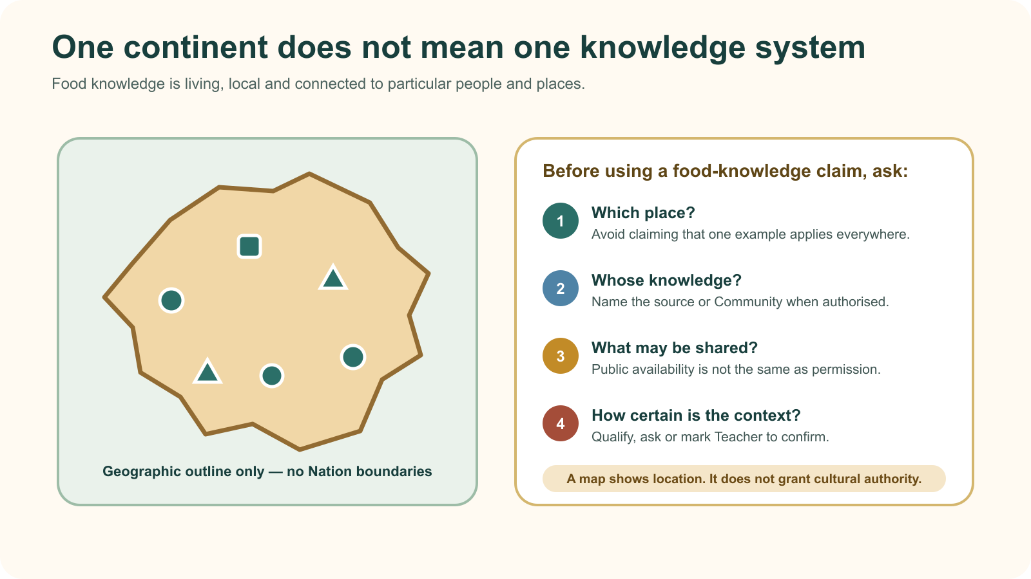
IDEA 1 · M02-S01
Country, identity and respectful language
There is no single Aboriginal or Torres Strait Islander food culture. Food knowledge is place-based, living and connected to authority. Name the source and place, stay within what is publicly shared, and avoid national generalisations.
Notice: Why are there no Nation boundaries or cultural labels on the outline? Which question stops a national generalisation?
A map can show geography; it cannot show every knowledge system or grant permission to use Cultural Knowledge.
YEAR 9 FOOD IN AUSTRALIA • MODULE 02
03
Notes:
Explain: There is no single Aboriginal or Torres Strait Islander food culture. Food knowledge is place-based, living and connected to authority. Name the source and place, stay within what is publicly shared, and avoid national generalisations.
Ask students to respond to the on-slide notice prompt before volunteering an answer.
Misconception to correct: A national map or generic source makes knowledge universal.
Transition: connect this idea to native foods and nutrition, then move to "the second idea".
[Sources]
- Teacher-supplied Food in Australia unit program and Classroom/Drive masters; private identifiers retained only in source-map v1.1.
- NESA Food Technology Years 7–10 Syllabus (2019), the controlling 2026 syllabus basis recorded in source-map v1.1.
- Arts Law Centre of Australia ICIP guidance and authorised public cultural sources recorded in source-map v1.1.
- Course theory section m02-s01: Country, identity and respectful language.
- Course visual: assets/diagrams/m02-s01-place-specific-knowledge.svg; Course-original schematic SVG; geography is illustrative and contains no Nation boundaries; project-local educational use pending release authority.
[/Sources]

Slide 4
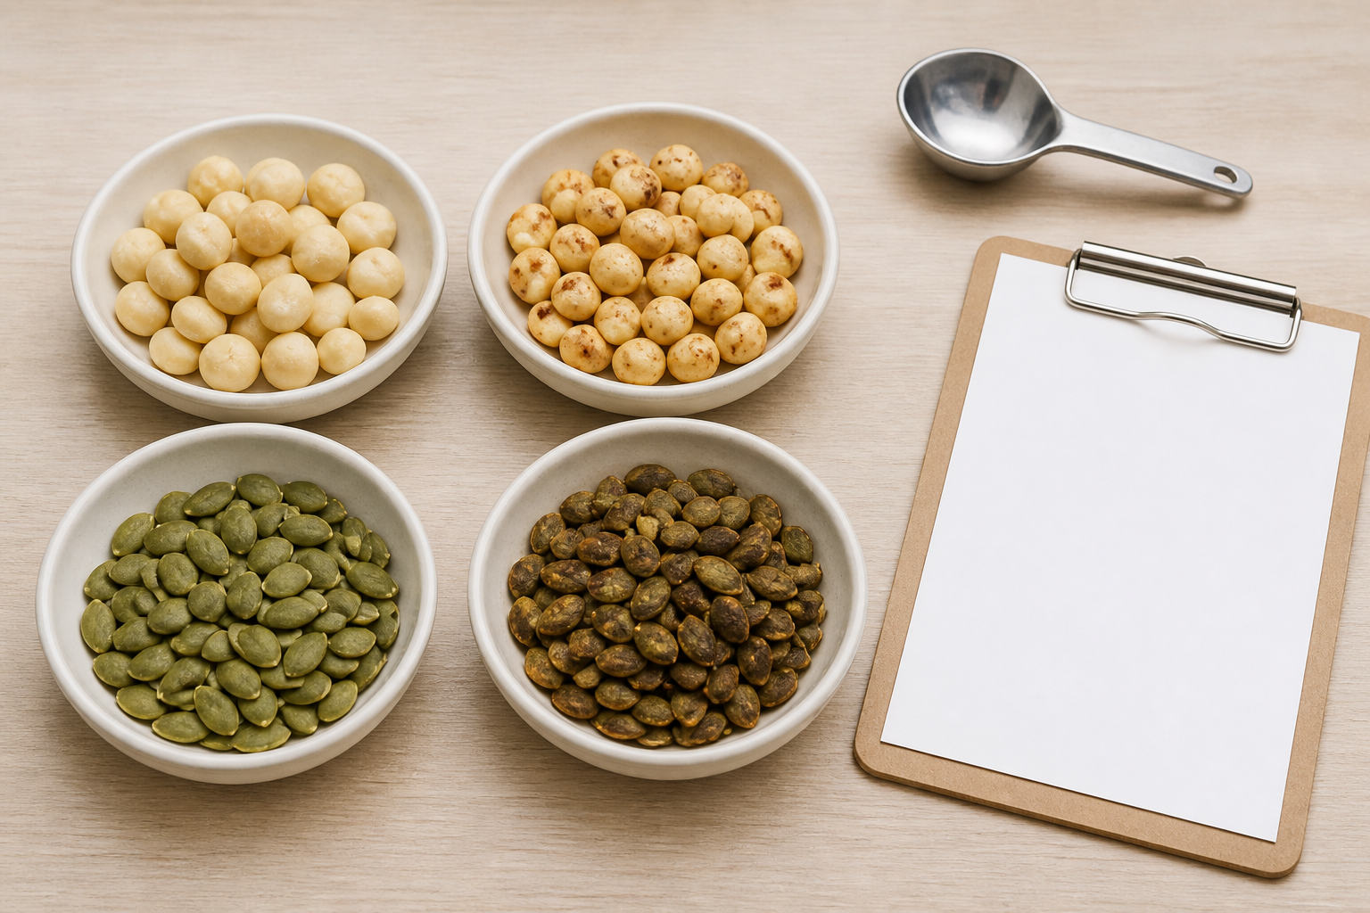
IDEA 2 · M02-S02
Compare nutrition evidence fairly
A fair nutrition comparison matches the exact food, preparation state, nutrient and comparison basis. One value supports a narrow claim, not a total ranking such as ‘healthiest’ or ‘superfood’.
Notice: Which samples form fair pairs? What information would you still need before making a nutrition claim?
A fair nutrition comparison starts by matching the food, preparation state, nutrient and comparison basis.
YEAR 9 FOOD IN AUSTRALIA • MODULE 02
04
Notes:
Explain: A fair nutrition comparison matches the exact food, preparation state, nutrient and comparison basis. One value supports a narrow claim, not a total ranking such as ‘healthiest’ or ‘superfood’.
Ask students to respond to the on-slide notice prompt before volunteering an answer.
Misconception to correct: One nutrient value proves a food is ‘healthiest’.
Transition: connect this idea to native foods and nutrition, then move to "the final idea".
[Sources]
- Teacher-supplied Food in Australia unit program and Classroom/Drive masters; private identifiers retained only in source-map v1.1.
- NESA Food Technology Years 7–10 Syllabus (2019), the controlling 2026 syllabus basis recorded in source-map v1.1.
- Arts Law Centre of Australia ICIP guidance and authorised public cultural sources recorded in source-map v1.1.
- Course theory section m02-s02: Compare nutrition evidence fairly.
- Course visual: assets/photos/m02-s02-fair-comparison.png; Course-original generated PNG; no source image or proprietary worksheet reproduced; project-local educational use pending release authority.
[/Sources]

Slide 5
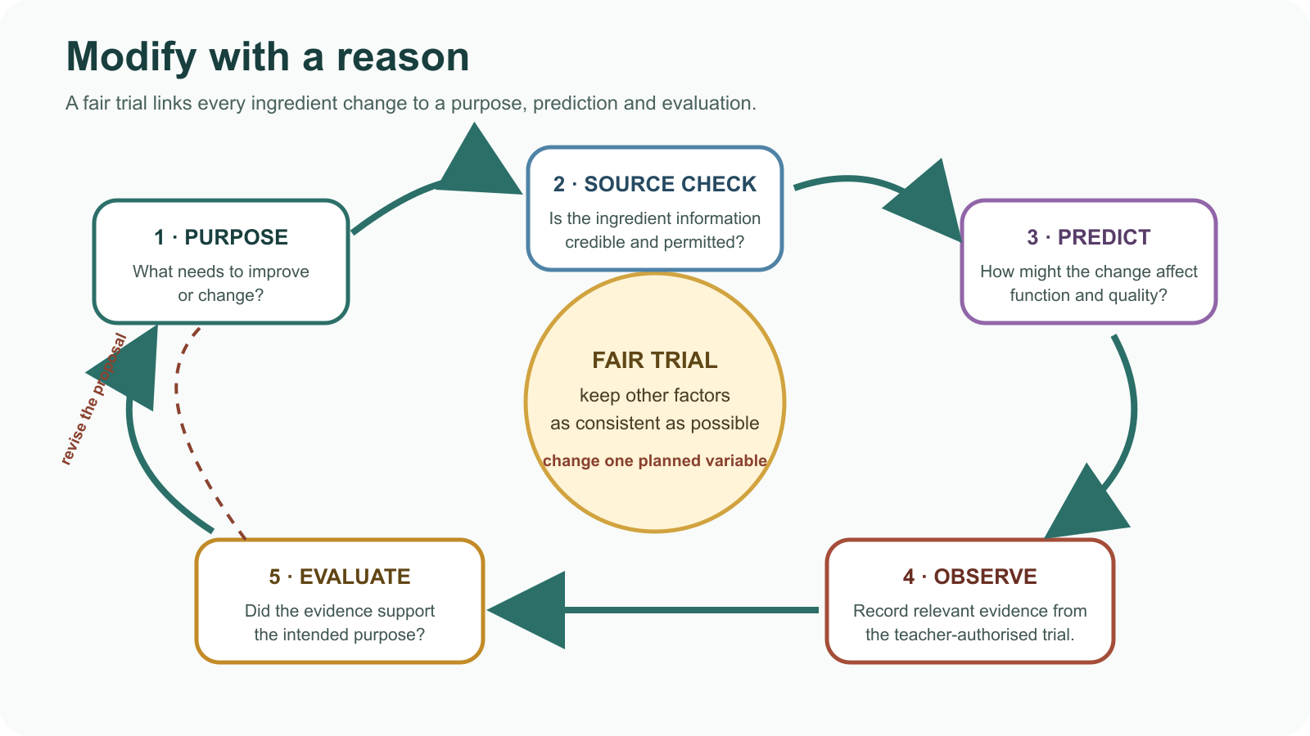
IDEA 3 · M02-S03
Modify with a reason
A purposeful modification begins with a user and reason, checks ingredient provenance and cultural context, predicts functional effects, and uses a fair trial. Teacher approval, availability, allergy and safety requirements remain separate.
Notice: Where is the reason for the change tested against evidence, and which step sends the design back for revision?
Purpose, source checking, prediction, fair observation and evaluation turn an ingredient change into an evidence-based modification.
YEAR 9 FOOD IN AUSTRALIA • MODULE 02
05
Notes:
Explain: A purposeful modification begins with a user and reason, checks ingredient provenance and cultural context, predicts functional effects, and uses a fair trial. Teacher approval, availability, allergy and safety requirements remain separate.
Ask students to respond to the on-slide notice prompt before volunteering an answer.
Misconception to correct: Adding a native ingredient automatically makes a modification respectful or successful.
Transition: students now rehearse all three ideas through the module activity and retrieval checks.
[Sources]
- Teacher-supplied Food in Australia unit program and Classroom/Drive masters; private identifiers retained only in source-map v1.1.
- NESA Food Technology Years 7–10 Syllabus (2019), the controlling 2026 syllabus basis recorded in source-map v1.1.
- Arts Law Centre of Australia ICIP guidance and authorised public cultural sources recorded in source-map v1.1.
- Course theory section m02-s03: Modify with a reason.
- Course visual: assets/diagrams/m02-s03-modification-design-loop.svg; Course-original SVG; no third-party artwork or recipe; project-local educational use pending release authority.
[/Sources]

Slide 6
NATIVE FOODS AND NUTRITION · REHEARSAL
Stop. Think. Explain.
Answer silently first. Then justify one response with a partner.
1
Which research sentence is most accurate and respectful?
APPLIED LEARNING ACTIVITY
Native-food evidence detective
2
Before comparing the iron values of two foods, which check matters most?
Practise keeping cultural and nutrition claims source-bounded and identifying the evidence a respectful modification needs.
3
Which plan would produce the clearest evidence about a proposed ingredient modification?
Try: How strong is each claim?
Rehearsal first. Save evidence only when the teacher directs.
YEAR 9 FOOD IN AUSTRALIA • MODULE 02
06
Notes:
Run the activity as rehearsal: Sort each claim by evidence quality, then repair the comparison plan.
Give quiet thinking time before discussion. Ask students to explain why an alternative is weaker, not merely name the correct choice.
Check 1: This named Aboriginal-authored source explains the food knowledge it is authorised to share in its identified place and context.
Check 2: Confirm the exact food and preparation state, the same nutrient and a matching basis such as per 100 g.
Check 3: Change one planned factor, keep important conditions comparable and record effects against the stated purpose.
Misconception to correct: a correct choice without reasoning is enough evidence. Ask for the link between the claim and the source or scenario.
Transition: move from short retrieval to one constructed evidence response.
[Sources]
- Teacher-supplied Food in Australia unit program and Classroom/Drive masters; private identifiers retained only in source-map v1.1.
- NESA Food Technology Years 7–10 Syllabus (2019), the controlling 2026 syllabus basis recorded in source-map v1.1.
- Arts Law Centre of Australia ICIP guidance and authorised public cultural sources recorded in source-map v1.1.
- Course activity activity-m02: Native-food evidence detective.
- Course formative check check-m02-s01 for m02-s01.
- Course formative check check-m02-s02 for m02-s02.
- Course formative check check-m02-s03 for m02-s03.
[/Sources]

Slide 7
NATIVE FOODS AND NUTRITION · GUIDED RESPONSE
Build evidence someone else can follow
THE QUESTION
Justify a proposed food modification by linking its purpose, supporting evidence, respectful use of the ingredient and predicted effects on food function. Identify what a fair trial would need to test.
1 READ
2 SELECT
3 EXPLAIN
4 CHECK
Underline the exact decision or explanation the prompt requires.
Choose evidence that connects change to purpose.
The design purpose is …
Identifies provenance or cultural-context evidence; predicts more than taste alone.
Save in My Folio only when your teacher asks. Saving is not submission.
YEAR 9 FOOD IN AUSTRALIA • MODULE 02
07
Notes:
Read the prompt aloud once, then ask students to restate its decision or explanation in their own words.
Model the sequence: Read → Select → Explain → Check. Use the starter "The design purpose is …" only if students need it.
Look for: connects change to purpose; identifies provenance or cultural-context evidence; predicts more than taste alone.
Misconception to correct: saving locally means the work has been submitted or formally assessed. It has not.
Transition: close with a three-part exit ticket and the teacher-controlled next step.
[Sources]
- Teacher-supplied Food in Australia unit program and Classroom/Drive masters; private identifiers retained only in source-map v1.1.
- NESA Food Technology Years 7–10 Syllabus (2019), the controlling 2026 syllabus basis recorded in source-map v1.1.
- Arts Law Centre of Australia ICIP guidance and authorised public cultural sources recorded in source-map v1.1.
- Course evidence record for m02-s03: Purposeful modification justification.
- Course folio contract: device-local saving is not submission.
[/Sources]

Slide 8
MODULE 02 · EXIT EVIDENCE
TEACHER TO CONFIRM
Leave with evidence, not a guess.
Ingredient access, allergies, cultural context and any practical trial approval.
1. One idea I can explain is Country, identity and respectful language because …
2. One connection across the three ideas is …
3. One question or check I still need is …
NEXT STEP
Use the module page to refine one response, then follow your teacher’s directions.
Evidence destination: My Folio when directed. Exporting or saving is not submission.
Notes:
Give students one minute to write all three exit lines. Ask for a specific connection, not a generic summary.
Listen for the module takeaway: Respectful food study connects Country, source authority, fair evidence and purposeful design.
State the sign-off exactly as shown: Teacher to confirm ingredient access, allergies, cultural context and any practical trial approval.
Do not announce a practical, due date, weighting, grade or submission route unless it is in the current teacher-issued instruction.
Close by directing students to the Module 02 page or My Folio only as the teacher decides.
[Sources]
- Teacher-supplied Food in Australia unit program and Classroom/Drive masters; private identifiers retained only in source-map v1.1.
- NESA Food Technology Years 7–10 Syllabus (2019), the controlling 2026 syllabus basis recorded in source-map v1.1.
- Arts Law Centre of Australia ICIP guidance and authorised public cultural sources recorded in source-map v1.1.
- Current Year 9 Assessment Booklet 2026: course-level task boundaries only; this deck does not invent unit task details.
- Course source-map v1.1 and assessment-orientation boundary.
[/Sources]

