Slide 1
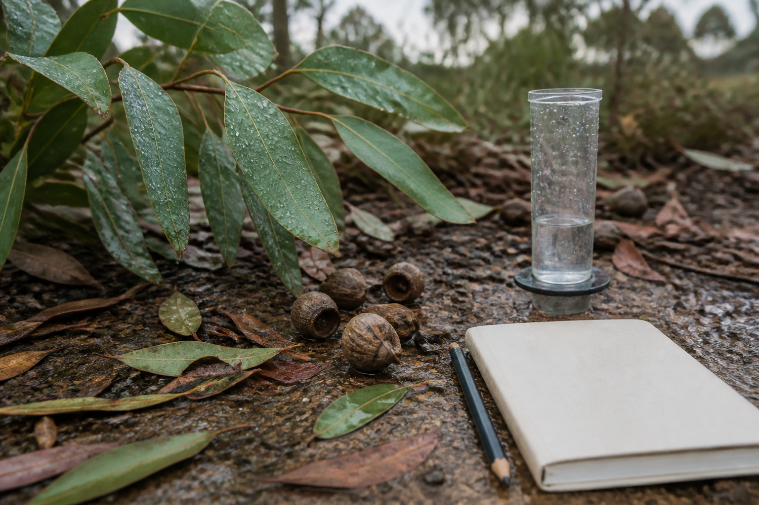
YEAR 9 FOOD IN AUSTRALIA
MODULE 03
Cultural Knowledge and ICIP
Responsible research keeps Cultural Knowledge connected to authority, context, permission and purpose.
Generated learning visual — not documentary evidence.
Editable classroom presentation • Local review copy
Notes:
Open with the module question: how does cultural knowledge and icip change a food decision or explanation?
State the outcome in plain language: Responsible research keeps Cultural Knowledge connected to authority, context, permission and purpose.
Ask students what the visual helps them notice, then make clear that it is a generated learning visual, not documentary evidence or practical permission.
Transition: the next slide shows the three connected ideas students will use to reach the outcome.
[Sources]
- Teacher-supplied Food in Australia unit program and Classroom/Drive masters; private identifiers retained only in source-map v1.1.
- NESA Food Technology Years 7–10 Syllabus (2019), the controlling 2026 syllabus basis recorded in source-map v1.1.
- Arts Law Centre of Australia ICIP guidance and authorised public cultural sources recorded in source-map v1.1.
- Course visual: assets/photos/m03-s02-seasonal-observation.png; Course-original generated PNG; depicts a generic observation setting only; project-local educational use pending release authority.
[/Sources]

Slide 2
CULTURAL KNOWLEDGE AND ICIP · LEARNING PATHWAY
Three ideas build one explanation
Retrieval warm-up: What do you already know—and what needs checking?
1
2
3
Cultural Knowledge is living, local and owned
Seasons, cycles and caring for resources
Research, permission and ICIP
Recognise living, local ownership
Separate observation from local knowledge
Check authority, rights and purpose
Connect all three: Responsible research keeps Cultural Knowledge connected to authority, context, permission and purpose.
YEAR 9 FOOD IN AUSTRALIA • MODULE 03
02
Notes:
Use the timeline as a learning sequence, not an agenda. Briefly name each idea and show how the third depends on the first two.
Retrieval prompt: ask students to define or exemplify one term from Cultural Knowledge is living, local and owned, then name one uncertainty to check.
Listen for unsupported certainty. Model language such as ‘the source supports…’, ‘in this context…’ and ‘Teacher to confirm…’ where relevant.
Transition: begin with Cultural Knowledge is living, local and owned; students will use it as the first part of the final explanation.
[Sources]
- Teacher-supplied Food in Australia unit program and Classroom/Drive masters; private identifiers retained only in source-map v1.1.
- NESA Food Technology Years 7–10 Syllabus (2019), the controlling 2026 syllabus basis recorded in source-map v1.1.
- Arts Law Centre of Australia ICIP guidance and authorised public cultural sources recorded in source-map v1.1.
- Course theory section m03-s01: Cultural Knowledge is living, local and owned.
- Course theory section m03-s02: Seasons, cycles and caring for resources.
- Course theory section m03-s03: Research, permission and ICIP.
[/Sources]

Slide 3
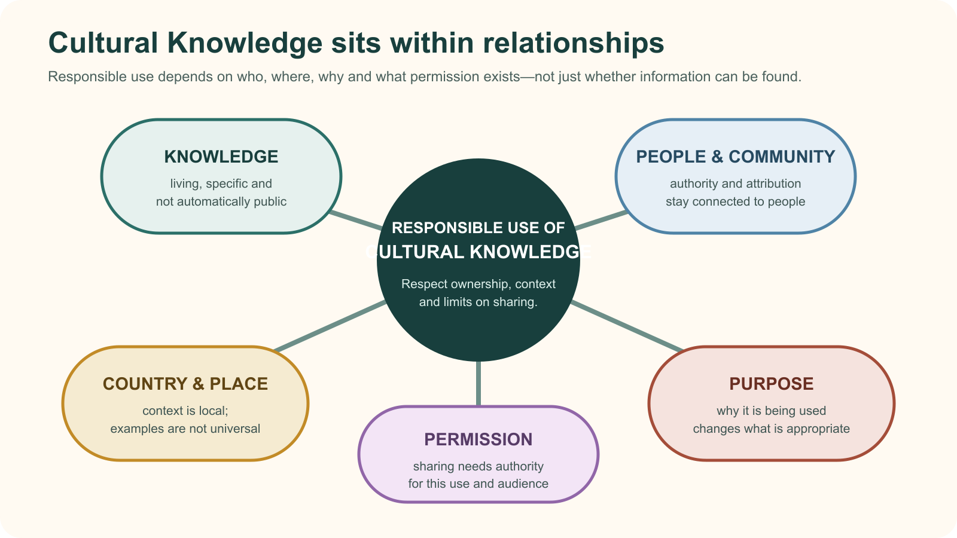
IDEA 1 · M03-S01
Cultural Knowledge is living, local and owned
Cultural Knowledge is living and connected to people, Community, Country, permission and purpose. Finding information online does not transfer authority or make every use appropriate.
Notice: If one relationship is missing—for example, permission—why is finding the information not enough?
Cultural Knowledge remains connected to people, Community, Country, permission and purpose.
YEAR 9 FOOD IN AUSTRALIA • MODULE 03
03
Notes:
Explain: Cultural Knowledge is living and connected to people, Community, Country, permission and purpose. Finding information online does not transfer authority or make every use appropriate.
Ask students to respond to the on-slide notice prompt before volunteering an answer.
Misconception to correct: Publicly accessible information is free to reuse.
Transition: connect this idea to cultural knowledge and icip, then move to "the second idea".
[Sources]
- Teacher-supplied Food in Australia unit program and Classroom/Drive masters; private identifiers retained only in source-map v1.1.
- NESA Food Technology Years 7–10 Syllabus (2019), the controlling 2026 syllabus basis recorded in source-map v1.1.
- Arts Law Centre of Australia ICIP guidance and authorised public cultural sources recorded in source-map v1.1.
- Course theory section m03-s01: Cultural Knowledge is living, local and owned.
- Course visual: assets/diagrams/m03-s01-knowledge-permission-web.svg; Course-original abstract relationship SVG with no cultural motifs or third-party artwork; project-local educational use pending release authority.
[/Sources]

Slide 4
IDEA 2 · M03-S02
Seasons, cycles and caring for resources
Seasonal knowledge is place-specific and may use local environmental indicators rather than four imported seasons. Observe only what you can see; do not invent local interpretation, harvesting permission or cultural authority.
Notice: Which clues can you observe directly? Which interpretation would require an authorised local source rather than your own assumption?
A generic observation setting—not a Cultural calendar or source of Cultural Knowledge. Local interpretation requires authorised local sources and permission.
YEAR 9 FOOD IN AUSTRALIA • MODULE 03
04
Notes:
Explain: Seasonal knowledge is place-specific and may use local environmental indicators rather than four imported seasons. Observe only what you can see; do not invent local interpretation, harvesting permission or cultural authority.
Ask students to respond to the on-slide notice prompt before volunteering an answer.
Misconception to correct: A generic observation can stand in for local seasonal knowledge.
Transition: connect this idea to cultural knowledge and icip, then move to "the final idea".
[Sources]
- Teacher-supplied Food in Australia unit program and Classroom/Drive masters; private identifiers retained only in source-map v1.1.
- NESA Food Technology Years 7–10 Syllabus (2019), the controlling 2026 syllabus basis recorded in source-map v1.1.
- Arts Law Centre of Australia ICIP guidance and authorised public cultural sources recorded in source-map v1.1.
- Course theory section m03-s02: Seasons, cycles and caring for resources.
- Course visual: assets/photos/m03-s02-seasonal-observation.png; Course-original generated PNG; depicts a generic observation setting only; project-local educational use pending release authority.
[/Sources]

Slide 5
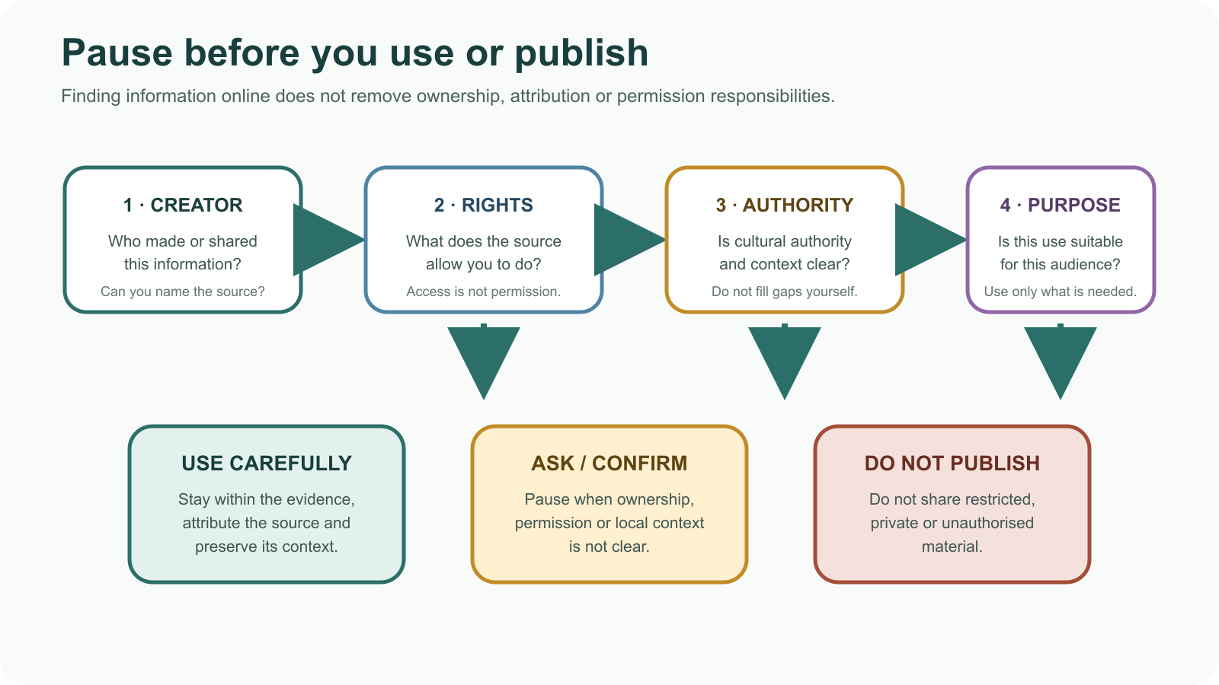
IDEA 3 · M03-S03
Research, permission and ICIP
Check creator, rights, cultural authority, purpose and reuse conditions. Attribution is necessary but not always sufficient. If authority or permission is unclear, pause, link, ask or leave the material out.
Notice: Which question would stop you from publishing material even if you could open it online?
Check creator, rights, cultural authority and purpose before using or publishing information.
YEAR 9 FOOD IN AUSTRALIA • MODULE 03
05
Notes:
Explain: Check creator, rights, cultural authority, purpose and reuse conditions. Attribution is necessary but not always sufficient. If authority or permission is unclear, pause, link, ask or leave the material out.
Ask students to respond to the on-slide notice prompt before volunteering an answer.
Misconception to correct: Giving credit is always the same as having permission.
Transition: students now rehearse all three ideas through the module activity and retrieval checks.
[Sources]
- Teacher-supplied Food in Australia unit program and Classroom/Drive masters; private identifiers retained only in source-map v1.1.
- NESA Food Technology Years 7–10 Syllabus (2019), the controlling 2026 syllabus basis recorded in source-map v1.1.
- Arts Law Centre of Australia ICIP guidance and authorised public cultural sources recorded in source-map v1.1.
- Course theory section m03-s03: Research, permission and ICIP.
- Course visual: assets/diagrams/m03-s03-icip-source-check.svg; Course-original SVG; no third-party source content; project-local educational use pending release authority.
[/Sources]

Slide 6
CULTURAL KNOWLEDGE AND ICIP · REHEARSAL
Stop. Think. Explain.
Answer silently first. Then justify one response with a partner.
1
Which source check best supports responsible use of Cultural Knowledge in a school explanation?
APPLIED LEARNING ACTIVITY
ICIP source-permission audit
2
What is a responsible conclusion from a public Aboriginal seasonal calendar?
Practise checking identity, place, purpose, permission and renewal without reproducing Cultural Knowledge.
3
A source names no creator or Community and gives no reuse conditions. What is the best next step?
Try: For this fictional source card, mark each detail as clear or unclear: it names an Aboriginal organisation, identifies Country, states 'public classroom viewing', asks users to link rather than copy, but gives no harvesting advice.
Rehearsal first. Save evidence only when the teacher directs.
YEAR 9 FOOD IN AUSTRALIA • MODULE 03
06
Notes:
Run the activity as rehearsal: Audit fictional source metadata only. Decide what is clear, then choose a responsible action.
Give quiet thinking time before discussion. Ask students to explain why an alternative is weaker, not merely name the correct choice.
Check 1: Identify the creator, Country or Community context, public purpose, authority and stated limits before deciding how to use it.
Check 2: It can show relationships among local indicators, timing, decisions and care in the identified context, but it does not grant harvesting permission.
Check 3: Pause, seek context or teacher guidance, and prefer linking or a clearer authorised source rather than guessing permission.
Misconception to correct: a correct choice without reasoning is enough evidence. Ask for the link between the claim and the source or scenario.
Transition: move from short retrieval to one constructed evidence response.
[Sources]
- Teacher-supplied Food in Australia unit program and Classroom/Drive masters; private identifiers retained only in source-map v1.1.
- NESA Food Technology Years 7–10 Syllabus (2019), the controlling 2026 syllabus basis recorded in source-map v1.1.
- Arts Law Centre of Australia ICIP guidance and authorised public cultural sources recorded in source-map v1.1.
- Course activity activity-m03: ICIP source-permission audit.
- Course formative check check-m03-s01 for m03-s01.
- Course formative check check-m03-s02 for m03-s02.
- Course formative check check-m03-s03 for m03-s03.
[/Sources]

Slide 7
CULTURAL KNOWLEDGE AND ICIP · GUIDED RESPONSE
Build evidence someone else can follow
THE QUESTION
Explain why a chosen source is appropriate to use and how your proposed research action respects its authority, context, reuse conditions and acknowledgement needs.
1 READ
2 SELECT
3 EXPLAIN
4 CHECK
Underline the exact decision or explanation the prompt requires.
Choose evidence that separates attribution from permission.
I can verify the source's …
Uses source-specific evidence; pauses or links when authority is unclear.
Save in My Folio only when your teacher asks. Saving is not submission.
YEAR 9 FOOD IN AUSTRALIA • MODULE 03
07
Notes:
Read the prompt aloud once, then ask students to restate its decision or explanation in their own words.
Model the sequence: Read → Select → Explain → Check. Use the starter "I can verify the source's …" only if students need it.
Look for: separates attribution from permission; uses source-specific evidence; pauses or links when authority is unclear.
Misconception to correct: saving locally means the work has been submitted or formally assessed. It has not.
Transition: close with a three-part exit ticket and the teacher-controlled next step.
[Sources]
- Teacher-supplied Food in Australia unit program and Classroom/Drive masters; private identifiers retained only in source-map v1.1.
- NESA Food Technology Years 7–10 Syllabus (2019), the controlling 2026 syllabus basis recorded in source-map v1.1.
- Arts Law Centre of Australia ICIP guidance and authorised public cultural sources recorded in source-map v1.1.
- Course evidence record for m03-s03: ICIP-aware research pathway.
- Course folio contract: device-local saving is not submission.
[/Sources]

Slide 8
MODULE 03 · EXIT EVIDENCE
TEACHER TO CONFIRM
Leave with evidence, not a guess.
Local Community, AECG or Knowledge Holder guidance before localising cultural content.
1. One idea I can explain is Cultural Knowledge is living, local and owned because …
2. One connection across the three ideas is …
3. One question or check I still need is …
NEXT STEP
Use the module page to refine one response, then follow your teacher’s directions.
Evidence destination: My Folio when directed. Exporting or saving is not submission.
Notes:
Give students one minute to write all three exit lines. Ask for a specific connection, not a generic summary.
Listen for the module takeaway: Responsible research keeps Cultural Knowledge connected to authority, context, permission and purpose.
State the sign-off exactly as shown: Teacher to confirm local community, aecg or knowledge holder guidance before localising cultural content.
Do not announce a practical, due date, weighting, grade or submission route unless it is in the current teacher-issued instruction.
Close by directing students to the Module 03 page or My Folio only as the teacher decides.
[Sources]
- Teacher-supplied Food in Australia unit program and Classroom/Drive masters; private identifiers retained only in source-map v1.1.
- NESA Food Technology Years 7–10 Syllabus (2019), the controlling 2026 syllabus basis recorded in source-map v1.1.
- Arts Law Centre of Australia ICIP guidance and authorised public cultural sources recorded in source-map v1.1.
- Current Year 9 Assessment Booklet 2026: course-level task boundaries only; this deck does not invent unit task details.
- Course source-map v1.1 and assessment-orientation boundary.
[/Sources]

