Slide 1

YEAR 9 FOOD IN AUSTRALIA
MODULE 04
Food systems, missions and nutrition
Historical food explanations connect systems, sources and limits without turning one account into a universal story.
Generated learning visual — not documentary evidence.
Editable classroom presentation • Local review copy
Notes:
Open with the module question: how does food systems, missions and nutrition change a food decision or explanation?
State the outcome in plain language: Historical food explanations connect systems, sources and limits without turning one account into a universal story.
Ask students what the visual helps them notice, then make clear that it is a generated learning visual, not documentary evidence or practical permission.
Transition: the next slide shows the three connected ideas students will use to reach the outcome.
[Sources]
- Teacher-supplied Food in Australia unit program and Classroom/Drive masters; private identifiers retained only in source-map v1.1.
- NESA Food Technology Years 7–10 Syllabus (2019), the controlling 2026 syllabus basis recorded in source-map v1.1.
- Arts Law Centre of Australia ICIP guidance and authorised public cultural sources recorded in source-map v1.1.
- Course visual: assets/photos/m04-s03-source-analysis-workspace.png; Course-original generated PNG; no historical document, private material or proprietary image reproduced; project-local educational use pending release authority.
[/Sources]

Slide 2
FOOD SYSTEMS, MISSIONS AND NUTRITION · LEARNING PATHWAY
Three ideas build one explanation
Retrieval warm-up: What do you already know—and what needs checking?
1
2
3
Roles, knowledge and responsibility
Introduced rations and nutrition
Read historical food sources critically
Test claims about roles and responsibility
Trace access changes through a system
Read sources for evidence and limits
Connect all three: Historical food explanations connect systems, sources and limits without turning one account into a universal story.
YEAR 9 FOOD IN AUSTRALIA • MODULE 04
02
Notes:
Use the timeline as a learning sequence, not an agenda. Briefly name each idea and show how the third depends on the first two.
Retrieval prompt: ask students to define or exemplify one term from Roles, knowledge and responsibility, then name one uncertainty to check.
Listen for unsupported certainty. Model language such as ‘the source supports…’, ‘in this context…’ and ‘Teacher to confirm…’ where relevant.
Transition: begin with Roles, knowledge and responsibility; students will use it as the first part of the final explanation.
[Sources]
- Teacher-supplied Food in Australia unit program and Classroom/Drive masters; private identifiers retained only in source-map v1.1.
- NESA Food Technology Years 7–10 Syllabus (2019), the controlling 2026 syllabus basis recorded in source-map v1.1.
- Arts Law Centre of Australia ICIP guidance and authorised public cultural sources recorded in source-map v1.1.
- Course theory section m04-s01: Roles, knowledge and responsibility.
- Course theory section m04-s02: Introduced rations and nutrition.
- Course theory section m04-s03: Read historical food sources critically.
[/Sources]

Slide 3
IDEA 1 · M04-S01
Roles, knowledge and responsibility
Food-related responsibilities varied by Nation, Community, Country, family, expertise, time and source perspective. One historical observer cannot establish a universal rule. State what the source says and where its limits begin.
Context
Source perspective
Limited claim
Notice the relationship. What does it change in your explanation?
One account cannot establish a universal rule.
YEAR 9 FOOD IN AUSTRALIA • MODULE 04
03
Notes:
Explain: Food-related responsibilities varied by Nation, Community, Country, family, expertise, time and source perspective. One historical observer cannot establish a universal rule. State what the source says and where its limits begin.
Ask students to respond to the on-slide notice prompt before volunteering an answer.
Misconception to correct: One source can establish fixed roles for all Communities.
Transition: connect this idea to food systems, missions and nutrition, then move to "the second idea".
[Sources]
- Teacher-supplied Food in Australia unit program and Classroom/Drive masters; private identifiers retained only in source-map v1.1.
- NESA Food Technology Years 7–10 Syllabus (2019), the controlling 2026 syllabus basis recorded in source-map v1.1.
- Arts Law Centre of Australia ICIP guidance and authorised public cultural sources recorded in source-map v1.1.
- Course theory section m04-s01: Roles, knowledge and responsibility.
- Editable simple concept pathway created from course theory section m04-s01; no cultural motif, historical source or external artwork used.
[/Sources]

Slide 4
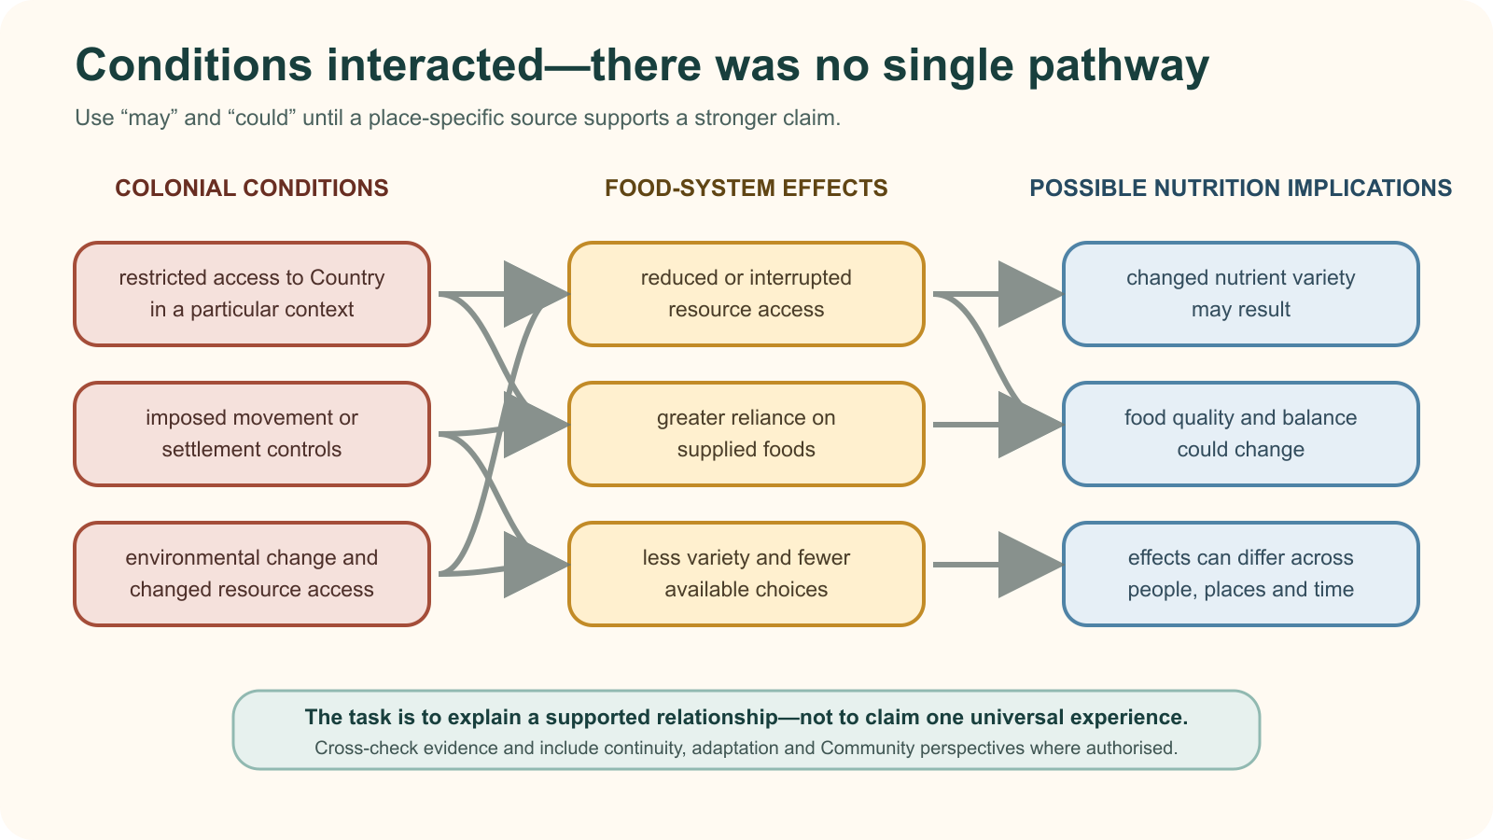
IDEA 2 · M04-S02
Introduced rations and nutrition
Colonial conditions could restrict access to Country, change movement and supply introduced foods. Possible nutrition effects need a chain of evidence and careful language because experiences varied by place, time and system.
Notice: Follow two different pathways through the network. Which words keep the explanation appropriately cautious?
Colonial conditions, food access and nutrition implications interacted differently across places and times.
YEAR 9 FOOD IN AUSTRALIA • MODULE 04
04
Notes:
Explain: Colonial conditions could restrict access to Country, change movement and supply introduced foods. Possible nutrition effects need a chain of evidence and careful language because experiences varied by place, time and system.
Ask students to respond to the on-slide notice prompt before volunteering an answer.
Misconception to correct: Food-pattern change can be explained by individual choice alone.
Transition: connect this idea to food systems, missions and nutrition, then move to "the final idea".
[Sources]
- Teacher-supplied Food in Australia unit program and Classroom/Drive masters; private identifiers retained only in source-map v1.1.
- NESA Food Technology Years 7–10 Syllabus (2019), the controlling 2026 syllabus basis recorded in source-map v1.1.
- Arts Law Centre of Australia ICIP guidance and authorised public cultural sources recorded in source-map v1.1.
- Course theory section m04-s02: Introduced rations and nutrition.
- Course visual: assets/diagrams/m04-s02-interacting-food-system-changes.svg; Course-original SVG; no historical image, ration list or third-party artwork; project-local educational use pending release authority.
[/Sources]

Slide 5
IDEA 3 · M04-S03
Read historical food sources critically
A source has a creator, context, audience and purpose. Separate what it directly shows from what you infer, then cross-check with other evidence and identify whose perspective is missing.
Notice: Which tools help you organise an analysis, and which questions about creator, context and missing perspectives cannot be answered by the tools alone?
Research tools can support analysis, but context, attribution and cross-checking determine what a source can reasonably support.
YEAR 9 FOOD IN AUSTRALIA • MODULE 04
05
Notes:
Explain: A source has a creator, context, audience and purpose. Separate what it directly shows from what you infer, then cross-check with other evidence and identify whose perspective is missing.
Ask students to respond to the on-slide notice prompt before volunteering an answer.
Misconception to correct: A source is either fully reliable or useless.
Transition: students now rehearse all three ideas through the module activity and retrieval checks.
[Sources]
- Teacher-supplied Food in Australia unit program and Classroom/Drive masters; private identifiers retained only in source-map v1.1.
- NESA Food Technology Years 7–10 Syllabus (2019), the controlling 2026 syllabus basis recorded in source-map v1.1.
- Arts Law Centre of Australia ICIP guidance and authorised public cultural sources recorded in source-map v1.1.
- Course theory section m04-s03: Read historical food sources critically.
- Course visual: assets/photos/m04-s03-source-analysis-workspace.png; Course-original generated PNG; no historical document, private material or proprietary image reproduced; project-local educational use pending release authority.
[/Sources]

Slide 6
FOOD SYSTEMS, MISSIONS AND NUTRITION · REHEARSAL
Stop. Think. Explain.
Answer silently first. Then justify one response with a partner.
1
One historical observer describes food roles in one place. Which conclusion is defensible?
APPLIED LEARNING ACTIVITY
Historical claim surgery
2
Which explanation avoids blaming people for changes in food patterns?
Practise separating a source claim from inference and building a qualified access-to-nutrition chain.
3
A photograph shows one food-related scene. What can a careful researcher claim?
Try: Build a careful historical explanation.
Rehearsal first. Save evidence only when the teacher directs.
YEAR 9 FOOD IN AUSTRALIA • MODULE 04
06
Notes:
Run the activity as rehearsal: Put the reasoning stages into a defensible order, then choose the conclusion the evidence can support.
Give quiet thinking time before discussion. Ask students to explain why an alternative is weaker, not merely name the correct choice.
Check 1: The account may offer evidence about that setting, but its creator, purpose, time, place and missing perspectives limit broader conclusions.
Check 2: Explain how policy, disrupted access to Country, available supplies and living conditions shaped realistic choices in the sourced context.
Check 3: Describe what is directly visible, investigate creator and context, and separate later interpretation from what the image itself supports.
Misconception to correct: a correct choice without reasoning is enough evidence. Ask for the link between the claim and the source or scenario.
Transition: move from short retrieval to one constructed evidence response.
[Sources]
- Teacher-supplied Food in Australia unit program and Classroom/Drive masters; private identifiers retained only in source-map v1.1.
- NESA Food Technology Years 7–10 Syllabus (2019), the controlling 2026 syllabus basis recorded in source-map v1.1.
- Arts Law Centre of Australia ICIP guidance and authorised public cultural sources recorded in source-map v1.1.
- Course activity activity-m04: Historical claim surgery.
- Course formative check check-m04-s01 for m04-s01.
- Course formative check check-m04-s02 for m04-s02.
- Course formative check check-m04-s03 for m04-s03.
[/Sources]

Slide 7
FOOD SYSTEMS, MISSIONS AND NUTRITION · GUIDED RESPONSE
Build evidence someone else can follow
THE QUESTION
Judge how much confidence a supplied historical source deserves for one specific food-history claim. Distinguish direct evidence, inference, corroboration and missing perspectives.
1 READ
2 SELECT
3 EXPLAIN
4 CHECK
Underline the exact decision or explanation the prompt requires.
Choose evidence that separates observation and inference.
The source directly shows or states …
Uses corroboration meaningfully; states uncertainty precisely.
Save in My Folio only when your teacher asks. Saving is not submission.
YEAR 9 FOOD IN AUSTRALIA • MODULE 04
07
Notes:
Read the prompt aloud once, then ask students to restate its decision or explanation in their own words.
Model the sequence: Read → Select → Explain → Check. Use the starter "The source directly shows or states …" only if students need it.
Look for: separates observation and inference; uses corroboration meaningfully; states uncertainty precisely.
Misconception to correct: saving locally means the work has been submitted or formally assessed. It has not.
Transition: close with a three-part exit ticket and the teacher-controlled next step.
[Sources]
- Teacher-supplied Food in Australia unit program and Classroom/Drive masters; private identifiers retained only in source-map v1.1.
- NESA Food Technology Years 7–10 Syllabus (2019), the controlling 2026 syllabus basis recorded in source-map v1.1.
- Arts Law Centre of Australia ICIP guidance and authorised public cultural sources recorded in source-map v1.1.
- Course evidence record for m04-s03: Confidence in a historical source.
- Course folio contract: device-local saving is not submission.
[/Sources]

Slide 8
MODULE 04 · EXIT EVIDENCE
TEACHER TO CONFIRM
Leave with evidence, not a guess.
The historical sources approved for this class and any local contextual guidance.
1. One idea I can explain is roles, knowledge and responsibility because …
2. One connection across the three ideas is …
3. One question or check I still need is …
NEXT STEP
Use the module page to refine one response, then follow your teacher’s directions.
Evidence destination: My Folio when directed. Exporting or saving is not submission.
Notes:
Give students one minute to write all three exit lines. Ask for a specific connection, not a generic summary.
Listen for the module takeaway: Historical food explanations connect systems, sources and limits without turning one account into a universal story.
State the sign-off exactly as shown: Teacher to confirm the historical sources approved for this class and any local contextual guidance.
Do not announce a practical, due date, weighting, grade or submission route unless it is in the current teacher-issued instruction.
Close by directing students to the Module 04 page or My Folio only as the teacher decides.
[Sources]
- Teacher-supplied Food in Australia unit program and Classroom/Drive masters; private identifiers retained only in source-map v1.1.
- NESA Food Technology Years 7–10 Syllabus (2019), the controlling 2026 syllabus basis recorded in source-map v1.1.
- Arts Law Centre of Australia ICIP guidance and authorised public cultural sources recorded in source-map v1.1.
- Current Year 9 Assessment Booklet 2026: course-level task boundaries only; this deck does not invent unit task details.
- Course source-map v1.1 and assessment-orientation boundary.
[/Sources]

