Slide 1
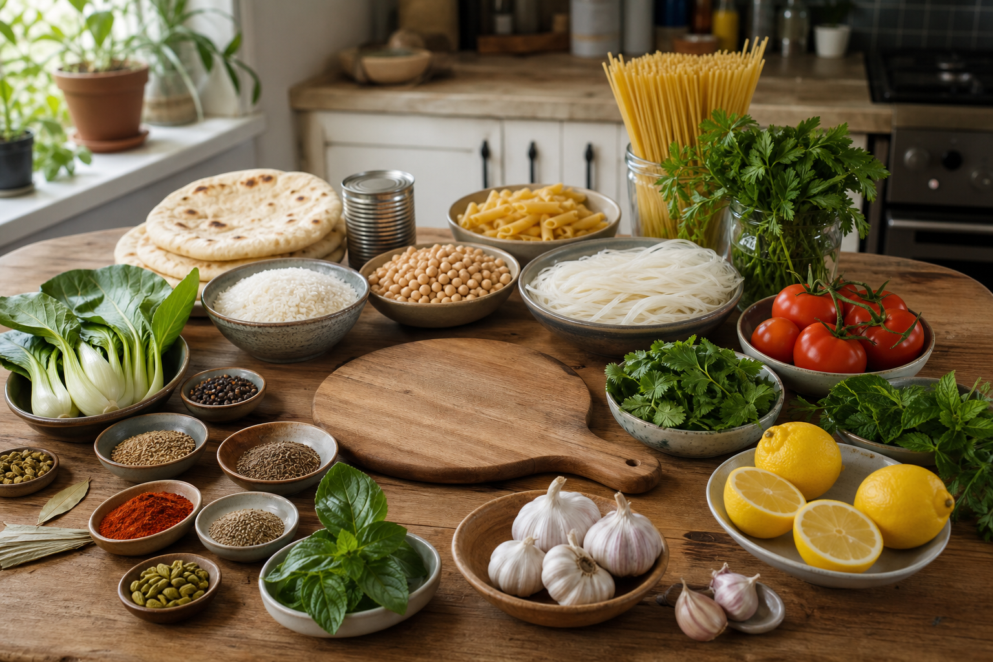
YEAR 9 FOOD IN AUSTRALIA
MODULE 05
Colonisation, settlement and migration
Food systems changed through disruption, technology, migration and adaptation—not through one simple pathway.
Generated learning visual — not documentary evidence.
Editable classroom presentation • Local review copy
Notes:
Open with the module question: how does colonisation, settlement and migration change a food decision or explanation?
State the outcome in plain language: Food systems changed through disruption, technology, migration and adaptation—not through one simple pathway.
Ask students what the visual helps them notice, then make clear that it is a generated learning visual, not documentary evidence or practical permission.
Transition: the next slide shows the three connected ideas students will use to reach the outcome.
[Sources]
- Teacher-supplied Food in Australia unit program and Classroom/Drive masters; private identifiers retained only in source-map v1.1.
- NESA Food Technology Years 7–10 Syllabus (2019), the controlling 2026 syllabus basis recorded in source-map v1.1.
- Arts Law Centre of Australia ICIP guidance and authorised public cultural sources recorded in source-map v1.1.
- Course visual: assets/photos/m05-s03-contemporary-ingredient-diversity.png; Course-original generated PNG; no person, brand, flag or proprietary source image; project-local educational use pending release authority.
[/Sources]

Slide 2
COLONISATION, SETTLEMENT AND MIGRATION · LEARNING PATHWAY
Three ideas build one explanation
Retrieval warm-up: What do you already know—and what needs checking?
1
2
3
Colonisation changed food access
Settler food constraints and technology
Migration changed Australian food habits
Hold disruption beside continuity
Judge technology in its context
Explain migration through mechanisms
Connect all three: Food systems changed through disruption, technology, migration and adaptation—not through one simple pathway.
YEAR 9 FOOD IN AUSTRALIA • MODULE 05
02
Notes:
Use the timeline as a learning sequence, not an agenda. Briefly name each idea and show how the third depends on the first two.
Retrieval prompt: ask students to define or exemplify one term from Colonisation changed food access, then name one uncertainty to check.
Listen for unsupported certainty. Model language such as ‘the source supports…’, ‘in this context…’ and ‘Teacher to confirm…’ where relevant.
Transition: begin with Colonisation changed food access; students will use it as the first part of the final explanation.
[Sources]
- Teacher-supplied Food in Australia unit program and Classroom/Drive masters; private identifiers retained only in source-map v1.1.
- NESA Food Technology Years 7–10 Syllabus (2019), the controlling 2026 syllabus basis recorded in source-map v1.1.
- Arts Law Centre of Australia ICIP guidance and authorised public cultural sources recorded in source-map v1.1.
- Course theory section m05-s01: Colonisation changed food access.
- Course theory section m05-s02: Settler food constraints and technology.
- Course theory section m05-s03: Migration changed Australian food habits.
[/Sources]

Slide 3
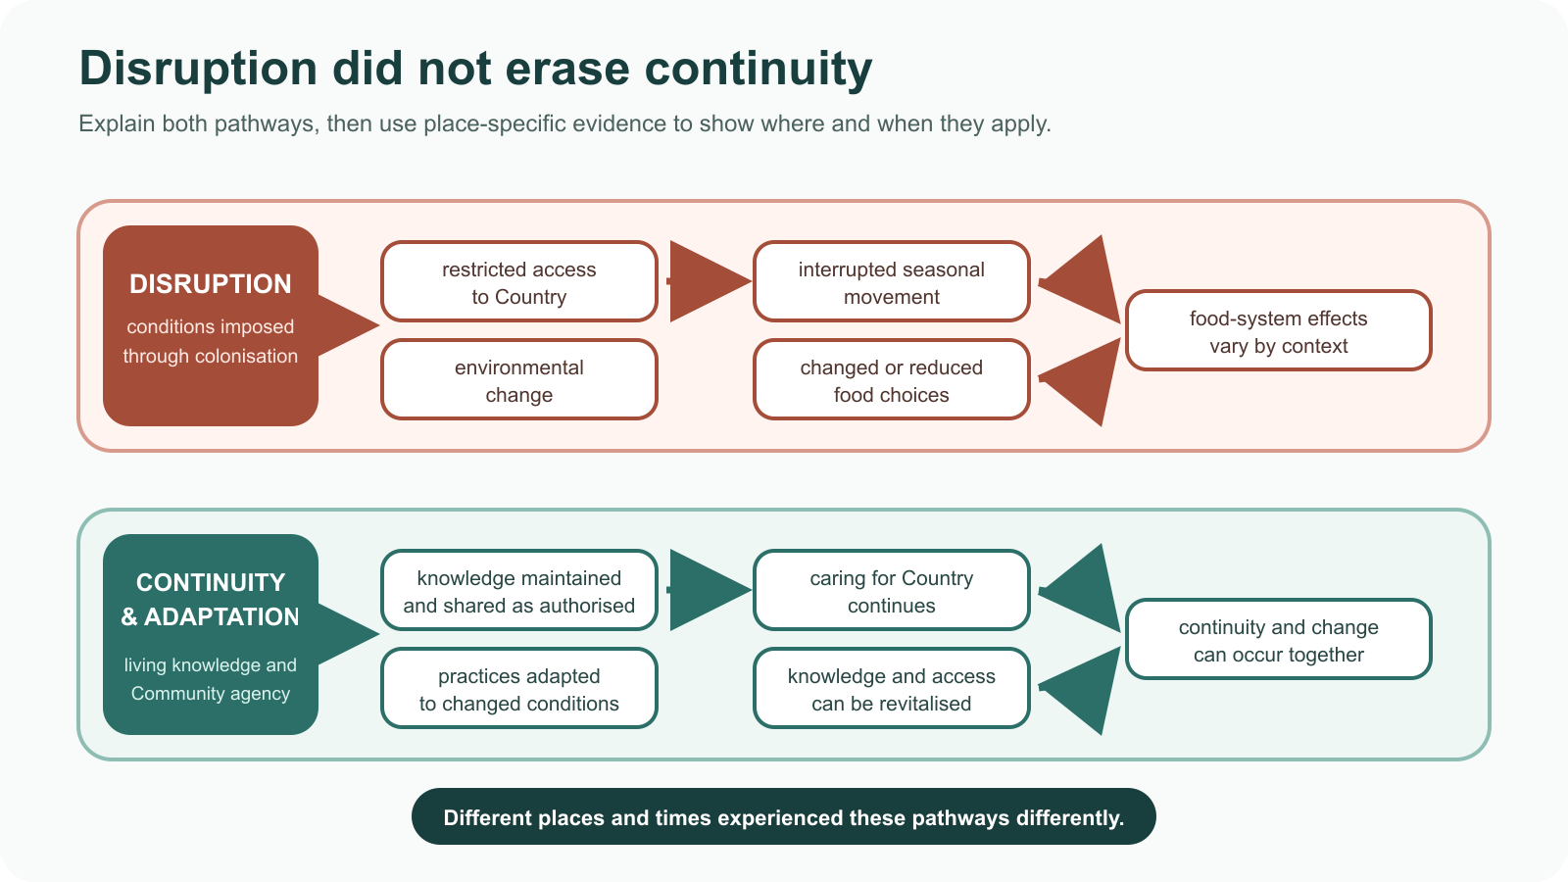
IDEA 1 · M05-S01
Colonisation changed food access
Colonisation disrupted access to Country and food systems, but it did not erase Cultural Knowledge. Strong explanations hold disruption beside continuity, adaptation, Community agency and revitalisation—and limit claims to the sourced context.
Notice: Which pathway shows disruption, and which features show that knowledge and caring practices can continue, adapt or be revitalised?
Disruption, continuity and adaptation can occur together; place-specific evidence shows how the pathways differ.
YEAR 9 FOOD IN AUSTRALIA • MODULE 05
03
Notes:
Explain: Colonisation disrupted access to Country and food systems, but it did not erase Cultural Knowledge. Strong explanations hold disruption beside continuity, adaptation, Community agency and revitalisation—and limit claims to the sourced context.
Ask students to respond to the on-slide notice prompt before volunteering an answer.
Misconception to correct: Colonisation affected every place in the same way or erased all knowledge.
Transition: connect this idea to colonisation, settlement and migration, then move to "the second idea".
[Sources]
- Teacher-supplied Food in Australia unit program and Classroom/Drive masters; private identifiers retained only in source-map v1.1.
- NESA Food Technology Years 7–10 Syllabus (2019), the controlling 2026 syllabus basis recorded in source-map v1.1.
- Arts Law Centre of Australia ICIP guidance and authorised public cultural sources recorded in source-map v1.1.
- Course theory section m05-s01: Colonisation changed food access.
- Course visual: assets/diagrams/m05-s01-disruption-continuity-pathways.svg; Course-original abstract pathway SVG with no cultural motif or third-party artwork; project-local educational use pending release authority.
[/Sources]

Slide 4
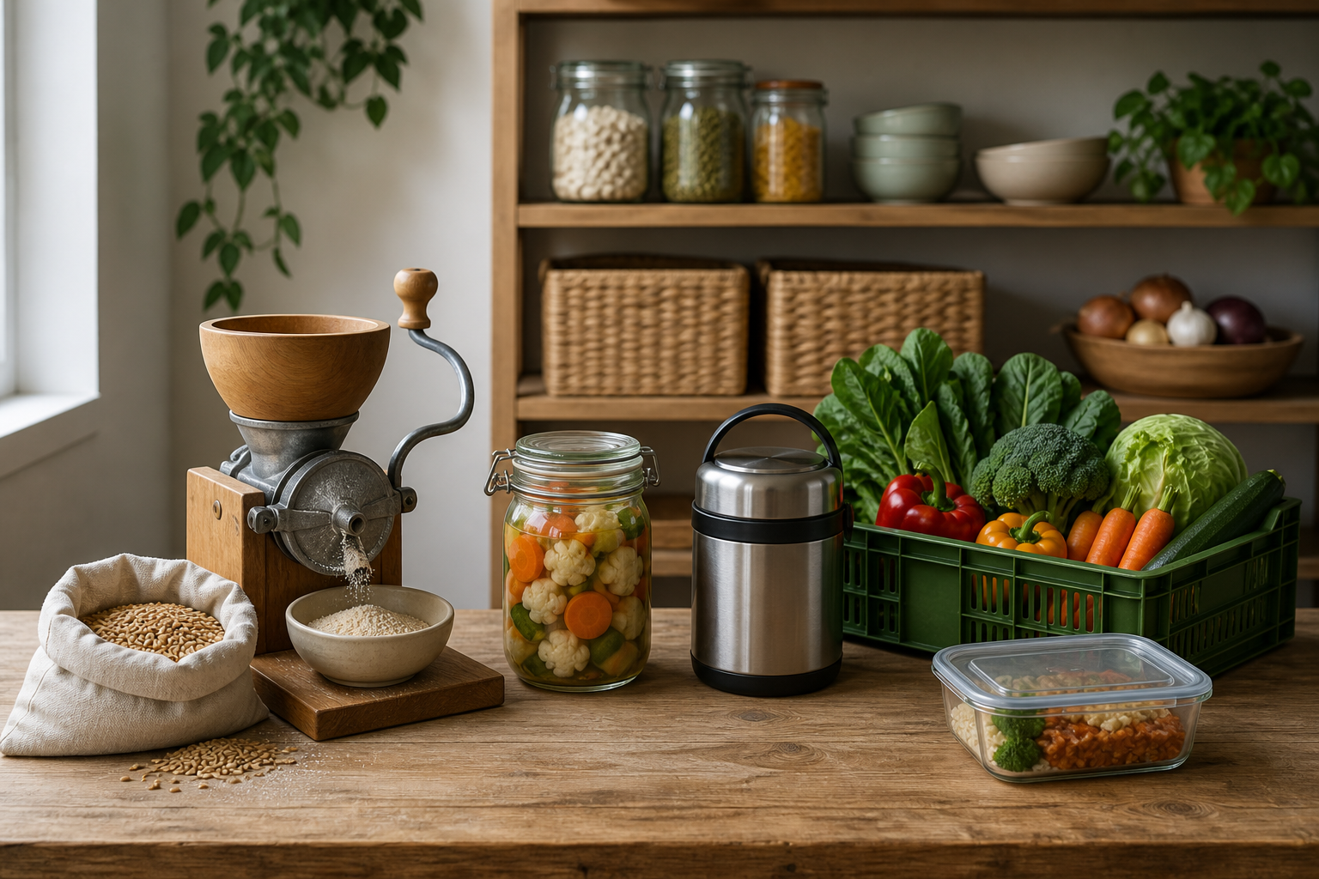
IDEA 2 · M05-S02
Settler food constraints and technology
Settler food patterns depended on access, preservation, transport, storage, cost and technology. Judge a technology by the constraint it addressed, its system effect, who benefited and the trade-offs—not by novelty alone.
Notice: Choose one food and trace how processing, preservation, transport or storage could change access. What trade-off would need evidence?
Food access is shaped by a connected system; technology can change more than one point and can introduce trade-offs.
YEAR 9 FOOD IN AUSTRALIA • MODULE 05
04
Notes:
Explain: Settler food patterns depended on access, preservation, transport, storage, cost and technology. Judge a technology by the constraint it addressed, its system effect, who benefited and the trade-offs—not by novelty alone.
Ask students to respond to the on-slide notice prompt before volunteering an answer.
Misconception to correct: New technology always improved access for everyone.
Transition: connect this idea to colonisation, settlement and migration, then move to "the final idea".
[Sources]
- Teacher-supplied Food in Australia unit program and Classroom/Drive masters; private identifiers retained only in source-map v1.1.
- NESA Food Technology Years 7–10 Syllabus (2019), the controlling 2026 syllabus basis recorded in source-map v1.1.
- Arts Law Centre of Australia ICIP guidance and authorised public cultural sources recorded in source-map v1.1.
- Course theory section m05-s02: Settler food constraints and technology.
- Course visual: assets/photos/m05-s02-food-access-technologies.png; Course-original generated PNG; no historical artefact claim or proprietary source image; project-local educational use pending release authority.
[/Sources]

Slide 5
IDEA 3 · M05-S03
Migration changed Australian food habits
Migration changes food habits through people, knowledge, ingredients, businesses and adaptation. Explain the pathway, acknowledge origins and variation, and avoid reducing a culture to a famous dish.
Notice: Which ingredients could move through many home, Community and business settings? Why can ingredients alone not represent a culture or migration story?
Contemporary food habits overlap and adapt; an ingredient table can show variety, but it cannot represent a culture by itself.
YEAR 9 FOOD IN AUSTRALIA • MODULE 05
05
Notes:
Explain: Migration changes food habits through people, knowledge, ingredients, businesses and adaptation. Explain the pathway, acknowledge origins and variation, and avoid reducing a culture to a famous dish.
Ask students to respond to the on-slide notice prompt before volunteering an answer.
Misconception to correct: Migration influence can be shown by naming a dish.
Transition: students now rehearse all three ideas through the module activity and retrieval checks.
[Sources]
- Teacher-supplied Food in Australia unit program and Classroom/Drive masters; private identifiers retained only in source-map v1.1.
- NESA Food Technology Years 7–10 Syllabus (2019), the controlling 2026 syllabus basis recorded in source-map v1.1.
- Arts Law Centre of Australia ICIP guidance and authorised public cultural sources recorded in source-map v1.1.
- Course theory section m05-s03: Migration changed Australian food habits.
- Course visual: assets/photos/m05-s03-contemporary-ingredient-diversity.png; Course-original generated PNG; no person, brand, flag or proprietary source image; project-local educational use pending release authority.
[/Sources]

Slide 6
COLONISATION, SETTLEMENT AND MIGRATION · REHEARSAL
Stop. Think. Explain.
Answer silently first. Then justify one response with a partner.
1
Which structure best explains a colonisation-related food-system change?
APPLIED LEARNING ACTIVITY
Change-pathway mapper
2
Which analysis of a historical food technology is strongest?
Practise tracing causes and mechanisms while retaining trade-offs, continuity and variation.
3
Which explanation goes beyond simply naming a migrant-associated dish?
Try: What job does each statement perform in a technology explanation?
Rehearsal first. Save evidence only when the teacher directs.
YEAR 9 FOOD IN AUSTRALIA • MODULE 05
06
Notes:
Run the activity as rehearsal: Match each evidence clue to the analytical role it performs, then choose the strongest migration pathway.
Give quiet thinking time before discussion. Ask students to explain why an alternative is weaker, not merely name the correct choice.
Check 1: A specific evidenced change, its direct food-system effect, a supported consequence, and evidence of continuity or adaptation where available.
Check 2: Identify the context and constraint, explain what changed in the system, then weigh a benefit against a trade-off.
Check 3: Trace how people, knowledge, ingredients, growing, businesses or adaptation affected wider habits in a specific evidenced example.
Misconception to correct: a correct choice without reasoning is enough evidence. Ask for the link between the claim and the source or scenario.
Transition: move from short retrieval to one constructed evidence response.
[Sources]
- Teacher-supplied Food in Australia unit program and Classroom/Drive masters; private identifiers retained only in source-map v1.1.
- NESA Food Technology Years 7–10 Syllabus (2019), the controlling 2026 syllabus basis recorded in source-map v1.1.
- Arts Law Centre of Australia ICIP guidance and authorised public cultural sources recorded in source-map v1.1.
- Course activity activity-m05: Change-pathway mapper.
- Course formative check check-m05-s01 for m05-s01.
- Course formative check check-m05-s02 for m05-s02.
- Course formative check check-m05-s03 for m05-s03.
[/Sources]

Slide 7
COLONISATION, SETTLEMENT AND MIGRATION · GUIDED RESPONSE
Build evidence someone else can follow
THE QUESTION
Use one sourced migration example to explain three mechanisms through which people and knowledge influenced Australian food habits. Show adaptation without assuming every group followed the same pathway.
1 READ
2 SELECT
3 EXPLAIN
4 CHECK
Underline the exact decision or explanation the prompt requires.
Choose evidence that moves beyond naming dishes.
The sourced example identifies …
Links mechanisms to evidence; acknowledges origins and variation.
Save in My Folio only when your teacher asks. Saving is not submission.
YEAR 9 FOOD IN AUSTRALIA • MODULE 05
07
Notes:
Read the prompt aloud once, then ask students to restate its decision or explanation in their own words.
Model the sequence: Read → Select → Explain → Check. Use the starter "The sourced example identifies …" only if students need it.
Look for: moves beyond naming dishes; links mechanisms to evidence; acknowledges origins and variation.
Misconception to correct: saving locally means the work has been submitted or formally assessed. It has not.
Transition: close with a three-part exit ticket and the teacher-controlled next step.
[Sources]
- Teacher-supplied Food in Australia unit program and Classroom/Drive masters; private identifiers retained only in source-map v1.1.
- NESA Food Technology Years 7–10 Syllabus (2019), the controlling 2026 syllabus basis recorded in source-map v1.1.
- Arts Law Centre of Australia ICIP guidance and authorised public cultural sources recorded in source-map v1.1.
- Course evidence record for m05-s03: Migration influence pathway.
- Course folio contract: device-local saving is not submission.
[/Sources]

Slide 8
MODULE 05 · EXIT EVIDENCE
TEACHER TO CONFIRM
Leave with evidence, not a guess.
The place, period and source set students should use for historical claims.
1. One idea I can explain is colonisation changed food access because …
2. One connection across the three ideas is …
3. One question or check I still need is …
NEXT STEP
Use the module page to refine one response, then follow your teacher’s directions.
Evidence destination: My Folio when directed. Exporting or saving is not submission.
Notes:
Give students one minute to write all three exit lines. Ask for a specific connection, not a generic summary.
Listen for the module takeaway: Food systems changed through disruption, technology, migration and adaptation—not through one simple pathway.
State the sign-off exactly as shown: Teacher to confirm the place, period and source set students should use for historical claims.
Do not announce a practical, due date, weighting, grade or submission route unless it is in the current teacher-issued instruction.
Close by directing students to the Module 05 page or My Folio only as the teacher decides.
[Sources]
- Teacher-supplied Food in Australia unit program and Classroom/Drive masters; private identifiers retained only in source-map v1.1.
- NESA Food Technology Years 7–10 Syllabus (2019), the controlling 2026 syllabus basis recorded in source-map v1.1.
- Arts Law Centre of Australia ICIP guidance and authorised public cultural sources recorded in source-map v1.1.
- Current Year 9 Assessment Booklet 2026: course-level task boundaries only; this deck does not invent unit task details.
- Course source-map v1.1 and assessment-orientation boundary.
[/Sources]

