Slide 1
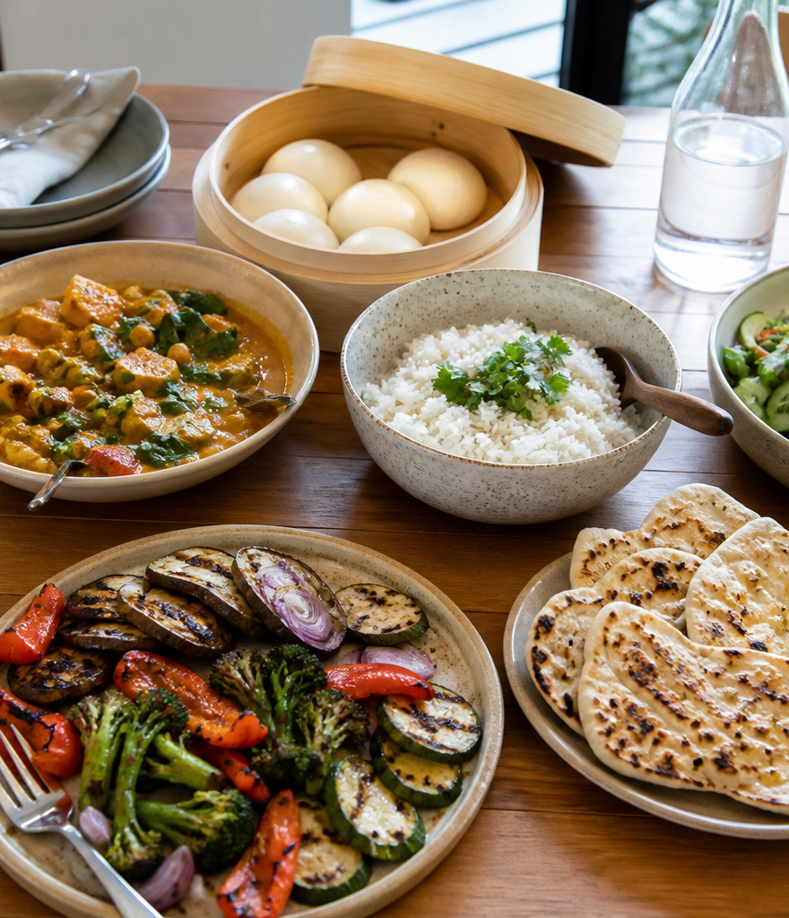
YEAR 9 FOOD IN AUSTRALIA
MODULE 06
Multicultural influences
Australian cuisine keeps changing because people, methods, ingredients and contexts interact.
Generated learning visual — not documentary evidence.
Editable classroom presentation • Local review copy
Notes:
Open with the module question: how does multicultural influences change a food decision or explanation?
State the outcome in plain language: Australian cuisine keeps changing because people, methods, ingredients and contexts interact.
Ask students what the visual helps them notice, then make clear that it is a generated learning visual, not documentary evidence or practical permission.
Transition: the next slide shows the three connected ideas students will use to reach the outcome.
[Sources]
- Teacher-supplied Food in Australia unit program and Classroom/Drive masters; private identifiers retained only in source-map v1.1.
- NESA Food Technology Years 7–10 Syllabus (2019), the controlling 2026 syllabus basis recorded in source-map v1.1.
- Course visual: assets/photos/m06-contemporary-food-network.png; provenance recorded in the visual production manifest.
[/Sources]

Slide 2
MULTICULTURAL INFLUENCES · LEARNING PATHWAY
Three ideas build one explanation
Retrieval warm-up: What do you already know—and what needs checking?
1
2
3
Contemporary Australian cuisine keeps changing
Research one food culture without stereotyping
Ingredients, flavours and methods work together
See cuisine as a changing system
Research one bounded food context
Connect methods to observable results
Connect all three: Australian cuisine keeps changing because people, methods, ingredients and contexts interact.
YEAR 9 FOOD IN AUSTRALIA • MODULE 06
02
Notes:
Use the timeline as a learning sequence, not an agenda. Briefly name each idea and show how the third depends on the first two.
Retrieval prompt: ask students to define or exemplify one term from Contemporary Australian cuisine keeps changing, then name one uncertainty to check.
Listen for unsupported certainty. Model language such as ‘the source supports…’, ‘in this context…’ and ‘Teacher to confirm…’ where relevant.
Transition: begin with Contemporary Australian cuisine keeps changing; students will use it as the first part of the final explanation.
[Sources]
- Teacher-supplied Food in Australia unit program and Classroom/Drive masters; private identifiers retained only in source-map v1.1.
- NESA Food Technology Years 7–10 Syllabus (2019), the controlling 2026 syllabus basis recorded in source-map v1.1.
- Course theory section m06-s01: Contemporary Australian cuisine keeps changing.
- Course theory section m06-s02: Research one food culture without stereotyping.
- Course theory section m06-s03: Ingredients, flavours and methods work together.
[/Sources]

Slide 3
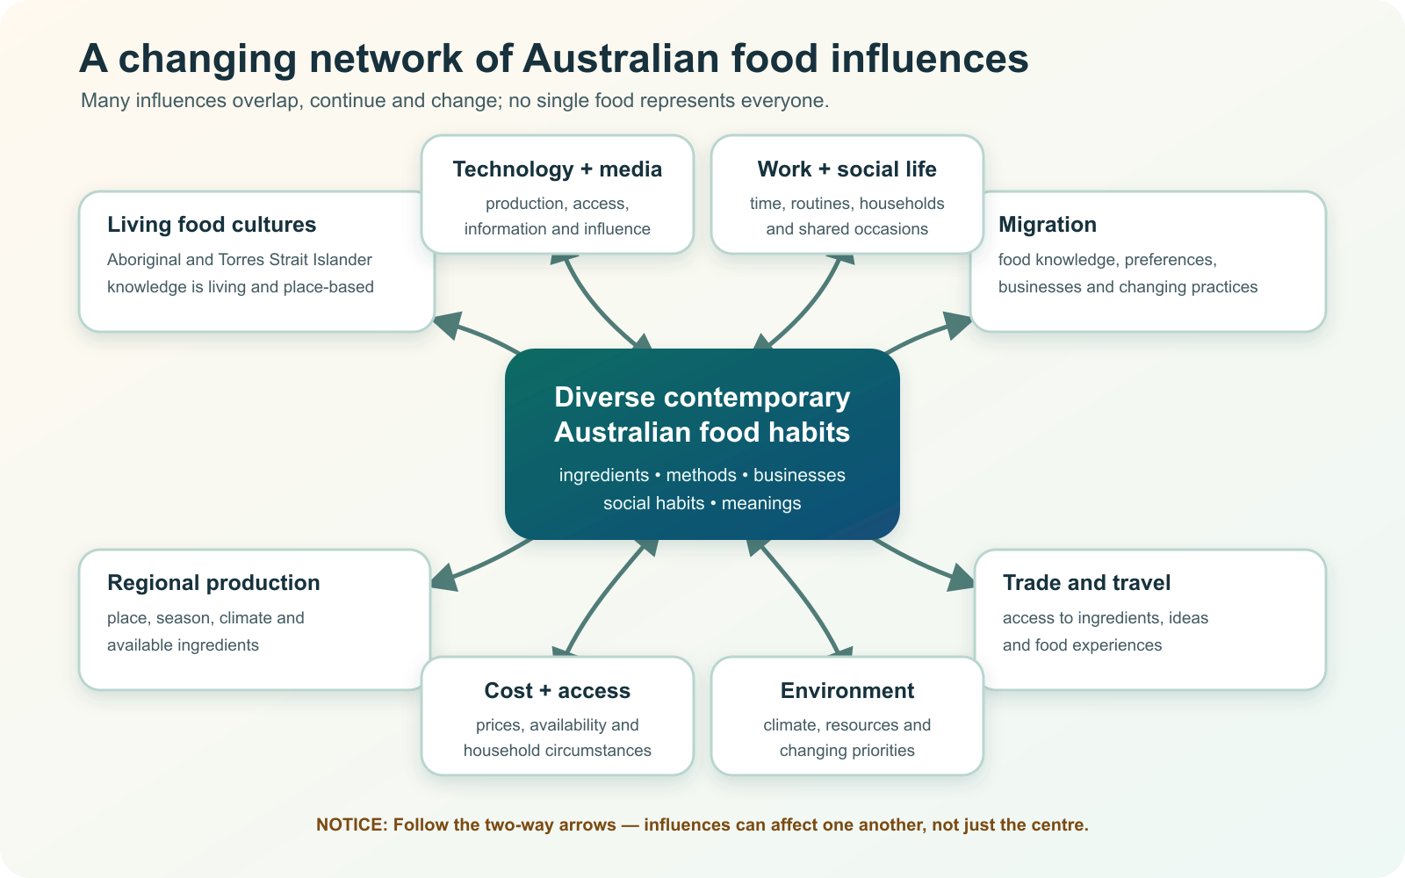
IDEA 1 · M06-S01
Contemporary Australian cuisine keeps changing
Contemporary Australian cuisine is a changing system, not a fixed list of national dishes. Continuing First Nations cultures, migration, agriculture, industry, technology, media, travel and individual choice interact in different contexts.
Follow the two-way arrows. Which influences could affect one another before they shape food habits?
Australian food habits sit within a changing network of influences; arrows run both ways because these factors can interact.
YEAR 9 FOOD IN AUSTRALIA • MODULE 06
03
Notes:
Explain: Contemporary Australian cuisine is a changing system, not a fixed list of national dishes. Continuing First Nations cultures, migration, agriculture, industry, technology, media, travel and individual choice interact in different contexts.
Ask students to respond to the on-slide notice prompt before volunteering an answer.
Misconception to correct: Australian cuisine can be represented by a fixed list.
Transition: connect this idea to multicultural influences, then move to "the second idea".
[Sources]
- Teacher-supplied Food in Australia unit program and Classroom/Drive masters; private identifiers retained only in source-map v1.1.
- NESA Food Technology Years 7–10 Syllabus (2019), the controlling 2026 syllabus basis recorded in source-map v1.1.
- Course theory section m06-s01: Contemporary Australian cuisine keeps changing.
- Course visual: assets/diagrams/m06-influence-network.svg; provenance recorded in the visual production manifest.
[/Sources]

Slide 4
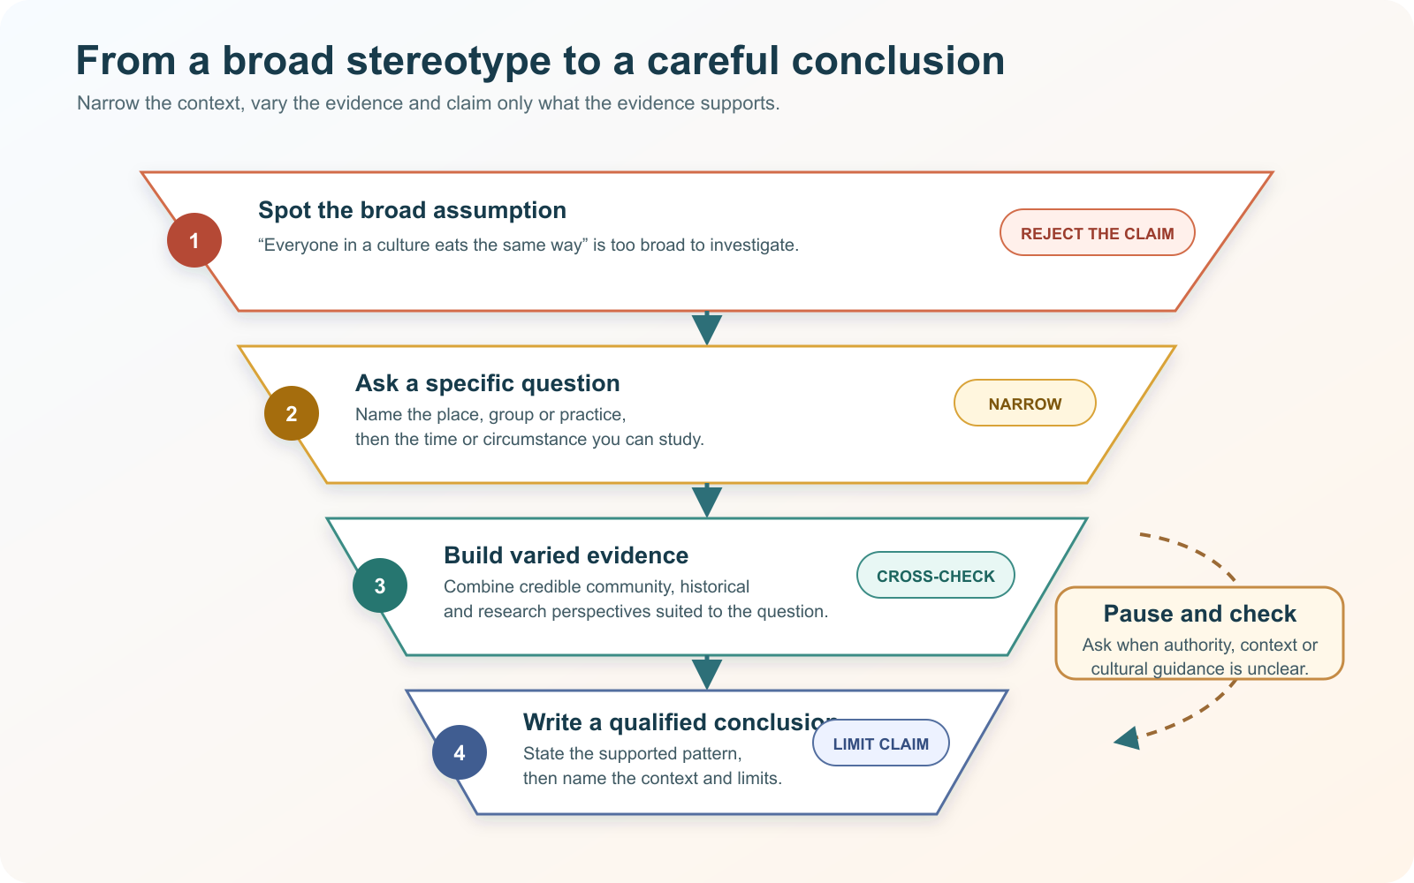
IDEA 2 · M06-S02
Research one food culture without stereotyping
A careful food-culture investigation narrows place, time and context. Use more than one credible source, compare perspectives and describe what the evidence supports without presenting a whole country or culture as one diet.
At which stage would a broad cultural claim be narrowed, cross-checked or stopped for guidance?
A careful investigation narrows its context, uses varied evidence and limits the conclusion to what the sources support.
YEAR 9 FOOD IN AUSTRALIA • MODULE 06
04
Notes:
Explain: A careful food-culture investigation narrows place, time and context. Use more than one credible source, compare perspectives and describe what the evidence supports without presenting a whole country or culture as one diet.
Ask students to respond to the on-slide notice prompt before volunteering an answer.
Misconception to correct: One source or famous dish represents a whole culture.
Transition: connect this idea to multicultural influences, then move to "the final idea".
[Sources]
- Teacher-supplied Food in Australia unit program and Classroom/Drive masters; private identifiers retained only in source-map v1.1.
- NESA Food Technology Years 7–10 Syllabus (2019), the controlling 2026 syllabus basis recorded in source-map v1.1.
- Course theory section m06-s02: Research one food culture without stereotyping.
- Course visual: assets/diagrams/m06-research-funnel.svg; provenance recorded in the visual production manifest.
[/Sources]

Slide 5
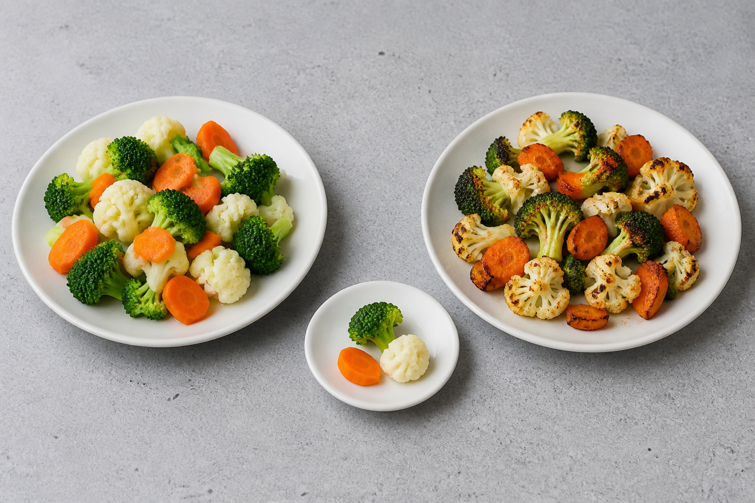
IDEA 3 · M06-S03
Ingredients, flavours and methods work together
Ingredients, methods and sensory results work together. Start with the desired observable quality, then explain how an ingredient’s properties and a preparation or cooking method could produce it within the stated constraint.
Compare the surfaces, colour and apparent moisture. Which differences are observable, and which sensory qualities would still need testing?
A controlled visual comparison of steamed and roasted vegetables; observations support predictions but do not replace testing or teacher-approved methods.
YEAR 9 FOOD IN AUSTRALIA • MODULE 06
05
Notes:
Explain: Ingredients, methods and sensory results work together. Start with the desired observable quality, then explain how an ingredient’s properties and a preparation or cooking method could produce it within the stated constraint.
Ask students to respond to the on-slide notice prompt before volunteering an answer.
Misconception to correct: An ingredient alone determines a food’s result.
Transition: students now rehearse all three ideas through the module activity and retrieval checks.
[Sources]
- Teacher-supplied Food in Australia unit program and Classroom/Drive masters; private identifiers retained only in source-map v1.1.
- NESA Food Technology Years 7–10 Syllabus (2019), the controlling 2026 syllabus basis recorded in source-map v1.1.
- Course theory section m06-s03: Ingredients, flavours and methods work together.
- Course visual: assets/photos/m06-method-properties-comparison.png; provenance recorded in the visual production manifest.
[/Sources]

Slide 6
MULTICULTURAL INFLUENCES · REHEARSAL
Stop. Think. Explain.
Answer silently first. Then justify one response with a partner.
1
Which evidence set best represents changing contemporary Australian cuisine?
APPLIED LEARNING ACTIVITY
Culture-research repair workshop
2
Which research question is most likely to avoid stereotyping?
Practise narrowing cultural research and connecting methods with observable food purposes.
3
What makes a method justification useful?
Try: Which question is best bounded for a short investigation?
Rehearsal first. Save evidence only when the teacher directs.
YEAR 9 FOOD IN AUSTRALIA • MODULE 06
06
Notes:
Run the activity as rehearsal: Repair the broad research question, then match each claim with the evidence it needs.
Give quiet thinking time before discussion. Ask students to explain why an alternative is weaker, not merely name the correct choice.
Check 1: Evidence about ingredients, methods, businesses, technologies, social habits and meanings across varied contexts.
Check 2: How do three credible sources describe weekday meal practices in a named place and time, and what variation do they show?
Check 3: Link the desired observable result to ingredient properties, preparation and heat transfer, within the available evidence and context.
Misconception to correct: a correct choice without reasoning is enough evidence. Ask for the link between the claim and the source or scenario.
Transition: move from short retrieval to one constructed evidence response.
[Sources]
- Teacher-supplied Food in Australia unit program and Classroom/Drive masters; private identifiers retained only in source-map v1.1.
- NESA Food Technology Years 7–10 Syllabus (2019), the controlling 2026 syllabus basis recorded in source-map v1.1.
- Course activity activity-m06: Culture-research repair workshop.
- Course formative check check-m06-s01 for m06-s01.
- Course formative check check-m06-s02 for m06-s02.
- Course formative check check-m06-s03 for m06-s03.
[/Sources]

Slide 7
MULTICULTURAL INFLUENCES · GUIDED RESPONSE
Build evidence someone else can follow
THE QUESTION
Select a preparation or cooking method for a stated sensory purpose and constraint. Justify the choice using ingredient properties, heat transfer and observable effects.
1 READ
2 SELECT
3 EXPLAIN
4 CHECK
Underline the exact decision or explanation the prompt requires.
Choose evidence that starts with the desired result.
The intended observable result is …
Explains mechanism; avoids claiming a method is universally best.
Save in My Folio only when your teacher asks. Saving is not submission.
YEAR 9 FOOD IN AUSTRALIA • MODULE 06
07
Notes:
Read the prompt aloud once, then ask students to restate its decision or explanation in their own words.
Model the sequence: Read → Select → Explain → Check. Use the starter "The intended observable result is …" only if students need it.
Look for: starts with the desired result; explains mechanism; avoids claiming a method is universally best.
Misconception to correct: saving locally means the work has been submitted or formally assessed. It has not.
Transition: close with a three-part exit ticket and the teacher-controlled next step.
[Sources]
- Teacher-supplied Food in Australia unit program and Classroom/Drive masters; private identifiers retained only in source-map v1.1.
- NESA Food Technology Years 7–10 Syllabus (2019), the controlling 2026 syllabus basis recorded in source-map v1.1.
- Course evidence record for m06-s03: Method for a sensory purpose.
- Course folio contract: device-local saving is not submission.
[/Sources]

Slide 8
MODULE 06 · EXIT EVIDENCE
TEACHER TO CONFIRM
Leave with evidence, not a guess.
The class research focus, approved sources and any practical method or equipment.
1. One idea I can explain is contemporary Australian cuisine keeps changing because …
2. One connection across the three ideas is …
3. One question or check I still need is …
NEXT STEP
Use the module page to refine one response, then follow your teacher’s directions.
Evidence destination: My Folio when directed. Exporting or saving is not submission.
Notes:
Give students one minute to write all three exit lines. Ask for a specific connection, not a generic summary.
Listen for the module takeaway: Australian cuisine keeps changing because people, methods, ingredients and contexts interact.
State the sign-off exactly as shown: Teacher to confirm the class research focus, approved sources and any practical method or equipment.
Do not announce a practical, due date, weighting, grade or submission route unless it is in the current teacher-issued instruction.
Close by directing students to the Module 06 page or My Folio only as the teacher decides.
[Sources]
- Teacher-supplied Food in Australia unit program and Classroom/Drive masters; private identifiers retained only in source-map v1.1.
- NESA Food Technology Years 7–10 Syllabus (2019), the controlling 2026 syllabus basis recorded in source-map v1.1.
- Current Year 9 Assessment Booklet 2026: course-level task boundaries only; this deck does not invent unit task details.
- Course source-map v1.1 and assessment-orientation boundary.
[/Sources]

