Slide 1
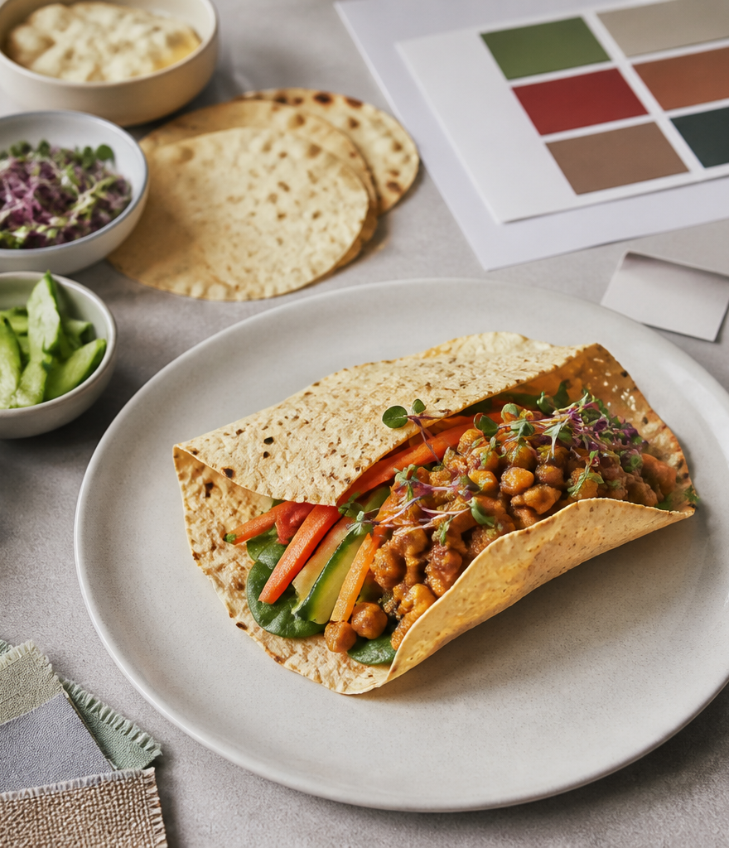
YEAR 9 FOOD IN AUSTRALIA
MODULE 07
Fusion food design
A strong fusion concept has a user, purpose, researched rationale and an honest plan for evidence.
Generated learning visual — not documentary evidence.
Editable classroom presentation • Local review copy
Notes:
Open with the module question: how does fusion food design change a food decision or explanation?
State the outcome in plain language: A strong fusion concept has a user, purpose, researched rationale and an honest plan for evidence.
Ask students what the visual helps them notice, then make clear that it is a generated learning visual, not documentary evidence or practical permission.
Transition: the next slide shows the three connected ideas students will use to reach the outcome.
[Sources]
- Teacher-supplied Food in Australia unit program and Classroom/Drive masters; private identifiers retained only in source-map v1.1.
- NESA Food Technology Years 7–10 Syllabus (2019), the controlling 2026 syllabus basis recorded in source-map v1.1.
- Course visual: assets/photos/m07-purposeful-fusion-workspace.png; provenance recorded in the visual production manifest.
[/Sources]

Slide 2
FUSION FOOD DESIGN · LEARNING PATHWAY
Three ideas build one explanation
Retrieval warm-up: What do you already know—and what needs checking?
1
2
3
Fusion needs a purpose
Research before you design
Annotate a safe, feasible concept
Give the fusion a purpose
Gather research that changes decisions
Annotate reasoning, constraints and tests
Connect all three: A strong fusion concept has a user, purpose, researched rationale and an honest plan for evidence.
YEAR 9 FOOD IN AUSTRALIA • MODULE 07
02
Notes:
Use the timeline as a learning sequence, not an agenda. Briefly name each idea and show how the third depends on the first two.
Retrieval prompt: ask students to define or exemplify one term from Fusion needs a purpose, then name one uncertainty to check.
Listen for unsupported certainty. Model language such as ‘the source supports…’, ‘in this context…’ and ‘Teacher to confirm…’ where relevant.
Transition: begin with Fusion needs a purpose; students will use it as the first part of the final explanation.
[Sources]
- Teacher-supplied Food in Australia unit program and Classroom/Drive masters; private identifiers retained only in source-map v1.1.
- NESA Food Technology Years 7–10 Syllabus (2019), the controlling 2026 syllabus basis recorded in source-map v1.1.
- Course theory section m07-s01: Fusion needs a purpose.
- Course theory section m07-s02: Research before you design.
- Course theory section m07-s03: Annotate a safe, feasible concept.
[/Sources]

Slide 3
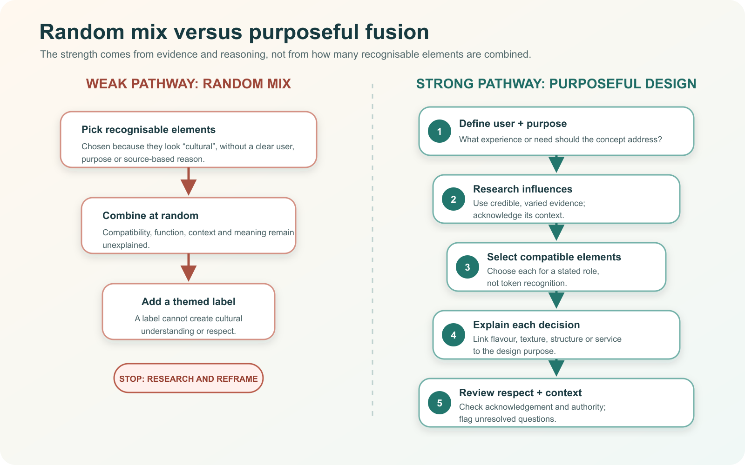
IDEA 1 · M07-S01
Fusion needs a purpose
Purposeful fusion starts with an intended user and reason. Each influence needs a functional contribution, researched context and honest acknowledgement. Combining recognisable elements at random is not a design rationale.
Compare the two pathways. At which step does evidence begin changing the quality of the design reasoning?
A themed label cannot make a random combination respectful; a purposeful pathway connects research and design decisions to user, function and context.
YEAR 9 FOOD IN AUSTRALIA • MODULE 07
03
Notes:
Explain: Purposeful fusion starts with an intended user and reason. Each influence needs a functional contribution, researched context and honest acknowledgement. Combining recognisable elements at random is not a design rationale.
Ask students to respond to the on-slide notice prompt before volunteering an answer.
Misconception to correct: Fusion means combining anything recognisable.
Transition: connect this idea to fusion food design, then move to "the second idea".
[Sources]
- Teacher-supplied Food in Australia unit program and Classroom/Drive masters; private identifiers retained only in source-map v1.1.
- NESA Food Technology Years 7–10 Syllabus (2019), the controlling 2026 syllabus basis recorded in source-map v1.1.
- Course theory section m07-s01: Fusion needs a purpose.
- Course visual: assets/diagrams/m07-purposeful-fusion-pathways.svg; provenance recorded in the visual production manifest.
[/Sources]

Slide 4
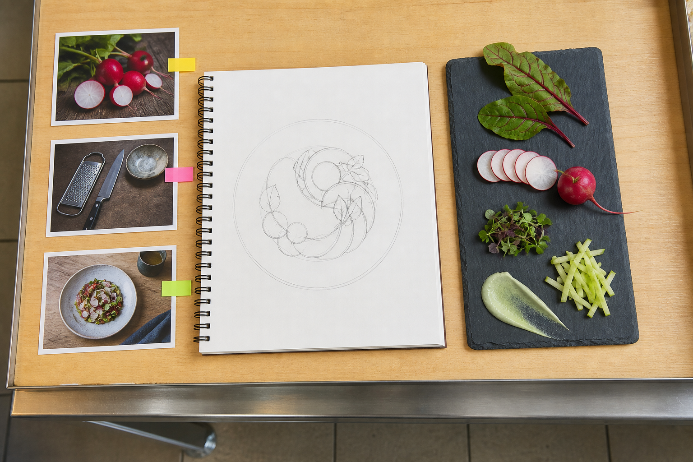
IDEA 2 · M07-S02
Research before you design
Design research should change a decision. Gather a small, relevant evidence set about origins, methods, predicted effects and constraints, then record how each source shaped the concept.
Trace the visual path from source cards to sketch and ingredient arrangement. What design decision could each type of evidence inform?
A fictional research workspace showing evidence feeding a design decision; blank cards avoid invented sources and private information.
YEAR 9 FOOD IN AUSTRALIA • MODULE 07
04
Notes:
Explain: Design research should change a decision. Gather a small, relevant evidence set about origins, methods, predicted effects and constraints, then record how each source shaped the concept.
Ask students to respond to the on-slide notice prompt before volunteering an answer.
Misconception to correct: More research notes always produce a better design.
Transition: connect this idea to fusion food design, then move to "the final idea".
[Sources]
- Teacher-supplied Food in Australia unit program and Classroom/Drive masters; private identifiers retained only in source-map v1.1.
- NESA Food Technology Years 7–10 Syllabus (2019), the controlling 2026 syllabus basis recorded in source-map v1.1.
- Course theory section m07-s02: Research before you design.
- Course visual: assets/photos/m07-evidence-to-design-workspace.png; provenance recorded in the visual production manifest.
[/Sources]

Slide 5
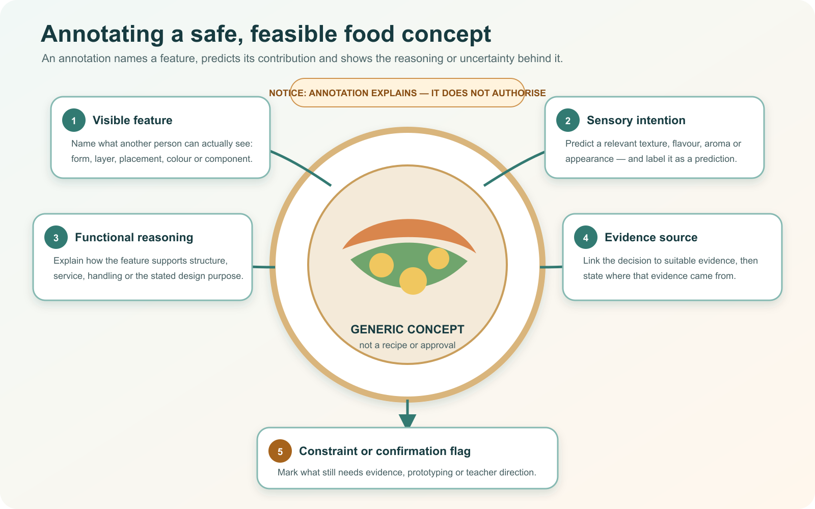
IDEA 3 · M07-S03
Annotate a safe, feasible concept
An annotated concept makes the reasoning visible: user, purpose, form, components, predicted sensory and functional effects, evidence, constraints and questions. It is a proposal, not practical permission.
Follow each arrow. Which annotation describes observation, which predicts an effect, and which records uncertainty?
An annotation explains a feature and its reasoning; it does not authorise a practical method or erase a question that needs confirmation.
YEAR 9 FOOD IN AUSTRALIA • MODULE 07
05
Notes:
Explain: An annotated concept makes the reasoning visible: user, purpose, form, components, predicted sensory and functional effects, evidence, constraints and questions. It is a proposal, not practical permission.
Ask students to respond to the on-slide notice prompt before volunteering an answer.
Misconception to correct: A labelled sketch is automatically a tested or approved concept.
Transition: students now rehearse all three ideas through the module activity and retrieval checks.
[Sources]
- Teacher-supplied Food in Australia unit program and Classroom/Drive masters; private identifiers retained only in source-map v1.1.
- NESA Food Technology Years 7–10 Syllabus (2019), the controlling 2026 syllabus basis recorded in source-map v1.1.
- Course theory section m07-s03: Annotate a safe, feasible concept.
- Course visual: assets/diagrams/m07-concept-annotation-map.svg; provenance recorded in the visual production manifest.
[/Sources]

Slide 6
FUSION FOOD DESIGN · REHEARSAL
Stop. Think. Explain.
Answer silently first. Then justify one response with a partner.
1
Which rationale describes purposeful fusion design?
APPLIED LEARNING ACTIVITY
Fusion rationale studio
2
Which research note belongs in a design evidence set?
Practise ranking design rationales and turning labels into evidence-aware annotations.
3
Which annotation shows the strongest design reasoning?
Try: Rank these rationales from strongest to weakest.
Rehearsal first. Save evidence only when the teacher directs.
YEAR 9 FOOD IN AUSTRALIA • MODULE 07
06
Notes:
Run the activity as rehearsal: Rank the rationales from strongest to weakest, then choose the annotation that communicates a decision and its uncertainty.
Give quiet thinking time before discussion. Ask students to explain why an alternative is weaker, not merely name the correct choice.
Check 1: Each influence is researched and contributes deliberately to the user, purpose, sensory result, structure or meaning, with appropriate acknowledgement.
Check 2: A credible source or observation that changes or supports a named design decision.
Check 3: It names the feature, predicts its contribution, connects that contribution to purpose, and flags evidence or teacher confirmation still needed.
Misconception to correct: a correct choice without reasoning is enough evidence. Ask for the link between the claim and the source or scenario.
Transition: move from short retrieval to one constructed evidence response.
[Sources]
- Teacher-supplied Food in Australia unit program and Classroom/Drive masters; private identifiers retained only in source-map v1.1.
- NESA Food Technology Years 7–10 Syllabus (2019), the controlling 2026 syllabus basis recorded in source-map v1.1.
- Course activity activity-m07: Fusion rationale studio.
- Course formative check check-m07-s01 for m07-s01.
- Course formative check check-m07-s02 for m07-s02.
- Course formative check check-m07-s03 for m07-s03.
[/Sources]

Slide 7
FUSION FOOD DESIGN · GUIDED RESPONSE
Build evidence someone else can follow
THE QUESTION
Defend the strongest decision in an annotated concept and identify the first assumption that should be tested through evidence, prototyping or feedback. Keep practical approval separate.
1 READ
2 SELECT
3 EXPLAIN
4 CHECK
Underline the exact decision or explanation the prompt requires.
Choose evidence that uses the annotation reasoning chain.
The feature is intended to …
Identifies uncertainty; does not imply practical permission.
Save in My Folio only when your teacher asks. Saving is not submission.
YEAR 9 FOOD IN AUSTRALIA • MODULE 07
07
Notes:
Read the prompt aloud once, then ask students to restate its decision or explanation in their own words.
Model the sequence: Read → Select → Explain → Check. Use the starter "The feature is intended to …" only if students need it.
Look for: uses the annotation reasoning chain; identifies uncertainty; does not imply practical permission.
Misconception to correct: saving locally means the work has been submitted or formally assessed. It has not.
Transition: close with a three-part exit ticket and the teacher-controlled next step.
[Sources]
- Teacher-supplied Food in Australia unit program and Classroom/Drive masters; private identifiers retained only in source-map v1.1.
- NESA Food Technology Years 7–10 Syllabus (2019), the controlling 2026 syllabus basis recorded in source-map v1.1.
- Course evidence record for m07-s03: Defend and test a concept.
- Course folio contract: device-local saving is not submission.
[/Sources]

Slide 8
MODULE 07 · EXIT EVIDENCE
TEACHER TO CONFIRM
Leave with evidence, not a guess.
Practical approval, ingredients, equipment and any cultural permission required.
1. One idea I can explain is fusion needs a purpose because …
2. One connection across the three ideas is …
3. One question or check I still need is …
NEXT STEP
Use the module page to refine one response, then follow your teacher’s directions.
Evidence destination: My Folio when directed. Exporting or saving is not submission.
Notes:
Give students one minute to write all three exit lines. Ask for a specific connection, not a generic summary.
Listen for the module takeaway: A strong fusion concept has a user, purpose, researched rationale and an honest plan for evidence.
State the sign-off exactly as shown: Teacher to confirm practical approval, ingredients, equipment and any cultural permission required.
Do not announce a practical, due date, weighting, grade or submission route unless it is in the current teacher-issued instruction.
Close by directing students to the Module 07 page or My Folio only as the teacher decides.
[Sources]
- Teacher-supplied Food in Australia unit program and Classroom/Drive masters; private identifiers retained only in source-map v1.1.
- NESA Food Technology Years 7–10 Syllabus (2019), the controlling 2026 syllabus basis recorded in source-map v1.1.
- Current Year 9 Assessment Booklet 2026: course-level task boundaries only; this deck does not invent unit task details.
- Course source-map v1.1 and assessment-orientation boundary.
[/Sources]

