Slide 1
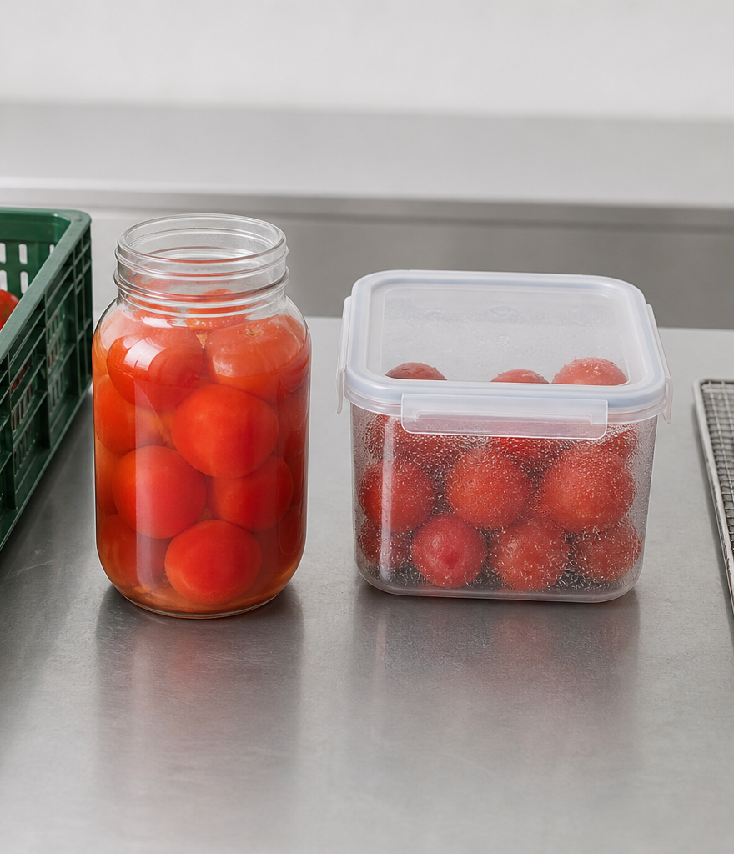
YEAR 9 FOOD IN AUSTRALIA
MODULE 08
Food production and processing
Choose and judge food technologies by how they change properties, systems and trade-offs for a purpose.
Generated learning visual — not documentary evidence.
Editable classroom presentation • Local review copy
Notes:
Open with the module question: how does food production and processing change a food decision or explanation?
State the outcome in plain language: Choose and judge food technologies by how they change properties, systems and trade-offs for a purpose.
Ask students what the visual helps them notice, then make clear that it is a generated learning visual, not documentary evidence or practical permission.
Transition: the next slide shows the three connected ideas students will use to reach the outcome.
[Sources]
- Teacher-supplied Food in Australia unit program and Classroom/Drive masters; private identifiers retained only in source-map v1.1.
- NESA Food Technology Years 7–10 Syllabus (2019), the controlling 2026 syllabus basis recorded in source-map v1.1.
- Course visual: assets/photos/m08-preservation-system-comparison.png; provenance recorded in the visual production manifest.
[/Sources]

Slide 2
FOOD PRODUCTION AND PROCESSING · LEARNING PATHWAY
Three ideas build one explanation
Retrieval warm-up: What do you already know—and what needs checking?
1
2
3
Food technology changes systems
Processing changes food properties
Choose a method for the purpose
Analyse technology inside a system
Explain observable property change
Compare methods against one purpose
Connect all three: Choose and judge food technologies by how they change properties, systems and trade-offs for a purpose.
YEAR 9 FOOD IN AUSTRALIA • MODULE 08
02
Notes:
Use the timeline as a learning sequence, not an agenda. Briefly name each idea and show how the third depends on the first two.
Retrieval prompt: ask students to define or exemplify one term from Food technology changes systems, then name one uncertainty to check.
Listen for unsupported certainty. Model language such as ‘the source supports…’, ‘in this context…’ and ‘Teacher to confirm…’ where relevant.
Transition: begin with Food technology changes systems; students will use it as the first part of the final explanation.
[Sources]
- Teacher-supplied Food in Australia unit program and Classroom/Drive masters; private identifiers retained only in source-map v1.1.
- NESA Food Technology Years 7–10 Syllabus (2019), the controlling 2026 syllabus basis recorded in source-map v1.1.
- Course theory section m08-s01: Food technology changes systems.
- Course theory section m08-s02: Processing changes food properties.
- Course theory section m08-s03: Choose a method for the purpose.
[/Sources]

Slide 3
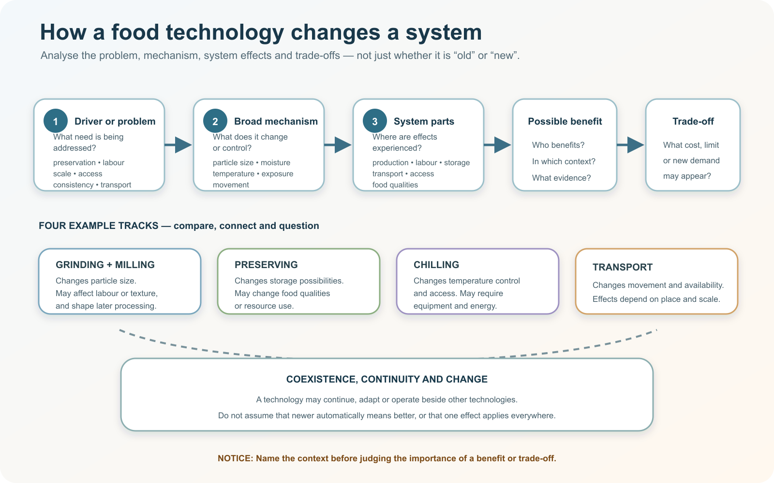
IDEA 1 · M08-S01
Food technology changes systems
A food technology belongs in a system. Analyse the problem, how it works, who uses it, the benefit, the trade-off and the context. Newer does not automatically mean better.
Choose one technology track. What problem, mechanism, system effect, benefit and trade-off would need evidence in a named context?
Food technologies create system ripples; judgement depends on mechanism, users, context, benefits and trade-offs rather than age alone.
YEAR 9 FOOD IN AUSTRALIA • MODULE 08
03
Notes:
Explain: A food technology belongs in a system. Analyse the problem, how it works, who uses it, the benefit, the trade-off and the context. Newer does not automatically mean better.
Ask students to respond to the on-slide notice prompt before volunteering an answer.
Misconception to correct: Newer technology is automatically better.
Transition: connect this idea to food production and processing, then move to "the second idea".
[Sources]
- Teacher-supplied Food in Australia unit program and Classroom/Drive masters; private identifiers retained only in source-map v1.1.
- NESA Food Technology Years 7–10 Syllabus (2019), the controlling 2026 syllabus basis recorded in source-map v1.1.
- Course theory section m08-s01: Food technology changes systems.
- Course visual: assets/diagrams/m08-technology-system-ripples.svg; provenance recorded in the visual production manifest.
[/Sources]

Slide 4
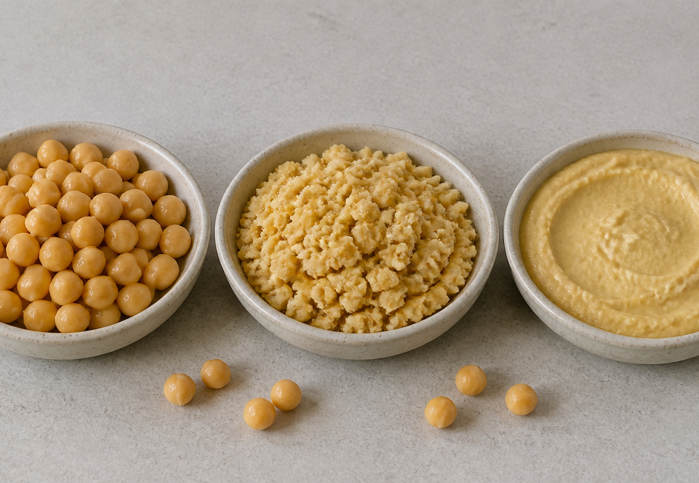
IDEA 2 · M08-S02
Processing changes food properties
Use an evidence chain: processing action → property change → observable sign → product effect. Decide whether the change is physical, chemical or combined, and explain the mechanism rather than merely naming the result.
Track the change from whole to coarse to smooth. Which properties can you observe directly, and which mechanism would need explanation?
A fictional mechanical-processing sequence showing decreasing particle size and changing structure; no method, quantity or equipment use is implied.
YEAR 9 FOOD IN AUSTRALIA • MODULE 08
04
Notes:
Explain: Use an evidence chain: processing action → property change → observable sign → product effect. Decide whether the change is physical, chemical or combined, and explain the mechanism rather than merely naming the result.
Ask students to respond to the on-slide notice prompt before volunteering an answer.
Misconception to correct: Naming a change is the same as explaining its mechanism.
Transition: connect this idea to food production and processing, then move to "the final idea".
[Sources]
- Teacher-supplied Food in Australia unit program and Classroom/Drive masters; private identifiers retained only in source-map v1.1.
- NESA Food Technology Years 7–10 Syllabus (2019), the controlling 2026 syllabus basis recorded in source-map v1.1.
- Course theory section m08-s02: Processing changes food properties.
- Course visual: assets/photos/m08-processing-property-change.png; provenance recorded in the visual production manifest.
[/Sources]

Slide 5
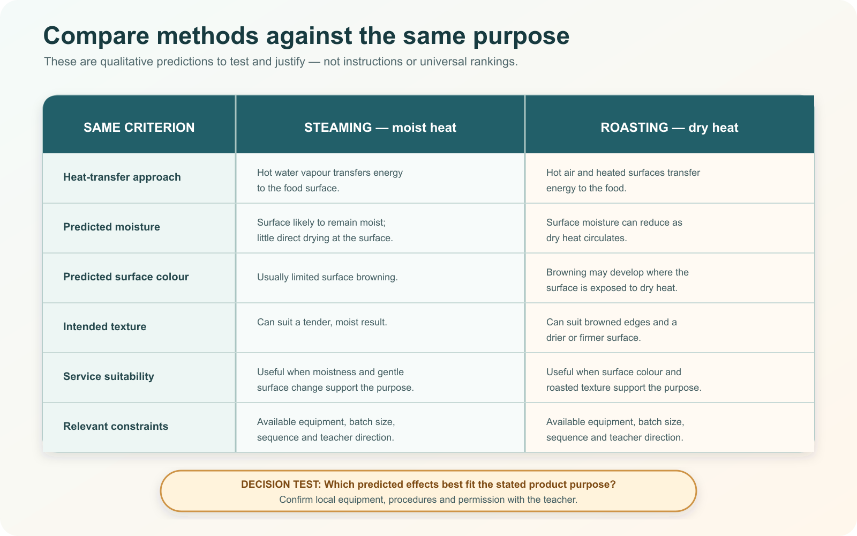
IDEA 3 · M08-S03
Choose a method for the purpose
Choose a method against a stated purpose, common criteria and constraints. Compare expected sensory effects, ingredient properties, heat transfer, time, equipment and resource use, then name the trade-off and what still needs teacher confirmation.
Read across one criterion at a time. Which predicted effect best fits a stated product purpose, and what still needs teacher confirmation?
Steaming and roasting are compared against the same qualitative criteria; suitability depends on purpose and local constraints.
YEAR 9 FOOD IN AUSTRALIA • MODULE 08
05
Notes:
Explain: Choose a method against a stated purpose, common criteria and constraints. Compare expected sensory effects, ingredient properties, heat transfer, time, equipment and resource use, then name the trade-off and what still needs teacher confirmation.
Ask students to respond to the on-slide notice prompt before volunteering an answer.
Misconception to correct: One method is best in every context.
Transition: students now rehearse all three ideas through the module activity and retrieval checks.
[Sources]
- Teacher-supplied Food in Australia unit program and Classroom/Drive masters; private identifiers retained only in source-map v1.1.
- NESA Food Technology Years 7–10 Syllabus (2019), the controlling 2026 syllabus basis recorded in source-map v1.1.
- Course theory section m08-s03: Choose a method for the purpose.
- Course visual: assets/diagrams/m08-method-comparison-matrix.svg; provenance recorded in the visual production manifest.
[/Sources]

Slide 6
FOOD PRODUCTION AND PROCESSING · REHEARSAL
Stop. Think. Explain.
Answer silently first. Then justify one response with a partner.
1
Which judgement about food technology is best supported?
APPLIED LEARNING ACTIVITY
Process-change investigator
2
Which explanation best describes evidence of processing?
Practise connecting processing observations with mechanisms and selecting methods against a stated purpose.
3
What should a recommendation compare before choosing a food-processing method?
Try: Classify the strongest interpretation of each fictional observation.
Rehearsal first. Save evidence only when the teacher directs.
YEAR 9 FOOD IN AUSTRALIA • MODULE 08
06
Notes:
Run the activity as rehearsal: Classify the evidence, then choose the recommendation that weighs purpose and trade-offs.
Give quiet thinking time before discussion. Ask students to explain why an alternative is weaker, not merely name the correct choice.
Check 1: Its value depends on the problem, context, mechanism, benefits and trade-offs, including access and resource needs.
Check 2: Name an observable change, propose a supported physical or chemical mechanism, and explain its effect on product quality.
Check 3: The product purpose, predicted observable effects, common criteria, constraints, trade-offs and any teacher-controlled requirements.
Misconception to correct: a correct choice without reasoning is enough evidence. Ask for the link between the claim and the source or scenario.
Transition: move from short retrieval to one constructed evidence response.
[Sources]
- Teacher-supplied Food in Australia unit program and Classroom/Drive masters; private identifiers retained only in source-map v1.1.
- NESA Food Technology Years 7–10 Syllabus (2019), the controlling 2026 syllabus basis recorded in source-map v1.1.
- Course activity activity-m08: Process-change investigator.
- Course formative check check-m08-s01 for m08-s01.
- Course formative check check-m08-s02 for m08-s02.
- Course formative check check-m08-s03 for m08-s03.
[/Sources]

Slide 7
FOOD PRODUCTION AND PROCESSING · GUIDED RESPONSE
Build evidence someone else can follow
THE QUESTION
Recommend a method for a stated food purpose. Compare alternatives using common criteria, explain one important trade-off and identify any practical requirement that still needs teacher confirmation.
1 READ
2 SELECT
3 EXPLAIN
4 CHECK
Underline the exact decision or explanation the prompt requires.
Choose evidence that uses common comparison criteria.
The product purpose and criteria are …
Links prediction to purpose; records an honest teacher-confirm item.
Save in My Folio only when your teacher asks. Saving is not submission.
YEAR 9 FOOD IN AUSTRALIA • MODULE 08
07
Notes:
Read the prompt aloud once, then ask students to restate its decision or explanation in their own words.
Model the sequence: Read → Select → Explain → Check. Use the starter "The product purpose and criteria are …" only if students need it.
Look for: uses common comparison criteria; links prediction to purpose; records an honest teacher-confirm item.
Misconception to correct: saving locally means the work has been submitted or formally assessed. It has not.
Transition: close with a three-part exit ticket and the teacher-controlled next step.
[Sources]
- Teacher-supplied Food in Australia unit program and Classroom/Drive masters; private identifiers retained only in source-map v1.1.
- NESA Food Technology Years 7–10 Syllabus (2019), the controlling 2026 syllabus basis recorded in source-map v1.1.
- Course evidence record for m08-s03: Method recommendation with trade-off.
- Course folio contract: device-local saving is not submission.
[/Sources]

Slide 8
MODULE 08 · EXIT EVIDENCE
TEACHER TO CONFIRM
Leave with evidence, not a guess.
Equipment, method, safety conditions and teacher-controlled practical requirements.
1. One idea I can explain is food technology changes systems because …
2. One connection across the three ideas is …
3. One question or check I still need is …
NEXT STEP
Use the module page to refine one response, then follow your teacher’s directions.
Evidence destination: My Folio when directed. Exporting or saving is not submission.
Notes:
Give students one minute to write all three exit lines. Ask for a specific connection, not a generic summary.
Listen for the module takeaway: Choose and judge food technologies by how they change properties, systems and trade-offs for a purpose.
State the sign-off exactly as shown: Teacher to confirm equipment, method, safety conditions and teacher-controlled practical requirements.
Do not announce a practical, due date, weighting, grade or submission route unless it is in the current teacher-issued instruction.
Close by directing students to the Module 08 page or My Folio only as the teacher decides.
[Sources]
- Teacher-supplied Food in Australia unit program and Classroom/Drive masters; private identifiers retained only in source-map v1.1.
- NESA Food Technology Years 7–10 Syllabus (2019), the controlling 2026 syllabus basis recorded in source-map v1.1.
- Current Year 9 Assessment Booklet 2026: course-level task boundaries only; this deck does not invent unit task details.
- Course source-map v1.1 and assessment-orientation boundary.
[/Sources]

