Slide 1

YEAR 9 FOOD IN AUSTRALIA
MODULE 09
Food choice and advertising
Food choice and advertising are best explained with evidence, interacting influences and ethical claims.
Generated learning visual — not documentary evidence.
Editable classroom presentation • Local review copy
Notes:
Open with the module question: how does food choice and advertising change a food decision or explanation?
State the outcome in plain language: Food choice and advertising are best explained with evidence, interacting influences and ethical claims.
Ask students what the visual helps them notice, then make clear that it is a generated learning visual, not documentary evidence or practical permission.
Transition: the next slide shows the three connected ideas students will use to reach the outcome.
[Sources]
- Teacher-supplied Food in Australia unit program and Classroom/Drive masters; private identifiers retained only in source-map v1.1.
- NESA Food Technology Years 7–10 Syllabus (2019), the controlling 2026 syllabus basis recorded in source-map v1.1.
- Course visual: assets/photos/m09-fictional-advertising-frame.png; provenance recorded in the visual production manifest.
[/Sources]

Slide 2
FOOD CHOICE AND ADVERTISING · LEARNING PATHWAY
Three ideas build one explanation
Retrieval warm-up: What do you already know—and what needs checking?
1
2
3
Food choices have interacting influences
Decode a food advertisement
Persuade without misleading
Trace interacting choice influences
Separate observation from inference
Persuade creatively without misleading
Connect all three: Food choice and advertising are best explained with evidence, interacting influences and ethical claims.
YEAR 9 FOOD IN AUSTRALIA • MODULE 09
02
Notes:
Use the timeline as a learning sequence, not an agenda. Briefly name each idea and show how the third depends on the first two.
Retrieval prompt: ask students to define or exemplify one term from Food choices have interacting influences, then name one uncertainty to check.
Listen for unsupported certainty. Model language such as ‘the source supports…’, ‘in this context…’ and ‘Teacher to confirm…’ where relevant.
Transition: begin with Food choices have interacting influences; students will use it as the first part of the final explanation.
[Sources]
- Teacher-supplied Food in Australia unit program and Classroom/Drive masters; private identifiers retained only in source-map v1.1.
- NESA Food Technology Years 7–10 Syllabus (2019), the controlling 2026 syllabus basis recorded in source-map v1.1.
- Course theory section m09-s01: Food choices have interacting influences.
- Course theory section m09-s02: Decode a food advertisement.
- Course theory section m09-s03: Persuade without misleading.
[/Sources]

Slide 3
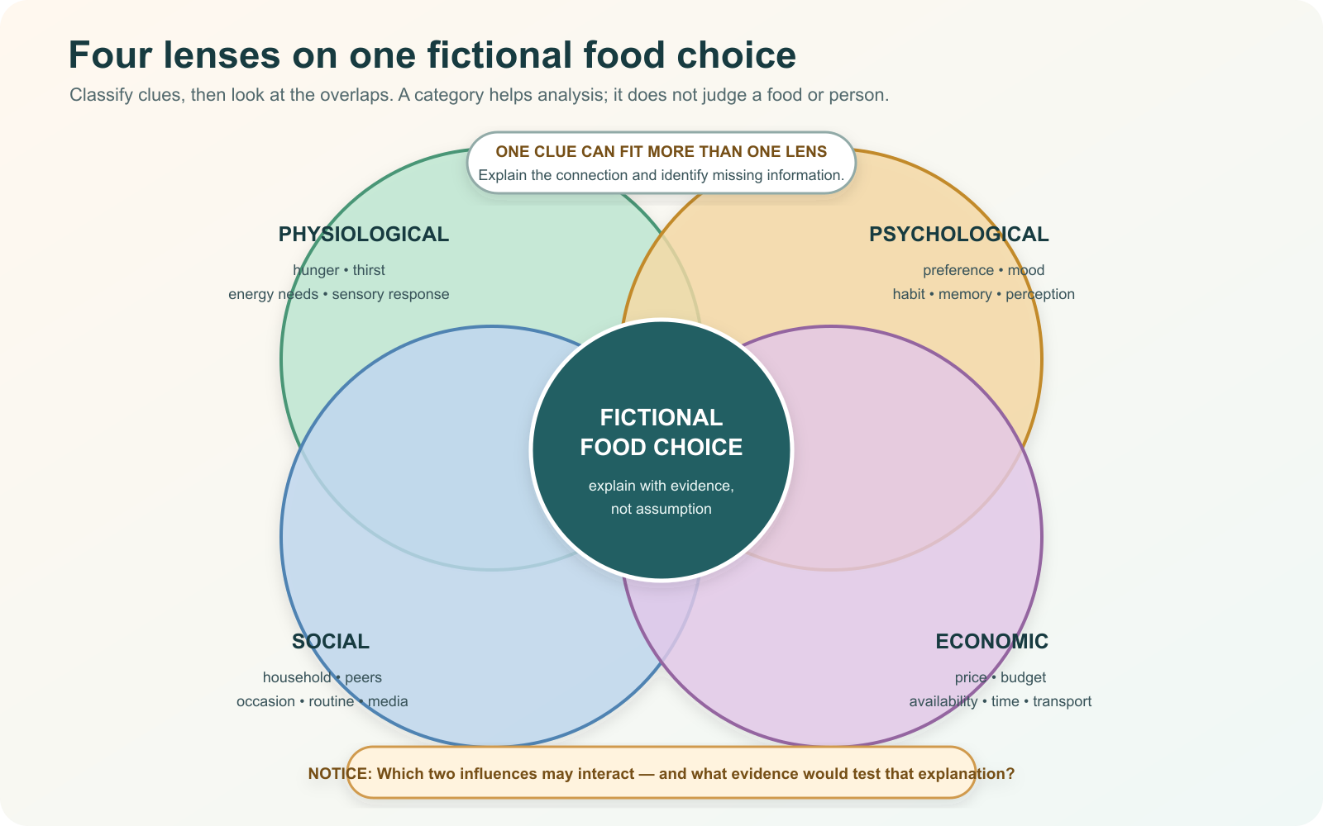
IDEA 1 · M09-S01
Food choices have interacting influences
Food choices can reflect physiological, psychological, social and economic influences at the same time. Use scenario evidence, avoid moral judgement and state what extra information would test your explanation.
Choose one clue near an overlap. Which two lenses could explain it, and what additional evidence would help?
Four analytical lenses can overlap in one food decision; the task is to explain evidence and interaction, not rank the categories or judge a person.
YEAR 9 FOOD IN AUSTRALIA • MODULE 09
03
Notes:
Explain: Food choices can reflect physiological, psychological, social and economic influences at the same time. Use scenario evidence, avoid moral judgement and state what extra information would test your explanation.
Ask students to respond to the on-slide notice prompt before volunteering an answer.
Misconception to correct: One influence explains a food decision.
Transition: connect this idea to food choice and advertising, then move to "the second idea".
[Sources]
- Teacher-supplied Food in Australia unit program and Classroom/Drive masters; private identifiers retained only in source-map v1.1.
- NESA Food Technology Years 7–10 Syllabus (2019), the controlling 2026 syllabus basis recorded in source-map v1.1.
- Course theory section m09-s01: Food choices have interacting influences.
- Course visual: assets/diagrams/m09-four-influence-lenses.svg; provenance recorded in the visual production manifest.
[/Sources]

Slide 4
IDEA 2 · M09-S02
Decode a food advertisement
Advertising analysis separates observation from inference. Identify the technique, intended audience and claim, then ask whether the evidence actually supports the message. Appeal and popularity are not proof.
Name three visible persuasive choices. For each, separate what you observed from a possible audience effect and the evidence you would need.
A fictional unbranded food-ad frame designed for analysis of colour, scale, framing and lighting; it contains no factual product claim.
YEAR 9 FOOD IN AUSTRALIA • MODULE 09
04
Notes:
Explain: Advertising analysis separates observation from inference. Identify the technique, intended audience and claim, then ask whether the evidence actually supports the message. Appeal and popularity are not proof.
Ask students to respond to the on-slide notice prompt before volunteering an answer.
Misconception to correct: Noticing a technique proves its effect.
Transition: connect this idea to food choice and advertising, then move to "the final idea".
[Sources]
- Teacher-supplied Food in Australia unit program and Classroom/Drive masters; private identifiers retained only in source-map v1.1.
- NESA Food Technology Years 7–10 Syllabus (2019), the controlling 2026 syllabus basis recorded in source-map v1.1.
- Course theory section m09-s02: Decode a food advertisement.
- Course visual: assets/photos/m09-fictional-advertising-frame.png; provenance recorded in the visual production manifest.
[/Sources]

Slide 5
IDEA 3 · M09-S03
Persuade without misleading
Ethical persuasion can still be memorable. Match the strength of a claim to its evidence, keep generated imagery from masquerading as product proof, avoid false endorsement and make uncertainty clear.
Supported fact
Creative appeal
Clear limit
What evidence or confirmation should change the next decision?
Ethical persuasion keeps all three visible.
YEAR 9 FOOD IN AUSTRALIA • MODULE 09
05
Notes:
Explain: Ethical persuasion can still be memorable. Match the strength of a claim to its evidence, keep generated imagery from masquerading as product proof, avoid false endorsement and make uncertainty clear.
Ask students to respond to the on-slide notice prompt before volunteering an answer.
Misconception to correct: Ethical persuasion cannot be creative.
Transition: students now rehearse all three ideas through the module activity and retrieval checks.
[Sources]
- Teacher-supplied Food in Australia unit program and Classroom/Drive masters; private identifiers retained only in source-map v1.1.
- NESA Food Technology Years 7–10 Syllabus (2019), the controlling 2026 syllabus basis recorded in source-map v1.1.
- Course theory section m09-s03: Persuade without misleading.
- Editable simple concept pathway created from course theory section m09-s03; no cultural motif, historical source or external artwork used.
[/Sources]

Slide 6
FOOD CHOICE AND ADVERTISING · REHEARSAL
Stop. Think. Explain.
Answer silently first. Then justify one response with a partner.
1
A fictional student buys a familiar snack near the station after sport. Which analysis is most careful?
APPLIED LEARNING ACTIVITY
Advertisement evidence decoder
2
An advertisement uses bright colours and says a product is 'the ultimate choice'. What is the best analysis?
Practise separating observation, inference and evidence, then repair an unsupported persuasive claim.
3
Which design choice keeps a food message persuasive without misleading its audience?
Try: Classify each statement about a fictional advertisement.
Rehearsal first. Save evidence only when the teacher directs.
YEAR 9 FOOD IN AUSTRALIA • MODULE 09
06
Notes:
Run the activity as rehearsal: Label what the analysis is doing, then choose the ethical revision.
Give quiet thinking time before discussion. Ask students to explain why an alternative is weaker, not merely name the correct choice.
Check 1: Several physiological, psychological, social or economic influences may interact; use the supplied clues and state what further evidence is needed.
Check 2: Describe the visible technique, infer its possible effect for a stated audience, and test any factual claim against actual evidence.
Check 3: Use creative layout, imagery and a call to action while keeping factual wording within the evidence and avoiding implied endorsements.
Misconception to correct: a correct choice without reasoning is enough evidence. Ask for the link between the claim and the source or scenario.
Transition: move from short retrieval to one constructed evidence response.
[Sources]
- Teacher-supplied Food in Australia unit program and Classroom/Drive masters; private identifiers retained only in source-map v1.1.
- NESA Food Technology Years 7–10 Syllabus (2019), the controlling 2026 syllabus basis recorded in source-map v1.1.
- Course activity activity-m09: Advertisement evidence decoder.
- Course formative check check-m09-s01 for m09-s01.
- Course formative check check-m09-s02 for m09-s02.
- Course formative check check-m09-s03 for m09-s03.
[/Sources]

Slide 7
FOOD CHOICE AND ADVERTISING · GUIDED RESPONSE
Build evidence someone else can follow
THE QUESTION
Justify three ethical choices in a concept food message and identify one claim or design decision that still needs stronger evidence. Do not represent a generated visual as proof of a real product.
1 READ
2 SELECT
3 EXPLAIN
4 CHECK
Underline the exact decision or explanation the prompt requires.
Choose evidence that keeps appeal and accuracy together.
My message persuades through …
Avoids misleading imagery or endorsement; identifies a real evidence gap.
Save in My Folio only when your teacher asks. Saving is not submission.
YEAR 9 FOOD IN AUSTRALIA • MODULE 09
07
Notes:
Read the prompt aloud once, then ask students to restate its decision or explanation in their own words.
Model the sequence: Read → Select → Explain → Check. Use the starter "My message persuades through …" only if students need it.
Look for: keeps appeal and accuracy together; avoids misleading imagery or endorsement; identifies a real evidence gap.
Misconception to correct: saving locally means the work has been submitted or formally assessed. It has not.
Transition: close with a three-part exit ticket and the teacher-controlled next step.
[Sources]
- Teacher-supplied Food in Australia unit program and Classroom/Drive masters; private identifiers retained only in source-map v1.1.
- NESA Food Technology Years 7–10 Syllabus (2019), the controlling 2026 syllabus basis recorded in source-map v1.1.
- Course evidence record for m09-s03: Ethical persuasive concept.
- Course folio contract: device-local saving is not submission.
[/Sources]

Slide 8
MODULE 09 · EXIT EVIDENCE
TEACHER TO CONFIRM
Leave with evidence, not a guess.
The advertisement or source students may analyse and any publication audience.
1. One idea I can explain is food choices have interacting influences because …
2. One connection across the three ideas is …
3. One question or check I still need is …
NEXT STEP
Use the module page to refine one response, then follow your teacher’s directions.
Evidence destination: My Folio when directed. Exporting or saving is not submission.
Notes:
Give students one minute to write all three exit lines. Ask for a specific connection, not a generic summary.
Listen for the module takeaway: Food choice and advertising are best explained with evidence, interacting influences and ethical claims.
State the sign-off exactly as shown: Teacher to confirm the advertisement or source students may analyse and any publication audience.
Do not announce a practical, due date, weighting, grade or submission route unless it is in the current teacher-issued instruction.
Close by directing students to the Module 09 page or My Folio only as the teacher decides.
[Sources]
- Teacher-supplied Food in Australia unit program and Classroom/Drive masters; private identifiers retained only in source-map v1.1.
- NESA Food Technology Years 7–10 Syllabus (2019), the controlling 2026 syllabus basis recorded in source-map v1.1.
- Current Year 9 Assessment Booklet 2026: course-level task boundaries only; this deck does not invent unit task details.
- Course source-map v1.1 and assessment-orientation boundary.
[/Sources]

