Slide 1

YEAR 9 FOOD IN AUSTRALIA
MODULE 10
Synthesis and assessment readiness
Strong assessment evidence is selected, explained, qualified and kept within teacher directions.
Generated learning visual — not documentary evidence.
Editable classroom presentation • Local review copy
Notes:
Open with the module question: how does synthesis and assessment readiness change a food decision or explanation?
State the outcome in plain language: Strong assessment evidence is selected, explained, qualified and kept within teacher directions.
Ask students what the visual helps them notice, then make clear that it is a generated learning visual, not documentary evidence or practical permission.
Transition: the next slide shows the three connected ideas students will use to reach the outcome.
[Sources]
- Teacher-supplied Food in Australia unit program and Classroom/Drive masters; private identifiers retained only in source-map v1.1.
- NESA Food Technology Years 7–10 Syllabus (2019), the controlling 2026 syllabus basis recorded in source-map v1.1.
- Course visual: assets/photos/m10-evidence-selection-workspace.png; provenance recorded in the visual production manifest.
[/Sources]

Slide 2
SYNTHESIS AND ASSESSMENT READINESS · LEARNING PATHWAY
Three ideas build one explanation
Retrieval warm-up: What do you already know—and what needs checking?
1
2
3
Analyse a food diary without judgement
Explain change with evidence
Select, reflect and present evidence
Read diary evidence without judgement
Explain change with connected evidence
Select, reflect and present purposefully
Connect all three: Strong assessment evidence is selected, explained, qualified and kept within teacher directions.
YEAR 9 FOOD IN AUSTRALIA • MODULE 10
02
Notes:
Use the timeline as a learning sequence, not an agenda. Briefly name each idea and show how the third depends on the first two.
Retrieval prompt: ask students to define or exemplify one term from Analyse a food diary without judgement, then name one uncertainty to check.
Listen for unsupported certainty. Model language such as ‘the source supports…’, ‘in this context…’ and ‘Teacher to confirm…’ where relevant.
Transition: begin with Analyse a food diary without judgement; students will use it as the first part of the final explanation.
[Sources]
- Teacher-supplied Food in Australia unit program and Classroom/Drive masters; private identifiers retained only in source-map v1.1.
- NESA Food Technology Years 7–10 Syllabus (2019), the controlling 2026 syllabus basis recorded in source-map v1.1.
- Course theory section m10-s01: Analyse a food diary without judgement.
- Course theory section m10-s02: Explain change with evidence.
- Course theory section m10-s03: Select, reflect and present evidence.
[/Sources]

Slide 3
IDEA 1 · M10-S01
Analyse a food diary without judgement
A short food diary is limited, private evidence—not a diagnosis or judgement. Describe the recorded pattern, suggest interacting influences with qualified language, and state the limits created by duration, context and missing information.
Recorded pattern
Possible influences
Evidence limits
Notice the relationship. What does it change in your explanation?
Private, neutral and non-diagnostic.
YEAR 9 FOOD IN AUSTRALIA • MODULE 10
03
Notes:
Explain: A short food diary is limited, private evidence—not a diagnosis or judgement. Describe the recorded pattern, suggest interacting influences with qualified language, and state the limits created by duration, context and missing information.
Ask students to respond to the on-slide notice prompt before volunteering an answer.
Misconception to correct: A one-day diary reveals a person’s usual diet or health.
Transition: connect this idea to synthesis and assessment readiness, then move to "the second idea".
[Sources]
- Teacher-supplied Food in Australia unit program and Classroom/Drive masters; private identifiers retained only in source-map v1.1.
- NESA Food Technology Years 7–10 Syllabus (2019), the controlling 2026 syllabus basis recorded in source-map v1.1.
- Course theory section m10-s01: Analyse a food diary without judgement.
- Editable simple concept pathway created from course theory section m10-s01; no cultural motif, historical source or external artwork used.
[/Sources]

Slide 4
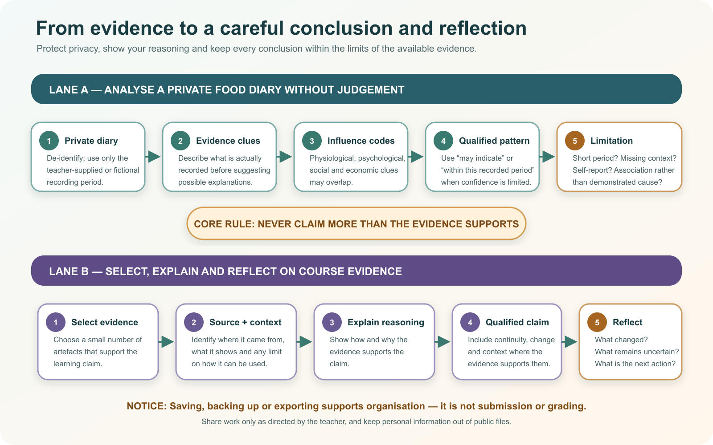
IDEA 2 · M10-S02
Explain change with evidence
A strong explanation makes a claim, selects evidence from at least two unit domains, explains how factors interacted, and qualifies the conclusion. Lists show what happened; reasoning shows why the evidence matters.
Compare the two lanes. Where does each pathway limit a claim, and where should uncertainty or context be made visible?
Private diary analysis and course synthesis use the same discipline: protect context, explain reasoning and never claim more than the evidence supports.
YEAR 9 FOOD IN AUSTRALIA • MODULE 10
04
Notes:
Explain: A strong explanation makes a claim, selects evidence from at least two unit domains, explains how factors interacted, and qualifies the conclusion. Lists show what happened; reasoning shows why the evidence matters.
Ask students to respond to the on-slide notice prompt before volunteering an answer.
Misconception to correct: A list of facts is an explanation.
Transition: connect this idea to synthesis and assessment readiness, then move to "the final idea".
[Sources]
- Teacher-supplied Food in Australia unit program and Classroom/Drive masters; private identifiers retained only in source-map v1.1.
- NESA Food Technology Years 7–10 Syllabus (2019), the controlling 2026 syllabus basis recorded in source-map v1.1.
- Course theory section m10-s02: Explain change with evidence.
- Course visual: assets/diagrams/m10-evidence-to-conclusion.svg; provenance recorded in the visual production manifest.
[/Sources]

Slide 5
IDEA 3 · M10-S03
Select, reflect and present evidence
Select evidence for a learning purpose. Explain what each example demonstrates, how your thinking changed and what you would improve. Saving or exporting a copy does not submit it; follow teacher directions.
Follow the movement from the large stack to three selected cards and the notebook. What should be kept private, contextualised or left out?
A fictional private-safe evidence workspace showing selection, privacy and reflection; the blank artefacts are not student work or assessment evidence.
YEAR 9 FOOD IN AUSTRALIA • MODULE 10
05
Notes:
Explain: Select evidence for a learning purpose. Explain what each example demonstrates, how your thinking changed and what you would improve. Saving or exporting a copy does not submit it; follow teacher directions.
Ask students to respond to the on-slide notice prompt before volunteering an answer.
Misconception to correct: More saved work automatically means stronger evidence.
Transition: students now rehearse all three ideas through the module activity and retrieval checks.
[Sources]
- Teacher-supplied Food in Australia unit program and Classroom/Drive masters; private identifiers retained only in source-map v1.1.
- NESA Food Technology Years 7–10 Syllabus (2019), the controlling 2026 syllabus basis recorded in source-map v1.1.
- Course theory section m10-s03: Select, reflect and present evidence.
- Course visual: assets/photos/m10-evidence-selection-workspace.png; provenance recorded in the visual production manifest.
[/Sources]

Slide 6
SYNTHESIS AND ASSESSMENT READINESS · REHEARSAL
Stop. Think. Explain.
Answer silently first. Then justify one response with a partner.
1
A one-day fictional diary shows two rushed meals. Which conclusion matches the evidence?
APPLIED LEARNING ACTIVITY
Evidence triage and synthesis
2
What turns a list of historical food facts into an explanation?
Practise selecting evidence for a purpose, qualifying diary conclusions and assembling claim–evidence–reasoning–qualification.
3
Which evidence selection shows the strongest reflection?
Try: What should happen to each possible evidence item?
Rehearsal first. Save evidence only when the teacher directs.
YEAR 9 FOOD IN AUSTRALIA • MODULE 10
06
Notes:
Run the activity as rehearsal: Triage each evidence example, then order the parts of a responsible synthesis.
Give quiet thinking time before discussion. Ask students to explain why an alternative is weaker, not merely name the correct choice.
Check 1: Within this recorded day, time pressure may have influenced the choices; more days and context would be needed to identify a typical pattern.
Check 2: A clear claim, relevant attributed evidence, reasoning that connects evidence to the claim, and a qualification matching the limits.
Check 3: A small relevant example, an explanation of what it demonstrates, how evidence or feedback changed thinking, and one specific next step.
Misconception to correct: a correct choice without reasoning is enough evidence. Ask for the link between the claim and the source or scenario.
Transition: move from short retrieval to one constructed evidence response.
[Sources]
- Teacher-supplied Food in Australia unit program and Classroom/Drive masters; private identifiers retained only in source-map v1.1.
- NESA Food Technology Years 7–10 Syllabus (2019), the controlling 2026 syllabus basis recorded in source-map v1.1.
- Course activity activity-m10: Evidence triage and synthesis.
- Course formative check check-m10-s01 for m10-s01.
- Course formative check check-m10-s02 for m10-s02.
- Course formative check check-m10-s03 for m10-s03.
[/Sources]

Slide 7
SYNTHESIS AND ASSESSMENT READINESS · GUIDED RESPONSE
Build evidence someone else can follow
THE QUESTION
Make one clear claim about your learning, support it with two carefully selected examples, explain how your thinking changed and identify one specific next step. State how any saved or exported copy will be used only as your teacher directs.
1 READ
2 SELECT
3 EXPLAIN
4 CHECK
Underline the exact decision or explanation the prompt requires.
Choose evidence that selects rather than accumulates evidence.
I can now explain …
Explains change in thinking; keeps export separate from submission.
Save in My Folio only when your teacher asks. Saving is not submission.
YEAR 9 FOOD IN AUSTRALIA • MODULE 10
07
Notes:
Read the prompt aloud once, then ask students to restate its decision or explanation in their own words.
Model the sequence: Read → Select → Explain → Check. Use the starter "I can now explain …" only if students need it.
Look for: selects rather than accumulates evidence; explains change in thinking; keeps export separate from submission.
Misconception to correct: saving locally means the work has been submitted or formally assessed. It has not.
Transition: close with a three-part exit ticket and the teacher-controlled next step.
[Sources]
- Teacher-supplied Food in Australia unit program and Classroom/Drive masters; private identifiers retained only in source-map v1.1.
- NESA Food Technology Years 7–10 Syllabus (2019), the controlling 2026 syllabus basis recorded in source-map v1.1.
- Course evidence record for m10-s03: Course synthesis and reflection.
- Course folio contract: device-local saving is not submission.
[/Sources]

Slide 8
MODULE 10 · EXIT EVIDENCE
TEACHER TO CONFIRM
Leave with evidence, not a guess.
The current formal task, due date, weighting, required evidence and submission instructions.
1. One idea I can explain is analyse a food diary without judgement because …
2. One connection across the three ideas is …
3. One question or check I still need is …
NEXT STEP
Use the module page to refine one response, then follow your teacher’s directions.
Evidence destination: My Folio when directed. Exporting or saving is not submission.
Notes:
Give students one minute to write all three exit lines. Ask for a specific connection, not a generic summary.
Listen for the module takeaway: Strong assessment evidence is selected, explained, qualified and kept within teacher directions.
State the sign-off exactly as shown: Teacher to confirm the current formal task, due date, weighting, required evidence and submission instructions.
Do not announce a practical, due date, weighting, grade or submission route unless it is in the current teacher-issued instruction.
Close by directing students to the Module 10 page or My Folio only as the teacher decides.
[Sources]
- Teacher-supplied Food in Australia unit program and Classroom/Drive masters; private identifiers retained only in source-map v1.1.
- NESA Food Technology Years 7–10 Syllabus (2019), the controlling 2026 syllabus basis recorded in source-map v1.1.
- Current Year 9 Assessment Booklet 2026: course-level task boundaries only; this deck does not invent unit task details.
- Course source-map v1.1 and assessment-orientation boundary.
[/Sources]

