Slide 1
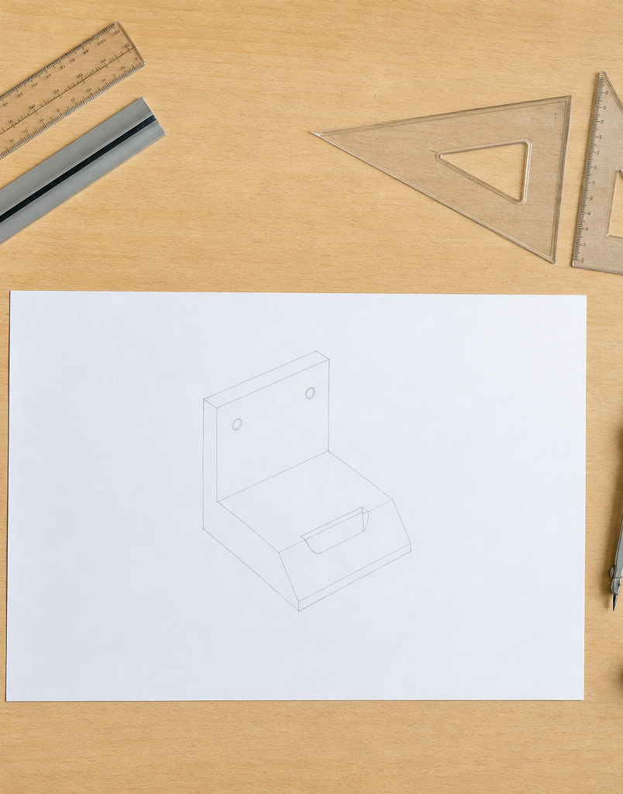
MODULE 1
Drawing Foundations &
Visual Communication
Build risk-aware studio habits, control sketching and instrument techniques, then use views and dimensions to communicate form clearly.
Read the visuals. Explain the decision. Save the evidence.
Notes:
Teacher talking points — Drawing Foundations and Visual Communication, slide 1
- Frame the module as communication, not drawing decoration.
- Keep all local WHS procedures with the teacher's current authorised instruction.
- Ask: What communication job will Drawing Foundations and Visual Communication help us complete?
- Invite a short continuous explanation while students point to the visible evidence; the slide is a prompt, not a script to read aloud.
[Sources]
- https://curriculum.nsw.edu.au/learning-areas/tas/communication-technology-7-10-2025/content/stage-5/faedaf189a
- https://curriculum.nsw.edu.au/learning-areas/tas/communication-technology-7-10-2025/content/stage-5/fa63ae38e0
- Course visual: assets/images/m01s01-safe-workspace.jpg — AI-generated teaching visual; provenance recorded in the module visual manifest.

Slide 2
Three ideas build one communication workflow
Keep this sequence in mind: understand the context, make a controlled representation, then justify what the evidence means.
1
2
3
Safe studio, instruments and line language
Sketching, rendering and geometric construction
Views, projection and dimensioning
Retrieval prompt • Which idea depends most on the one before it?
YEAR 9 GRAPHICS • MODULE 1
02
Notes:
Teacher talking points — Drawing Foundations and Visual Communication, slide 2
- Preview the three section packages and ask students which idea depends on the previous one.
- Make the progression explicit: risk-aware practice, controlled representation, then coordinated views.
- Ask: Which idea depends most on the one before it?
- Invite a short continuous explanation while students point to the visible evidence; the slide is a prompt, not a script to read aloud.
[Sources]
- https://curriculum.nsw.edu.au/learning-areas/tas/communication-technology-7-10-2025/content/stage-5/faedaf189a
- https://curriculum.nsw.edu.au/learning-areas/tas/communication-technology-7-10-2025/content/stage-5/fa63ae38e0
- https://curriculum.nsw.edu.au/learning-areas/tas/communication-technology-7-10-2025/content/stage-5/fa698bf5c2

Slide 3
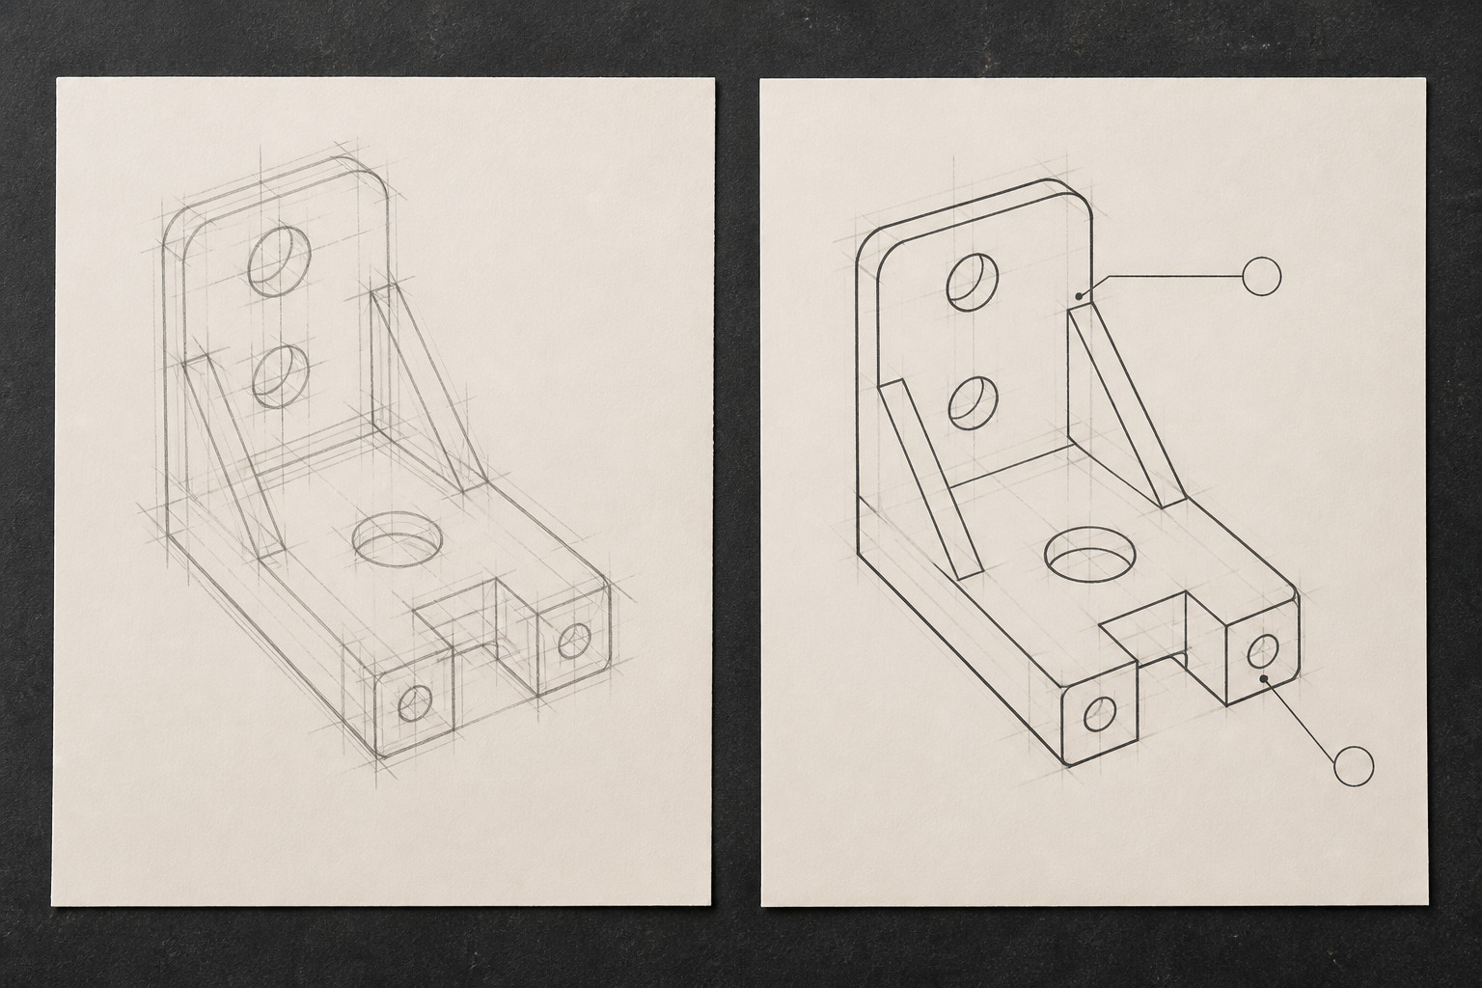
Line language makes a drawing readable
Safe graphics work starts with noticing hazards or uncertainty, checking the current authorised instruction and continuing to monitor the task. Choose instruments by the job they control. Use construction lines, visible outlines and annotations as different parts of a visual language—not as decoration.
Notice → Which line communicates the object, which line builds it, and what local instruction must still be checked?
Line weight, darkness and pattern should make purpose visible; they do not prove full standards compliance.
YEAR 9 GRAPHICS • MODULE 1
03
Notes:
Teacher talking points — Drawing Foundations and Visual Communication, slide 3
- Ask students to identify the communication job of each line before naming it.
- Distinguish an observable convention from an unsupported standards-compliance claim.
- Notice → Which line communicates the object, which line builds it, and what local instruction must still be checked?
- Invite a short continuous explanation while students point to the visible evidence; the slide is a prompt, not a script to read aloud.
[Sources]
- https://curriculum.nsw.edu.au/learning-areas/tas/communication-technology-7-10-2025/content/stage-5/faedaf189a
- https://curriculum.nsw.edu.au/learning-areas/tas/communication-technology-7-10-2025/content/stage-5/fa63ae38e0
- Course visual: assets/images/m01s01-line-language.jpg — AI-generated teaching visual; provenance recorded in the module visual manifest.

Slide 4
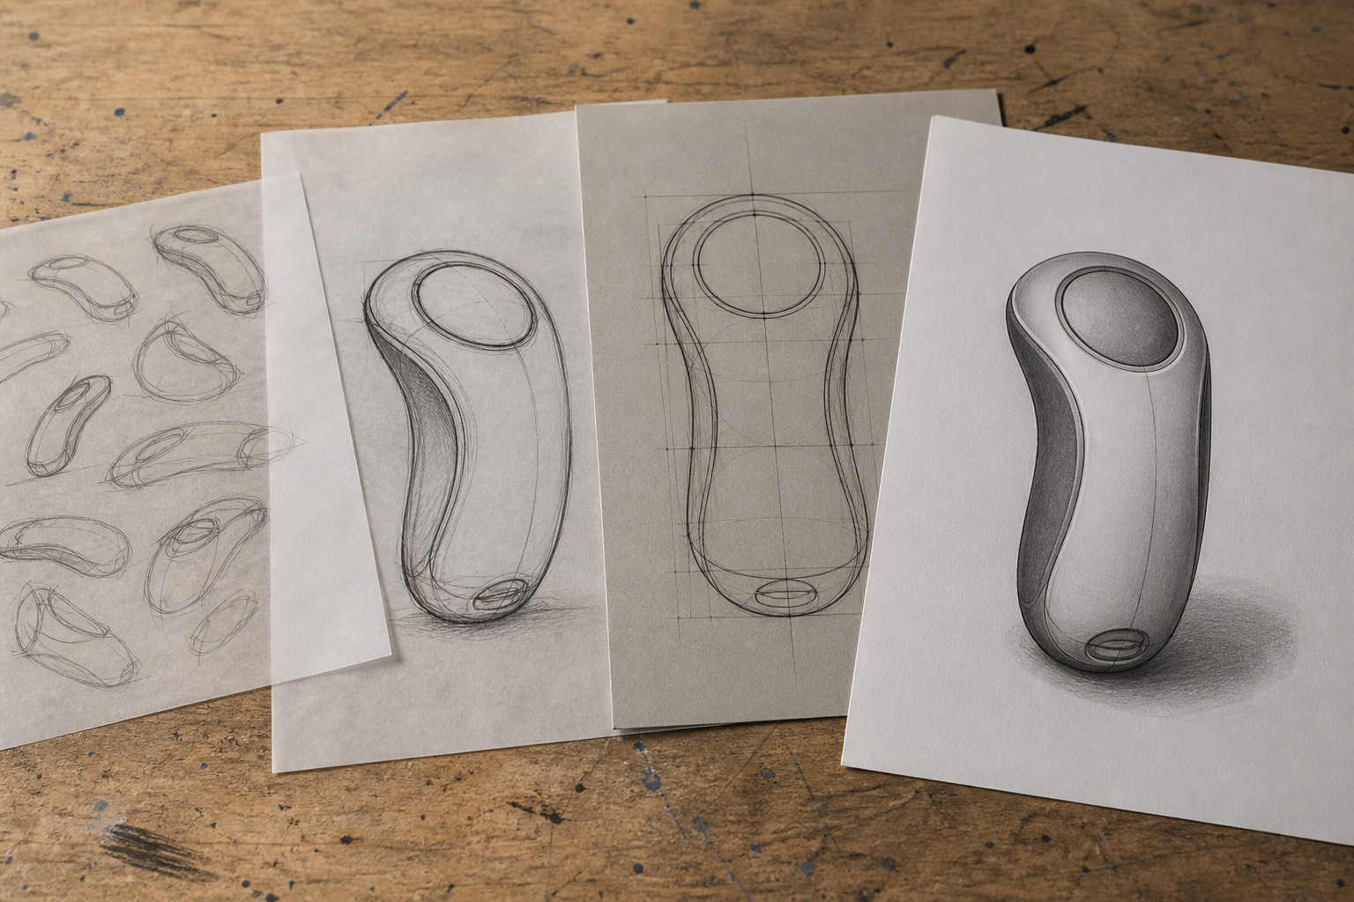
Sketches explore; construction and rendering explain
Early sketches help compare genuinely different options before a final idea is fixed. Geometric construction creates controlled relationships, while rendering adds evidence of form, surface and light. A strong progression moves from thumbnails to construction, then develops one chosen view with a single, consistent light direction.
Compare → Which stage changes the idea, and which stage makes the chosen form easier to read?
Neatness is not the same as design thinking: preserve the options, construction logic and visual decisions.
YEAR 9 GRAPHICS • MODULE 1
04
Notes:
Teacher talking points — Drawing Foundations and Visual Communication, slide 4
- Move from divergent thumbnails to one controlled construction and rendered explanation.
- Ask what the light direction predicts on every surface.
- Compare → Which stage changes the idea, and which stage makes the chosen form easier to read?
- Invite a short continuous explanation while students point to the visible evidence; the slide is a prompt, not a script to read aloud.
[Sources]
- https://curriculum.nsw.edu.au/learning-areas/tas/communication-technology-7-10-2025/content/stage-5/fa63ae38e0
- https://curriculum.nsw.edu.au/learning-areas/tas/communication-technology-7-10-2025/content/stage-5/fa698bf5c2
- Course visual: assets/images/m01s02-idea-to-render.jpg — AI-generated teaching visual; provenance recorded in the module visual manifest.

Slide 5
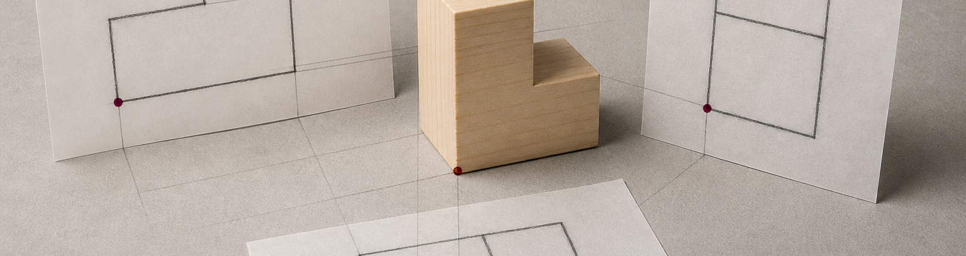
Different views answer different questions about one object
Front, top and side views separate width, height and depth so features can be located accurately. Projection keeps those views aligned. Pictorial views help a reader visualise form; working views and dimensions communicate controlled size and relationships. Use only authorised dimensions—never estimate a missing value from a picture.
Cross-check → Which additional view removes ambiguity, and which dimensions are purposeful?
A view reveals only part of the object. Coordinate views before making a size or shape claim.
YEAR 9 GRAPHICS • MODULE 1
05
Notes:
Teacher talking points — Drawing Foundations and Visual Communication, slide 5
- Use the visual to show that each view reveals some features and hides others.
- Do not infer missing dimensions from the image; use only the authorised source.
- Cross-check → Which additional view removes ambiguity, and which dimensions are purposeful?
- Invite a short continuous explanation while students point to the visible evidence; the slide is a prompt, not a script to read aloud.
[Sources]
- https://curriculum.nsw.edu.au/learning-areas/tas/communication-technology-7-10-2025/content/stage-5/fa63ae38e0
- https://curriculum.nsw.edu.au/learning-areas/tas/communication-technology-7-10-2025/content/stage-5/fa698bf5c2
- https://cad.onshape.com/help/Content/Drawing/views.htm
- https://cad.onshape.com/help/Content/Drawing/drawing_dimensions.htm
- Course visual: assets/images/m01s03-one-object-many-views.jpg — AI-generated teaching visual; provenance recorded in the module visual manifest.

Slide 6
Retrieve before you look back
Answer in a phrase first. Then add the because.
01
Why are construction lines and visible outlines intentionally different?
02
How does a thumbnail sketch support design choice?
03
What makes rendered light look consistent across a form?
04
Why can one view or one dimension be insufficient?
Check: can your partner point to the slide evidence that supports the answer?
YEAR 9 GRAPHICS • MODULE 1
06
Notes:
Teacher talking points — Drawing Foundations and Visual Communication, slide 6
- Run 60–90 seconds of no-notes retrieval, then pair-check against slides 3–5.
- Require a because statement, not a one-word answer.
- Ask students to support each response with evidence from the teaching slides.
- Invite a short continuous explanation while students point to the visible evidence; the slide is a prompt, not a script to read aloud.
[Sources]
- https://curriculum.nsw.edu.au/learning-areas/tas/communication-technology-7-10-2025/content/stage-5/faedaf189a
- https://curriculum.nsw.edu.au/learning-areas/tas/communication-technology-7-10-2025/content/stage-5/fa63ae38e0
- https://curriculum.nsw.edu.au/learning-areas/tas/communication-technology-7-10-2025/content/stage-5/fa698bf5c2

Slide 7
Build evidence: Read → Select → Explain → Check
READ
SELECT
EXPLAIN
CHECK
Name the task, source or view.
→
Choose one drawing or relationship.
→
State what it communicates and why.
→
Limit the claim to the available evidence.
Sentence support
The drawing communicates ___ because ___. The view or line evidence is ___. I still need to check ___ before claiming ___.
YEAR 9 GRAPHICS • MODULE 1
07
Notes:
Teacher talking points — Drawing Foundations and Visual Communication, slide 7
- Students select one real drawing decision and build a claim from visible evidence.
- Challenge any claim that extends beyond the drawing, current instruction or source.
- Ask students to read their completed sentence and identify the exact evidence behind it.
- Invite a short continuous explanation while students point to the visible evidence; the slide is a prompt, not a script to read aloud.
[Sources]
- https://curriculum.nsw.edu.au/learning-areas/tas/communication-technology-7-10-2025/content/stage-5/faedaf189a

Slide 8
MODULE 1
1 One foundation I can now explain
EXIT
2 One visual relationship I can point to
EVIDENCE
3 One local or standards claim I must still verify
SAVE TO MY FOLIO
One dated drawing or process image; a caption naming the line, view or rendering decision; and a short reflection explaining what the evidence shows.
Next: open the matching section package for feedback, then save the stronger response—not every draft.
YEAR 9 GRAPHICS • MODULE 1
08
Notes:
Teacher talking points — Drawing Foundations and Visual Communication, slide 8
- Collect one spoken response from each prompt before students save evidence.
- This is formative evidence; no formal task, date, weight or submission rule is implied.
- Ask students which single evidence item is worth saving and why.
- Invite a short continuous explanation while students point to the visible evidence; the slide is a prompt, not a script to read aloud.
[Sources]
- https://curriculum.nsw.edu.au/learning-areas/tas/communication-technology-7-10-2025/content/stage-5/faedaf189a

