Slide 1
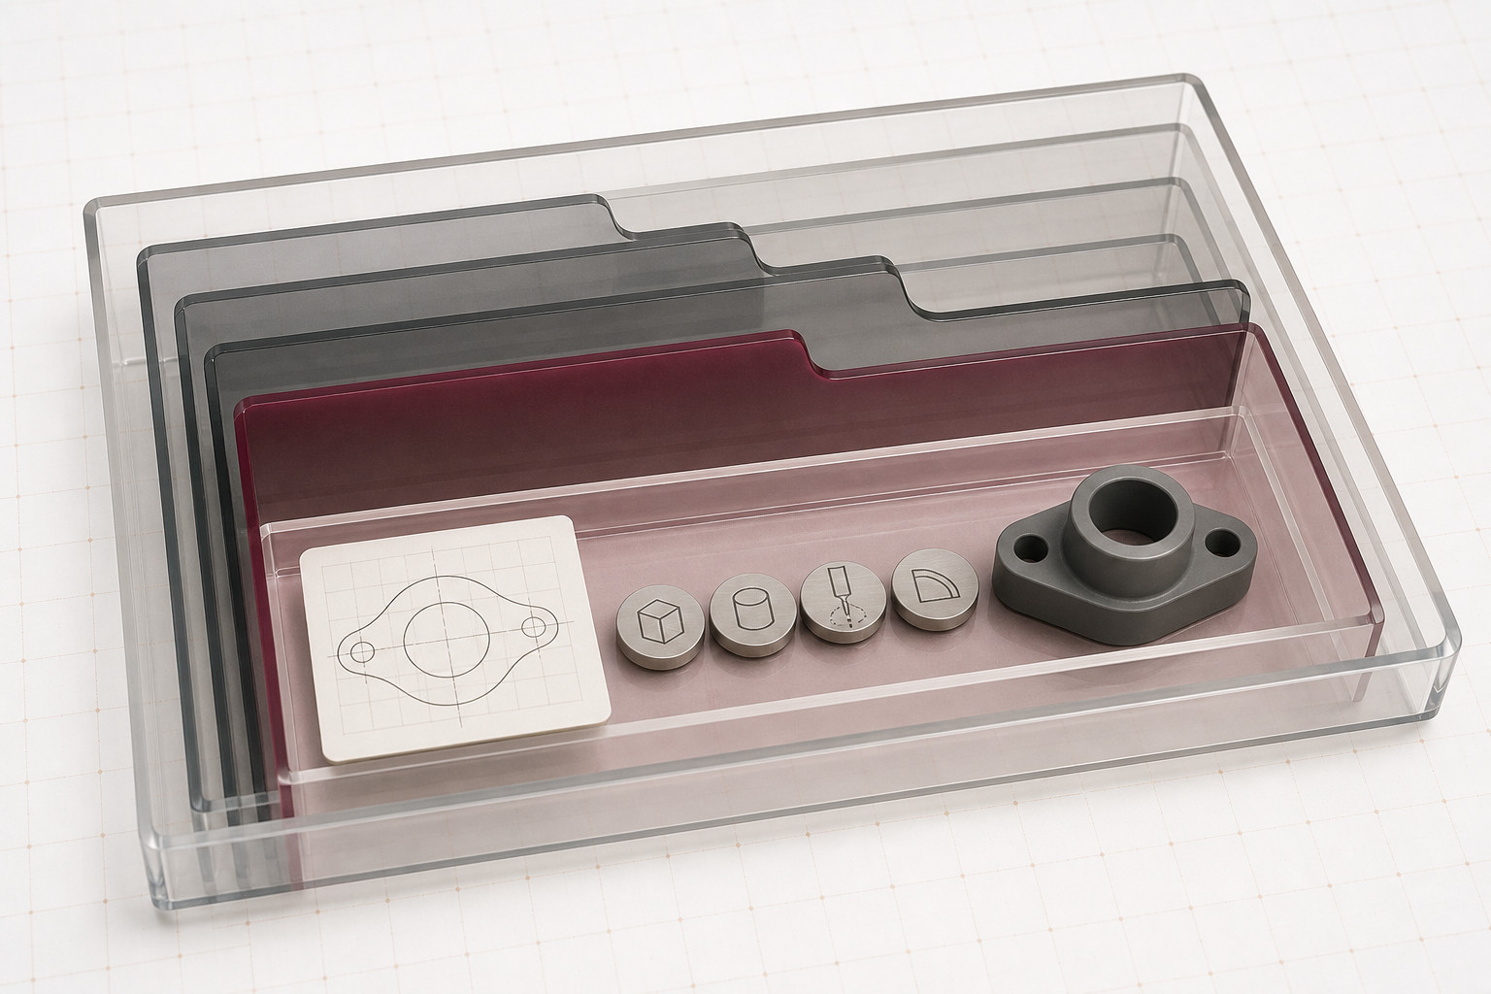
MODULE 2
Onshape Product Drawing
Build reliable Onshape documents, sketches and features, then produce coordinated drawings, purposeful dimensions, versions and exports.
Read the visuals. Explain the decision. Save the evidence.
Notes:
Teacher talking points — Onshape Product Drawing, slide 1
- State the course pathway clearly: Onshape is the sole CAD package used here.
- Connect modelling decisions to later drawing and evidence, not interface memorisation.
- Ask: What communication job will Onshape Product Drawing help us complete?
- Invite a short continuous explanation while students point to the visible evidence; the slide is a prompt, not a script to read aloud.
[Sources]
- https://curriculum.nsw.edu.au/learning-areas/tas/communication-technology-7-10-2025/content/stage-5/faedaf189a
- https://curriculum.nsw.edu.au/learning-areas/tas/communication-technology-7-10-2025/content/stage-5/fa63ae38e0
- https://cad.onshape.com/help/Content/Document/documents.htm
- Course visual: assets/images/m02s01-document-architecture.jpg — AI-generated teaching visual; provenance recorded in the module visual manifest.

Slide 2
Three ideas build one communication workflow
Keep this sequence in mind: understand the context, make a controlled representation, then justify what the evidence means.
1
2
3
Documents, sketch planes and constraints
Features, accuracy and design intent
Drawings, dimensions, exports and versions
Retrieval prompt • Which idea depends most on the one before it?
YEAR 9 GRAPHICS • MODULE 2
02
Notes:
Teacher talking points — Onshape Product Drawing, slide 2
- Preview the document–feature–handoff sequence.
- Ask students which later errors become easier to prevent when the document structure is understood first.
- Ask: Which idea depends most on the one before it?
- Invite a short continuous explanation while students point to the visible evidence; the slide is a prompt, not a script to read aloud.
[Sources]
- https://curriculum.nsw.edu.au/learning-areas/tas/communication-technology-7-10-2025/content/stage-5/faedaf189a
- https://curriculum.nsw.edu.au/learning-areas/tas/communication-technology-7-10-2025/content/stage-5/fa698bf5c2

Slide 3
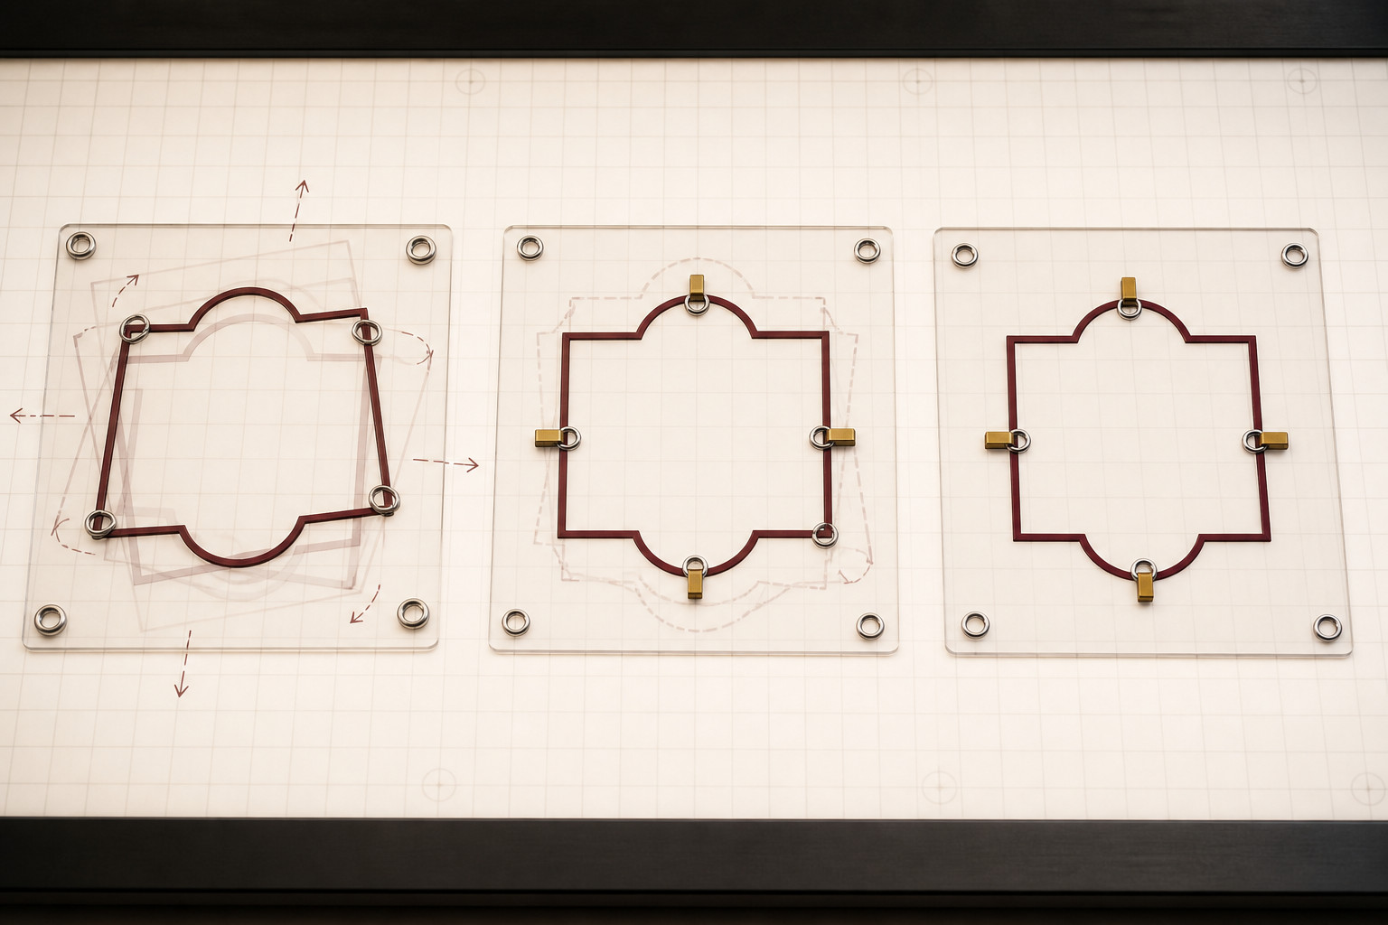
Good Onshape sketches capture intent, not just shape
An Onshape document can contain Part Studios, Assemblies and Drawings; tabs are not separate mystery files. Choose a sketch plane because it supports the model's intended orientation and later features. Dimensions control size; geometric constraints control relationships. Read the sketch status and diagnose conflicts instead of memorising screen colours.
Test → Which relationship should remain true when one authorised dimension changes?
A fully constrained sketch can still express a poor decision; the relationships must serve the design intent.
YEAR 9 GRAPHICS • MODULE 2
03
Notes:
Teacher talking points — Onshape Product Drawing, slide 3
- Demonstrate that dimensions control size and constraints control relationships.
- Use the visual as a model of logic, not as a fake software screenshot.
- Test → Which relationship should remain true when one authorised dimension changes?
- Invite a short continuous explanation while students point to the visible evidence; the slide is a prompt, not a script to read aloud.
[Sources]
- https://cad.onshape.com/help/Content/Document/documents.htm
- https://cad.onshape.com/help/Content/Sketch/sketch_basics.htm
- https://cad.onshape.com/help/Content/Sketch/working_with_constraints.htm
- Course visual: assets/images/m02s01-constraint-progression.jpg — AI-generated teaching visual; provenance recorded in the module visual manifest.

Slide 4
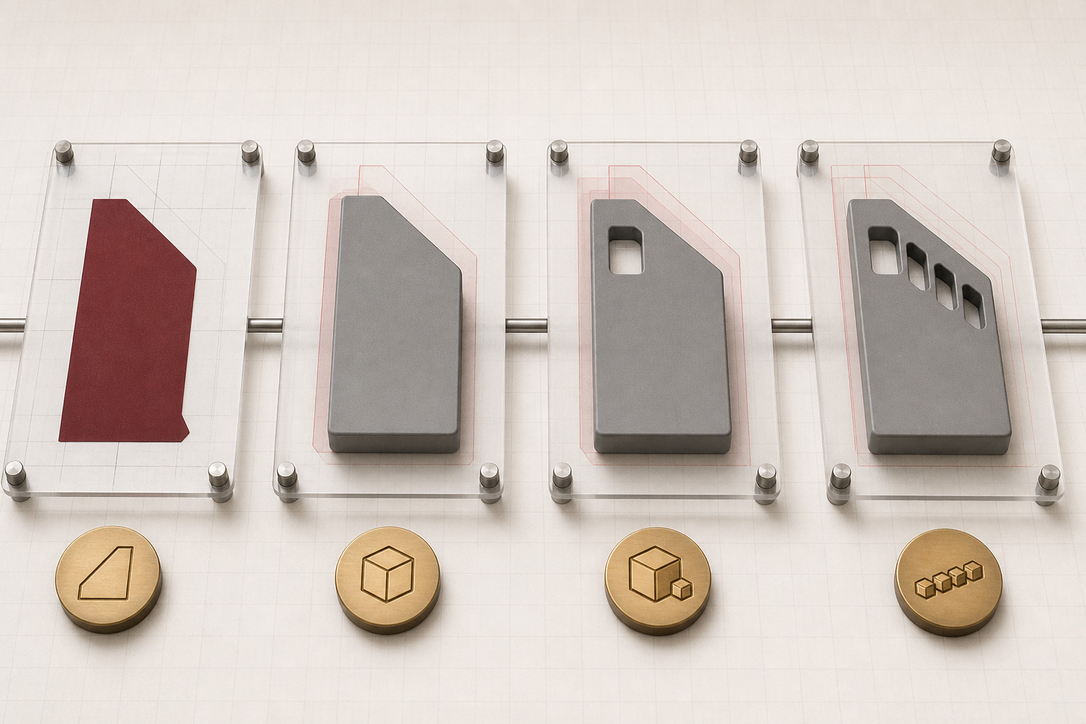
Feature history should tell a robust modelling story
Each feature depends on earlier geometry. Stable references and deliberate result types help later changes propagate predictably.
Trace → Which feature breaks if an early sketch or reference changes?
Use the Feature list to read cause and effect: sketch, feature, then revision.
YEAR 9 GRAPHICS • MODULE 2
04
Notes:
Teacher talking points — Onshape Product Drawing, slide 4
- Read feature history from left to right as cause and effect.
- Use an authorised change to test whether references are robust or fragile.
- Trace → Which feature breaks if an early sketch or reference changes?
- Invite a short continuous explanation while students point to the visible evidence; the slide is a prompt, not a script to read aloud.
[Sources]
- https://curriculum.nsw.edu.au/learning-areas/tas/communication-technology-7-10-2025/content/stage-5/fa698bf5c2
- https://cad.onshape.com/help/Content/PartStudio/feature_tools.htm
- Course visual: assets/images/m02s02-feature-history-story.jpg — AI-generated teaching visual; provenance recorded in the module visual manifest.

Slide 5
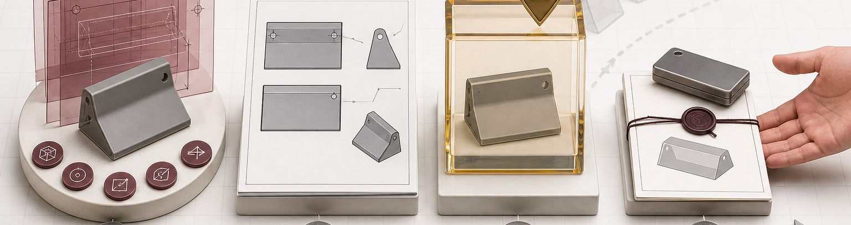
A model becomes evidence when the drawing and handoff are controlled
Create drawing views from the intended model state, then add only dimensions that help the reader identify size, location or relationships. Cross-check views after model changes. A workspace is live work; a named version records a milestone. Export a suitable copy for the destination without replacing the editable Onshape source.
Release-check → What changed, which views need checking, and which version should be handed off?
Onshape remains the source of truth. An export is a purpose-built snapshot.
YEAR 9 GRAPHICS • MODULE 2
05
Notes:
Teacher talking points — Onshape Product Drawing, slide 5
- Separate the live workspace, a named version and an exported copy.
- Cross-check every drawing view after a model change before handoff.
- Release-check → What changed, which views need checking, and which version should be handed off?
- Invite a short continuous explanation while students point to the visible evidence; the slide is a prompt, not a script to read aloud.
[Sources]
- https://cad.onshape.com/help/Content/Drawing/drawing_basics.htm
- https://cad.onshape.com/help/Content/Drawing/views.htm
- https://cad.onshape.com/help/Content/Drawing/drawing_dimensions.htm
- https://cad.onshape.com/help/Content/File/exporting_files.htm
- https://cad.onshape.com/help/Content/Document/versions_and_history.htm
- Course visual: assets/images/m02s03-model-drawing-version-export-flow.jpg — AI-generated teaching visual; provenance recorded in the module visual manifest.

Slide 6
Retrieve before you look back
Answer in a phrase first. Then add the because.
01
Why choose a sketch plane before drawing geometry?
02
How do constraints differ from dimensions?
03
Why can a fragile reference cause later features to fail?
04
What must be checked before exporting an Onshape drawing?
Check: can your partner point to the slide evidence that supports the answer?
YEAR 9 GRAPHICS • MODULE 2
06
Notes:
Teacher talking points — Onshape Product Drawing, slide 6
- Run no-notes retrieval, then require students to locate the supporting slide evidence.
- Ask for one Onshape-specific example in each explanation.
- Ask students to support each response with evidence from the teaching slides.
- Invite a short continuous explanation while students point to the visible evidence; the slide is a prompt, not a script to read aloud.
[Sources]
- https://cad.onshape.com/help/Content/Sketch/working_with_constraints.htm
- https://cad.onshape.com/help/Content/PartStudio/feature_tools.htm
- https://cad.onshape.com/help/Content/Drawing/drawing_basics.htm

Slide 7
Build evidence: Read → Select → Explain → Check
READ
SELECT
EXPLAIN
CHECK
Name the intended relationship or handoff.
→
Choose one sketch, feature or view.
→
State how it preserves design intent.
→
Change one authorised value and recheck.
Sentence support
The Onshape relationship I tested was ___. When ___ changed, ___ should update because ___. The drawing or version evidence shows ___.
YEAR 9 GRAPHICS • MODULE 2
07
Notes:
Teacher talking points — Onshape Product Drawing, slide 7
- Students test one relationship, record the expected change and compare it with the result.
- A successful update is evidence about that relationship, not proof of the whole product.
- Ask students to read their completed sentence and identify the exact evidence behind it.
- Invite a short continuous explanation while students point to the visible evidence; the slide is a prompt, not a script to read aloud.
[Sources]
- https://cad.onshape.com/help/Content/Document/documents.htm
- https://cad.onshape.com/help/Content/Document/versions_and_history.htm

Slide 8
MODULE 2
1 One Onshape relationship I can now explain
EXIT
2 One model-to-drawing check I can demonstrate
EVIDENCE
3 One handoff claim I must keep within the evidence
SAVE TO MY FOLIO
One dated Onshape screenshot or exported drawing; a caption identifying the relationship or change; and a short version note.
Next: open the matching section package for feedback, then save the stronger response—not every draft.
YEAR 9 GRAPHICS • MODULE 2
08
Notes:
Teacher talking points — Onshape Product Drawing, slide 8
- Students identify the strongest Onshape evidence worth saving.
- No local file name, export type or submission process is prescribed.
- Ask students which single evidence item is worth saving and why.
- Invite a short continuous explanation while students point to the visible evidence; the slide is a prompt, not a script to read aloud.
[Sources]
- https://cad.onshape.com/help/Content/Drawing/drawing_basics.htm
- https://cad.onshape.com/help/Content/Document/versions_and_history.htm

