Slide 1

MODULE 3
Graphic Modelling &
Prototyping
Turn research and a brief into alternative concepts, develop parts and assemblies in Onshape, then use purposeful prototypes and testing evidence to improve the design.
Read the visuals. Explain the decision. Save the evidence.
Notes:
Teacher talking points — Graphic Modelling and Prototyping, slide 1
- Frame modelling and prototyping as an evidence cycle, not a race to a polished object.
- Onshape remains the only CAD pathway in this module.
- Ask: What communication job will Graphic Modelling and Prototyping help us complete?
- Invite a short continuous explanation while students point to the visible evidence; the slide is a prompt, not a script to read aloud.
[Sources]
- https://curriculum.nsw.edu.au/learning-areas/tas/communication-technology-7-10-2025/content/stage-5/ol635da461/faod1879211
- https://curriculum.nsw.edu.au/learning-areas/tas/communication-technology-7-10-2025/content/stage-5/faedaf189a
- Course visual: assets/images/m03s01-research-observation-inference-opportunity.jpg — AI-generated teaching visual; provenance recorded in the module visual manifest.

Slide 2
Three ideas build one communication workflow
Keep this sequence in mind: understand the context, make a controlled representation, then justify what the evidence means.
1
2
3
Product research, brief and concept choice
Parts, cutting lists and assemblies
Prototype pathway, testing and evaluation
Retrieval prompt • Which idea depends most on the one before it?
YEAR 9 GRAPHICS • MODULE 3
02
Notes:
Teacher talking points — Graphic Modelling and Prototyping, slide 2
- Preview the movement from research to product structure to testing.
- Ask where a weak early decision would cause the largest downstream problem.
- Ask: Which idea depends most on the one before it?
- Invite a short continuous explanation while students point to the visible evidence; the slide is a prompt, not a script to read aloud.
[Sources]
- https://curriculum.nsw.edu.au/learning-areas/tas/communication-technology-7-10-2025/content/stage-5/ol635da461/faod1879211
- https://curriculum.nsw.edu.au/learning-areas/tas/communication-technology-7-10-2025/content/stage-5/fa698bf5c2
- https://curriculum.nsw.edu.au/learning-areas/tas/communication-technology-7-10-2025/content/stage-5/faedaf189a

Slide 3
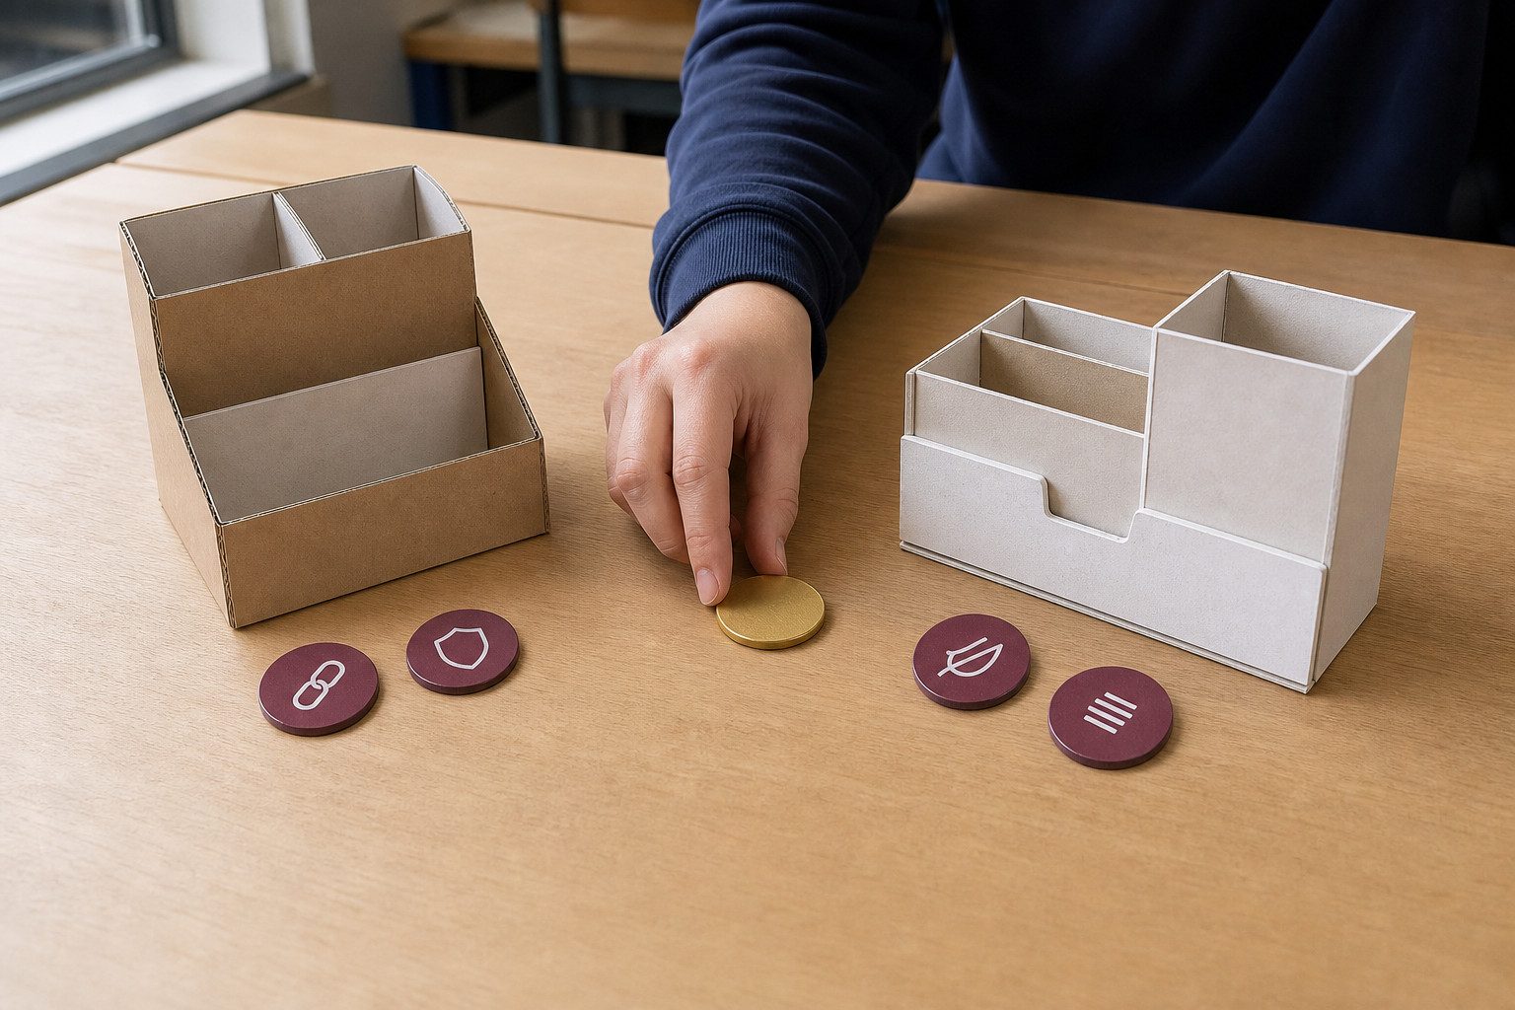
Research should separate observation, inference and opportunity
Start with what can be observed about users, products and contexts. Turn the need into a brief, then a checkable specification of criteria and constraints. Generate genuinely different concepts and compare them against the same evidence. The chosen concept is defensible when the reasoning is visible—not because it was the first idea.
Compare → Which concept responds best to the specification, and what evidence supports that choice?
Observation describes what is seen; inference is a reasoned interpretation; opportunity frames a design direction.
YEAR 9 GRAPHICS • MODULE 3
03
Notes:
Teacher talking points — Graphic Modelling and Prototyping, slide 3
- Separate observation from inference before discussing opportunities.
- Compare concepts against the same criteria and require one named trade-off.
- Compare → Which concept responds best to the specification, and what evidence supports that choice?
- Invite a short continuous explanation while students point to the visible evidence; the slide is a prompt, not a script to read aloud.
[Sources]
- https://curriculum.nsw.edu.au/learning-areas/tas/communication-technology-7-10-2025/content/stage-5/ol635da461/faod1879211
- https://curriculum.nsw.edu.au/learning-areas/tas/communication-technology-7-10-2025/content/stage-5/faedaf189a
- Course visual: assets/images/m03s01-evidence-based-concept-choice.jpg — AI-generated teaching visual; provenance recorded in the module visual manifest.

Slide 4
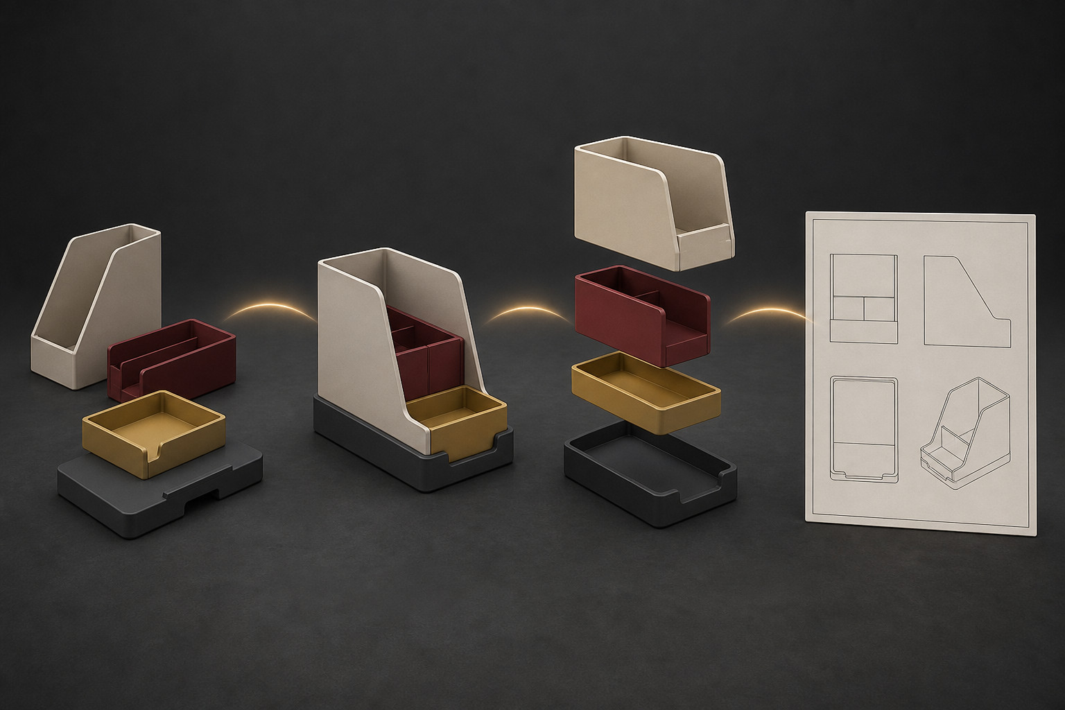
Onshape parts and assemblies express a product structure
A product can contain parts, repeated instances and subassemblies. Develop parts in Part Studios, assemble instances in an Assembly and create a Drawing when controlled communication is needed. A cutting list supports manufacture; a parts list or BOM describes what is in the product. Do not treat them as interchangeable.
Trace → Where is one component created, repeated, assembled and documented?
Model the hierarchy deliberately so the Onshape document tells the same product story as the design evidence.
YEAR 9 GRAPHICS • MODULE 3
04
Notes:
Teacher talking points — Graphic Modelling and Prototyping, slide 4
- Trace one component from part definition to assembly instance and drawing label.
- Contrast a cutting list's manufacture purpose with a parts list or BOM.
- Trace → Where is one component created, repeated, assembled and documented?
- Invite a short continuous explanation while students point to the visible evidence; the slide is a prompt, not a script to read aloud.
[Sources]
- https://curriculum.nsw.edu.au/learning-areas/tas/communication-technology-7-10-2025/content/stage-5/ol635da461/faod1879211
- https://curriculum.nsw.edu.au/learning-areas/tas/communication-technology-7-10-2025/content/stage-5/fa698bf5c2
- https://cad.onshape.com/help/Content/Assembly/assembly.htm
- https://cad.onshape.com/help/Content/Assembly/bill_of_material.htm
- https://cad.onshape.com/help/Content/Assembly/exploded_views.htm
- Course visual: assets/images/m03s02-onshape-part-assembly-drawing-pathway.jpg — AI-generated teaching visual; provenance recorded in the module visual manifest.

Slide 5

A prototype should answer a named design question
Choose prototype fidelity from the question: form, fit, arrangement, access or communication. Turn a specification point into a test, record observable results and treat feedback as evidence—not as an automatic instruction. Preserve the before state, revise in Onshape and evaluate the change against the original criterion.
Evaluate → What did the test show, what changed, and what limitation remains?
A polished model is not proof. The claim must match the prototype, test method and recorded evidence.
YEAR 9 GRAPHICS • MODULE 3
05
Notes:
Teacher talking points — Graphic Modelling and Prototyping, slide 5
- Name the question before selecting prototype fidelity.
- Feedback becomes useful when it is recorded, interpreted and connected to a criterion.
- Evaluate → What did the test show, what changed, and what limitation remains?
- Invite a short continuous explanation while students point to the visible evidence; the slide is a prompt, not a script to read aloud.
[Sources]
- https://curriculum.nsw.edu.au/learning-areas/tas/communication-technology-7-10-2025/content/stage-5/ol635da461/faod1879211
- https://curriculum.nsw.edu.au/learning-areas/tas/communication-technology-7-10-2025/content/stage-5/faedaf189a
- https://cad.onshape.com/help/Content/Document/versions_and_history.htm
- Course visual: assets/images/m03s03-evaluation-evidence-cycle.jpg — AI-generated teaching visual; provenance recorded in the module visual manifest.

Slide 6
Retrieve before you look back
Answer in a phrase first. Then add the because.
01
How does a specification differ from a broad brief?
02
Why must concepts be meaningfully different before comparison?
03
What is the difference between a cutting list and a parts list?
04
How does a prototype question control the evidence collected?
Check: can your partner point to the slide evidence that supports the answer?
YEAR 9 GRAPHICS • MODULE 3
06
Notes:
Teacher talking points — Graphic Modelling and Prototyping, slide 6
- Run no-notes retrieval and pair-check using slide evidence.
- Require students to explain the distinction, not only define each term.
- Ask students to support each response with evidence from the teaching slides.
- Invite a short continuous explanation while students point to the visible evidence; the slide is a prompt, not a script to read aloud.
[Sources]
- https://curriculum.nsw.edu.au/learning-areas/tas/communication-technology-7-10-2025/content/stage-5/ol635da461/faod1879211
- https://curriculum.nsw.edu.au/learning-areas/tas/communication-technology-7-10-2025/content/stage-5/faedaf189a
- https://cad.onshape.com/help/Content/Assembly/assembly.htm

Slide 7
Build evidence: Read → Select → Explain → Check
READ
SELECT
EXPLAIN
CHECK
Name the brief, criterion or test question.
→
Choose one concept, model or test result.
→
State what it proves and why it matters.
→
Limit the claim to the fidelity and evidence.
Sentence support
The criterion was ___. I compared or tested ___. The evidence showed ___. I revised ___ in Onshape because ___. A limitation is ___.
YEAR 9 GRAPHICS • MODULE 3
07
Notes:
Teacher talking points — Graphic Modelling and Prototyping, slide 7
- Students build one defensible claim from a concept, model or prototype result.
- Limit the claim to what the test and fidelity can actually show.
- Ask students to read their completed sentence and identify the exact evidence behind it.
- Invite a short continuous explanation while students point to the visible evidence; the slide is a prompt, not a script to read aloud.
[Sources]
- https://curriculum.nsw.edu.au/learning-areas/tas/communication-technology-7-10-2025/content/stage-5/faedaf189a
- https://cad.onshape.com/help/Content/Document/versions_and_history.htm

Slide 8
MODULE 3
1 One product relationship I can now explain
EXIT
2 One test result or revision I can point to
EVIDENCE
3 One claim I must limit to the prototype evidence
SAVE TO MY FOLIO
One dated concept comparison, Onshape model view or prototype test; a caption stating what it proves; and a reasoned next step.
Next: open the matching section package for feedback, then save the stronger response—not every draft.
YEAR 9 GRAPHICS • MODULE 3
08
Notes:
Teacher talking points — Graphic Modelling and Prototyping, slide 8
- Students save a concise before–evidence–after trail.
- Do not infer a formal assessment task, required evidence count or deadline.
- Ask students which single evidence item is worth saving and why.
- Invite a short continuous explanation while students point to the visible evidence; the slide is a prompt, not a script to read aloud.
[Sources]
- https://curriculum.nsw.edu.au/learning-areas/tas/communication-technology-7-10-2025/content/stage-5/faedaf189a
- https://curriculum.nsw.edu.au/learning-areas/tas/communication-technology-7-10-2025/content/stage-5/ol635da461/faod1879211

