Slide 1
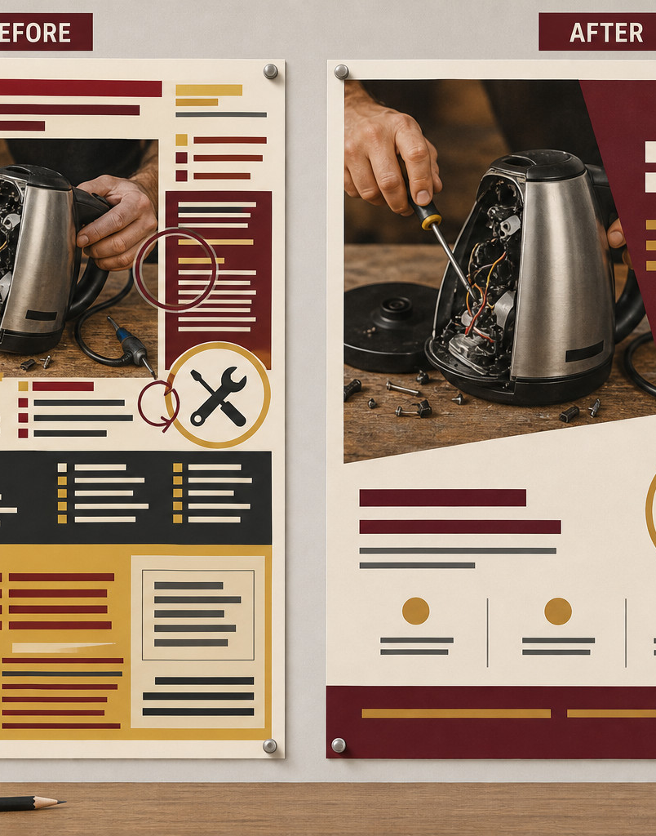
MODULE 4
Graphic Design &
Communication
Design graphics for a defined audience, choose ethical sources and suitable vector or raster workflows, then communicate through layout, motion and curated evidence.
Read the visuals. Explain the decision. Save the evidence.
Notes:
Teacher talking points — Graphic Design and Communication, slide 1
- Frame design as a sequence of audience, source and output decisions.
- Keep companion image, layout and motion software tool-neutral; Onshape is the only CAD pathway.
- Ask: What communication job will Graphic Design and Communication help us complete?
- Invite a short continuous explanation while students point to the visible evidence; the slide is a prompt, not a script to read aloud.
[Sources]
- https://curriculum.nsw.edu.au/learning-areas/tas/communication-technology-7-10-2025/content/stage-5/ol635da461/faoecc76bd4
- https://curriculum.nsw.edu.au/learning-areas/tas/communication-technology-7-10-2025/content/stage-5/faedaf189a
- Course visual: assets/images/m04s01-02-before-after-poster.jpg — AI-generated teaching visual; provenance recorded in the module visual manifest.

Slide 2
Three ideas build one communication workflow
Keep this sequence in mind: understand the context, make a controlled representation, then justify what the evidence means.
1
2
3
Audience, design principles and ethical sources
Vector, raster, colour and layout
Motion, portfolio and presentation
Retrieval prompt • Which idea depends most on the one before it?
YEAR 9 GRAPHICS • MODULE 4
02
Notes:
Teacher talking points — Graphic Design and Communication, slide 2
- Preview the move from audience and ethics to asset structure and then presentation evidence.
- Ask which later decision depends most on a clear audience purpose.
- Ask: Which idea depends most on the one before it?
- Invite a short continuous explanation while students point to the visible evidence; the slide is a prompt, not a script to read aloud.
[Sources]
- https://curriculum.nsw.edu.au/learning-areas/tas/communication-technology-7-10-2025/content/stage-5/ol635da461/faoecc76bd4
- https://curriculum.nsw.edu.au/learning-areas/tas/communication-technology-7-10-2025/content/stage-5/faedaf189a

Slide 3

Audience and ethics shape every visual decision
Start with what the audience needs to notice, understand and do. Use hierarchy, contrast, proportion, balance and negative space to guide attention. Record the creator and source, check actual permission, protect privacy and transform material honestly. Attribution alone is not permission; uncertain cultural or AI-assisted material needs accountable human review.
Decide → Which visual choice serves the audience, and which source check must happen before release?
Clear communication and ethical sourcing belong in the same design workflow.
YEAR 9 GRAPHICS • MODULE 4
03
Notes:
Teacher talking points — Graphic Design and Communication, slide 3
- Use the source pathway to show that attribution does not replace permission.
- Pause unresolved cultural, privacy or AI-assisted material for accountable human review.
- Decide → Which visual choice serves the audience, and which source check must happen before release?
- Invite a short continuous explanation while students point to the visible evidence; the slide is a prompt, not a script to read aloud.
[Sources]
- https://curriculum.nsw.edu.au/learning-areas/tas/communication-technology-7-10-2025/content/stage-5/ol635da461/faoecc76bd4
- https://curriculum.nsw.edu.au/learning-areas/tas/communication-technology-7-10-2025/content/stage-5/faedaf189a
- Course visual: assets/images/m04s01-03-ethical-source-pathway.jpg — AI-generated teaching visual; provenance recorded in the module visual manifest.

Slide 4

Vector, raster, colour and layout solve different jobs
Vector graphics use paths and suit scalable icons, diagrams and lettering. Raster graphics use pixels and suit detailed images; enlarging cannot recover missing detail. Screens use RGB light while print commonly uses CMYK inks, so appearance may change. Grids support alignment and grouping, while hierarchy and space still require judgement.
Choose → Which structure and colour pathway suit the content and destination?
Choose output characteristics from the content, editability needs and destination—not one universal setting.
YEAR 9 GRAPHICS • MODULE 4
04
Notes:
Teacher talking points — Graphic Design and Communication, slide 4
- Compare vector paths and raster pixels by job, not by a simplistic good-versus-bad ranking.
- Connect colour and file choices to the destination rather than a universal setting.
- Choose → Which structure and colour pathway suit the content and destination?
- Invite a short continuous explanation while students point to the visible evidence; the slide is a prompt, not a script to read aloud.
[Sources]
- https://curriculum.nsw.edu.au/learning-areas/tas/communication-technology-7-10-2025/content/stage-5/ol635da461/faoecc76bd4
- https://curriculum.nsw.edu.au/learning-areas/tas/communication-technology-7-10-2025/content/stage-5/faedaf189a
- Course visual: assets/images/m04s02-01-vector-raster-zoom.jpg — AI-generated teaching visual; provenance recorded in the module visual manifest.

Slide 5
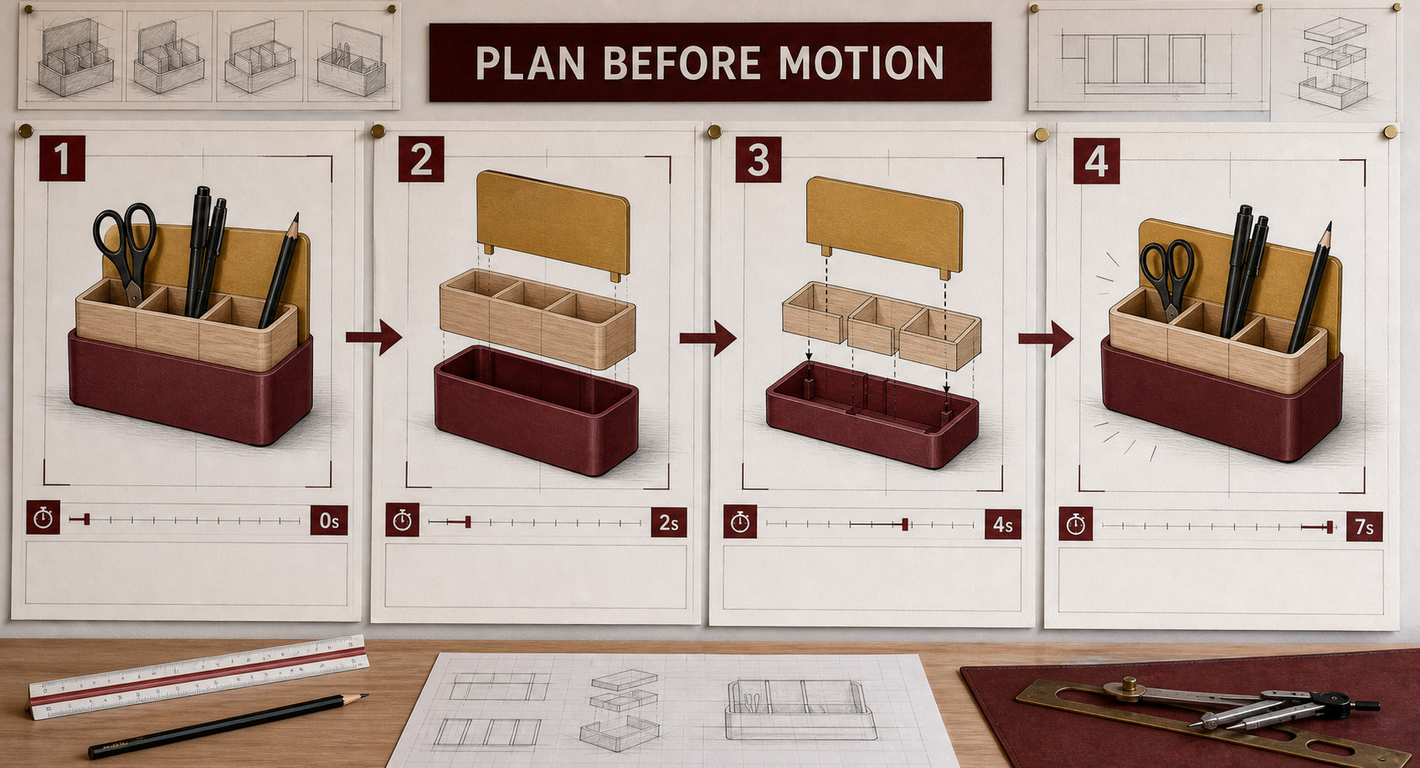
Motion and portfolio evidence need a communication job
Storyboard motion before production so sequence, timing and captions support the message. Provide a static or text pathway so meaning does not depend on motion, colour or audio alone. Curate intention, concepts, feedback, revision, result and evaluation into a clear presentation rather than dumping every file.
Edit → Which evidence makes the decision visible, and what next improvement can you defend?
A strong presentation connects claim, evidence and reasoning, then acknowledges a limitation.
YEAR 9 GRAPHICS • MODULE 4
05
Notes:
Teacher talking points — Graphic Design and Communication, slide 5
- Give motion a named communication job before planning it.
- Show how a static or text pathway keeps the meaning available without motion or audio.
- Edit → Which evidence makes the decision visible, and what next improvement can you defend?
- Invite a short continuous explanation while students point to the visible evidence; the slide is a prompt, not a script to read aloud.
[Sources]
- https://curriculum.nsw.edu.au/learning-areas/tas/communication-technology-7-10-2025/content/stage-5/ol635da461/faod1879211
- https://curriculum.nsw.edu.au/learning-areas/tas/communication-technology-7-10-2025/content/stage-5/ol635da461/faoecc76bd4
- https://curriculum.nsw.edu.au/learning-areas/tas/communication-technology-7-10-2025/content/stage-5/faedaf189a
- https://cad.onshape.com/help/Content/Assembly/exploded_views.htm
- https://www.w3.org/WAI/WCAG22/Understanding/animation-from-interactions.html
- Course visual: assets/images/m04s03-01-storyboard.jpg — AI-generated teaching visual; provenance recorded in the module visual manifest.

Slide 6
Retrieve before you look back
Answer in a phrase first. Then add the because.
01
How do audience needs change hierarchy or layout?
02
Why is attribution alone not enough to reuse an image?
03
When should vector and raster content be chosen?
04
What makes motion or portfolio evidence purposeful?
Check: can your partner point to the slide evidence that supports the answer?
YEAR 9 GRAPHICS • MODULE 4
06
Notes:
Teacher talking points — Graphic Design and Communication, slide 6
- Run no-notes retrieval and ask students to point to the exact visual evidence.
- Follow every answer with why it matters for the audience or source decision.
- Ask students to support each response with evidence from the teaching slides.
- Invite a short continuous explanation while students point to the visible evidence; the slide is a prompt, not a script to read aloud.
[Sources]
- https://curriculum.nsw.edu.au/learning-areas/tas/communication-technology-7-10-2025/content/stage-5/ol635da461/faoecc76bd4
- https://curriculum.nsw.edu.au/learning-areas/tas/communication-technology-7-10-2025/content/stage-5/faedaf189a

Slide 7
Build evidence: Read → Select → Explain → Check
READ
SELECT
EXPLAIN
CHECK
Name the audience, source or criterion.
→
Choose one visual, decision or revision.
→
State what it communicates and why.
→
Verify permission, privacy and evidence limits.
Sentence support
My audience needs ___. I changed ___ because the evidence showed ___. The source check is ___. A remaining limitation and next step are ___.
YEAR 9 GRAPHICS • MODULE 4
07
Notes:
Teacher talking points — Graphic Design and Communication, slide 7
- Students connect one audience need to one design change and one source check.
- A polished outcome does not remove the need to state limitations.
- Ask students to read their completed sentence and identify the exact evidence behind it.
- Invite a short continuous explanation while students point to the visible evidence; the slide is a prompt, not a script to read aloud.
[Sources]
- https://curriculum.nsw.edu.au/learning-areas/tas/communication-technology-7-10-2025/content/stage-5/faedaf189a
- https://curriculum.nsw.edu.au/learning-areas/tas/communication-technology-7-10-2025/content/stage-5/ol635da461/faoecc76bd4

Slide 8
MODULE 4
1 One design principle I can now explain
EXIT
2 One source, layout or motion decision I can point to
EVIDENCE
3 One claim I must keep within the evidence
SAVE TO MY FOLIO
One dated design comparison, source record or storyboard frame; a caption explaining the decision; and a reasoned evaluation.
Next: open the matching section package for feedback, then save the stronger response—not every draft.
YEAR 9 GRAPHICS • MODULE 4
08
Notes:
Teacher talking points — Graphic Design and Communication, slide 8
- Students save only evidence that explains a significant decision or revision.
- No local folio length, presentation duration, export format or assessment rule is implied.
- Ask students which single evidence item is worth saving and why.
- Invite a short continuous explanation while students point to the visible evidence; the slide is a prompt, not a script to read aloud.
[Sources]
- https://curriculum.nsw.edu.au/learning-areas/tas/communication-technology-7-10-2025/content/stage-5/faedaf189a
- https://curriculum.nsw.edu.au/learning-areas/tas/communication-technology-7-10-2025/content/stage-5/ol635da461/faoecc76bd4

