Slide 1

1
YEAR 9 TEXTILES TECHNOLOGY
Safety & sewing confidence
Learn the room routine, use equipment safely and begin controlling a sewing machine through paper sewing and threading practice.
TODAY: understand → retrieve → explain → save evidence
01
Notes:
[Sources]
Website course data: assets/course-data.js, Module 1, module summary and evidence sequence.
Course authority: work/source-contract.md and work/source-audit.md.
Local visual: assets/visuals/textiles-course-hero.svg, source-bound course artwork rasterised for PowerPoint.
Source boundary: exact practical settings, construction directions and current assessment arrangements remain teacher-controlled.
[/Sources]
Teaching note: State the module purpose. Ask students which part of the topic feels familiar and which part is new.
Slide 1 of 8.

Slide 2
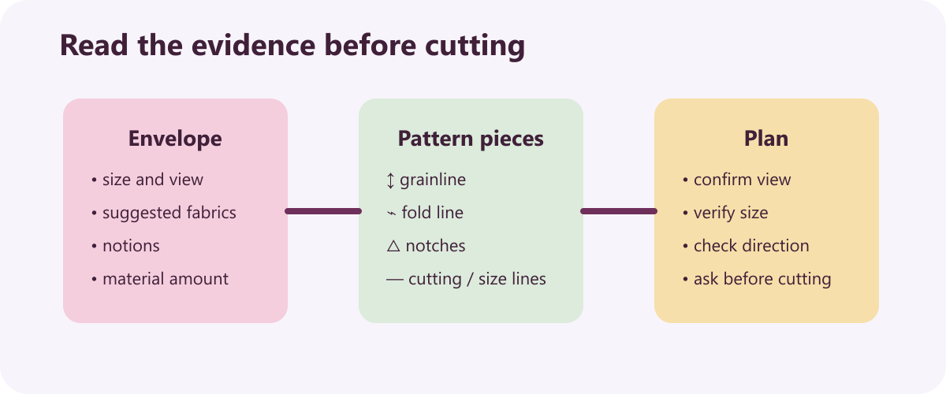
LEARNING MAP + RETRIEVAL STARTER
Three ideas to connect
1
Working safely in the textiles room
Stop a jammed or unusually noisy machine and ask the teacher for help.
2
Sewing-machine setup and control
Paper sewing develops steering, starting, stopping and turning control.
RETRIEVE FIRST
3
Pincushion practice and reflection
Without notes: say one fact you already know and one question you need answered.
A pincushion is judged first by how safely and securely it holds pins.
YEAR 9 TEXTILES · MODULE 1
02
Notes:
[Sources]
Website course data: assets/course-data.js, Module 1, all three section titles and first facts.
Course authority: work/source-contract.md and work/source-audit.md.
Local visual: assets/visuals/pattern-symbols.svg, source-bound course artwork rasterised for PowerPoint.
Source boundary: exact practical settings, construction directions and current assessment arrangements remain teacher-controlled.
[/Sources]
Teaching note: Give students 30 seconds of silent retrieval, then connect their responses to the three-part learning map.
Slide 2 of 8.

Slide 3
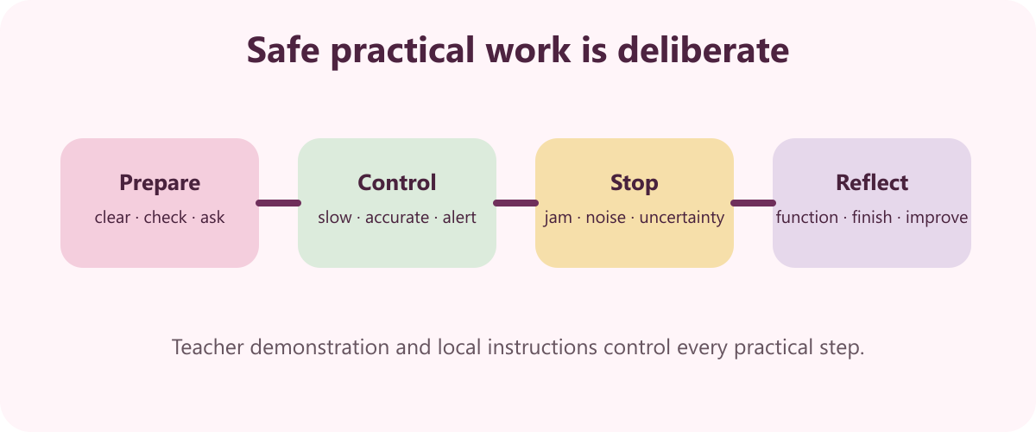
THEORY 1 OF 3
Working safely in the textiles room
UNDERSTAND THE IDEA
Stop a jammed or unusually noisy machine and ask the teacher for help. Stopping prevents a small fault becoming an injury or equipment failure.
Keep threads, pins and electrical leads controlled and off walkways. Clear movement areas reduce slip and trip risks.
Carry closed scissors by the blades and offer the handles first. The receiving person can take the tool without contacting the sharp end.
SEE THE RELATIONSHIP
EVIDENCE PROMPT
Explain three actions that make the textiles room safer and why each action matters.
YEAR 9 TEXTILES · MODULE 1
03
Notes:
[Sources]
Website course data: assets/course-data.js, Module 1, Section 1: Working safely in the textiles room.
Course authority: work/source-contract.md and work/source-audit.md.
Local visual: assets/visuals/safety-studio.svg, source-bound course artwork rasterised for PowerPoint.
Source boundary: exact practical settings, construction directions and current assessment arrangements remain teacher-controlled.
[/Sources]
Teaching note: Teach the three points, then pause for students to answer the evidence prompt in one or two precise sentences.
Slide 3 of 8.

Slide 4
THEORY 2 OF 3
Sewing-machine setup and control
1
Paper sewing develops steering, starting, stopping and turning control
UNDERSTAND THE IDEA
Paper sewing develops steering, starting, stopping and turning control. It isolates machine control before fabric and thread add complexity.
Accuracy matters more than speed when learning machine control. Slow deliberate movement gives time to follow lines and respond safely.
Turn the electricity off while threading the needle. This prevents accidental movement while fingers are near the needle.
2
Accuracy matters more than speed when learning machine control
3
Turn the electricity off while threading the needle
CONNECT THE IDEA — DO NOT JUST LIST IT
EVIDENCE PROMPT
Describe how you would build confidence from paper sewing to correctly threaded fabric sewing.
YEAR 9 TEXTILES · MODULE 1
04
Notes:
[Sources]
Website course data: assets/course-data.js, Module 1, Section 2: Sewing-machine setup and control.
Course authority: work/source-contract.md and work/source-audit.md.
Visual treatment: editable PowerPoint diagram generated only from the cited module facts.
Source boundary: exact practical settings, construction directions and current assessment arrangements remain teacher-controlled.
[/Sources]
Teaching note: Teach the three points, then pause for students to answer the evidence prompt in one or two precise sentences.
Slide 4 of 8.

Slide 5
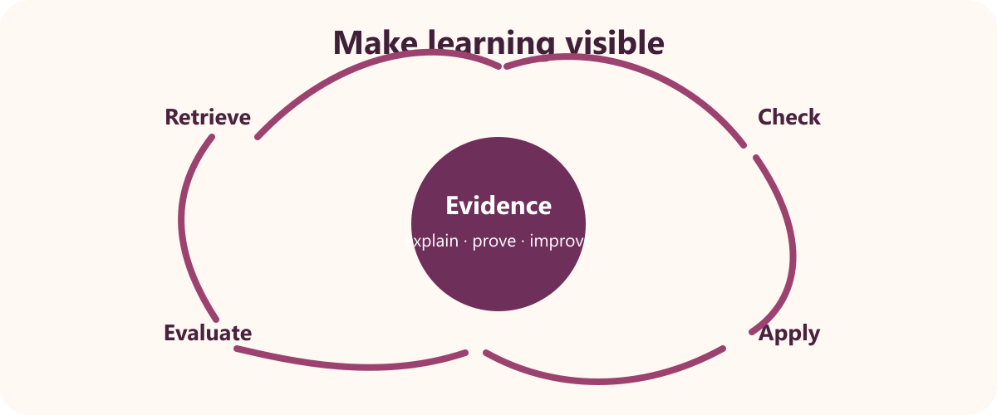
THEORY 3 OF 3
Pincushion practice and reflection
UNDERSTAND THE IDEA
A pincushion is judged first by how safely and securely it holds pins. Function is part of the design brief, not an optional decoration.
Consistent shape and filling affect the product's usefulness. Uneven or loose filling can make pins unstable.
An evaluation identifies achievements as well as difficulties. Balanced reflection shows what to repeat and what to improve.
SEE THE RELATIONSHIP
EVIDENCE PROMPT
Evaluate a practice pincushion by discussing function, presentation, one achievement and one improvement.
YEAR 9 TEXTILES · MODULE 1
05
Notes:
[Sources]
Website course data: assets/course-data.js, Module 1, Section 3: Pincushion practice and reflection.
Course authority: work/source-contract.md and work/source-audit.md.
Local visual: assets/visuals/evaluation-cycle.svg, source-bound course artwork rasterised for PowerPoint.
Source boundary: exact practical settings, construction directions and current assessment arrangements remain teacher-controlled.
[/Sources]
Teaching note: Teach the three points, then pause for students to answer the evidence prompt in one or two precise sentences.
Slide 5 of 8.

Slide 6
NO NOTES FOR THE FIRST ATTEMPT
Retrieve before you check
1
2
3
Working safely in the textiles room
Sewing-machine setup and control
Pincushion practice and reflection
Define working safely in the textiles room in your own words and give one course example.
Why does sewing-machine setup and control matter to a successful textile outcome?
What evidence would prove you understand pincushion practice and reflection?
Attempt → check the module → correct in a different colour
YEAR 9 TEXTILES · MODULE 1
06
Notes:
[Sources]
Website course data: assets/course-data.js, Module 1, retrieval questions generated from the first fact in each section.
Course authority: work/source-contract.md and work/source-audit.md.
Visual treatment: editable PowerPoint diagram generated only from the cited module facts.
Source boundary: exact practical settings, construction directions and current assessment arrangements remain teacher-controlled.
[/Sources]
Teaching note: Keep the first attempt closed-book. Accuracy improves when students check and visibly correct the response afterwards.
Slide 6 of 8.

Slide 7
READ → SELECT → EXPLAIN → CHECK
Build one strong written response
QUESTION
Evaluate a practice pincushion by discussing function, presentation, one achievement and one improvement.
1
READ
2
SELECT
3
EXPLAIN
4
CHECK
Underline the action word and the exact topic.
Choose two or three course facts that answer it.
Link each fact to why it matters or what it proves.
Return to the question; correct gaps and vague words.
Strong responses use evidence and reasoning—not a copied paragraph.
YEAR 9 TEXTILES · MODULE 1
07
Notes:
[Sources]
Website course data: assets/course-data.js, Module 1, Section 3 evidence prompt plus the course response scaffold.
Course authority: work/source-contract.md and work/source-audit.md.
Visual treatment: editable PowerPoint diagram generated only from the cited module facts.
Source boundary: exact practical settings, construction directions and current assessment arrangements remain teacher-controlled.
[/Sources]
Teaching note: Model the four-step process aloud. Students should be able to point to the fact and the explanation in their finished response.
Slide 7 of 8.

Slide 8
EXIT TICKET + NEXT STEP
Finish with evidence
EXIT TICKET
SAVE THIS EVIDENCE
Safety reflection, sewing-machine confidence check and pincushion evaluation.
1
Name one idea you can now explain accurately.
2
Identify one correction you made after retrieval.
3
State the evidence you will save from this module.
Return to the module page, complete the evidence prompt and use teacher directions for practical work.
NEXT STEP
Explain it. Check it. Save it.
YEAR 9 TEXTILES · MODULE 1
08
Notes:
[Sources]
Website course data: assets/course-data.js, Module 1, module evidence summary and student next step.
Course authority: work/source-contract.md and work/source-audit.md.
Visual treatment: editable PowerPoint diagram generated only from the cited module facts.
Source boundary: exact practical settings, construction directions and current assessment arrangements remain teacher-controlled.
[/Sources]
Teaching note: Collect a brief spoken or written exit response. Remind students that the website and teacher directions control the practical next step.
Slide 8 of 8.

