Slide 1

2
YEAR 9 TEXTILES TECHNOLOGY
Design foundations
Understand textiles as a design medium, use the elements of design and turn inspiration into a purposeful mood board.
TODAY: understand → retrieve → explain → save evidence
01
Notes:
[Sources]
Website course data: assets/course-data.js, Module 2, module summary and evidence sequence.
Course authority: work/source-contract.md and work/source-audit.md.
Local visual: assets/visuals/textiles-course-hero.svg, source-bound course artwork rasterised for PowerPoint.
Source boundary: exact practical settings, construction directions and current assessment arrangements remain teacher-controlled.
[/Sources]
Teaching note: State the module purpose. Ask students which part of the topic feels familiar and which part is new.
Slide 1 of 8.

Slide 2
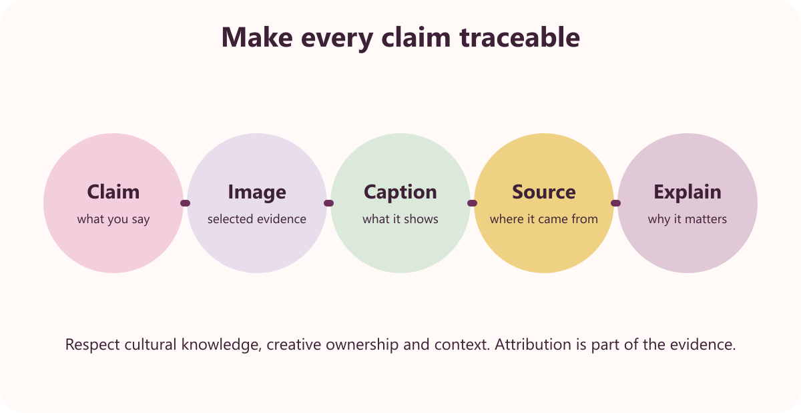
LEARNING MAP + RETRIEVAL STARTER
Three ideas to connect
1
Textiles as a design medium
The five focus areas are apparel, furnishings, costume, textile art and non-apparel.
2
Elements of design
Line, direction, shape, size, colour, value and texture are design elements.
RETRIEVE FIRST
3
Sources of inspiration and mood boards
Without notes: say one fact you already know and one question you need answered.
History, culture, nature, manufactured items, events and emotions can inspire design.
YEAR 9 TEXTILES · MODULE 2
02
Notes:
[Sources]
Website course data: assets/course-data.js, Module 2, all three section titles and first facts.
Course authority: work/source-contract.md and work/source-audit.md.
Local visual: assets/visuals/respectful-magazine.svg, source-bound course artwork rasterised for PowerPoint.
Source boundary: exact practical settings, construction directions and current assessment arrangements remain teacher-controlled.
[/Sources]
Teaching note: Give students 30 seconds of silent retrieval, then connect their responses to the three-part learning map.
Slide 2 of 8.

Slide 3
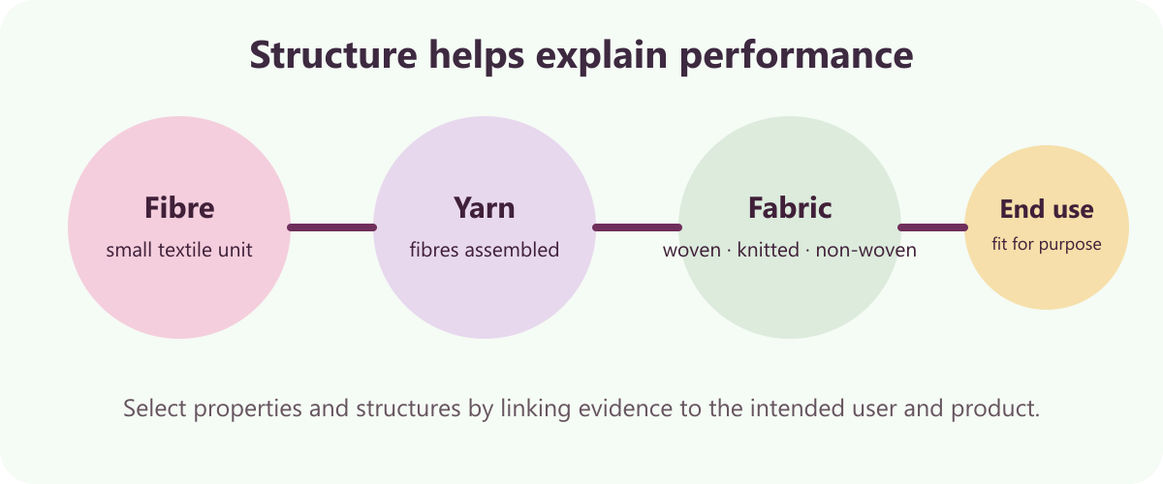
THEORY 1 OF 3
Textiles as a design medium
UNDERSTAND THE IDEA
The five focus areas are apparel, furnishings, costume, textile art and non-apparel. They organise the different end uses of textile design.
Textile fibres, yarns and fabrics can be used as a design medium. Their flexible structures can be selected and manipulated for many products.
Purpose and user needs guide material and process choices. A successful item must perform for its intended end use.
SEE THE RELATIONSHIP
EVIDENCE PROMPT
Choose one focus area and explain how user, purpose, material and equipment would influence a textile design.
YEAR 9 TEXTILES · MODULE 2
03
Notes:
[Sources]
Website course data: assets/course-data.js, Module 2, Section 1: Textiles as a design medium.
Course authority: work/source-contract.md and work/source-audit.md.
Local visual: assets/visuals/fibre-yarn-fabric.svg, source-bound course artwork rasterised for PowerPoint.
Source boundary: exact practical settings, construction directions and current assessment arrangements remain teacher-controlled.
[/Sources]
Teaching note: Teach the three points, then pause for students to answer the evidence prompt in one or two precise sentences.
Slide 3 of 8.

Slide 4
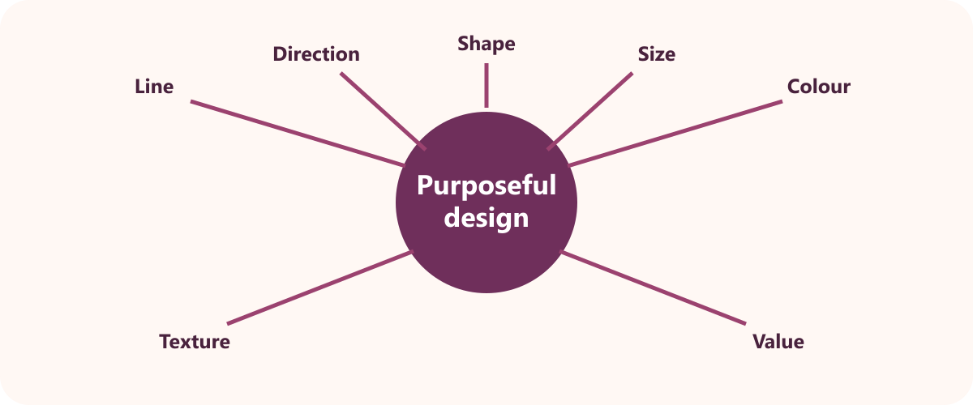
THEORY 2 OF 3
Elements of design
UNDERSTAND THE IDEA
Line, direction, shape, size, colour, value and texture are design elements. They are visual tools used to communicate and develop ideas.
Elements can be isolated or combined. Designers control emphasis and visual effect through their relationships.
Texture describes a surface's visual or tactile quality. It affects how an item looks and can affect how it feels.
SEE THE RELATIONSHIP
EVIDENCE PROMPT
Explain how you would use three design elements to communicate a chosen mood for nightwear.
YEAR 9 TEXTILES · MODULE 2
04
Notes:
[Sources]
Website course data: assets/course-data.js, Module 2, Section 2: Elements of design.
Course authority: work/source-contract.md and work/source-audit.md.
Local visual: assets/visuals/design-elements.svg, source-bound course artwork rasterised for PowerPoint.
Source boundary: exact practical settings, construction directions and current assessment arrangements remain teacher-controlled.
[/Sources]
Teaching note: Teach the three points, then pause for students to answer the evidence prompt in one or two precise sentences.
Slide 4 of 8.

Slide 5
THEORY 3 OF 3
Sources of inspiration and mood boards
UNDERSTAND THE IDEA
1
History, culture, nature, manufactured items, events and emotions can inspire design
History, culture, nature, manufactured items, events and emotions can inspire design. A broad source range helps designers generate varied directions.
Inspiration is transformed rather than copied. Original design develops selected features for a new purpose.
A mood board communicates a coherent direction. Related images, colours and textures make the intended mood visible.
2
Inspiration is transformed rather than copied
3
A mood board communicates a coherent direction
CONNECT THE IDEA — DO NOT JUST LIST IT
EVIDENCE PROMPT
Describe a mood-board direction for Designer Pyjamas and explain how the sources would lead to original design ideas.
YEAR 9 TEXTILES · MODULE 2
05
Notes:
[Sources]
Website course data: assets/course-data.js, Module 2, Section 3: Sources of inspiration and mood boards.
Course authority: work/source-contract.md and work/source-audit.md.
Visual treatment: editable PowerPoint diagram generated only from the cited module facts.
Source boundary: exact practical settings, construction directions and current assessment arrangements remain teacher-controlled.
[/Sources]
Teaching note: Teach the three points, then pause for students to answer the evidence prompt in one or two precise sentences.
Slide 5 of 8.

Slide 6
NO NOTES FOR THE FIRST ATTEMPT
Retrieve before you check
1
2
3
Textiles as a design medium
Elements of design
Sources of inspiration and mood boards
Define textiles as a design medium in your own words and give one course example.
Why does elements of design matter to a successful textile outcome?
What evidence would prove you understand sources of inspiration and mood boards?
Attempt → check the module → correct in a different colour
YEAR 9 TEXTILES · MODULE 2
06
Notes:
[Sources]
Website course data: assets/course-data.js, Module 2, retrieval questions generated from the first fact in each section.
Course authority: work/source-contract.md and work/source-audit.md.
Visual treatment: editable PowerPoint diagram generated only from the cited module facts.
Source boundary: exact practical settings, construction directions and current assessment arrangements remain teacher-controlled.
[/Sources]
Teaching note: Keep the first attempt closed-book. Accuracy improves when students check and visibly correct the response afterwards.
Slide 6 of 8.

Slide 7
READ → SELECT → EXPLAIN → CHECK
Build one strong written response
QUESTION
Describe a mood-board direction for Designer Pyjamas and explain how the sources would lead to original design ideas.
1
READ
2
SELECT
3
EXPLAIN
4
CHECK
Underline the action word and the exact topic.
Choose two or three course facts that answer it.
Link each fact to why it matters or what it proves.
Return to the question; correct gaps and vague words.
Strong responses use evidence and reasoning—not a copied paragraph.
YEAR 9 TEXTILES · MODULE 2
07
Notes:
[Sources]
Website course data: assets/course-data.js, Module 2, Section 3 evidence prompt plus the course response scaffold.
Course authority: work/source-contract.md and work/source-audit.md.
Visual treatment: editable PowerPoint diagram generated only from the cited module facts.
Source boundary: exact practical settings, construction directions and current assessment arrangements remain teacher-controlled.
[/Sources]
Teaching note: Model the four-step process aloud. Students should be able to point to the fact and the explanation in their finished response.
Slide 7 of 8.

Slide 8
EXIT TICKET + NEXT STEP
Finish with evidence
EXIT TICKET
SAVE THIS EVIDENCE
Mood board, two initial concepts and an annotated design decision.
1
Name one idea you can now explain accurately.
2
Identify one correction you made after retrieval.
3
State the evidence you will save from this module.
Return to the module page, complete the evidence prompt and use teacher directions for practical work.
NEXT STEP
Explain it. Check it. Save it.
YEAR 9 TEXTILES · MODULE 2
08
Notes:
[Sources]
Website course data: assets/course-data.js, Module 2, module evidence summary and student next step.
Course authority: work/source-contract.md and work/source-audit.md.
Visual treatment: editable PowerPoint diagram generated only from the cited module facts.
Source boundary: exact practical settings, construction directions and current assessment arrangements remain teacher-controlled.
[/Sources]
Teaching note: Collect a brief spoken or written exit response. Remind students that the website and teacher directions control the practical next step.
Slide 8 of 8.

