Slide 1

3
YEAR 9 TEXTILES TECHNOLOGY
Designer pyjamas
Translate user needs into pyjama and hoodie ideas, read commercial-pattern information and develop two labelled concepts.
TODAY: understand → retrieve → explain → save evidence
01
Notes:
[Sources]
Website course data: assets/course-data.js, Module 3, module summary and evidence sequence.
Course authority: work/source-contract.md and work/source-audit.md.
Local visual: assets/visuals/textiles-course-hero.svg, source-bound course artwork rasterised for PowerPoint.
Source boundary: exact practical settings, construction directions and current assessment arrangements remain teacher-controlled.
[/Sources]
Teaching note: State the module purpose. Ask students which part of the topic feels familiar and which part is new.
Slide 1 of 8.

Slide 2
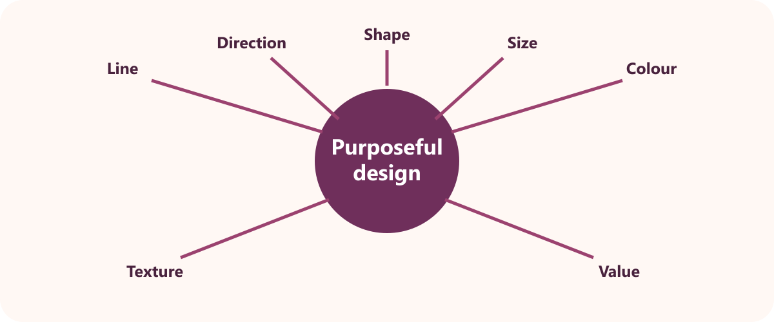
LEARNING MAP + RETRIEVAL STARTER
Three ideas to connect
1
Target markets and nightwear needs
A target market is the intended group of users.
2
Reading a commercial pattern
The pattern envelope identifies views, sizes, fabrics and notions.
RETRIEVE FIRST
3
Developing and selecting design ideas
Without notes: say one fact you already know and one question you need answered.
Two developed ideas allow comparison before selection.
YEAR 9 TEXTILES · MODULE 3
02
Notes:
[Sources]
Website course data: assets/course-data.js, Module 3, all three section titles and first facts.
Course authority: work/source-contract.md and work/source-audit.md.
Local visual: assets/visuals/design-elements.svg, source-bound course artwork rasterised for PowerPoint.
Source boundary: exact practical settings, construction directions and current assessment arrangements remain teacher-controlled.
[/Sources]
Teaching note: Give students 30 seconds of silent retrieval, then connect their responses to the three-part learning map.
Slide 2 of 8.

Slide 3
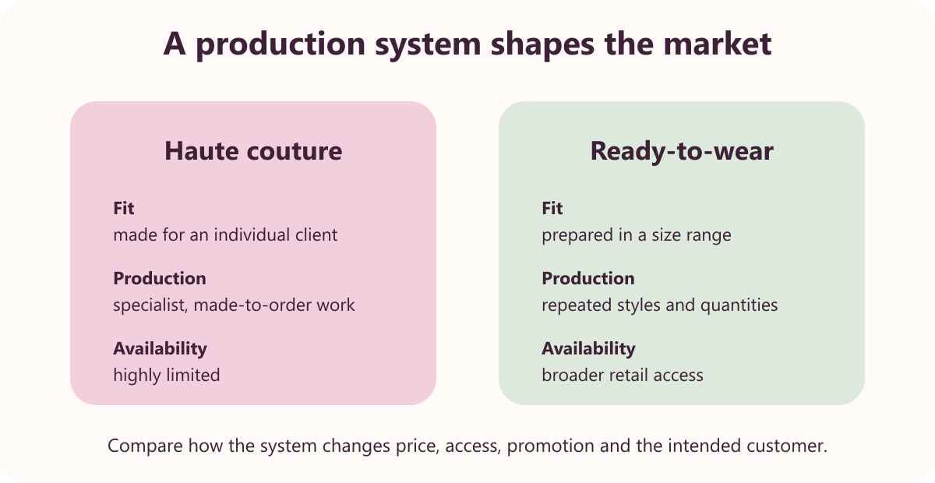
THEORY 1 OF 3
Target markets and nightwear needs
UNDERSTAND THE IDEA
A target market is the intended group of users. Knowing the user helps the designer make relevant choices.
Nightwear needs include comfort, movement, fit, climate and care. The item must perform during rest and routine use.
Personal style is considered alongside function. A useful design can also express the user's preferred colours and details.
SEE THE RELATIONSHIP
EVIDENCE PROMPT
Create a target-market profile for a nightwear user and justify three design requirements.
YEAR 9 TEXTILES · MODULE 3
03
Notes:
[Sources]
Website course data: assets/course-data.js, Module 3, Section 1: Target markets and nightwear needs.
Course authority: work/source-contract.md and work/source-audit.md.
Local visual: assets/visuals/designer-market.svg, source-bound course artwork rasterised for PowerPoint.
Source boundary: exact practical settings, construction directions and current assessment arrangements remain teacher-controlled.
[/Sources]
Teaching note: Teach the three points, then pause for students to answer the evidence prompt in one or two precise sentences.
Slide 3 of 8.

Slide 4
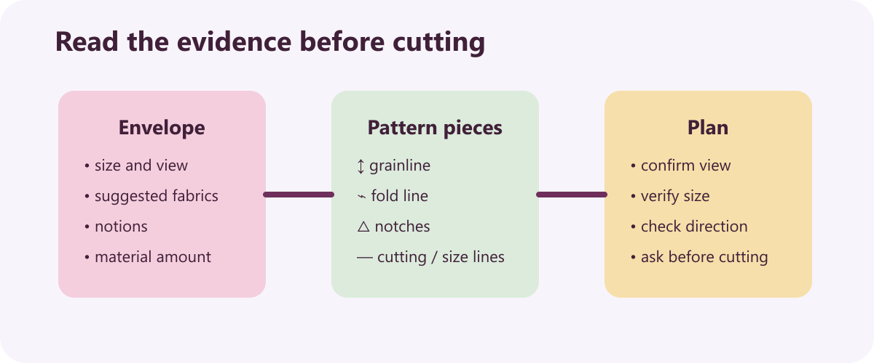
THEORY 2 OF 3
Reading a commercial pattern
UNDERSTAND THE IDEA
The pattern envelope identifies views, sizes, fabrics and notions. It gives the information needed before selecting and cutting materials.
A grainline guides how a pattern piece aligns with the fabric grain. Correct alignment supports expected hang and performance.
Notches help match corresponding construction points. They support accurate alignment during assembly.
SEE THE RELATIONSHIP
EVIDENCE PROMPT
Explain the information you would check before cutting fabric from a commercial pattern and why it matters.
YEAR 9 TEXTILES · MODULE 3
04
Notes:
[Sources]
Website course data: assets/course-data.js, Module 3, Section 2: Reading a commercial pattern.
Course authority: work/source-contract.md and work/source-audit.md.
Local visual: assets/visuals/pattern-symbols.svg, source-bound course artwork rasterised for PowerPoint.
Source boundary: exact practical settings, construction directions and current assessment arrangements remain teacher-controlled.
[/Sources]
Teaching note: Teach the three points, then pause for students to answer the evidence prompt in one or two precise sentences.
Slide 4 of 8.

Slide 5
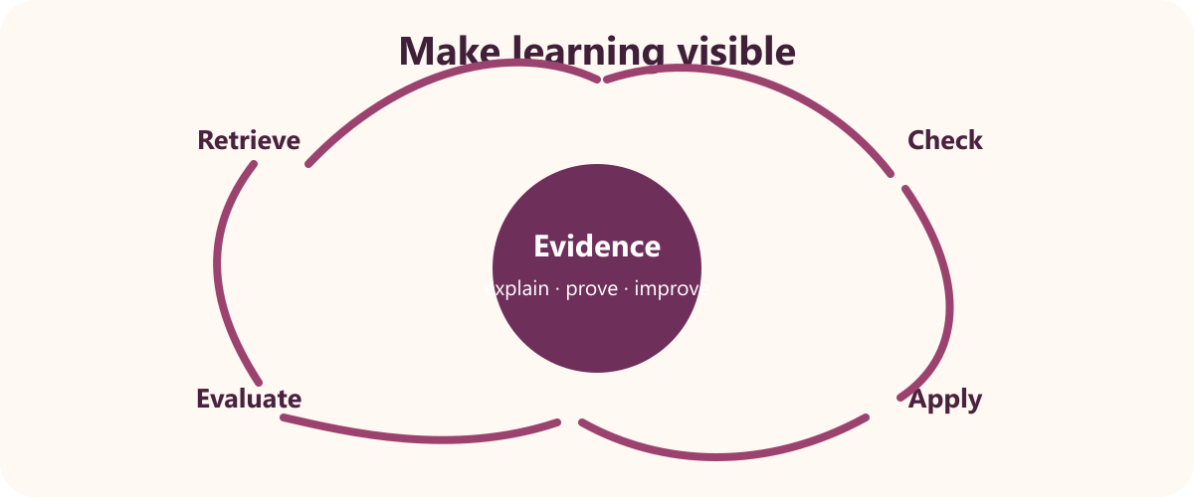
THEORY 3 OF 3
Developing and selecting design ideas
UNDERSTAND THE IDEA
Two developed ideas allow comparison before selection. Alternatives reveal different strengths, weaknesses and opportunities.
Front and back views communicate the whole garment. Construction and design details can differ between views.
Annotations explain features, materials and construction intentions. Labels make design thinking visible and assessable.
SEE THE RELATIONSHIP
EVIDENCE PROMPT
Compare two pyjama or hoodie concepts and justify which one should be developed.
YEAR 9 TEXTILES · MODULE 3
05
Notes:
[Sources]
Website course data: assets/course-data.js, Module 3, Section 3: Developing and selecting design ideas.
Course authority: work/source-contract.md and work/source-audit.md.
Local visual: assets/visuals/evaluation-cycle.svg, source-bound course artwork rasterised for PowerPoint.
Source boundary: exact practical settings, construction directions and current assessment arrangements remain teacher-controlled.
[/Sources]
Teaching note: Teach the three points, then pause for students to answer the evidence prompt in one or two precise sentences.
Slide 5 of 8.

Slide 6
NO NOTES FOR THE FIRST ATTEMPT
Retrieve before you check
1
2
3
Target markets and nightwear needs
Reading a commercial pattern
Developing and selecting design ideas
Define target markets and nightwear needs in your own words and give one course example.
Why does reading a commercial pattern matter to a successful textile outcome?
What evidence would prove you understand developing and selecting design ideas?
Attempt → check the module → correct in a different colour
YEAR 9 TEXTILES · MODULE 3
06
Notes:
[Sources]
Website course data: assets/course-data.js, Module 3, retrieval questions generated from the first fact in each section.
Course authority: work/source-contract.md and work/source-audit.md.
Visual treatment: editable PowerPoint diagram generated only from the cited module facts.
Source boundary: exact practical settings, construction directions and current assessment arrangements remain teacher-controlled.
[/Sources]
Teaching note: Keep the first attempt closed-book. Accuracy improves when students check and visibly correct the response afterwards.
Slide 6 of 8.

Slide 7
READ → SELECT → EXPLAIN → CHECK
Build one strong written response
QUESTION
Compare two pyjama or hoodie concepts and justify which one should be developed.
1
READ
2
SELECT
3
EXPLAIN
4
CHECK
Underline the action word and the exact topic.
Choose two or three course facts that answer it.
Link each fact to why it matters or what it proves.
Return to the question; correct gaps and vague words.
Strong responses use evidence and reasoning—not a copied paragraph.
YEAR 9 TEXTILES · MODULE 3
07
Notes:
[Sources]
Website course data: assets/course-data.js, Module 3, Section 3 evidence prompt plus the course response scaffold.
Course authority: work/source-contract.md and work/source-audit.md.
Visual treatment: editable PowerPoint diagram generated only from the cited module facts.
Source boundary: exact practical settings, construction directions and current assessment arrangements remain teacher-controlled.
[/Sources]
Teaching note: Model the four-step process aloud. Students should be able to point to the fact and the explanation in their finished response.
Slide 7 of 8.

Slide 8
EXIT TICKET + NEXT STEP
Finish with evidence
EXIT TICKET
SAVE THIS EVIDENCE
Target-market profile, pattern reading notes, two concepts and a selected final design.
1
Name one idea you can now explain accurately.
2
Identify one correction you made after retrieval.
3
State the evidence you will save from this module.
Return to the module page, complete the evidence prompt and use teacher directions for practical work.
NEXT STEP
Explain it. Check it. Save it.
YEAR 9 TEXTILES · MODULE 3
08
Notes:
[Sources]
Website course data: assets/course-data.js, Module 3, module evidence summary and student next step.
Course authority: work/source-contract.md and work/source-audit.md.
Visual treatment: editable PowerPoint diagram generated only from the cited module facts.
Source boundary: exact practical settings, construction directions and current assessment arrangements remain teacher-controlled.
[/Sources]
Teaching note: Collect a brief spoken or written exit response. Remind students that the website and teacher directions control the practical next step.
Slide 8 of 8.

