Slide 1

4
YEAR 9 TEXTILES TECHNOLOGY
Fibres, yarns & fabrics
Trace the relationship from fibre to yarn to fabric and connect structure and properties to a suitable end use.
TODAY: understand → retrieve → explain → save evidence
01
Notes:
[Sources]
Website course data: assets/course-data.js, Module 4, module summary and evidence sequence.
Course authority: work/source-contract.md and work/source-audit.md.
Local visual: assets/visuals/textiles-course-hero.svg, source-bound course artwork rasterised for PowerPoint.
Source boundary: exact practical settings, construction directions and current assessment arrangements remain teacher-controlled.
[/Sources]
Teaching note: State the module purpose. Ask students which part of the topic feels familiar and which part is new.
Slide 1 of 8.

Slide 2
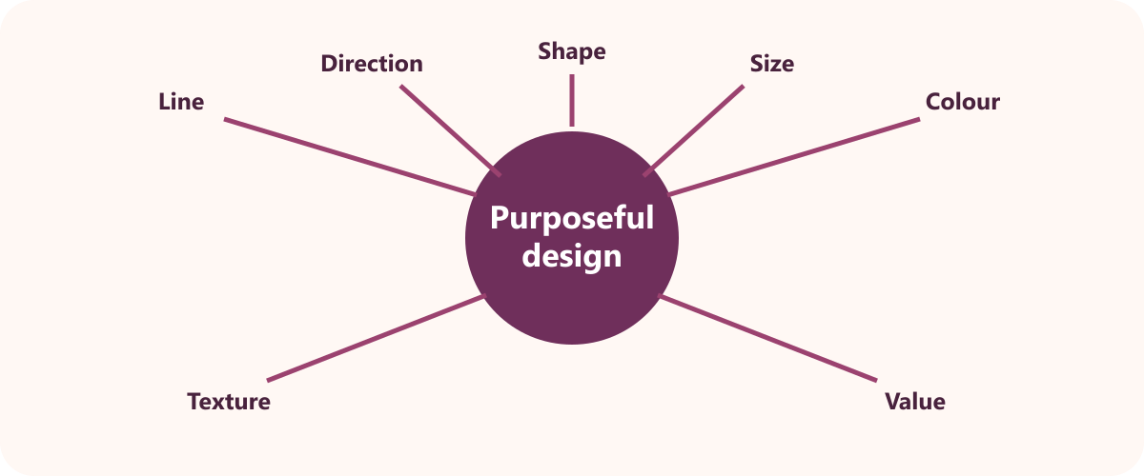
LEARNING MAP + RETRIEVAL STARTER
Three ideas to connect
1
Fibre classification and properties
Fibres are raw materials used to make yarns and fabrics.
2
From fibres to yarns
Staple fibres are short lengths and filament fibres are continuous lengths.
RETRIEVE FIRST
3
Woven, knitted and non-woven fabrics
Without notes: say one fact you already know and one question you need answered.
Woven fabric interlaces warp and weft yarns.
YEAR 9 TEXTILES · MODULE 4
02
Notes:
[Sources]
Website course data: assets/course-data.js, Module 4, all three section titles and first facts.
Course authority: work/source-contract.md and work/source-audit.md.
Local visual: assets/visuals/design-elements.svg, source-bound course artwork rasterised for PowerPoint.
Source boundary: exact practical settings, construction directions and current assessment arrangements remain teacher-controlled.
[/Sources]
Teaching note: Give students 30 seconds of silent retrieval, then connect their responses to the three-part learning map.
Slide 2 of 8.

Slide 3
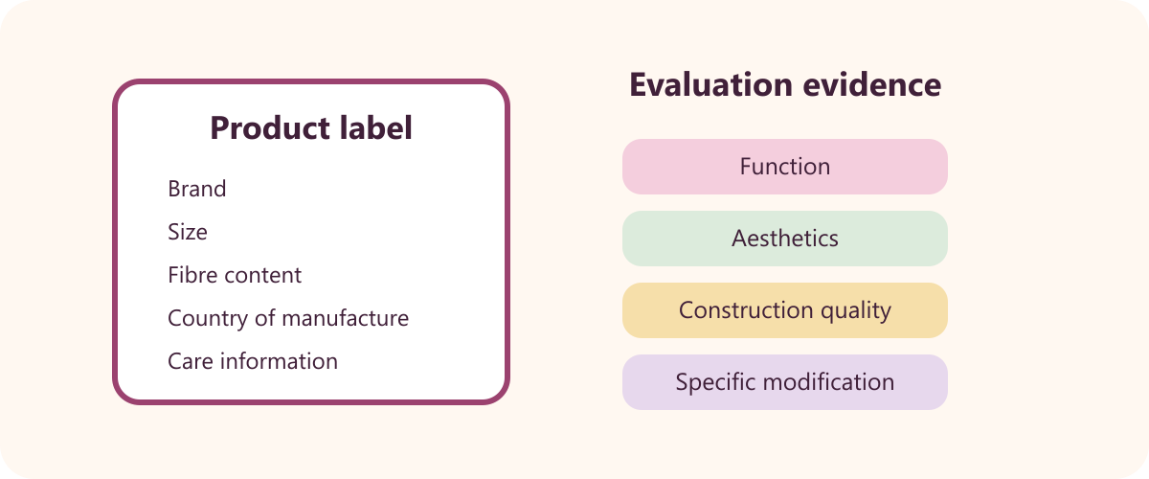
THEORY 1 OF 3
Fibre classification and properties
UNDERSTAND THE IDEA
Fibres are raw materials used to make yarns and fabrics. Their characteristics influence the finished textile.
Natural and manufactured are the two main fibre classifications. The classification describes how fibres originate.
Plant fibres are commonly described as cellulose fibres. Their material source is plant-based.
SEE THE RELATIONSHIP
EVIDENCE PROMPT
Classify four fibres and explain how one fibre property makes a fabric suitable for a chosen item.
YEAR 9 TEXTILES · MODULE 4
03
Notes:
[Sources]
Website course data: assets/course-data.js, Module 4, Section 1: Fibre classification and properties.
Course authority: work/source-contract.md and work/source-audit.md.
Local visual: assets/visuals/garment-label.svg, source-bound course artwork rasterised for PowerPoint.
Source boundary: exact practical settings, construction directions and current assessment arrangements remain teacher-controlled.
[/Sources]
Teaching note: Teach the three points, then pause for students to answer the evidence prompt in one or two precise sentences.
Slide 3 of 8.

Slide 4
THEORY 2 OF 3
From fibres to yarns
1
Staple fibres are short lengths and filament fibres are continuous lengths
UNDERSTAND THE IDEA
Staple fibres are short lengths and filament fibres are continuous lengths. Fibre length changes how yarn is produced and behaves.
Spinning draws out fibres and adds twist. Twist binds fibres into a usable yarn structure.
Higher twist generally produces a stronger yarn. Tighter fibre binding improves cohesion.
2
Spinning draws out fibres and adds twist
3
Higher twist generally produces a stronger yarn
CONNECT THE IDEA — DO NOT JUST LIST IT
EVIDENCE PROMPT
Explain the path from fibre to yarn and how changing twist or yarn structure can change performance.
YEAR 9 TEXTILES · MODULE 4
04
Notes:
[Sources]
Website course data: assets/course-data.js, Module 4, Section 2: From fibres to yarns.
Course authority: work/source-contract.md and work/source-audit.md.
Visual treatment: editable PowerPoint diagram generated only from the cited module facts.
Source boundary: exact practical settings, construction directions and current assessment arrangements remain teacher-controlled.
[/Sources]
Teaching note: Teach the three points, then pause for students to answer the evidence prompt in one or two precise sentences.
Slide 4 of 8.

Slide 5
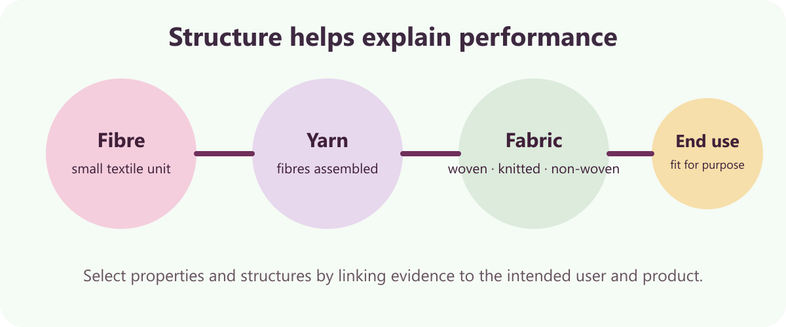
THEORY 3 OF 3
Woven, knitted and non-woven fabrics
UNDERSTAND THE IDEA
Woven fabric interlaces warp and weft yarns. Two yarn systems cross to form the structure.
Warp runs along the fabric length and weft across its width. The directional yarn systems define woven structure.
Plain, twill and satin or sateen are basic weave structures. Changing the interlacing pattern changes fabric characteristics.
SEE THE RELATIONSHIP
EVIDENCE PROMPT
Compare woven, knitted and non-woven structures and recommend one for a specific textile end use.
YEAR 9 TEXTILES · MODULE 4
05
Notes:
[Sources]
Website course data: assets/course-data.js, Module 4, Section 3: Woven, knitted and non-woven fabrics.
Course authority: work/source-contract.md and work/source-audit.md.
Local visual: assets/visuals/fibre-yarn-fabric.svg, source-bound course artwork rasterised for PowerPoint.
Source boundary: exact practical settings, construction directions and current assessment arrangements remain teacher-controlled.
[/Sources]
Teaching note: Teach the three points, then pause for students to answer the evidence prompt in one or two precise sentences.
Slide 5 of 8.

Slide 6
NO NOTES FOR THE FIRST ATTEMPT
Retrieve before you check
1
2
3
Fibre classification and properties
From fibres to yarns
Woven, knitted and non-woven fabrics
Define fibre classification and properties in your own words and give one course example.
Why does from fibres to yarns matter to a successful textile outcome?
What evidence would prove you understand woven, knitted and non-woven fabrics?
Attempt → check the module → correct in a different colour
YEAR 9 TEXTILES · MODULE 4
06
Notes:
[Sources]
Website course data: assets/course-data.js, Module 4, retrieval questions generated from the first fact in each section.
Course authority: work/source-contract.md and work/source-audit.md.
Visual treatment: editable PowerPoint diagram generated only from the cited module facts.
Source boundary: exact practical settings, construction directions and current assessment arrangements remain teacher-controlled.
[/Sources]
Teaching note: Keep the first attempt closed-book. Accuracy improves when students check and visibly correct the response afterwards.
Slide 6 of 8.

Slide 7
READ → SELECT → EXPLAIN → CHECK
Build one strong written response
QUESTION
Compare woven, knitted and non-woven structures and recommend one for a specific textile end use.
1
READ
2
SELECT
3
EXPLAIN
4
CHECK
Underline the action word and the exact topic.
Choose two or three course facts that answer it.
Link each fact to why it matters or what it proves.
Return to the question; correct gaps and vague words.
Strong responses use evidence and reasoning—not a copied paragraph.
YEAR 9 TEXTILES · MODULE 4
07
Notes:
[Sources]
Website course data: assets/course-data.js, Module 4, Section 3 evidence prompt plus the course response scaffold.
Course authority: work/source-contract.md and work/source-audit.md.
Visual treatment: editable PowerPoint diagram generated only from the cited module facts.
Source boundary: exact practical settings, construction directions and current assessment arrangements remain teacher-controlled.
[/Sources]
Teaching note: Model the four-step process aloud. Students should be able to point to the fact and the explanation in their finished response.
Slide 7 of 8.

Slide 8
EXIT TICKET + NEXT STEP
Finish with evidence
EXIT TICKET
SAVE THIS EVIDENCE
Classification chart, fibre-to-fabric explanation and justified material choice.
1
Name one idea you can now explain accurately.
2
Identify one correction you made after retrieval.
3
State the evidence you will save from this module.
Return to the module page, complete the evidence prompt and use teacher directions for practical work.
NEXT STEP
Explain it. Check it. Save it.
YEAR 9 TEXTILES · MODULE 4
08
Notes:
[Sources]
Website course data: assets/course-data.js, Module 4, module evidence summary and student next step.
Course authority: work/source-contract.md and work/source-audit.md.
Visual treatment: editable PowerPoint diagram generated only from the cited module facts.
Source boundary: exact practical settings, construction directions and current assessment arrangements remain teacher-controlled.
[/Sources]
Teaching note: Collect a brief spoken or written exit response. Remind students that the website and teacher directions control the practical next step.
Slide 8 of 8.

