Slide 1
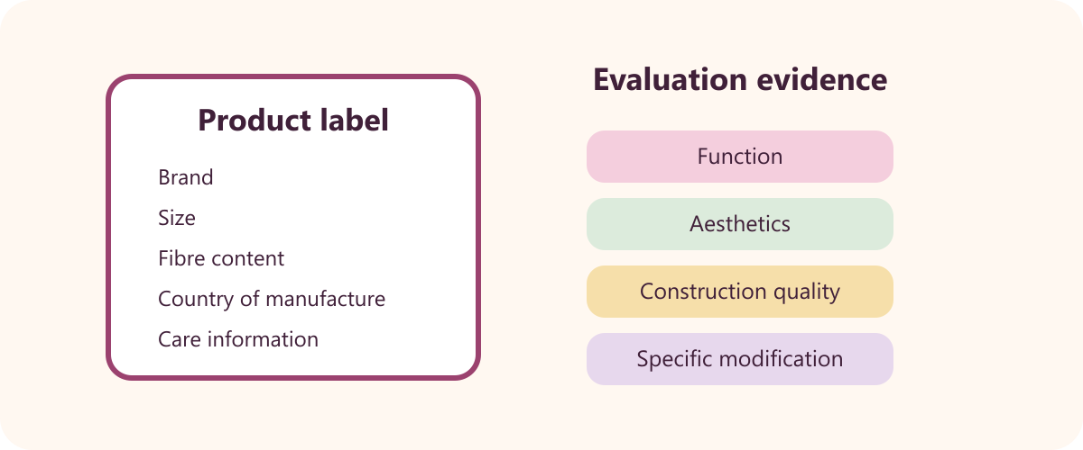
5
YEAR 9 TEXTILES TECHNOLOGY
Apparel production & evaluation
Use teacher demonstrations and issued patterns to make the project, document construction and create accurate product-care information.
TODAY: understand → retrieve → explain → save evidence
01
Notes:
[Sources]
Website course data: assets/course-data.js, Module 5, module summary and evidence sequence.
Course authority: work/source-contract.md and work/source-audit.md.
Local visual: assets/visuals/garment-label.svg, source-bound course artwork rasterised for PowerPoint.
Source boundary: exact practical settings, construction directions and current assessment arrangements remain teacher-controlled.
[/Sources]
Teaching note: State the module purpose. Ask students which part of the topic feels familiar and which part is new.
Slide 1 of 8.

Slide 2

LEARNING MAP + RETRIEVAL STARTER
Three ideas to connect
1
Construction sequence and technique samples
The current pattern instructions and teacher demonstration control construction order.
2
Resources, equipment and costing
Equipment is used to make the item; resources are consumed in making it.
RETRIEVE FIRST
3
Product labels and evaluation
Without notes: say one fact you already know and one question you need answered.
The source activity checks brand, size, fibre content, country and care information.
YEAR 9 TEXTILES · MODULE 5
02
Notes:
[Sources]
Website course data: assets/course-data.js, Module 5, all three section titles and first facts.
Course authority: work/source-contract.md and work/source-audit.md.
Local visual: assets/visuals/textiles-course-hero.svg, source-bound course artwork rasterised for PowerPoint.
Source boundary: exact practical settings, construction directions and current assessment arrangements remain teacher-controlled.
[/Sources]
Teaching note: Give students 30 seconds of silent retrieval, then connect their responses to the three-part learning map.
Slide 2 of 8.

Slide 3
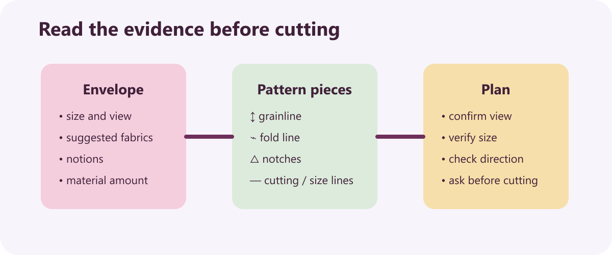
THEORY 1 OF 3
Construction sequence and technique samples
UNDERSTAND THE IDEA
The current pattern instructions and teacher demonstration control construction order. They are the local authority for the exact project method.
Technique samples provide evidence before or alongside the final garment. They show how seams, finishes or hems were practised and refined.
Each construction step should include a quality check. Checking alignment and finish early prevents faults carrying forward.
SEE THE RELATIONSHIP
EVIDENCE PROMPT
Outline a safe construction-record format that follows the issued pattern and includes useful quality checks.
YEAR 9 TEXTILES · MODULE 5
03
Notes:
[Sources]
Website course data: assets/course-data.js, Module 5, Section 1: Construction sequence and technique samples.
Course authority: work/source-contract.md and work/source-audit.md.
Local visual: assets/visuals/pattern-symbols.svg, source-bound course artwork rasterised for PowerPoint.
Source boundary: exact practical settings, construction directions and current assessment arrangements remain teacher-controlled.
[/Sources]
Teaching note: Teach the three points, then pause for students to answer the evidence prompt in one or two precise sentences.
Slide 3 of 8.

Slide 4
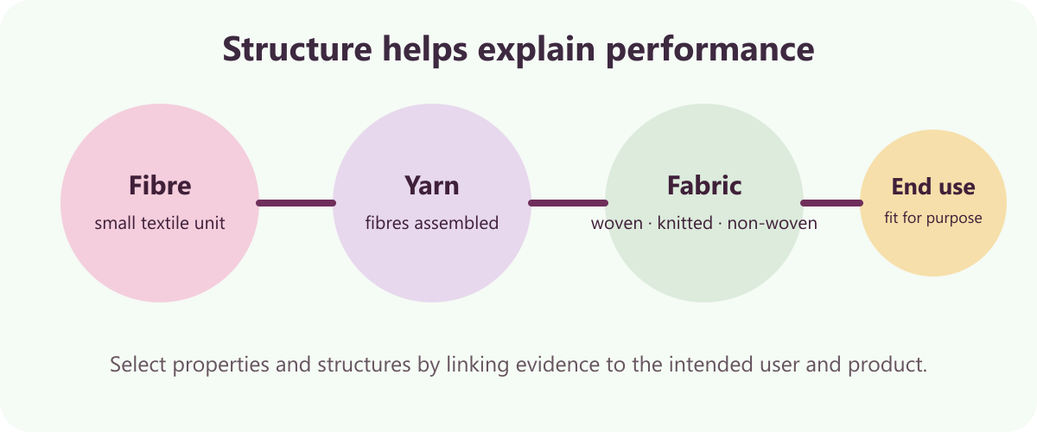
THEORY 2 OF 3
Resources, equipment and costing
UNDERSTAND THE IDEA
Equipment is used to make the item; resources are consumed in making it. The distinction supports planning and accurate documentation.
A costing table records item, quantity, unit cost and total. The columns make the calculation traceable.
Use real receipts, labels or teacher-issued figures. Evidence-based costs can be checked and updated.
SEE THE RELATIONSHIP
EVIDENCE PROMPT
Design the headings for a resource and costing table and explain what evidence you would use to complete it.
YEAR 9 TEXTILES · MODULE 5
04
Notes:
[Sources]
Website course data: assets/course-data.js, Module 5, Section 2: Resources, equipment and costing.
Course authority: work/source-contract.md and work/source-audit.md.
Local visual: assets/visuals/fibre-yarn-fabric.svg, source-bound course artwork rasterised for PowerPoint.
Source boundary: exact practical settings, construction directions and current assessment arrangements remain teacher-controlled.
[/Sources]
Teaching note: Teach the three points, then pause for students to answer the evidence prompt in one or two precise sentences.
Slide 4 of 8.

Slide 5
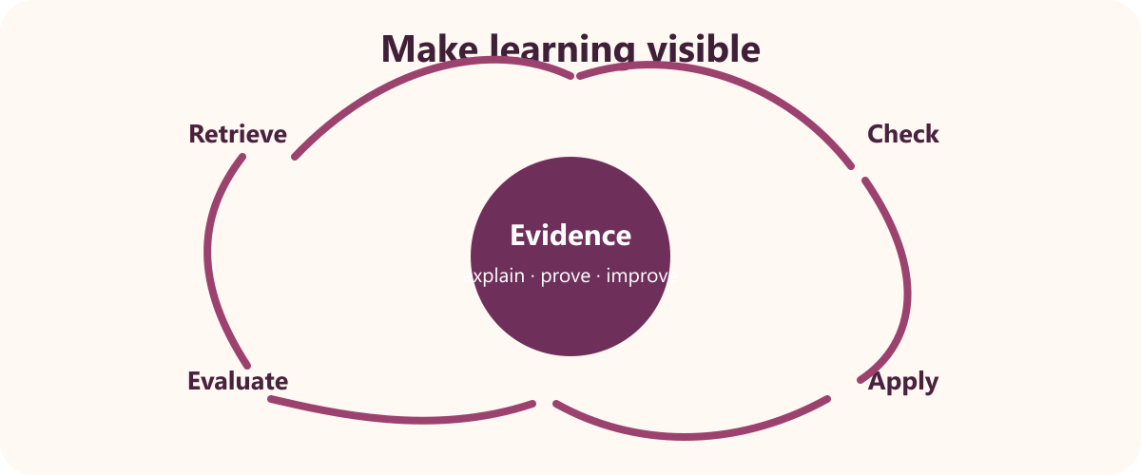
THEORY 3 OF 3
Product labels and evaluation
UNDERSTAND THE IDEA
The source activity checks brand, size, fibre content, country and care information. These details help a consumer identify and care for the product.
Care symbols communicate laundering or cleaning instructions. They support correct maintenance of the textile item.
Fibre content helps explain care and performance. Different fibres can respond differently to heat, moisture and wear.
SEE THE RELATIONSHIP
EVIDENCE PROMPT
Draft the information plan for a product label, then explain how you would evaluate the finished apparel item.
YEAR 9 TEXTILES · MODULE 5
05
Notes:
[Sources]
Website course data: assets/course-data.js, Module 5, Section 3: Product labels and evaluation.
Course authority: work/source-contract.md and work/source-audit.md.
Local visual: assets/visuals/evaluation-cycle.svg, source-bound course artwork rasterised for PowerPoint.
Source boundary: exact practical settings, construction directions and current assessment arrangements remain teacher-controlled.
[/Sources]
Teaching note: Teach the three points, then pause for students to answer the evidence prompt in one or two precise sentences.
Slide 5 of 8.

Slide 6
NO NOTES FOR THE FIRST ATTEMPT
Retrieve before you check
1
2
3
Construction sequence and technique samples
Resources, equipment and costing
Product labels and evaluation
Define construction sequence and technique samples in your own words and give one course example.
Why does resources, equipment and costing matter to a successful textile outcome?
What evidence would prove you understand product labels and evaluation?
Attempt → check the module → correct in a different colour
YEAR 9 TEXTILES · MODULE 5
06
Notes:
[Sources]
Website course data: assets/course-data.js, Module 5, retrieval questions generated from the first fact in each section.
Course authority: work/source-contract.md and work/source-audit.md.
Visual treatment: editable PowerPoint diagram generated only from the cited module facts.
Source boundary: exact practical settings, construction directions and current assessment arrangements remain teacher-controlled.
[/Sources]
Teaching note: Keep the first attempt closed-book. Accuracy improves when students check and visibly correct the response afterwards.
Slide 6 of 8.

Slide 7
READ → SELECT → EXPLAIN → CHECK
Build one strong written response
QUESTION
Draft the information plan for a product label, then explain how you would evaluate the finished apparel item.
1
READ
2
SELECT
3
EXPLAIN
4
CHECK
Underline the action word and the exact topic.
Choose two or three course facts that answer it.
Link each fact to why it matters or what it proves.
Return to the question; correct gaps and vague words.
Strong responses use evidence and reasoning—not a copied paragraph.
YEAR 9 TEXTILES · MODULE 5
07
Notes:
[Sources]
Website course data: assets/course-data.js, Module 5, Section 3 evidence prompt plus the course response scaffold.
Course authority: work/source-contract.md and work/source-audit.md.
Visual treatment: editable PowerPoint diagram generated only from the cited module facts.
Source boundary: exact practical settings, construction directions and current assessment arrangements remain teacher-controlled.
[/Sources]
Teaching note: Model the four-step process aloud. Students should be able to point to the fact and the explanation in their finished response.
Slide 7 of 8.

Slide 8
EXIT TICKET + NEXT STEP
Finish with evidence
EXIT TICKET
SAVE THIS EVIDENCE
Construction sequence, technique samples, resource list, costing, product label and evaluation.
1
Name one idea you can now explain accurately.
2
Identify one correction you made after retrieval.
3
State the evidence you will save from this module.
Return to the module page, complete the evidence prompt and use teacher directions for practical work.
NEXT STEP
Explain it. Check it. Save it.
YEAR 9 TEXTILES · MODULE 5
08
Notes:
[Sources]
Website course data: assets/course-data.js, Module 5, module evidence summary and student next step.
Course authority: work/source-contract.md and work/source-audit.md.
Visual treatment: editable PowerPoint diagram generated only from the cited module facts.
Source boundary: exact practical settings, construction directions and current assessment arrangements remain teacher-controlled.
[/Sources]
Teaching note: Collect a brief spoken or written exit response. Remind students that the website and teacher directions control the practical next step.
Slide 8 of 8.

