Slide 1
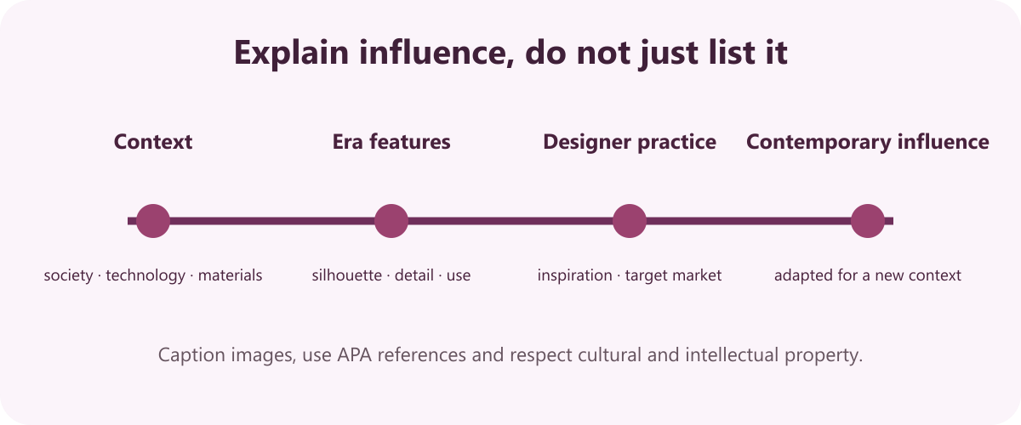
6
YEAR 9 TEXTILES TECHNOLOGY
Designers & fashion eras
Investigate fashion history, designer practice, inspiration, target markets and the way earlier design features reappear in contemporary work.
TODAY: understand → retrieve → explain → save evidence
01
Notes:
[Sources]
Website course data: assets/course-data.js, Module 6, module summary and evidence sequence.
Course authority: work/source-contract.md and work/source-audit.md.
Local visual: assets/visuals/fashion-timeline.svg, source-bound course artwork rasterised for PowerPoint.
Source boundary: exact practical settings, construction directions and current assessment arrangements remain teacher-controlled.
[/Sources]
Teaching note: State the module purpose. Ask students which part of the topic feels familiar and which part is new.
Slide 1 of 8.

Slide 2
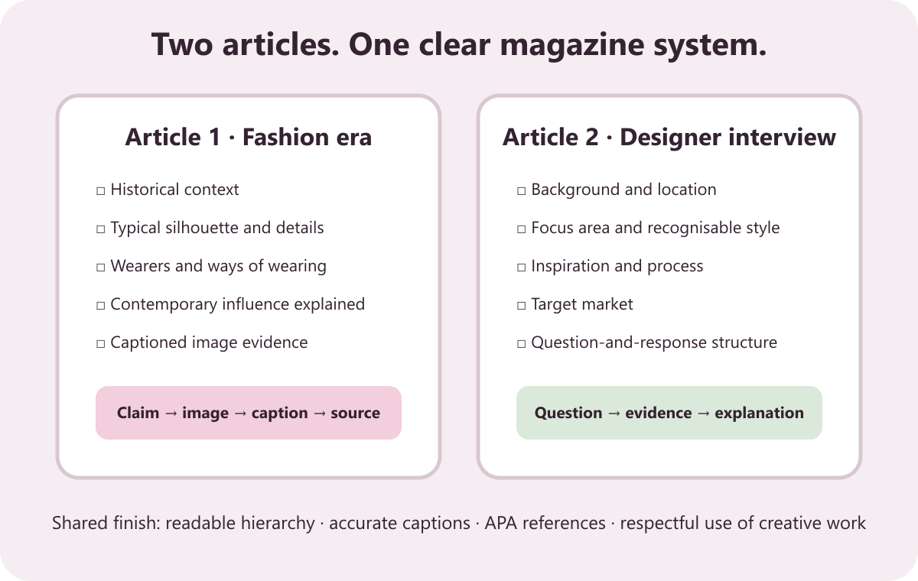
LEARNING MAP + RETRIEVAL STARTER
Three ideas to connect
1
Fashion eras and historical influence
Fashion changes with social, technological and material conditions.
2
Designer practice and target markets
Styling, material quality, price and marketing shape a designer's image.
RETRIEVE FIRST
3
Magazine research and respectful evidence
Without notes: say one fact you already know and one question you need answered.
The task requires two magazine articles.
YEAR 9 TEXTILES · MODULE 6
02
Notes:
[Sources]
Website course data: assets/course-data.js, Module 6, all three section titles and first facts.
Course authority: work/source-contract.md and work/source-audit.md.
Local visual: assets/visuals/magazine-evidence-map.svg, source-bound course artwork rasterised for PowerPoint.
Source boundary: exact practical settings, construction directions and current assessment arrangements remain teacher-controlled.
[/Sources]
Teaching note: Give students 30 seconds of silent retrieval, then connect their responses to the three-part learning map.
Slide 2 of 8.

Slide 3
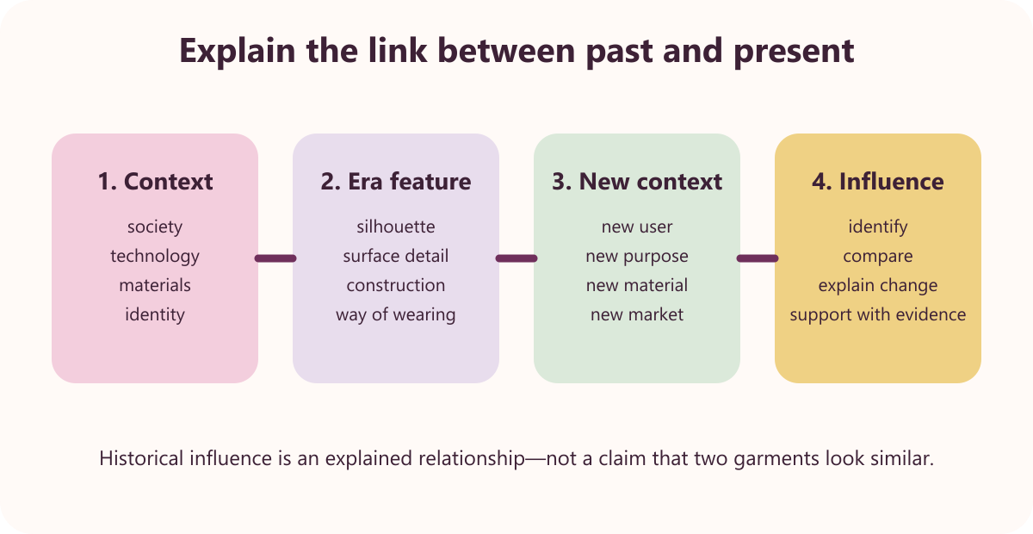
THEORY 1 OF 3
Fashion eras and historical influence
UNDERSTAND THE IDEA
Fashion changes with social, technological and material conditions. Clothing reflects the circumstances and values of its time.
Industrialisation supported sewing-machine use and ready-to-wear production. Technology changed how garments could be manufactured and sold.
Historical features can reappear in contemporary fashion. Designers reinterpret silhouettes, details or materials for a new context.
SEE THE RELATIONSHIP
EVIDENCE PROMPT
Choose a fashion era and explain two design features and one way the era influences contemporary fashion.
YEAR 9 TEXTILES · MODULE 6
03
Notes:
[Sources]
Website course data: assets/course-data.js, Module 6, Section 1: Fashion eras and historical influence.
Course authority: work/source-contract.md and work/source-audit.md.
Local visual: assets/visuals/fashion-era-influence.svg, source-bound course artwork rasterised for PowerPoint.
Source boundary: exact practical settings, construction directions and current assessment arrangements remain teacher-controlled.
[/Sources]
Teaching note: Teach the three points, then pause for students to answer the evidence prompt in one or two precise sentences.
Slide 3 of 8.

Slide 4
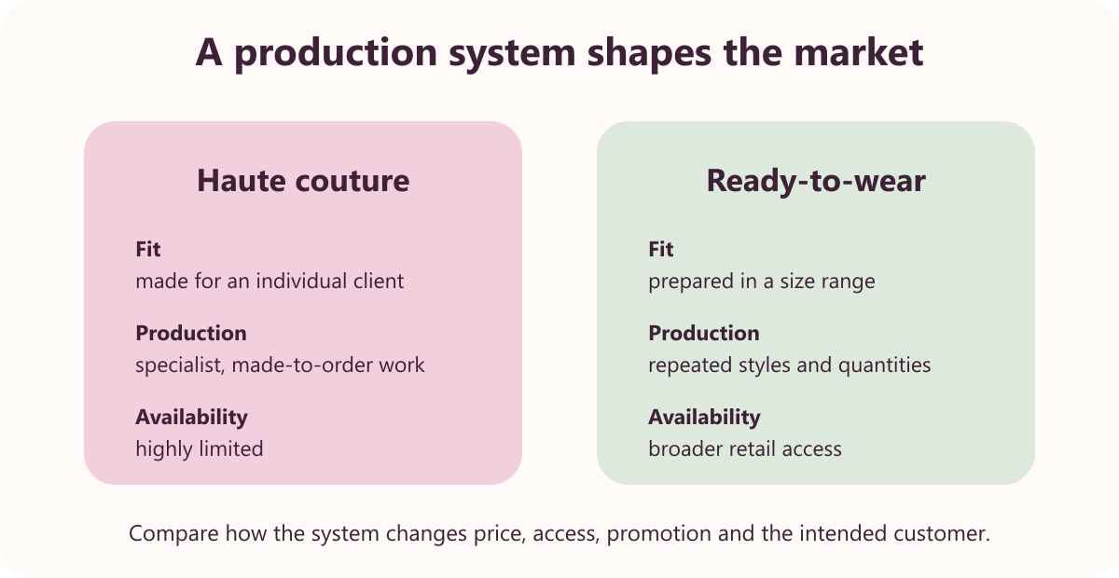
THEORY 2 OF 3
Designer practice and target markets
UNDERSTAND THE IDEA
Styling, material quality, price and marketing shape a designer's image. These decisions communicate position and target market.
Haute couture is custom made for private clients. It uses made-to-order design, fittings and specialist production.
Ready-to-wear is produced in sizes for retail sale. Customers can select from prepared styles and take the garment home.
SEE THE RELATIONSHIP
EVIDENCE PROMPT
Compare haute couture and ready-to-wear, then explain how a designer's target market changes their decisions.
YEAR 9 TEXTILES · MODULE 6
04
Notes:
[Sources]
Website course data: assets/course-data.js, Module 6, Section 2: Designer practice and target markets.
Course authority: work/source-contract.md and work/source-audit.md.
Local visual: assets/visuals/designer-market.svg, source-bound course artwork rasterised for PowerPoint.
Source boundary: exact practical settings, construction directions and current assessment arrangements remain teacher-controlled.
[/Sources]
Teaching note: Teach the three points, then pause for students to answer the evidence prompt in one or two precise sentences.
Slide 4 of 8.

Slide 5
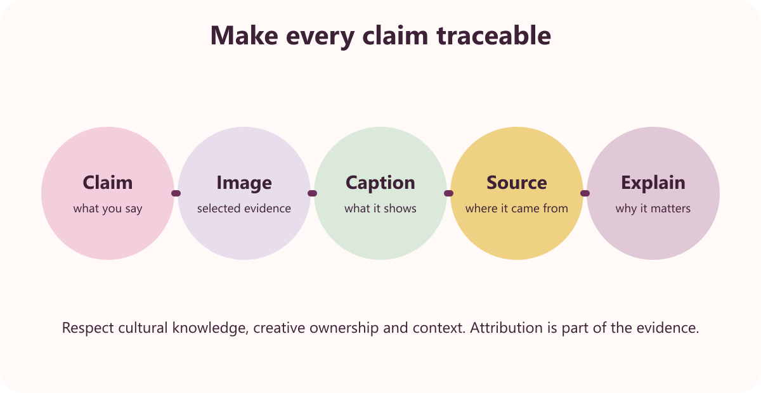
THEORY 3 OF 3
Magazine research and respectful evidence
UNDERSTAND THE IDEA
The task requires two magazine articles. One covers a fashion era and one presents a textile-designer interview.
Magazine styling should support readable information. Layout and images communicate best when hierarchy remains clear.
Images require captions and APA references. The reader must be able to identify and trace the source.
SEE THE RELATIONSHIP
EVIDENCE PROMPT
Plan the two magazine articles, including headings, image evidence and how you will reference sources respectfully.
YEAR 9 TEXTILES · MODULE 6
05
Notes:
[Sources]
Website course data: assets/course-data.js, Module 6, Section 3: Magazine research and respectful evidence.
Course authority: work/source-contract.md and work/source-audit.md.
Local visual: assets/visuals/respectful-magazine.svg, source-bound course artwork rasterised for PowerPoint.
Source boundary: exact practical settings, construction directions and current assessment arrangements remain teacher-controlled.
[/Sources]
Teaching note: Teach the three points, then pause for students to answer the evidence prompt in one or two precise sentences.
Slide 5 of 8.

Slide 6
NO NOTES FOR THE FIRST ATTEMPT
Retrieve before you check
1
2
3
Fashion eras and historical influence
Designer practice and target markets
Magazine research and respectful evidence
Define fashion eras and historical influence in your own words and give one course example.
Why does designer practice and target markets matter to a successful textile outcome?
What evidence would prove you understand magazine research and respectful evidence?
Attempt → check the module → correct in a different colour
YEAR 9 TEXTILES · MODULE 6
06
Notes:
[Sources]
Website course data: assets/course-data.js, Module 6, retrieval questions generated from the first fact in each section.
Course authority: work/source-contract.md and work/source-audit.md.
Visual treatment: editable PowerPoint diagram generated only from the cited module facts.
Source boundary: exact practical settings, construction directions and current assessment arrangements remain teacher-controlled.
[/Sources]
Teaching note: Keep the first attempt closed-book. Accuracy improves when students check and visibly correct the response afterwards.
Slide 6 of 8.

Slide 7
READ → SELECT → EXPLAIN → CHECK
Build one strong written response
QUESTION
Plan the two magazine articles, including headings, image evidence and how you will reference sources respectfully.
1
READ
2
SELECT
3
EXPLAIN
4
CHECK
Underline the action word and the exact topic.
Choose two or three course facts that answer it.
Link each fact to why it matters or what it proves.
Return to the question; correct gaps and vague words.
Strong responses use evidence and reasoning—not a copied paragraph.
YEAR 9 TEXTILES · MODULE 6
07
Notes:
[Sources]
Website course data: assets/course-data.js, Module 6, Section 3 evidence prompt plus the course response scaffold.
Course authority: work/source-contract.md and work/source-audit.md.
Visual treatment: editable PowerPoint diagram generated only from the cited module facts.
Source boundary: exact practical settings, construction directions and current assessment arrangements remain teacher-controlled.
[/Sources]
Teaching note: Model the four-step process aloud. Students should be able to point to the fact and the explanation in their finished response.
Slide 7 of 8.

Slide 8
EXIT TICKET + NEXT STEP
Finish with evidence
EXIT TICKET
SAVE THIS EVIDENCE
Two-part magazine: a fashion-era report and a designer interview with images and APA references.
1
Name one idea you can now explain accurately.
2
Identify one correction you made after retrieval.
3
State the evidence you will save from this module.
Return to the module page, complete the evidence prompt and use teacher directions for practical work.
NEXT STEP
Explain it. Check it. Save it.
YEAR 9 TEXTILES · MODULE 6
08
Notes:
[Sources]
Website course data: assets/course-data.js, Module 6, module evidence summary and student next step.
Course authority: work/source-contract.md and work/source-audit.md.
Visual treatment: editable PowerPoint diagram generated only from the cited module facts.
Source boundary: exact practical settings, construction directions and current assessment arrangements remain teacher-controlled.
[/Sources]
Teaching note: Collect a brief spoken or written exit response. Remind students that the website and teacher directions control the practical next step.
Slide 8 of 8.

