Slide 1
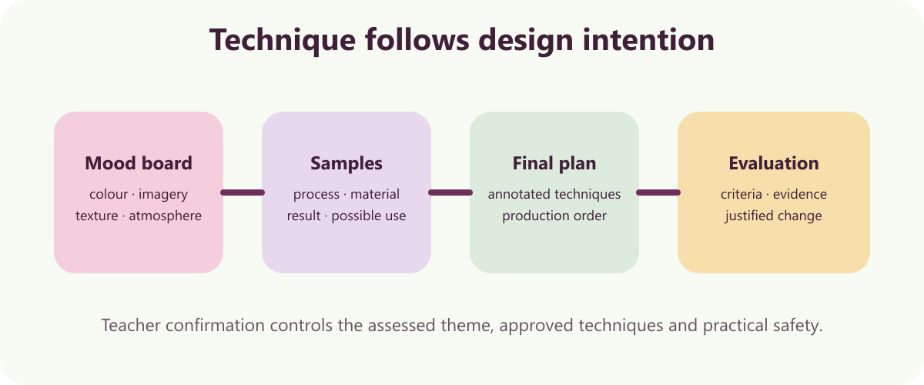
7
YEAR 9 TEXTILES TECHNOLOGY
Textile art: ideas to evidence
Explore textile-art techniques, develop an original concept for the teacher-confirmed theme and document a controlled production process.
TODAY: understand → retrieve → explain → save evidence
01
Notes:
[Sources]
Website course data: assets/course-data.js, Module 7, module summary and evidence sequence.
Course authority: work/source-contract.md and work/source-audit.md.
Local visual: assets/visuals/textile-art-techniques.svg, source-bound course artwork rasterised for PowerPoint.
Source boundary: the assessed textile-art theme is Teacher to confirm because supplied sources conflict.
[/Sources]
Teaching note: State the module purpose. Ask students which part of the topic feels familiar and which part is new.
Slide 1 of 8.

Slide 2

LEARNING MAP + RETRIEVAL STARTER
Three ideas to connect
1
Exploring textile-art techniques
Technique samples record process, materials, result and possible use.
2
Developing an original textile-art design
The current assessed theme must be confirmed by the teacher.
RETRIEVE FIRST
3
Production drawing, making and evaluation
Without notes: say one fact you already know and one question you need answered.
A production drawing clearly communicates the intended textile item.
YEAR 9 TEXTILES · MODULE 7
02
Notes:
[Sources]
Website course data: assets/course-data.js, Module 7, all three section titles and first facts.
Course authority: work/source-contract.md and work/source-audit.md.
Local visual: assets/visuals/textiles-course-hero.svg, source-bound course artwork rasterised for PowerPoint.
Source boundary: the assessed textile-art theme is Teacher to confirm because supplied sources conflict.
[/Sources]
Teaching note: Give students 30 seconds of silent retrieval, then connect their responses to the three-part learning map.
Slide 2 of 8.

Slide 3
THEORY 1 OF 3
Exploring textile-art techniques
UNDERSTAND THE IDEA
1
Technique samples record process, materials, result and possible use
Technique samples record process, materials, result and possible use. They turn experimentation into evidence for later design decisions.
Appliqué adds fabric shapes to a base fabric. Layered shapes can build colour, form and imagery.
Couching secures a yarn or cord on the surface. It can create controlled lines and texture without pulling the yarn through every stitch.
2
Appliqué adds fabric shapes to a base fabric
3
Couching secures a yarn or cord on the surface
CONNECT THE IDEA — DO NOT JUST LIST IT
EVIDENCE PROMPT
Select four explored techniques and explain what each could contribute to a textile artwork for the teacher-confirmed theme.
YEAR 9 TEXTILES · MODULE 7
03
Notes:
[Sources]
Website course data: assets/course-data.js, Module 7, Section 1: Exploring textile-art techniques.
Course authority: work/source-contract.md and work/source-audit.md.
Visual treatment: editable PowerPoint diagram generated only from the cited module facts.
Source boundary: the assessed textile-art theme is Teacher to confirm because supplied sources conflict.
[/Sources]
Teaching note: Teach the three points, then pause for students to answer the evidence prompt in one or two precise sentences.
Slide 3 of 8.

Slide 4
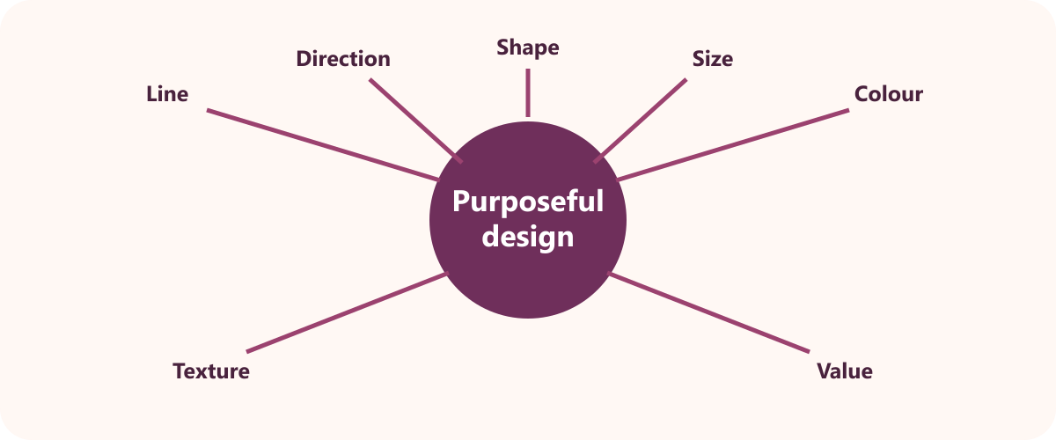
THEORY 2 OF 3
Developing an original textile-art design
UNDERSTAND THE IDEA
The current assessed theme must be confirmed by the teacher. The supplied task sources conflict, so the deck cannot choose the controlling fact.
A mood board establishes colour, imagery, texture and atmosphere. It gives a coherent source base for original idea development.
Two ideas should be compared before final selection. Comparison helps improve originality and achievable technique use.
SEE THE RELATIONSHIP
EVIDENCE PROMPT
Develop a concept statement for the teacher-confirmed theme and justify the selected imagery, colour and four techniques.
YEAR 9 TEXTILES · MODULE 7
04
Notes:
[Sources]
Website course data: assets/course-data.js, Module 7, Section 2: Developing an original textile-art design.
Course authority: work/source-contract.md and work/source-audit.md.
Local visual: assets/visuals/design-elements.svg, source-bound course artwork rasterised for PowerPoint.
Source boundary: the assessed textile-art theme is Teacher to confirm because supplied sources conflict.
[/Sources]
Teaching note: Teach the three points, then pause for students to answer the evidence prompt in one or two precise sentences.
Slide 4 of 8.

Slide 5
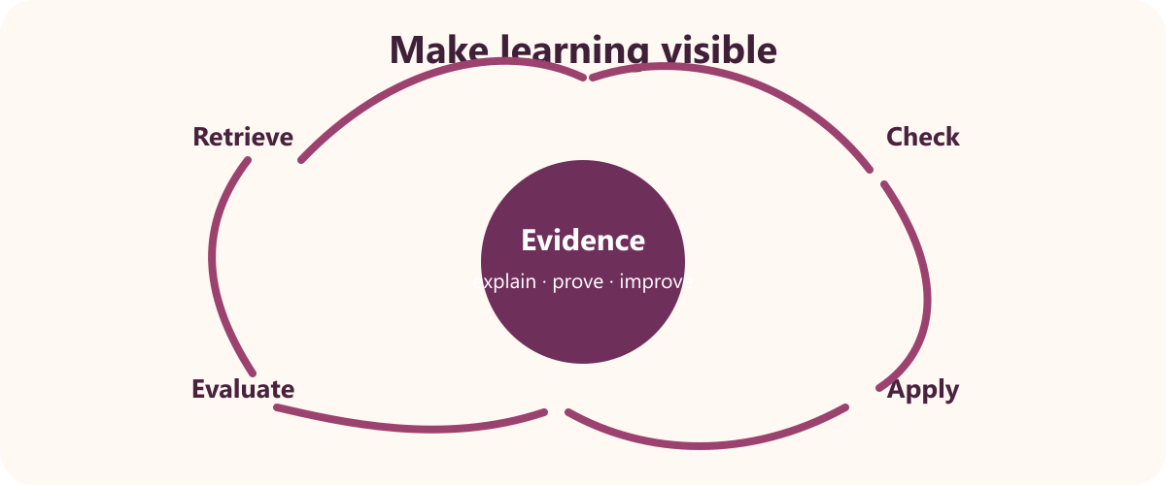
THEORY 3 OF 3
Production drawing, making and evaluation
UNDERSTAND THE IDEA
A production drawing clearly communicates the intended textile item. It connects design details, size, materials and technique locations.
Use real design dimensions rather than invented values. The drawing must match the student's actual planned item.
A technique key explains symbols or labels on the drawing. It helps the reader locate and understand planned processes.
SEE THE RELATIONSHIP
EVIDENCE PROMPT
Explain how your production drawing, construction sequence and evaluation will work together as evidence.
YEAR 9 TEXTILES · MODULE 7
05
Notes:
[Sources]
Website course data: assets/course-data.js, Module 7, Section 3: Production drawing, making and evaluation.
Course authority: work/source-contract.md and work/source-audit.md.
Local visual: assets/visuals/evaluation-cycle.svg, source-bound course artwork rasterised for PowerPoint.
Source boundary: the assessed textile-art theme is Teacher to confirm because supplied sources conflict.
[/Sources]
Teaching note: Teach the three points, then pause for students to answer the evidence prompt in one or two precise sentences.
Slide 5 of 8.

Slide 6
NO NOTES FOR THE FIRST ATTEMPT
Retrieve before you check
1
2
3
Exploring textile-art techniques
Developing an original textile-art design
Production drawing, making and evaluation
Define exploring textile-art techniques in your own words and give one course example.
Why does developing an original textile-art design matter to a successful textile outcome?
What evidence would prove you understand production drawing, making and evaluation?
Attempt → check the module → correct in a different colour
YEAR 9 TEXTILES · MODULE 7
06
Notes:
[Sources]
Website course data: assets/course-data.js, Module 7, retrieval questions generated from the first fact in each section.
Course authority: work/source-contract.md and work/source-audit.md.
Visual treatment: editable PowerPoint diagram generated only from the cited module facts.
Source boundary: the assessed textile-art theme is Teacher to confirm because supplied sources conflict.
[/Sources]
Teaching note: Keep the first attempt closed-book. Accuracy improves when students check and visibly correct the response afterwards.
Slide 6 of 8.

Slide 7
READ → SELECT → EXPLAIN → CHECK
Build one strong written response
QUESTION
Explain how your production drawing, construction sequence and evaluation will work together as evidence.
1
READ
2
SELECT
3
EXPLAIN
4
CHECK
Underline the action word and the exact topic.
Choose two or three course facts that answer it.
Link each fact to why it matters or what it proves.
Return to the question; correct gaps and vague words.
Strong responses use evidence and reasoning—not a copied paragraph.
YEAR 9 TEXTILES · MODULE 7
07
Notes:
[Sources]
Website course data: assets/course-data.js, Module 7, Section 3 evidence prompt plus the course response scaffold.
Course authority: work/source-contract.md and work/source-audit.md.
Visual treatment: editable PowerPoint diagram generated only from the cited module facts.
Source boundary: the assessed textile-art theme is Teacher to confirm because supplied sources conflict.
[/Sources]
Teaching note: Model the four-step process aloud. Students should be able to point to the fact and the explanation in their finished response.
Slide 7 of 8.

Slide 8
EXIT TICKET + NEXT STEP
Finish with evidence
EXIT TICKET
SAVE THIS EVIDENCE
Technique samples, mood board, two designs, final design, production drawing, resources, label and evaluation.
1
Name one idea you can now explain accurately.
2
Identify one correction you made after retrieval.
3
State the evidence you will save from this module.
Return to the module page, complete the evidence prompt and use teacher directions for practical work.
NEXT STEP
Explain it. Check it. Save it.
YEAR 9 TEXTILES · MODULE 7
08
Notes:
[Sources]
Website course data: assets/course-data.js, Module 7, module evidence summary and student next step.
Course authority: work/source-contract.md and work/source-audit.md.
Visual treatment: editable PowerPoint diagram generated only from the cited module facts.
Source boundary: the assessed textile-art theme is Teacher to confirm because supplied sources conflict.
[/Sources]
Teaching note: Collect a brief spoken or written exit response. Remind students that the website and teacher directions control the practical next step.
Slide 8 of 8.

