Slide 1
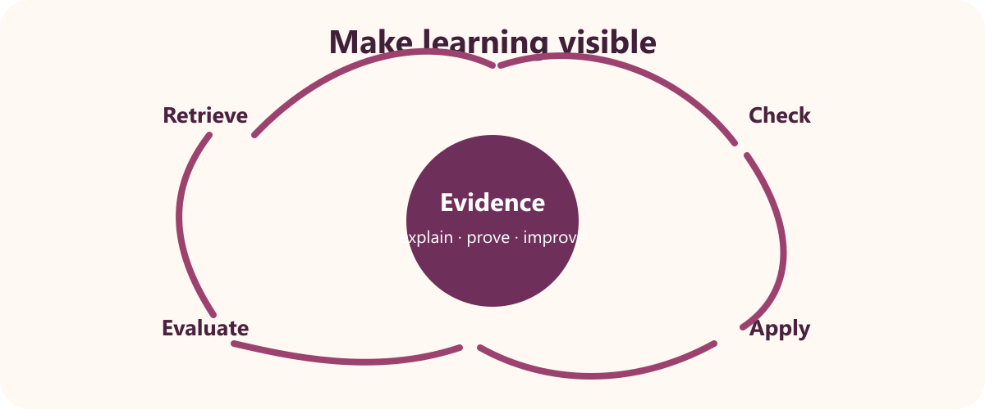
8
YEAR 9 TEXTILES TECHNOLOGY
Consolidation & textiles gifts
Consolidate the three areas of study, improve portfolio evidence and apply the design process to a small teacher-approved gift project.
TODAY: understand → retrieve → explain → save evidence
01
Notes:
[Sources]
Website course data: assets/course-data.js, Module 8, module summary and evidence sequence.
Course authority: work/source-contract.md and work/source-audit.md.
Local visual: assets/visuals/evaluation-cycle.svg, source-bound course artwork rasterised for PowerPoint.
Source boundary: examination status, scope and weighting are not claimed; this deck presents consolidation and extension only.
[/Sources]
Teaching note: State the module purpose. Ask students which part of the topic feels familiar and which part is new.
Slide 1 of 8.

Slide 2

LEARNING MAP + RETRIEVAL STARTER
Three ideas to connect
1
Revision across the three areas of study
The three areas are Design, Properties and Performance, and Textiles and Society.
2
Final evaluation and portfolio readiness
A portfolio records the design and production process.
RETRIEVE FIRST
3
Textiles as Gifts: a teacher-approved extension
Without notes: say one fact you already know and one question you need answered.
The source outline names Textiles as Gifts as a free-choice practical destination.
YEAR 9 TEXTILES · MODULE 8
02
Notes:
[Sources]
Website course data: assets/course-data.js, Module 8, all three section titles and first facts.
Course authority: work/source-contract.md and work/source-audit.md.
Local visual: assets/visuals/textiles-course-hero.svg, source-bound course artwork rasterised for PowerPoint.
Source boundary: examination status, scope and weighting are not claimed; this deck presents consolidation and extension only.
[/Sources]
Teaching note: Give students 30 seconds of silent retrieval, then connect their responses to the three-part learning map.
Slide 2 of 8.

Slide 3
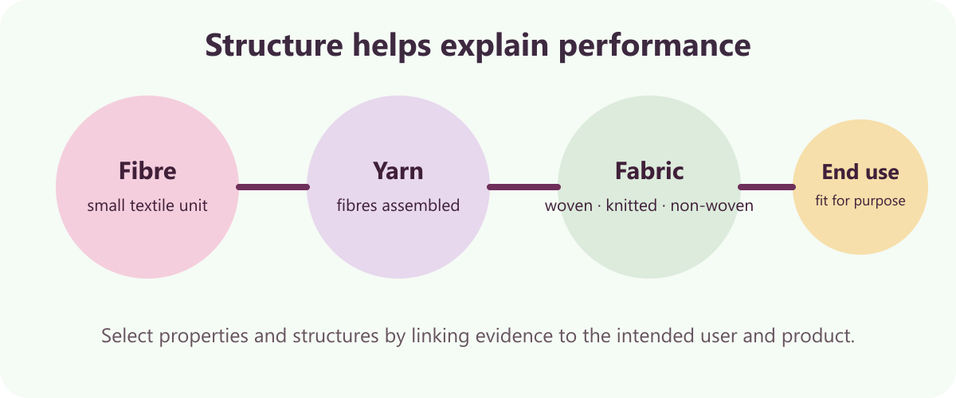
THEORY 1 OF 3
Revision across the three areas of study
UNDERSTAND THE IDEA
The three areas are Design, Properties and Performance, and Textiles and Society. They organise the core theory in the posted course material.
Retrieval means explaining from memory before checking. It reveals what is understood and what needs correction.
Project examples make theory easier to apply. A real item connects concepts such as fibre, structure, user and design.
SEE THE RELATIONSHIP
EVIDENCE PROMPT
Create a three-column revision map linking one key idea from each area of study to a course project example.
YEAR 9 TEXTILES · MODULE 8
03
Notes:
[Sources]
Website course data: assets/course-data.js, Module 8, Section 1: Revision across the three areas of study.
Course authority: work/source-contract.md and work/source-audit.md.
Local visual: assets/visuals/fibre-yarn-fabric.svg, source-bound course artwork rasterised for PowerPoint.
Source boundary: examination status, scope and weighting are not claimed; this deck presents consolidation and extension only.
[/Sources]
Teaching note: Teach the three points, then pause for students to answer the evidence prompt in one or two precise sentences.
Slide 3 of 8.

Slide 4
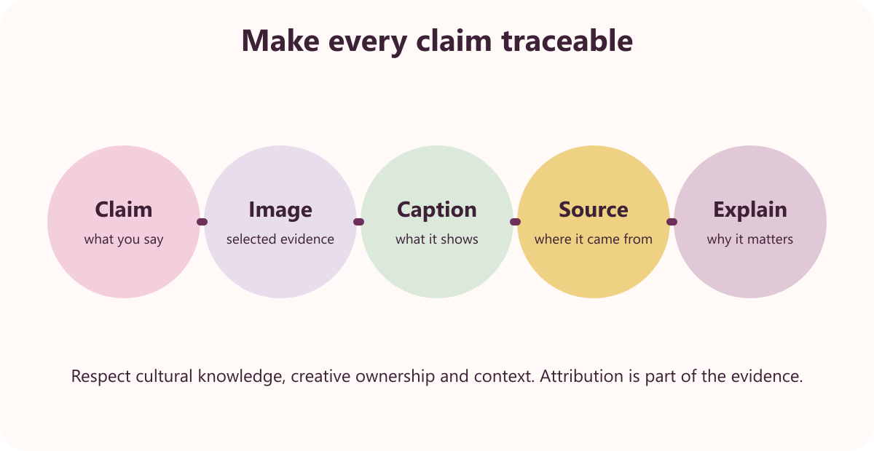
THEORY 2 OF 3
Final evaluation and portfolio readiness
UNDERSTAND THE IDEA
A portfolio records the design and production process. It explains decisions and evidence, not just the finished appearance.
Each evidence section needs a clear heading and context. The reader should understand what the evidence shows.
The final evaluation returns to criteria and project evidence. It shows whether intended performance was achieved.
SEE THE RELATIONSHIP
EVIDENCE PROMPT
Write a final portfolio readiness checklist and explain how you would prove one evaluation judgement.
YEAR 9 TEXTILES · MODULE 8
04
Notes:
[Sources]
Website course data: assets/course-data.js, Module 8, Section 2: Final evaluation and portfolio readiness.
Course authority: work/source-contract.md and work/source-audit.md.
Local visual: assets/visuals/respectful-magazine.svg, source-bound course artwork rasterised for PowerPoint.
Source boundary: examination status, scope and weighting are not claimed; this deck presents consolidation and extension only.
[/Sources]
Teaching note: Teach the three points, then pause for students to answer the evidence prompt in one or two precise sentences.
Slide 4 of 8.

Slide 5
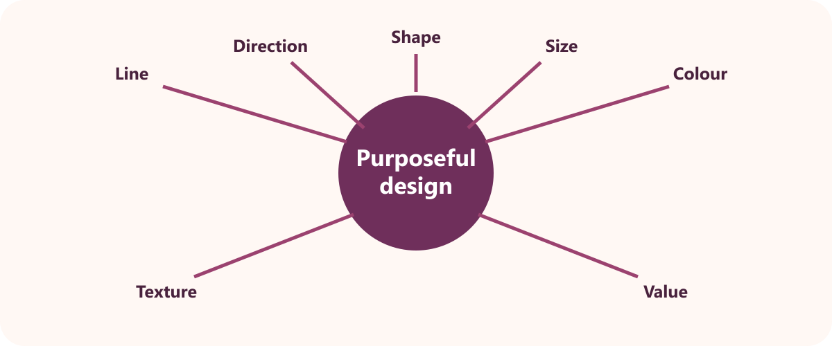
THEORY 3 OF 3
Textiles as Gifts: a teacher-approved extension
UNDERSTAND THE IDEA
The source outline names Textiles as Gifts as a free-choice practical destination. It provides the context but not one controlling project plan.
A gift brief identifies recipient, need and criteria. These facts guide a purposeful design decision.
The teacher approves the idea and practical method. Local resources, safety and feasibility must be confirmed.
SEE THE RELATIONSHIP
EVIDENCE PROMPT
Draft a brief for a textiles gift, including the recipient, need, three criteria and the questions the teacher must confirm.
YEAR 9 TEXTILES · MODULE 8
05
Notes:
[Sources]
Website course data: assets/course-data.js, Module 8, Section 3: Textiles as Gifts: a teacher-approved extension.
Course authority: work/source-contract.md and work/source-audit.md.
Local visual: assets/visuals/design-elements.svg, source-bound course artwork rasterised for PowerPoint.
Source boundary: examination status, scope and weighting are not claimed; this deck presents consolidation and extension only.
[/Sources]
Teaching note: Teach the three points, then pause for students to answer the evidence prompt in one or two precise sentences.
Slide 5 of 8.

Slide 6
NO NOTES FOR THE FIRST ATTEMPT
Retrieve before you check
1
2
3
Revision across the three areas of study
Final evaluation and portfolio readiness
Textiles as Gifts: a teacher-approved extension
Define revision across the three areas of study in your own words and give one course example.
Why does final evaluation and portfolio readiness matter to a successful textile outcome?
What evidence would prove you understand textiles as gifts: a teacher-approved extension?
Attempt → check the module → correct in a different colour
YEAR 9 TEXTILES · MODULE 8
06
Notes:
[Sources]
Website course data: assets/course-data.js, Module 8, retrieval questions generated from the first fact in each section.
Course authority: work/source-contract.md and work/source-audit.md.
Visual treatment: editable PowerPoint diagram generated only from the cited module facts.
Source boundary: examination status, scope and weighting are not claimed; this deck presents consolidation and extension only.
[/Sources]
Teaching note: Keep the first attempt closed-book. Accuracy improves when students check and visibly correct the response afterwards.
Slide 6 of 8.

Slide 7
READ → SELECT → EXPLAIN → CHECK
Build one strong written response
QUESTION
Draft a brief for a textiles gift, including the recipient, need, three criteria and the questions the teacher must confirm.
1
READ
2
SELECT
3
EXPLAIN
4
CHECK
Underline the action word and the exact topic.
Choose two or three course facts that answer it.
Link each fact to why it matters or what it proves.
Return to the question; correct gaps and vague words.
Strong responses use evidence and reasoning—not a copied paragraph.
YEAR 9 TEXTILES · MODULE 8
07
Notes:
[Sources]
Website course data: assets/course-data.js, Module 8, Section 3 evidence prompt plus the course response scaffold.
Course authority: work/source-contract.md and work/source-audit.md.
Visual treatment: editable PowerPoint diagram generated only from the cited module facts.
Source boundary: examination status, scope and weighting are not claimed; this deck presents consolidation and extension only.
[/Sources]
Teaching note: Model the four-step process aloud. Students should be able to point to the fact and the explanation in their finished response.
Slide 7 of 8.

Slide 8
EXIT TICKET + NEXT STEP
Finish with evidence
EXIT TICKET
SAVE THIS EVIDENCE
Revision map, final project evaluation and a brief for a teacher-approved textiles gift.
1
Name one idea you can now explain accurately.
2
Identify one correction you made after retrieval.
3
State the evidence you will save from this module.
Return to the module page, complete the evidence prompt and use teacher directions for practical work.
NEXT STEP
Explain it. Check it. Save it.
YEAR 9 TEXTILES · MODULE 8
08
Notes:
[Sources]
Website course data: assets/course-data.js, Module 8, module evidence summary and student next step.
Course authority: work/source-contract.md and work/source-audit.md.
Visual treatment: editable PowerPoint diagram generated only from the cited module facts.
Source boundary: examination status, scope and weighting are not claimed; this deck presents consolidation and extension only.
[/Sources]
Teaching note: Collect a brief spoken or written exit response. Remind students that the website and teacher directions control the practical next step.
Slide 8 of 8.

