Slide 1
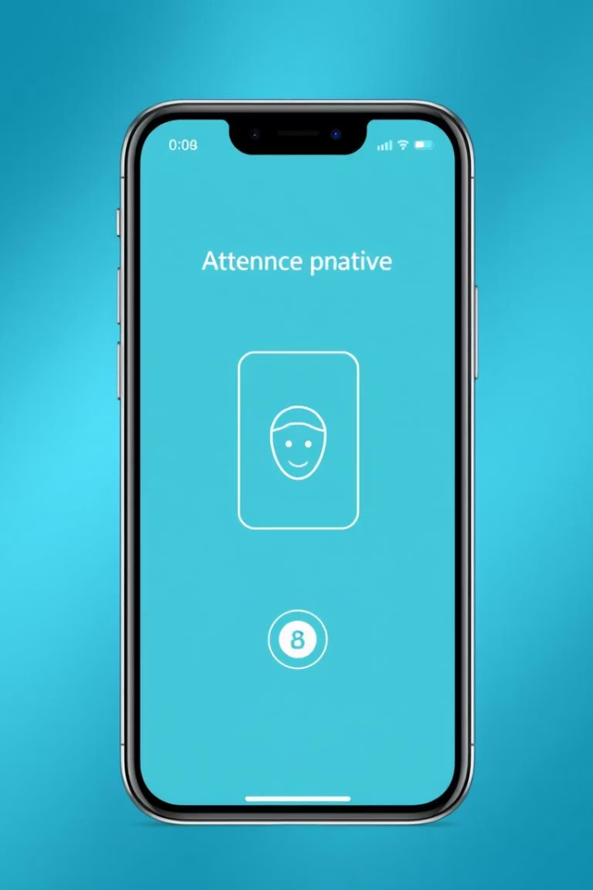
Requirement Analysis for Mobile-Based Attendance System
This presentation covers the comprehensive requirement analysis for a mobile attendance management system integrating facial recognition and geofencing. We explore completeness, clarity, technical feasibility, dependencies, risks, prioritization, and stakeholder validation to ensure a robust and secure solution.

Slide 2
Requirement Analysis Objectives
Evaluate gathered requirements for:
Completeness Findings
Completeness
Clarity
Technical Feasibility
Dependencies
Present:
Check-in via Face & GPS
Instructor Dashboard
Filtering, History View
Missing:
Auth, Role Mgmt
Course Scheduling
Session Logic, Errors
Notifications, Reporting

Slide 3

Clarity Analysis and Resolution
Clear Requirements
Ambiguities Identified
Check-in time under 5 seconds and geofence boundary enforcement are well-defined and measurable.
Geofence radius and GPS drift tolerance unspecified.
Facial recognition algorithm and device support unclear.
Data security standards and real-time definitions vague.
Resolutions
Set geofence radius to 30m ±5m, recognition threshold at 85%, Android 9+ support, and AES encryption standards.

Slide 4
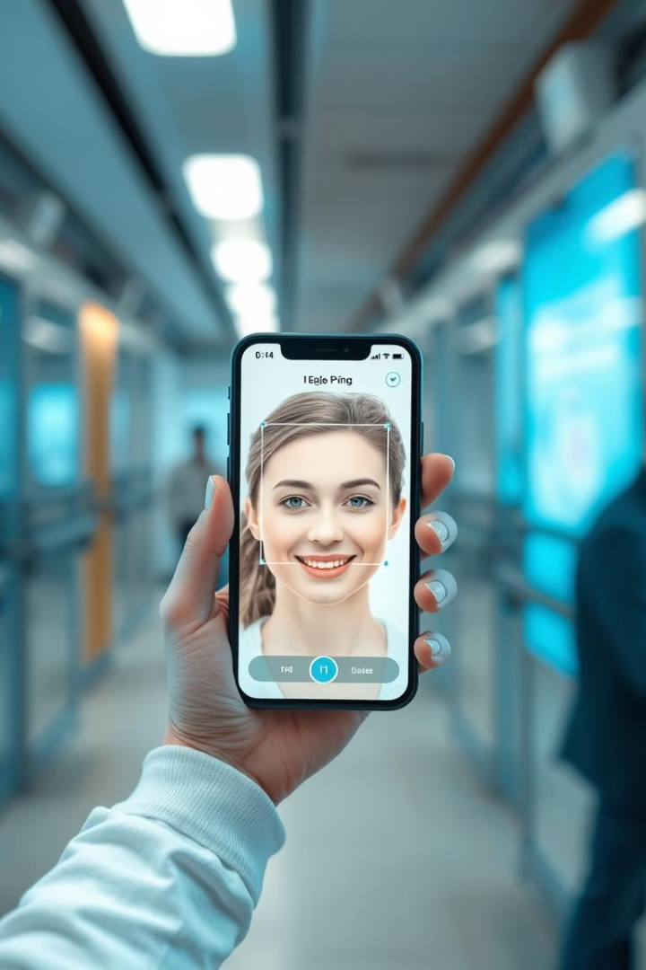
Technical Feasibility Analysis
Facial Recognition
Geofencing
Supported by modern smartphones and frameworks like OpenCV and TensorFlow Lite; challenges include lighting and occlusions.
Native APIs available on Android and iOS; GPS accuracy varies indoors; background permissions affect reliability.
Real-Time Processing & Security
Check-in under 5 seconds feasible with on-device processing.

Slide 5
Dependency Relationships and Risks
Key Dependencies
Risks and Mitigations
Face recognition depends on camera and ML inference.
Permission denial disables features; clear prompts needed.
Geofencing relies on GPS, permissions, and OS settings.
Check-in requires successful face and geofence validation within time limits.
Battery optimizations may block background tasks.
Model drift requires periodic retraining.

Slide 6
Potential Risks and Mitigation Strategies
Low-Light or Occluded Faces
GPS Spoofing or Drift
Use image pre-processing like histogram equalization to improve recognition.
Validate location using Wi-Fi and cell tower data fusion.
Permissions Denied
Device Variance
Provide clear rationale and fallback options to encourage access.
Set minimum hardware requirements to ensure consistent experience.
Network Dependency
Privacy Concerns
Enable offline caching with delayed synchronization.
Anonymize data and store biometric embeddings instead of photos.

Slide 7
Requirement Prioritization Using MoSCoW Method
Must-Have
Should-Have & Could-Have
Facial recognition check-in
Instructor dashboard and filtering
Geofencing with radius control
Concurrent check-in performance
Attendance activation by lecturer
Manual attendance override
Face spoof detection
Offline mode and UI theming
Check-in latency ≤ 5s
Student attendance history
Secure authentication and encryption
GDPR compliance

Slide 8
Functional and Non-Functional Requirements Classification
Functional Requirements
Non-Functional Requirements
Facial recognition and GPS attendance
Performance: concurrency, latency, availability
QR code backup and attendance verification
Security: encryption, authentication, auditing
Course and class management
Usability: UI design, accessibility, learnability
Reporting, notifications, and user management
Maintainability and scalability

Slide 9
SOFTWARE REQUIREMENT SPECIFICATION DOCUMENT
ID | Requirement: Authentication and management |  | Description
FR2.1 | Facial Recognition |  | Students shall be able to mark attendance using facial recognition verification.
FR2.2 | GPS Attendance |  | Students shall be able to mark attendance only when physically present within the configured geofence of the class location.
FR2.3 | QR Code Backup |  | The system shall provide QR code-based attendance marking as a backup when facial recognition or GPS functionality is unavailable.
FR2.4 | Attendance History |  | Students shall be able to view their personal attendance history with filtering options.
FR2.5 | Attendance Correction |  | Faculty shall be able to manually correct or overrides attendance records with justification notes.
1. What SRS Document is ?
Software Requirement Specification document is a formal document that shows the detail description of each requirement and how the system is expected to work.
2. NEED OF THIS SRS DOCUMENT
-To minimize the possible misunderstanding between us the developers and the stakeholders
-To formalize all our requirements
- To provides our team members with all the necessary information while working on the project

Slide 10
Stakeholder Validation
The Validate Requirements with Stakeholders session ensures that all gathered requirements are accurate, complete, understandable, feasible, and agreed upon. This alignment prevents costly misunderstandings by confirming that stakeholder expectations match what will be built
Validation Outcomes
Requirements are accurate, complete, and understandable.
Feasibility confirmed within budget and timeline.
Consensus reached to minimize future conflicts.

Slide 11
Requirements Alignment and Feasibility
Stakeholders’ Expectation
Requirements Gathered
Stakeholders Concern
Real-time facial recognition check-in
Facial-recognition check-in & Offline mode
Students & Lecturers
Geofencing location validation
Geofencing (location-based verification)
Administrator & Lecturer
Check-in process ≤ 5 seconds
End-to-end check-in latency ≤ 5s
Students & Lecturers
Secure biometric data storage
Data encryption (biometric & GPS data)
Students & Administrator
Instructor real-time attendance view
Instructor dashboard (attendance overview)
Lecturers
Accuracy & Completeness
Feasibility
Consensus
All stakeholder expectations are addressed with clear, specific requirements ensuring no critical elements are missing.
Project feasibility depends on resources like mobile frameworks, facial recognition SDKs, geofencing APIs, budget ($150,000–$300,000), and a 3-month timeline.
Stakeholders reached mutual agreement to minimize future conflicts and ensure smooth project development.

Slide 12
Conclusion
Thorough requirement analysis ensures a robust, secure, and user-friendly attendance system. Addressing gaps and ambiguities early supports successful implementation and stakeholder satisfaction.

Slide 13
THANK YOU

