Slide 1

System Modeling And Design
Automating attendance with facial recognition and geofencing.

Slide 2
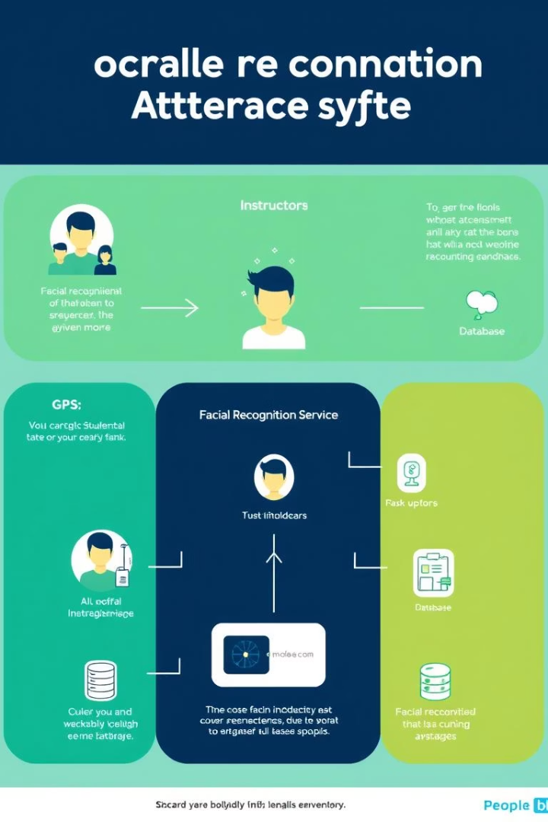
System Context Overview
System Boundary
Data Flows
Central process connects with five external entities.
Information exchanges between system and users/services.
Security Focus
Biometric and location data handled securely.

Slide 3
Key External Interactions
Students
Instructors
GPS Service
Send login and biometric data
Submit attendance requests
Provide location details
Receive authentication and attendance confirmation
Receive attendance reports
Receive location requests

Slide 4

Security and Privacy Measures
Biometric Data
Location Data
Encrypted transfer and storage, compliant with regulations.
Used only for attendance verification with user transparency.
Access Control
Role-based permissions and strict authentication protocols.

Slide 5
Data Flow Diagram (Level 1)
Processes
Data Stores
Register, Login, Location Confirm
Database holds credentials, logs, biometric and geofence data.
Facial Recognition, Attendance Recording
Real-Time Monitoring

Slide 6
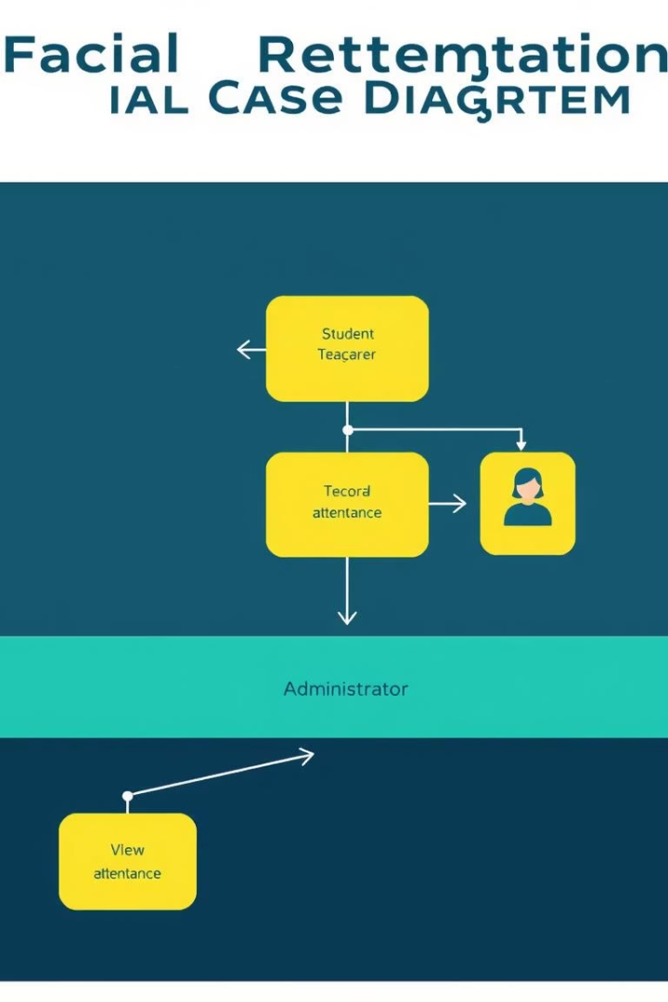
Use Case Diagram and Analysis
Actors
Students, Lecturers, Admins, External Systems
Key Use Cases
Facial Check-In, Geofencing, Manual Override
Report Generation, Geofence Configuration

Slide 7
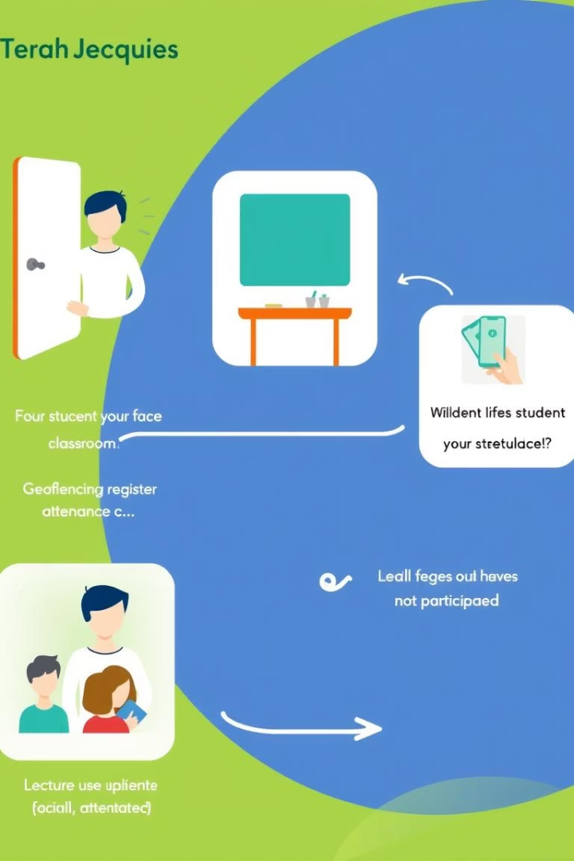
Sequence Diagram Highlights
1
Student Signup & Login
2
Attendance Check-In
Register with biometric data, authenticate with matricule and password.
Verify active session, location, and facial identity.
3
Lecturer Actions
Initiate sessions, track attendance, generate reports.

Slide 8
Class Diagram Overview
Role-Based Structure
Session & Attendance
Validation & Notifications
Distinct roles for students, lecturers, and admins.
Sessions linked to geofences; attendance logged with verification.
Face and location checks with real-time alerts.

Slide 9
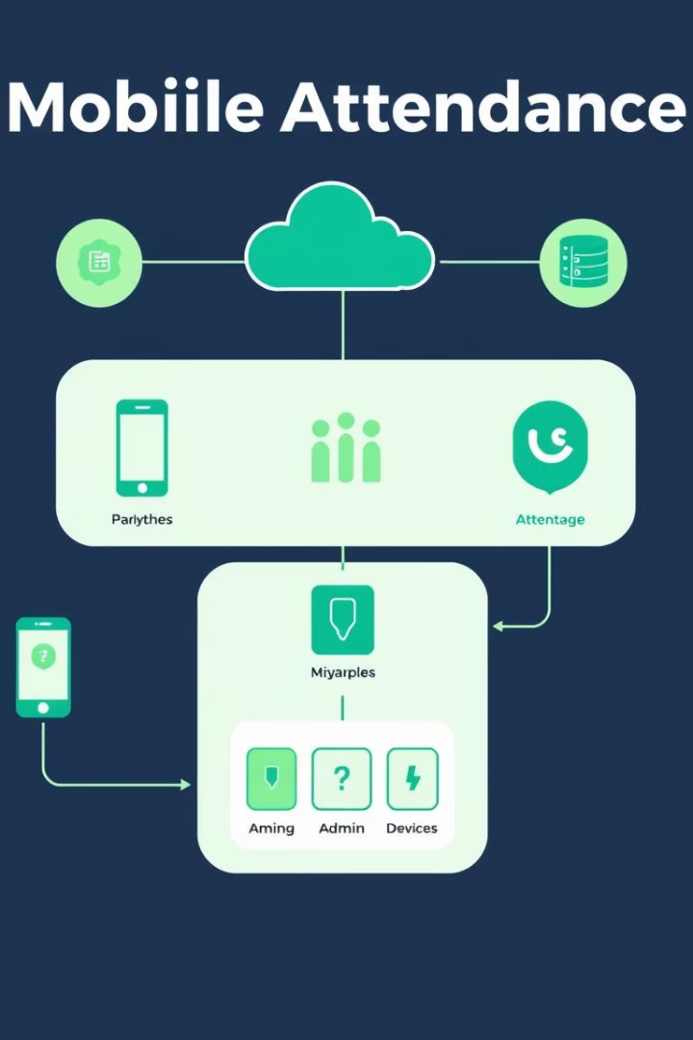
Deployment Diagram & System Flow
Components
Interactions
Mobile app, cloud services, database, admin interface.
Real-time facial and location verification with secure data flow.
Functionality
Automated attendance logging with scalable cloud backend.

