Slide 1
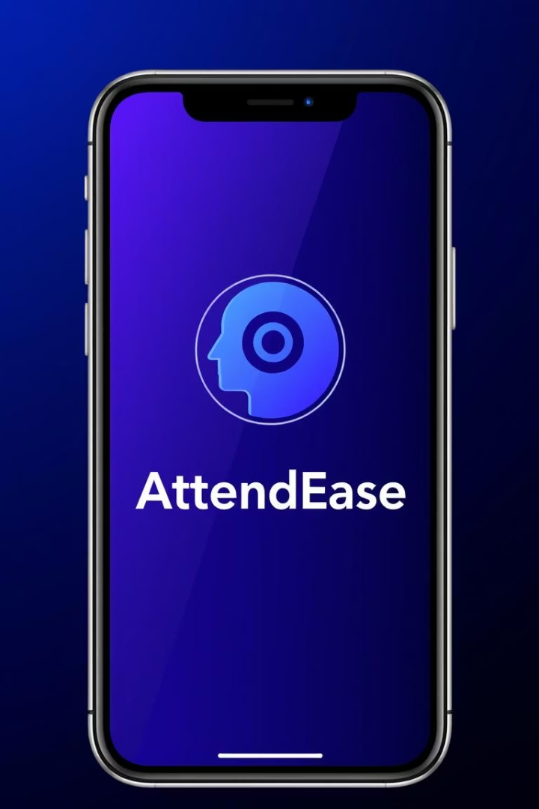

AttendEase: Smart Attendance Management
This report details the AttendEase mobile-based attendance management system, leveraging geofencing and facial recognition for educational institutions. It covers the app's identity, design process using Figma, and frontend implementation in Flutter. The app targets students, lecturers, and administrators with tailored functionalities, ensuring a streamlined and efficient attendance tracking experience.
by Nsondo Mirelle

Slide 2




App Identity: Branding and Purpose
Modern & Efficient
Color Scheme
AttendEase simplifies attendance tracking with innovative technology, emphasizing accuracy and convenience.
Primary blue and purple gradients convey trust and professionalism. Secondary green and red are used for status indicators.
Core Features
The tagline "Smart attendance management with facial recognition and geofencing technology" highlights cutting-edge features.

Slide 3
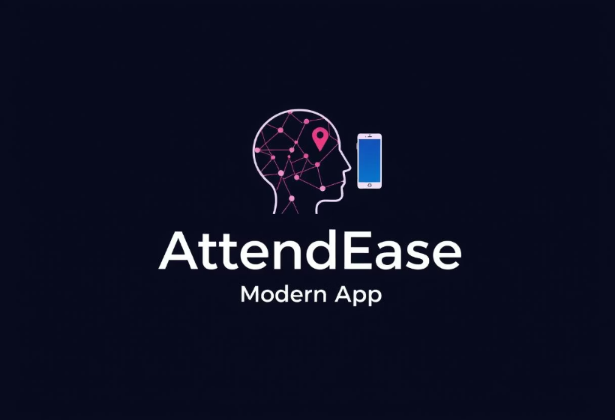
Logo Design: Symbolizing Core Functionalities
The AttendEase logo visually encapsulates the app's core functionalities. It features a stylized human head with a geofencing marker above, symbolizing location-based attendance. A smartphone icon alongside represents facial recognition, while a gradient circular background in blue and purple ties into the app’s color scheme. The bold "AttendEase" text and "MODERN APP" reinforce its contemporary approach.

Slide 4
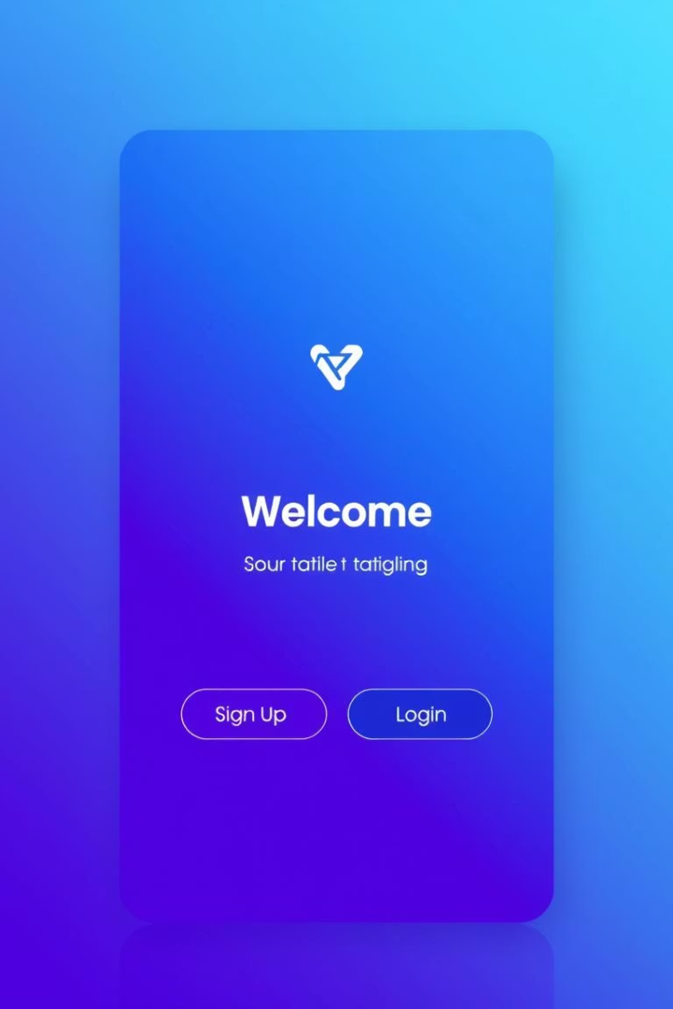



Design Process: UI/UX with Figma
Collaborative Tool
Figma was chosen for its iterative prototyping and team feedback capabilities, ensuring a seamless design-to-development transition.
High-Fidelity Mockups
Used to create detailed mockups, design systems, and interactive prototypes for all app screens.
Visually Appealing Entry
The welcome screen features a gradient background, prominent logo, tagline, and clear sign-up/login buttons.

Slide 5
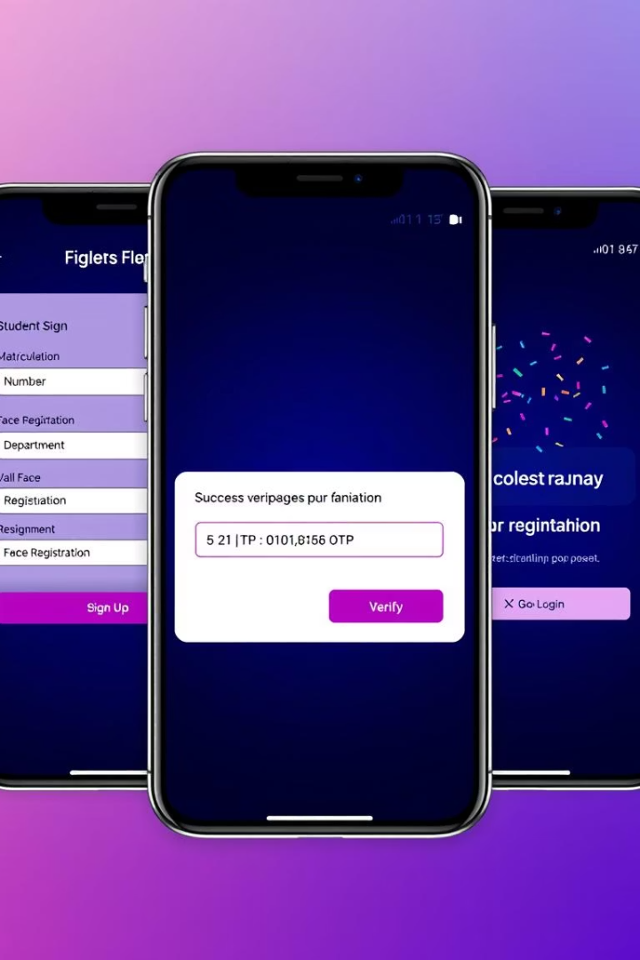
Tailored Sign-Up and Verification Screens
Role-Specific Sign-Up
Verification Screen
Separate screens for students (matriculation, department, face registration), lecturers (ID), and admins (organization) cater to unique needs.
Clean layout with a 6-digit OTP input field, styled with role-specific colors, supporting auto-submission and resend options.
Success Screen
Features a Lottie animation for visual feedback upon successful account creation, followed by navigation to the login screen.

Slide 6
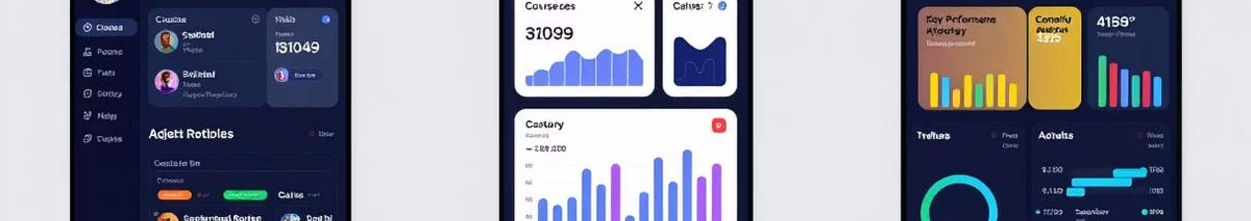



User-Centric Dashboard Designs
Student Dashboard
Welcome card, quick stats (attendance percentage, counts), and today’s classes with check-in functionality.
Lecturer Dashboard
Quick actions (start session, live attendance) and a list of active courses for efficient management.
Admin Dashboard
Overview with stat cards (total students, lecturers, active sessions) and quick action cards for management tasks.

Slide 7
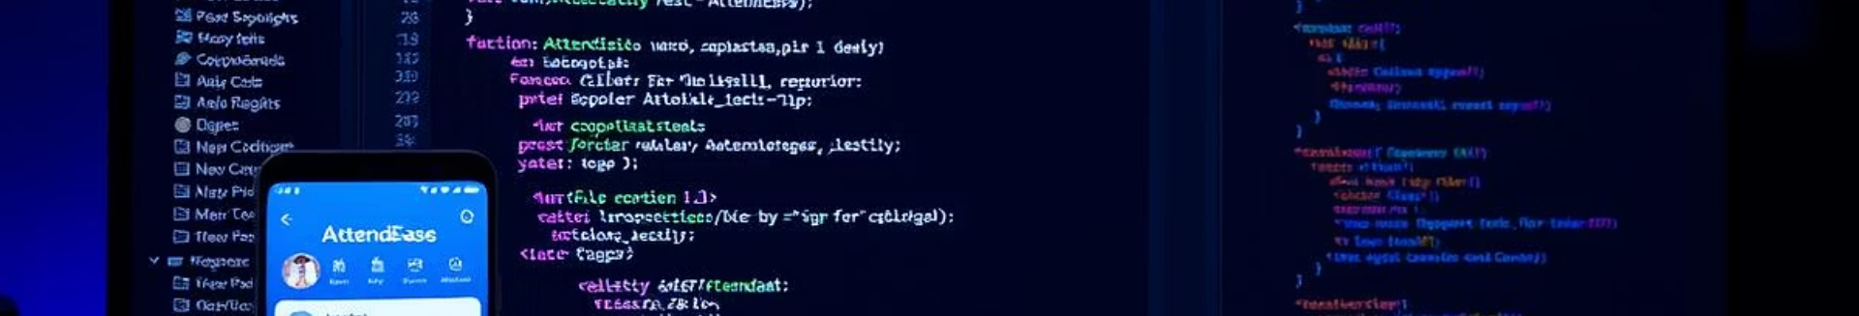
Frontend Implementation: Flutter & Dart
Flutter Framework
Android Emulator
Cross-platform development, enabling a single codebase for Android and iOS apps.
Used for testing and deployment, ensuring compatibility and functionality on Android devices.
1
2
3
Dart Language
Used for writing the app’s logic and UI components, ensuring efficient performance.

Slide 8




Structured Folder Organization
lib/
1
Main Dart code directory, containing core and feature-specific code.
features/
2
Feature-specific code, including authentication, dashboard, and welcome screens.
core/
3
Includes constants (colors), themes, utilities, and reusable widgets.
android/
4
Android-specific configurations, permissions, and metadata.
The AttendEase project follows a well-defined folder structure in VSCode to ensure modularity and maintainability. The lib/ directory is the heart of the Dart code, housing both core components and feature-specific modules. This organization facilitates efficient development and future scalability.

Slide 9
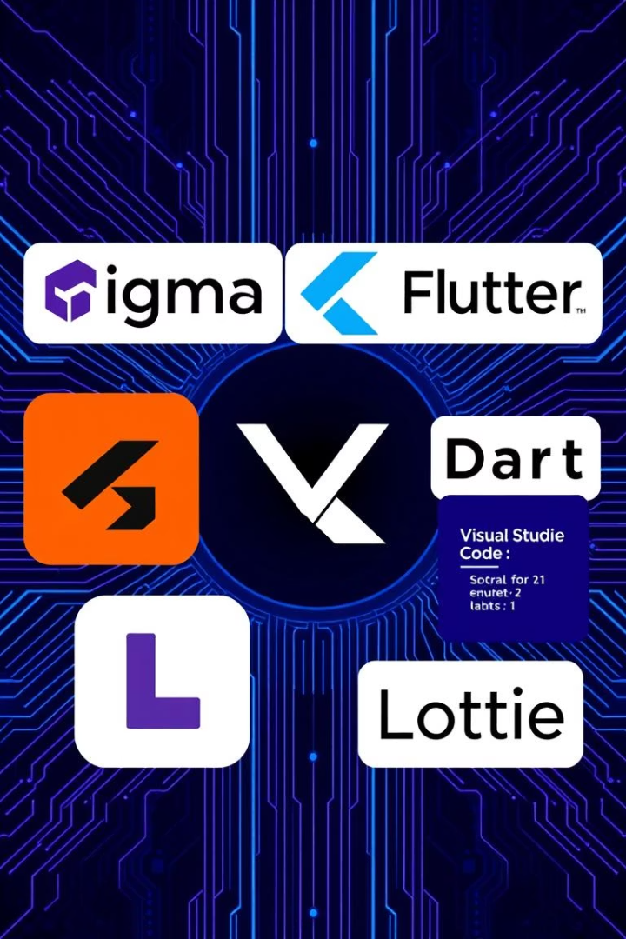
Key Software Tools and Functions
Figma
UI/UX design, high-fidelity mockups, prototypes
Flutter
Cross-platform app development framework
Dart
Programming language for app logic and UI
Visual Studio Code
Code editor for writing and debugging
Android Emulator
Simulated device for app testing
Lottie
Library for animations
Pin Code Fields
Flutter package for OTP input

Slide 10
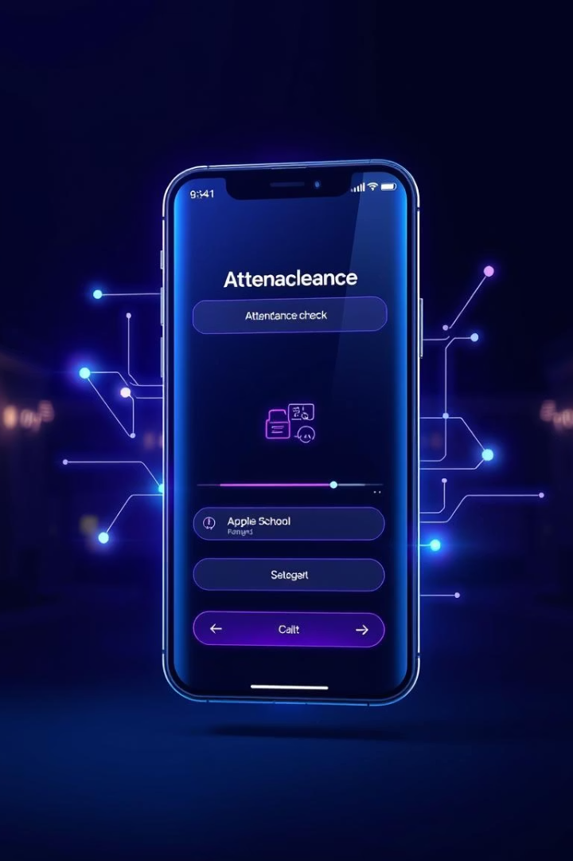
Conclusion and Future Enhancements
Successful Delivery
AttendEase offers a modern attendance solution with cohesive branding, thoughtful design, and robust frontend implementation.
Streamlined Development
Figma enabled efficient design, while Flutter ensured effective cross-platform development and thorough testing via Android emulator.
Future Considerations
Integrate actual API calls, add iOS-specific testing, and implement advanced geofencing algorithms for enhanced functionality.

