Slide 1
PROVE Tool
Open source domain specific modeling platform for Research related Process Design & Evaluation
Avi Shaked
Systems Engineering Research Initiative
Tel Aviv University

Slide 2
PROVE Tool
Supports PROVE modeling
Concepts
Notation
Open source
Based on the popular Eclipse Modeling Framework + Sirius

Slide 3
Section I: Preparing PROVE modeling environment from Sirius
Requires:
Installation of PROVE Tool plugin for Sirius or use of our Obeo+PROVE Tool distribution

Slide 4
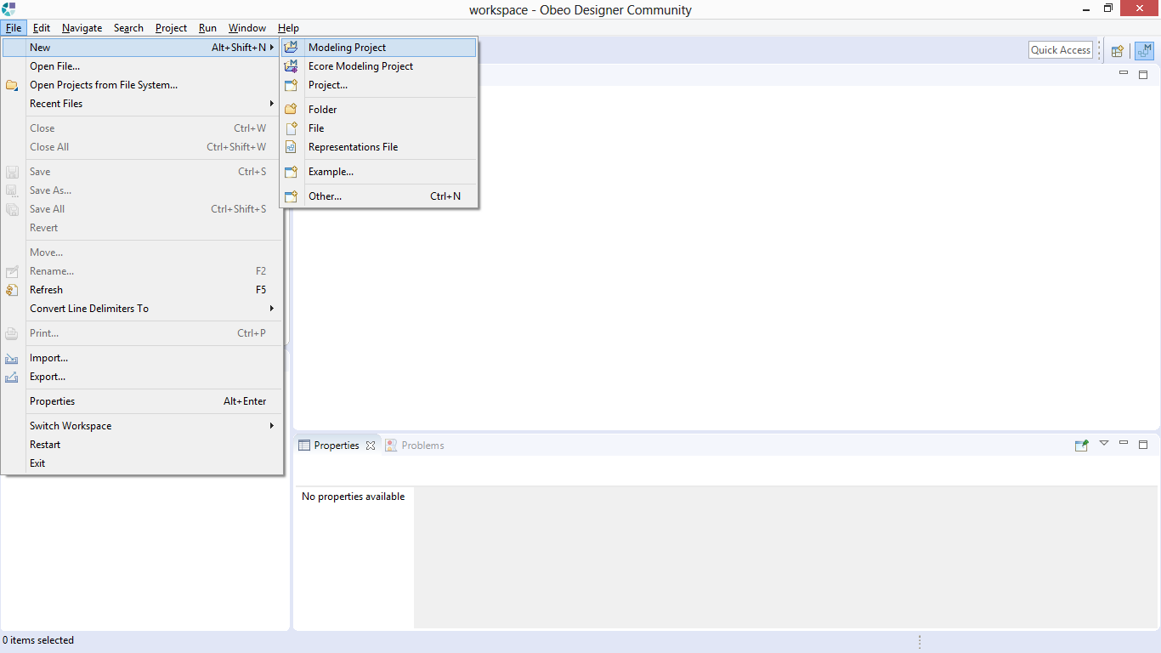
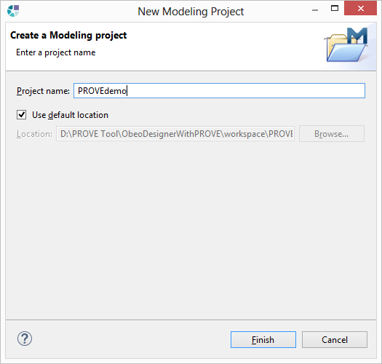
File->New->Modeling Project
+
Name your project
and click on “Finish”

Slide 5
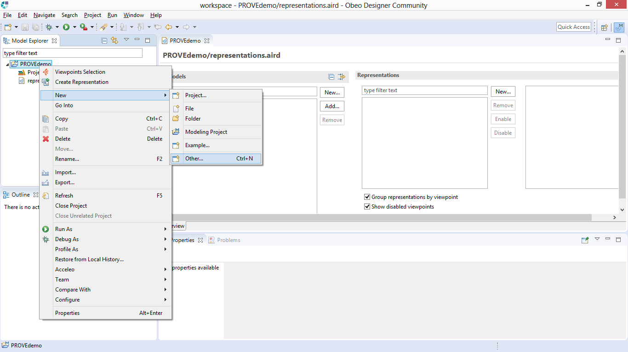
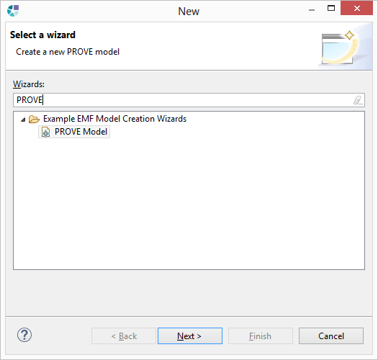
Right click->New ->Other
+
Select PROVE Model

Slide 6
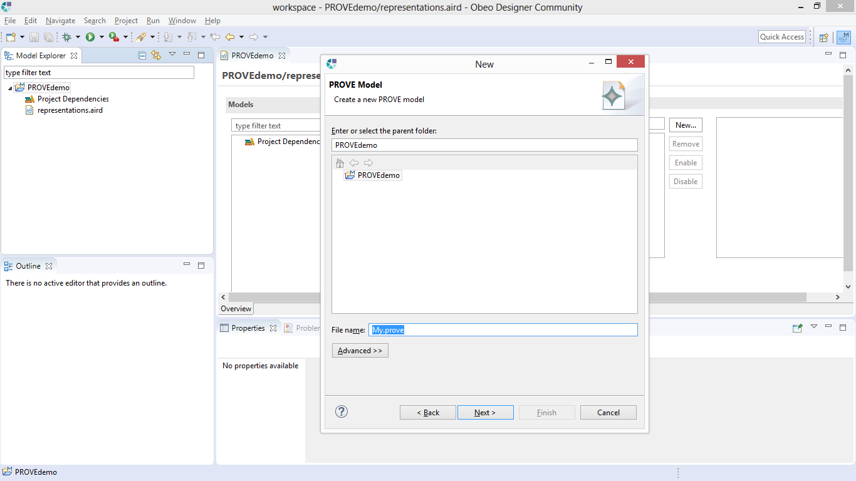
Name your PROVE Model
and click on “Next”

Slide 7
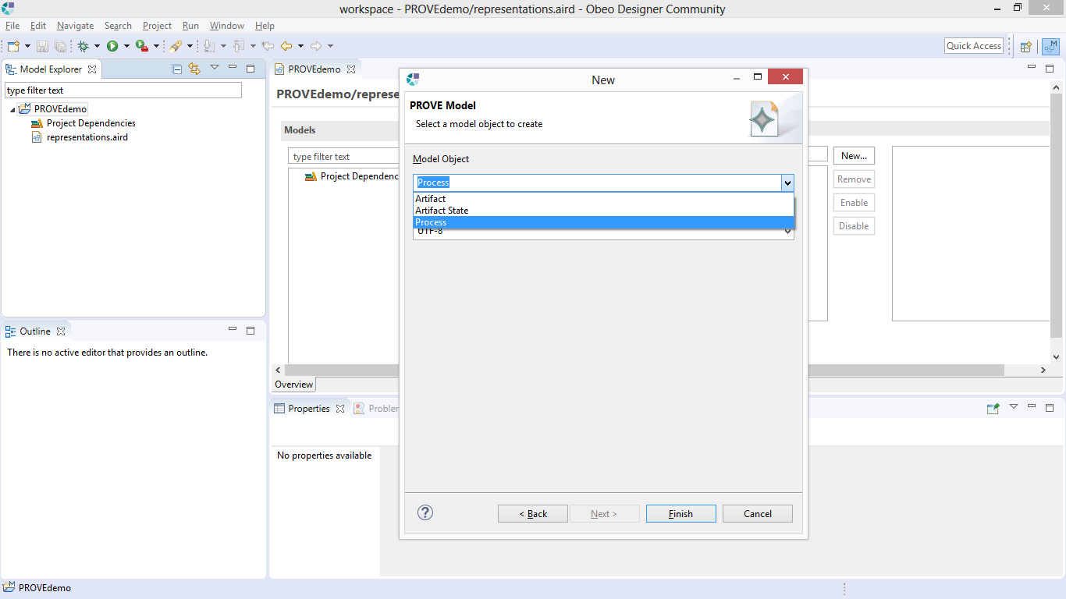
Select “Process” as the seed object of your PROVE Model
and click on “Finish”

Slide 8
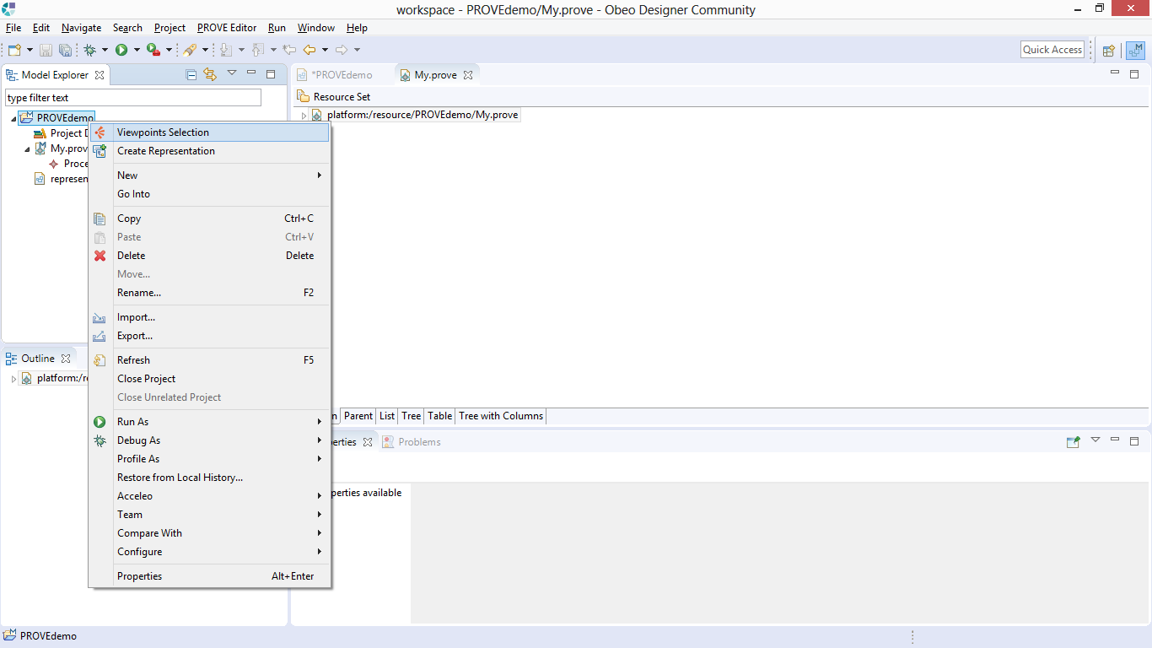
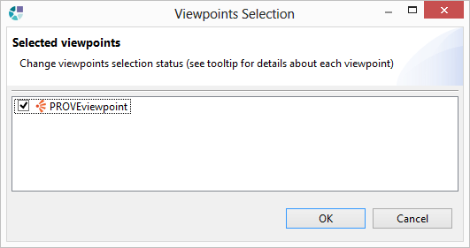
Right click on your project -> “Viewpoints Selection”-> mark the PROVEviewpoint ->
click on “OK”

Slide 9
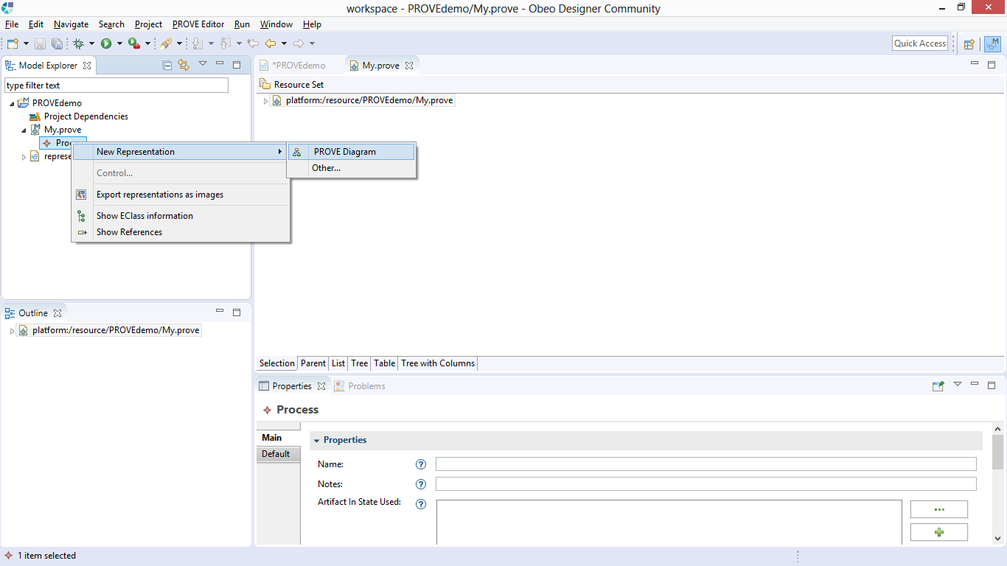
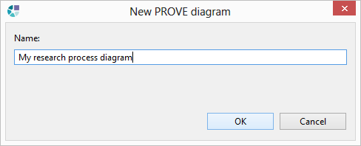
You are now able to create PROVE diagrams!
Right click on the PROVE model entity->”New Representation” -> PROVE Diagram

Slide 10
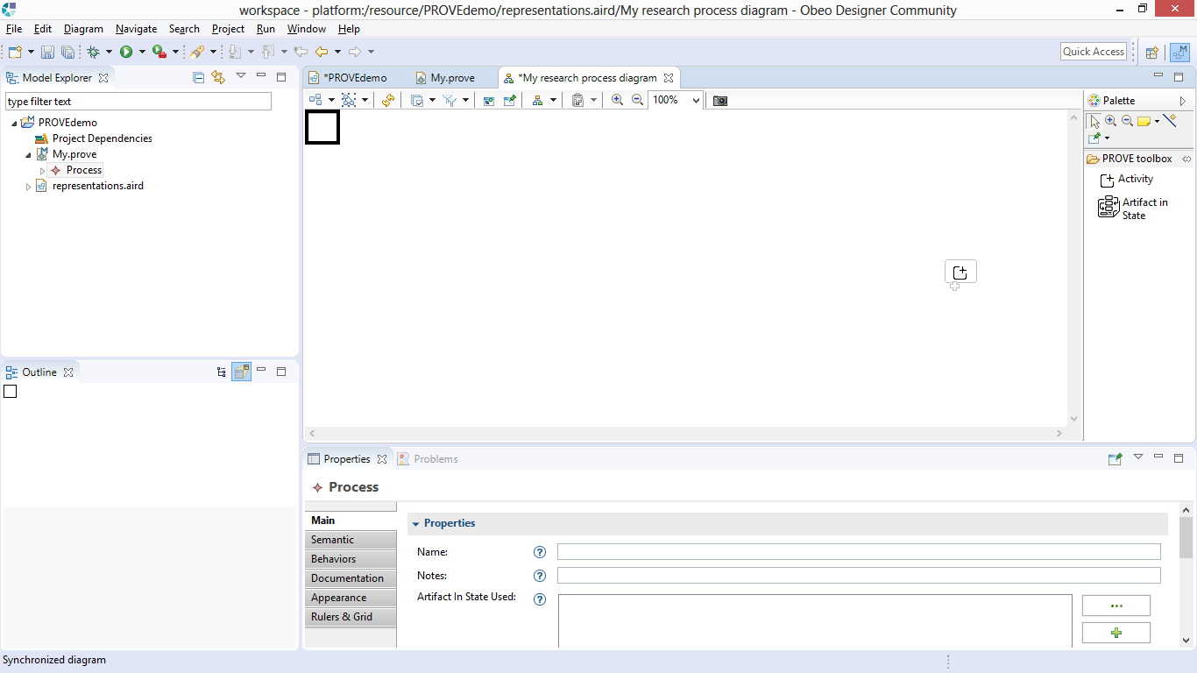
You created a PROVE diagram entity in the model!
You can now continue and use PROVE for process design

Slide 11
Section II: Modeling with PROVE

Slide 12
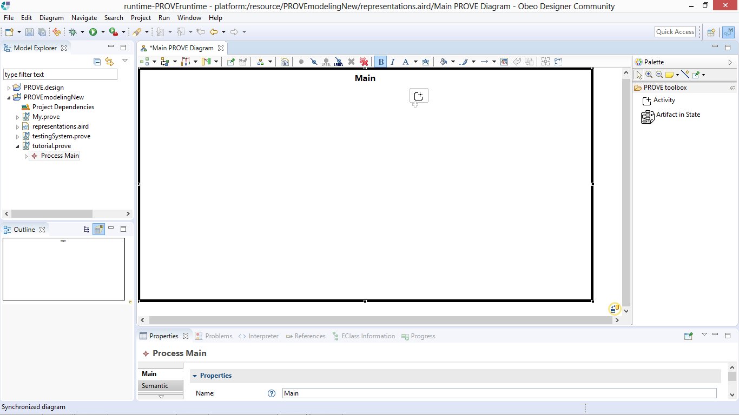
A new diagram is created and opened, presenting the scope of the Main process
This is our modeling tool box
Attributes of elements are shown in the Properties tab

Slide 13
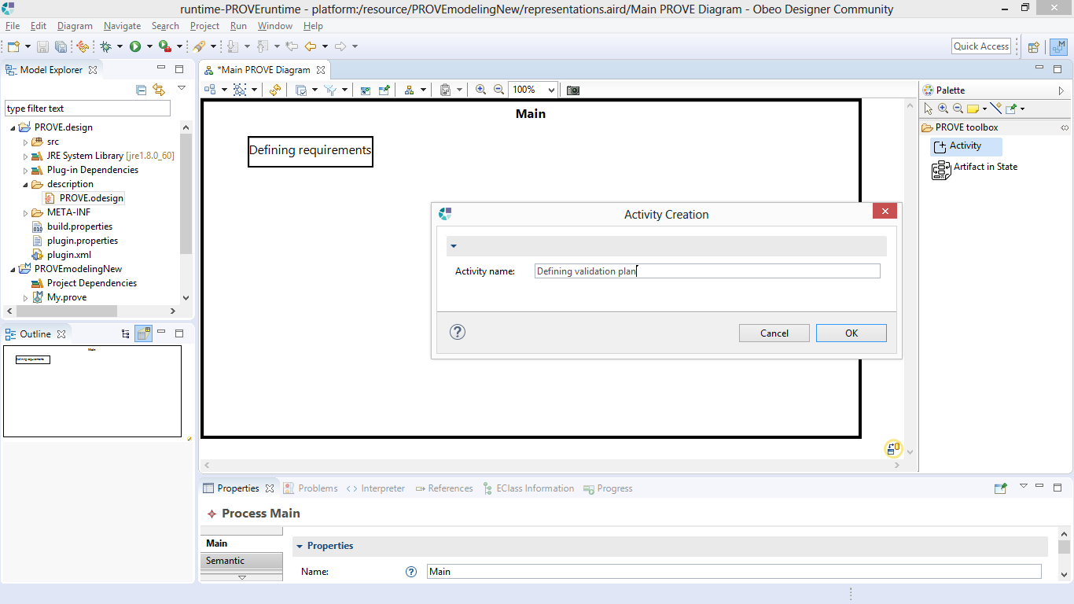
We have created “Defining requirements” activity within the main process by selecting the activity tool and clicking inside the “Main” box. Then, we do the same to create another activity.

Slide 14
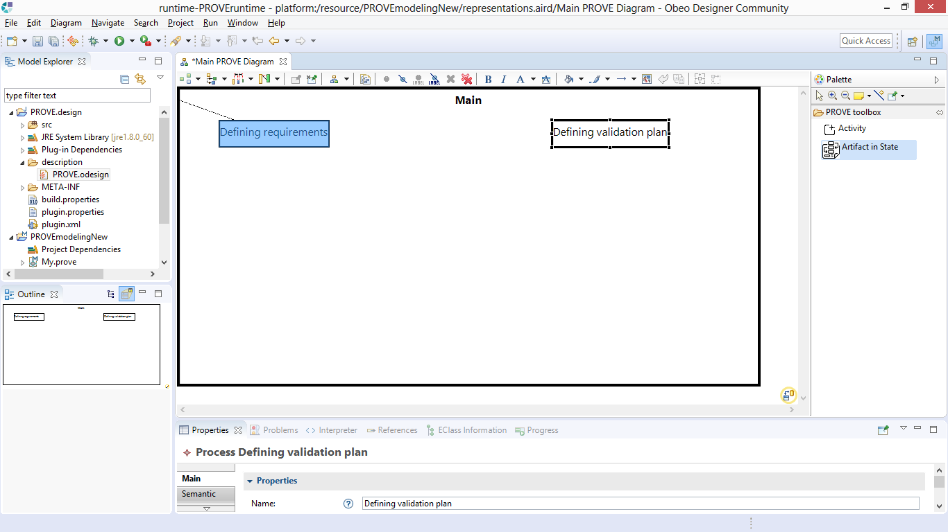
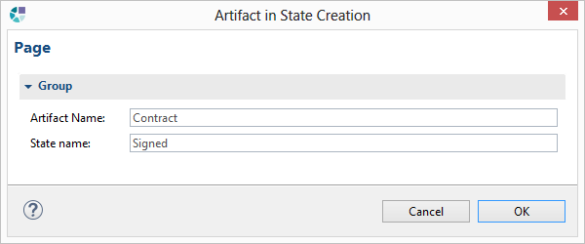
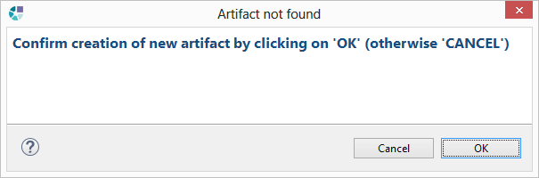
1. We create a new artifact in state flow by using the second tool, and clicking on the first process and then on the second process.
2. We fill the form which pops up
3. We approve creating a new artifact that does not exist (if an artifact by the name exists – this will not appear, and a new state will be assigned to the state model of the existing artifact)

Slide 15
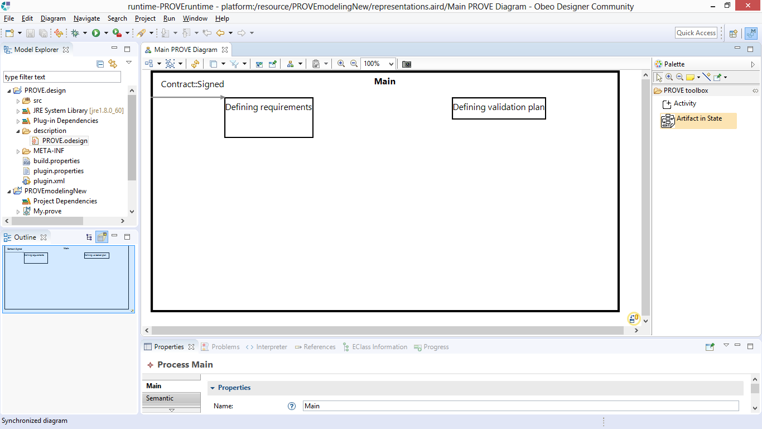
1. We create a new artifact in state flow by using the second tool, and clicking on the first process and then on the second process.
2. We fill the form which pops up
3. We approve creating a new artifact that does not exist

Slide 16
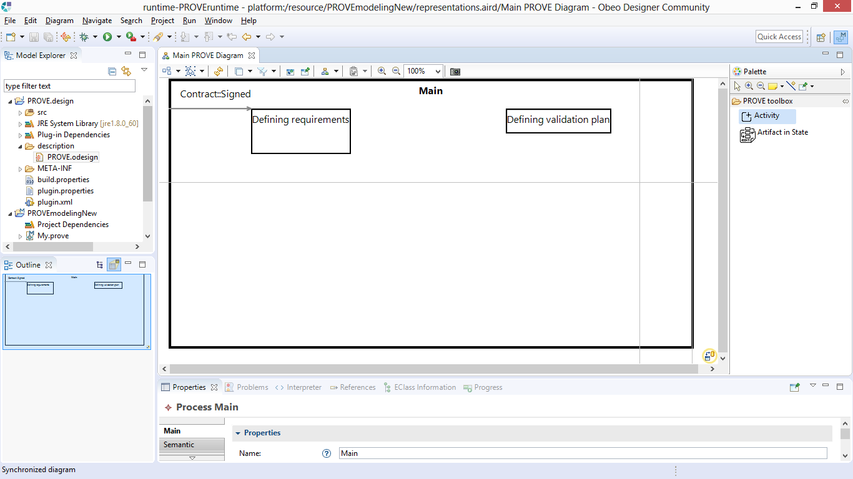
We now add lower level activities within “Defining requirements”, by using the same “Activity” tool and clicking inside the activity

Slide 17
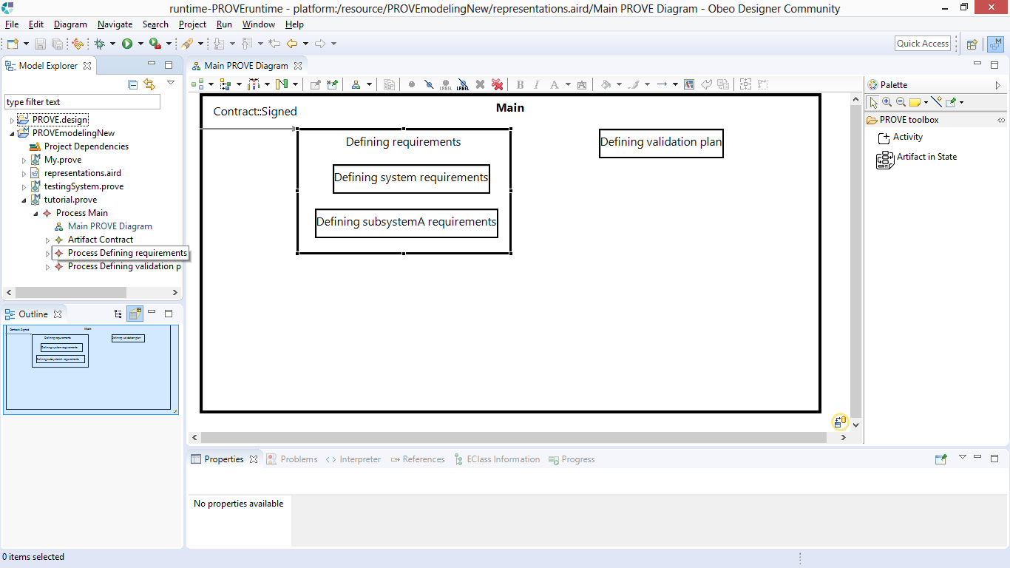
It may become hard to further detail the activity as a white-box, so we can create a new, synchronized representation

Slide 18
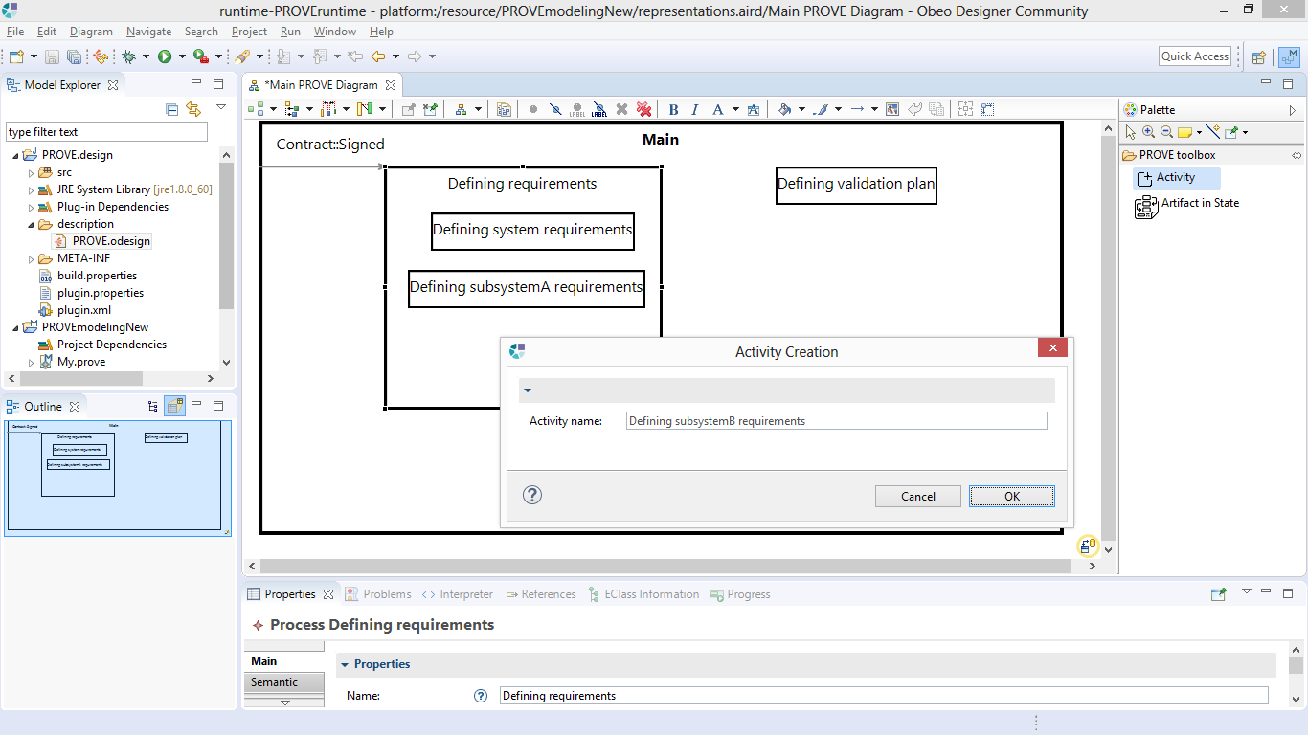

Slide 19
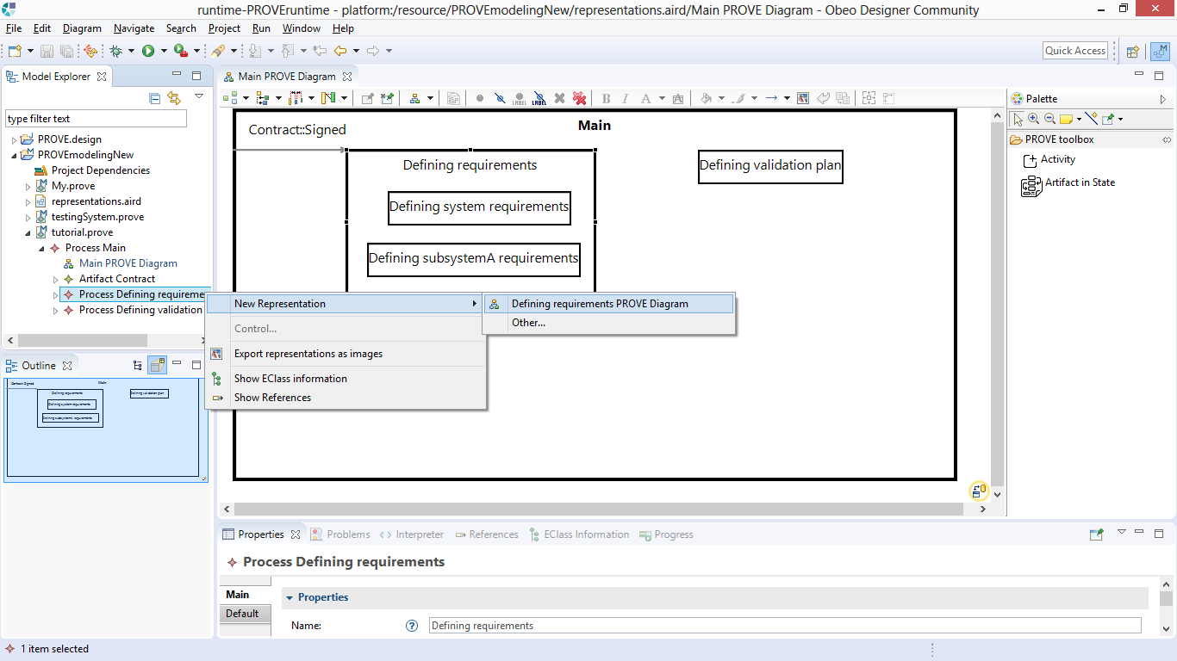

Slide 20
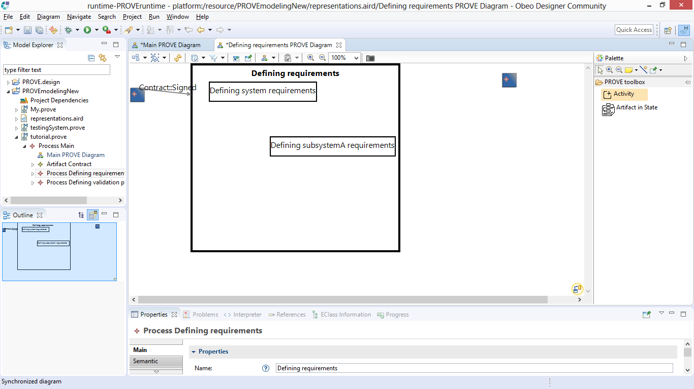
These are dummy nodes (supporting our technical implementation). We will hide them from now on.
This is view is created automatically according to the model. We will now add further details, the same way we did before

Slide 21
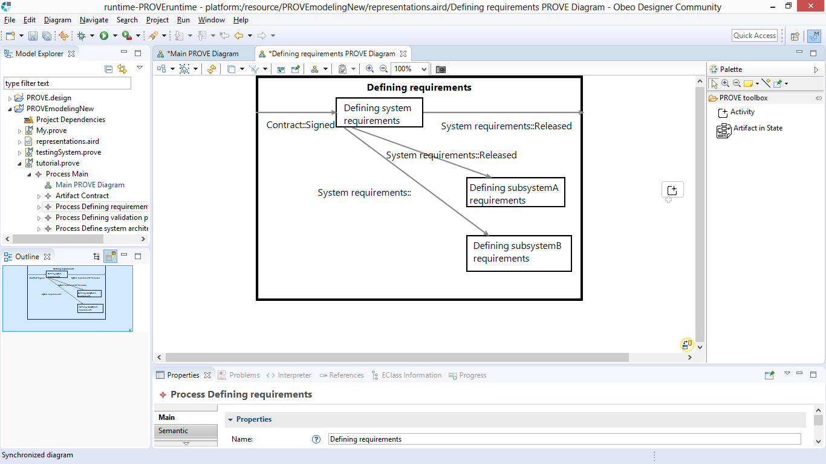
We have created an artifact flow without specifying a state, because we were not sure about it yet
We will now return to our main diagram. It should be synced automatically with our new details

Slide 22
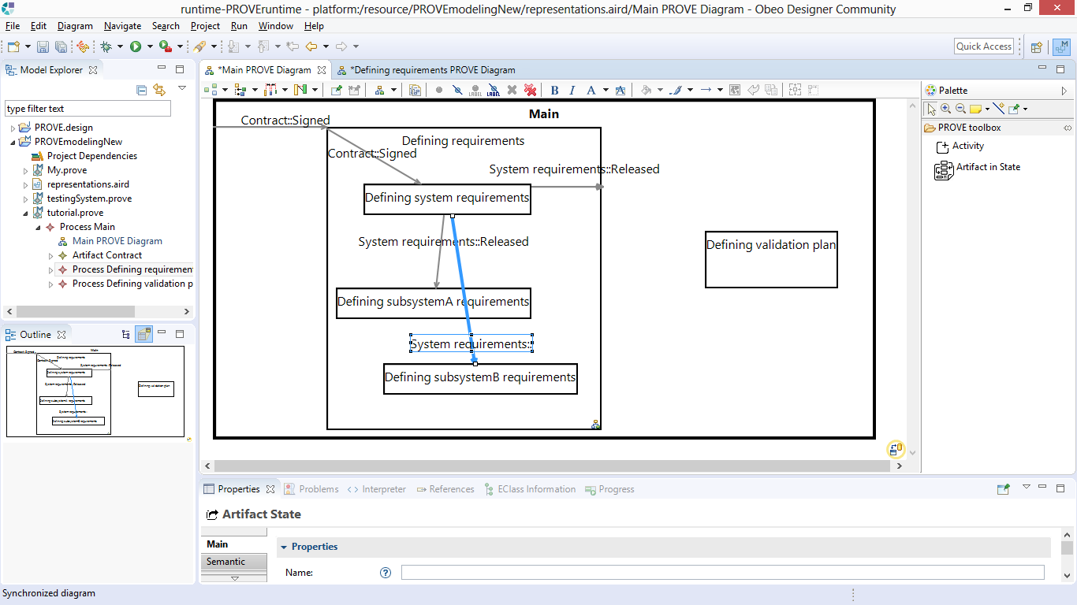
Let’s add more high level activities and artifacts

Slide 23
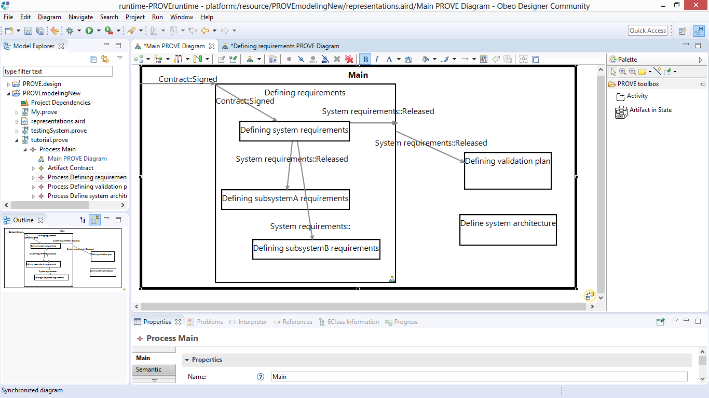
We have transferred this artifact-in-state from one process to another
We realized we forgot to add an input artifact to this one. We will now add it.

Slide 24
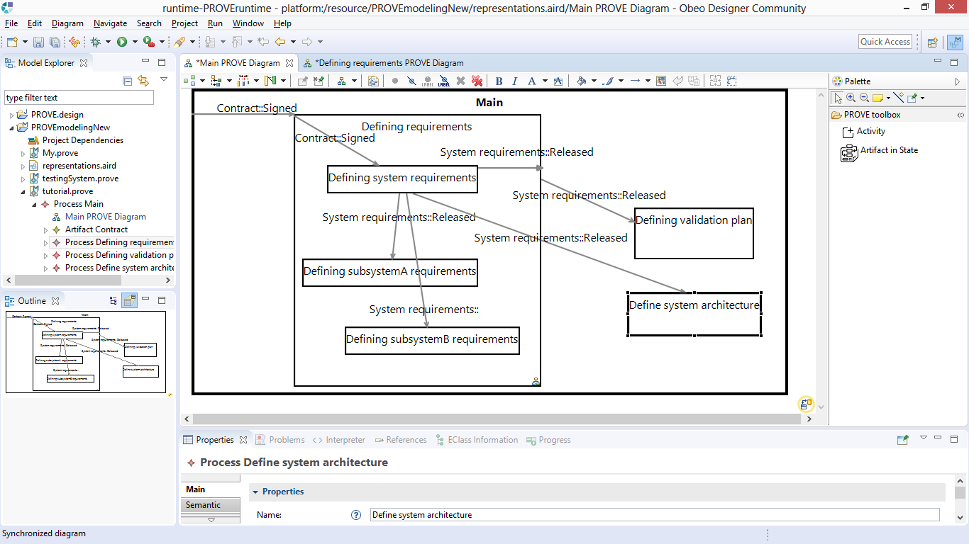

Slide 25
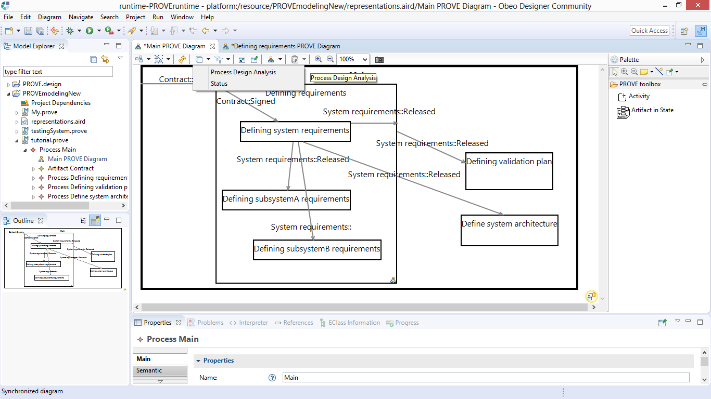
Now, we will use our design analysis layer to see how we are doing

Slide 26
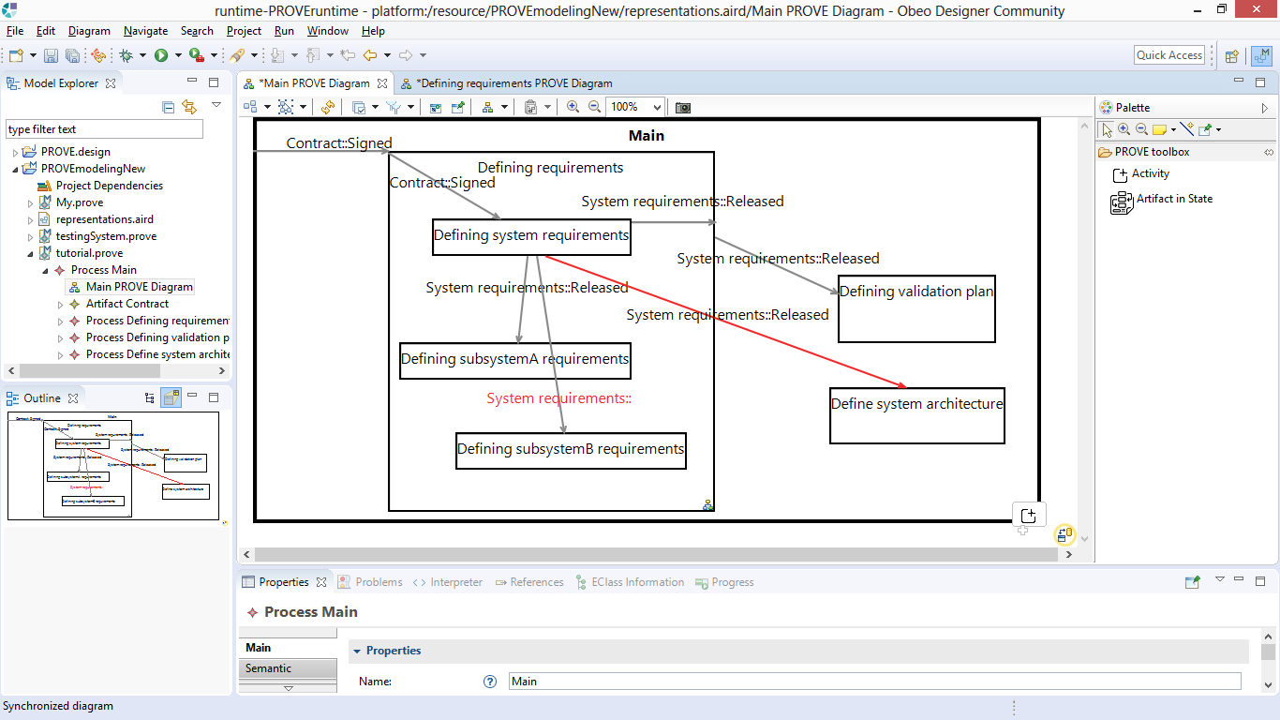
This is the automated, model-based analysis result: one artifact-in-state line is colored red because it violates activity scope
+ one artifact-in-state label is designated in red, as there is a missing state definition.

Slide 27
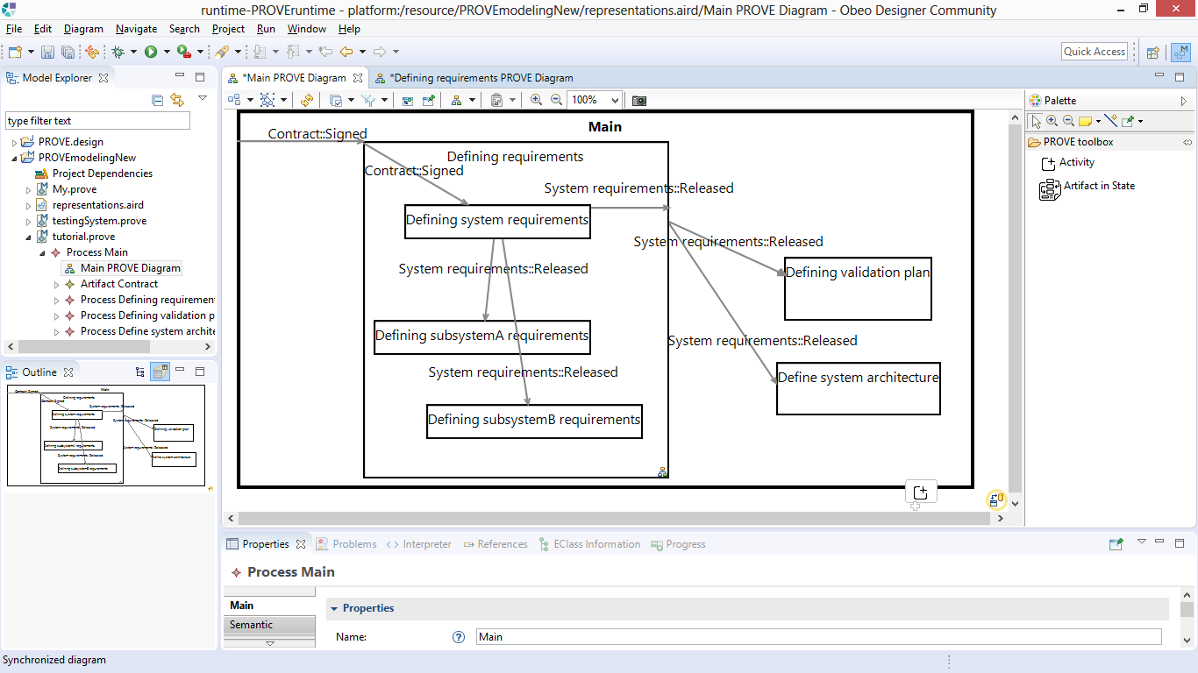
We improved the process design (fixing the aforementioned issues), and all color annotations disappeared.

Slide 28
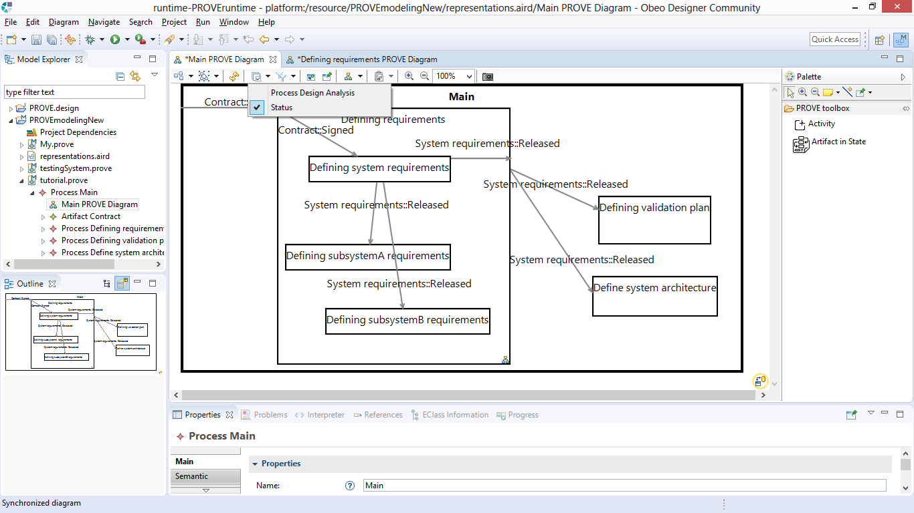
Now, we deselected the design analysis layer, and selected the Status layer instead.

Slide 29
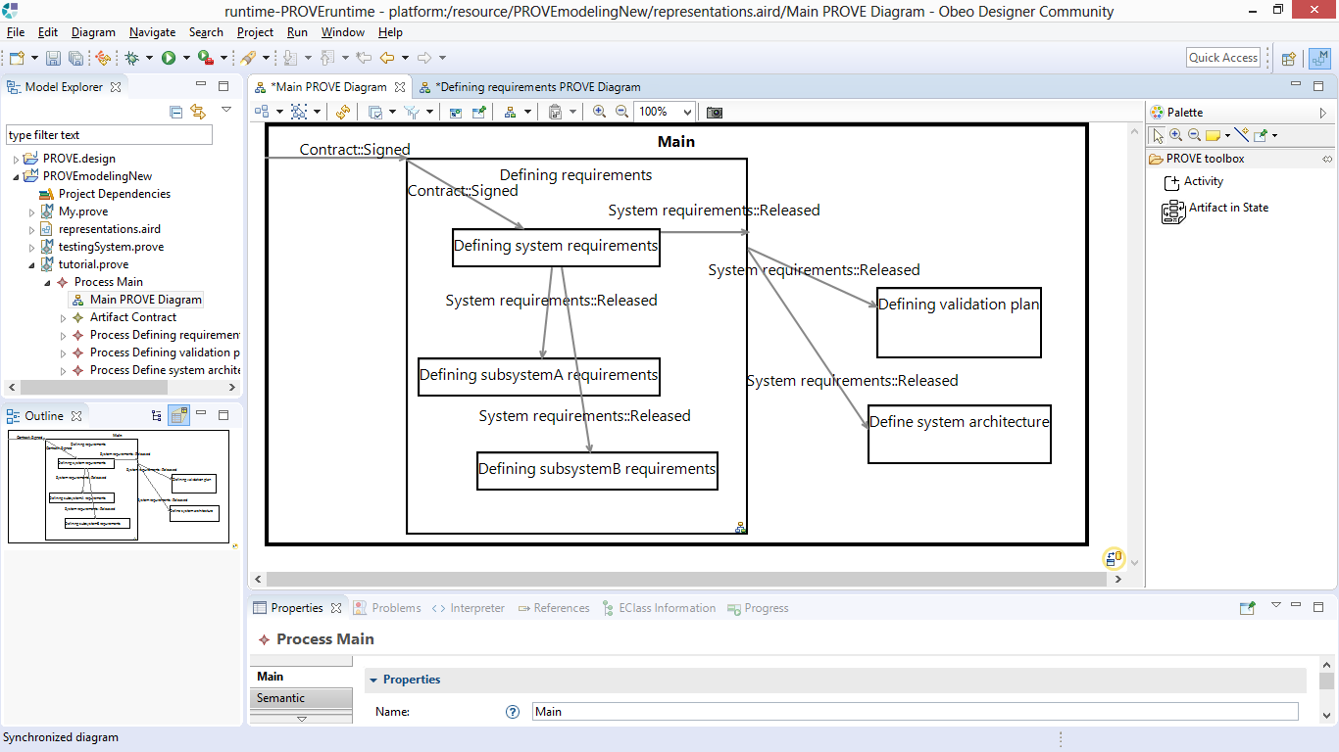
Nothing happened, because we have not set a status for any artifact. We double click on this “Contract::Signed” artifact

Slide 30
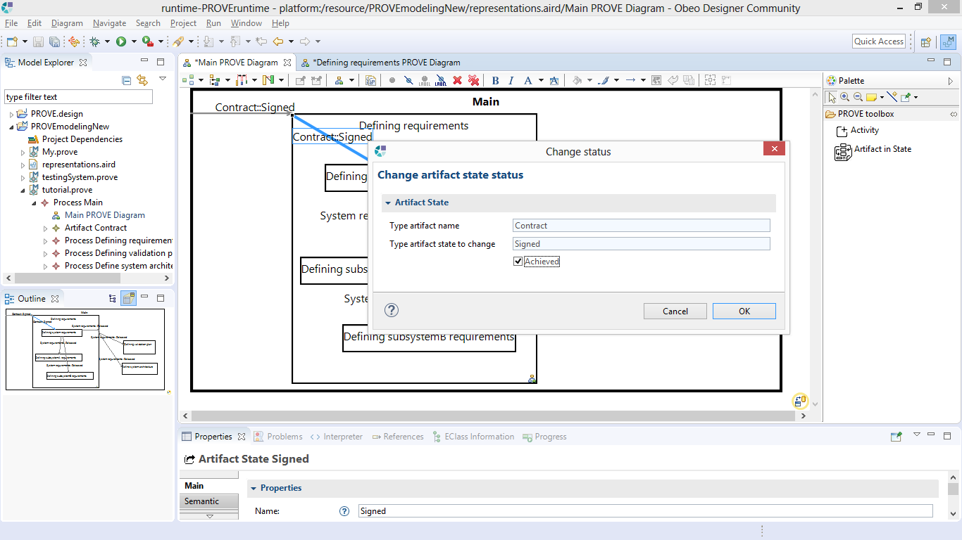
We mark “Achieved” to update that the artifact has achieved its designated state

Slide 31
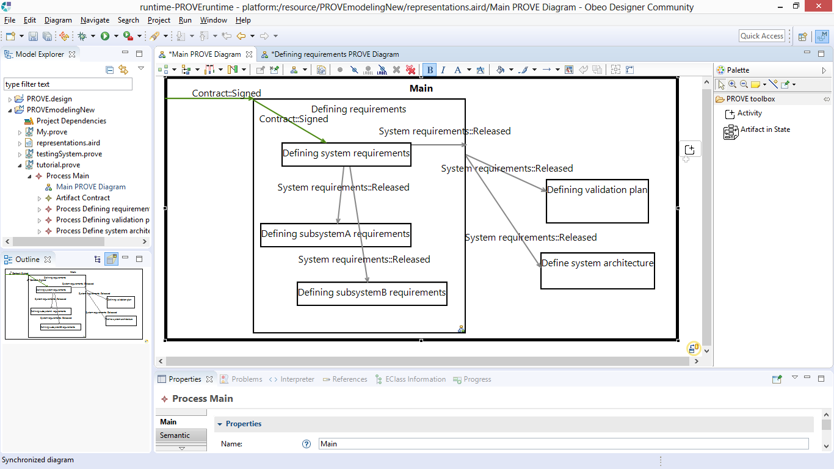
Line color changed to green, to mark the artifact has achieved its state. This reflects process status.

Slide 32
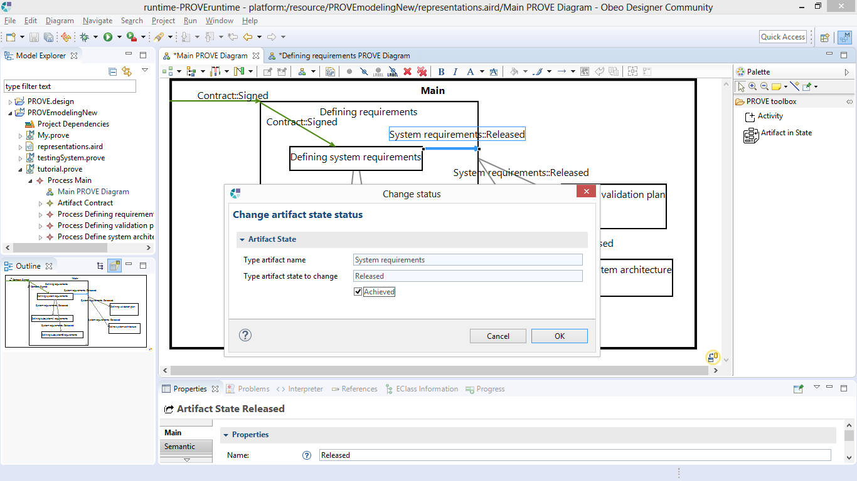
We do the same thing to reflect that System requirements were released, in order to see the updated status

Slide 33
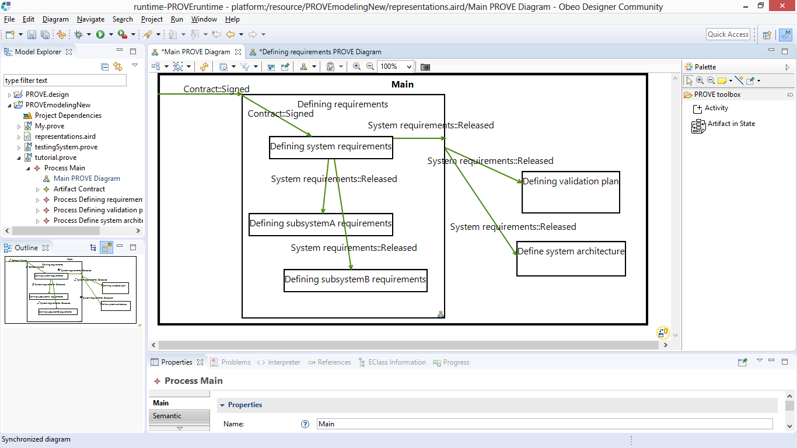
All instances of the same artifact-in-state definition were updated, and colored green to reflect our progress!

Slide 34
Summary: PROVE Tool Features
Build a model of your process
Using an immediate GUI coupled with the easy to learn PROVE domain specific notation
Benefit from inherent PROVE design mechanisms
Design your processes and methods easily and rigorously
Detail process hierarchies, while keeping them synchronized automatically
Identify issues in design based on your process model
Keep track of your progress
Update status based on well defined achievements (artifact in states), synchronized across the entire model
Continuously plan and revise your process design based on the actual progress

Slide 35
Thank you
Contact: avishakedse@gmail.com

