Slide 1
Build Your Own Agent
Platform Comparison & Recommendation
NinjaCat | Akkio | MindStudio | Relevance AI | Lyzr
Google Vertex AI | Google Workspace Studio | Microsoft Copilot Studio | Claude
TAU | March 2026

Slide 2
Agent Types Framework
How we categorise agents by function
Data Collectors
Campaign metrics, CRM sync, competitor monitoring, web scraping
Gather, ingest & normalise data from APIs, feeds, platforms
Alerting / Monitoring
Budget pacing alerts, performance drops, brand mention detection
Watch for thresholds, anomalies, changes & notify
Analysis / Insights
Cross-channel attribution, audience insights, creative performance
Process data to surface patterns, trends & recommendations
Action / Optimisation
Pause underperformers, reallocate budget, adjust bids, A/B test
Take autonomous actions based on analysis
Content / Creative
Client reports, ad copy, email drafts, social posts
Generate reports, copy, emails, presentations
Orchestration
Multi-step pipelines: collect > analyse > alert > act > report
Coordinate multiple agents in workflows

Slide 3
Platform Comparison Matrix
Platform
Data Collectors
Alerts / Monitoring
Analysis / Insights
Action / Optimise
Content / Creative
Orchestration
No-Code
White Label
Free Tier
NinjaCat
Yes
Yes
Yes
Yes
Yes
Partial
Yes
No
No
Akkio
Yes
Partial
Yes
No
Yes
No
Yes
Yes
Trial
MindStudio
Yes
Yes
Yes
Partial
Yes
Partial
Yes
No
Yes
Relevance AI
Yes
Partial
Yes
Partial
Yes
Yes
Low
No
Yes
Lyzr
Yes
Partial
Yes
Partial
Yes
Yes
Yes
No
?
Google Vertex
Yes
Yes
Yes
Yes
Yes
Yes
Low
No
GCP
Google Workspace
Partial
Partial
Yes
Partial
Yes
No
Yes
No
Plan
Copilot Studio
Yes
Yes
Yes
Yes
Yes
Yes
Yes
No
Trial
Claude
Yes
Partial
Yes
Yes
Yes
Yes
Code
No
Plan
Y = Full support | P = Partial/limited | N = Not available | Low = Low-code (some coding needed) | Code = Code-first

Slide 4
Key Limitations by Platform
NinjaCat
Marketing only - no general-purpose agents. Closed ecosystem. No white-label. Premium pricing, no free tier.
Akkio
Analytics/BI focused - no action agents (can't pause campaigns, adjust bids). No alerting. No multi-agent orchestration.
MindStudio
No native data connectors for ad platforms. No white-label. Orchestration is basic (no true multi-agent teams).
Relevance AI
Sales/GTM focus - not built for media/advertising. Credit-based pricing scales fast. 20% markup on LLM costs.
Lyzr
Enterprise focus - overkill for small teams. Limited pre-built marketing templates. Pricing not transparent.
Google Vertex
Requires GCP expertise. Steep learning curve. Code-heavy for advanced agents. Costs can spiral with scale.
Google Workspace
Limited to Workspace data. No ad platform integrations. No action agents. Basic agent capabilities.
Copilot Studio
Microsoft ecosystem lock-in. Limited ad platform connectors. Enterprise pricing. Complex for simple use cases.
Claude
Code-first - not for non-technical users. No native ad platform connectors. No built-in scheduling/triggers.

Slide 5
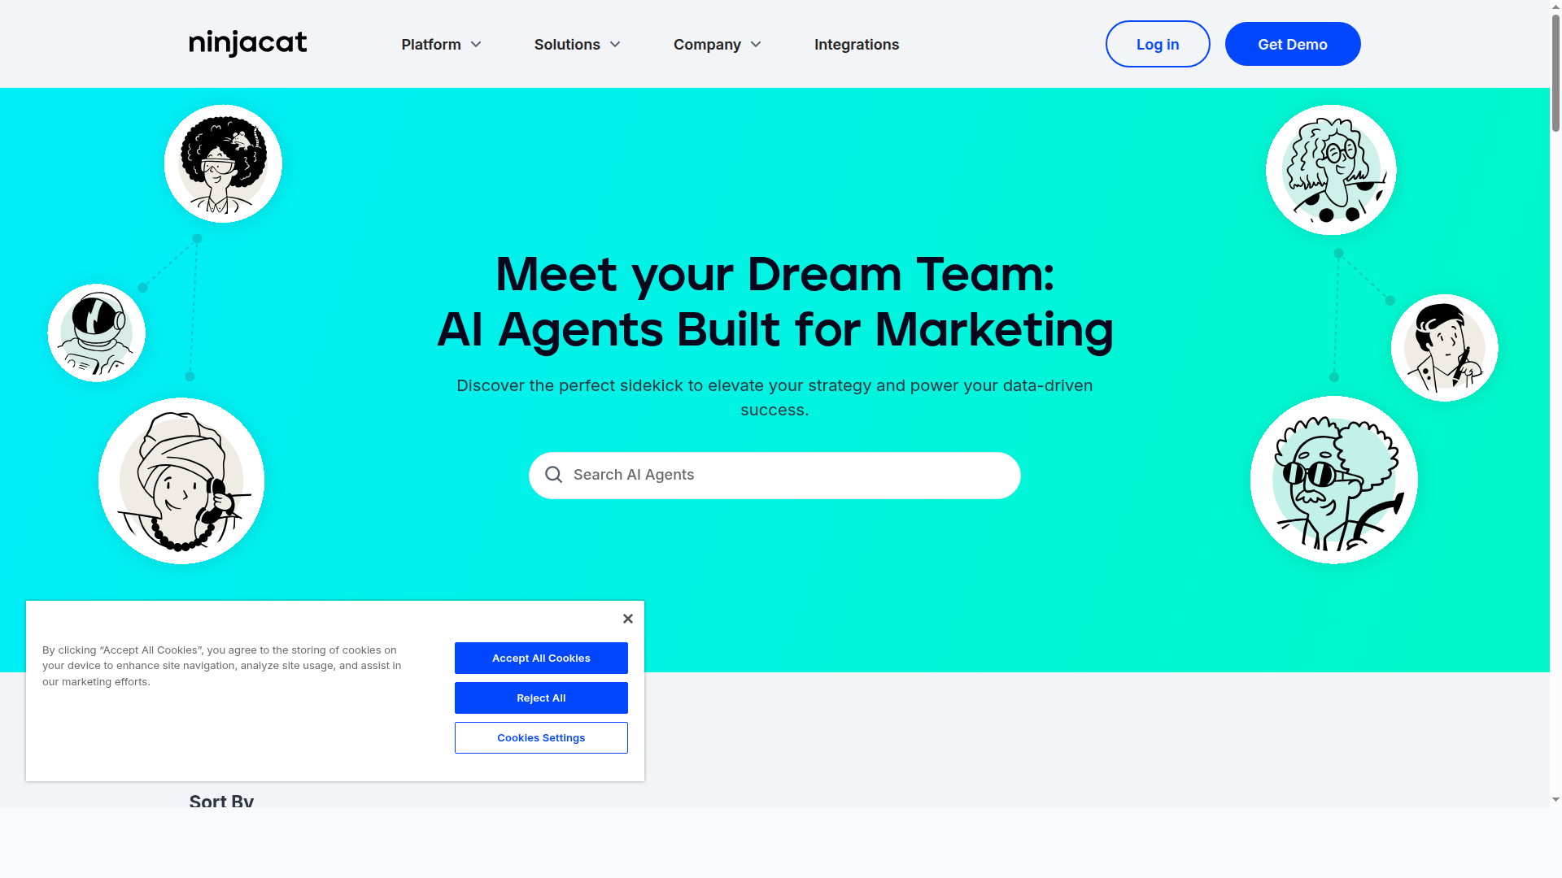
NinjaCat
AI Agents Built for Marketing
ninjacat.io
Agent Capabilities:
Data Collectors: Auto-ingest from Google Ads, Meta, GA4, LinkedIn, CRM, 100+ sources
Alerts: Spend pacing, CPA targets, impression share, engagement anomalies
Analysis: Cross-account benchmarking, KPI trend digests, creative performance
Actions: Pause underperformers, reallocate budgets, adjust bids automatically
Content: Auto-generate dashboards, performance summaries, client briefs
Strengths:
Most complete marketing agent platform. Data Cloud unifies all sources. Agents are pre-trained on ad-tech patterns.
Limitations:
Marketing only. No general-purpose agents. Closed ecosystem. No free tier.
BEST FOR: Agencies wanting turnkey marketing AI agents

Slide 6
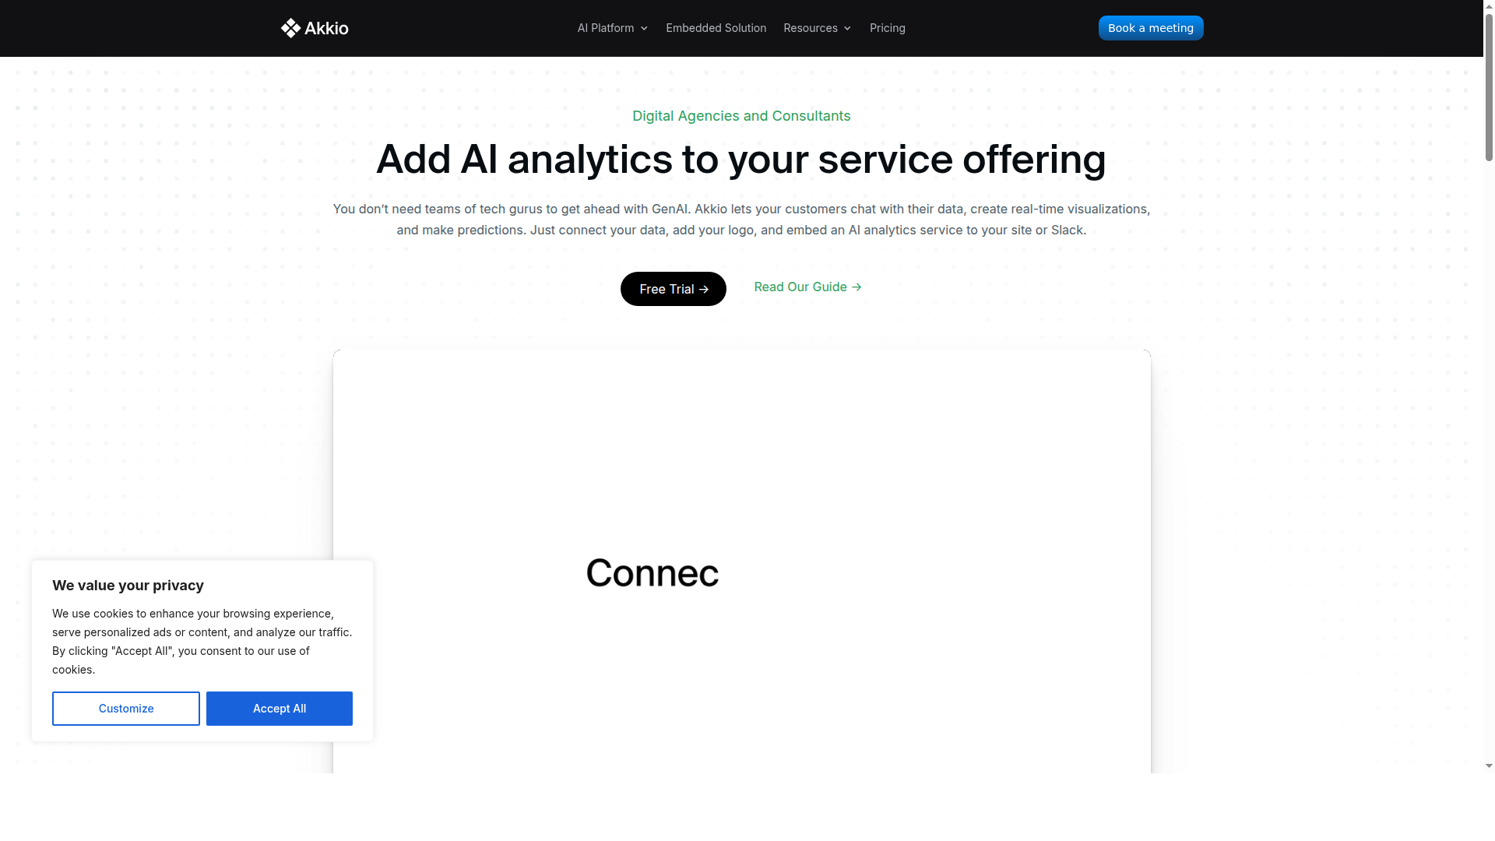
Akkio
White-Label Generative BI for Agencies
akkio.com
Agent Capabilities:
Data Collectors: Connect client data sources, auto-clean and prepare
Analysis: Chat Explore (natural language queries), ML predictions, forecasts
Content: Branded dashboards, insights reports, visualisations
Alerts: Limited - no proactive monitoring or threshold alerts
Actions: None - analytics only, no campaign actions
Strengths:
Only true white-label option. Agencies embed under their own brand. Great for client self-service analytics.
Limitations:
No action agents. No alerting. No orchestration. Analytics/BI only - not a full agent platform.
BEST FOR: Agencies wanting to resell AI analytics under their brand

Slide 7
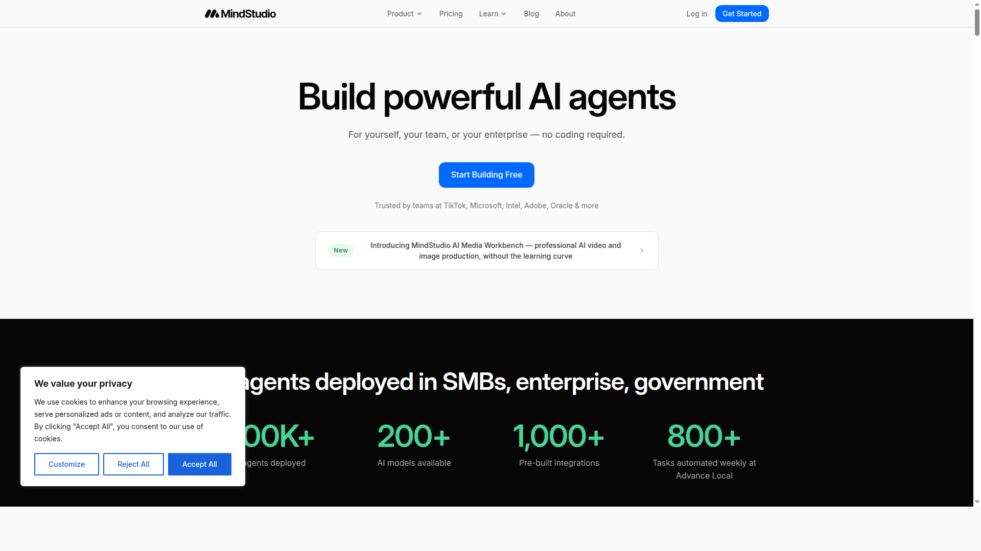
MindStudio
200+ AI Models, No-Code Agent Builder
mindstudio.ai
Agent Capabilities:
Data Collectors: API calls, web scraping, SQL queries, webhook triggers
Alerts: Scheduled agents + webhook triggers for monitoring workflows
Analysis: Data viz agents, research agents, market analysis
Content: Email drafts, reports, social posts, ad copy — 100+ templates
Actions: Partial - can call APIs but no native ad platform connectors
Strengths:
Most model-agnostic (200+ models). Dynamic Tool Use. Deploy anywhere (web, email, API, browser extension).
Limitations:
No native ad platform integrations. No white-label. Basic orchestration only.
BEST FOR: Teams wanting maximum flexibility across AI models and use cases

Slide 8
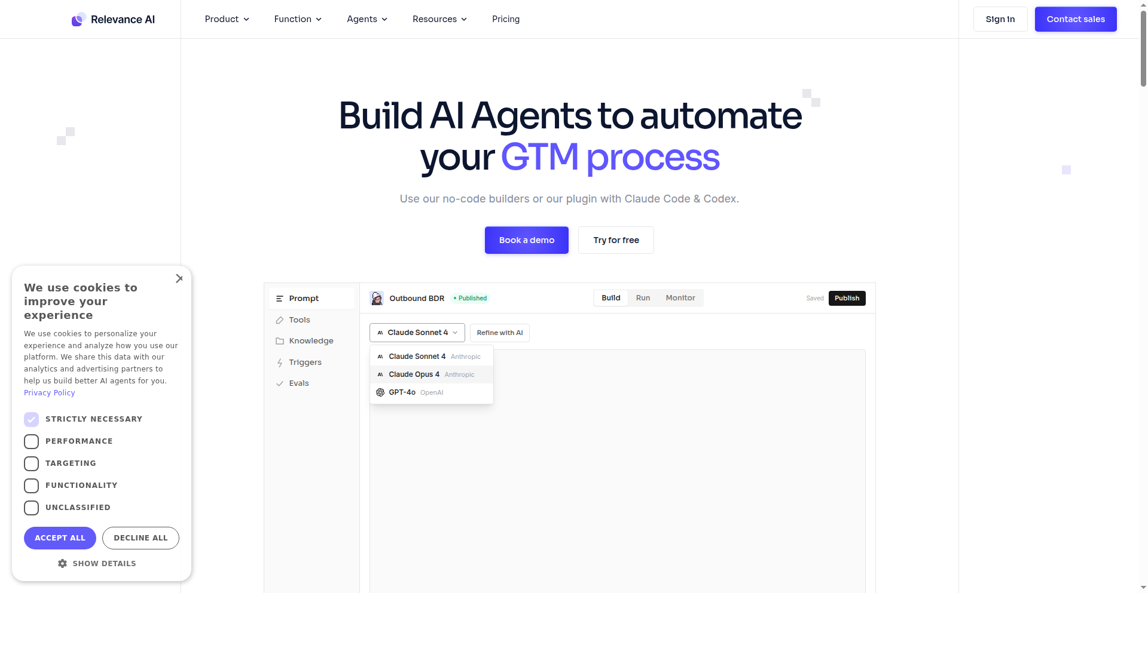
Relevance AI
Multi-Agent AI Workforce for Sales & GTM
relevanceai.com
Agent Capabilities:
Data Collectors: Lead research, CRM enrichment, competitor analysis, web research
Alerts: Limited - notification on task completion, no real-time monitoring
Analysis: Deal intelligence, campaign performance, market data analysis
Content: Proposals, email personalisation, content repurposing, blog drafts
Orchestration: Multi-agent teams (research > verify > write > distribute)
Strengths:
Best multi-agent orchestration. 100+ templates. Agents collaborate as teams on complex tasks.
Limitations:
Sales/GTM focus. Credit pricing scales fast. 20% LLM markup without own API keys.
BEST FOR: Sales teams wanting autonomous BDR and research agents

Slide 9
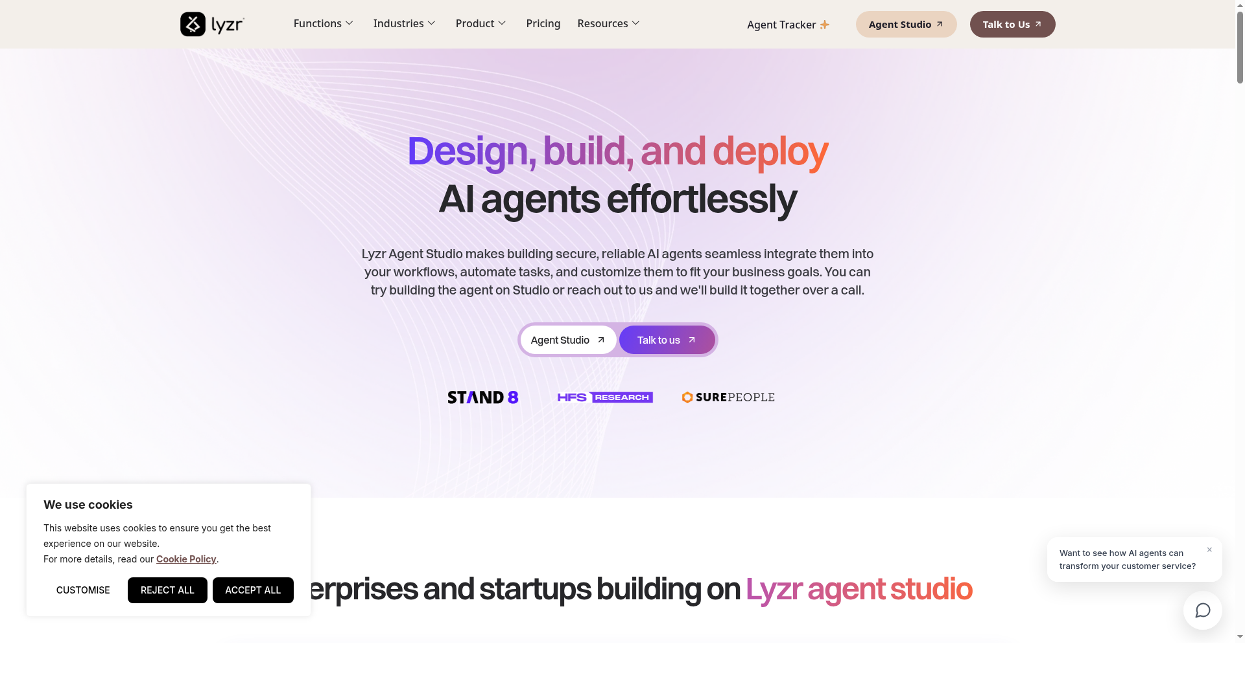
Lyzr
Enterprise AI Agent Studio with Safe AI
lyzr.ai
Agent Capabilities:
Data Collectors: API connectors, custom tool integration, data pipelines
Alerts: Partial - workflow-triggered notifications
Analysis: LLM + ML hybrid for better accuracy, blueprints for support/ops/finance
Content: Report generation, customer communications
Orchestration: Solo agents, multi-agent systems, full orchestration
Strengths:
Enterprise compliance (SOC2, GDPR, HIPAA, ISO 27001). Safe AI built into core. Flexible deployment.
Limitations:
Enterprise-focused - overkill for small teams. Limited marketing templates. Opaque pricing.
BEST FOR: Regulated industries needing compliance-first agent platform

Slide 10
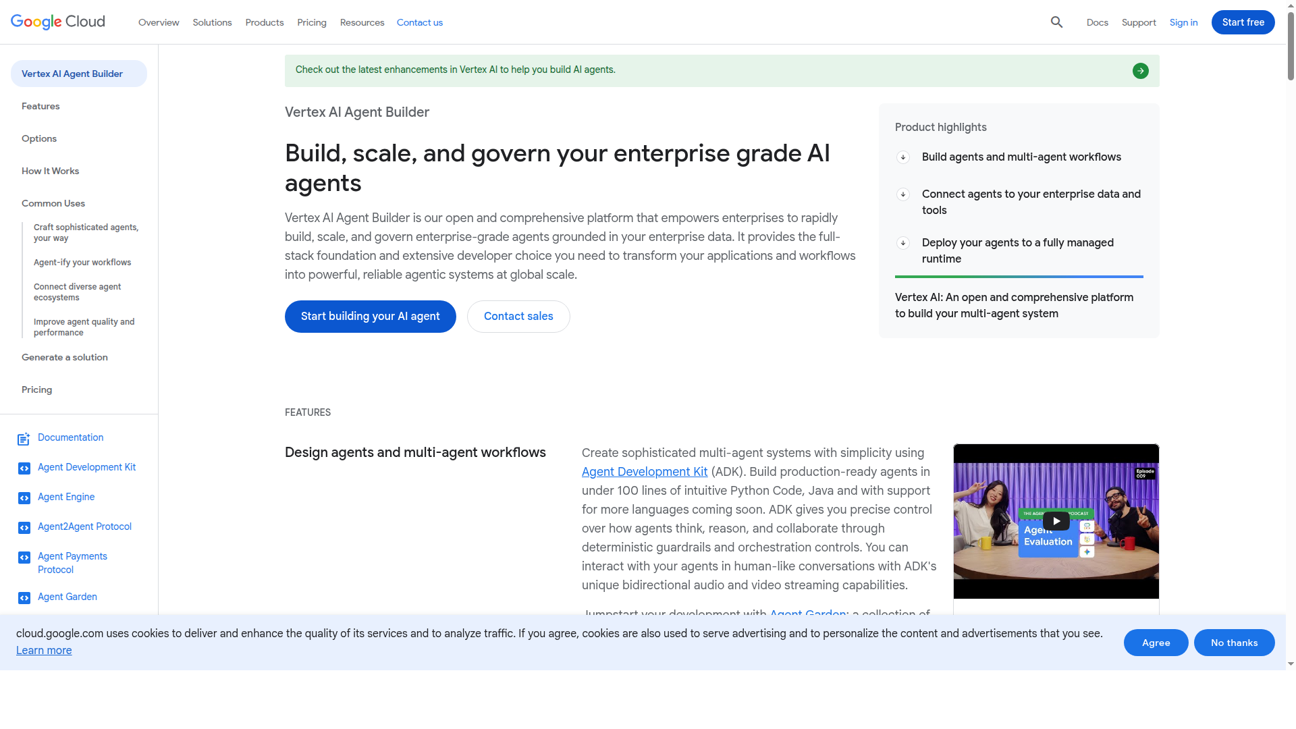
Google Vertex AI Agent Builder
Enterprise-Grade Agent Development on GCP
cloud.google.com/products/agent-builder
Agent Capabilities:
Data Collectors: BigQuery, Cloud Storage, 100+ connectors, Dataproc for large-scale
Alerts: Cloud Monitoring, auto-monitoring of agent behaviour and reasoning
Analysis: Multi-agent financial research, RAG agents, custom ML pipelines
Actions: Enterprise system connectors (ERP, procurement, HR), workflow automation
Orchestration: Agent Engine (managed runtime), directed graph workflows, ADK framework
Strengths:
Most powerful and scalable. Open-source ADK. Full lifecycle management. Global scale.
Limitations:
Requires GCP expertise. Steep learning curve. Code-heavy. Costs can spiral.
BEST FOR: Engineering teams building production-grade agent systems at scale

Slide 11
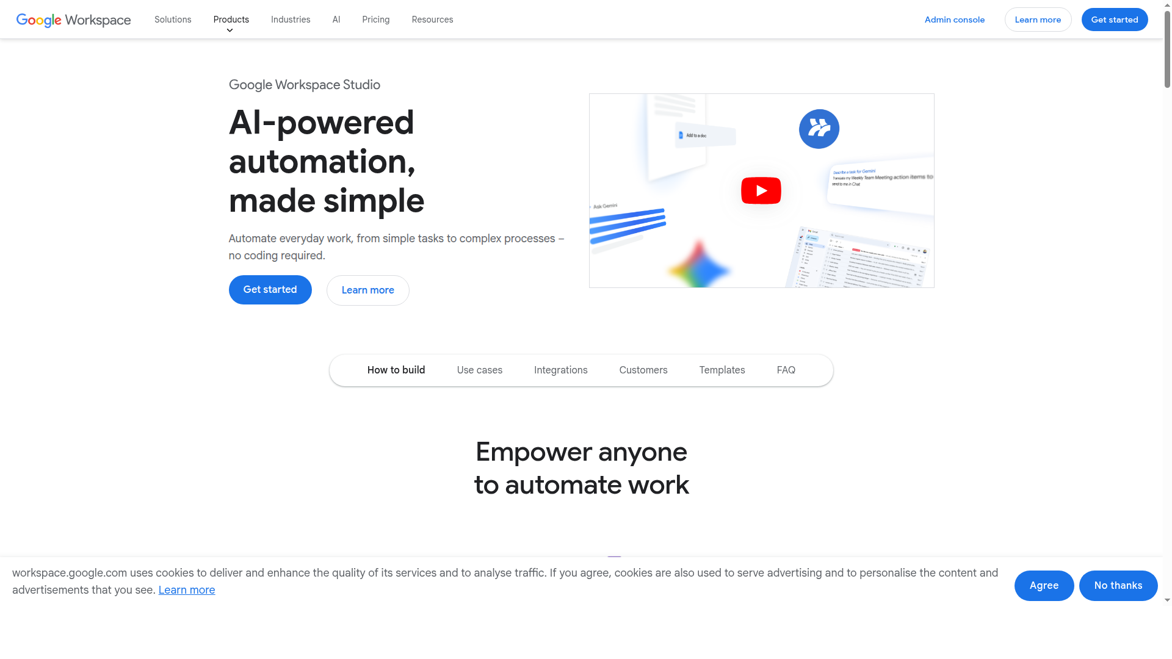
Google Workspace Studio
No-Code Agents for Google Workspace
workspace.google.com/studio
Agent Capabilities:
Data Collectors: Partial - Gmail, Drive, Sheets, Calendar data only
Alerts: Partial - can trigger on Workspace events
Analysis: Summarise docs, analyse spreadsheets, extract email insights
Content: Draft emails, create docs, generate presentations
Actions: Partial - Workspace actions only (send email, create doc, update sheet)
Strengths:
Zero friction for Google Workspace orgs. Build in minutes. No coding. Free with Business/Enterprise.
Limitations:
Limited to Workspace data. No ad platforms. No real agent orchestration. Basic capabilities.
BEST FOR: Quick internal automations within Google Workspace

Slide 12
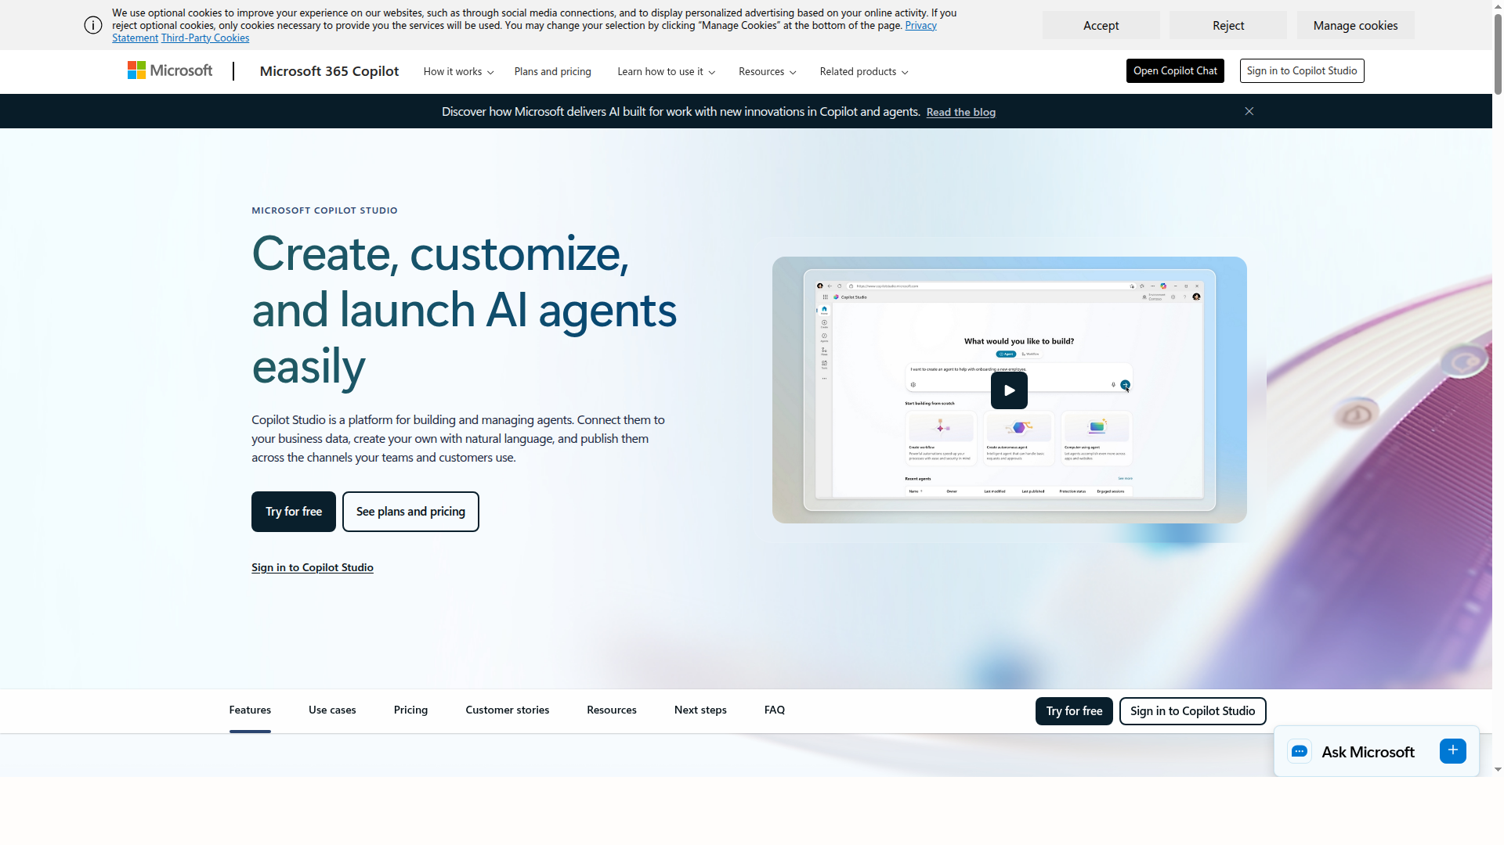
Microsoft Copilot Studio
Create, Customise and Launch AI Agents
microsoft.com/copilot-studio
Agent Capabilities:
Data Collectors: SharePoint, OneDrive, Planner, Forms, Dynamics 365, custom connectors
Alerts: Event triggers (file created, task completed, form submitted, schedule-based)
Analysis: Conversational analytics over M365 data, Power BI integration
Actions: Autonomous agents that monitor, decide, and execute without user prompts
Orchestration: Agent flows, multi-step automations, Power Automate integration
Strengths:
Best autonomous agent triggers. Deep M365 integration. No-code. Enterprise-grade audit logging.
Limitations:
Microsoft ecosystem lock-in. Limited ad platform connectors. Enterprise pricing.
BEST FOR: Microsoft-heavy organisations wanting autonomous background agents

Slide 13
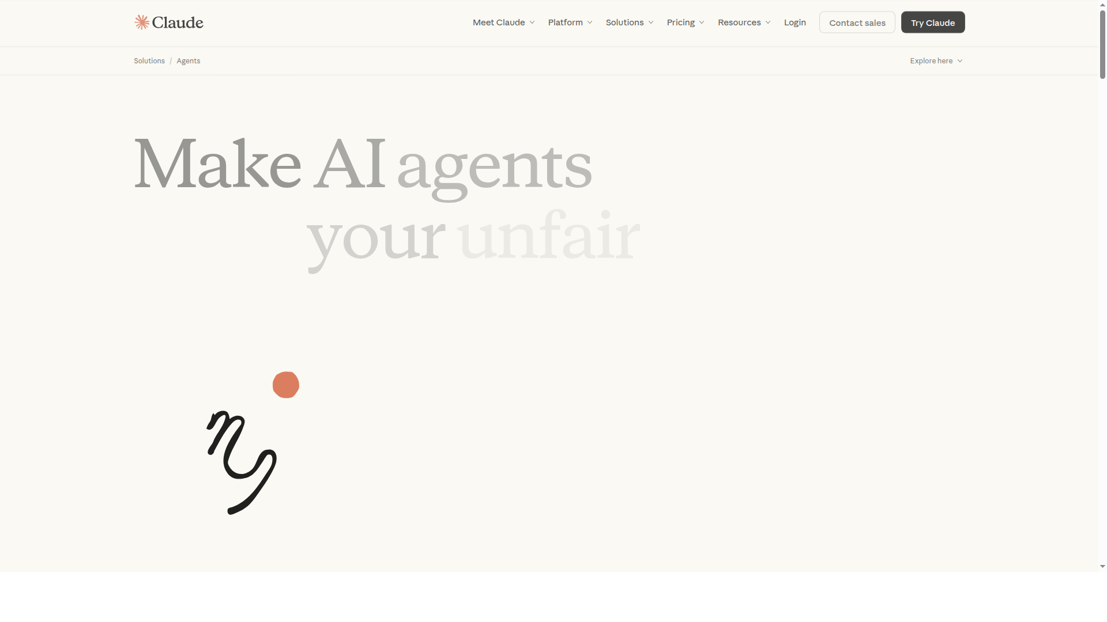
Claude (Anthropic)
AI Agents via Cowork & Agent SDK
claude.com/solutions/agents
Agent Capabilities:
Data Collectors: Web scraping, API calls, file processing, MCP server integrations
Alerts: Partial - no built-in scheduling, needs external triggers
Analysis: Most capable reasoning — multi-step analysis, code execution, research
Actions: File editing, code execution, tool calling, system commands
Orchestration: Agent Teams (up to 10 parallel sub-agents), Agent SDK, Skills marketplace
Strengths:
Most capable reasoning model. Best for complex multi-step tasks. Open SDK. Agent Teams for parallelism.
Limitations:
Code-first — not for non-technical users. No native ad connectors. No scheduling/triggers.
BEST FOR: Developer teams building custom intelligent workflows

Slide 14
Recommendation
For a Retail Media / Ad-Tech Context:
Tier 1: Purpose-Built for Marketing
NinjaCat — if you want the most complete out-of-the-box marketing agent platform (data collection, alerts, analysis, actions, reporting all built in). Best if you need agents that understand ad-tech natively.
Tier 2: White-Label & Client-Facing
Akkio — if the goal is giving clients self-service analytics under your brand. Not a full agent platform but the only real white-label option.
Tier 3: Build Custom (Most Flexible)
Google Vertex AI — if you have engineering resource and want full control at scale.
Copilot Studio — if you're a Microsoft shop wanting autonomous background agents with triggers.
Claude Agent SDK — if you want the most capable reasoning for complex analysis tasks.
Tier 4: General Purpose / Niche
MindStudio (model flexibility), Relevance AI (sales teams), Lyzr (regulated industries), Google Workspace Studio (internal automations)
Key insight: No single platform covers all 6 agent types well for ad-tech. NinjaCat is closest but lacks white-label. A hybrid approach (NinjaCat + Akkio) may be optimal.

