Slide 1
NECTAR360
Retail Media Performance Review
Q1 2026 — Sponsored & Display Campaign Analysis
March 2026
TAU — The Independent Marketing Intelligence Architect

Slide 2
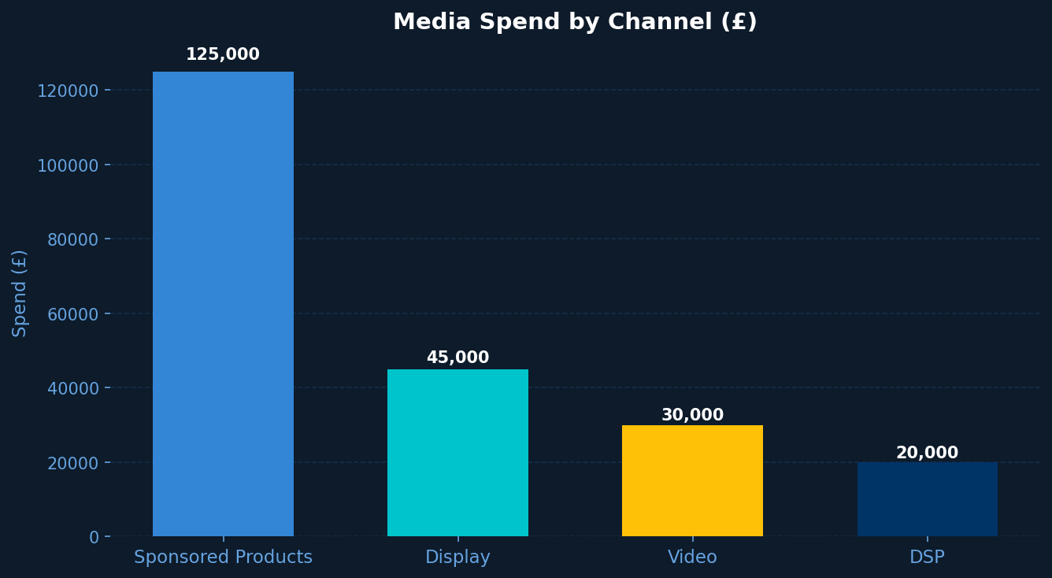
Spend by Channel
↗ Total spend distributed across key retail media channels
TAU — The Independent Marketing Intelligence Architect

Slide 3
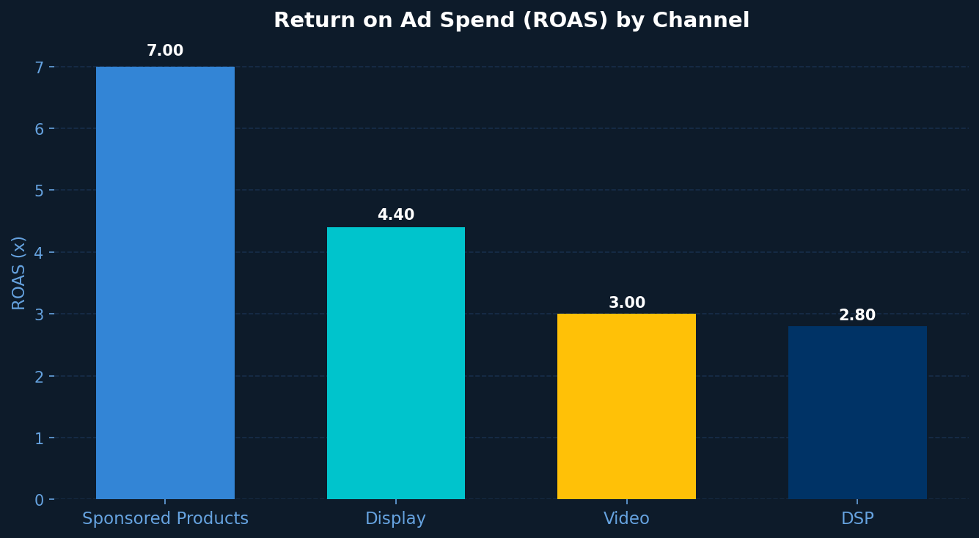
ROAS Performance by Channel
↗ Sponsored Products delivers highest return on ad spend
TAU — The Independent Marketing Intelligence Architect

Slide 4
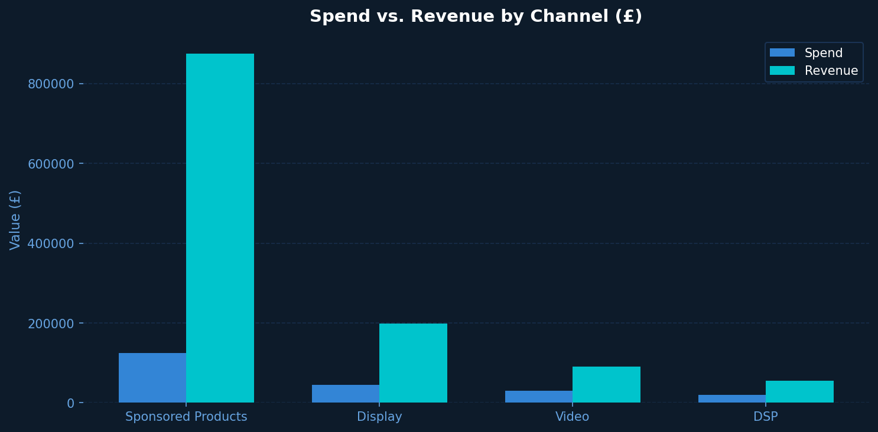
Spend vs. Revenue by Channel
↗ Revenue consistently outpaces spend across all channels
TAU — The Independent Marketing Intelligence Architect

Slide 5
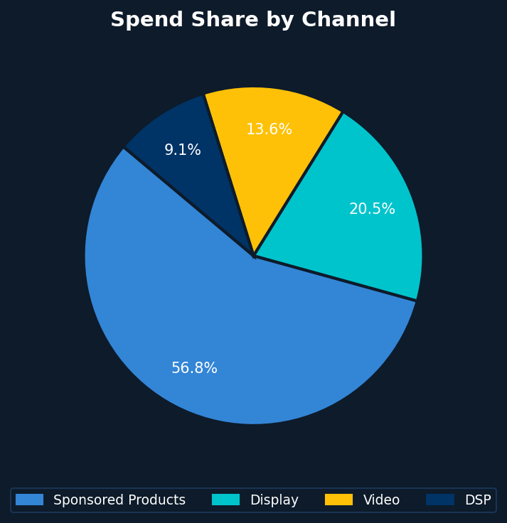
Spend Share by Channel
↗ Sponsored Products accounts for the majority of investment
TAU — The Independent Marketing Intelligence Architect

Slide 6
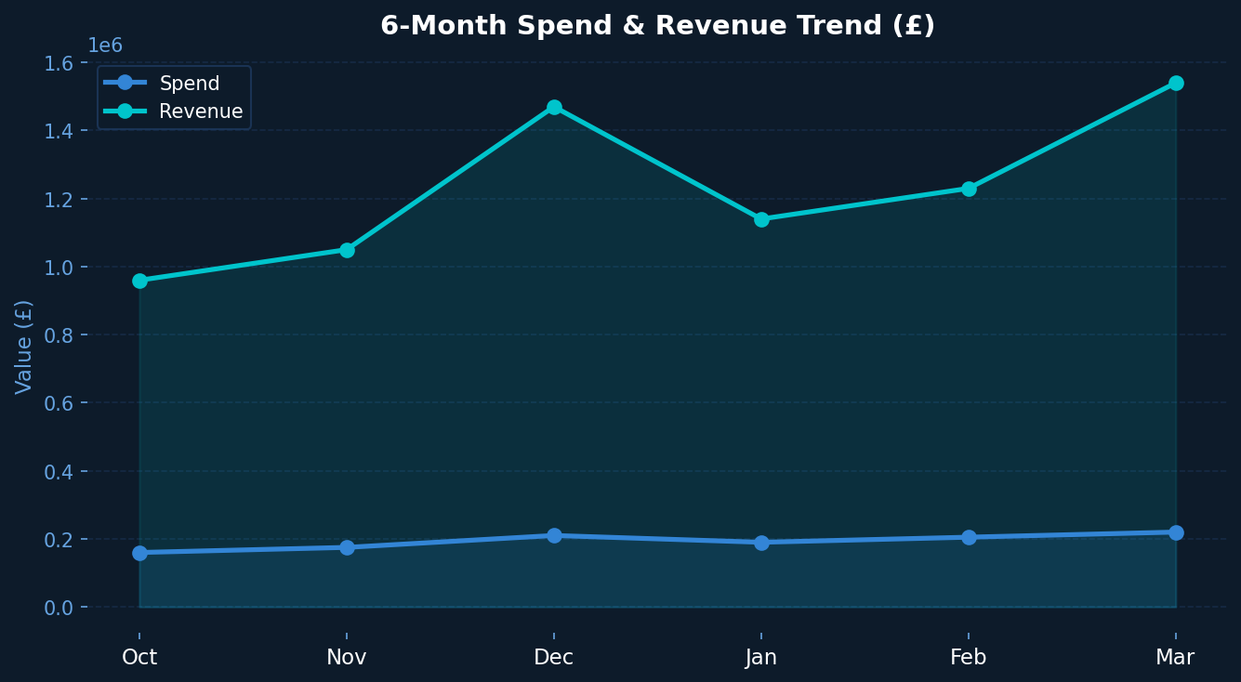
6-Month Performance Trend
↗ Strong revenue growth driven by increasing spend efficiency
TAU — The Independent Marketing Intelligence Architect

Slide 7
Executive Summary
Total retail media investment: £220k in March 2026
Blended ROAS of 5.8x across all channels — up 12% MoM
Sponsored Products remains top-performing channel at 7.0x ROAS
Video CPM down 18% while impressions grew 23%
Incremental revenue attributed to retail media: £1.54M
TAU — The Independent Marketing Intelligence Architect

Slide 8
Strategic Recommendations
Shift budget toward highest-ROAS channels and scale seasonal peaks
TAU — The Independent Marketing Intelligence Architect

Slide 9
Recommended Actions
Increase Sponsored Products budget by 15% in April
Expand Display retargeting to mid-funnel audiences
Test Video creative A/B for improved VTR
Implement dayparting to reduce off-peak CPC waste
Launch new category page placements ahead of summer
TAU — The Independent Marketing Intelligence Architect

Slide 10
Next Steps & Contact
April planning session — w/c 7 April Budget reallocation sign-off by 31 March Contact: strategy@tau.ai | tau.ai
TAU — The Independent Marketing Intelligence Architect | tau.ai

