Slide 1

CMR COLLEGE OF ENGINEERING & TECHNOLOGY
Kandlakoya, Medchal, Hyderabad - 501401
Department of Computer Science and Engineering
Toxic Comment Classification System Using LSTM
Batch No.:19
Name of the student:
MD Khaja Tazeem (20H51A05E8)
J. Harshini Naik (20H51A05K9)
K.Kavya Sree (20H51A05P0)
Under esteemed guidance of
Mr. B. K. ChinnaMaddileti
(Assistant Professor)
Batch: 2020-2024 Major Project Phase 2

Slide 2
Outline
Abstract
Introduction
Literature Survey
-Existing System
- Problems in Existing System
Research Objective
Problem Definition
Research Work
- Proposed system
- Architecture
- Comparision of Proposed system with an Existing System
Performance Measure
Result
Conclusion
Future Work
References
Notes:
2

Slide 3
Abstract
Notes:
3

Slide 4
ABSTRACT
• Over the past decade, social networking and social media platforms have
experienced exponential growth. Today, individuals have the ability to share
their thoughts and opinions with a global audience through these channels.
• In this context, it's expected that debates may emerge as a result of differing
viewpoints. However, at times, these discussions can take a negative turn,
escalating into conflicts on social media platforms
• The identification of toxic comments presents a significant challenge for
scholars in the field of research and development.
• Through the application of Natural Language Processing (NLP), text classifiers
can automatically assess text and assign a set of predefined tags or categories
based on its content. This particular model utilizes Long Short-Term Memory
(LSTM) architecture to address the aforementioned issue

Slide 5
INTRODUCTION
Notes:
5

Slide 6
Introduction
Internet negativity has always been a hot topic. The anonymity and the sense
of distance of people’s internet presence have encouraged people to express
themselves freely.
Extreme negativities has sometimes stopped people from expressing them
selves or made them give up looking for different opinions online. Issues
like this happen almost all the time, across all platforms of discussion, and
the modulators of these platforms have limited capabilities dealing with it.
To tackle the above-mentioned problem, we have developed a Toxic
Comment Classification System using Deep Learning.
It helps people refrain from using negative or profane language while inter-
acting with others and promote healthy conversation among users.
Notes:
6

Slide 7
Research Objective
Notes:
7

Slide 8
Research objective
The research objective of employing Long Short-Term Memory (LSTM)
networks for toxic comment classification is to develop an efficient and
effective solution to combat the proliferation of harmful,offensive, and
inappropriate content in online communication channels.
In a digital landscape where social media platforms and online forums
play a pivotal role in shaping public discourse, it is imperative to create
a safer and more inclusive online environment.
Additionally, the research aims to address ethical concerns related to
content moderation, emphasizing the importance of free speech and
responsible online behavior.

Slide 9
Problem Definition
Notes:
9

Slide 10
Problem Definition
The objective of this project is to develop a Toxic Comment Classification System utilizing Long Short-Term Memory (LSTM) architecture.
The system aims to automatically identify and categorize toxic comments within textual data across various online platforms, such as social media, forums, and comment sections.
A toxic comment is defined as any form of text containing offensive, harmful, or inappropriate language that may potentially incite hostility or discomfort among readers.
The primary goal of this system is to create a robust and accurate model capable of distinguishing toxic comments from non-toxic ones

Slide 11
Literature Review
Notes:
11

Slide 12
Comparison table for the existing system
S.No | Authors and Journal Name& Year of publication | Problem Statement | Name of the Proposed solution/Method | Solution | Remarks
1 | Automated NER, Sentiment Analysis and Toxic Comment Classification for a Goal-Oriented Chatbot. Authors:1.Sourabh Raja Murali 2.Sanketh Rangerji October 2020 | chatbot's sensitivity to a user's comment and the tone of a conversation through designing a fine-grained sentiment analysis module. | entity recognition, sentiment analysis and toxic comment classification modules | self-learning chatbot is positive and pleasant through a toxic-comment classifier that improves upon a dictionary-based profanity detection module. | performance of these modules in comparison with predecessor approaches and the code to reproduce the results have also been included to facilitate further improvements in these directions.
2 | Toxicity in Twitch Live Stream Chats: Towards Understanding the Impact of Gender, Size of Community and Game Genre Authors:1Johanna 2.Lukas Dreier August 2023 | streaming content, and gender, we offer insights into this under-represented research topic and propose ideas for preventing toxicity in live chats. | streaming content, and gender, we offer insights into this under-represented research topic and propose ideas for preventing toxicity in live chats Using machine learning methods. | Twitch’s fast-growing user base creates a potential breeding ground for toxic and hateful behavior. The viewers interact with each other or the streamer through a chat. | negative posts in the chat, a common challenge on social media platforms

Slide 13
Comparison table for the existing system
S.No | Authors and Journal Name& Year of publication | Problem Statement | Name of the Proposed solution/Method by authors | Solution | sffRemarks
3 |  | it discusses the MERN stack, highlighting its advantages over previous technologies such as HTML, CSS, SQL, and NoSQL | It primarily serves as an introduction to the MERN stack and a comparison with other technologies also proposed a solution re our project is to create an online system that provides interactive textbooks, notes and quizzes. | it highlights the advantages of the MERN stack for web development, such as using a single language (JavaScript) for both front-end and back-end development, cost-effectiveness due to open-source technologies | It focuses onReact vs. HTML/CSS SQL vs. MongoDB and NoSQL Databases MongoDB vs. Other NoSQL Databases
4 | College ERP Using MERN Stack - A Comprehensive Review* Authors:Shubham Patil, Saurav Daware (IJERT may 2021) | Traditional college management systems are manual, time-consuming, and error-prone. With the increasing number of student. | This system leverages the MERN stack, which comprises MongoDB, Express.js, React.js, and Node.js, to create, a scalable platform for managing various activities within a college to access, upload, and download information securely. | it suggest to develop the mern stack website on college ERP and it comprises of frontend using React and express and backend using node and mango dB database | The proposed College ERP using MERN stack addresses the limitations of manual systems by offering an integrated, cloud-based solution JavaScript-based development environment from the front-end to the back-end. This approach ensures seamless communication, quick data processing and updates

Slide 14
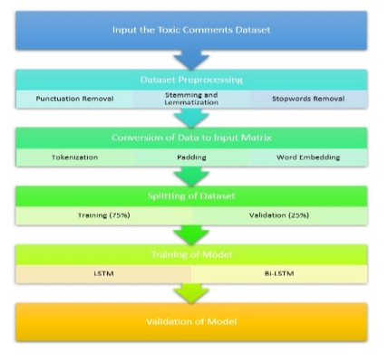
Implementation of Existing System

Slide 15
Implementation of Existing System
Components are Reusable by using ReactJs and props are Parameter (props) is used to pass the information from one page to another
Backend Like Node.js is used to create a backend environment to run the server helpful in creating Http request and response from the server and also developing API
The Existing System uses Mango DB for data access like Authentication, features like problem solving and express is a framework helps Nodejs to Work on API(Application Programming Interface)

Slide 16
Research work
Notes:
16

Slide 17
Proposed Method
In our approach, we use mechanism design to understand whether the following comment falls under the toxic or non toxic comment category by using multiple machine learning algorithms techniques
It focuses on toxic comment classification using both LSTM (Long Short-Term Memory) and Bi-LSTM (Bidirectional Long Short-Term Memory) networks is extensive and encompasses several critical components

Slide 18
Architecture
Notes:
18

Slide 19
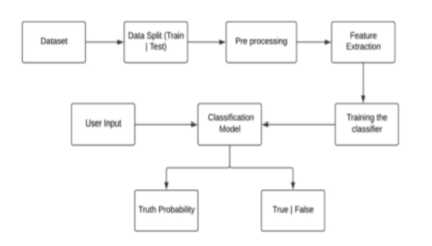
Architecture

Slide 20
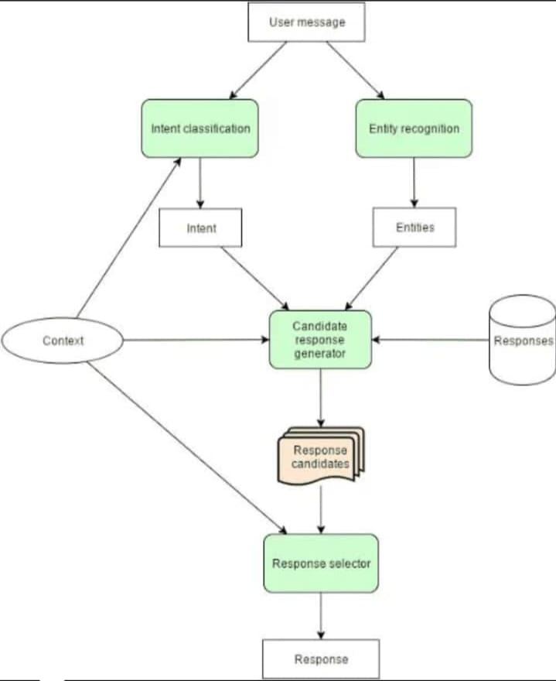
Block Diagram

Slide 21
Performance Measure

Slide 22
The project focused on toxic comment classification using both LSTM (Long Short-Term Memory) and Bi-LSTM (Bidirectional Long short-term Memory) networks is extensive and encompasses several critical components.It has 95 % of accuracy to detect the text or comment.This project aims to develop a robust and versatile solution to the pervasiveissue of identifying and mitigating toxic content in online interactions
Performance

Slide 23
User Module
Registration:
The user would require to register first.
Login:
The user can log in using their credentials.
Chat:
1. The user would require to select a particular user for chatting.
2.The user will add text and we will check
a. If the comment is toxic, we will highlight the text using JavaScript.
b. We will check if there is a toxic word in the sentence with the pre-defined list of words.
If there is,the system will give out non-toxic synonyms for that word.
c. After all the conditions are checked, the system will post that chat.

Slide 24
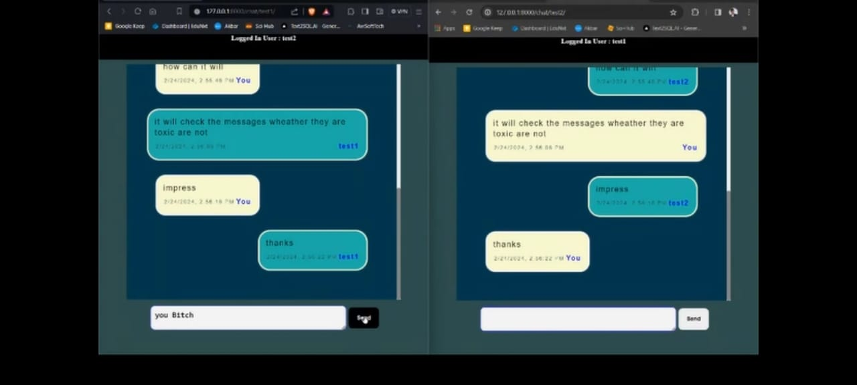
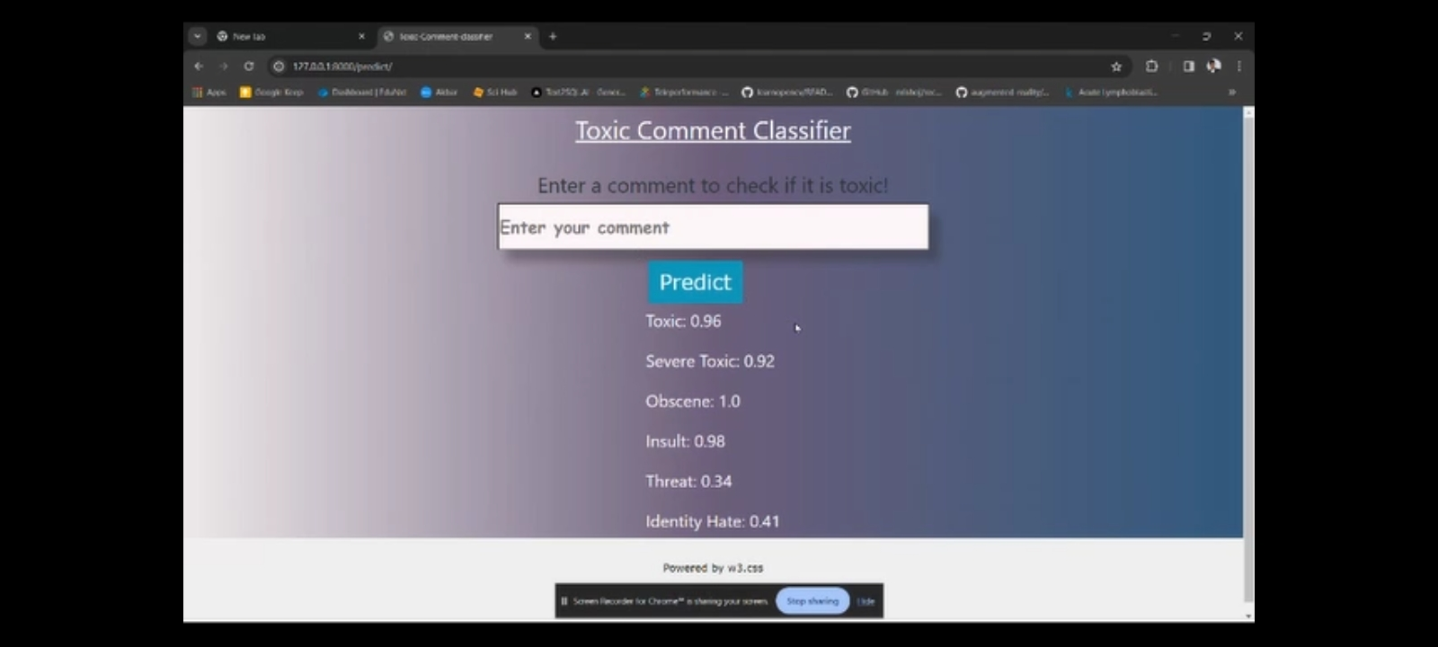
Result
Text Classification
Comment prediction

Slide 25
Conclusion
In conclusion, toxic comment classification using Long Short-Term Memory (LSTM) networks is a powerful and effective approach for identifying and filtering out harmful, offensive, or inappropriate content in online discussions and social media platforms. This technology has been extensively applied in various applications, including content moderation, online safety, and maintaining a positive online environment.

Slide 26
Some negative short cuts of languages are not added to the pre-defined list. Multiple Users can access in the single system instead of multiple systems.
Future work

Slide 27
References
https://arxiv.org/ftp/arxiv/papers/1903/1903.06765.pdf
https://web.stanford.edu/class/archive/cs/cs224n/cs224n.1184/reports/6837517.pdf
https://aclanthology.org/W18-5105.pdf
Richard Socher.CS224d Deep Learning for Natural Language Processing Lecture 2:Word Vectors. url: https://cs224d.stanford.edu/lectures/CS224d-Lecture2.pdf

Slide 28
Thank You!

