Slide 1

CMR COLLEGE OF ENGINEERING & TECHNOLOGY
Kandlakoya, Medchal, Hyderabad - 501401
Department of Computer Science and Engineering
Toxic Comment Classification System using LSTM
Batch No.:19
Name of the student:
20H51A05E8 MD. Khaja Tazeem
20H51A05K9 J. Harshini Naik
20H51A05P0 K. Kavya Sree
Under esteemed guidance of
Guide Name Mr. B. K. ChinnaMaddileti
Assistant Professor
Batch: 2020-2024 Major Project Phase 1

Slide 2
Outline
Abstract
Introduction
Research Objective
Problem Definition
Scope of the Project
Literature Review
Implementation of Existing system
Conclusion
References
Notes:
2

Slide 3
Abstract
Notes:
3

Slide 4
ABSTRACT
Over the past decade, social networking and social media platforms have experienced exponential growth. Today, individuals have the ability to share their thoughts and opinions with a global audience through these channels. In this context, it's expected that debates may emerge as a result of differing viewpoints. However, at times, these discussions can take a negative turn, escalating into conflicts on social media platforms, where one party may resort to using offensive language, commonly referred to as toxic comments.
The identification of toxic comments presents a significant challenge for scholars in the field of research and development. Through the application of Natural Language Processing (NLP), text classifiers can automatically assess text and assign a set of predefined tags or categories based on its content. This particular model utilizes Long Short-Term Memory (LSTM) architecture to address the aforementioned issue. Its purpose is to encourage individuals to refrain from employing negative or profane language when engaging with others, thus fostering a healthier and more constructive conversation among users.

Slide 5
INTRODUCTION
Notes:
5

Slide 6
Introduction
Internet negativity has always been a hot topic. The anonymity and the sense of distance of people’s internet presence have encouraged people to express themselves freely. This freedom can sometimes lead to extreme outtakes on others people or the particular topics. Extreme negativities has sometimes stopped people from expressing themselves or made them give up looking for different opinions online. Issues like this happen almost all the time, across all platforms of discussion, and the modulators of these platforms have limited capabilities dealing with it. Needless to say the time, energy and effort these modulators have to put into controlling this negativity on their platform. People have been seeking help from various tools to analyze text-based information so that they can identify toxic expressions from a sea of information, both efficiently, and more importantly, accurately.
To tackle the above-mentioned problem, we have developed a Toxic Comment Classification System using Deep Learning. The system is designed to detect and classify toxic comments or texts while chatting. It helps people refrain from using negative or profane language while interacting with others and promote healthy conversation among users. The model used for this system is LSTM. LSTM stands for Long-Short Term Memory. It is a type of recurrent neural network that is better than traditional recurrent neural networks in terms of memory.
Notes:
6

Slide 7
Research Objective
Notes:
7

Slide 8
Research objective
The research objective of employing Long Short-Term Memory (LSTM) networks for toxic comment classification is to develop an efficient and effective solution to combat the proliferation of harmful, offensive, and inappropriate content in online communication channels. In a digital landscape where social media platforms and online forums play a pivotal role in shaping public discourse, it is imperative to create a safer and more inclusive online environment. By harnessing the power of LSTM networks, the primary aim of this research is to design, implement, and evaluate a robust model capable of accurately identifying and categorizing toxic comments. This includes the exploration of various LSTM architectures, the optimization of hyperparameters, and the utilization of interpretable methods to better understand the decision-making process of the model. Additionally, the research aims to address ethical concerns related to content moderation, emphasizing the importance of free speech and responsible online behavior. Ultimately, this research seeks to contribute to the development of advanced tools for content moderation that can be deployed at scale, enabling platforms to proactively manage and mitigate harmful content while fostering a more positive and respectful online community.

Slide 9
Problem Definition
Notes:
9

Slide 10
Problem Definition
The objective of this project is to develop a Toxic Comment Classification System utilizing Long Short-Term Memory (LSTM) architecture. The system aims to automatically identify and categorize toxic comments within textual data across various online platforms, such as social media, forums, and comment sections. A toxic comment is defined as any form of text containing offensive, harmful, or inappropriate language that may potentially incite hostility or discomfort among readers.
The primary goal of this system is to create a robust and accurate model capable of distinguishing toxic comments from non-toxic ones. This involves training the LSTM-based classifier on a diverse dataset of labeled comments, encompassing a wide range of toxic behaviors, including but not limited to hate speech, harassment, profanity, and personal attacks. In this project, we proposed a multi-label classification model using LSTM and Bi-LSTM to classify the various toxic comments into six classes namely toxic, severe toxic, obscene, threat, insult and identity hate.

Slide 11
Scope of the Project
Notes:
11

Slide 12
Scope of the Project
The scope of a project focused on toxic comment classification using both LSTM (Long Short-Term Memory) and Bi-LSTM (Bidirectional Long Short-Term Memory) networks is extensive and encompasses several critical components. This project aims to develop a robust and versatile solution to the pervasive issue of identifying and mitigating toxic content in online interactions

Slide 13
Literature Review
Notes:
13

Slide 14
Comparison table for the existing system
S.No | Authors and Journal Name& Year of publication | Problem Statement | Name of the Proposed solution/Method | Solution | Remarks
1 | Vaibhav Rupapar 2021 | Impact of SMOTE on imbalanced text features for toxic comments classification using RVVC Model | regression vector voting classifier (RVVC), for toxic comment classification. RVVC is an ensemble classifier that combines the logistic regression and support vector classifier through soft voting criteria. | For evaluation, term frequency-inverse document frequency (TF-IDF) and bag-of-words (BoW) are utilized as feature extraction with imbalanced and imbalanced datasets. Synthetic minority oversampling technique (SMOTE) and random under-sampling technique are used for balancing the datasets. Several state-of-the-art models are used along with machine learning models including support vector machine (SVM), random forest (RF), gradient boosting machine (GBM), logistic regression (LR), and k-nearest neighbor (K-NN) for performance appraisal. | The proposed model RVVC outperforms both the RNN and machine learning models due to its structure.
2 | Alessio 2022 | The goal is to detect and classify toxic comments in online conversations using Jigsaw's Toxic Comment Classification dataset. | focused on the Jigsaw Toxic Comment Classification Challenge hosted on Kaggle. The task consists of aa Multilabel text classification problem where a given toxic comment | three distinct models using TensorFlow to address the challenge. 1)Bi-LSTM network with embeddings trained from scratch. 2) a variation of the baseline approach that incorporated Glove's pre-trained embeddings with the Bidirectional LSTM architecture. 3) the well-known BERT model | AUC-ROC can be misleading in case of imbalanced data, as it only considers the overall performance of the model without taking into account class imbalance.
3 | Aits journal 2021 | Toxic comment classification | The topic is particularly intriguing because of the intense debates about how poisonous information on the internet has impacted society’s general health. | train.csv — the training set, contains comments with their binary labels test.csv — the test set, you must predict the toxicity probabilities for these comments. | Acuuray rate
4 | IEEE explorer 2022 | Classification of online toxic comments using the machine learning | online bullying and harassment affects the free flow of thoughts by restricting the dissenting opinions of people. | use six machine learning algorithms and apply them to our data to solve the problem of text classification. | toxicity with high accuracy to limit down its adverse effects which will be an incentive for organizations to take the necessary steps.

Slide 15
Comparison table for the existing system
S.No | Authors and Journal Name& Year of publication | Problem Statement | Name of the Proposed solution/Method by authors | Solution | Remarks
5 | IEEE Explorer 2021 | To understand whether the followingcomment falls under the toxic or nontoxic category by using multiple machine learning techniques | The following study uses 6 different traits, with the help of vectorization a dictionary will be created out of known vocabulary(Dataset) to train the ML model. | Random Forest algorithm performed well against all types of traitswhich gave us a good accuracy | Machine learning models have less accuracy rate when compared to the deep learning models
6 | IEEE Explorer 2020 | Multi-label Comment Classification Using GloVe-RNN Framework | Multi-label comment classification using GloVe embedding is addressed using deep neural networks | Long short-term memory (LSTM), convolutional neural network (CNN), and gated recurrent neural network (GRU) models have been used for the classification phase. | The evaluation of results shows that recurrent neural network-based models outperform convolutional neural network-based models.
7 | IEEE Explorer 2023 | Multilingual Toxic Comment Classifier | dataset with more than one language there are many problems faced in writing the pseudo-code of the Deep learning algorithms | neural network (CNN), and gated recurrent neural network (GRU) models | Acuuracy rate is average
8 | Nithin kumar IEEE Explorer 2023 | Machine Learning-based Multilabel Toxic Comment Classification | cyberbullying, personal assaults, and the use of profane language. To tackle this challenge, we are detecting the toxicity level in the Jigsaw dataset | Multinomial NB, Logistic Regression, and Support Vector Machine with TF-IDF on identifying toxicity in text. | Logistic Regression trumps the other models in terms of accuracy and hamming loss.

Slide 16
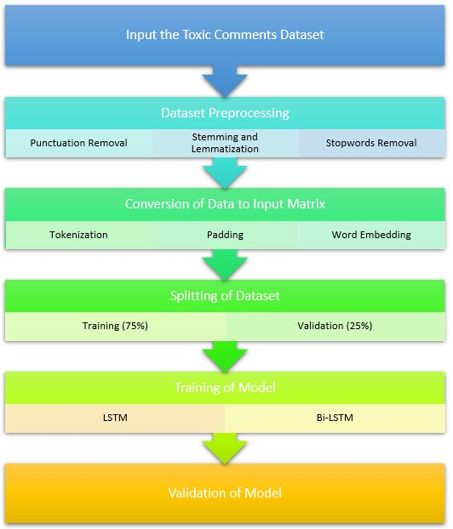
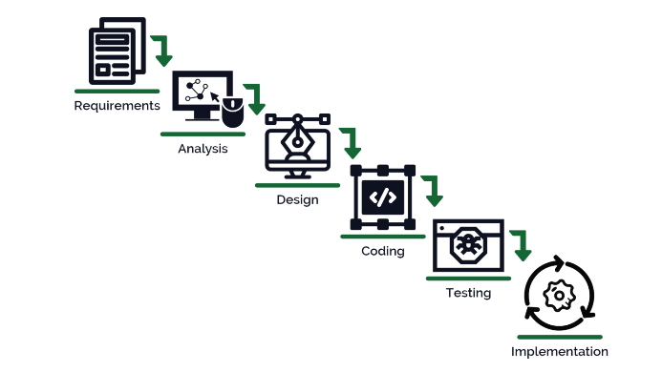
Implementation of Existing System

Slide 17
Result
Our Toxic Comment Classification System is developed to efficiently classify negative comments to promote healthy relationships.We defined fine-grained classification schemes for toxicity to support further progress in this field and we gave an overview of publicly available datasets and state-of-the-art neural network architectures. Toxic comment detection was also set into context with the most recent research on transfer learning and on explaining neural networks. Finally, we outlined current challenges and future directions for research in this field.

Slide 18
Conclusion
In conclusion, toxic comment classification using Long Short-Term Memory (LSTM) networks is a powerful and effective approach for identifying and filtering out harmful, offensive, or inappropriate content in online discussions and social media platforms. This technology has been extensively applied in various applications, including content moderation, online safety, and maintaining a positive online environment. One motivation for this task is the overwhelming number of comments posted online, which needs moderation to remain engaging, respectful, and informative

Slide 19
References
https://arxiv.org/ftp/arxiv/papers/1903/1903.06765.pdf
https://web.stanford.edu/class/archive/cs/cs224n/cs224n.1184/reports/6837517.pdf
https://aclanthology.org/W18-5105.pdf
Richard Socher.CS224d Deep Learning for Natural Language Processing Lecture 2:Word Vectors. url: https://cs224d.stanford.edu/lectures/CS224d-Lecture2.pdf

Slide 20
Thank You!

