Slide 1

AUTOMATION TESTING ON DEMOBLAZE
PRESENTED BY:
MD KHAJA TAZEEM HASHMEE
TRAINER:
ANAND

Slide 2
INTRODUCTION
DemoBlaze is a user-friendly e-commerce website specializing in a wide range of electronic products, including smartphones, laptops, and tablets. It provides a seamless shopping experience with features such as detailed product listings, a convenient shopping cart, and a streamlined checkout process. Users can browse through various product categories, compare items, and make secure purchases. The website also offers user account management, allowing customers to log in, and manage their personal information.

Slide 3
PROJECT OVERVIEW
Automated test framework for DemoBlaze e-commerce site.
Built using Selenium WebDriver, TestNG, Cucumber.
Implements Page Object Model (POM) and Page Factory.
Ensures seamless shopping experience by testing login, signup, cart management, and checkout functionalities.

Slide 4
PROBLEM STATEMENT & OBJECTIVE
Challenges with Manual Testing:
Time-consuming and labor-intensive.
Prone to human errors.
Inefficient for frequent UI changes and feature updates.
Project Objective:
Enhance testing efficiency and reduce execution time.
Automate workflows like login, product selection, cart management, and checkout.

Slide 5
TOOLS AND TECHNOLOGIES
Programming Language: Java
Build Tool: Maven
Testing Frameworks: TestNG, Cucumber
Automation Tool: Selenium WebDriver
Design Pattern: Page Object Model (POM), Page Factory
Reporting Tools: Extent Reports, Cucumber Reports, Allure Reports
Exception Handling: Try-catch blocks
Test Execution: TestNG XML, POM.XML

Slide 6
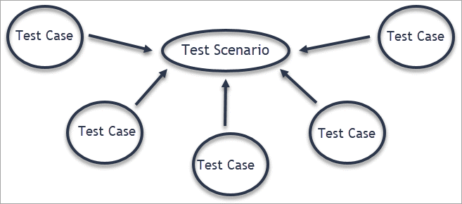
TEST SCENARIOS
SIGN UP
LOGIN
HOME PAGE
PRODUCT SELECTION
CART MANAGEMENT
CHECKOUT

Slide 7
REPORTS AND CONCLUSION
Test Reports:
Extent Reports: HTML-based detailed test logs.
Cucumber Reports: BDD-style execution details.
Allure Reports: Interactive and visual test execution insights.
Conclusion:
The framework effectively automates DemoBlaze’s core functionalities.
Ensures maintainability, scalability, and efficiency.
Future enhancements: API automation, performance testing, and CI/CD integration.

Slide 8


