Slide 1
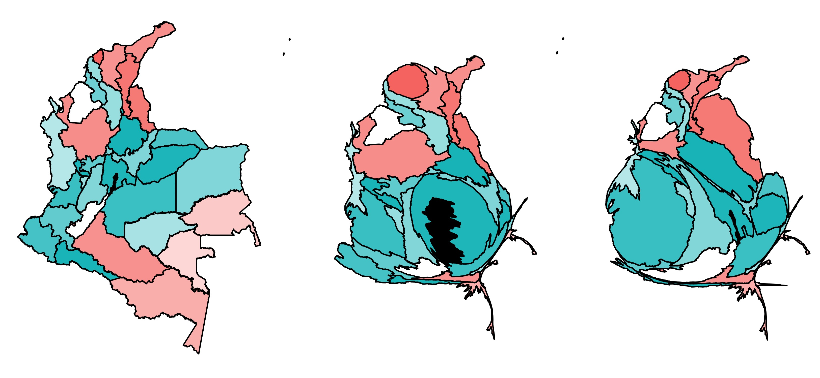
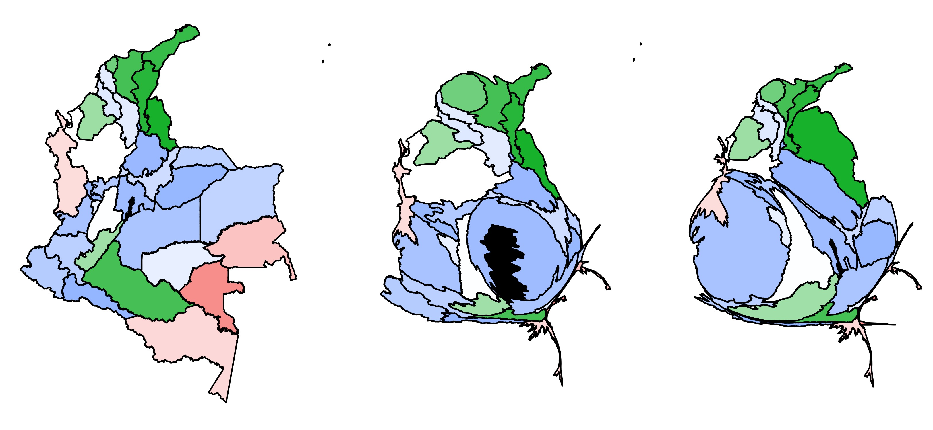
Departmental-level group assignments
Number of groups = 2
Number of groups = 3
Area
Population
Incidence

