Slide 1
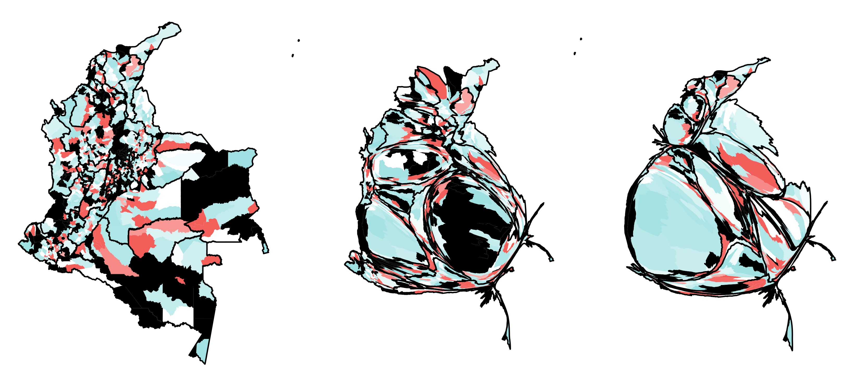
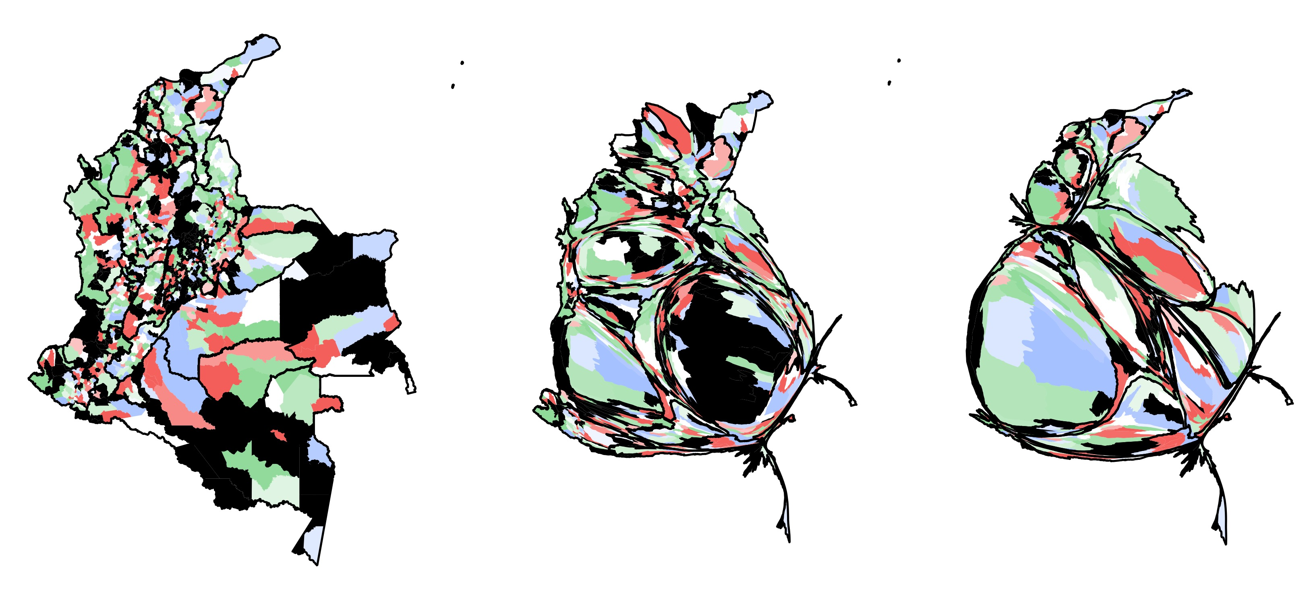
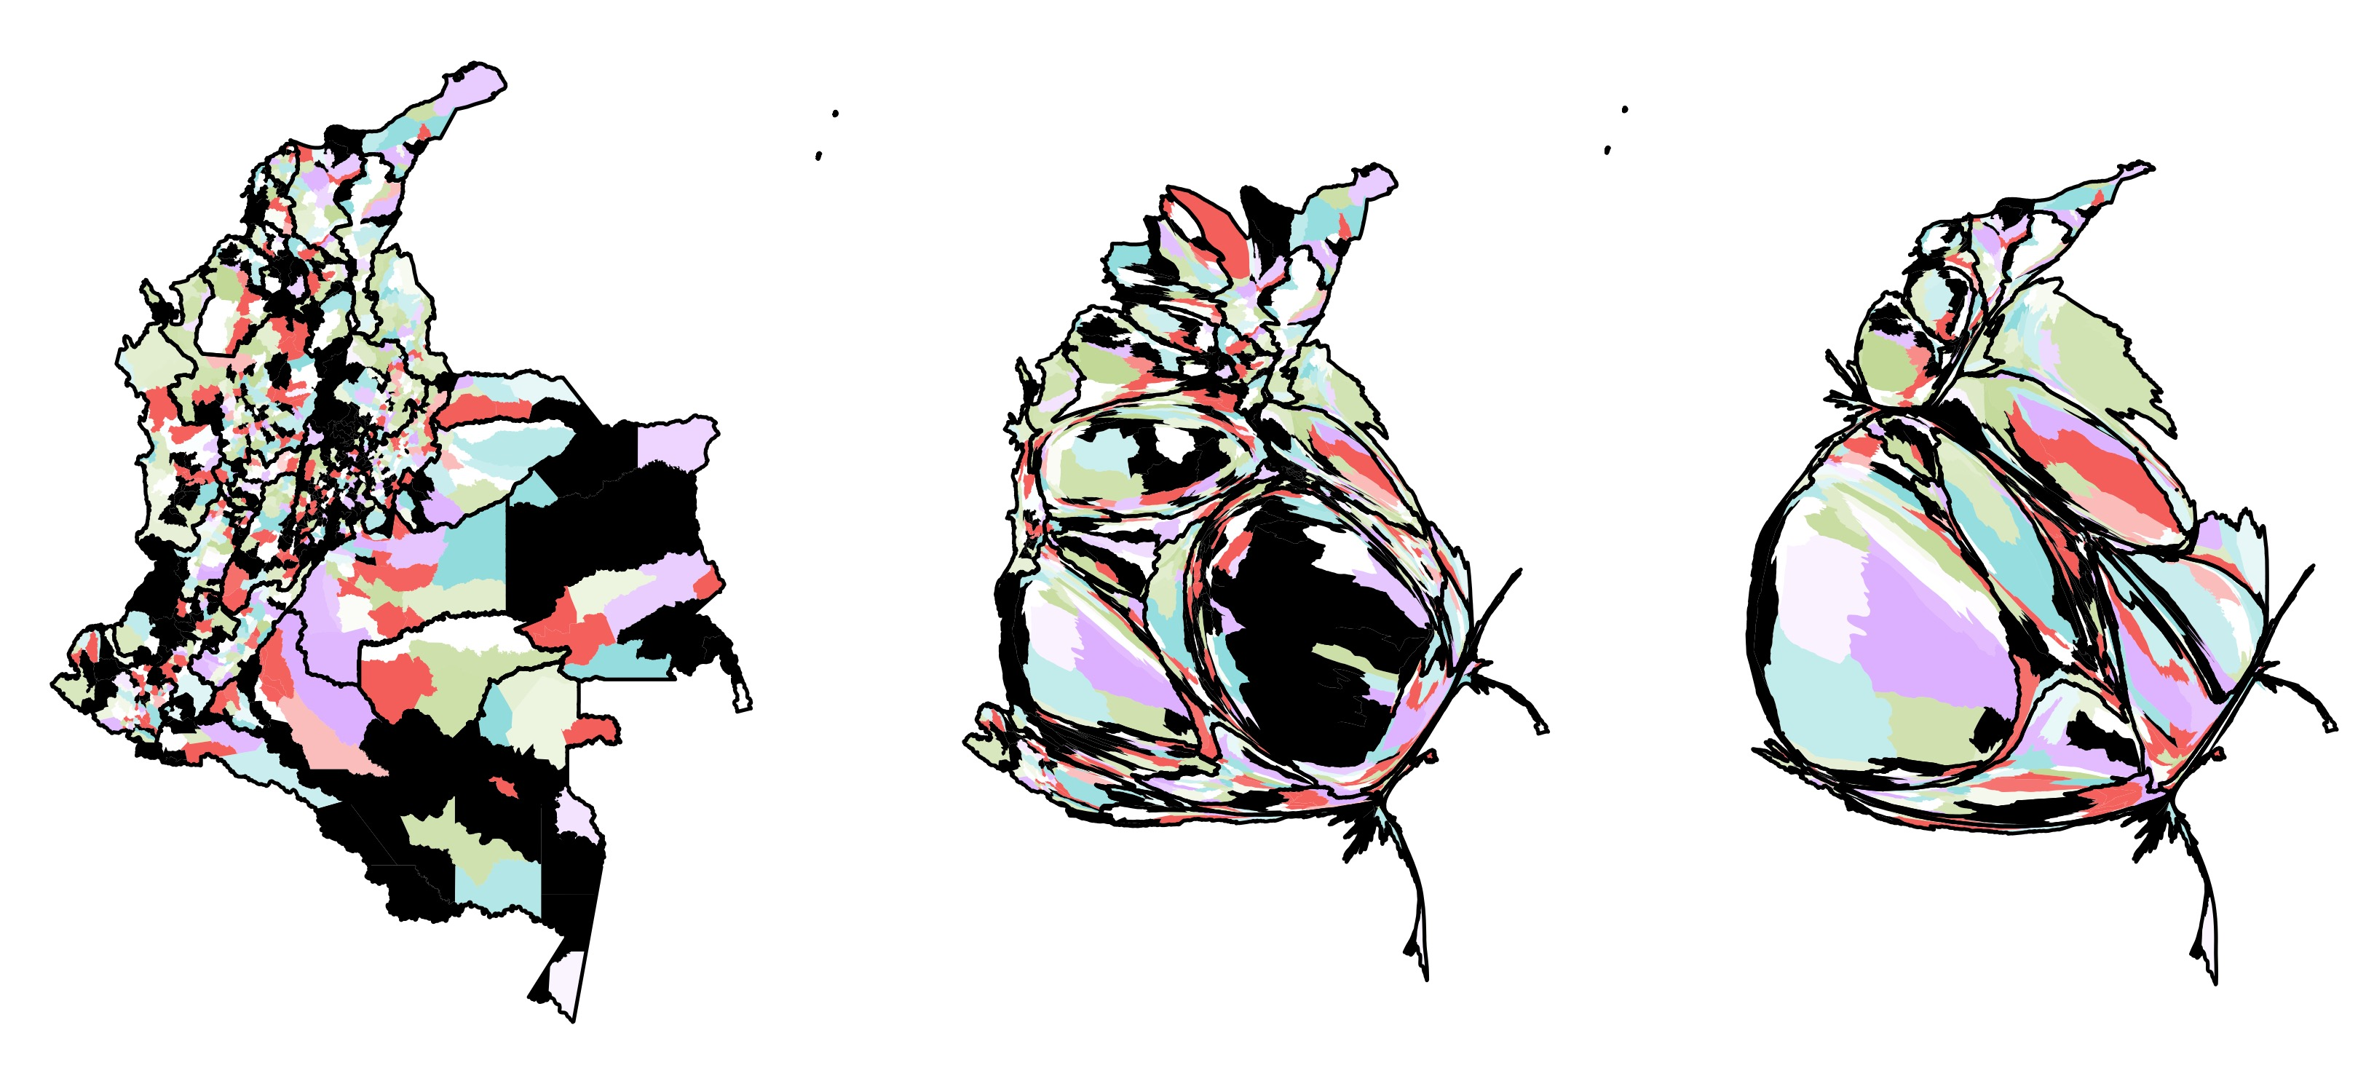
Municipal-level group assignments
Number of groups = 2
Number of groups = 3
Number of groups = 4
Area
Population
Incidence

