Slide 1
Webmeeting WAGO Device Manager 751-9402 WDX
2025-01
Johannes Bachem
Daniela Meyer
WAGO GmbH & Co. KG

Slide 2


WAGO tooling today and in future - motivation
Current Situation
Configuration via WBM (Linux Scripts), Ethernet Settings, WAGO IO-Check, WAGOupload
FW Upload via SD Card (WinDiskImager), WAGOupload, WBM, several legacy WAGO FW Tools
Security Some services are protected (pwd, crypted) (ssh, https), some unprotected (WAGO IO-Check, Ethernet settings)
Over the years a mixture of different technologies, archictectures and tools have been developed. Some of them do not meet the
increasing security requirements.
There is a need for a unified technology, which meets state of the art security standards, allows parameter handling, fw upload, backup/restore of single devices as well as mass handling incl. a standardized interface for third party tools.
The Cyber Resilience Act (European Union) requires after a transition period (until 2027) product compliance with IEC 62443. Legacy products, which are not compliant may not have new features, but only bug and security fixes. Old tools may only be treated as accessories
Due to this requirement, WAGO changes the LINUX platform for new products (incl. CC100, PFC300) from PTXdist to Yocto, which meets the requirements of IEC 62443.
In this context we also need a parameter and FW update mechanism, which meets the requirements of security, offline configuration, mass handling and uniformity.
Future Situation
WDx will be the base of an entirely new toolchain (Device Manager, Device Sphere …), WDA is based on https and JSON (REST-API)
This is secure on the one hand thanks https, on the other hand an common interface which can easy be implemented everywhere.
Legacy products might add WDx to the existing legacy mechanisms
New products (yocto platform) will be based on WDX only

Slide 3
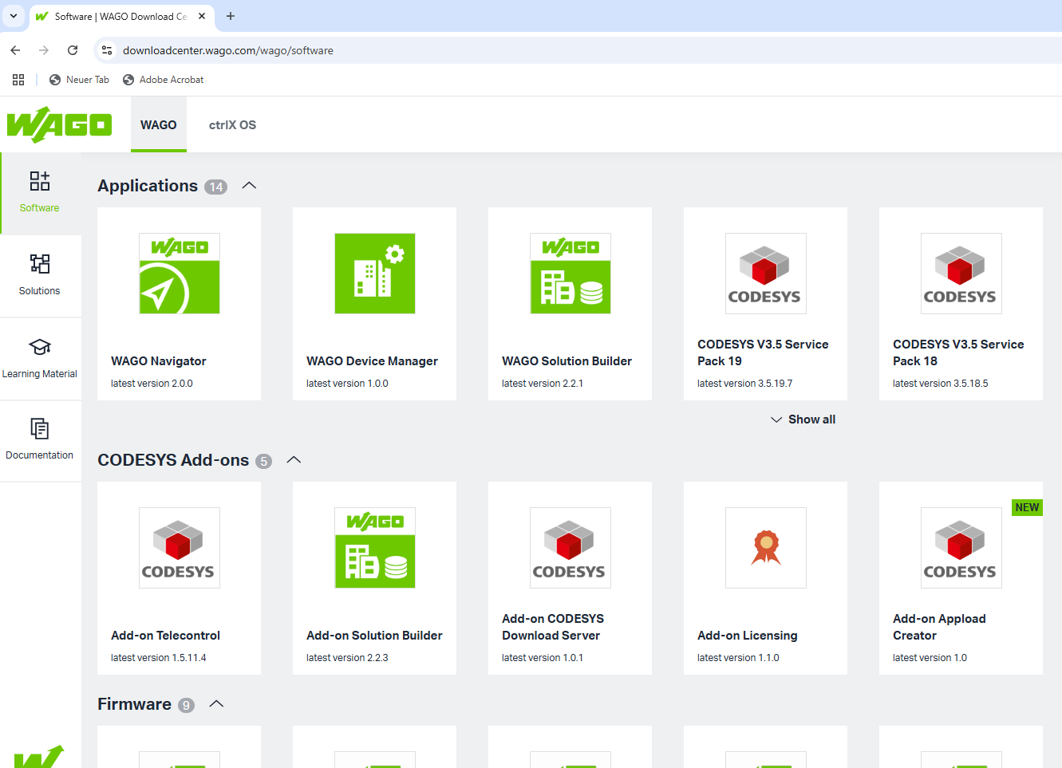
WAGO Device Manager
WAGO Device Manager is available at downloadcenter.wago.com

Slide 4
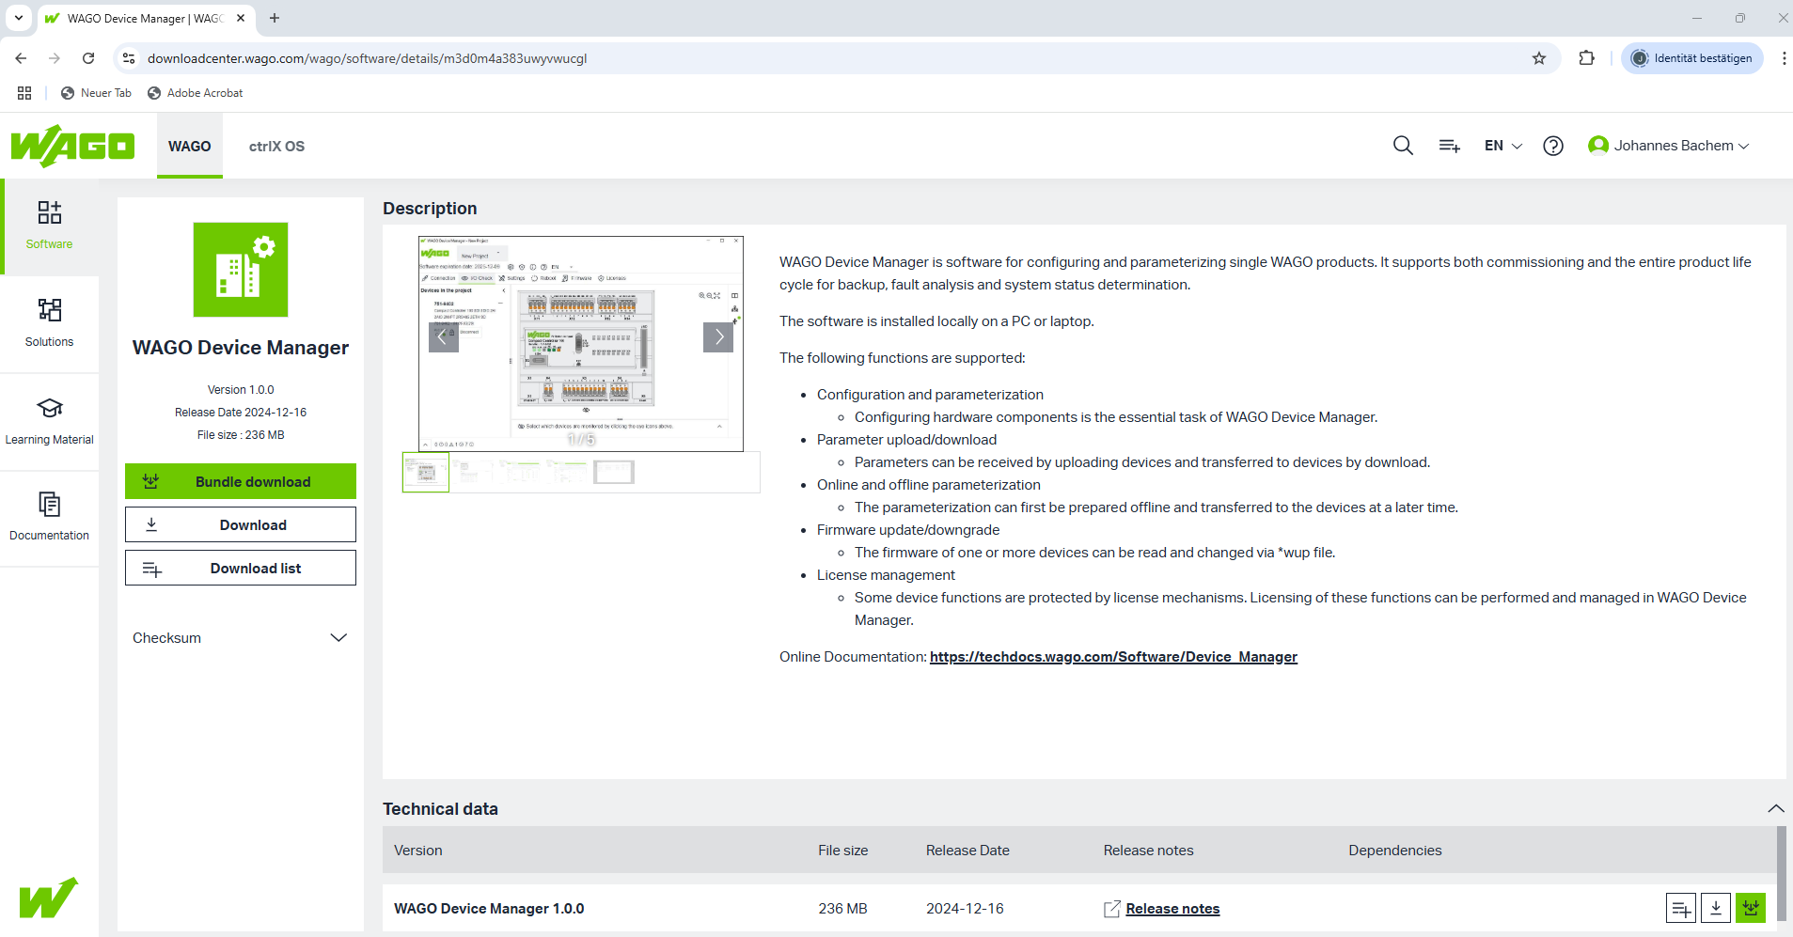
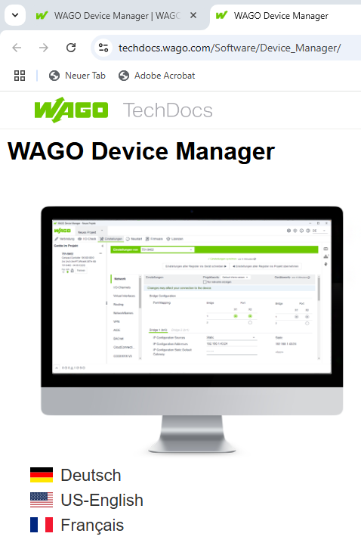
WAGO Device Manager
WAGO Device Manager is available at downloadcenter.wago.com
You can find the
online documentation also
at the downloadcenter

Slide 5
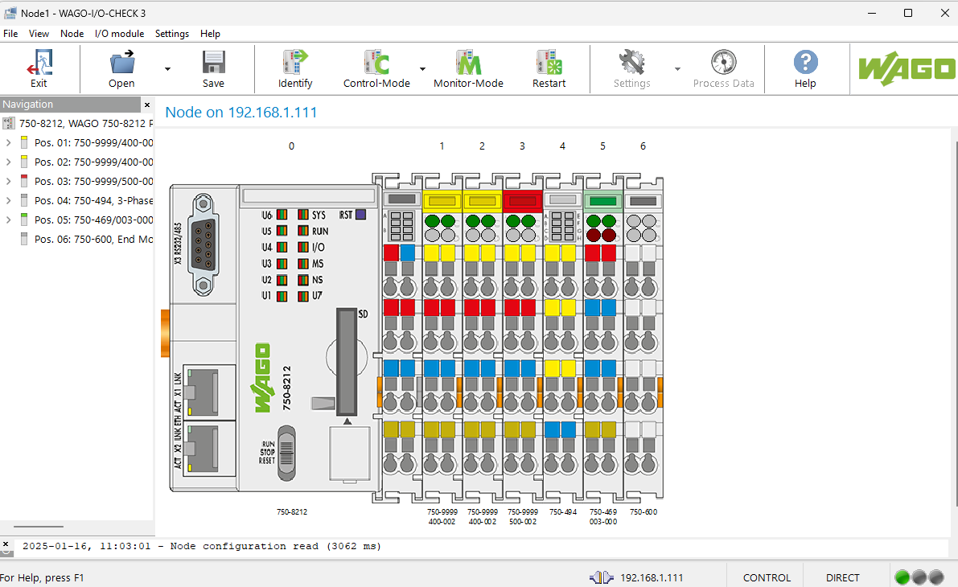
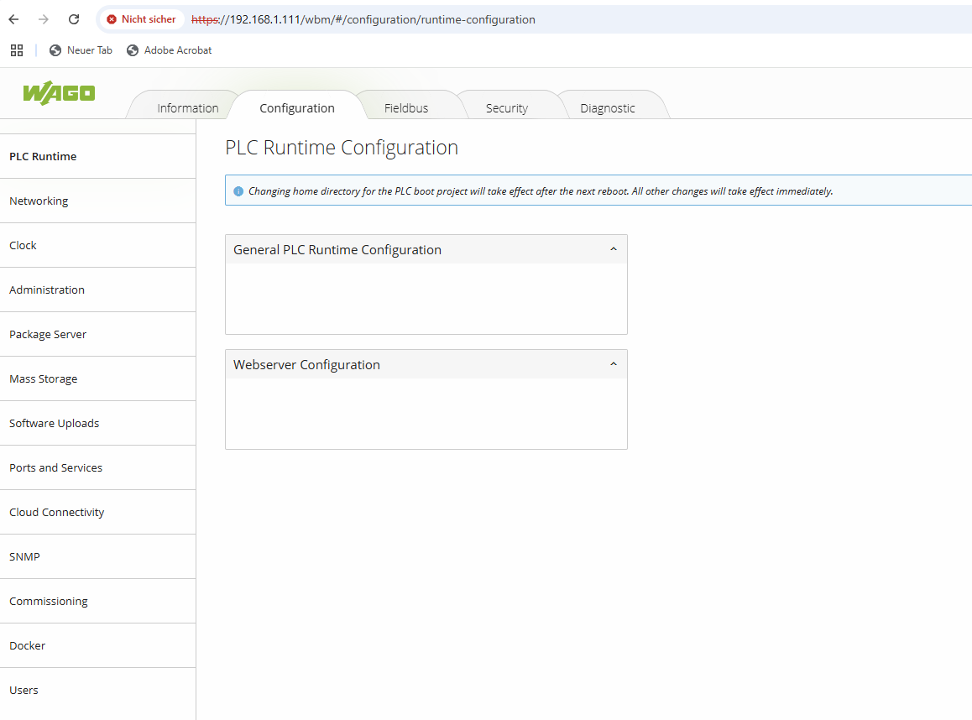
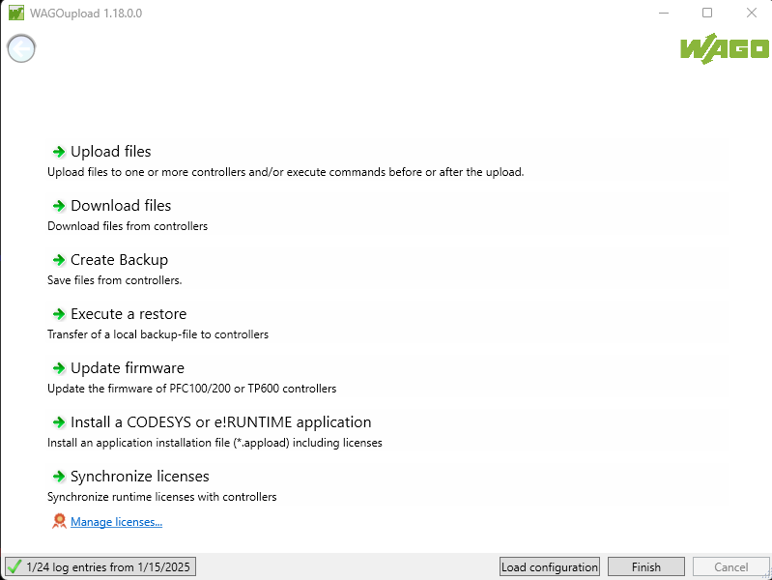
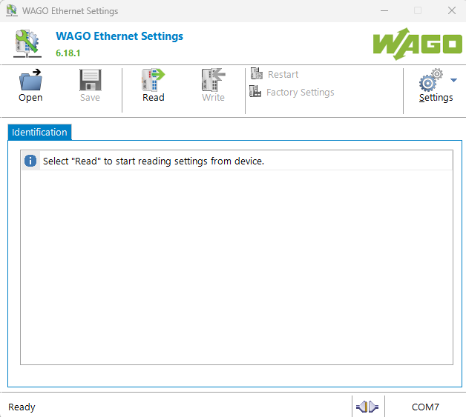
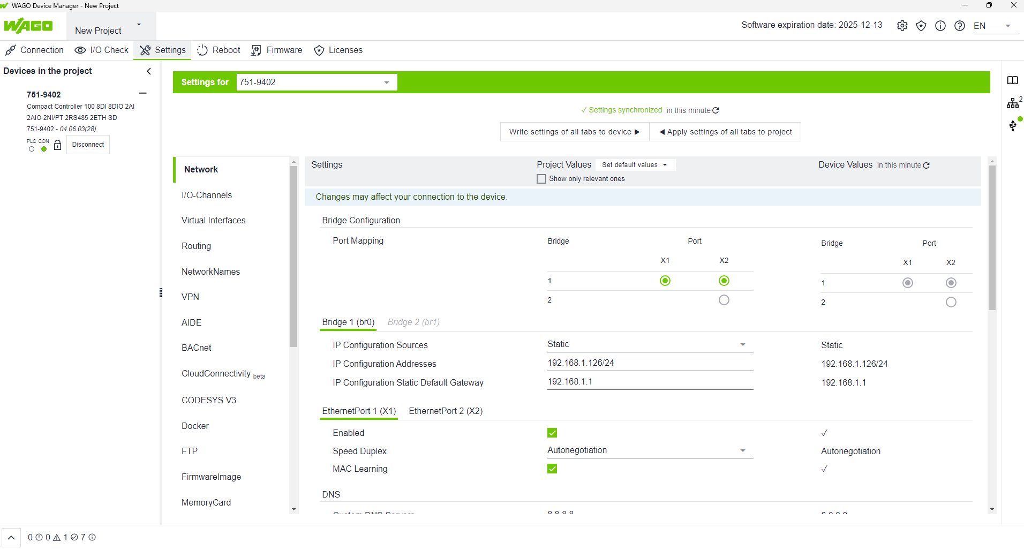
WAGO Device Manager
WAGO Device Manager
owns the functionalities of
WAGO IO Check
Web Based Management
WAGOupload
WAGO Ethernet Settings
WAGO Device Manager works in the first step with CC100 only
It is fully based on WDX
Configuration can be done online and offline
Configurations can be saved and restored or copied to other devices

Slide 6
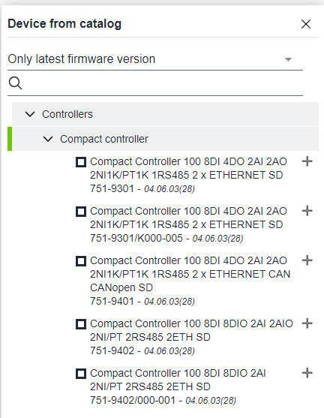
WAGO Device Manager
WAGO Device Manager requires a
Device Catalog.
Currently supported devices
With IO Check
751-9402
Without IO Check
751-9301
751-9401
Device Files are currently part of installation. In the future it will be possible to add device files

Slide 7
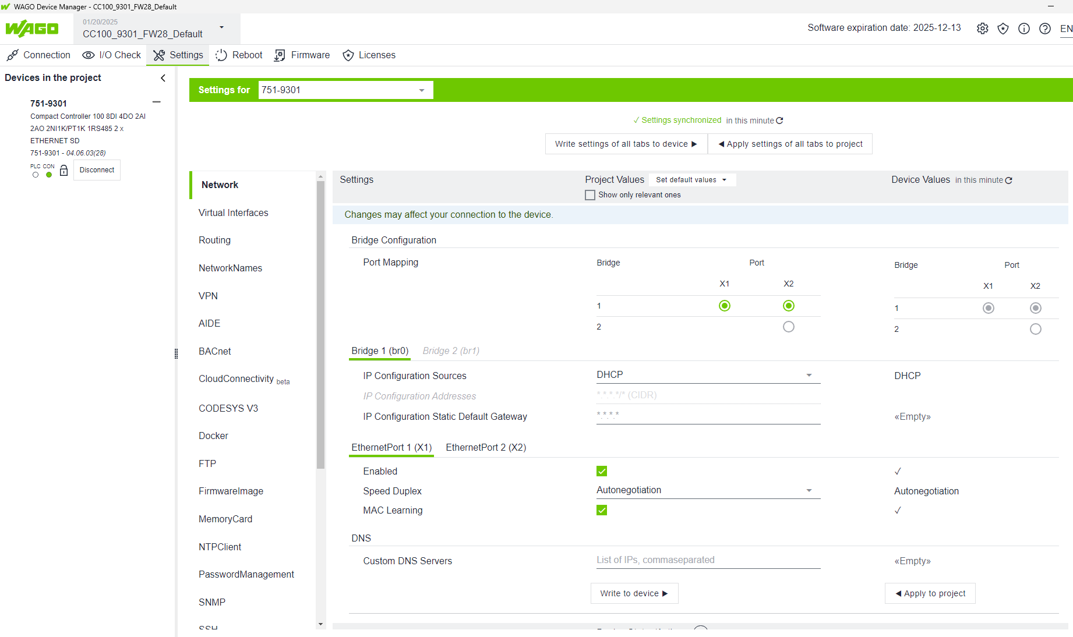
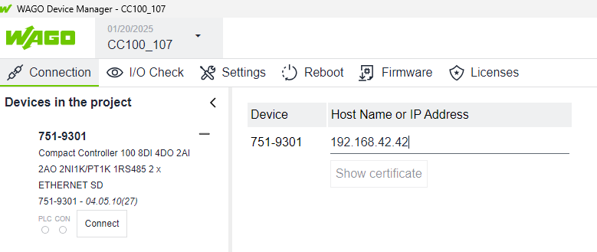
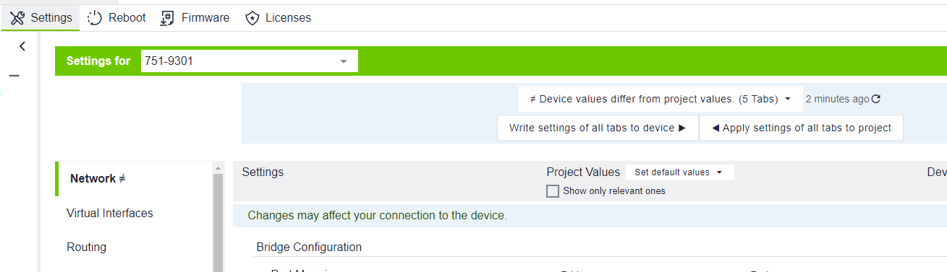
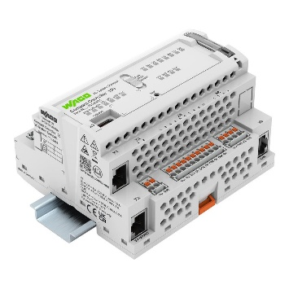
WAGO Device Manager, Copy Parameters
Disconnect
Change connection
Connect
Connect or open file and
read parameters,
change some parameters if required
Settings/ Write settings of all tabs to device
It saves all parameters but passwords
CC100 #1
CC100 #2

Slide 8
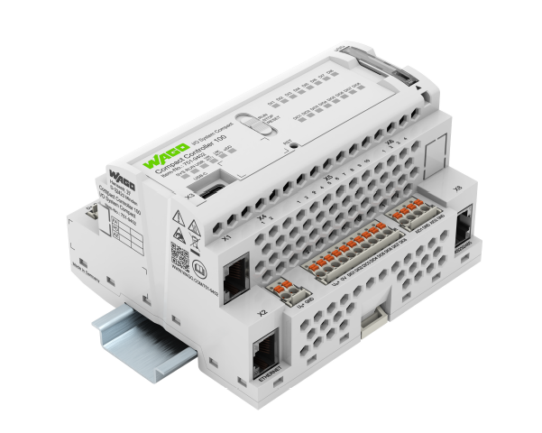
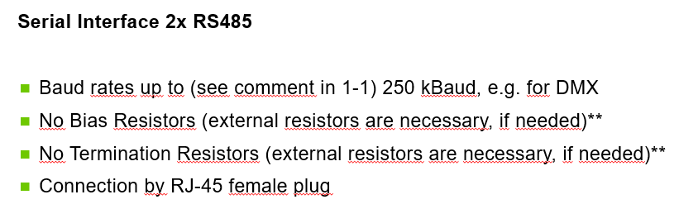
751-9402 CC100 V2 configurable I/Os
Digital I/O
8 x DI/ DO configurable
8 x DI
Analog I/O
2 x AI/ AO configurable
0..20mA, 4..20mA, 3.6..21mA
0-10V, +/- 10V
Resolution AI: 16bit, AO: 12bit
2 x AI configurable
0..20mA, 4..20mA, 3.6..21mA
0-10V, +/- 10V
Resolution 16bit
2 x RTD configurable
PT100 (-200°C..+850°C)
PT200 (-200°C..+850°C)
PT500 (-200°C..+850°C)
PT1000 (-200°C..+850°C)
Ni100 (-60°C..+250°C)
Ni1000 (-60°C..+250°C), TK6180
Ni1000 (-60°C..+250°C), TK5000
Ni120 (-80°C..+260°C)
Poti (0..1.2kOhm)
Poti (0..4kOhm)
Cortex A7 Dual Core, 650MHz
(equiv. 751-9401)
First controller with WDX parameters for controller and I/O‘s
(WAGO Device Manager, WAGO Device Sphere)
New Product Training November 2024 BU-AUT
Notes:
Intro:
Many new products and topics
Light and Building 2024
Mobile Lösungen
Push Button Ausbau
Werkzeugausbau
Ausblick auf Produkthighlights für PG 7
Geburtstagsfeier
Marketing Campaign for WINSTA
Digital Services
English: (Digital) Services IC
Mini Terminal Block Assistant (Sven Rasser)
Compact Data Download (Sven Rasser)
Marking Assistant (Sven Rasser)
Strieplan and Interface (Sven Rasser)
ePLAN Selector (Sven Rasser)
Deutsch: (Digital) Services IC
Creators (Manuela Sievers/Wawruszczak)
Mini Terminal Block Assistant (Sven Rasser)
Compact Data Download (Sven Rasser)
Marking Assistant (Sven Rasser)
Strieplan and Interface (Sven Rasser)
ePLAN Selector (Sven Rasser)

Slide 9
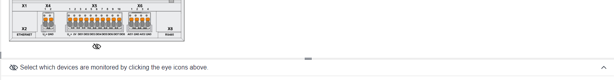
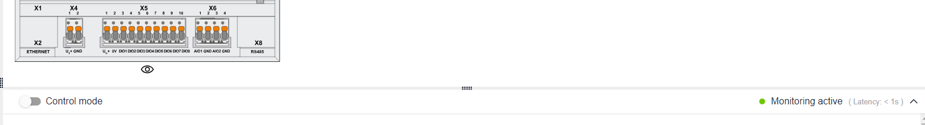
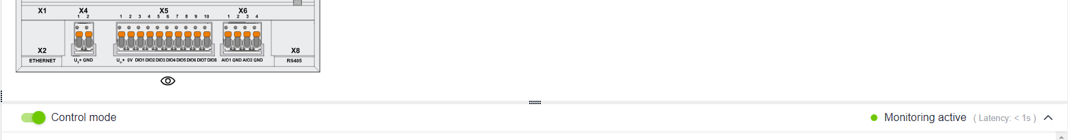
WAGO Device Manager
WAGO Device Manager IO Check Modes
(WDX: „0-0-io-iocheckaccessmode“)
value=0 no access mode (default)
value=1 monitor mode
value=2 control mode
CODESYS can not start if control mode is set.
Control mode can not be set, if CODESYS runs.

Slide 10
WAGO Device Manager, WDA, CODESYS
IO Parameters can only be saved, if CODESYS runtime is stopped.
=> it is not possible to set the local IO parameters via CODESYS FB and WDA
CODESYS overwrites WDX parameters permanently
=> CODESYS configuration changes parameters from default
CODESYS can not start if control mode is set.
Control mode can not be set, if CODESYS runs.
Only one Device Manager can connect to a device at one time. Other WDA access can also cause interferences to a Device Manager connection.

Slide 11
WAGO Device Manager, different options to WBM
New or improved
Work online or offline, copy parameters from one device to another directly or via file
Much improved visibility of installed licenses
All user passwords (root, user, admin) can be managed in user configuration
You can re-start the CODESYS Runtime without reboot
LED explanation
Currently missing (or not found)
STP/ RSTP Firewall
Log file display/ download IO Check disable
Network capture DHCP server
Boot mode Software uploads (ipk)
OPC UA config Package Server

Slide 12
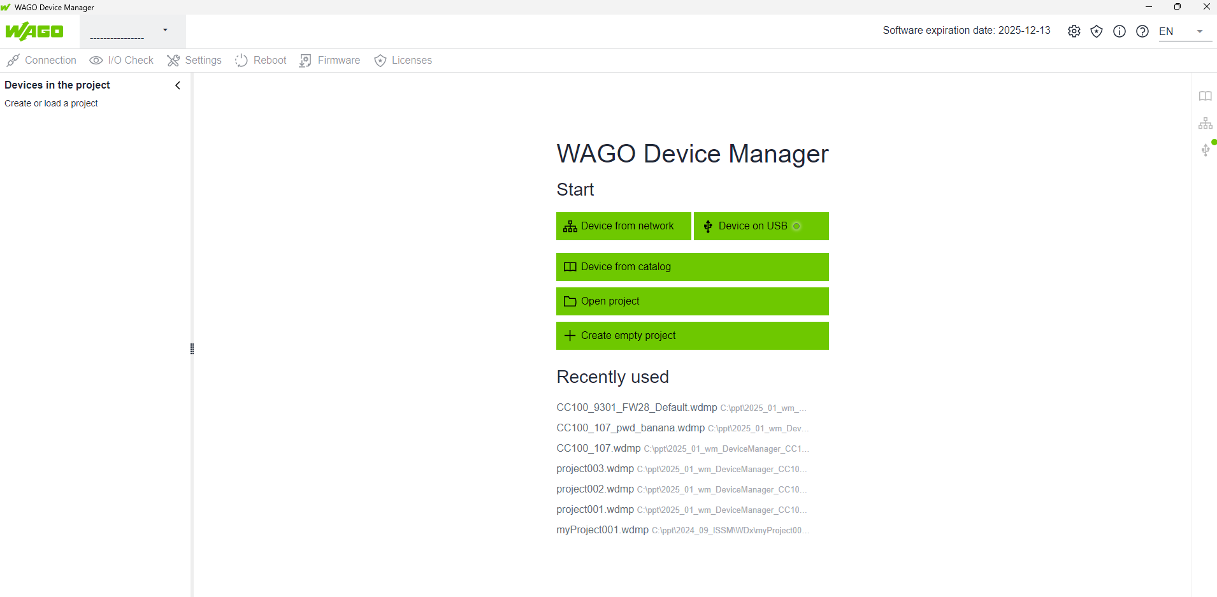
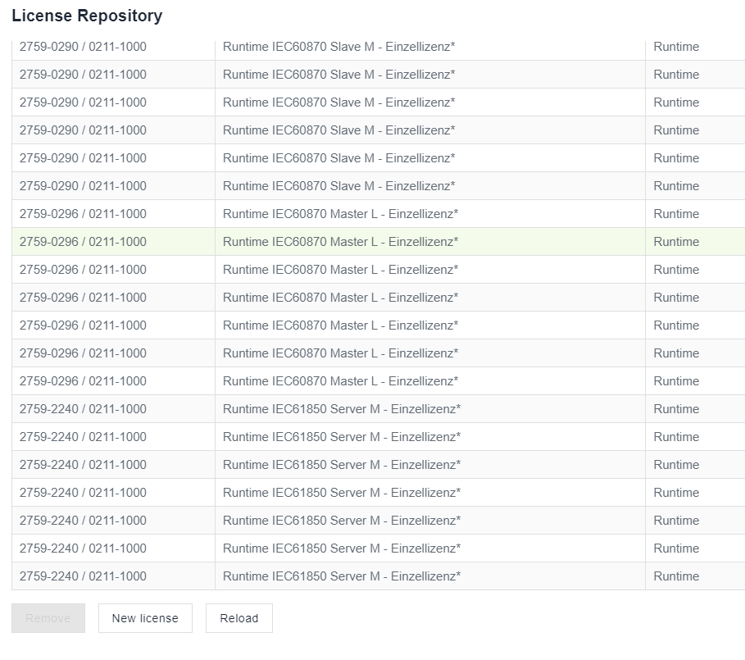
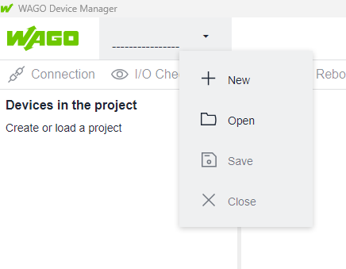
WAGO Device Manager „hidden buttons“

Slide 13
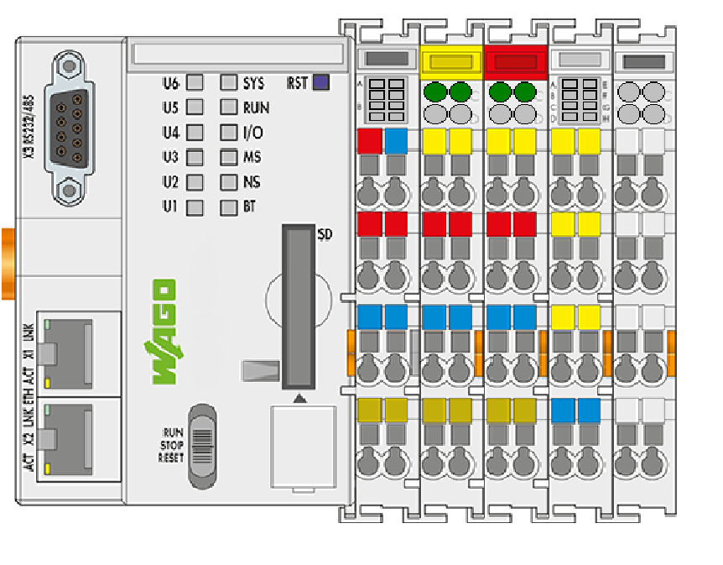
Device Manager Outlook
WDx = WDM WAGO Device Model
+ WDD WAGO Device Description
+ WDA WAGO Device Access
WAGO Device Manager
(WBM, IO Check, WAGOupload…)
WDA SysCom Rest Interface
„WBM“
CODESYS client adapter
Node-RED client adapter
WAGO Device Sphere
(WDMR for many devices)
ParameterServiceFunction
Parameter Service, Device Functions
WDM Parameters, Methods, PI
WDD
https
://
Third party tools

Slide 14
WDX parameter and IO services

Slide 15
Parameters and Services with WDx
Current Situation
Planned
Device Client Serie 750
Device Client WAGO
Client Functions
Client Functions
Serie750Services
ConfigTools.ssh
Linux Native.ssh
Codesys
WDA
…
…
…
…
…
…
…
…
…
…
…
…
Device Serie 750
Device WAGO
Serie750Services
ConfigTools.ssh
Linux Native.ssh
Codesys
WDA
Device Functions
Device Functions

Slide 16
Parameters and Services with WDx
Current Situation
Planned
Device Client Serie 750
Device Client WAGO
Client Functions
Client Functions
Serie750Services
ConfigTools.ssh
Linux Native.ssh
Codesys
WDA
…
…
…
…
…
…
…
…
…
…
…
…
Device Serie 750
Device WAGO
Serie750Services
ConfigTools.ssh
Linux Native.ssh
Codesys
WDA
Device Functions
Device Functions

Slide 17
WDx
WDx = WDM WAGO Device Model
+ WDD WAGO Device Description
+ WDA WAGO Device Access
WAGO Device Model (WDM)
Elements: feature, class, parameter
JSON format
WAGO Device Description (WDD)
JSON
WDM and WDD allow also tools for offline configuration
WAGO Device Access
https via REST API
Device Client WAGO
Client Functions
WDA
…
…
Device WAGO
WDA
Device Functions

Slide 18
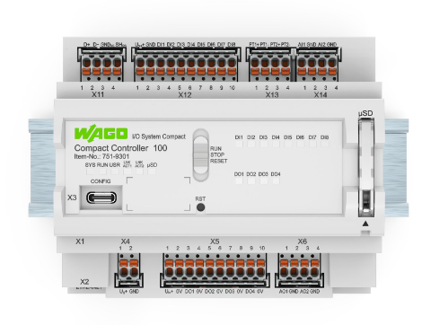
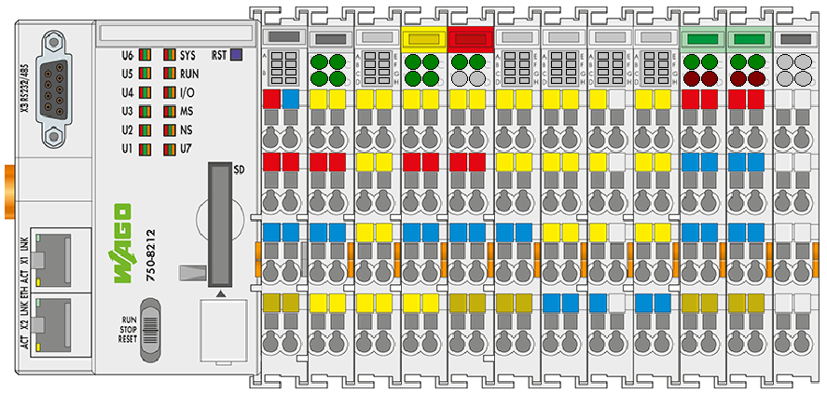
WDx – Timeline – WDx Devices
…
Summer 2024
WDM is already partially integrated in PFC, TP, CC
(most controller parameters, no kbus-module parameters yet)
WDD defined for 750-8212, CC100, TP600
End of 2024
CC100 V2 (configurable IO) will be the first product to use WDx Toolchain and also IO parameters towards customers and end-users
On the roadmap
Definition of the WDM for the Kbus Modules to allow WAGO-IO-Check functionality
via WDx
…
WDx

Slide 19
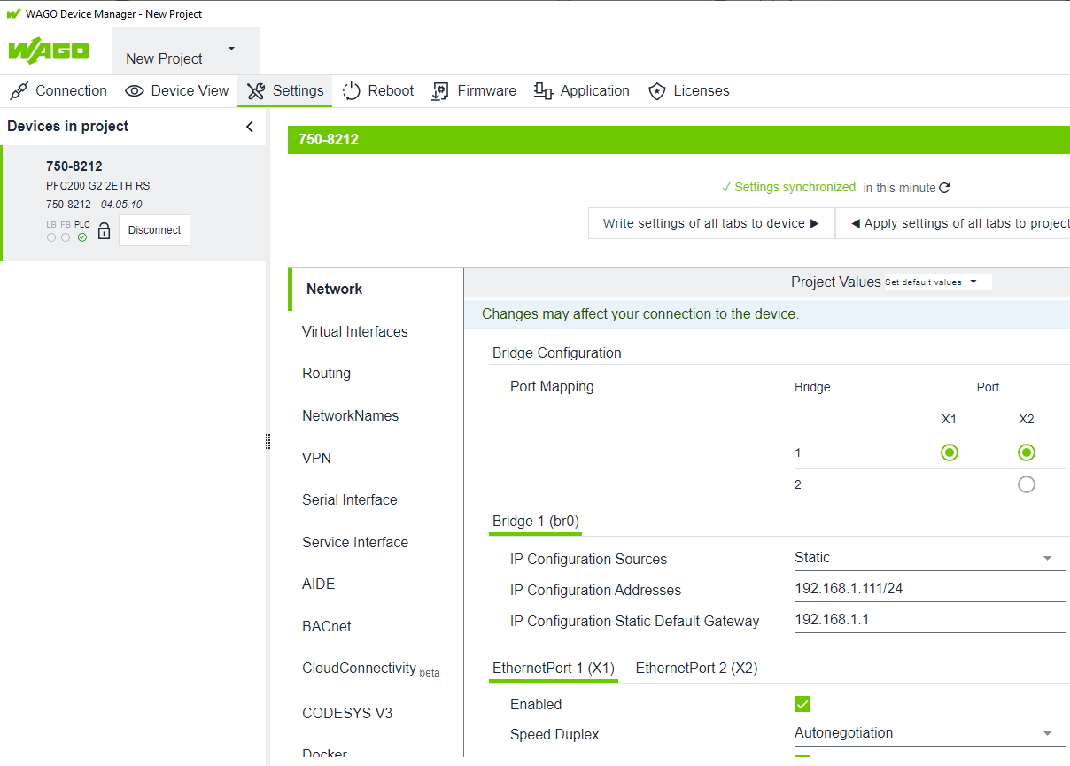
WDx – Timeline – WDx Devices
WAGO Device Manager – to configure one device via PC or via Web GUI
WAGO Device Sphere – to configure many devices via PC
Device Manager
WAGO Device Sphere
Client Functions
Client Functions
WDA
WDA
…
…
…
WDx

Slide 20
WDx – WAGO Device Manager (WDMR)
Configuration and Paramterization of single couplers/ controllers
Error Analysis, download IEC aplplications
Firmware-Update and License-Handling
Generic UI, based on WDx
Runs on PC, Server and Controller
Usable as Windows-App, via Browser or Tablet
Offline- and Online-configuration with data comparison
In future: WBM and Windows tool from one source
…
…
WDx

Slide 21
WDx – 3rd party tools
myCustomers tool
To communicate to WDx from a third party tool/device you can use the
implemented REST API (WDA)
Client Functions
WDA
…
myCustomer
…
WDx

Slide 22
WDM – parameters
https://downloadcenter.wago.com/productgroup/wdm
https://192.168.1.126/wda/parameters?page[limit]=20000
Structure
Parameter Example:
0-0-networking-ethernetports-1-macaddress
Structure:
address -feature -level1-(level1inst) -level2-(level2inst) - level3-(level3inst) …..-leveln-(levelninst)
https://192.168.1.126/wda/parameter-definitions?page[limit]=20000
addr | feature | level1 | inst | level2 | inst | level3 | inst | id
0-0 | networking | ethernetports | 1 | macaddress |  |  |  | 0-0-networking-ethernetports-1-macaddress
0-0 | networking | ethernetports | 2 | macaddress |  |  |  | 0-0-networking-ethernetports-2-macaddress
0-0 | networking | ethernetports | 1 | enabled |  |  |  | 0-0-networking-ethernetports-1-enabled
0-0 | networking | ethernetports | 2 | enabled |  |  |  | 0-0-networking-ethernetports-2-enabled
0-0 | networking | dns |  | customdnssservers |  |  |  | 0-0-networking-dns-customdnssservers
0-0 | networking | hostname |  | currentname |  |  |  | 0-0-networking-hostname-currentname
0-0 | networking | bridges | 1 | ipconfiguration |  | addresses | 1 | 0-0-bridges-1-ipconfiguration-addresses
0-0 | openvpn | privatekey |  |  |  |  |  | 0-0-openvpn-privatekey
0-0 | ftp | enabled |  |  |  |  |  | 0-0-ftp-enabled

Slide 23
WDM – parameters
Feature:
The collection of parameters, which can be integrated as an entity to a device
Currently the 750-8212 owns following features:
BACnet
Version
Networking
DRM
Identity
Localbus
Docker
FTP
FTPS
FirmwareUpdate
Memorycard
NTPclient
PasswordManagement
Reboot
Codesys3
SSH
IPsec
OpenVPN
AIDE
SerialInterfaceOwner
SNMP
SwitchConfiguration
SystemTime
WAGODeviceAccess
WebBasedManagement
Webserver
TimeZone
CloudConnections
SerialInterfaces
Systems
LEDstates
Localusers
Feature is the entity, which can be implemented in a device
Feature: bacnet
enabled
status
storagelocation-persistence
….
Additionally in TP600
display
integratedwebbrowsers
customfonts
frontled
touchpanel
Feature: version
softwarereleaseindex
hardwarereleaseindex
firmwareversion
…
Feature: networking
customdomain
currentdomain
customname
….
Feature: drm
status
evaluationtime
maximumlicenses
….
….

Slide 24
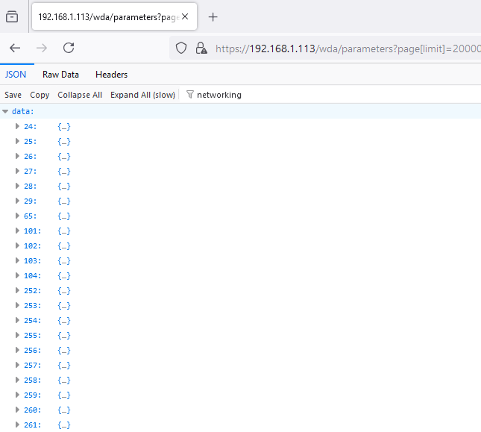
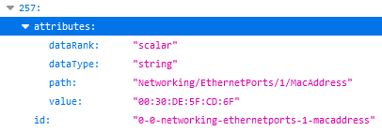
WDA – parameters
addr –feature -level1 -inst-level2
0-0-networking-ethernetports-1-macaddress
Example: Feature Networking
The feature networking has currently 63 parameters @750-8212
Level1 Level2
domain
hostname
routing
switchconfiguration
switchcon_ion
ethernetports
bridges
ipv4dipswitch
dummyinterfaces
vlaninterfaces
1-name
1-enabled
1-haslink
1-speedduplex
1-currentspeedduplex
1-macaddress
1-maclearning
2-name
2-enabled
2-haslink
2-speedduplex
2-currentspeedduplex
2-macaddress
2-maclearning
Parameters are not clustered acc. to features in the JSON file

Slide 25
WDA – parameters
1.Call via Firefox: https://<ip>/wda/parameters?page[limit]=20000
2.Filter (eg acc. to feature)
3.Check available parameter names, select parameter number
4.Remove the filter and read the value or the entire parameter
How to find parameters
The feature networking has currently 63 parameters @750-8212
Level1 Level2
domain
hostname
routing
switchconfiguration
switchcon_ion
ethernetports
bridges
ipv4dipswitch
dummyinterfaces
vlaninterfaces
1-name
1-enabled
1-haslink
1-speedduplex
1-currentspeedduplex
1-macaddress
1-maclearning
2-name
2-enabled
2-haslink
2-speedduplex
2-currentspeedduplex
2-macaddress
2-maclearning
Parameters are not clustered acc. to features in the JSON file

Slide 26
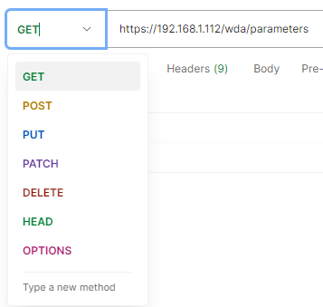
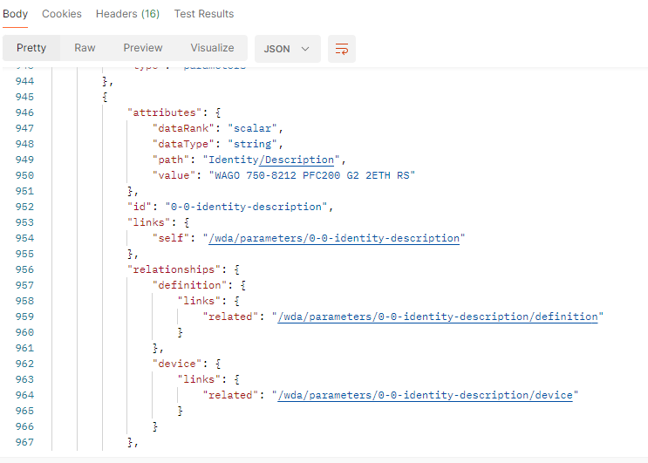
WDA – 3rd party tools (also CODESYS, NodeRED)
To communicate to WDx from a third party tool/device you can use the implemented REST-API
The parameters are formatted in JSON

Slide 27
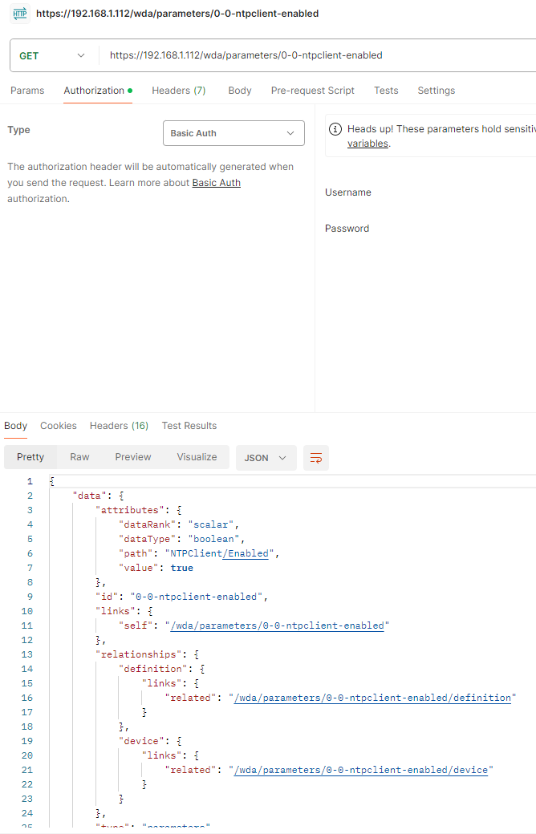
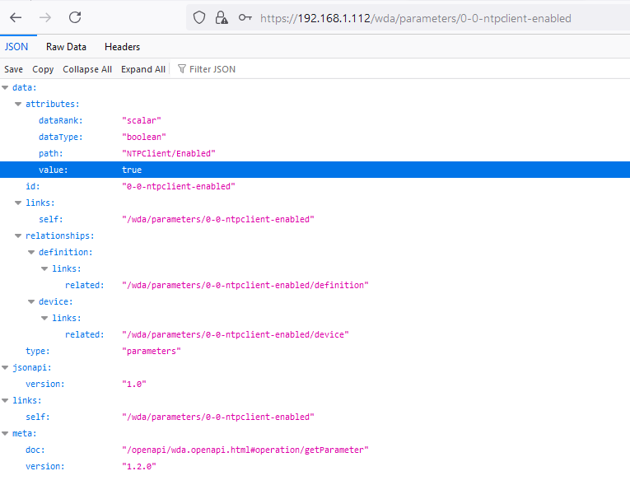
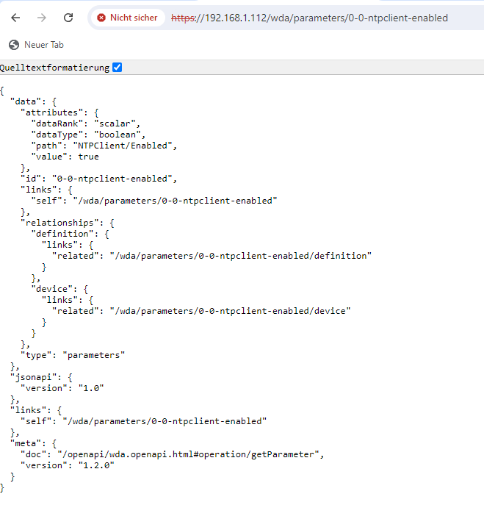
WDA – 3rd party tools
Postman (GET/POST) Firefox (GET) Chrome (GET)
https://192.168.1.126/wda/parameter-definitions?page[limit]=20000
https://192.168.1.126/wda/parameters?page[limit]=20000

Slide 28
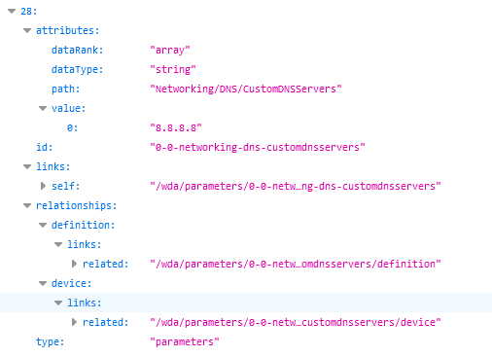
WDA – parameters
displayed at firefox browser
id: name of the parameter:
“0-0-networking-dns-customdnssservers“
value: value of the property:
value[0]= “8.8.8.8“ (in this case an array)
self: URL of the property:
“/wda/parameters/0-0-networking-dns-customdnsservers“

Slide 29
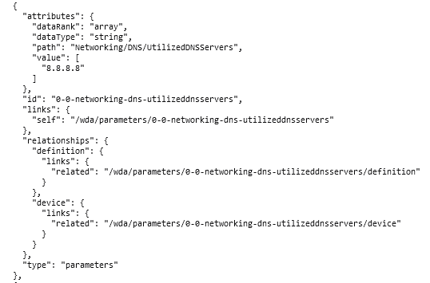
WDA – parameters
displayed in JSON
id: name of the parameter:
“0-0-networking-dns-customdnssservers“
value: value of the property:
value[0]= “8.8.8.8“ (in this case an array)
self: URL of the property:
“/wda/parameters/0-0-networking-dns-customdnsservers“

Slide 30
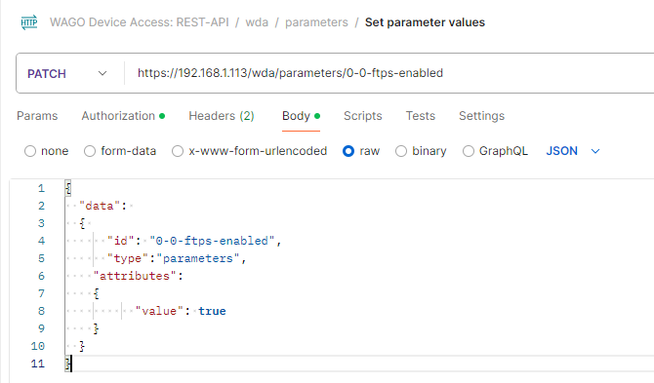
WDA – parameters
Patch (write parameters)
URL:
https://IP/wda/parameters/parameter-id
Body:
{
"data": {
"id": “parameter-id",
"type":"parameters",
"attributes":{
"value": parametervalue
}
}
}
media type: application/vnd.api+json

Slide 31
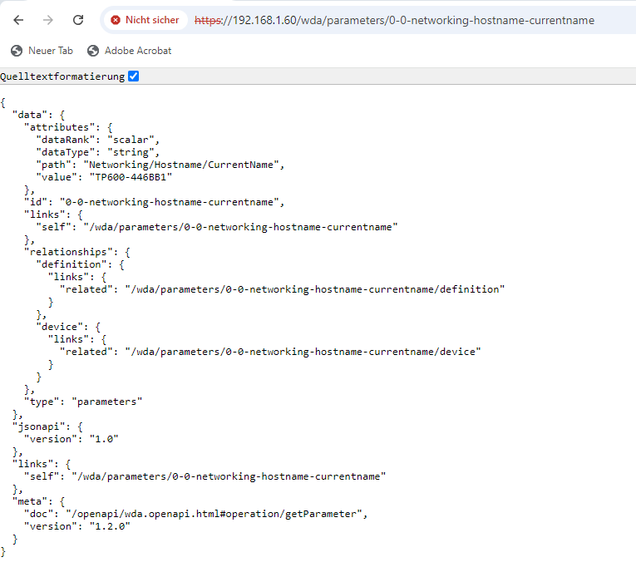
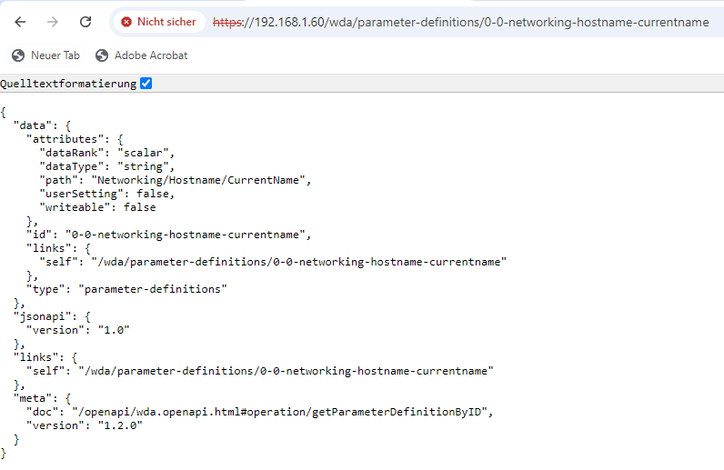
WDA – parameters – parameter definitions
Example: 0-0-networking-hostname-currentname

Slide 32
HTTP-REST Methods
HTTP Method | Description
GET | Requests the specified resource from the server. GET has no side effects. The state on the server is not changed, which is why GET is called safe.
POST | Inserts a new (sub)resource below the specified resource. Since the new resource does not yet have a URI, the URI addresses the parent resource. As a result, the new resource link is returned to the client. In a broader sense, POST can also be used to map operations that are not covered by any other method.
PUT | The specified resource is created. If the resource already exists, it is changed.
PATCH | A part of the specified resource is changed. Side effects are allowed here.
DELETE | Deletes the specified resource.

Slide 33

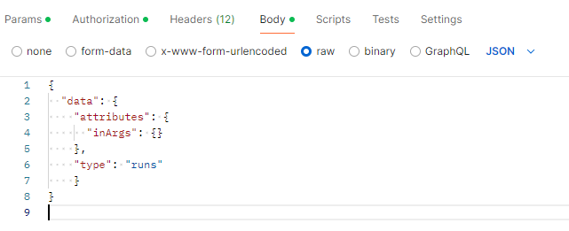
WDA Methods
750-8212 FW27 available methods
0-0-bacnet-secureconnect-generatecsr
0-0-drm-license-operation-beginsession
0-0-drm-license-operation-commitsession
0-0-drm-license-operation-cancelsession
0-0-drm-license-operation-addtodevice
0-0-drm-license-operation-remove
0-0-firmwareupdate-activate
0-0-firmwareupdate-getuploadids
0-0-firmwareupdate-start
0-0-firmwareupdate-finish
0-0-firmwareupdate-cancel
0-0-firmwareupdate-clear
0-0-firmwareupdate-getlastlogentries
0-0-firmwareupdate-settimeout
0-0-firmwareupdate-setcustomvalue
0-0-firmwareupdate-getcustomvalue
0-0-firmwareimage-copybootedimagetoexternalmedium
0-0-firmwareimage-copybootedimagetointernalmemory
0-0-firmwareimage-checkimagesize
0-0-memorycard-format
0-0-ntpclient-updatetime
0-0-reboot-beginreboot
0-0-codesys3-restart
0-0-aide-init
0-0-aide-check
0-0-aide-update
0-0-aide-readlog
0-0-systems-1-setconfigured
0-0-systems-2-setconfigured
0-0-localusers-1-changepassword
0-0-localusers-1001-changepassword
0-0-localusers-1003-changepassword

Slide 34
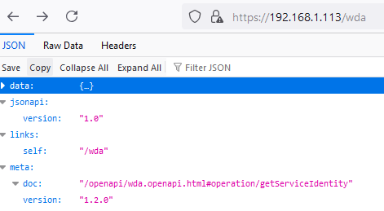
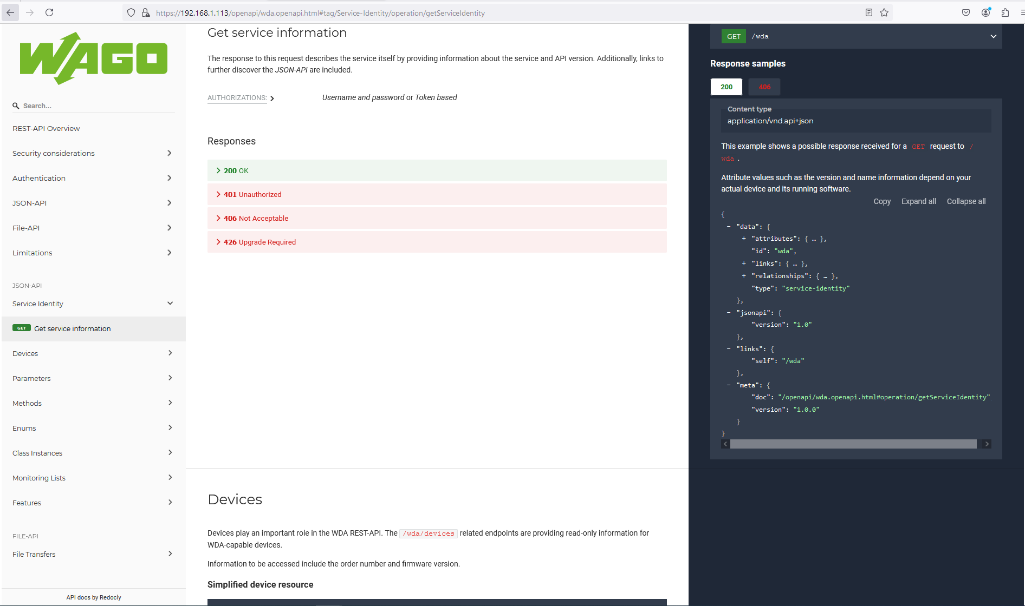
Openapi Documentation
https://<ip>/openapi/wda.openapi.html
The link
https://<ip>/openapi/wda.openapi.html#operation/getServiceIdentity
Or
https://<ip>/openapi/wda.openapi.html
can be found at the /wda site

Slide 35
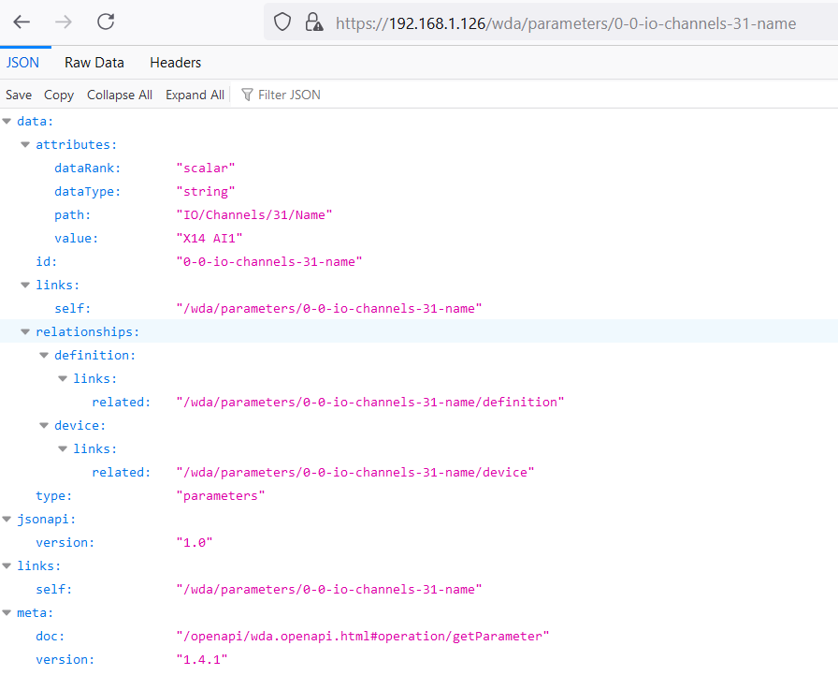
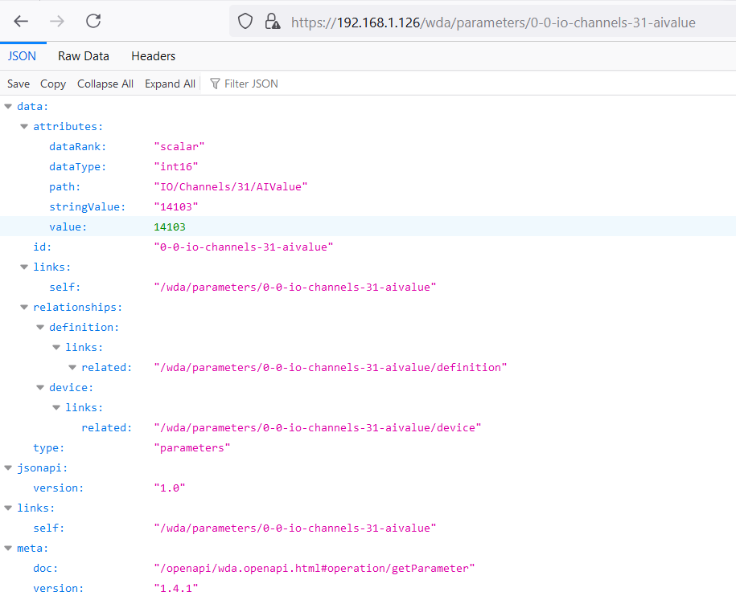
751-9402 IO parameters
https://192.168.1.126/wda/parameters/0-0-io-channels-31-name https://192.168.1.126/wda/parameters/0-0-io-channels-31-aivalue
https://downloadcenter.wago.com/productgroup/wdm

Slide 36
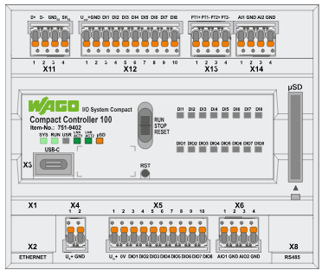
751-9402 IO parameters
Interface Channel Channel Number Interface Channel Channel Number
X5 DI1 1 X12 DI1 21
DI2 2 DI2 22
DI3 3 DI3 23
DI4 4 DI4 24
DI5 5 DI5 25
DI6 6 DI6 26
DI7 7 DI7 27
DI8 8 DI8 28
DO1 9 X13 AI1(RTD) 29
DO2 10 AI2(RTD) 30
DO3 11
DO4 12 X14 AI1 31
DO5 13 AI2 32
DO6 14
DO7 15 Process Data:
DO8 16 https://192.168.1.126/wda/parameters/0-0-io-channels-1-divalue
https://192.168.1.126/wda/parameters/0-0-io-channels-9-dovalue
X6 AI1 17 https://192.168.1.126/wda/parameters/0-0-io-channels-31-aivalue
AI2 18 https://192.168.1.126/wda/parameters/0-0-io-channels-19-aovalue
AO1 19 Channel Definition (Example Channel 29):
AO2 20 https://192.168.1.126/wda/parameters/0-0-io-channels-29-name
Parameters (Example Channel 17)
0-0-io-channels-17-aivalue
0-0-io-channels-17-measurementmode
0-0-io-channels-17-name
0-0-io-channels-17-usedpins

Slide 37
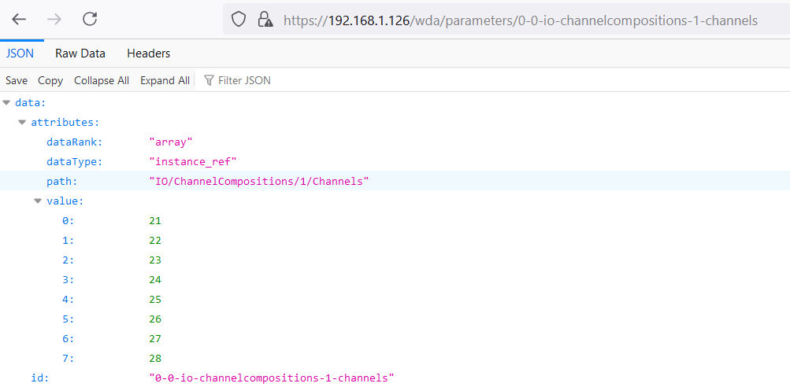
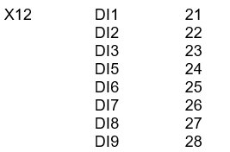
751-9402 IO parameters
Interface X12
https://192.168.1.126/wda/parameters/0-0-io-channelcompositions-1-channels

Slide 38
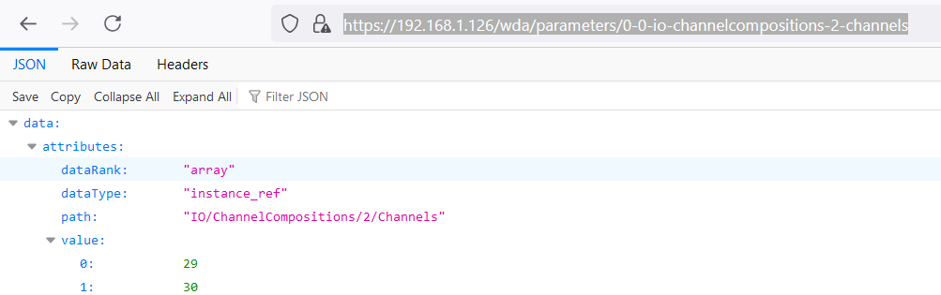

751-9402 IO parameters
Interface X13
https://192.168.1.126/wda/parameters/0-0-io-channelcompositions-2-channels

Slide 39
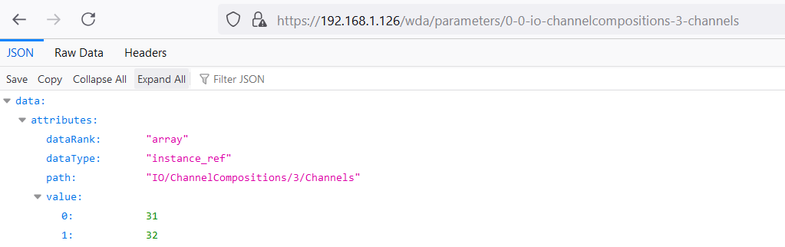

751-9402 IO parameters
Interface X14
https://192.168.1.126/wda/parameters/0-0-io-channelcompositions-3-channels

Slide 40
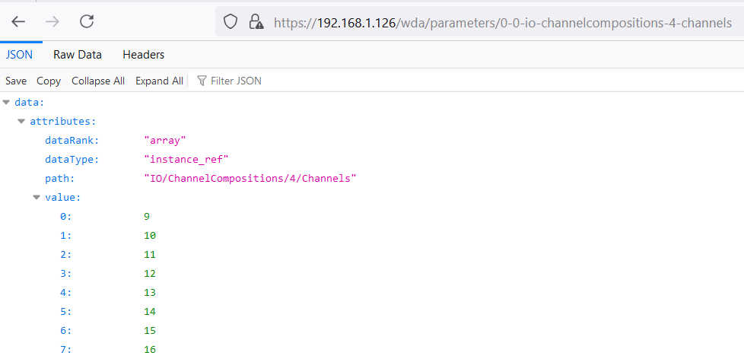
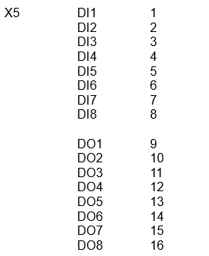
751-9402 IO parameters
Interface X5
https://192.168.1.126/wda/parameters/0-0-io-channelcompositions-4-channels

Slide 41
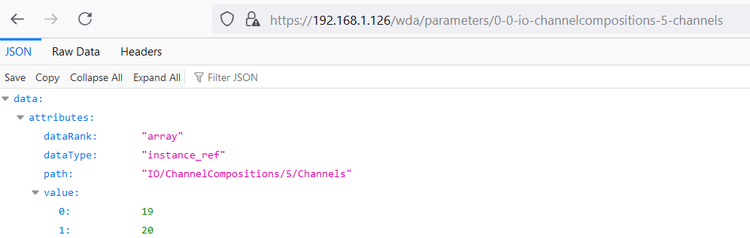

751-9402 IO parameters
Interface X6
https://192.168.1.126/wda/parameters/0-0-io-channelcompositions-5-channels

Slide 42

751-9402 IO parameters
0-0-io-iocheckaccessmode
Value 0: no access
1: monitor mode
2: control mode
https://192.168.1.126/wda/parameters/ 0-0-io-iocheckaccessmode

