Slide 1
Final Project
Information and Communications Technologies
Computer science engineering students
section A
Group 19
Taieb BenAbbes Nesrine

Slide 2

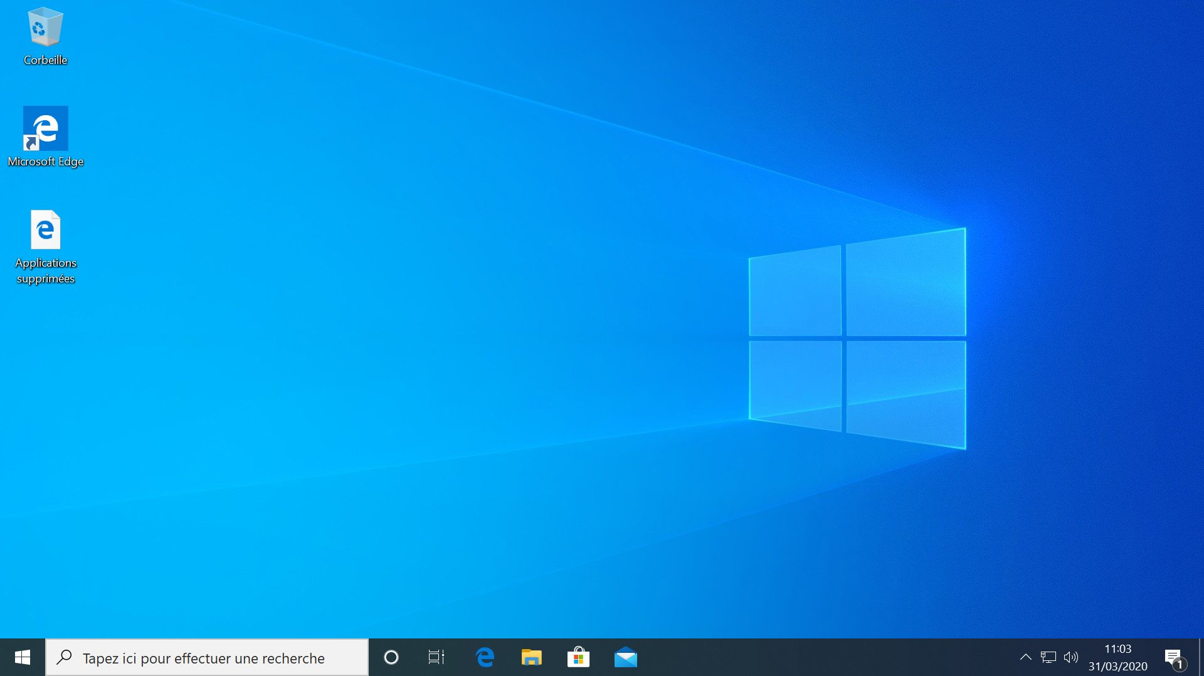
Work plan
Introduction
01
02
Microsoft Tools
Latex
03
04
HTML / CSS
Git / GitHub
05
Google
Services
06
Conclusion
07
2

Slide 3


Introduction
What is Windows ?.....
Operating systems vary in types, and certain variants enjoy greater usage than others. Windows stands out as a widely adopted operating system. Originating as a basic graphical user interface, Windows has developed into a comprehensive operating system specifically crafted for personal computers. Beyond its user-friendly interface, Windows holds immense significance, given its capability to seamlessly run virtually any software required by users.
3

Slide 4
Introduction
What is Microsoft Tools ?.....
Microsoft Tools are a type of application software. They help the users to perform office-related tasks easily and efficiently. Therefore, these tools help to create, manage, and manipulate large amounts of data and documents. Moreover, they help create presentations, reports, databases, etc. Hence, users can perform such tasks repeatedly with less time and effort.
4

Slide 5


Microsoft Tools
These tools include software such as Word, PowerPoint, Excel, etc.…
PowerPoint
Excel
Word
5

Slide 6












Microsoft Tools
Word
Features
grammar check
Adding images
…
Editing text
…
2
1
3
Since its debut in 1983, Microsoft Word has evolved into a versatile word processing tool, offering a sophisticated yet user-friendly interface.it serves a range of document creation needs, from simple letters to complex reports. offering a sophisticated yet user-friendly interface that facilitates seamless editing, formatting, and customization of documents.
…

Slide 7

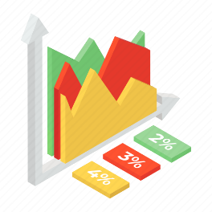
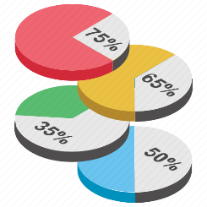


Microsoft Tools
Excel
1
introduced to the world in 1985, stands as a pioneering force in the landscape of data analysis and management. From its inception as a straightforward spreadsheet program, Excel has undergone a remarkable evolution, transforming into a formidable tool renowned for its proficiency in handling intricate calculations and generating insightful charts etc...
Features
Simple calculations
…
2
…
Graphs and charts
…
3
Notes:
introduced to the world in 1985, stands as a pioneering force in the landscape of data analysis and management. From its inception as a straightforward spreadsheet program,…

Slide 8


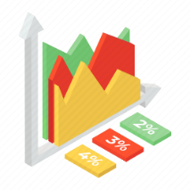



PowerPoint
Microsoft Tools
Microsoft PowerPoint, introduced in 1987, has solidified its position as the go-to presentation software, offering a plethora of tools and features that elevate the art of visual communication.
In addition to multimedia integration, PowerPoint provides tools for incorporating visual elements like images and charts seamlessly.
PowerPoint's adaptability is further highlighted by its compatibility with other Microsoft Office tools, such as Word and Excel. Users can seamlessly integrate content from these applications into their presentations, ensuring a cohesive and comprehensive delivery of information.
Features
so many tools
Notes:
Top Features of PowerPoint
a) Slide design and layout
b) Multimedia integration
c) Animations and transitions
d) SmartArt and charts
e) Collaboration and sharing
f) Presenter tools and notes
g) Customisation options
h) Slide master and layouts
i) Presenter view and slide show options

Slide 9

Latex
What is LaTeX ?.....
LaTeX, conceived by Leslie Lamport in 1985, is a document preparation system renowned for its unparalleled ability to generate high-quality typesetting for documents. At its core, LaTeX employs a markup language as its source code, empowering users to create and manipulate sophisticated document layouts. This robust system offers an extensive array of tools and features, elevating its utility for diverse applications.
LaTeX continues to be embraced by professionals who prioritize the aesthetic and scholarly integrity of their documents.
9

Slide 10


LATEX
Overleaf is a startup and social enterprise that builds modern collaborative authoring tools for scientists — like Google Docs for Science. Our primary product is an online, real time collaborative editor for papers, theses, technical reports and other documents written in the LaTeX markup language.
10

Slide 11
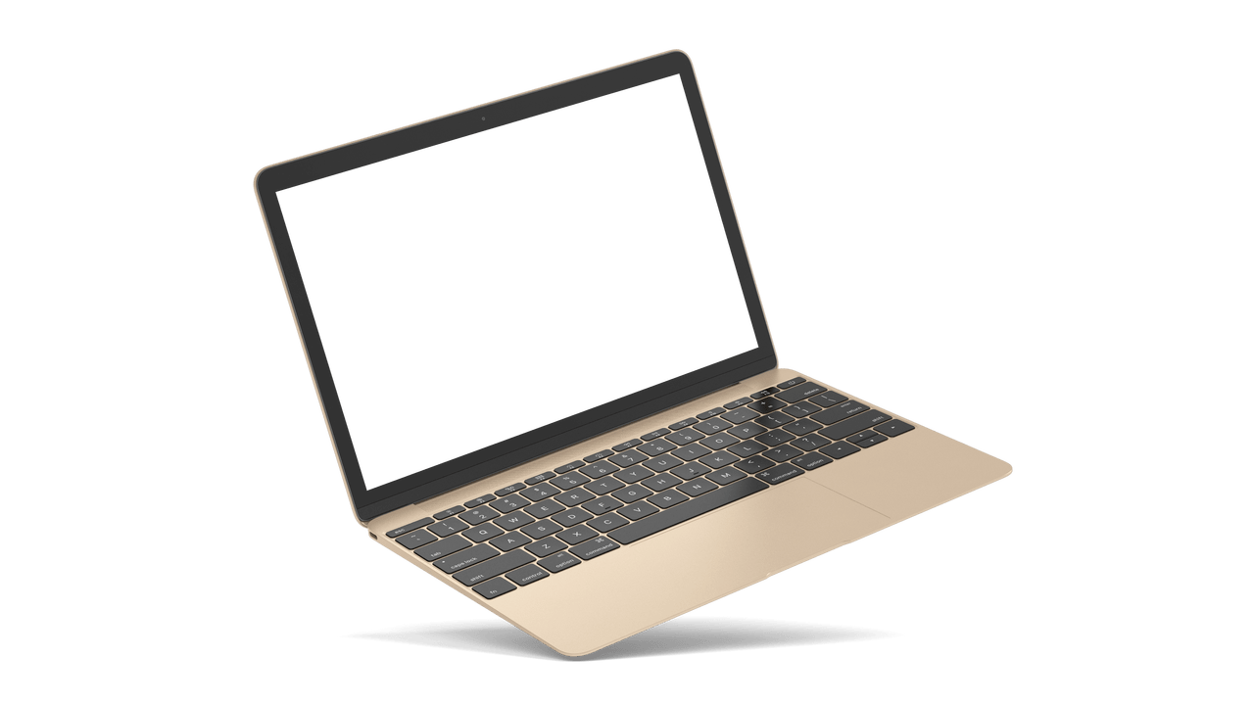
Latex
This example produces the following output:
Writing your first piece of LATEX
First document. This is a simple example, with no extra parameters or packages included.
The first step is to create a new LATEX project. You can do this on your own computer by creating a new .tex file; alternatively, you can start a new project in Overleaf.
This is a simplest working example, which can be opened directly in Overleaf
\documentclass{article}
\begin{document}
First document. This is a simple example, with no
extra parameters or packages included.
\end{document}
11

Slide 12
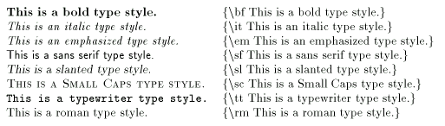
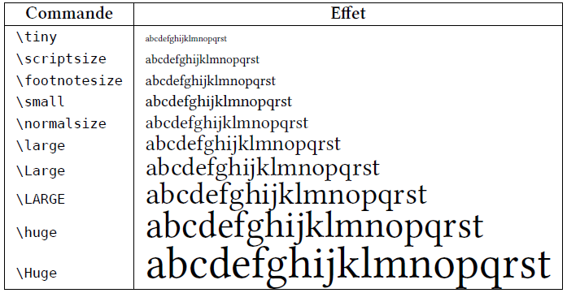
Latex
Some basic tools
12

Slide 13
HTML / CSS
What is HTML ?.....
HTML, standing for HyperText Markup Language, is a pivotal and standardized markup language that plays a crucial role in the creation and structuring of content on the vast landscape of the World Wide Web. Its origins trace back to 1989,
Since its inception, HTML has metamorphosed into an indispensable tool for web development, providing a rich set of tools and features essential for crafting engaging and interactive digital experiences.
13
Notes:
HTML, standing for HyperText Markup Language, is a pivotal and standardized markup language that plays a crucial role in the creation and structuring of content on the vast landscape of the World Wide Web. Its origins trace back to 1989,

Slide 14
HTML / CSS
What is CSS ?.....
Cascading Style Sheets (CSS) stands as a cornerstone in the realm of web development, offering a style sheet language designed to imbue web pages created with HTML with a rich array of styles and formatting. Conceived in 1996,
The multifaceted toolkit that CSS provides empowers developers to manipulate various design elements, including layout, typography, colors, spacing, and more, thereby facilitating the creation of visually captivating and user-friendly web pages and applications.
14

Slide 15
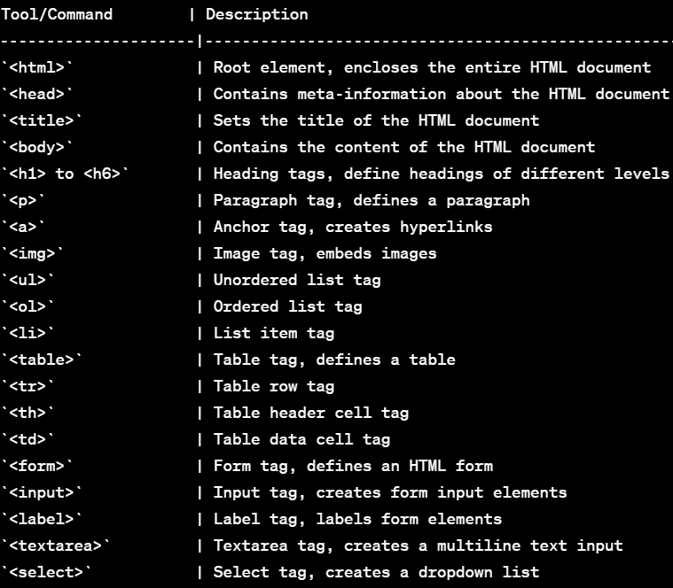
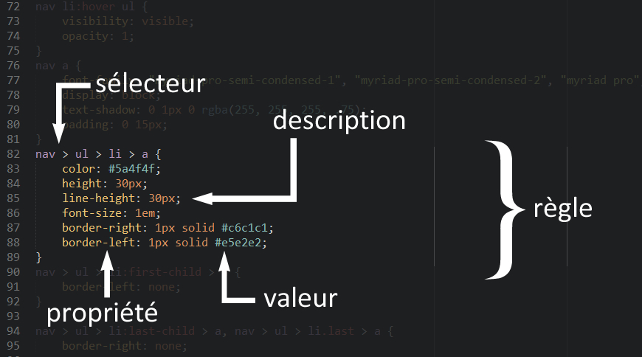
HTML / CSS
15

Slide 16
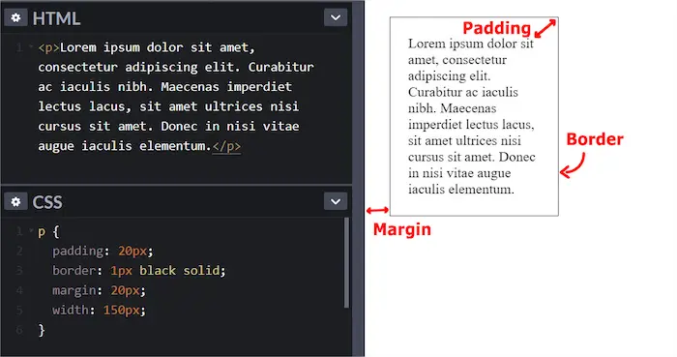
HTML / CSS
This is a simplest working example,
16

Slide 17




Git / GitHub
What are Git and GitHub ?.....
Git was developed in 2005 by Linus Torvalds as open source software for tracking changes in a distributed version control system.
Git is open source because its source code is made freely available for anyone to modify and use, aside from its creator. Open-source projects are built and maintained collectively by different developers in different locations.
GitHub is a "hub" (a place or platform) where Git users build software together. GitHub is also an hosting provider and version control platform you can use to collaborate on open source projects and share files. When you're using GitHub, you're working with Git beneath the hood.
17

Slide 18



Git / GitHub
Why Should You Learn Git and GitHub?
According to Techmonitor.ai, over 73 million developers use GitHub as of November 2021. And the GitHub community is set to hit 100 million users by 2025.
As you can see, millions of people all over the world use these tools, and the numbers just keep going up.
Because of this, more companies are requiring new hires to know how to use Git and GitHub. So if you're looking for a developer job, these are essential skills to have.
18

Slide 19
Git / GitHub
Differences between Git and GitHub
Common Git Commands to Know
Git is a version control system that manages and keeps track of your code. GitHub, on the other hand, is a service that let you host, share, and manage your code files on the internet.
GitHub uses Git underneath, and lets you manage your Git repositories or folders easily on its platform.
git init | lets you initialize Git in your folder.
git add Readme.md | lets you add the Readme file, while git add . lets you add all files in the present folder.
git commit | stores the added files. Use -m for message followed by the actual message.
git branch | creates a new branch which is a new version of the repository as it appears when added, and -M to move the name to main.
19

Slide 20

Google Services
What is Google ?.....
Established in 1998 by Larry Page and Sergey Brin, Google has grown into a worldwide technology powerhouse, transforming how individuals access information and engage with the digital landscape. Originating as a modest search engine, Google has evolved to offer a diverse set of tools integral to our daily routines.
Google has transformed into a global technology powerhouse, reshaping how people access information and engage with the digital realm. Initially a search engine, Google has expanded its services significantly.
20

Slide 21





Google Services
Google services are integral to the contemporary digital landscape, underscoring their crucial role in our daily lives. The widespread use of Google Search ensures instant and comprehensive information access, fundamentally shaping our knowledge-seeking behaviors.
Some Google services
Search Engine (Google Search)
Email Service (Gmail)
File Sharing Platform (Google Drive)
Mobile Operating System (Android)
Advertising Platform (Google Ads)
21

Slide 22
Conclusion
Microsoft Office is an essential tool that has revolutionized the way individuals, businesses, and organizations operate. This tools including Word, Excel, PowerPoint, have had a tremendous impact on the work environment by enabling efficient and faster communication, collaboration, data organization, and management.
LaTeX, HTML, CSS, Git and GiThub are not only important in the workplace but also in everyday life for creating documents, analyzing data, making presentations, and more.
Furthermore, students and professionals rely on these tools to complete various tasks, making Microsoft Office, Latex, GitHub, Google services an essential component of modern life.
22
Notes:
Microsoft Office is an essential tool that has revolutionized the way individuals, businesses, and organizations operate. This tools including Word, Excel, PowerPoint, have had a tremendous impact on the work environment by enabling efficient and faster ;;;

Slide 23
Thank you
For
Your
Kind Attention

