Slide 1
CeDInt-SEF · DataPack
Sprint 1 & Sprint 2
Execution Deck
A task-by-task launch and review guide for the Data Understanding → Data Preparation transition.
PM²
SCRUM
CRISP-DM
Purpose: launch each sprint with a shared definition of success, then use the same deck to verify completion.
CeDInt-SEF · DataPack · Sprint execution baseline

Slide 2
SPRINT 1
SPRINT OBJECTIVE
Build a trustworthy understanding of the historical Excel landscape, telemetry semantics, time coverage and ingestion process.
Data Understanding & Ingestion
TASKS
STORY POINTS
CRISP-DM
Late September → early October · establish the factual foundation before cleaning and modelling.
9
41
Data Understanding
WHAT WE SHOULD HAVE AT THE END
A complete source inventory, central data dictionary, temporal/quality profile and reproducible ingestion layer are available.
SPRINT TASKS
US-005 — Inventory all supplied Excel extracts
US-010 — Build a reproducible Excel ingestion layer
PM² + SCRUM + CRISP-DM
US-006 — Catalogue telemetry by device family
US-011 — Standardise timestamps and time zones
US-007 — Create the central data dictionary
US-012 — Detect irregular sampling frequencies
US-008 — Profile temporal coverage and granularity
US-017 — Represent the Building → Floor → Zone hierarchy
US-009 — Profile missingness and anomalies
CeDInt-SEF · DataPack · PM² + Scrum + CRISP-DM

Slide 3
Inventory all supplied Excel extracts
SPRINT 1
US-005
EP-02
3 SP
Must
Data Understanding
Dependency: US-001
USER STORY
As a data engineer, I want a complete inventory of source files so that ingestion is systematic and no supplied dataset is silently omitted.
WHY ARE WE DOING THIS?
VALUE FOR THE PROJECT
Creates a complete source-of-truth for the historical Excel landscape.
Prevents silent dataset omissions before ingestion begins.
Defines exactly what must be loaded.
Makes coverage, provenance and later QA auditable.
ACCEPTANCE CRITERIA — WHAT MUST BE TRUE AT REVIEW
EVIDENCE TO SHOW AT SPRINT REVIEW
Each source file has a recorded filename, source period if available, floor/zone context if available, device family and expected content.
• Duplicate or superseded extracts are identified.
• Inventory is version-controlled.
Source inventory file
Duplicate/superseded extract log
Version-controlled evidence
MAIN RISK TO WATCH
R1 — linked risk in the Product Backlog.
CeDInt-SEF · DataPack · PM² + Scrum + CRISP-DM

Slide 4
Catalogue telemetry by device family
SPRINT 1
US-006
EP-02
5 SP
Must
Data Understanding
Dependency: US-005
USER STORY
As an analyst, I want telemetry keys catalogued by device family so that variables are interpreted consistently.
WHY ARE WE DOING THIS?
VALUE FOR THE PROJECT
Telemetry keys have different meanings across device families.
The Business Case explicitly includes BM321, BMT01, BMP02, BSens, BSA02 and BSL01.
Prevents semantic mistakes in feature selection.
Provides the vocabulary used by the data dictionary and modelling.
ACCEPTANCE CRITERIA — WHAT MUST BE TRUE AT REVIEW
EVIDENCE TO SHOW AT SPRINT REVIEW
BM321, BMT01, BMP02, BSens, BSA02 and BSL01 are represented where present in the extracts.
• Units/meaning are documented when provided by the source.
• Unknown keys are flagged rather than guessed.
Telemetry catalogue
Unknown-key list
Units / meanings where available
MAIN RISK TO WATCH
R2 — linked risk in the Product Backlog.
CeDInt-SEF · DataPack · PM² + Scrum + CRISP-DM

Slide 5
Create the central data dictionary
SPRINT 1
US-007
EP-02
5 SP
Must
Data Understanding
Dependency: US-006
USER STORY
As the team, we want a single data dictionary so that device IDs, telemetry keys and spatial attributes are joined consistently.
WHY ARE WE DOING THIS?
VALUE FOR THE PROJECT
The project needs one authoritative semantic layer for IDs, telemetry and spatial attributes.
It becomes the reference for downstream transformations.
Avoids inconsistent joins and duplicated definitions.
Creates traceability from raw source to analytical dataset.
ACCEPTANCE CRITERIA — WHAT MUST BE TRUE AT REVIEW
EVIDENCE TO SHOW AT SPRINT REVIEW
Unique device ID, device family, telemetry key, unit, source file, time field and spatial fields are represented.
• Mapping provenance is recorded.
• The dictionary is used by downstream transformations.
Central data dictionary
Mapping provenance
Reference used downstream
MAIN RISK TO WATCH
R2 — linked risk in the Product Backlog.
CeDInt-SEF · DataPack · PM² + Scrum + CRISP-DM

Slide 6
Profile temporal coverage and granularity
SPRINT 1
US-008
EP-02
5 SP
Must
Data Understanding
Dependency: US-005
USER STORY
As a data analyst, I want to understand temporal coverage and sampling frequency so that modelling windows are realistic.
WHY ARE WE DOING THIS?
VALUE FOR THE PROJECT
Time-series modelling depends on knowing when data exists and at what frequency.
Irregular sampling is a named project risk.
Identifies realistic modelling windows.
Provides evidence for resampling decisions in Sprint 2.
ACCEPTANCE CRITERIA — WHAT MUST BE TRUE AT REVIEW
EVIDENCE TO SHOW AT SPRINT REVIEW
Start/end timestamps and observed sampling intervals are reported by relevant dataset/device family.
• Irregular sampling is quantified.
• Periods with insufficient coverage are flagged.
Coverage table
Sampling-frequency profile
Insufficient periods flagged
MAIN RISK TO WATCH
R1 — linked risk in the Product Backlog.
CeDInt-SEF · DataPack · PM² + Scrum + CRISP-DM

Slide 7
Profile missingness and anomalies
SPRINT 1
US-009
EP-02
5 SP
Must
Data Understanding
Dependency: US-008
USER STORY
As a data analyst, I want missingness and anomalous values quantified so that cleaning decisions are evidence-based.
WHY ARE WE DOING THIS?
VALUE FOR THE PROJECT
Missing values and anomalies can distort later cleaning and models.
Reset-related patterns must be understood before treatment.
Turns cleaning into evidence-based decisions.
Creates the anomaly baseline used by Sprint 2.
ACCEPTANCE CRITERIA — WHAT MUST BE TRUE AT REVIEW
EVIDENCE TO SHOW AT SPRINT REVIEW
Missing values are reported by key/device/time period.
• Candidate outliers and reset-related patterns are summarised.
• Cleaning decisions are logged with rationale.
Missingness report
Anomaly/reset summary
Cleaning decision log
MAIN RISK TO WATCH
R1 — linked risk in the Product Backlog.
CeDInt-SEF · DataPack · PM² + Scrum + CRISP-DM

Slide 8
Build a reproducible Excel ingestion layer
SPRINT 1
US-010
EP-03
5 SP
Must
Data Preparation
Dependency: US-005
USER STORY
As a data engineer, I want repeatable Excel ingestion so that the same source extracts can recreate the analytical dataset.
WHY ARE WE DOING THIS?
VALUE FOR THE PROJECT
Manual Excel handling is not reproducible enough for a controlled DataPack.
The project needs repeatable ingestion before transformation.
One procedure can recreate the analytical input.
Preserves source provenance and supports reproducibility.
ACCEPTANCE CRITERIA — WHAT MUST BE TRUE AT REVIEW
EVIDENCE TO SHOW AT SPRINT REVIEW
Multiple source files can be loaded through a consistent procedure.
• Column names and data types are standardised.
• The process records source filename and ingestion timestamp.
Reusable ingestion script/notebook
Standardised schema
Source provenance
MAIN RISK TO WATCH
R1 — linked risk in the Product Backlog.
CeDInt-SEF · DataPack · PM² + Scrum + CRISP-DM

Slide 9
Standardise timestamps and time zones
SPRINT 1
US-011
EP-03
3 SP
Must
Data Preparation
Dependency: US-008, US-010
USER STORY
As an analyst, I want a consistent time representation so that time-series aggregation and external joins are correct.
WHY ARE WE DOING THIS?
VALUE FOR THE PROJECT
Time alignment is required for aggregation and any contextual joins.
Invalid timestamps must be visible rather than silently corrected.
Creates one consistent temporal convention.
Reduces downstream temporal leakage and join errors.
ACCEPTANCE CRITERIA — WHAT MUST BE TRUE AT REVIEW
EVIDENCE TO SHOW AT SPRINT REVIEW
Timestamp parsing is deterministic.
• Invalid timestamps are reported.
• A single documented time convention is used throughout the analytical dataset.
Timestamp transformation
Invalid timestamp report
Documented time convention
MAIN RISK TO WATCH
R1 — linked risk in the Product Backlog.
CeDInt-SEF · DataPack · PM² + Scrum + CRISP-DM

Slide 10
Detect irregular sampling frequencies
SPRINT 1
US-012
EP-03
5 SP
Must
Data Preparation
Dependency: US-008, US-011
USER STORY
As a data engineer, I want sampling irregularities detected so that resampling decisions are explicit.
WHY ARE WE DOING THIS?
VALUE FOR THE PROJECT
Sampling frequency is not assumed to be uniform.
The team needs to distinguish expected from observed behaviour.
Defines which periods require treatment.
Feeds the resampling rules implemented in Sprint 2.
ACCEPTANCE CRITERIA — WHAT MUST BE TRUE AT REVIEW
EVIDENCE TO SHOW AT SPRINT REVIEW
Sampling intervals are calculated per relevant series.
• Expected/observed frequencies are compared.
• Irregular periods are flagged for treatment.
Frequency comparison
Irregular-period flags
Treatment input list
MAIN RISK TO WATCH
R1 — linked risk in the Product Backlog.
CeDInt-SEF · DataPack · PM² + Scrum + CRISP-DM

Slide 11
Represent the Building → Floor → Zone hierarchy
SPRINT 1
US-017
EP-04
5 SP
Must
Data Understanding / Preparation
Dependency: US-007
USER STORY
As the project, we want an explicit spatial hierarchy so that energy consumption can be interpreted in physical context.
WHY ARE WE DOING THIS?
VALUE FOR THE PROJECT
The CeDInt case is explicitly structured as Building → Floor → Zone.
The supplied plans show floor-level and orientation-based zones.
Allows energy to be interpreted in physical context.
Creates the semantic structure needed for spatial modelling.
ACCEPTANCE CRITERIA — WHAT MUST BE TRUE AT REVIEW
EVIDENCE TO SHOW AT SPRINT REVIEW
Every mapped record can be traced to building, floor and zone where the source data permits.
• Hierarchy rules are documented.
• Unmapped records are flagged.
Hierarchy schema
Unmapped-record list
Rules document
MAIN RISK TO WATCH
R2 — linked risk in the Product Backlog.
CeDInt-SEF · DataPack · PM² + Scrum + CRISP-DM

Slide 12
Sprint 1 — Data Readiness Checkpoint
SPRINT 1 REVIEW
Use this slide at the end of the sprint: every item must be evidenced, not simply declared complete.
DEFINITION OF DONE / REVIEW CHECK
EVIDENCE TO COLLECT
☐ All supplied Excel extracts are inventoried and version-controlled.
☐ Device families and telemetry keys are catalogued; unknown keys are flagged.
☐ The central data dictionary exists and is used as the semantic reference.
☐ Temporal coverage and sampling frequencies are quantified.
☐ Missingness and anomalies are quantified; cleaning decisions are logged.
☐ Excel ingestion is reproducible and preserves source provenance.
☐ Timestamps follow one documented convention.
☐ Building → Floor → Zone is represented where source data permits.
☐ No critical discovery is silently hidden from the backlog/risk log.
Source inventory + file catalogue
Telemetry catalogue + unknown-key list
Central data dictionary
Coverage / sampling profile
Missingness + anomaly report
Reproducible ingestion script/notebook
Timestamp QA output
Initial spatial hierarchy / mapping structure
Updated decision, issue and risk log
Decision: ☐ Accepted ☐ Accepted with actions ☐ Re-plan required
CeDInt-SEF · Sprint review · PM² quality gate

Slide 13
SPRINT 2
SPRINT OBJECTIVE
Resolve sampling, reset and missing-data issues while building and validating the Building → Floor → Zone semantic model.
Data Quality & Spatial Model
TASKS
STORY POINTS
CRISP-DM
Early → mid October · convert the Sprint 1 understanding into a controlled modelling dataset.
9
53
Data Preparation
WHAT WE SHOULD HAVE AT THE END
Data Readiness Gate G1 is passed: no critical unresolved data-quality or spatial-integrity issue blocks feature engineering.
SPRINT TASKS
US-013 — Define resampling and aggregation rules
US-019 — Validate orientation-based zone naming
PM² + SCRUM + CRISP-DM
US-014 — Detect device-reset interference
US-020 — Reconcile floor-plan context with dataset mappings
US-015 — Treat missing and invalid observations
US-021 — Handle floor-specific HVAC context
US-016 — Produce a clean analytical dataset
US-022 — Create a spatial validation report
US-018 — Map device IDs to zones
CeDInt-SEF · DataPack · PM² + Scrum + CRISP-DM

Slide 14
Define resampling and aggregation rules
SPRINT 2
US-013
EP-03
5 SP
Must
Data Preparation
Dependency: US-012
USER STORY
As an analyst, I want documented resampling rules so that energy and environmental signals remain analytically meaningful.
WHY ARE WE DOING THIS?
VALUE FOR THE PROJECT
Different variables require different aggregation/interpolation logic.
Blind interpolation can create artificial energy/environmental signals.
Locks an explicit modelling granularity.
Makes preparation choices reproducible and reviewable.
ACCEPTANCE CRITERIA — WHAT MUST BE TRUE AT REVIEW
EVIDENCE TO SHOW AT SPRINT REVIEW
A target modelling granularity is defined and documented.
• Aggregation functions are specified by variable type.
• No interpolation is applied blindly to variables for which it is inappropriate.
Resampling specification
Aggregation matrix
Interpolation rules
MAIN RISK TO WATCH
R1 — linked risk in the Product Backlog.
CeDInt-SEF · DataPack · PM² + Scrum + CRISP-DM

Slide 15
Detect device-reset interference
SPRINT 2
US-014
EP-03
8 SP
Must
Data Preparation
Dependency: US-009, US-012
USER STORY
As a data engineer, I want reset-related interference identified so that hardware artefacts do not distort model training.
WHY ARE WE DOING THIS?
VALUE FOR THE PROJECT
Unexpected device resets are explicitly identified as a data-quality issue.
Reset artefacts can create false patterns in model training.
Separates hardware artefacts from genuine behaviour.
Keeps original values recoverable for audit.
ACCEPTANCE CRITERIA — WHAT MUST BE TRUE AT REVIEW
EVIDENCE TO SHOW AT SPRINT REVIEW
Reset signatures are detected using documented rules/statistics.
• Affected intervals are tagged.
• The original values remain recoverable for audit.
Reset-detection rule
Affected-interval table
Original-value traceability
MAIN RISK TO WATCH
R1 — linked risk in the Product Backlog.
CeDInt-SEF · DataPack · PM² + Scrum + CRISP-DM

Slide 16
Treat missing and invalid observations
SPRINT 2
US-015
EP-03
8 SP
Must
Data Preparation
Dependency: US-013, US-014
USER STORY
As an analyst, I want missing/invalid values treated according to documented rules so that the modelling dataset is coherent.
WHY ARE WE DOING THIS?
VALUE FOR THE PROJECT
The model must train on coherent data without hiding how values were repaired.
Not every observation can be reliably reconstructed.
Creates traceable imputation/exclusion rules.
Protects the credibility of the final model.
ACCEPTANCE CRITERIA — WHAT MUST BE TRUE AT REVIEW
EVIDENCE TO SHOW AT SPRINT REVIEW
Each treatment is traceable to a rule.
• Imputed/interpolated values are flagged.
• Rows that cannot be reliably repaired are excluded with a documented reason.
Treatment log
Imputation flags
Exclusion reasons
MAIN RISK TO WATCH
R1 — linked risk in the Product Backlog.
CeDInt-SEF · DataPack · PM² + Scrum + CRISP-DM

Slide 17
Produce a clean analytical dataset
SPRINT 2
US-016
EP-03
8 SP
Must
Data Preparation
Dependency: US-015, US-022
USER STORY
As the modelling team, we want a clean, validated dataset so that feature engineering can start from a controlled baseline.
WHY ARE WE DOING THIS?
VALUE FOR THE PROJECT
Feature engineering should only start after a formal data-readiness gate.
The clean dataset is the controlled baseline for the rest of the project.
Prevents downstream work from building on unresolved quality issues.
Provides a versioned dataset and QA evidence.
ACCEPTANCE CRITERIA — WHAT MUST BE TRUE AT REVIEW
EVIDENCE TO SHOW AT SPRINT REVIEW
Schema is validated.
• Temporal, missingness and reset checks pass against defined thresholds.
• Data-quality summary is published.
• Dataset version is recorded.
Versioned clean dataset
QA summary
Data-readiness evidence
MAIN RISK TO WATCH
R1 — linked risk in the Product Backlog.
CeDInt-SEF · DataPack · PM² + Scrum + CRISP-DM

Slide 18
Map device IDs to zones
SPRINT 2
US-018
EP-04
8 SP
Must
Data Preparation
Dependency: US-007, US-017
USER STORY
As an analyst, I want devices linked to their zones through unique IDs so that telemetry is spatially attributable.
WHY ARE WE DOING THIS?
VALUE FOR THE PROJECT
Device IDs are the authoritative bridge between telemetry and physical context.
Ad-hoc manual joins would undermine reproducibility.
Makes every mapped record spatially attributable.
Enables zone-level aggregation and contextual features.
ACCEPTANCE CRITERIA — WHAT MUST BE TRUE AT REVIEW
EVIDENCE TO SHOW AT SPRINT REVIEW
Mappings use the established unique device IDs.
• Manual ad-hoc joins are not used as the authoritative mapping.
• Ambiguous mappings are flagged for review.
Device-to-zone mapping table
Ambiguity list
Join logic
MAIN RISK TO WATCH
R2 — linked risk in the Product Backlog.
CeDInt-SEF · DataPack · PM² + Scrum + CRISP-DM

Slide 19
Validate orientation-based zone naming
SPRINT 2
US-019
EP-04
3 SP
Must
Data Preparation
Dependency: US-017
USER STORY
As a data-quality owner, I want zone naming conventions validated so that identifiers such as 1NE/1NO are interpreted consistently.
WHY ARE WE DOING THIS?
VALUE FOR THE PROJECT
Identifiers such as 1NE and 1NO encode floor and orientation.
Incorrect parsing would propagate spatial errors.
Standardises the naming convention.
Flags unexpected labels before they enter the model.
ACCEPTANCE CRITERIA — WHAT MUST BE TRUE AT REVIEW
EVIDENCE TO SHOW AT SPRINT REVIEW
Naming patterns are documented.
• Floor number and orientation components are parsed where valid.
• Invalid or unexpected labels are flagged rather than silently transformed.
Naming convention
Parser/validation result
Invalid-label list
MAIN RISK TO WATCH
R2 — linked risk in the Product Backlog.
CeDInt-SEF · DataPack · PM² + Scrum + CRISP-DM

Slide 20
Reconcile floor-plan context with dataset mappings
SPRINT 2
US-020
EP-04
5 SP
Should
Data Preparation
Dependency: US-018, US-019
USER STORY
As a reviewer, I want spatial mappings checked against the supplied floor-plan visuals so that the semantic model reflects the documented building structure.
WHY ARE WE DOING THIS?
VALUE FOR THE PROJECT
The supplied floor plans are the visual evidence for the building structure.
Spatial semantics should be checked without inventing unsupported locations.
Catches mapping inconsistencies.
Strengthens the credibility of the spatial model.
ACCEPTANCE CRITERIA — WHAT MUST BE TRUE AT REVIEW
EVIDENCE TO SHOW AT SPRINT REVIEW
Representative device/zone mappings are cross-checked against the supplied plans.
• Exceptions are recorded.
• No unsupported physical location is inferred from visual proximity alone.
Plan cross-check table
Exceptions log
No-inference statement
MAIN RISK TO WATCH
R2 — linked risk in the Product Backlog.
CeDInt-SEF · DataPack · PM² + Scrum + CRISP-DM

Slide 21
Handle floor-specific HVAC context
SPRINT 2
US-021
EP-04
3 SP
Should
Data Preparation
Dependency: US-020
USER STORY
As an analyst, I want floor-specific HVAC context represented where documented so that model features do not assume identical systems across floors.
WHY ARE WE DOING THIS?
VALUE FOR THE PROJECT
HVAC context can differ by floor.
The supplied third-floor plan explicitly notes only four HVAC systems.
Prevents false assumptions of identical HVAC topology.
Preserves documented context for later analysis.
ACCEPTANCE CRITERIA — WHAT MUST BE TRUE AT REVIEW
EVIDENCE TO SHOW AT SPRINT REVIEW
Known floor-level HVAC information is captured where available.
• The third-floor note indicating four HVAC systems is preserved as source context.
• Unknown HVAC topology is not invented.
HVAC context table
Third-floor note retained
Unknowns documented
MAIN RISK TO WATCH
R2 — linked risk in the Product Backlog.
CeDInt-SEF · DataPack · PM² + Scrum + CRISP-DM

Slide 22
Create a spatial validation report
SPRINT 2
US-022
EP-04
5 SP
Must
Data Preparation
Dependency: US-018, US-019
USER STORY
As the team, we want a spatial QA report so that hierarchy and device-to-zone integrity are demonstrable.
WHY ARE WE DOING THIS?
VALUE FOR THE PROJECT
Spatial integrity is a formal Sprint 2 quality gate.
Unmapped and ambiguous devices must be visible before modelling.
Provides auditable evidence for the spatial model.
Closes the loop between data mapping and PM² quality control.
ACCEPTANCE CRITERIA — WHAT MUST BE TRUE AT REVIEW
EVIDENCE TO SHOW AT SPRINT REVIEW
Coverage of Building → Floor → Zone mapping is quantified.
• Unmapped/ambiguous devices are listed.
• QA evidence is stored with the release documentation.
Spatial QA report
Coverage metrics
Unmapped/ambiguous device list
MAIN RISK TO WATCH
R2 — linked risk in the Product Backlog.
CeDInt-SEF · DataPack · PM² + Scrum + CRISP-DM

Slide 23
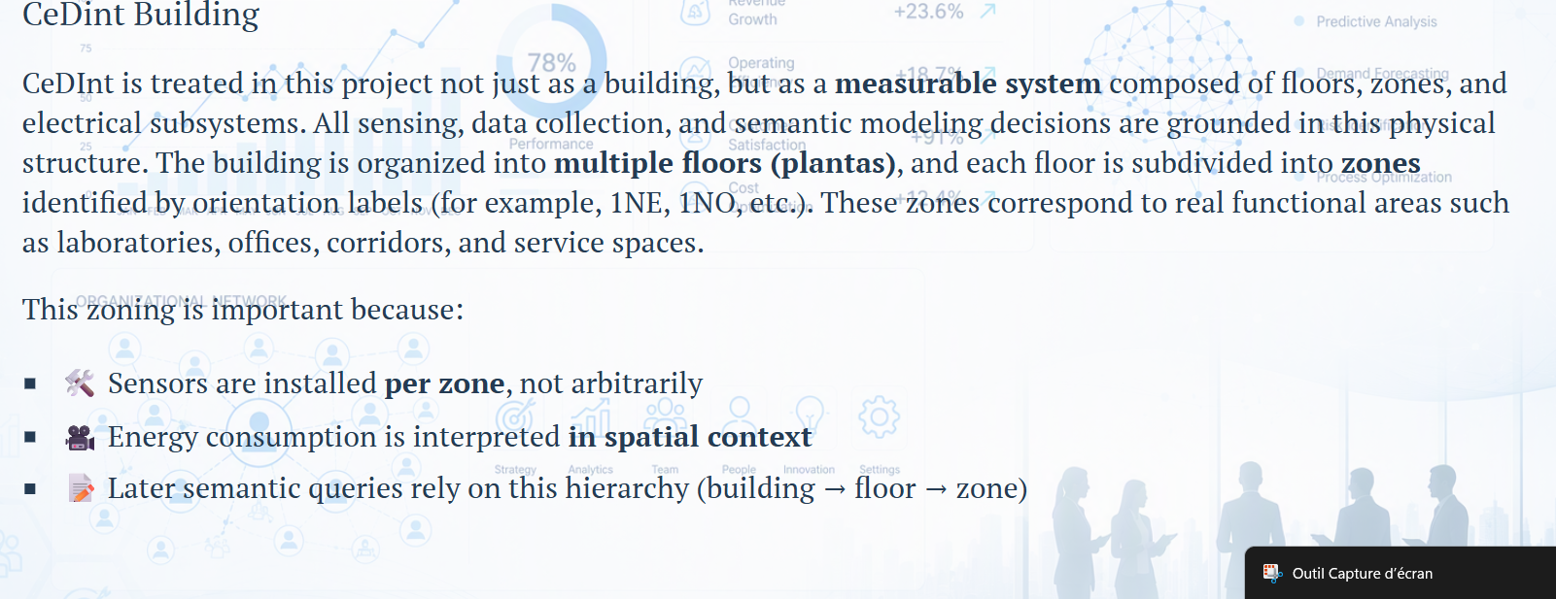
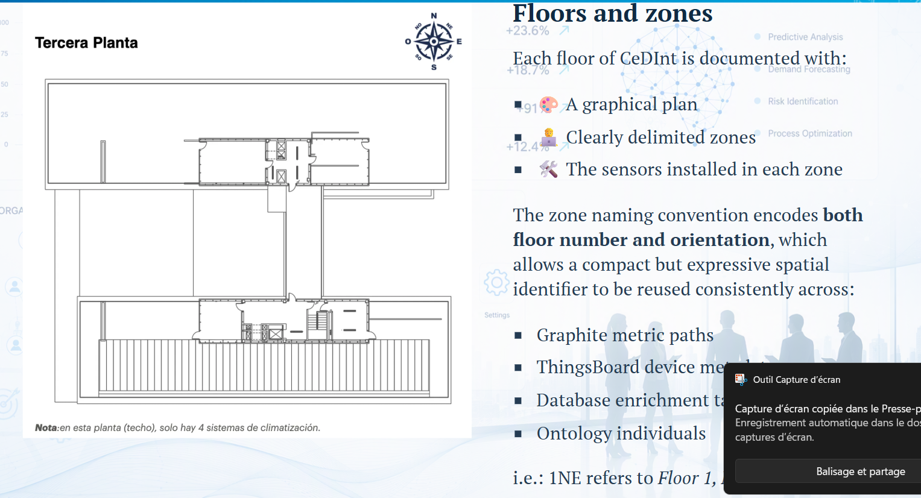
Spatial model — visual cross-check
SPRINT 2 SUPPORT
The floor plans are evidence for the documented building structure; they are not a licence to infer unsupported physical locations.
CHECK DURING US-020
Cross-check representative device/zone mappings against the supplied plans; record exceptions; do not infer location from visual proximity alone.
CeDInt-SEF · DataPack · PM² + Scrum + CRISP-DM

Slide 24
Sprint 2 — Gate G1: Data Readiness & Spatial Integrity
SPRINT 2 REVIEW
Use this slide at the end of the sprint: every item must be evidenced, not simply declared complete.
DEFINITION OF DONE / REVIEW CHECK
EVIDENCE TO COLLECT
☐ A target modelling granularity is documented.
☐ Aggregation rules are specified by variable type; interpolation is not applied blindly.
☐ Reset-related intervals are detected, tagged and auditable.
☐ Missing/invalid observations are treated with traceable rules.
☐ A versioned clean analytical dataset is produced.
☐ Building → Floor → Zone hierarchy is explicitly represented.
☐ Device IDs are mapped to zones using the authoritative mapping logic.
☐ Zone naming (e.g., 1NE / 1NO) is validated and unexpected labels are flagged.
☐ Floor-plan cross-checks and floor-specific HVAC context are documented where available.
☐ Spatial QA quantifies coverage and lists unmapped/ambiguous devices.
☐ Gate G1: no critical unresolved issue blocks feature engineering.
Resampling / aggregation specification
Reset-detection and affected-interval evidence
Missing-data treatment log
Versioned clean dataset + data-quality summary
Spatial hierarchy + device-to-zone mapping
Zone naming validation output
Floor-plan cross-check / exceptions log
HVAC context note
Spatial validation report
Updated risk / issue / decision log
Formal G1 decision
Decision: ☐ Accepted ☐ Accepted with actions ☐ Re-plan required
CeDInt-SEF · Sprint review · PM² quality gate

Slide 25
What Sprint 1 & 2 unlock
TRANSITION TO MODELLING
The objective is not simply to have a clean file — it is to have a defensible modelling foundation.
SPRINT 1 DELIVERS
SPRINT 2 TURNS IT INTO A MODELLING BASELINE
Source inventory and provenance
Telemetry semantics and central data dictionary
Temporal coverage and sampling evidence
Missingness / anomaly baseline
Reproducible ingestion
Consistent timestamps
Initial spatial hierarchy
Explicit resampling and aggregation rules
Reset and missing-data treatment
Versioned clean analytical dataset
Device → zone mapping
Validated Building → Floor → Zone model
Spatial QA evidence
G1 Data Readiness Gate
NEXT: Sprint 3 — Feature Engineering & Baseline Modelling
Only after G1 is accepted should the team move into the modelling chain.
CeDInt-SEF · DataPack · PM² + Scrum + CRISP-DM

