Slide 1
Info Challenge 2024:
UMD Sustainable Practices
Leon Battle
Travis Hockin
Conrad Jones
Thomas Kephart

Slide 2

Green Terp Program
Started fall of 2015, with the charge of investigating, researching and developing a residential sustainability program for UMD.
Recognize and reward leadership in sustainability
Educate participants about how and why to take action
Encourage and support action to conserve water, energy, waste, resources, and emissions
Promote campus policies and programs that advance sustainability
Engage the community in activities to strengthen UMD as a leader in sustainability
Support the University’s Climate Action Plan, Strategic Plan, and our contributions to UN Sustainable Development Goals
Further integrate sustainability into campus culture

Slide 3
Key Questions
Why does sustainability matter to UMD?
Who participates in the Green Terp Program?
How do we increase participation and retention in the Green Terp Program?

Slide 4
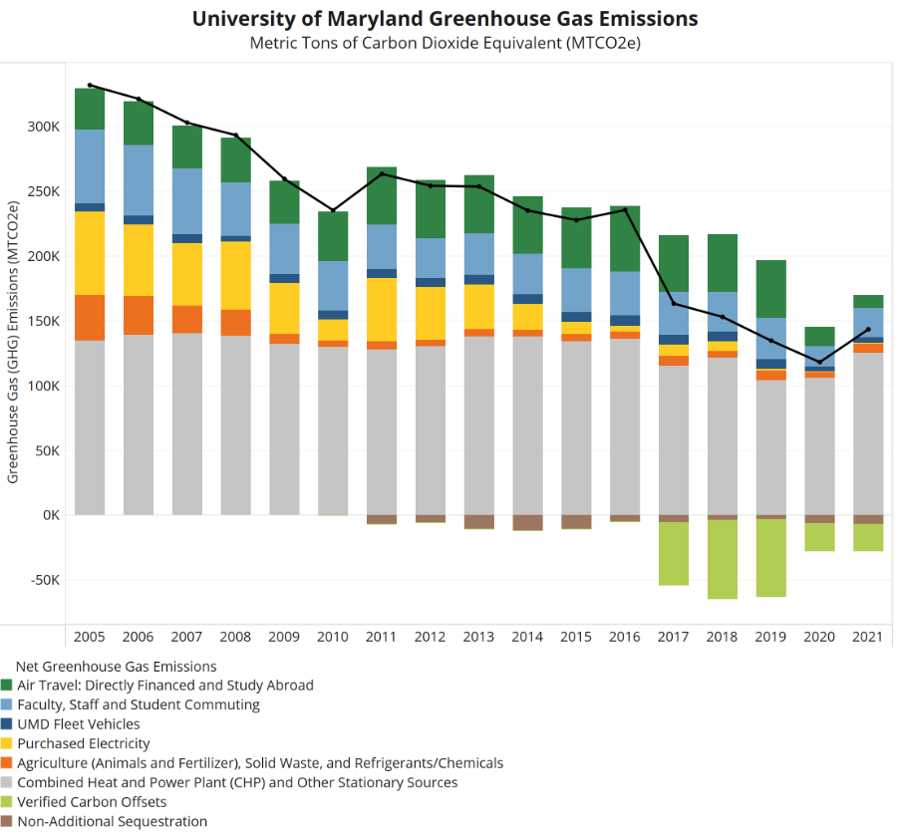
“The US Federal Government occasionally uses the Social Cost of Carbon to estimate economic damages associated with an increase in carbon dioxide emissions in a given year. Damages include decreased agricultural productivity, impacts on human health, property damages from increased flood risk, etc. Based on these government estimates, the University of Maryland has reduced its carbon liability and benefited the economy by $64.7 million by preventing approximately 1,243,222 metric tons of carbon dioxide equivalent (MTCO2e) from entering the atmosphere since 2005.”
- UMD Climate Action Plan
Notes:
Blue box when program committee started, Red box when program launched for students.

Slide 5
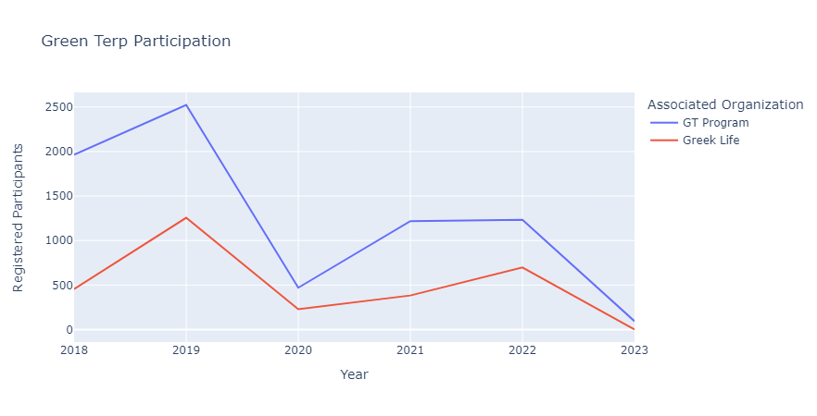

Slide 6
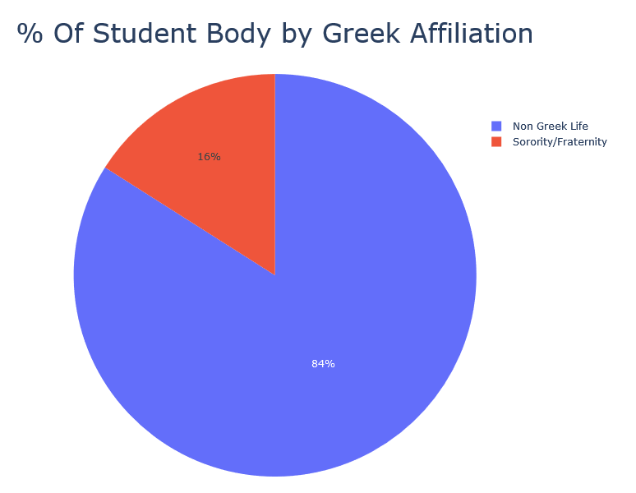
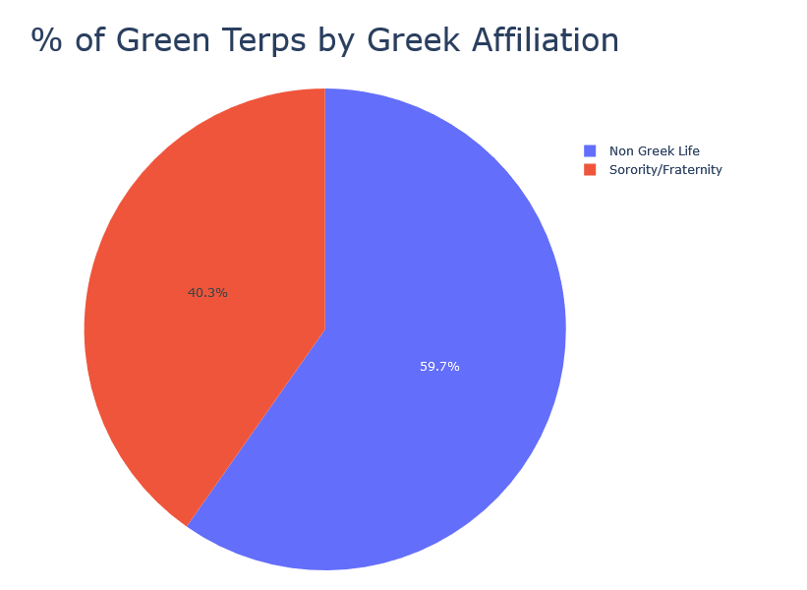
UMD Student Body vs Green Terp Program

Slide 7
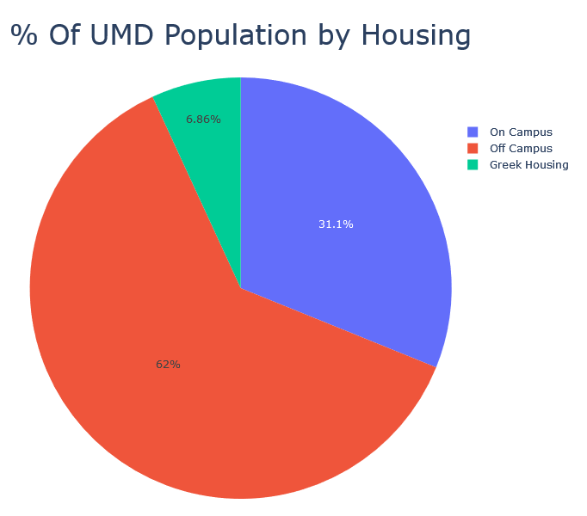
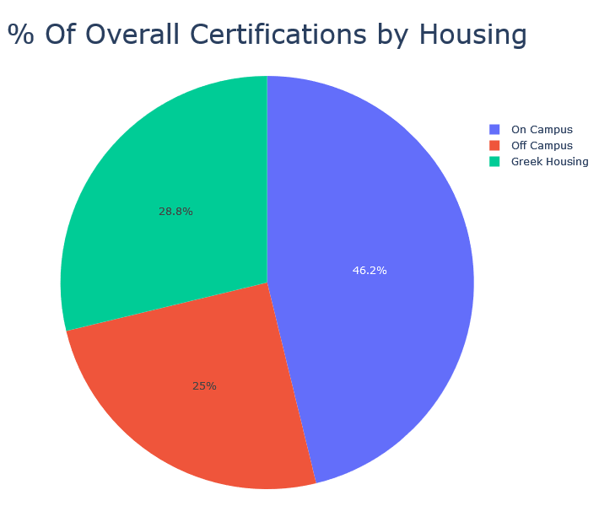
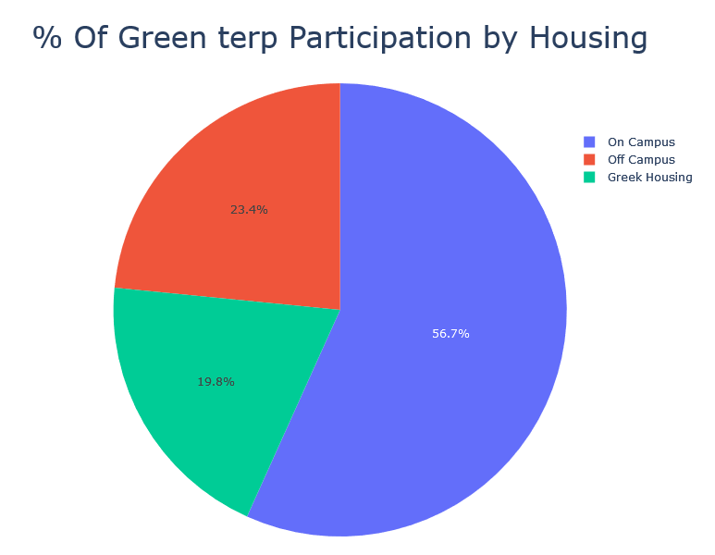
Comparison of housing and involvement in the Green Terp program

Slide 8
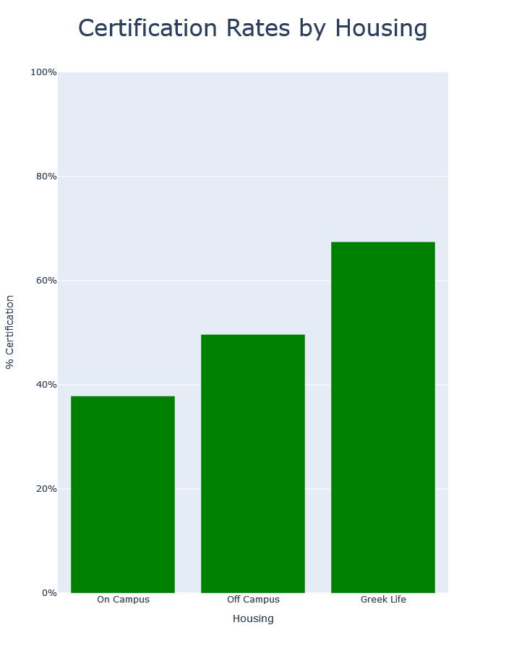
Students living in fraternity or sorority housing saw higher certification rates than those living in dorms or off campus.

Slide 9
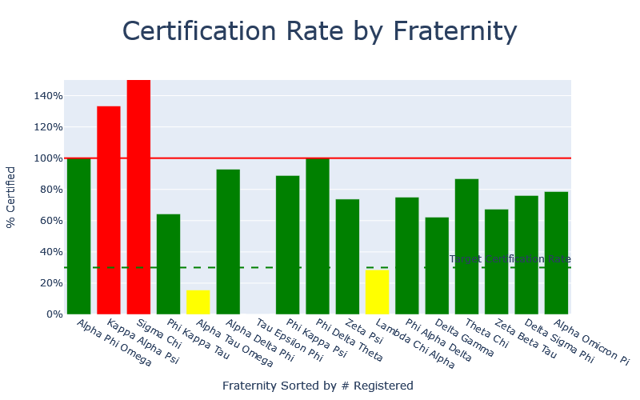

Slide 10
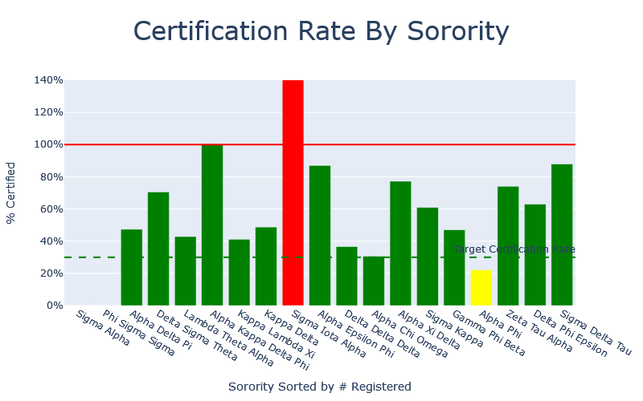

Slide 11
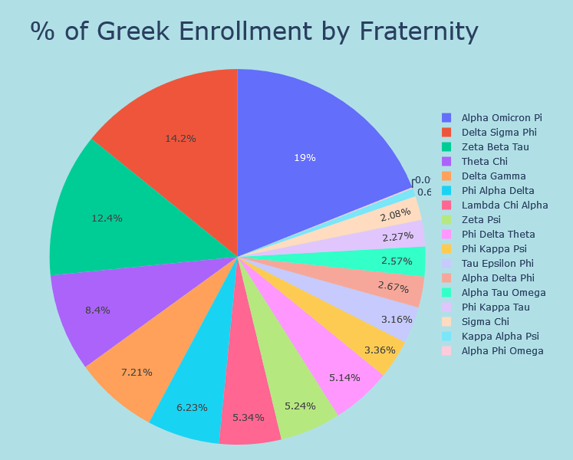
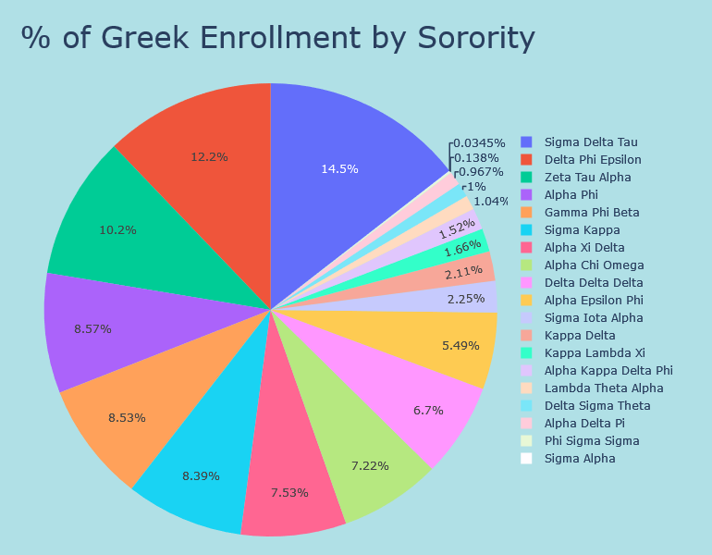
Participation by Greek Life

Slide 12
Moving Forward: Focus of Efforts
Green Terp Program leadership can choose to either focus on maximizing impact via Greek Life, or improving participation in other subgroups.
A focus on increasing ‘esprit de corps’ within on-campus res halls may be the key to exponential growth.
Fun and engaging competitions between resident halls with desirable rewards or recognition are one possible route.
Greek Life may be seeing higher rates of success in the Green Terp Program due to better unit cohesion and cultural buy-in.

Slide 13
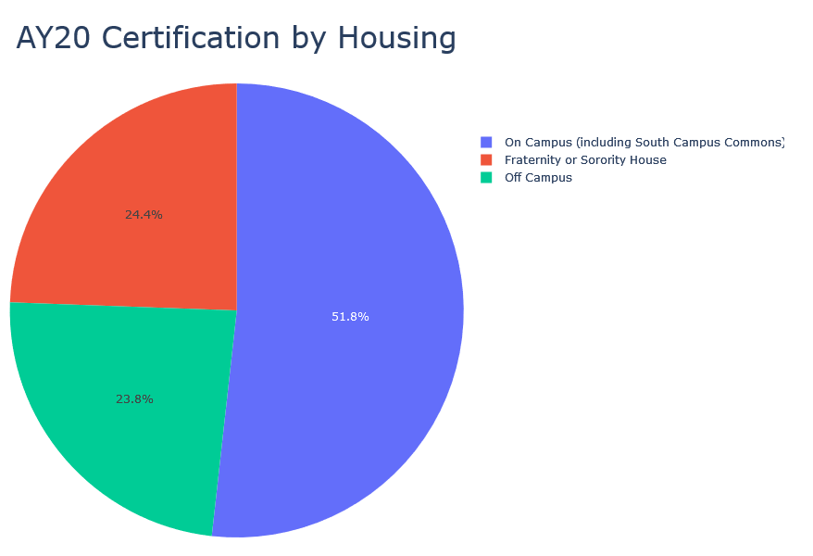
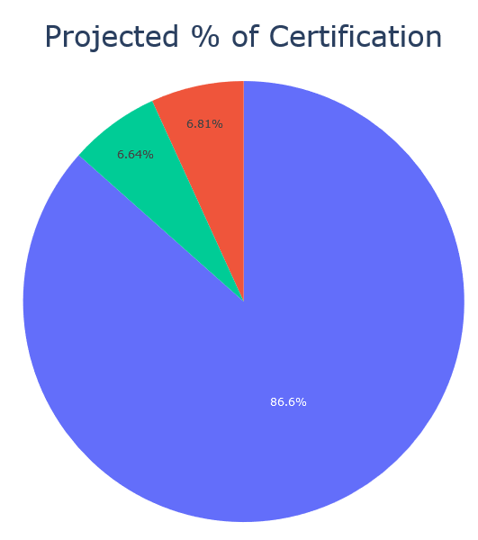
Predictive Analysis of Increased Res Hall Involvement
Total: 966
Total: 3466
AY20 (Pre-Covid) saw 966 total Green Terp certifications.
Only 5% of students living in dorms certified as Green Terps.
This leaves the other 95% as an untapped potential source of growth.
This is a projection of if res halls saw a participation level equivalent to the target participation level of Greek Institutions.
The projection sees a total of 3466, an increase of 259% in participation.
Using this projection, we recommend focusing efforts of the Green Terp Program on res halls.

Slide 14
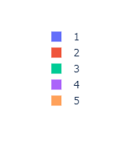
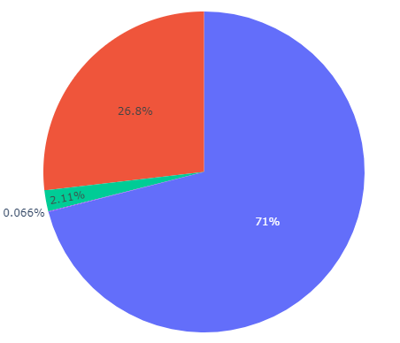
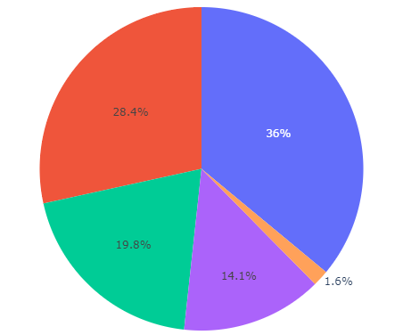

Student Participation & Retention
Student Participation By Grade Level
How Many Years Students Participated

Slide 15
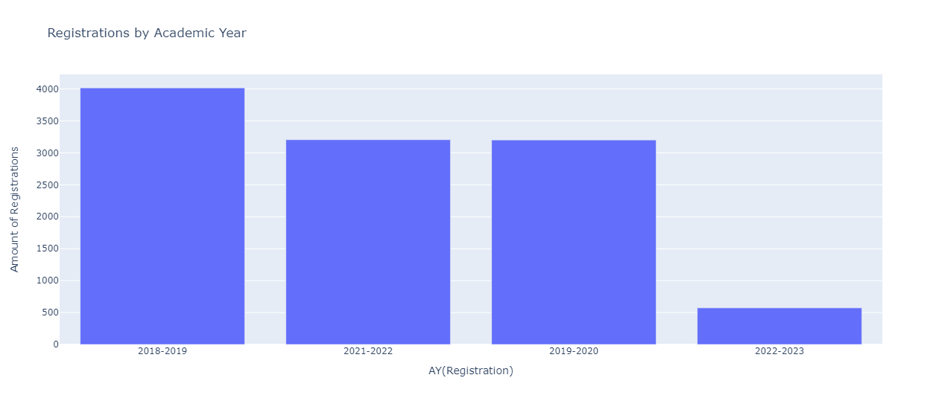
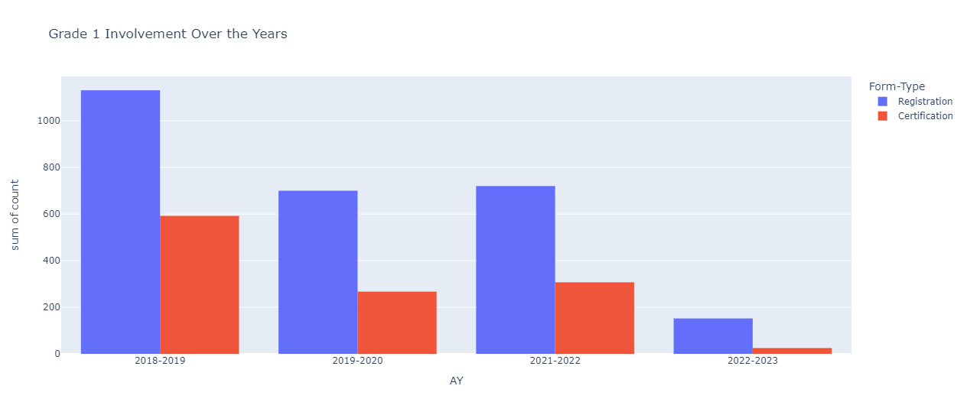
Overall Participation and 1st Year Participation

Slide 16
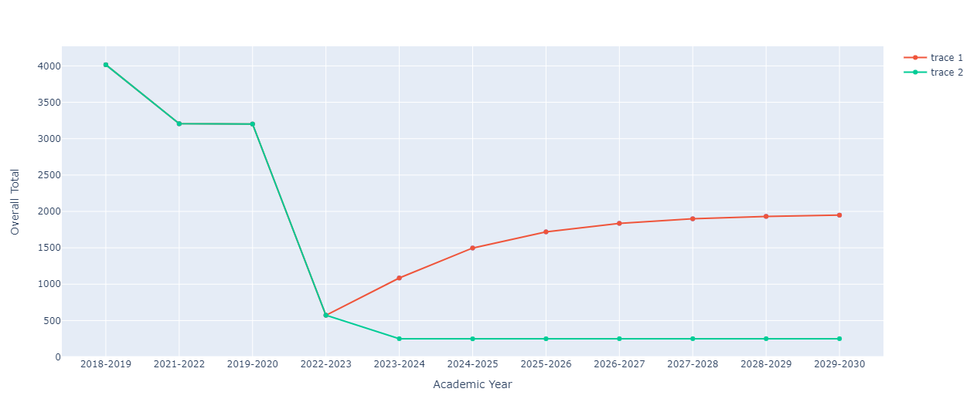
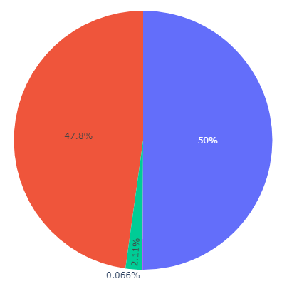
Suggestions to Improve Participation
With Suggestions
Without Suggestions
Maintain the Grade 1 Enrollment AVG
The given years have had an average of, roughly 20.5% of each incoming class participating in the program
Increase retention (at least increasing the number of students who participate for 2 years) to 50%
Seems daunting
Offer bigger incentives for consecutive AC Year certifications
Leads to more stable program participation
How Many Years Students Participated

Slide 17
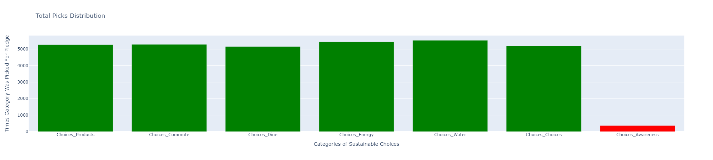
Total Participation in Pledge Categories

Slide 18
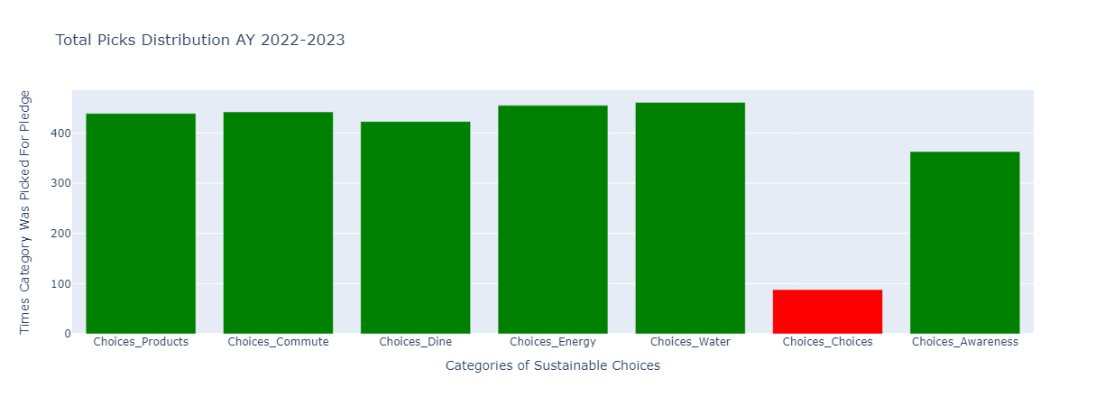
2023 Participation in Pledge Categories

Slide 19
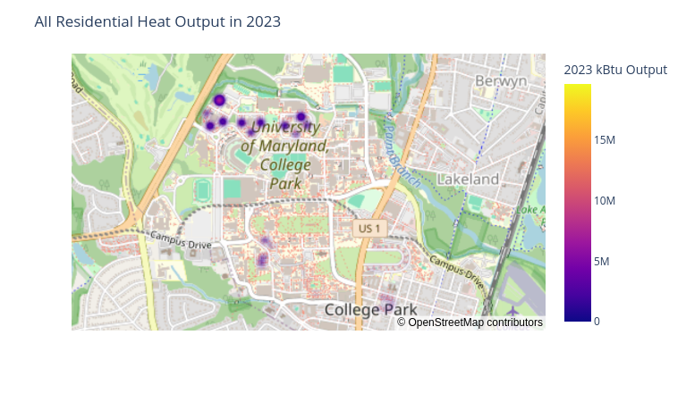

Slide 20
Sources
https://gist.github.com/eveninglily/34f7875ad0e302cbba8615f60460cdcb - building locations
https://sustainingprogress.umd.edu/progress-commitments/climate-action-plan
https://sites.google.com/umd.edu/greenterp/about
https://www.epa.gov/sites/default/files/2016-12/documents/social_cost_of_carbon_fact_sheet.pdf
https://campusvisitorguides.com/umd/life-on-campus/
https://www.usnews.com/best-colleges/university-of-maryland-2103/student-life
https://sustainability.umd.edu/get-involved/students/green-chapter
https://stackoverflow.com/questions/32589829/how-to-get-value-counts-for-multiple-columns-at-once-in-pandas-dataframe
https://academiccatalog.umd.edu/undergraduate/requirements-application-procedures/freshman-admission/#:~:text=We%20typically%20receive%20over%2058%2C000,academically%20successful%20at%20the%20university.
ChatGPT was used to help create certain visualizations

