Slide 1


Locker: a Simple Tool to Run and Manage Interactive Docker Containers Supporting Reproducible Research
Andrew Smith (andrew.smith1@bms.com)
December 2023

Slide 2
Overview
Brief Overview of Docker and Locker
Overview of Locker Application
Prerequisites and Setup
How to start Locker application directly using startup scripts (e.g., on Win or Mac laptop)
Overview of Locker functionality and UI
Safe Storage Locations inside Containers
Checklist for using Locker
Locker Services to start Locker Application on remote servers
Step-by-step guide to starting and developing with Locker
Acknowledgements

Slide 3
Overview of Docker and Locker

Slide 4
Brief Overview of Docker – Locker is based on and uses Docker
Basic idea: software virtualization of operating system and applications
E.g. run Ubuntu Linux and applications on a Mac or Windows machine
Much more space efficient than alternative virtualization solutions like VMware
Key Docker concepts/terms:
Image: static, single file that encapsulates all the necessary functionality of an operating system (e.g. Ubuntu Linux) and apps, to be run on top of a host operating system (Win, Mac, Linux)
Built from a Dockerfile: simple text file that lists all the steps (e.g. install programs, packages, and libraries, copy files, set env vars, etc.) to be run to create an image.
Container: a running virtual machine, started from an image, that you can access and use like you would your own physical computer (e.g. SSH into a terminal window, run commands like ‘ls’, edit and run scripts, etc.)
Docker Engine: system/program that lets you create & run Docker containers. Installed on host.
Docker Registry: A place (server) where images are stored (e.g. Docker Hub)
Pull: Download an image from a registry to local computer to start containers from it.
Bind Mount: Enable a host path to be available inside a running Docker container

Slide 5
Locker Key points and advantages
Developed internally at Bristol-Myers Squibb (BMS)
Supports the work of BMS Translational Bioinformatics Analysts
Can run on your Windows, Mac, or Linux machine, or on a remote/cloud server
Locker Services supports automatic starting of EC2s in AWS with Locker
Startup time fast (once server started and image is pulled)
Supports running analysis fully offline by enabling caching - onto your local drive - of network drive content (R packages, system libraries, etc.), network mount files, Github repos, etc.
Supports “sibling Docker containers”: ability to run other Docker images for specialized functionality, from inside your running Docker container/workspace
Supports GPUs (assuming computer Locker is running on supports, e.g. nvidia-smi, etc.)
Direct SSH access to started Locker containers supported

Slide 6
Locker Overview and Prerequisites, Initial Setup, Starting Locker using Startup Script

Slide 7
Locker Overview
Prerequisite: Docker is already installed and running on the computer where Locker will be run
Preinstalled and available on Locker Services-started servers, otherwise see https://docs.docker.com/get-docker/ for instructions
Locker is itself a Docker image
Runs as Docker container using “sibling Docker containers” method to start other containers.
Download and execute Bash script (Linux/Mac) or Win batch script to pull and start Locker
Or use Locker Web Services UI to (1) Start new server with Locker running (2) check/start Docker on existing server (3) Start Locker on existing server (e.g., cloud EC2)
Also server portal that lets you view and manage your started servers
Locker runs Flask web server that interacts with Docker using Docker SDK for Python
Access Locker in web browser via web UI, which communicates with Flask web server running on machine on which Docker images will be run as containers
Enables running Docker containers with:
One of: RStudio server, Jupyter, Jupyterlab
SSH (for direct login/terminal access)
Optionally also VSCode

Slide 8
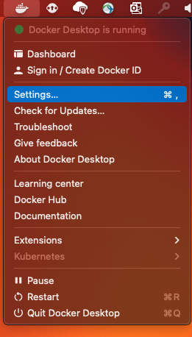
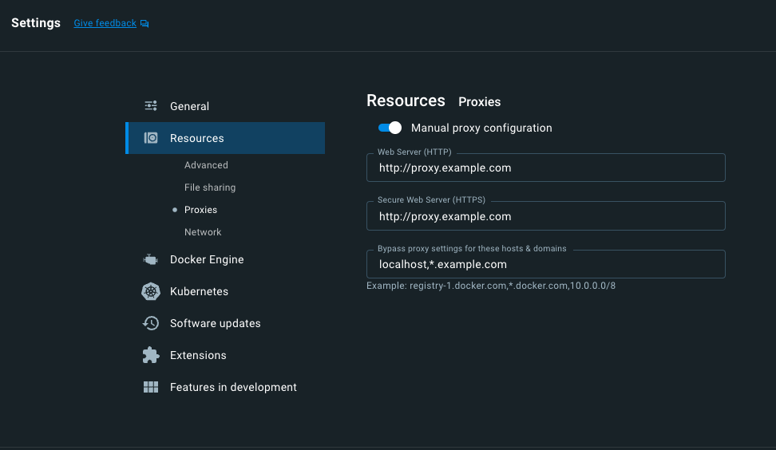
Setting Docker Proxies (if needed)*
Settings – Resources > Proxies in Docker Desktop:
*On Windows and Mac

Slide 9
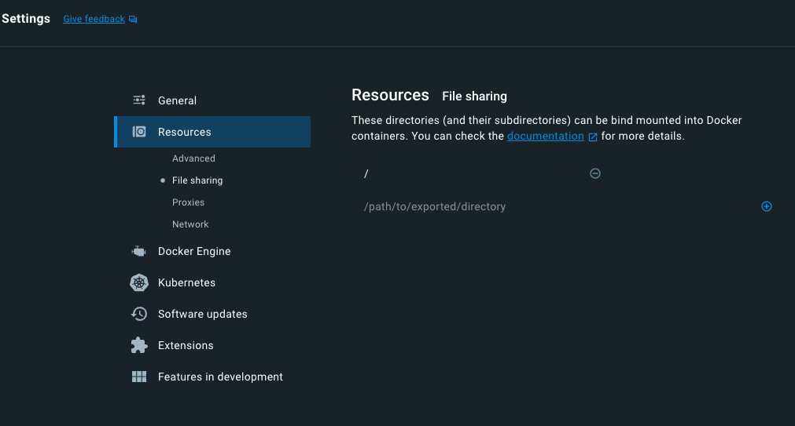
Allowing host root directory to be accessible inside started containers*
Settings – Resources > File Sharing in Docker Desktop:
Here, host root (’/’) is already set, but if not click the plus icon and then select the host root to add it to the list of directories that can be bind mounted into containers
*On Windows and Mac

Slide 10

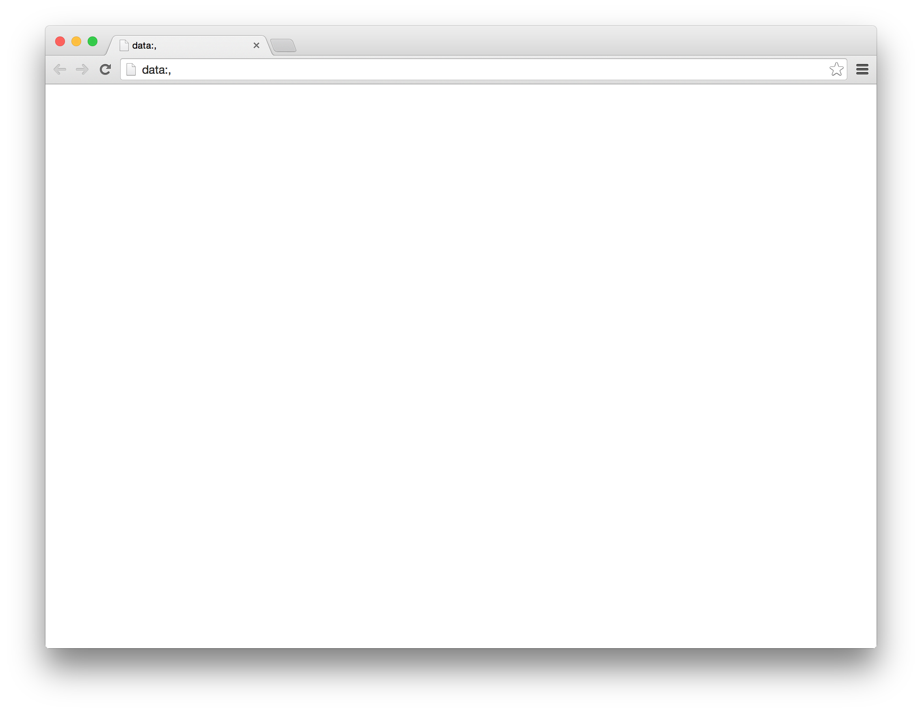
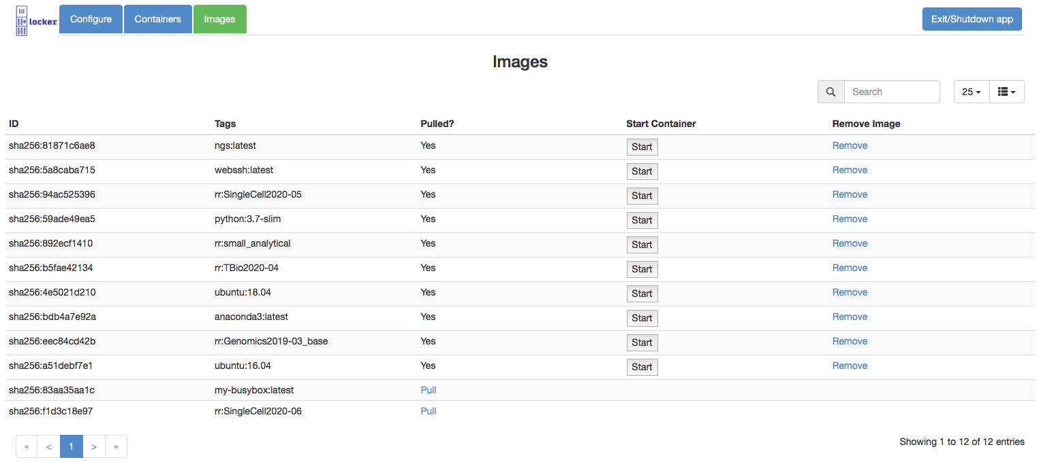

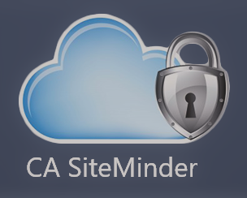
Two Modes of Running Locker Application: Local or Remote
Local
Accessible only on the local computer
The app (and started containers’ services RStudio, Jupyter, etc.) will accept localhost connections only (no connections over the network)
No access control, since assumed only the computer owner will have direct access to their Win/Mac/Linux laptop or computer
Remote
Accessible over the network (and locally)
The app (and containers’ services RStudio, Jupyter, etc.) accept connections over the internet (and locally as well)
Thus, access control required for security
SSO (e.g. SiteMinder) authenticate
Only the user who started Locker can access
Local Computer
Locker Client
Locker Server
Local Computer
Remote Workstation
Locker Server
Locker Client

Slide 11
Running Locker
2 options
Execute start_locker script on command line (next couple slides) to directly start on a computer
Use Locker Services web UI (this is easier, see later in presentation) for remote computers

Slide 12
Getting and Running the Locker app locally (e.g. on Win/Mac)
If you have setup Locker Services, you can download from there; otherwise generate by executing Makefile
Mac/Linux: start_locker.sh
Windows: start_locker_win.bat
Running the app
Mac and Linux
First, inside terminal window make the downloaded file executable using chmod command: chmod +x start_locker.sh
Execute the app in a terminal window: ./start_locker.sh
Windows is similar, download and execute start_locker_win.bat

Slide 13
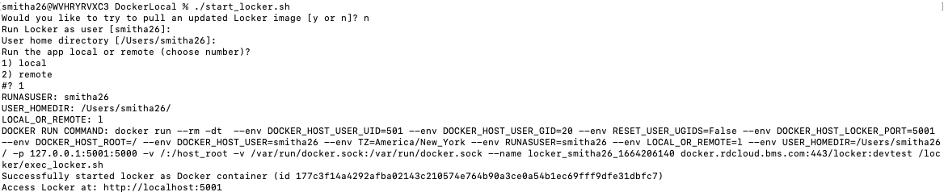

Starting the Locker Application
You will be asked some questions about how you want to run Locker:
Do you want to pull an updated image for Locker if available (if first time, image will automatically be pulled)? The user to run Locker as (only this user will be able to access, if running remote) and the user’s local home directory. Values inside brackets are the default if you simply hit enter without providing values. Run the app local (no access control) or remote (only specified user can access via SSO e.g. SiteMinder authentication)?
The actual ‘docker run’ command run to start Locker, the resulting container ID, and the URL where you can access Locker in a web browser
You can also just pass values directly on the command line when executing the start_locker.sh script:

Slide 14
User Interface Overview

Slide 15
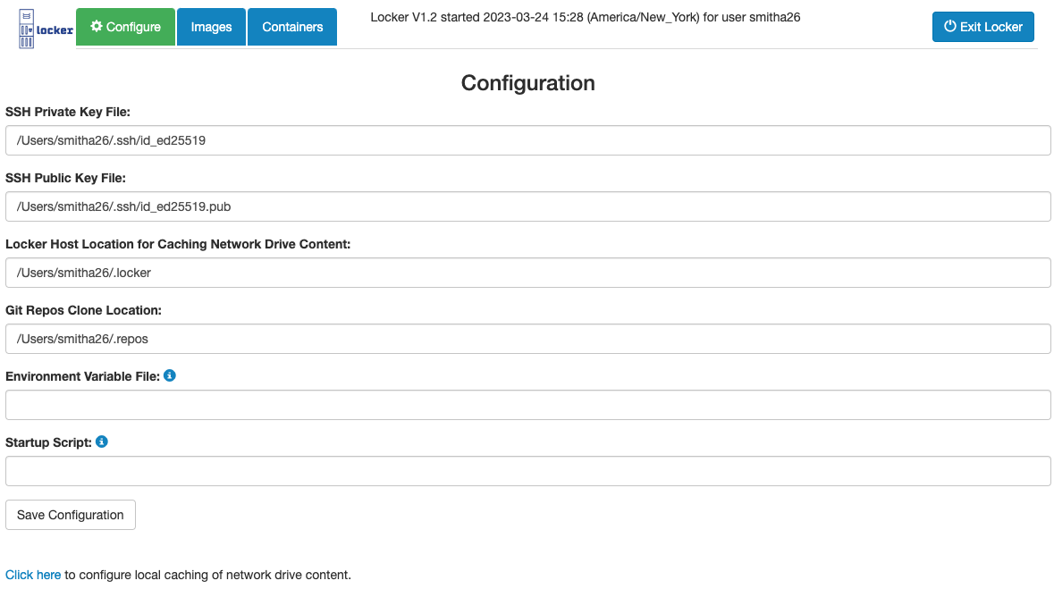
Locker UI - Configuration
Basic Locker info shown on all Locker pages
Provide your SSH keys: enable network drives to be automatically mounted, ability to SSH into containers (password not supported)
Specify Locker host locations for network drive and repos storage, to enable offline usage
Specify environment variable file, to be set in all started containers and services (Rstudio, Jupyter, etc.)
Specify startup script (e.g. bash script) to be executed at container startup for all containers
Configuration info stored in config.json file inside .locker dir in your Locker host home dir; example/template environment variable file and startup script also are provided there
Ability to copy/cache parts of network drive content (e.g. network home directory, etc.) locally for offline usage of Locker
Autocomplete and navigation of file hierarchy supported in all fields

Slide 16
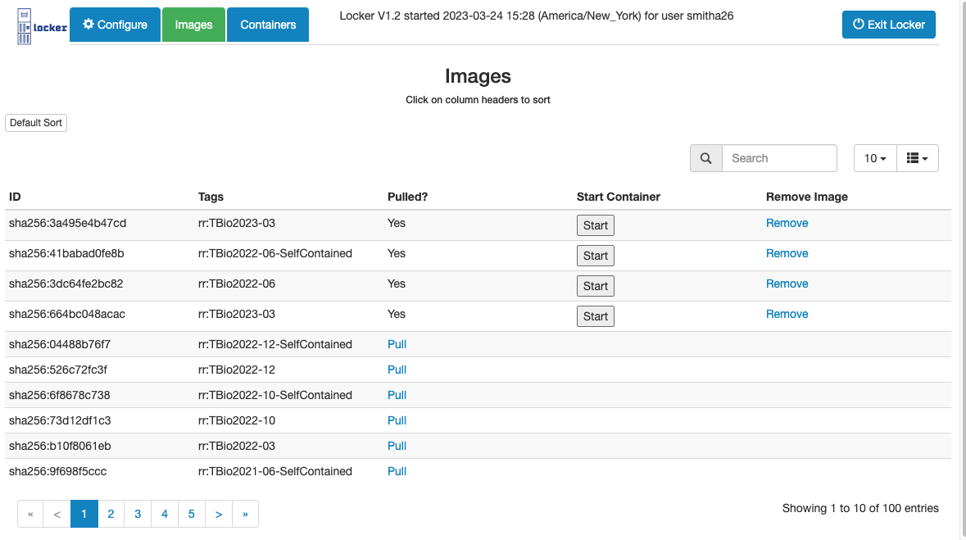

Locker UI - Images
Click to start container from image once image has been pulled
Basic info about images
Click to pull from Docker registry
Click to remove image (from your local Docker)

Slide 17

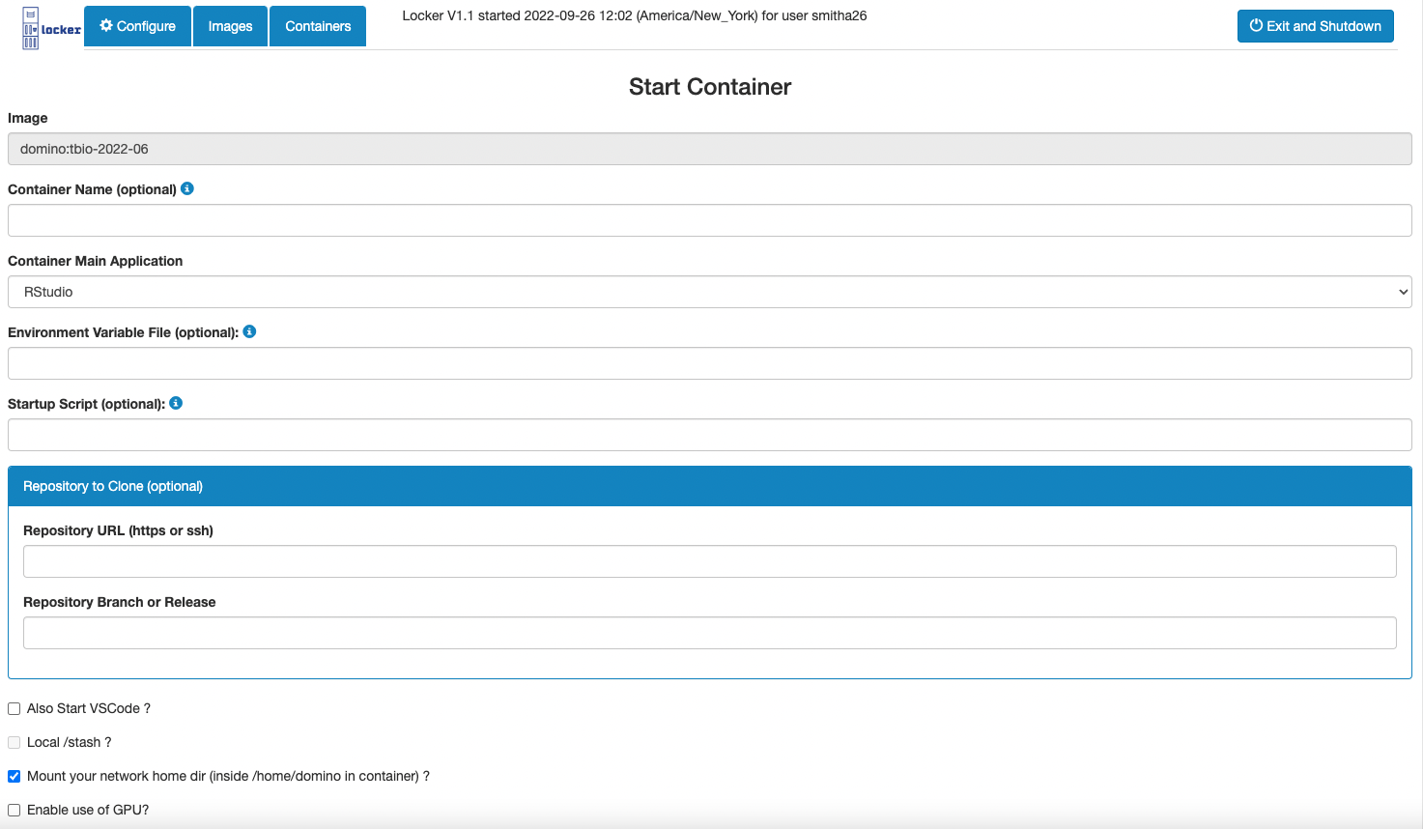
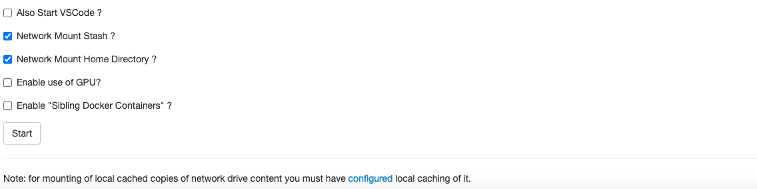
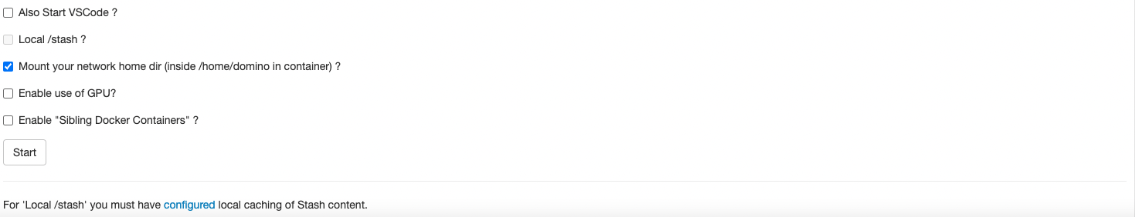
Locker UI - Start Container
Check “Also Start VSCode” to also start VScode (if not primary app)
Check checkboxes for mounting network drive content (e.g. “Network Mount Stash” and/or “Network Mount Home Directory” )
If you cached locally, checkboxes for mounting of this local cache will appear
Check “Enable use of GPU” to be able to use the GPU (on GPU host)
Check “Enable ‘Sibling Docker Containers’” to be able to do Docker commands inside the container.
After clicking Start, the container starts, new row added to the “Containers” page and you are redirected to the “Containers” page
Docker will name randomly if not provided
Choose from Rstudio, Jupyter, JupyterLab, or VScode
If set, these replace global values from configuration page (if any)
Clone GitHub repo and make available at /repos inside container (but stored on Locker host location, for data safety)
Click to configure local caching of network drive content, same link as on configuration page

Slide 18
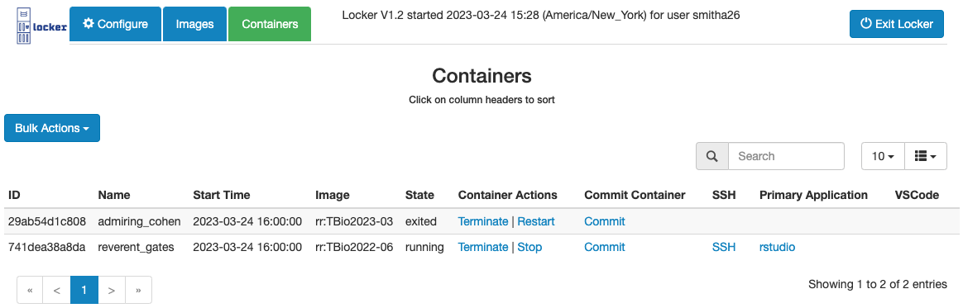
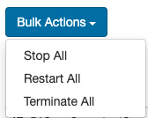
Locker UI - Containers
Basic info about the running containers
Links to access the running services in the container
Links to terminate (you will be asked to confirm), stop or restart containers. Note: ideally have only one container at a time running, to not overtax system resources. Also stop all containers before rebooting host server (they persist after reboot). Do quickly for all containers with Bulk Actions.
Create a new image from the container, e.g., after having installed new programs or packages

Slide 19
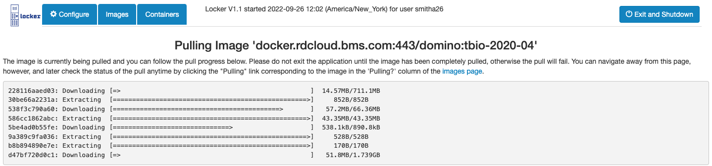
Locker UI - Pulling Image (follow progress of image pull)
‘docker.example.com:443/rr:img-2022-11’
See progress of Docker image layers as they are pulled
Once image is pulled, you can start containers from it. Pulling is a one-time operation per host.

Slide 20

Locker Offline Usage Overview

Slide 21
Offline Usage Overview and Rationale
Normally, to be able to run containers (started from Locker Docker images) you need to be connected to the internet and possibly also VPN or organization network
Image content (R packages, system libraries, etc.) stored on mounted network drive (e.g. EFS)
Network mounted directories, e.g. network home directory
Connection to github.com to clone, pull, and push repos
Issues: network might be slow or get disconnected, or you simply might not have access
Offline usage in Locker allows you to cache necessary online content so you can efficiently work fully offline (e.g., at the beach on your Mac!)
To configure and enable, while you ARE connected to internet and VPN or organization network:
Cache necessary parts of network mounted directories to your host local drive
Clone GitHub repos to your host local drive during container startup
Pull and use special versions of the Locker Docker images that are self-contained (i.e., that do not require a network drive such as EFS to be mounted)
Use this cached content when starting a new container → use that container offline
Note: the caching is to your configured local storage locations on your computer (laptop, etc.) that gets bind mounted into started containers → persists after containers stopped (no data loss)

Slide 22
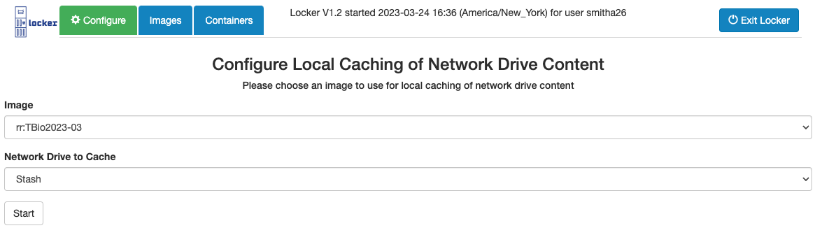

Locker UI - Configuring Local Caching of Network Drives
rr:img-2022-11
Get to this page after clicking link on Configuration page:
Caching is done using a (any) Locker image, so you must have already pulled one of those
Then choose the image to use (probably best to use most recent one although shouldn’t matter) and click Start.

Slide 23
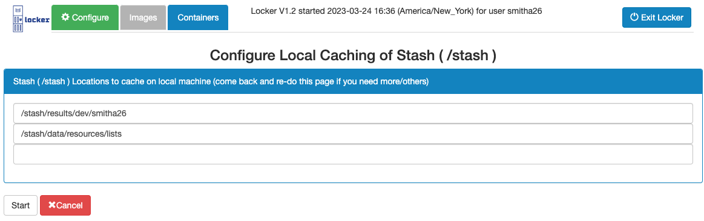
Locker UI - Configuring Local Caching of Network Drives (cont)
For a network drive mounted at /stash, choose /stash locations to cache to your host local drive. Autocomplete and navigation of file hierarchy supported.

Slide 24
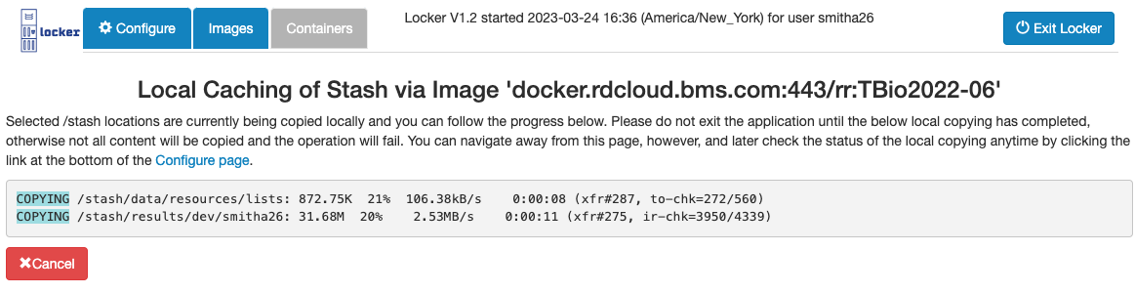
Locker UI - View Status of Local Caching of Network Drives
‘docker.example.com:443/rr:img-2022-11’
Click to stop caching to your local drive (but whatever copied so far remains)
Progress on caching network drive content e.g. /stash to host local drive (specifically rsync status lines)

Slide 25
Locker Safe Storage Locations, Recommendations and Checklist for use

Slide 26
Safe Storage Locations inside Running Containers
After container terminates, container files are lost unless they were in safe, persistent locations
Some directories inside containers can be either network mounted or “bind mounted” from the host machine, so any content inside them is safe and persists after container exit:
/repos – for cloned BioGit repositories
Automatically bind mounted from host if user configured Git repos clone location (direct network mounting not supported, but the location could be a network drive location on your host)
Network Drive Mounts, e.g. /netdrive
User can choose at container startup to either bind mount from host (if Offline Storage Location configured and exists in there) or network mount from configured host of the drive
/host_root
Automatically bind mounted from host’s root directory (allows access to any host file or dir)
Note: for bind mounting from host, safety of data assumes you backup the host (e.g. your Mac or Windows laptop)
Next slide delineates the locations outside the container for the above in-container paths

Slide 27
Safe Data Storage Locations Inside and Outside the Container
 | Location Outside of Container
Location Inside Container (LIC) | If LIC network mounted | If LIC bind-mounted from host local storage
/repos | Not Possible | <GIT_REPOS_CLONE_LOCATION>/repos
Network drive1 mount | <network_drive1_host>:/<network_drive1_mount_point> | <LOCKER_HOST_CACHE_LOCATION>/<network_drive1_mount_point>
Network drive2 mount | <network_drive2_host>:/<network_drive1_mount_point> | <LOCKER_HOST_CACHE_LOCATION>/<network_drive2_mount_point>
/host_root | Not Possible | ‘/’ (Mac/Linux) or ‘C:\’ (Windows)

Slide 28
Notes and Recommendations
Set a repos clone location and use it for /repos
Work as much as you can in your network-mounted drive locations
You can also store things safely under /host_root
Don’t ever rely on storing things in /tmp or other directories that are only available inside the container
Note: to directly access the Locker host cache location from inside the container, go to: /host_root/<LOCKER_HOST_CACHE_LOCATION>
Similarly to access Locker repos clone location inside the container, go to: /host_root/<GIT_REPOS_CLONE_LOCATION>

Slide 29
Basic Checklist for using Locker
One Time per host machine
Install Docker
Configure Docker proxies and allow Docker to bind mount host root directory
Optionally download/get Locker start script (start_locker.sh for Linux/Mac, start_locker_win.bat for Win)
Start Locker by executing the start script or using the Locker Services UI
Configure Locker: SSH public & private keys, Locker host cache location and Git repos clone location, environment variable and startup script files
Pull Images
Optional: configure offline caching of network drive content
Recurring
Start containers from pulled images
Use the running containers to do your work (RStudio, Jupyter, Jupyterlab, Vscode, etc.)
When done, stop the containers
Optionally exit Locker (can easily restart it later)
Periodically, during inactive periods (e.g., overnight, on weekends, during vacations):
Bulk stop all containers and shut down Locker host (e.g., cloud server or Locker services started server)
After host reboot, restart Locker (as above). Any stopped (but not terminated) containers will still appear on the Locker Containers page! In this way, you can maintain a persistent list of containers, one per project, on a given host machine and start them as needed.

Slide 30
User Interface Overview

Slide 31
Locker Services to Start Locker Application Remotely
Five services (flexibly use first 3 individually as needed, fourth one combines all 3)
New Server: Start new EC2/server in the Amazon AWS Cloud
Check/Start Docker: Check if Docker is Installed, Running, and Accessible on a server; Optionally Install and Start it if not
Start Locker: Start Locker on a Linux Server (assumes Docker already running and available)
Locker on New Server – Combines all three previous services into one simple to use
Locker Server Portal –View and manage all your started servers (stop/terminate/restart, etc.)
E.g. for an already running cloud server you could first Check/Start Docker then Start Locker. Or just Start Locker if you know Docker is already installed and ready.
E.g. If you need to run on special hardware just run Locker on New Server.
If you just want to run Locker remotely on an already running server, this is the easiest way to get it running.
Possible to directly use start_locker.sh, but then you’d have to handle all the low level details yourself

Slide 32
Locker Start Script vs Locker Services --- When To Use Each
Use Case | Locker Start Method
Run and use Locker locally on a Windows or Mac laptop | Use the start script
Run and use Locker remotely on an already running server | Use either, but Locker Services easier
Run and use Locker remotely on a new (temporary) EC2 Server | Use the Locker Services

Slide 33
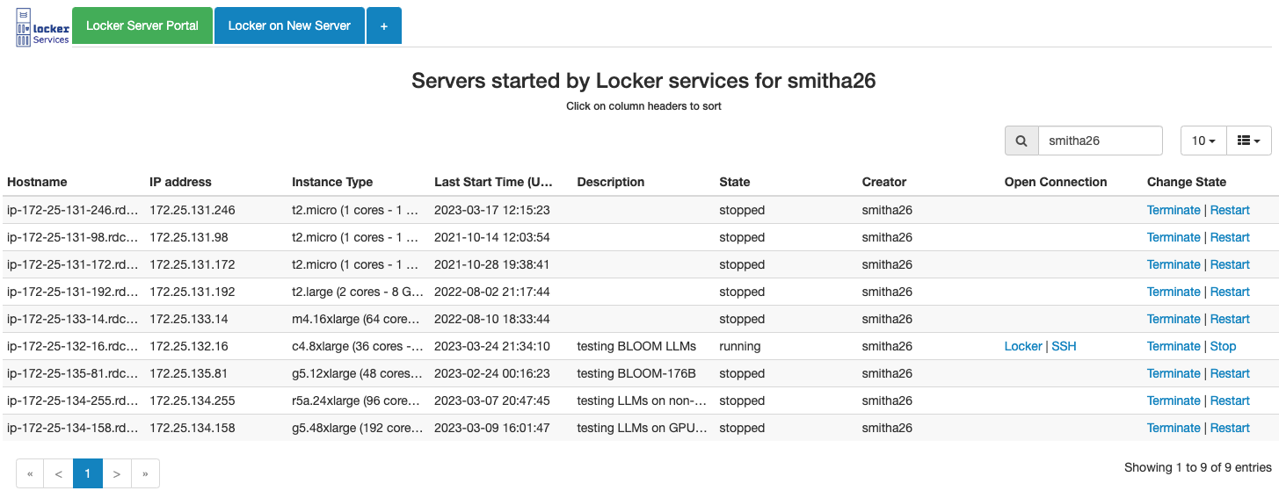


Locker Services – Locker Server Portal
Click ‘+’ to see all tabs (then ‘-’ if you want to hide again)
View details of all your started servers
Links to Terminate/Stop/Restart
Stop will automatically exit all containers first
Restart will automatically restart the container that runs Locker
Links to access running Locker on server and to SSH to it

Slide 34
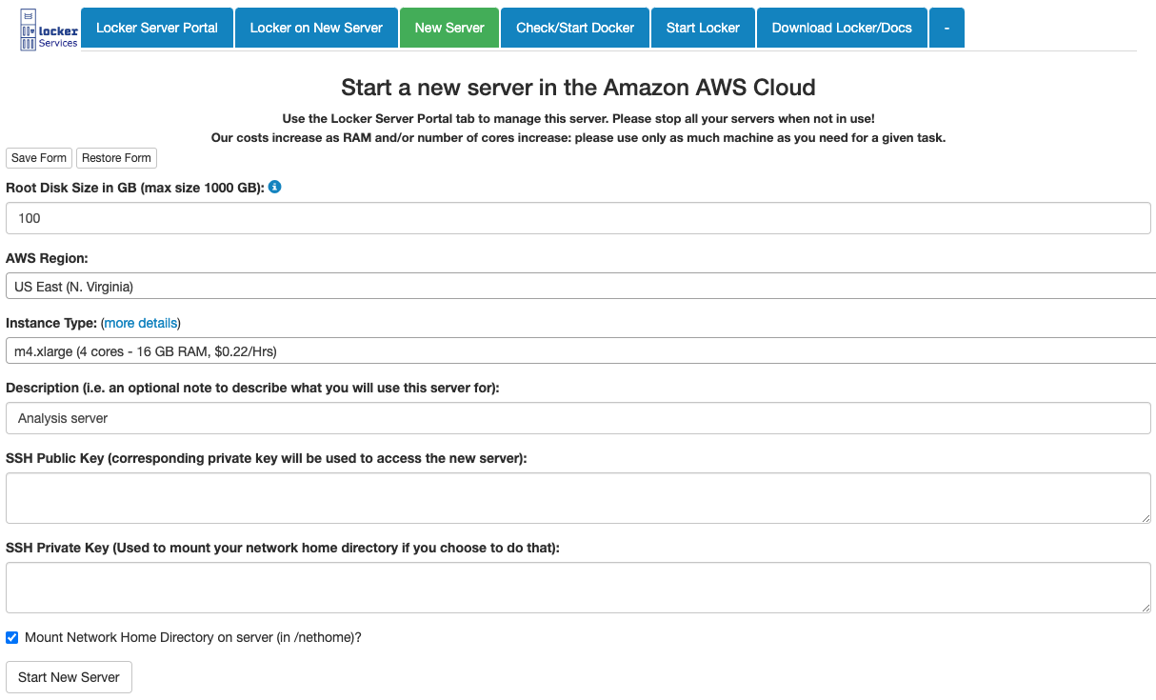
Locker Services – New Server
Note: you can click here to download start_locker.sh and docs
All the Locker services allow you to save your filled out form values to browser local storage, and then restore that later to avoid having to enter the same detailed info repetitively when you use the services often.
Optionally provide description of the server (shown in Locker server portal)
Optionally mount your network home directory on the started server

Slide 35
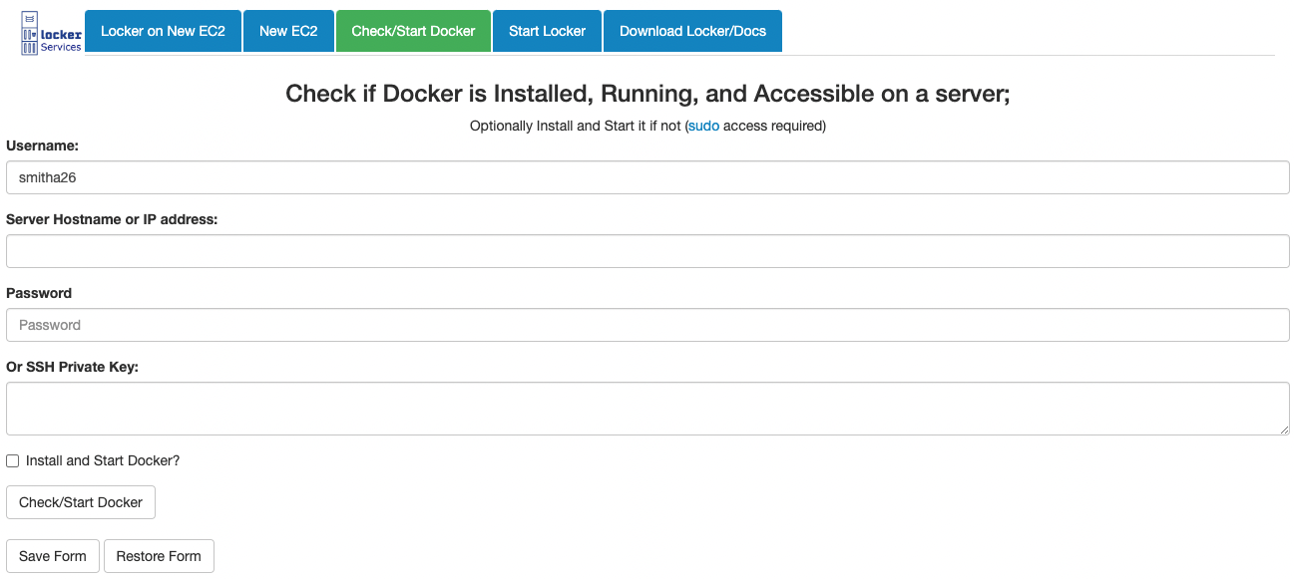


Locker Services – Check/Start Docker
Check this if you want to have Docker attempt to be installed (if it isn’t already); if not checked, Docker status on the server will be checked and reported back to you.

Slide 36
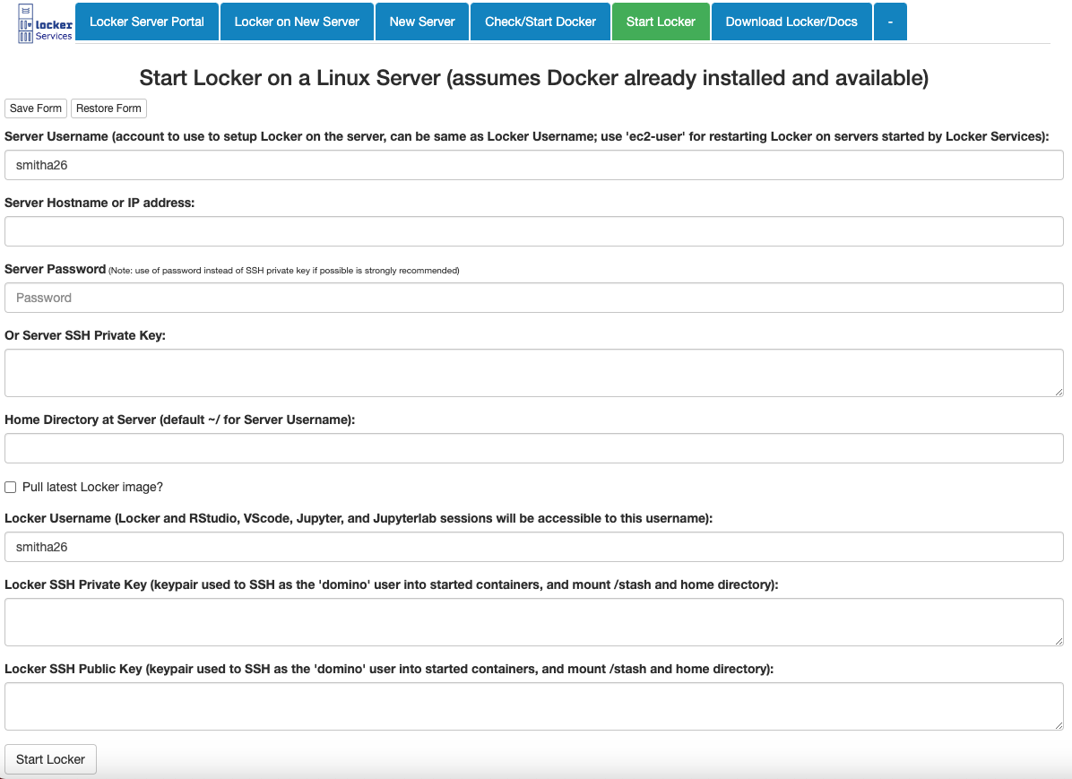
Locker Services – Start Locker
Note: Server Username and Locker Username will often be the same, but can be different if one person (e.g. admin) is starting Locker on behalf of another end user

Slide 37
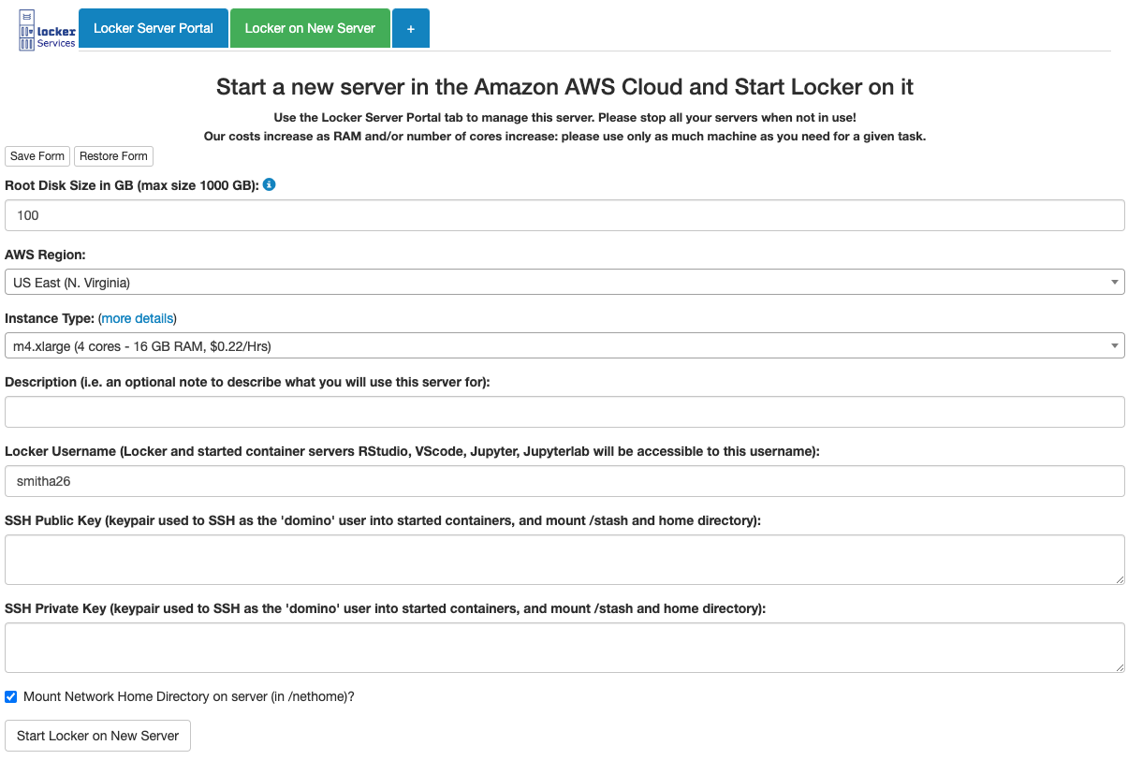
Locker Services – Locker on New Server – combines previous 3 services

Slide 38
Step-by-step Guide to Starting Locker and Developing using Locker and Locker Services

Slide 39
Starting Locker on a new EC2 instance (Page 1)
Choose this option when you need a new EC2 instance with Locker
Go to ‘Locker Services’
Click on ‘Locker on New Server’ tab
If you have a saved form, click on ‘Restore form’ and go to step 7; otherwise continue
Based on your project/analysis requirements,
Enter disk size, Instance Type (or leave the default selections)
Enter ‘Description’ if desired.
Enter your LDAP username (if not auto filled, or incorrect)
Copy SSH public and private key file contents and paste the text into the corresponding fields
Click on ‘Save form’ to save the current information entered for future use
Click on ‘Start Locker on New Server’
You will receive an email with a link to Locker.
You will also see the Locker status and the link on the browser.
Click on ‘Locker Server Portal’
Your new EC2 instance will be listed
You can access Locker by clicking on ‘Locker’ under ‘Open Connection’ column (You can also right click and click on Open Link in New Tab)

Slide 40
Managing your EC2 Instances
Go to ‘Locker Services’
‘Locker Server Portal’ will have all your EC2 instances that were started using Locker Services
Controlling your EC2
‘State’ – Possible States are ‘starting’, ‘running’, ‘stopping’, ‘stopped’
‘Open Connection’
‘Locker’ – To open running Locker session
‘SSH’- To open an SSH connection to the EC2 instance
On Mac, opens a Terminal
On Windows, displays the ssh command you can use to connect to the EC2 instance
‘Change State’
‘Terminate’ – Permanently shuts down the EC2 instance
Any data stored directly on the EC2 instance will be lost
‘Stop’ – Pauses the EC2 instance
Any data stored directly on the EC2 instance will be available after restart
‘Restart’ – Restarts a stopped EC2 instance
Click on the menu button on the upper right if you wish to select columns to be displayed

Slide 41
Starting Locker on existing server
Choose this option if Locker is not running and not paused on your server
Go to ‘Locker Services’
Click on ‘+’ tab
Click on ‘Start Locker’ tab
If you have a saved form, click on ‘Restore form’ and go to step 6; otherwise continue
Enter your username, server IP address, password (or the SSH private key)
Select checkbox for ‘Pull Latest Locker image’
Copy SSH public and private key content and paste the text into the corresponding fields
Click on ‘Save form’ to save the current information entered for future use
Click on ‘Start Locker’
You will receive an email with a link to Locker.
You will also see the Locker status and the link on the browser.
Click on ‘Locker Server Portal’ to find and manage your server if it was previously started by Locker Services (if not, it won’t be visible in Locker Server Portal)

Slide 42
Using Locker for Development (Page 1)
To access Locker:
Access the ‘Locker Server Portal’ of Locker Services and click on ‘Locker’ under the ‘Open Connection’ Column for your EC2 instance or
Click the ‘Access it here’ link in the email you got after starting Locker or
If you didn’t start Locker using Locker Services, go to the web link where your locker is running (e.g. as printed by start_locker.sh)
You will now see the Locker main page
Configure location for your Git repos (once per machine running locker)
On the ‘Configure’ tab, enter the location in ‘Locker Host Location for Caching Stash and Git Repos:’ (<lockerstorage>)
Choose a path available on the machine running locker, e.g. /home/<userID>/lockerstorage
By cloning repos here, even if a container stops, you will still see your changes in the selected directory
Inside a container, /repos is a symlink pointing to <lockerstorage>/repos. You can access your cloned repos at /repos.
Click on Images tab
Click on ‘Pull’ for the image you want to use (if you haven’t yet pulled any images)
Go to GitHub and copy the SSH link for the repository you want to clone and use
After ‘Pull’ is complete, we can start the container
On the Images tab, click on ‘Start’ under the Start Container column for the pulled image
Enter a project name for the ‘Container Name’ field
Choose the interactive application you want to use, e.g. ‘Rstudio’, as your Container main application
Under ‘Repository to clone’, Paste the SSH link for your repo into the ‘Repository URL’ box
Click checkboxes to have network drive directories mounted
Click on ‘Start’

Slide 43
Using Locker for Development (Page 2)
For working on multiple projects, you have two options
Start a new container for each project (recommended, usually most convenient)
Switch repos within a single container (you may have to clone additional repos at the command line)
We recommend you have only one container running at a time. You can stop any existing containers before starting a new container.
A stopped container can be restarted to resume work on a project
In this way, you can maintain a list of containers, one per project. This list persists between reboots of Locker host machine.
After the container starts you will land on the ‘Containers’ tab
Right-click link under Primary Application (e.g. ‘Rstudio’), click on ‘Open Link in New Tab’ to open your application workspace
We recommend opening in a new tab to keep your Containers page for visiting later
You can also bookmark your containers page or access it from Locker Services
Access your project repo in your Locker Rstudio workspace
You can navigate to your repo folder under /repos in the Files explorer tab on the right.
If you chose to mount network drive directories, you can access them at their mount points

Slide 44
Extra/Advanced Topics

Slide 45
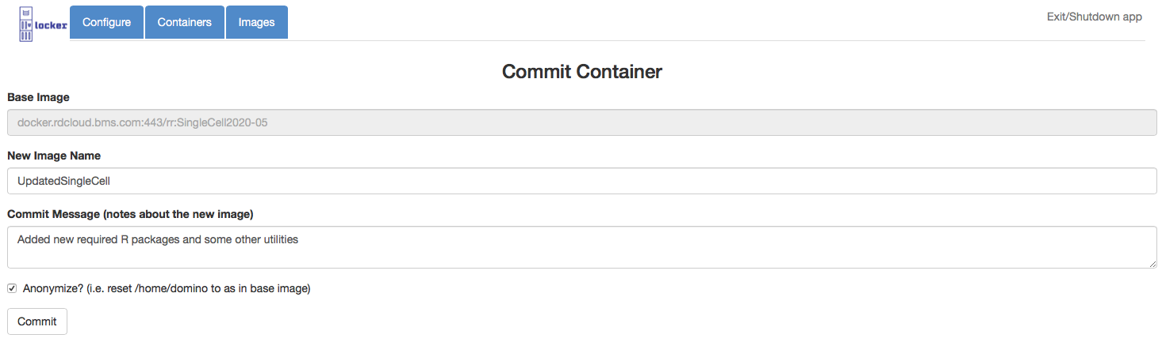
Commit Image Page
Basic idea: you modify an existing container (install new programs, packages, etc.) and want to create a new image from it (to start new containers in the future).
“Anonymize” will remove your sensitive private info
Can then safely push such anonymized images to your Docker registry to share with others

Slide 46
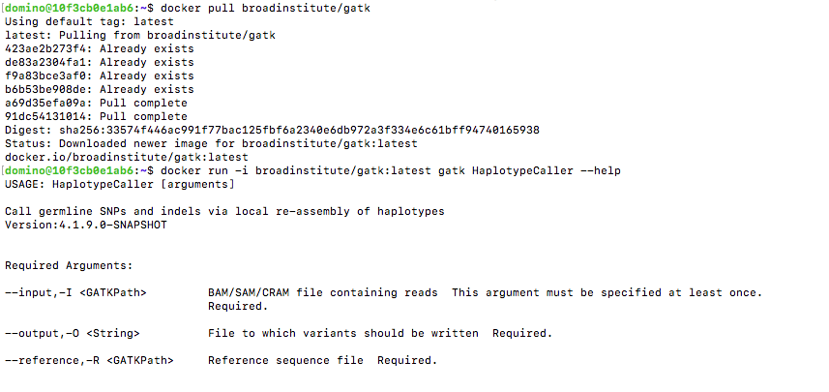
Sibling Docker Containers (advanced technique)
Rationale: Needed functionality is not installed/available in container you are currently running, can’t be added easily/quickly. BUT such functionality exists already in another Docker image (e.g. from Docker Hub or public GitHub) → use this inside your currently running container.
Sibling Docker container support allows you to run docker commands inside your running container (‘docker images’, ‘docker pull’, ‘docker ps –a’, ‘docker info’, ‘docker run’, etc.)
The commands actually go against the Docker in the host machine of your running container (thus any containers you start this way are “siblings” of your currently running container).
Download needed image (here GATK)
Example (inside running container):
Execute command using the image (here HaplotypeCaller)

Slide 47
Old, scraps

Slide 48
Video Demo of Locker
Get/See video here:
https://tbio-prd.rdcloud.bms.com/locker/LockerVideoDemoOct_24_2020.mov

Slide 49
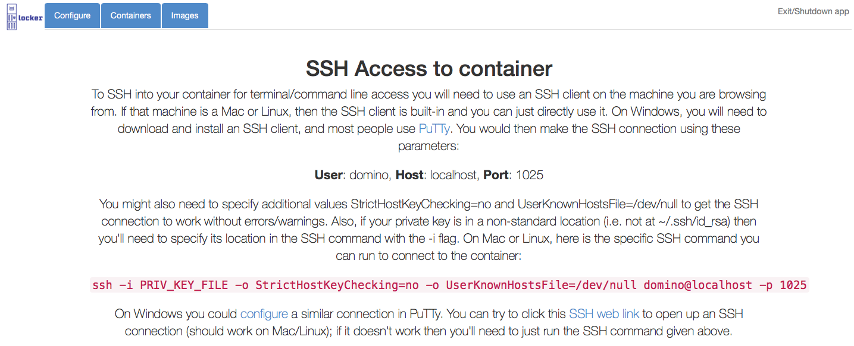
SSH Access to container page
Gives instructions to use SSH client to login to container

Slide 50
Where to Safely Store Data inside Running Containers
After container exits, any modified files are lost unless they were in persistent locations
Some directories inside containers are either network mounted or “bind mounted” from the host machine (user choice), so any content inside them persists after container exit:
/repos – cloned BioGit repositories (bind mounting only)
/stash
/home/domino/<USERNAME> (network mounting only)
/host_root ← catchall for the root directory of the host machine
So safe to store and modify data inside the above 4 paths
Note: for ”bind mounting” from host, safety of data assumes you backup the host (e.g. your Mac or Windows laptop)
Next slide delineates the locations outside the container for the above in-container paths

Slide 51
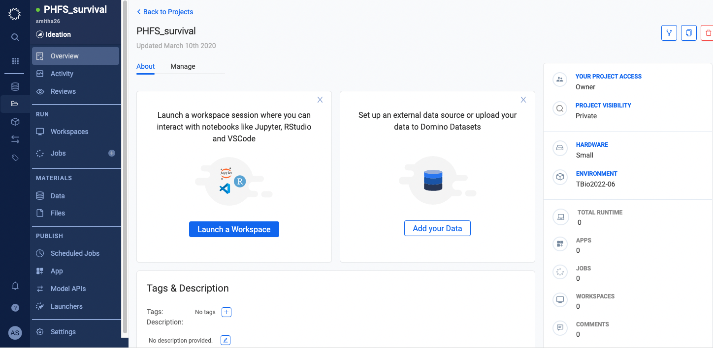
Overview of Domino
Genomics Integration Group creates Docker images used by TBio Analysts
R, many R packages, RStudio, SSH, Python, Jupyter, JupyterLab, VScode, etc.
Supports reproducible research (archive images, can easily re-run with them later)
Domino provides a solution to run our Docker images in the AWS cloud.
We define and build the software environments (images)
Domino provides a web UI and the cloud EC2 computers on which to run our images
For most analysts, basically a way to run and use RStudio and associated R packages in the cloud.
This is the Docker Image used in this project (Domino calls “Environment”)

Slide 52
Domino Limitations
Startup time can be slow
EC2 startup times can be slow, if new machine must be started (many minutes)
Docker image pull times can be slow, depending upon image size.
Lack of Control: must ask Domino Support or BMS admin
No permissions to set docker run container flags
Domino is a qualified application used by other BMS groups
Domino provides only email support: support@dominodatalab.com (but hours not days to reply)
You are not logged in with your BMS UNIX account (you are the ‘domino’ user): SSH must be used extensively
Domino is a separate, private company, supporting multiple customers and use cases
Backup plan if they can’t support us effectively, discontinue or go out of business?
Can only run on EC2s started by Domino; cannot run on your Win/Mac or cloud workstation → Locker can fill complementary “niche”
Must be connected to the internet and BMS network (cannot use when you are offline)
All needed functionality must be in a single Docker image (can’t use custom functionality available in additional Docker images)

Slide 53
Domino Limitations (cont)
Increasing restrictions and limitations on use, driven by BMS cost-savings goals
Workspaces automatically stopped after 2 days of inactivity
Workspaces deleted after 2 weeks of inactivity; potential to lose your work if not careful!!
Also cases of lost work even without having workspaces deleted (frozen workspaces that couldn’t be recovered, very frustrating).
Limited machine types available (e.g., max 300 GB memory, max of 80 CPUs)
Domino environment size limitations have previously required most content (R and Python packages, etc.) to be stored and accessed over a slow network drive, slowing down your analysis
- Recently we have been able to use large self contained images, but they can be slow to start
No direct SSH access to workspaces (must use limited built-in Rstudio, Jupyter, Jupyterlab, or VScode terminals)
Many users have complained Domino can be very slow and sluggish, and look for alternatives

Slide 54
Locker is an Attempt to Address Domino’s Limitations (cont)
Your Locker workspaces will never be automatically stopped or deleted
But cost savings are important and we do ask users to be mindful and not unnecessarily waste compute resources.
Terminate EC2 servers started for Locker when no longer needed; Stop when not using
Shutdown your cloud workstation when not in use
We may periodically remind Locker users about their running workspaces and ask them to shut them down if no longer needed (but never automatically stop or delete).
No limitations on machine types you can use for Locker (any type available in BMS’s network)
E.g., one user needed a terabyte of memory to execute their analysis and Domino could not meet this requirement (max 300 GB memory); the user successfully completed the analysis using Locker on a terabyte server
We make available special fully-contained versions of our Docker images
All content (R packages, Python modules, etc.) directly contained within image
No slow network file system access required → Better performance
Initial one-time pull of the image required, but fast startup once pulled

Slide 55
Acknowledgements
Acknowledgements
Mark Russo
Scott Chasalow
Jyotsna Pagidala
Reproducible Research Team
All the early Locker adopters and users

Slide 57
Current Status
start_locker scripts available to download: https://tbio-prd.rdcloud.bms.com/locker/
Locker Services available at https://tbio-prd.rdcloud.bms.com/cgi-bin/domrep/locker/locker.cgi
Or find link at purr.pri.bms.com
Please feel free to download and use it
Happy to meet and help you get started
Please let us know if you have questions, feedback, or suggestions for new features

