Slide 1
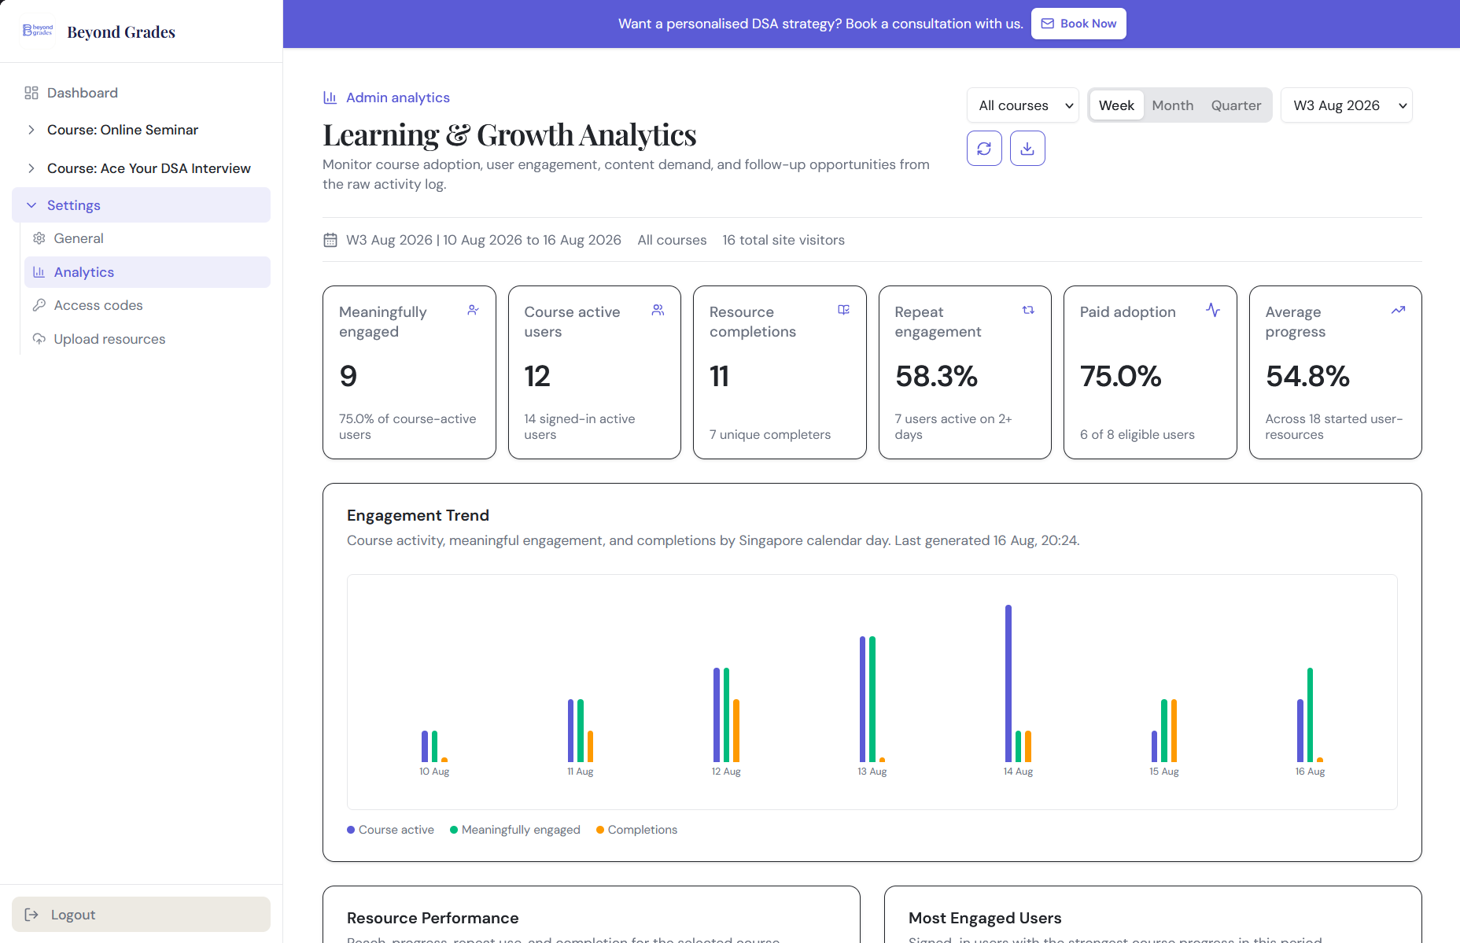
DASHBOARD INTRODUCTION AND METRIC GUIDE
BeyondGrades
Learning & Growth
Analytics
A component-by-component guide to what the dashboard shows, how each measure works, and how to interpret it.
Prepared for management review
Prepared by Yap Shen
16 August 2026

Slide 2
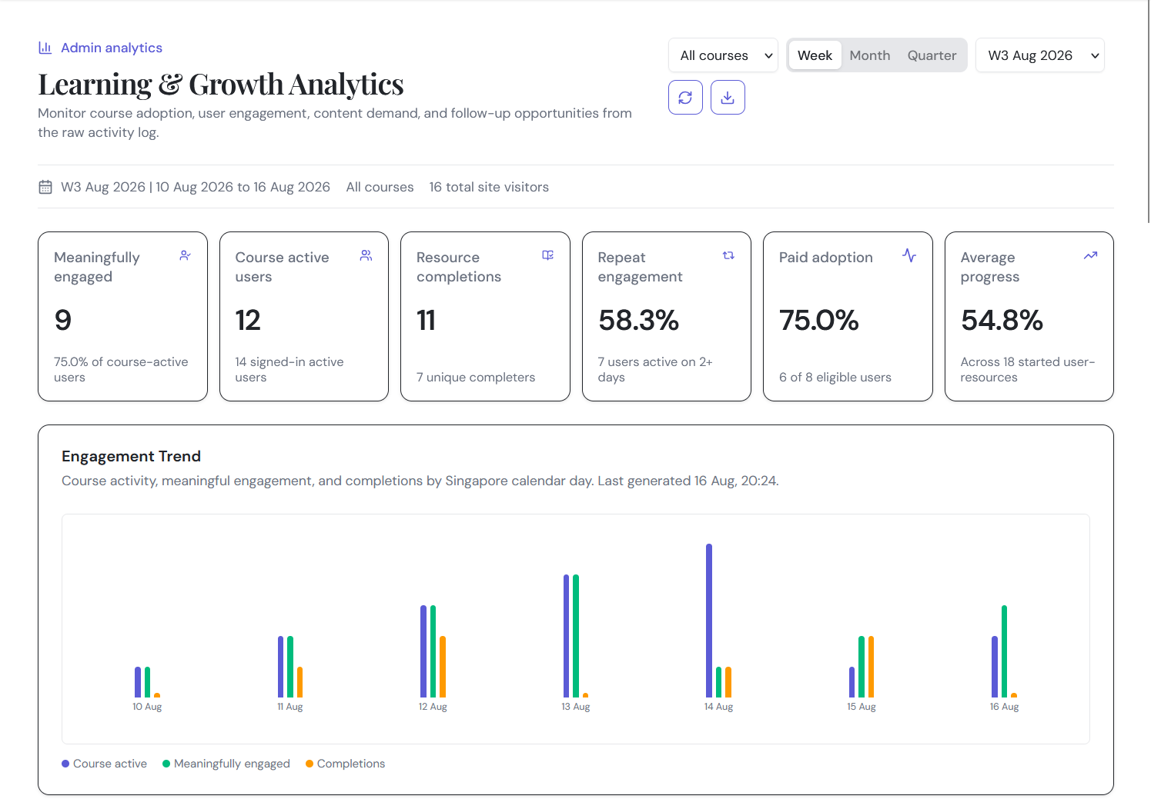
DASHBOARD OVERVIEW
2
What the dashboard is designed to answer
The dashboard separates traffic, account activity, course engagement, progress, and business follow-up so one number is not asked to represent every outcome.
WHAT IT SHOWS
- Who visited and whether they signed in.
- Who reached and meaningfully used course content.
- Which resources attract, retain, and progress users.
- Where paid adoption or follow-up opportunities exist.
HOW IT WORKS
- Raw events and progress history are filtered to one Singapore calendar period.
- Internal and test accounts on the ignored list are removed before rollups.
- The selected course is applied before course-specific metrics are calculated.
CALCULATION
The measurement ladder is: site visitor -> signed-in active -> course active -> meaningfully engaged -> resource completer. Each level answers a different question.
MANAGEMENT TAKEAWAY
Use the layers together. Engagement and completion are behavioral evidence, not proof of learning impact.
BeyondGrades Learning & Growth Analytics
All periods use Asia/Singapore time

Slide 3
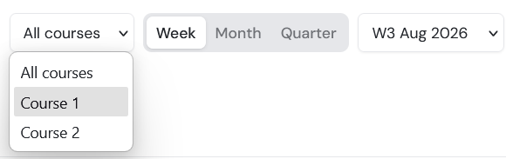
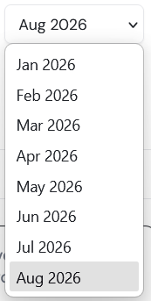
CONTROLS
3
Course and reporting-period filters
These controls determine which course activity and which Singapore calendar period are used throughout the dashboard.
WHAT IT SHOWS
- All Courses or one individual course.
- Week, Month, or Quarter reporting mode.
- A chronological period list from the earliest available data to the current period.
HOW IT WORKS
- Weeks run Monday to Monday and use labels such as W3 Aug 2026.
- Months run first day to first day; quarters begin in Jan, Apr, Jul, or Oct.
- The current period is partial and ends when the report is generated.
CALCULATION
Completed periods use occurred_at >= period_start and occurred_at < period_end. All boundaries are calculated in Asia/Singapore.
MANAGEMENT TAKEAWAY
Set the filters before reading or exporting results; course KPIs change with the selection.
BeyondGrades Learning & Growth Analytics
All periods use Asia/Singapore time

Slide 4
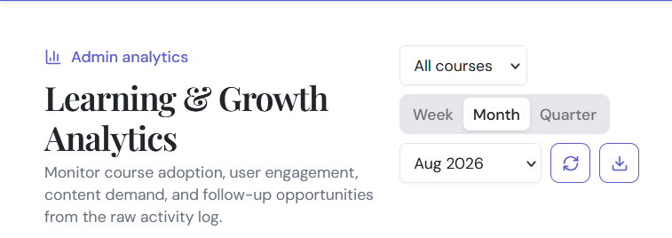
CONTROLS
4
Refresh and CSV export
The action buttons update the selected dashboard view or export its most decision-relevant tables for further analysis.
WHAT IT SHOWS
- Refresh reruns the analytics request for the current filters.
- The refresh icon spins while updated data is loading.
- Download creates a CSV from the currently loaded selection.
HOW IT WORKS
- CSV sections include KPIs, resource performance, top users, and funnel rows.
- The export does not currently include every diagnostic or follow-up panel.
- Refreshing does not change metric definitions; it only retrieves current data.
CALCULATION
No separate calculation is introduced. Exported values reuse the period, course, exclusions, and formulas already applied to the displayed summary.
MANAGEMENT TAKEAWAY
Use CSV when the selected view needs to be archived, compared, or worked on outside the portal.
BeyondGrades Learning & Growth Analytics
All periods use Asia/Singapore time

Slide 5
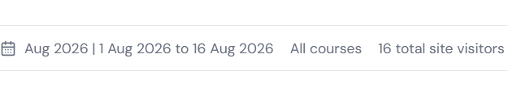
CONTEXT
5
Reporting context and total site visitors
The strip confirms the exact reporting window, selected course, and broad site traffic before the reader reaches the course KPIs.
WHAT IT SHOWS
- Full period label and displayed date range.
- All Courses or the selected course name.
- Total site visitors during the period.
HOW IT WORKS
- Site visitors are based on raw events, not registrations or progress alone.
- A signed-in event uses internal user ID; otherwise it uses anonymous browser ID.
- Pre-login and post-login identities are not retrospectively stitched.
CALCULATION
Total site visitors = count of distinct event actors in the selected period. One person can still be duplicated across browsers or identity states.
MANAGEMENT TAKEAWAY
Treat this as traffic context. Signed-in course metrics are more reliable for learning-content use.
BeyondGrades Learning & Growth Analytics
All periods use Asia/Singapore time

Slide 6
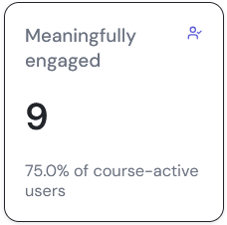
EXECUTIVE KPI 1 OF 6
6
Meaningfully engaged
The primary engagement KPI counts signed-in course users who did more than a likely accidental preview during the selected period.
WHAT IT SHOWS
- A unique-user count as the main value.
- The percentage of course-active users as supporting detail.
- One combined classification across several valid engagement behaviors.
HOW IT WORKS
- A user qualifies by meeting any one threshold: two resources, three visible minutes, 25% progress, completion, or download.
- Visible-time increments are capped at 120,000 ms before summing.
- Only signed-in, selected-course activity is included.
CALCULATION
Meaningful engagement rate = meaningfully engaged users / course-active users x 100. It is 0% when no course-active users exist.
MANAGEMENT TAKEAWAY
This is a versioned behavioral definition. The thresholds are product hypotheses, not proof of learning.
BeyondGrades Learning & Growth Analytics
All periods use Asia/Singapore time

Slide 7
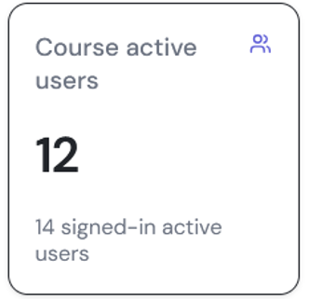
EXECUTIVE KPI 2 OF 6
7
Course active users
This KPI measures signed-in reach into the selected course, regardless of whether the activity was deep or brief.
WHAT IT SHOWS
- Distinct course-active users as the main value.
- Signed-in active users as contextual detail.
- A direct bridge between general account activity and course use.
HOW IT WORKS
- Qualifying signals include a course page, course resource event, visible resource time, download, or non-reset progress event.
- The course filter is applied before users are deduplicated.
- One shallow preview is sufficient, so this is a reach measure.
CALCULATION
Course active users = distinct signed-in user IDs with at least one selected-course signal in the period. Funnel rate = course active / signed-in active.
MANAGEMENT TAKEAWAY
Compare this with Meaningfully engaged to see how much course reach becomes substantive use.
BeyondGrades Learning & Growth Analytics
All periods use Asia/Singapore time

Slide 8
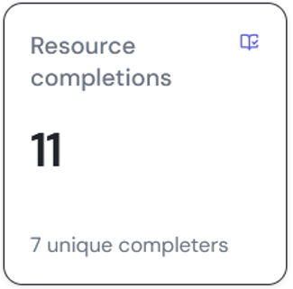
EXECUTIVE KPI 3 OF 6
8
Resource completions
This card separates the number of completed learner-resource relationships from the number of people who completed something.
WHAT IT SHOWS
- Unique completed user-resource pairs as the main value.
- Distinct users with at least one completion as the detail.
- Completion transitions from progress history, scoped to the period.
HOW IT WORKS
- A completion requires a completed progress event.
- Repeated completion events for the same user and resource count once in the period KPI.
- Daily trend completions remain event counts on the day they occurred.
CALCULATION
Resource completions = count(distinct user_id, resource_id) with completed event. Unique completers = count(distinct user_id) among those pairs.
MANAGEMENT TAKEAWAY
Read both figures: one person may complete several resources.
BeyondGrades Learning & Growth Analytics
All periods use Asia/Singapore time

Slide 9
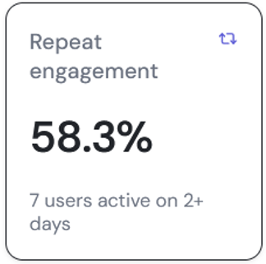
EXECUTIVE KPI 4 OF 6
9
Repeat engagement
This KPI shows whether course-active users returned on more than one Singapore calendar date inside the selected period.
WHAT IT SHOWS
- Repeat engagement rate as the main value.
- Number of users active on two or more days as the detail.
- Return frequency within the selected week, month, or quarter.
HOW IT WORKS
- Course activity dates are deduplicated in Asia/Singapore.
- A user must be course active on at least two distinct dates.
- This is within-period repetition, not later-period cohort retention.
CALCULATION
Repeat engagement rate = repeat users / course-active users x 100. It is 0% when no course-active users exist.
MANAGEMENT TAKEAWAY
Use this to identify repeat use, but do not label it retention without a first-use cohort.
BeyondGrades Learning & Growth Analytics
All periods use Asia/Singapore time

Slide 10
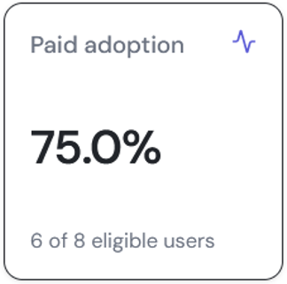
EXECUTIVE KPI 5 OF 6
10
Paid adoption
This card measures whether users entitled to paid content actually became active in an eligible paid course during the period.
WHAT IT SHOWS
- Paid adoption percentage as the main value.
- Activated and eligible user counts as supporting detail.
- A no-eligible-users message when the denominator is empty.
HOW IT WORKS
- Eligibility requires a non-free entitlement overlapping the period.
- Activation requires course activity in a paid course for which the user is eligible.
- All Courses uses the union of eligible users across paid courses.
CALCULATION
Paid adoption rate = paid activated users / paid eligible users x 100. It is 0% when no eligible users exist.
MANAGEMENT TAKEAWAY
This reveals access that is being used, not merely granted.
BeyondGrades Learning & Growth Analytics
All periods use Asia/Singapore time

Slide 11
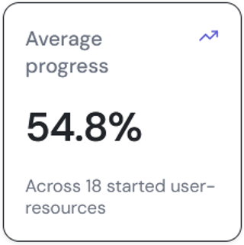
EXECUTIVE KPI 6 OF 6
11
Average progress
This card summarizes the observed progress of resource starts without allowing repeated updates for one resource to dominate the average.
WHAT IT SHOWS
- Average maximum progress as the main percentage.
- Number of started user-resource pairs as context.
- Progress from the selected course and period only.
HOW IT WORKS
- First take the highest progress recorded for each signed-in user-resource pair.
- Keep values above zero, representing started resources.
- Then calculate the arithmetic mean across those pairs.
CALCULATION
Average progress = sum(max progress per started user-resource pair) / number of started user-resource pairs.
MANAGEMENT TAKEAWAY
Always read the average with its sample size; median progress is available in supporting API/resource data.
BeyondGrades Learning & Growth Analytics
All periods use Asia/Singapore time

Slide 12
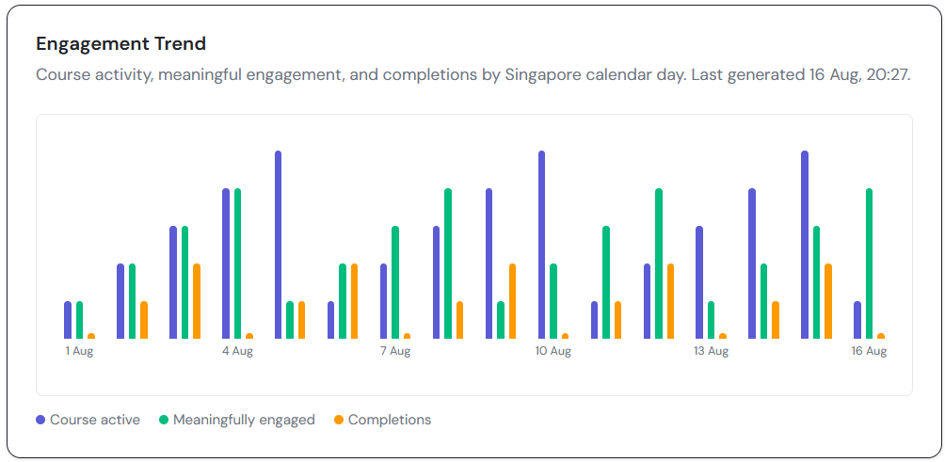
TREND ANALYSIS
12
Engagement Trend
The grouped bar chart shows how course reach, meaningful engagement, and completions vary by Singapore calendar date.
WHAT IT SHOWS
- Indigo: course-active users.
- Green: meaningfully engaged users.
- Amber: completion-transition events.
- Hover values and the report generation time.
HOW IT WORKS
- Each date is recalculated independently from that day's signals.
- A user can qualify across the whole period without qualifying on every day.
- For periods over 45 days, every third daily point is shown for readability; values are not combined.
CALCULATION
Daily user series are distinct users for that date. Daily completions count transition events, unlike the period KPI that deduplicates user-resource pairs.
MANAGEMENT TAKEAWAY
Use the chart to locate timing patterns, then investigate causes rather than assuming them.
BeyondGrades Learning & Growth Analytics
All periods use Asia/Singapore time

Slide 13
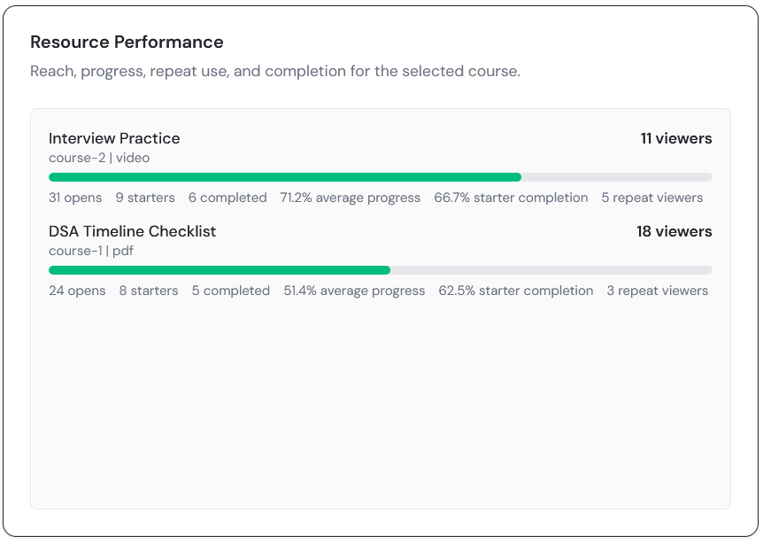
CONTENT ANALYSIS
13
Resource Performance
This scrollable ranking separates content reach, reuse, progress, and completion instead of relying on raw views alone.
WHAT IT SHOWS
- Title, course/type, viewers, progress bar, opens, starters, completions, completion rate, and repeat viewers.
- Up to 20 resources in the selected course scope.
- Average progress represented by the green bar.
HOW IT WORKS
- Opens count resource_view events; viewers deduplicate signed-in or anonymous actors.
- Repeat viewers are signed-in users with at least two opens.
- Resources sort by viewers, then starters, opens, and completed users.
CALCULATION
Starter completion rate = completed users / starter users x 100. Average progress uses each starter pair's maximum observed progress.
MANAGEMENT TAKEAWAY
Use this panel to distinguish discoverability problems from progress or completion problems.
BeyondGrades Learning & Growth Analytics
All periods use Asia/Singapore time

Slide 14
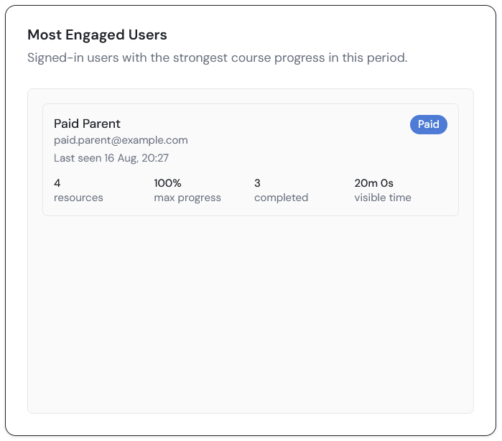
USER ANALYSIS
14
Most Engaged Users
This admin-only list identifies signed-in users showing the strongest course progress during the selected period.
WHAT IT SHOWS
- Name/email, last seen time, paid badge, resources, maximum progress, completed resources, and visible time.
- Up to 10 users.
- A prioritization view for understanding behavior or supportive follow-up.
HOW IT WORKS
- Users rank lexicographically by completions, distinct resources, maximum progress, then visible time.
- Visible time sums capped resource heartbeat/session-end increments.
- The ordering is not a weighted score or assessment of ability.
CALCULATION
Each row is built from one signed-in user's selected-course signals. Maximum progress is the highest observed value across their resources.
MANAGEMENT TAKEAWAY
Use the list for context and support, never for automated high-stakes learner decisions.
BeyondGrades Learning & Growth Analytics
All periods use Asia/Singapore time

Slide 15
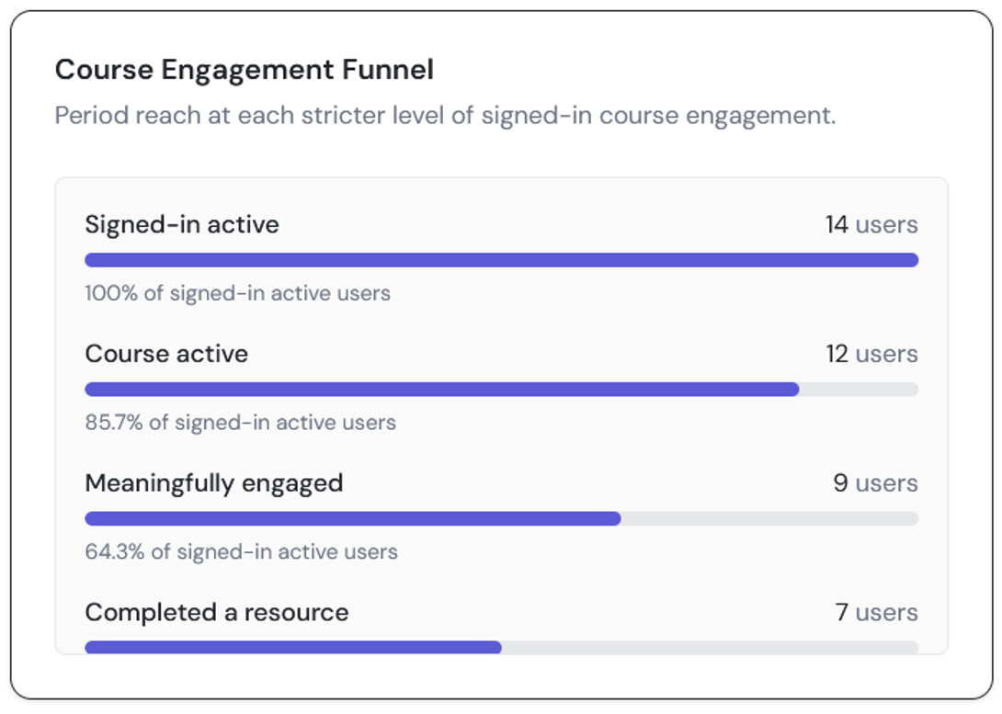
REACH ANALYSIS
15
Course Engagement Funnel
The funnel compares how many signed-in users reached increasingly substantive engagement states during the selected period.
WHAT IT SHOWS
- Signed-in active.
- Course active.
- Meaningfully engaged.
- Completed a resource.
HOW IT WORKS
- Every row shows users and a percentage of signed-in active users.
- Percentages are not calculated step-to-step.
- The display measures period reach and does not establish event order.
CALCULATION
Level percentage = users at level / signed-in active users x 100. Signed-in active is always the common denominator.
MANAGEMENT TAKEAWAY
Use this to locate the largest reach gap, not as proof of an ordered conversion journey.
BeyondGrades Learning & Growth Analytics
All periods use Asia/Singapore time

Slide 16
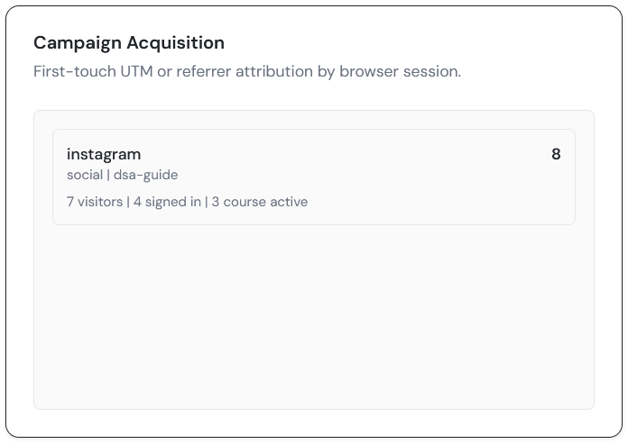
ACQUISITION
16
Campaign Acquisition
This panel connects the first page view of a browser session with later signed-in and course activity in that same session.
WHAT IT SHOWS
- Source, medium, campaign, sessions, visitors, signed-in users, and course-active users.
- Up to 10 attribution groups.
- UTM campaigns, external referrers, and Direct traffic.
HOW IT WORKS
- UTM source/medium/campaign takes priority on the first page view.
- Without UTM, the external referrer host is used; otherwise the source is Direct.
- Rows sort by course-active users and then sessions.
CALCULATION
Sessions are distinct session IDs; visitors are distinct actors; signed-in and course-active users are distinct signed-in IDs in attributed sessions.
MANAGEMENT TAKEAWAY
Attribution is directional. It does not prove causation, revenue, or completed consultation outcomes.
BeyondGrades Learning & Growth Analytics
All periods use Asia/Singapore time

Slide 17
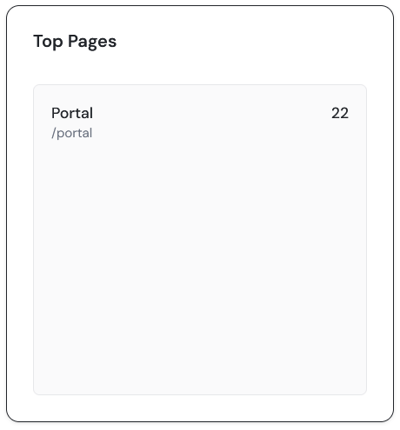
DIAGNOSTICS
17
Top Pages
This panel shows which portal routes receive the most page-view activity in the selected period.
WHAT IT SHOWS
- Friendly page label.
- Normalized route/path.
- Page-view count displayed at the right.
- Up to 10 paths.
HOW IT WORKS
- Page-view events are grouped after UTM and click-ID query parameters are removed.
- The backend also calculates unique actors for each path.
- The current card ranks and visibly displays the view total.
CALCULATION
Page views = count of page_view events for the normalized path. One visitor can contribute several views.
MANAGEMENT TAKEAWAY
Use this for traffic and navigation demand; do not describe the displayed count as users.
BeyondGrades Learning & Growth Analytics
All periods use Asia/Singapore time

Slide 18
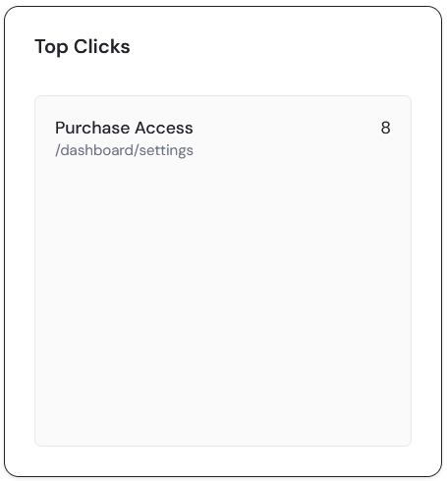
DIAGNOSTICS
18
Top Clicks
This panel identifies the interface actions most frequently clicked during the selected period.
WHAT IT SHOWS
- Resolved action label.
- Page path where the click occurred.
- Click-event count.
- Up to 10 label/path groups.
HOW IT WORKS
- Labels prefer analytics ID, accessible label, visible text, destination, then Unlabelled click.
- The same action on different paths remains separately identifiable.
- Repeated clicks from one actor remain repeated events.
CALCULATION
Clicks = count of click events grouped by resolved label and normalized page path.
MANAGEMENT TAKEAWAY
Use this to inspect interface demand or tracking quality, not unique-user engagement.
BeyondGrades Learning & Growth Analytics
All periods use Asia/Singapore time

Slide 19
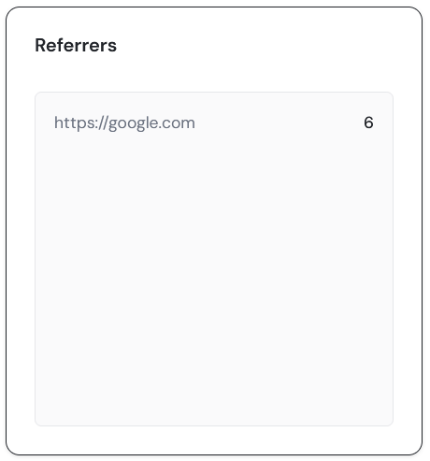
DIAGNOSTICS
19
Referrers
This panel shows external URLs that sent page-view traffic to BeyondGrades during the selected period.
WHAT IT SHOWS
- Normalized external source URL.
- Visit count for that source.
- Up to 10 referrers.
HOW IT WORKS
- Referrers are taken from page-view events.
- External URLs are normalized to HTTPS before grouping.
- Same-site referrers are excluded.
CALCULATION
Referrer visits = count of qualifying page-view events grouped by normalized external source URL.
MANAGEMENT TAKEAWAY
Use this as a traffic diagnostic; campaign attribution provides the richer session-level view.
BeyondGrades Learning & Growth Analytics
All periods use Asia/Singapore time

Slide 20
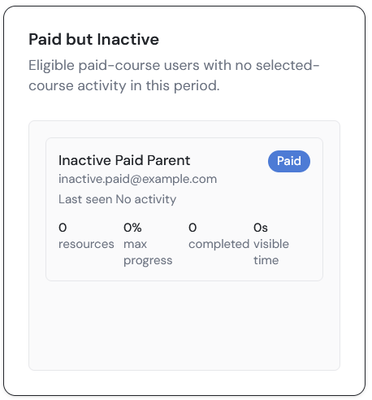
FOLLOW-UP
20
Paid but Inactive
This admin-only queue highlights paid-course users who had eligible access but no qualifying activity in the selected scope.
WHAT IT SHOWS
- User identity and last activity context.
- Paid badge and user metrics where available.
- Up to 20 eligible inactive users.
HOW IT WORKS
- The entitlement must overlap the reporting period.
- The user must not be active in an eligible selected paid course.
- With All Courses selected, free-course-only activity does not remove the user.
CALCULATION
Paid but inactive = paid eligible users minus paid activated users, excluding admins and ignored users.
MANAGEMENT TAKEAWAY
Use for considerate support or access checks, not automatic negative judgments about a learner.
BeyondGrades Learning & Growth Analytics
All periods use Asia/Singapore time

Slide 21
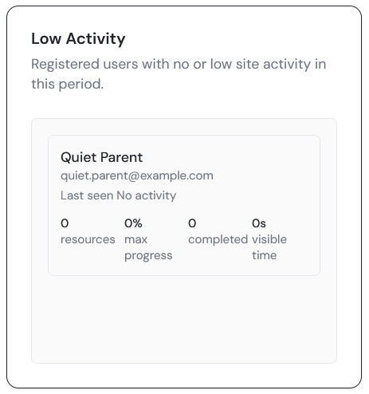
FOLLOW-UP
21
Low Activity
This queue surfaces registered users with no tracked activity first, then signed-in users with site activity but no course activity.
WHAT IT SHOWS
- Name/email, last seen, paid status, and available activity metrics.
- A maximum of 10 users.
- Users most likely to need onboarding or technical follow-up.
HOW IT WORKS
- Non-admin registered users with no raw event or non-reset progress event are selected first.
- Remaining spaces use signed-in users with no course activity.
- The latter group is ordered from least resource, session, and event activity upward.
CALCULATION
Low Activity is a two-stage operational selection, not a KPI rate or a claim about motivation.
MANAGEMENT TAKEAWAY
Check access, onboarding, and user intent before deciding whether follow-up is appropriate.
BeyondGrades Learning & Growth Analytics
All periods use Asia/Singapore time

Slide 22
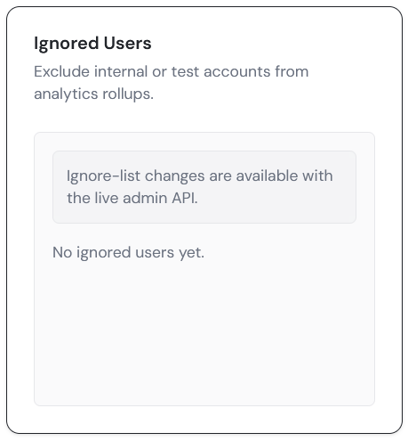
ADMINISTRATION
22
Ignored Users
This control keeps staff, internal testing, and known non-production activity from distorting dashboard results.
WHAT IT SHOWS
- Email or internal user-ID input.
- Optional reason for the exclusion.
- Current ignored list with remove controls.
HOW IT WORKS
- Adding or removing an entry invalidates and recalculates analytics rollups.
- Matches can use internal user ID, Clerk ID, or email in stored exclusions.
- The demo view explains that edits require the live admin API.
CALCULATION
Ignored users are removed from user records, raw events, progress history, KPI rollups, and follow-up queues before metrics are calculated.
MANAGEMENT TAKEAWAY
Maintain reasons and review the list periodically; exclusions have a large effect in a small user base.
BeyondGrades Learning & Growth Analytics
All periods use Asia/Singapore time

Slide 23
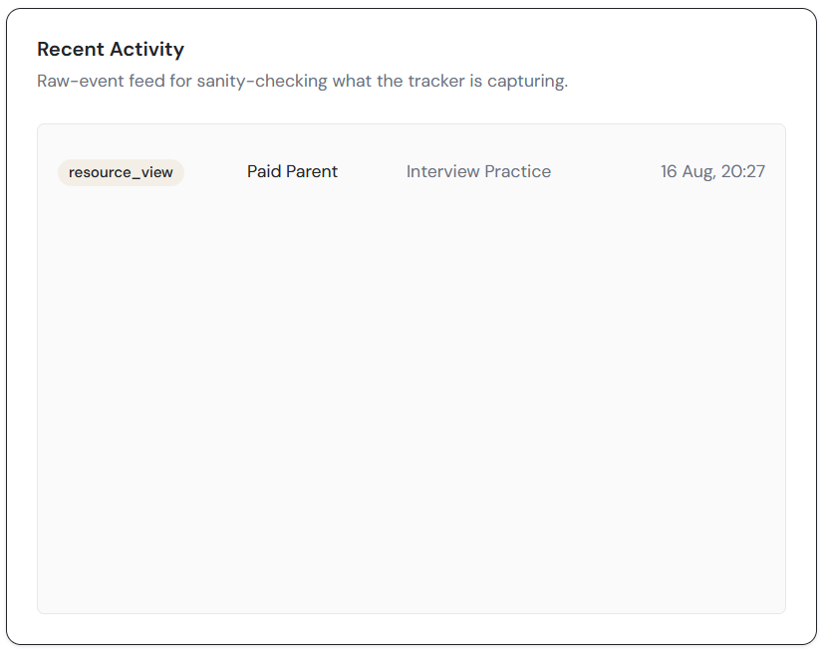
DIAGNOSTICS
23
Recent Activity
This raw-event feed lets administrators sanity-check what the tracker is recording without treating individual events as aggregate metrics.
WHAT IT SHOWS
- Event type, user/visitor label, resource or page path, and timestamp.
- Newest events first.
- The panel currently displays the latest 12 rows.
HOW IT WORKS
- The service prepares up to the latest 25 non-ignored raw events in the period.
- The website renders the first 12 of that response.
- User and resource labels are added where matching records exist.
CALCULATION
Recent Activity is ordered by occurred_at descending after period and ignored-user filtering. It is not deduplicated into users or sessions.
MANAGEMENT TAKEAWAY
Use this panel to verify instrumentation and investigate anomalies, not to measure performance by itself.
BeyondGrades Learning & Growth Analytics
All periods use Asia/Singapore time

