Slide 1
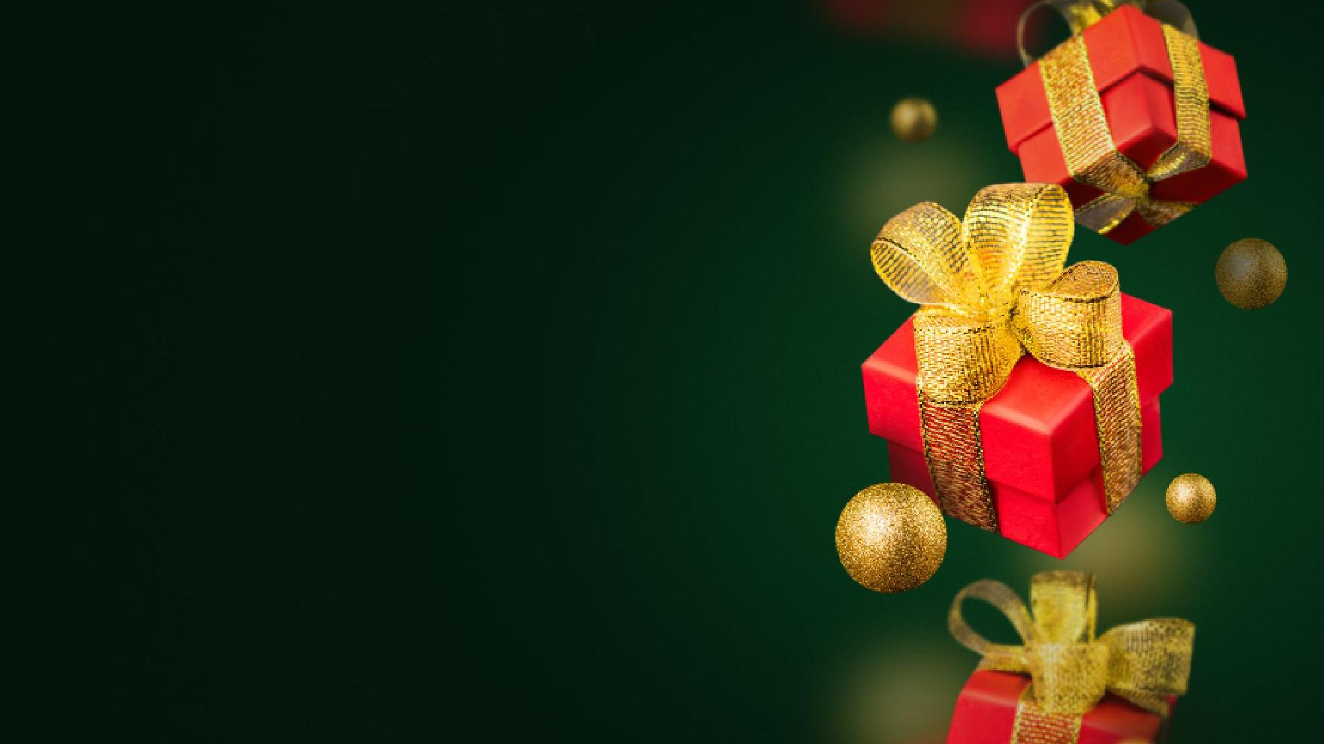
Gift deployment
The first few deliveries, done by our own team without the influencer. We get one delivery out for each brand early and settle how a delivery video should look before the bigger days.
21 – 23 Dec
Open
Deliveries run from 21 Dec into the new year, in three stages.
The days the influencer is with us. The biggest gifts and the experiences, such as a spa day or a dinner, are saved for these days, because they make the strongest videos and he brings the most viewers.
Every request goes to the brand whose product answers it best. Every brand gets its own delivery video, and an experience gets two.
24 – 31 Dec
Finale
In every video the product is in frame, the brand is tagged, and the person's thank-you to the brand is captured on camera.
The remaining gifts are delivered, and we close with one recap video that mentions every brand that took part.
From 1 Jan

Slide 2
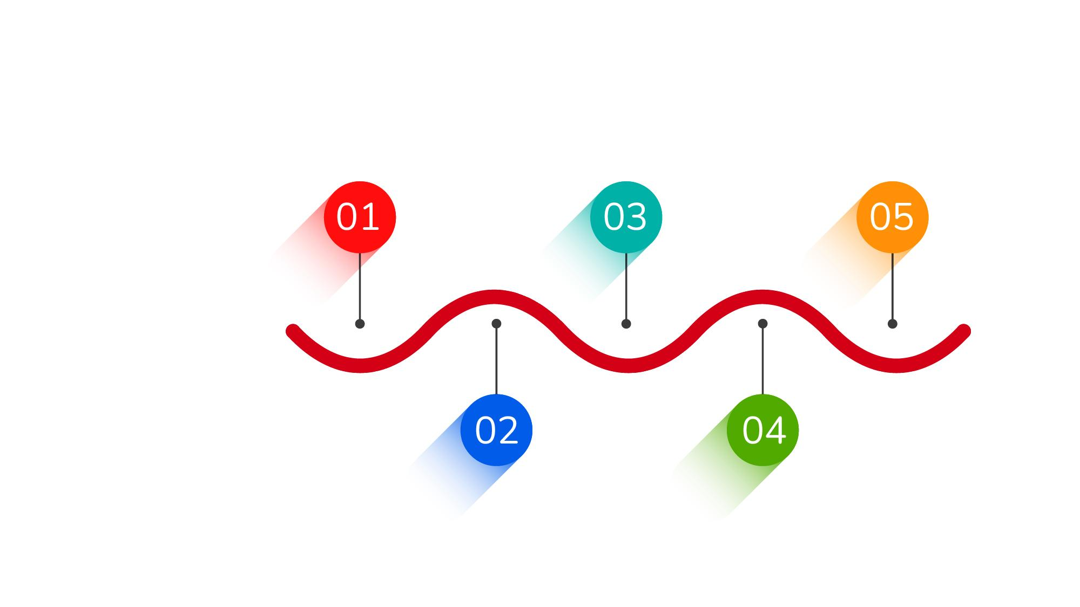
The roadmap
16 – 17 Nov
30 Nov – 18 Dec
Set up
Engage
26 Dec – mid Jan
Lock the hashtag, interviewer and locations. Pitch the first ten brands. Approach Asherkine. Set the ad budget.
Street videos go out. Online entries open. Gifts collected from brands as they sign on. Street entries close 15 Dec, online 18 Dec.
Tell
The documentary is cut and runs as ads. and public proof
Five phases, starting with two days of set-up before any camera rolls.
18 – 29 Nov
19 Dec – Jan
Announce
Finale for Gifts
First street shoot on 18 Nov. The teaser goes live on our pages.
Winners picked 19 Dec with brand managers. Deliveries from 21 Dec into the new year.

