Slide 1
Alarm Clock Timer FPGA Implementation of a VGA digital clock with timer functionality
Group 15: Feng Tai
Ziyuan Chu
Mincheol Kim

Slide 2
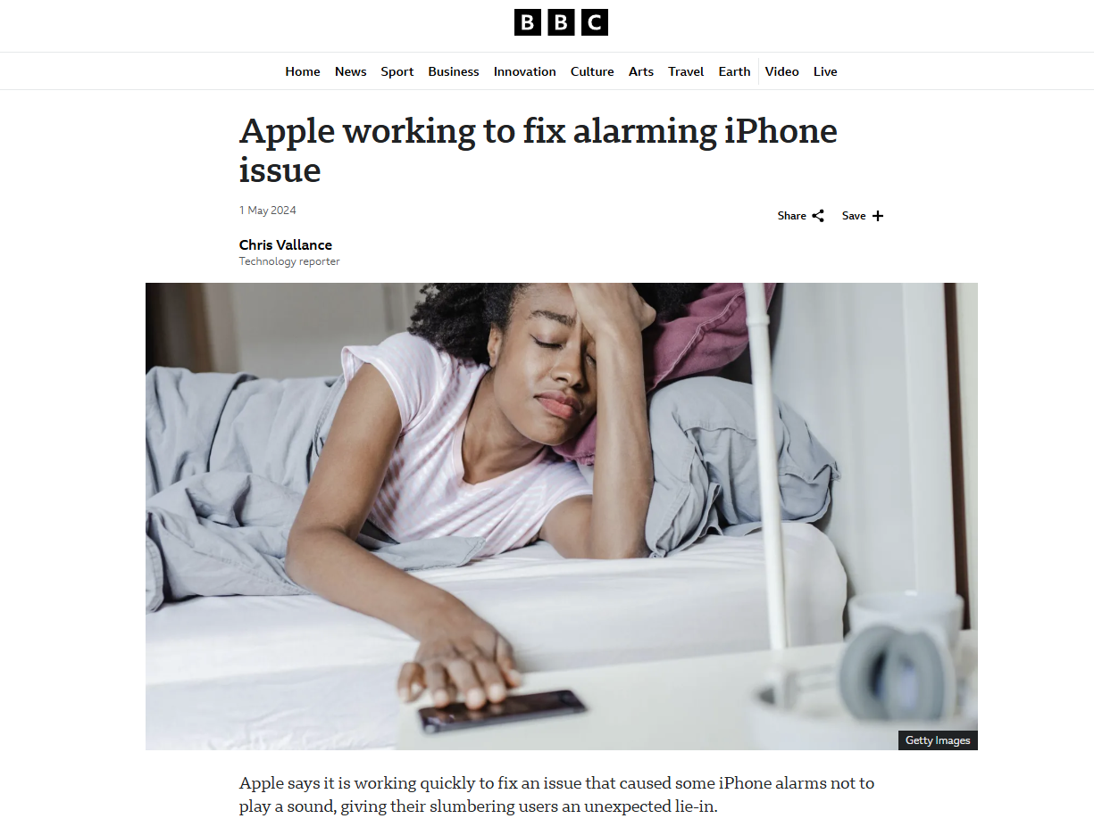
Motivation
Alarm Clocks
Scheduling
Multitasking
Stopwatch
Timing

Slide 3
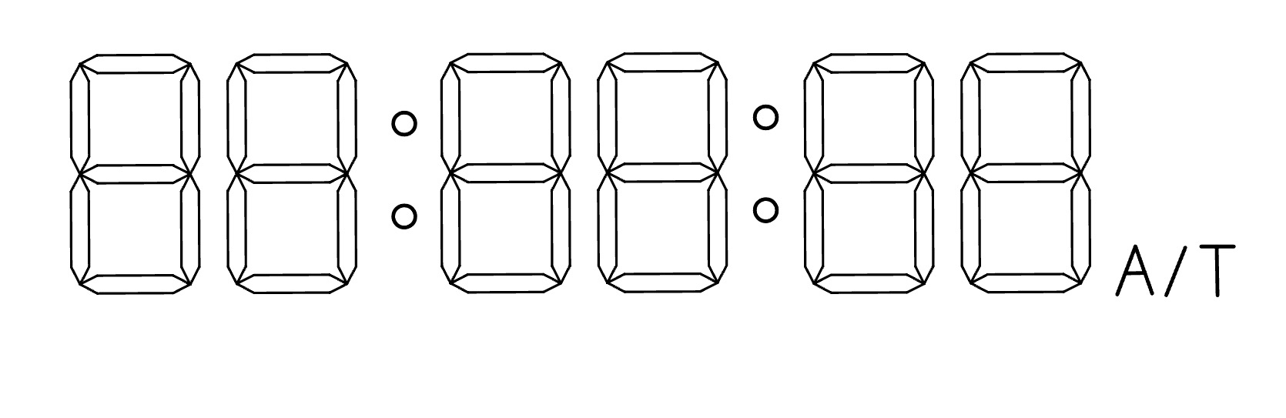
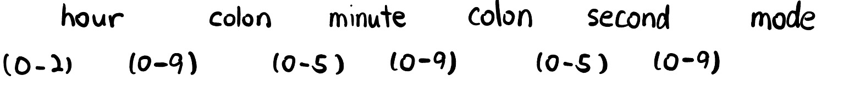
Functionality
Alarm Clock Function(A):
“hour”,”minute” and ”second” buttons to set time
Alert the user
“reset” button
Timer Function(T):
“start” button
“pause” button
“reset” button

Slide 4
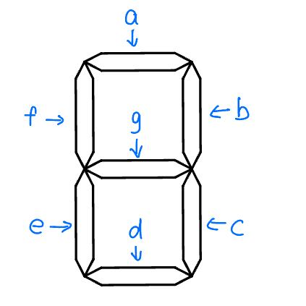
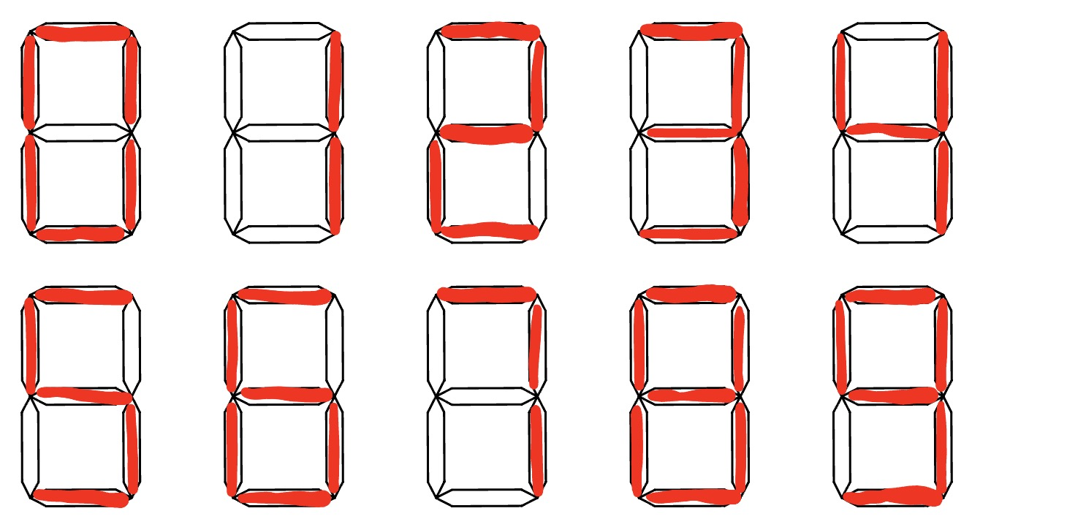
Each digit is composed of 7 segments.

Slide 5
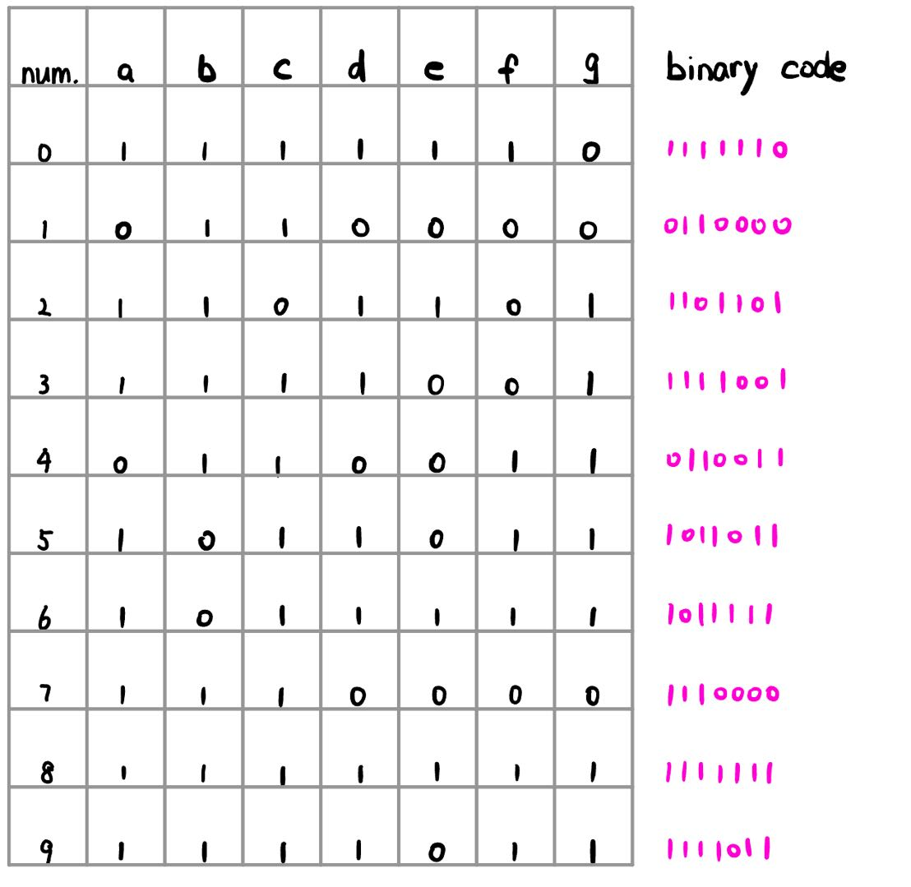
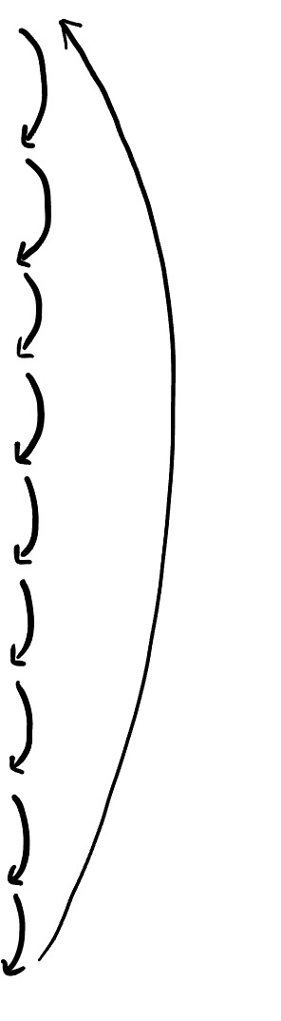
State Table!

Slide 6
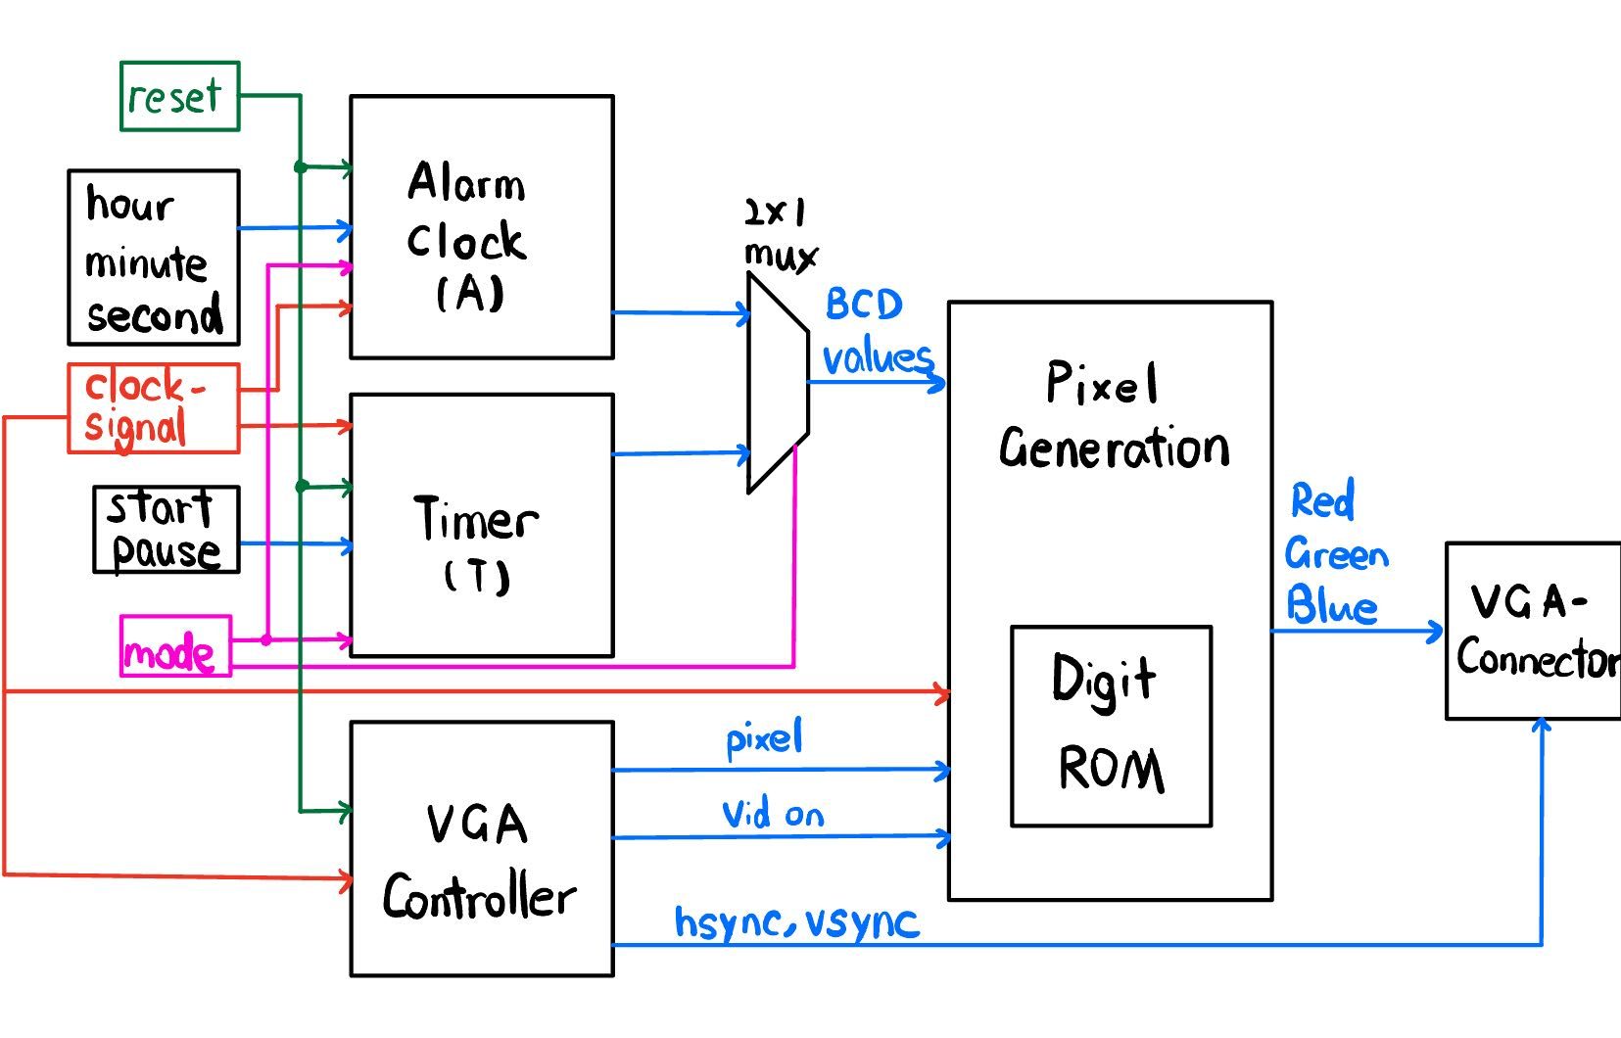
Specifications
Utilize FPGA with VGA to create visible clock
Possibly use UART to generate real time clock
MUX to control different functionalities

Slide 7
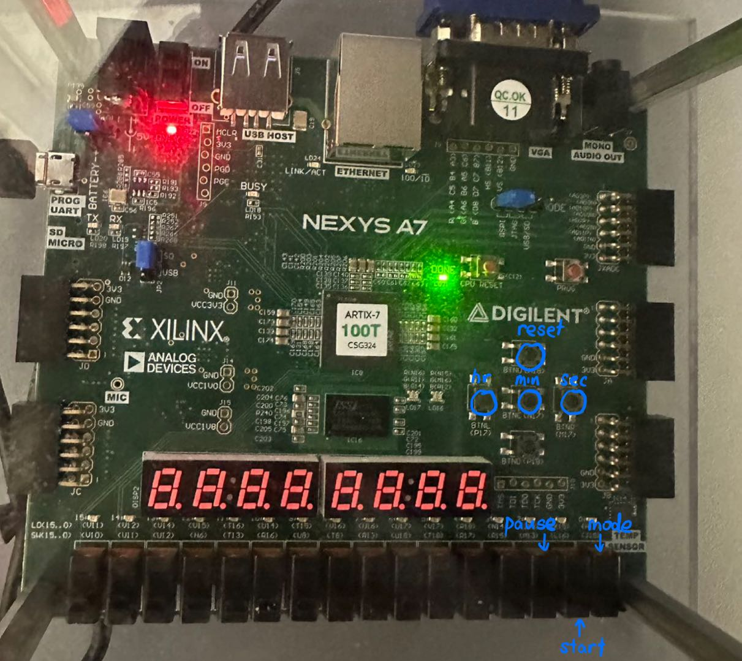

Slide 8
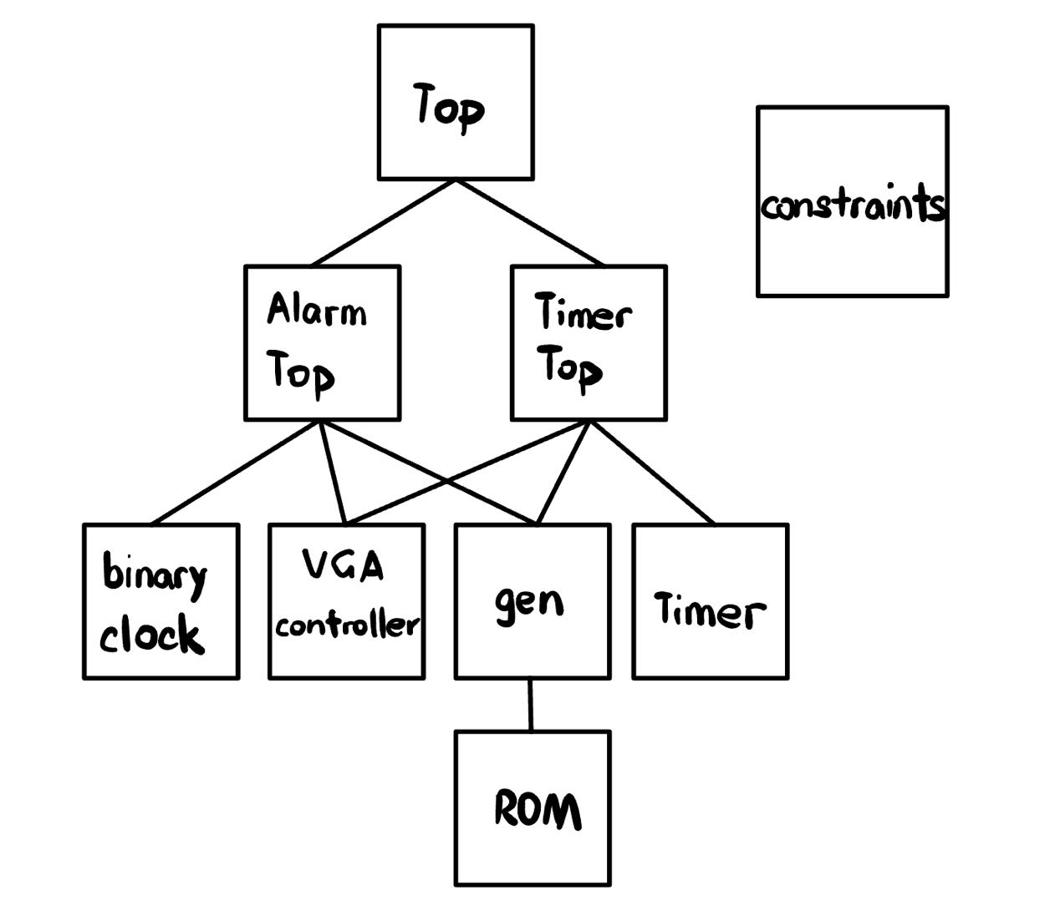
Block Diagram

Slide 9
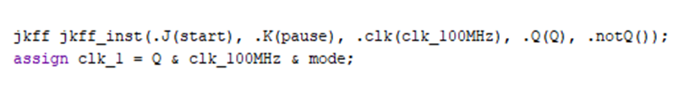
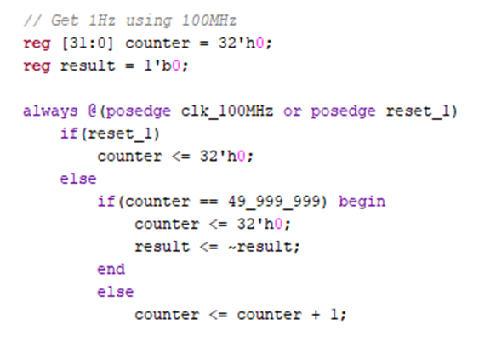
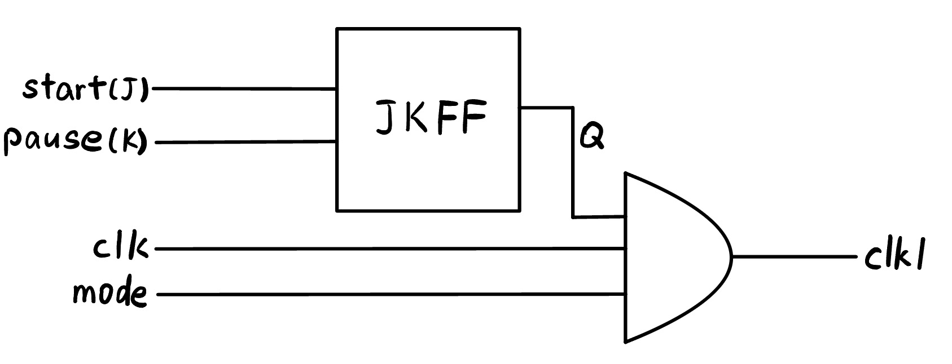
Verilog Code
JKFF
Clock divider

Slide 10
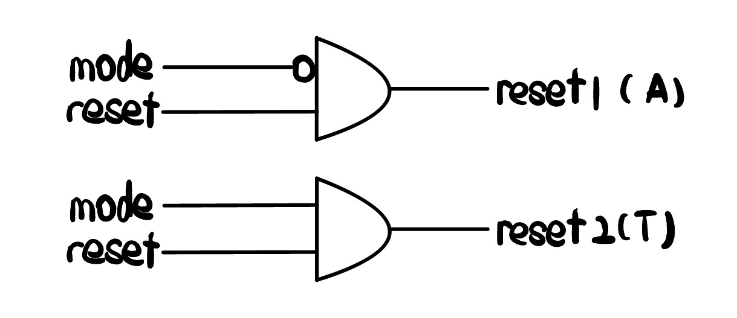
Problems we met
1 Debounce: numbers incremented multiple time with a single button click
2 VGA did not generate graphics with segments
3 Reset influenced unused mode
4 Problem with second button logic
5 Alarm clock functionality not achieved yet

Slide 11

Successes
Implement working clock with VGA
Created two different functionalities controlled by MUX
Fully functional buttons to alter time

Slide 12
Failures
Difficulty converting UART serial data into usable data
Incorporate alarm features
Incorporate date into alarm functionality

Slide 13
Reference
https://www.instructables.com/UART-Communication-on-Basys-3-FPGA-Dev-Board-Power-1/
https://www.youtube.com/watch?v=smeUN1Bxj3M&amp;list=PL4o6-0PKLFH9dmVsgrE3vUMe
HGDLBRdHJ&amp;index=2
https://www.bbc.com/news/articles/c0kl4glp547o

Slide 14
Thank you!

