Slide 1
ANN – Assignment 1

Slide 2



10000 Images
10x10=100
198x10=1980
198x10=1980
198x10=1980
198x10=1980
198x10=1980

Slide 3
Data Preprocessing
- Each image is 28x28 pixels, and each pixel has a value from 0-255
Step 1 – load the matrix with the values from 0-255 in 28x28 matrix
Step 2 – We used PIL (flatten) method to make the 2 dimensons matrix to a vector that has 784 (28x28 = 784).
Step 3 – We normlized the values of the vector so each value is from 0 to 1, by dividing 255 on the value.
Finally, We’ve got (X) which is two dimention array of 1980x784. (That means we have 1980 pictures and each picture has 784 column). And (Y) is a vector label it has value from 0 to 9.
[0.1 , 0.5, 0 , 1 , 0.2 , …]

Slide 4
ANN
Structure:
…
…
…
…
784 Neurons
Input Layer
32 Neurons
Hidden Layer
16 Neurons
Hidden Layer
10 Neurons
Output Layer

Slide 5
Initiating
-Input Layer
Weight Dimenstion matrix of 784x32
Bias Dimenstion matrix of 1x32
-Hidden Layer 1
Weight Dimenstion matrix of 32x16
Bias Dimenstion matrix of 1x16
-Hidden Layer 2
Weight Dimenstion matrix of 16x10
Bias Dimenstion matrix of 1x10
Weight Values
Weight = Learing rate * Random value
Random value is Standard Normal Description:
68% fall in –1 to 1
95% fall in –2 to 2
99.7% fall in –3 to 3
- Bias Values
Started with zeros, but when training data, it changes.

Slide 6
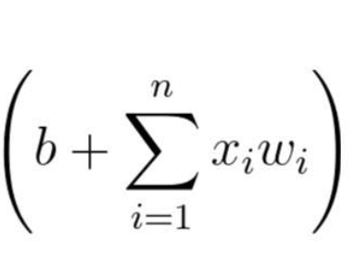
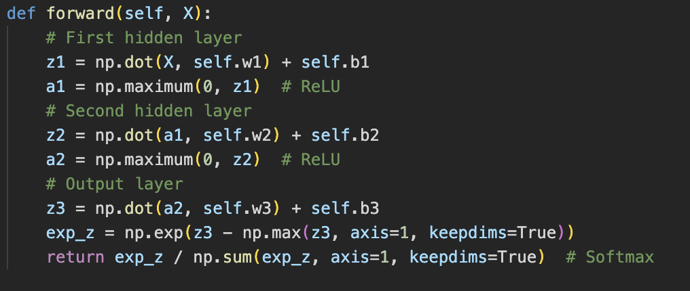
Forwarding
Make negetive values to 0 and keep positive values, nonlinear activation function.
Softmax Next Slide

Slide 7
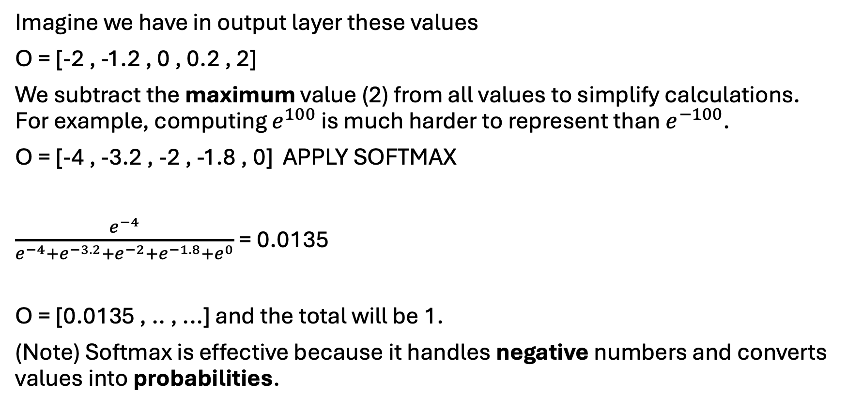
Softmax
Imagine we have in output layer these values
O = [-2 , -1.2 , 0 , 0.2 , 2]
We subtract the maximum value (2) from all values to simplify calculations. For example, computing $e^{100}$ is much harder to represent than $e^{−100}$.
O = [-4 , -3.2 , -2 , -1.8 , 0] APPLY SOFTMAX
$\frac{e^{−4}}{e^{−4}+e^{−3.2}+e^{−2}+e^{−1.8}+e^{0}}$ = 0.0135
O = [0.0135 , .. , ...] and the total will be 1.
(Note) Softmax is effective because it handles negative numbers and converts values into probabilities.

Slide 8
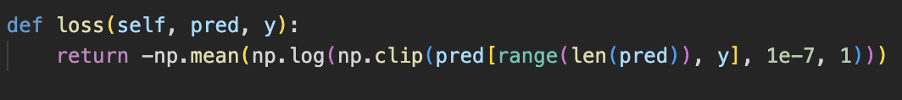
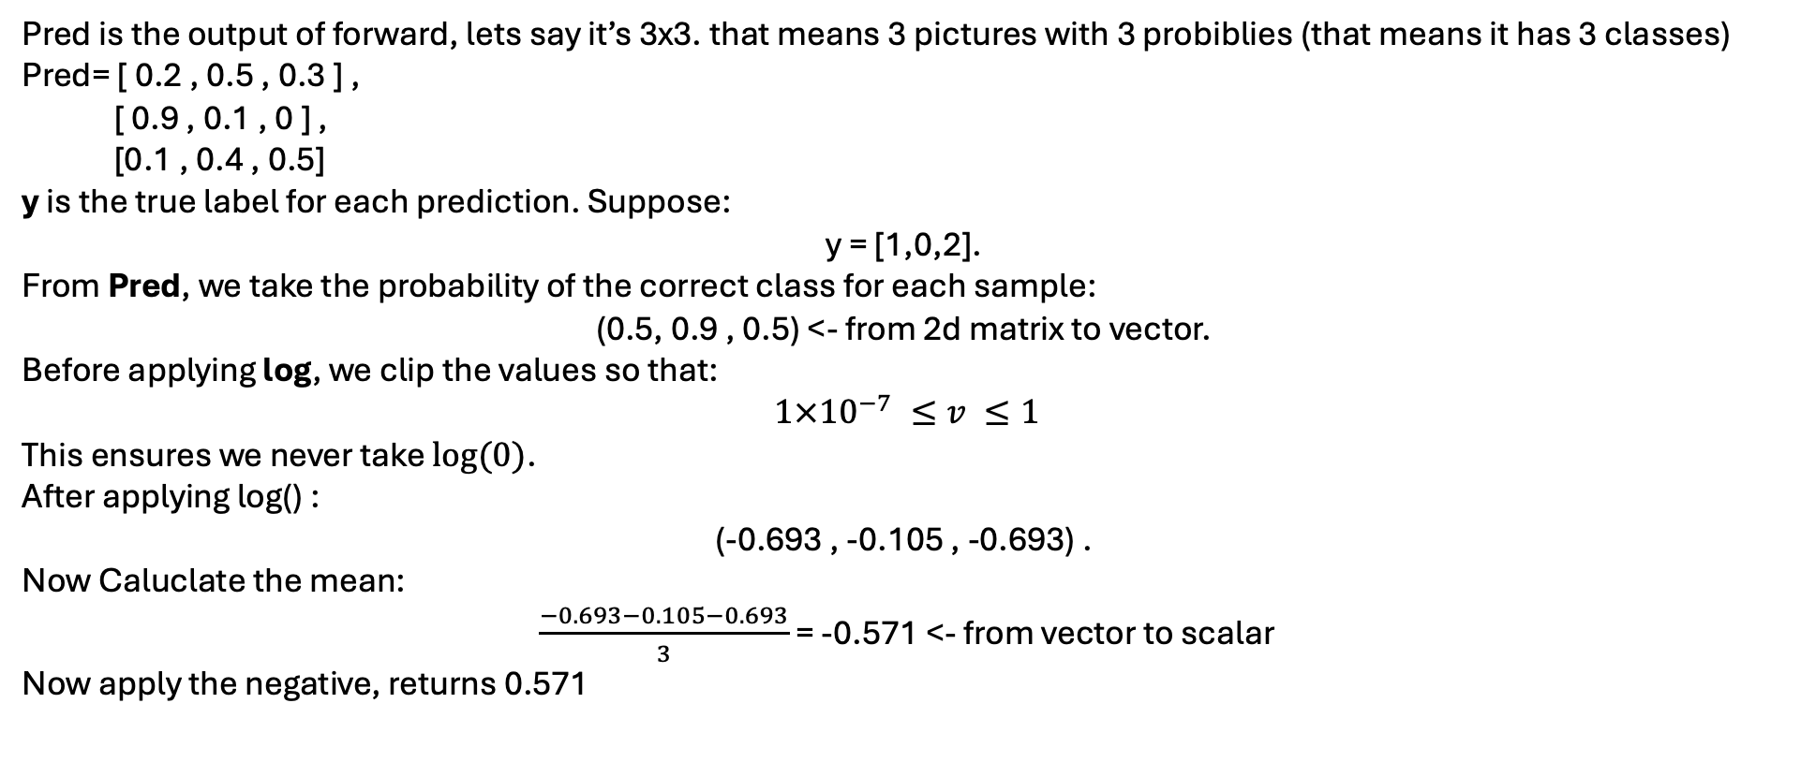
Categorical cross-entropy loss
Pred is the output of forward, lets say it’s 3x3. that means 3 pictures with 3 probiblies (that means it has 3 classes)
Pred= [ 0.2 , 0.5 , 0.3 ] ,
[ 0.9 , 0.1 , 0 ] ,
[0.1 , 0.4 , 0.5]
y is the true label for each prediction. Suppose:
y = [1,0,2].
From Pred, we take the probability of the correct class for each sample:
(0.5, 0.9 , 0.5) <- from 2d matrix to vector.
Before applying log, we clip the values so that:
$1×{10}^{−7} ≤v ≤1$
This ensures we never take $\log{(0)}$.
After applying log() :
(-0.693 , -0.105 , -0.693) .
Now Caluclate the mean:
$\frac{−0.693−0.105−0.693}{3}$ = -0.571 <- from vector to scalar
Now apply the negative, returns 0.571

Slide 9
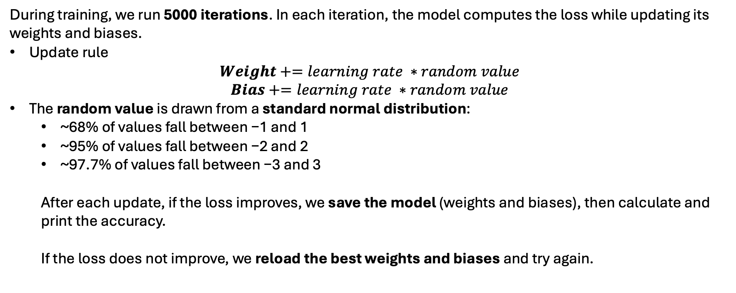
Training
During training, we run 5000 iterations. In each iteration, the model computes the loss while updating its weights and biases.
Update rule
$$Weight+=learning rate ∗random value$$
$$Bias+=learning rate ∗random value$$
The random value is drawn from a standard normal distribution:
~68% of values fall between −1 and 1
~95% of values fall between −2 and 2
~97.7% of values fall between −3 and 3
After each update, if the loss improves, we save the model (weights and biases), then calculate and print the accuracy.
If the loss does not improve, we reload the best weights and biases and try again.

Slide 10
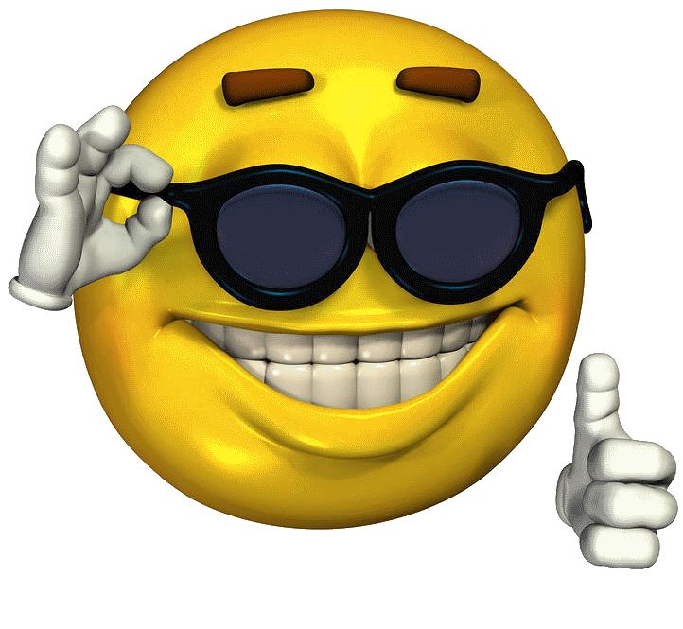
Testing
Model | Learning Rate | Random Seed | Accuracy
Mohammad | 0. 00885123 | 10 | 75%
Turki Alghamdi | 0.009 | 105 | 74%
Turki Alqahtani | 0.01 | 42 | 70%
Salem | 0.02 | 54 | 61%
Alaa | 0.0099911 | 67 | 69%
The chosen Model is Mohammad's Model since it have the highest accuracy 75%
Mohammad WINS !

Slide 11
Thank You
By:
Turki Alqahtani
Turki Alghamdi
Alaa Labban
Salem Eshaq
Mohammad Abu-Talib

